Slide 1
WEBINAR
SERIES
www.shlb.org/webinars
September 11, 2024
Preparing for the FCC's Cybersecurity Funding Opportunity

Slide 2
SHLB Sponsors

Slide 3
SOCIAL MEDIA
Follow us @SHLBCoalition
Join the conversation with #SHLBWebinars

Slide 4
Why Join SHLB
Shape Broadband Policy and Funding Outcomes
Connect and Collaborate for Success
Stay Ahead of the Curve
Learn more at www.shlb.org/membership

Slide 5
Speakers
Moderator: Kristen Corra, Policy Counsel, SHLB Coalition
Moderator: Julia Legg, Consultant, E-rate Central
Allison Baker, Senior Data Analytics Manager, FCC
Sue McNeil, Senior Counsel, FCC

Slide 6
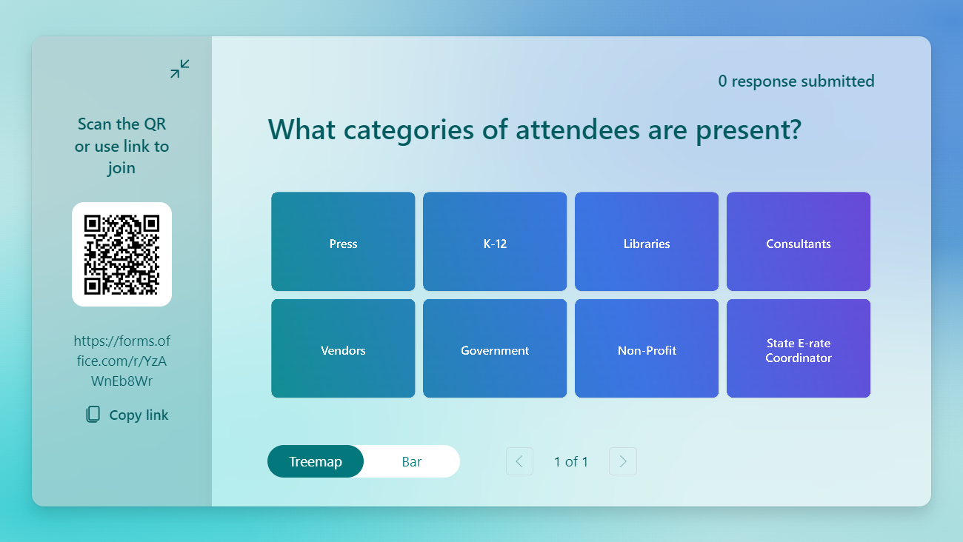

Slide 7
FCC Cyber Security Pilot
Music is playing. Please check sound.
Royalty Free Music: Bensound.com/royalty-free-music
License code: GZWV7W4TWX4NWW7N

Slide 8
Pilot Overview & Funding Details
Three-year pilot
Single filing application window will cover 3 years
$200 million cap
Notes:
Three-year pilot
Single filing application window will cover 3 years
$200 million cap
The goals are:
To Improve security and protection of E-Rate-funded networks and the data on those networks
To Measure the costs associated with cybersecurity services and equipment
Evaluate how to leverage other federal K-12 cybersecurity tools and resources to help schools and libraries effectively address their cybersecurity needs

Slide 9
Funding Objectives
Direct funding to:
Needy
As many as possible
Tribal entities
Mix of diverse applicants
Notes:
Direct funding to:
Those at the highest discount rate percentages
As many eligible schools, libraries, and consortia as possible
Those that include Tribal entities
A mix of large and small, urban and rural, schools, libraries, and consortia.
The goal is to ensure the selection presents a well-defined plan for meeting the cybersecurity needs of applicants, emphasizing resource-challenged and Tribal applicants.

Slide 10
Pre-Discount Budget Maximums
Schools
Libraries/
Library Systems
Consortia
$40.80 per student
$45,000 per site
(up to 11 sites)
School-only Consortium
$4.5 million maximum
Small School
(up to 1,100 students)
$45,000 minimum
Library/Library System
(over 11 sites)
$525,000 maximum
School and Library Combined Consortia
$4.5 million maximum
Larger Schools/Districts
$4.5 million maximum
Library-only Consortia
$525,000 maximum
Notes:
The typical E-rate eligible applicants are eligible for this Pilot
Consortia—Can be led by Schools,Libraries, or other Government/Non-profit entities on behalf of these eligible entities.
The amounts represented here are the maximums over the three-years of the pilot.
Schools: $13.60 per student annually; $40.80 over 3 years.
Libraries: These are site-based, not based on sq. ft. like Category 2 in E-rate.
Consortia of schools, libraries and/or a combination.
It’s important to NOTE: that the program will only permit an entity to appear on one application. A local filing won’t be permitted if participating in a consortia application, and vice versa.

Slide 11
Eligible Services & Products
Eligible costs include:
Maintenance, operation, and support charges
Monthly charges
Special construction
Installation and activation charges
Software
Modulating electronics and other equipment necessary to make eligible equipment and services functional
Notes:
All eligible equipment and services and related costs, including maintenance and operation, must be competitively bid.
If a piece of equipment/service is eligible for E-rate, it is not eligible for Cyber Security eligibility (for example, E-rate won’t fund a second basic firewall—it wouldn’t be eligible here because).
All eligible equipment and services must:
Be designed to detect and/or fix threats that could harm or interrupt the school or library’s network.
Include protection against threats from users who access the network remotely.
Eligibility is restricted to:
Network-Based Equipment: that is part of the network infrastructure.
Services: that operate over the network.
Locally Installed Services: like software installed directly on end-user devices, either owned or leased by the school or library, but it’s important to note that end-user devices are not eligible for this program.

Slide 12
Eligible Services & Products
Advanced/Next-Generation Firewalls
Advanced Threat Detection and Prevention
AI/ML Threat Detection and Response
Application Awareness & Control
Cloud-Delivered Threat Intelligence
Comprehensive Network Visibility Software-defined Firewalls
Deep Packet Inspection (DPI)
Distributed-denial-of-service (DDoS) protection
Firewall as a Service (FWaaS)
Integrated Intrusion Prevention Systems (IPS)
Internet of Things (IoT) Security
Intrusion prevention/detection
Malware Detection
Network Segmentation
Patch Management Systems
Virtual Private Network (VPN)
Endpoint Protection
Anti-ransomware
Anti-spam
Anti-virus
Endpoint Detection & Response (EDR)
Extended Detection & Response (XDR)
Insider and privilege misuse
Privileged Access Management
Secure Sockets Layer (SSL) inspections
Target intrusions
Web application hacking
Notes:
Any equipment and/or services are eligible if they “constitute a protection designed to improve or enhance the cybersecurity of a K-12 school, library, or consortia.”
The four categories identified by the Commission include examples of eligible equipment and services, but eligibility isn’t limited to these examples.
Other equipment and/or services are eligible if they meet the Commission’s broad eligibility criteria.
These are some examples in the categories of:
Advanced/Next-Generation Firewalls
and
Endpoint Protection

Slide 13
Eligible Services & Products
Identity Protection and Authentication
Active Countermeasure Tools
Cloud application protection
Cloud Services
Credential stuffing
Content blocking and filtering/uniform resource locator (URL) filtering
Content Caching Systems and Service
Customer portal services
Digital identity tools
Distributed-denial-of-service (DDoS) protection
Domain Name System (DNS)/DNS-layer security, blocking, and filtering
Email and Web security
Identity governance & technologies
Intrusion Detection Systems (IDS)
Logging practices/event logging
Identity Protection and Authentication
Network access control
Offsite/Immutable back-ups
Multi-Factor Authentication (MFA)/phishing-resistant MFA
Patching
Password spraying
Privileged identity management
Secure Access Service Edge (SASE)
Secure-By-Design equipment and services
Security Information and Event Management (SIEM)
Security Updates
Single sign-on (SSO)
Trusted Platform Module (TPM) and products with TPM chips
Web Content Controls
Wireless access controllers
Zero Trust Architecture
Notes:
A vast set of examples of Identity Protection and Authentication services and equipment…

Slide 14
Eligible Services & Products
Monitoring, Detection, and Response
Advanced attack surface management and asset management solutions
Bug bounty solutions & services
Compliance assessment
Dark web scanning
Data Loss Prevention
Internal/external vulnerability scanning
Network/device monitoring & response
Network Security Audit
Network traffic analysis
Managed detection & response (MDR)
Managed Service Providers
Maturity models
Network Detection Response (NDR)
Penetration testing
Security Operations Center (SOC) for around-the-clock (24/7/365) monitoring, detection, and
response
Threat hunting/Updates and threat intelligence
Vulnerability management
Notes:
And Monitoring, Detection, and Response
You may notice that certain technologies (e.g., DDoS protection) are listed in multiple categories. This is reflective of the multiple ways they are categorized in the marketplace.
Multi-year licenses can be purchased for eligible services beyond the pilot window; however, reimbursement is capped at three years for pilot services.
Manufacturer’s multi-year warranties of up to 3 years, included with an eligible component, can be included in the cost of the component, but not separately identifiable.

Slide 15
Eligible Services & Products
Training
Training is eligible as a part of the installation of the equipment and services only if it is basic instruction on the use of the eligible equipment and services, directly associated with equipment and services installation, and is part of the contract or agreement for the equipment and services.
Training must occur concurrently with or within a reasonable time after installation.
Training is not required to be on-site.
Does not need to be specifically mentioned during the competitive bid process.
Notes:
Training on the equipment and services is conditionally eligible
Must occur concurrently or within a reasonable time for install.
And Training is not required to be on-site.
Training need not be specifically mentioned during the competitive bidding process but must be provided in compliance with these limitations in order to be eligible for reimbursement. Footnote 160, Page 26:

Slide 16
Ineligible Services & Products
Already eligible under the E-rate program
Reimbursed (or planned for reimbursement) by other USF or federal, state, or local programs
End-user devices like tablets, smartphones, and laptops
Staff salaries and labor costs
Cybersecurity training for staff/students/patrons unrelated to the purchased equipment/services
Consulting services unrelated to the installation or configuration of eligible equipment
Equipment on the FCC’s Covered List (e.g., Huawei Technologies Company, ZTE Corporation, and their parents, affiliates, and subsidiaries)
Notes:
There are some things that will be ineligible:
Things already eligible under E-rate
Already reimbursed or planned items from other programs
End-user devices
Staff salaries/labor costs
Cybersecurity training on for staff & students
Consulting services not related to install and configuration
Equipment from the FCC’s Covered List

Slide 17
Audience Poll
What services does your
school or library most need?

Slide 18
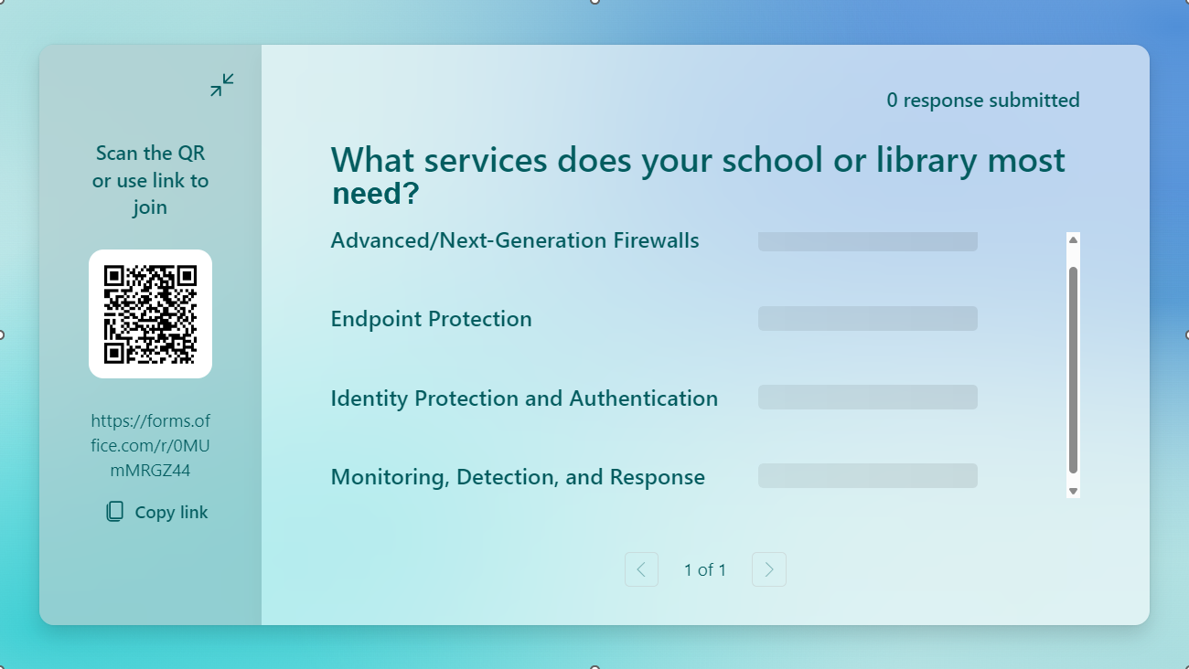

Slide 19
Process Flow & Required Forms
Mirrors E-rate processes & forms
P-484- Part 1
P-484-Part 2
If selected, will complete Part 2.
P-474-SPI
P-470
P-471
P-472-BEAR
488-Service Substitution
Notes:
Although the Pilot Program will leverage the FCC forms from the E-Rate program, the Pilot forms will have their own distinct prefixes or identifiers to distinguish them from the E-Rate forms.
Final forms are slated to wrap their comment period this week!
Form data will be treated as confidential and not made available. Reporting out will be anonymized and aggregated.
Receipt Acknowledgement Letters will be provided upon submission of each form.
The 484 is split into two parts
Part 1
Uses pre-populated demographics data where possible
With Yes/No questions and questions with predetermined responses
You’ll provide:
Overview of your Pilot project with Goals and objectives
Equipment and services planned
Cybersecurity experience
Education Dept./CISA resources used/planned
Estimate of total costs, including planned purchases with non-Pilot resources
Proposed metrics

Slide 20
Pilot Launch Dates Announced
USAC announces preliminary Pilot program participants.
Sept 17: Form 484 (Part One) window opening
Nov. 1: Form 484 (Part One) window closes
Jan. 3: USAC confirms final Pilot program participants.
Jan. 6: Pilot Form 470s made available for filing.
Feb. 3-Mar. 28 Pilot Form 471 window.
Notes:
The window dates have been announced for the Form 484!
Opening Sept 17
Closing Nov 1

Slide 21
Review & Announcements
Will consult on reviews with :
OEA: Office of Economics and Analytics
PSHSB: Public Safety and Homeland Security Bureau
OMD: Office of Management and Data
OGC: Office of General Counsel
Will announce via Public Notice
Notes:
The FCC has given some insight for the selection process
And will consult with a variety of government entities during their reviews.
They will announce selections via public notice.

Slide 22
Process Flow & Required Forms
May be submitted in tandem
with the P-471
P-484- Part 1
P-484-Part 2
P-474-SPI
P-470
P-471
P-472-BEAR
488-Service Substitution
Notes:
Once selected, participants will move forward in the process.
The Form 484-Part 2 (only completed by those selected)
It includes more detailed cybersecurity data and Pilot project information.
FCC recently announced applicants could submit this in tandem with the Form P-471

Slide 23
P-484 Part 2 will ask…
How the project will prevent/address issues
How funding will:
Protect Network and Data
Types of Equipment/Services Planned
How it will be used
Self-Sustaining Capacity
Experience:
Implementing protections/measures
Years experience
Officer/Senior staff member designed
Details of Recent Incidents (One-year):
When
How
Impact
Vulnerabilities exploited & techniques used
Identity of bad actors, if known
Best Practices:
CISA
US Ed
Participation in collaborative/information-sharing groups (not required)
Cost and Funding:
Total Estimated Costs
Source of Non-Discount Costs Coverage
Other Funding Received/Expected
Free/No-cost resources to be required of service provider
If service provider will be required to capture cost-effectiveness/readiness data
Other non-monetary challenges
Baseline Data :
Current posture
Management/mitigation
Security flaws
Routine backups
Planned cybersecurity changes/advancements outside of the Pilot
Training Policies & Procedures:
Frequency and Sessions: Staff and student training
Participation Rates
Notes:
Here’s a streamlined overview of the Form 484.
It discusses:
How issues will be prevented and/or addressed
Funding Utilization
Experience and Designees
Details of Recent Incidents in the past year
Best Practices being followed or implemented
Cost and Funding, including ineligible and non-discount costs, additional funding sources, and any free or low-cost resources from providers.
Your Baseline Data
Training Policies and Offerings for staff and students, including frequency and participation rates.

Slide 24
Process Flow & Required Forms
May be submitted in tandem
with the P-471
P-484- Part 1
P-484-Part 2
P-474-SPI
P-470
P-471
P-472-BEAR
488-Service Substitution
Notes:
The P-470
Must be posted a minimum of 28 days
Not required to issue RFP unless mandated by state/local/tribal requirements
Must select the most cost-effective (with price as primary factor)
If naming products/services, “or equivalent” must be used
Master Service Agreements (MSA) bid and put in place by a government entity for use by an eligible entity that used the E-rate 470-process may be exempt from bidding.
Must use mini-bid if required by the relevant MSA
No existing contracts grandfathered, including MSAs without an E-rate 470
Cannot “Kalamazoo” an existing contract as a bid in a P-470 procurement
Gift rules will apply to all staff and consultants, along with the service providers’ prohibition against offering gifts

Slide 25
Process Flow & Required Forms
May be submitted in tandem
with the P-471
P-484- Part 1
P-484-Part 2
P-474-SPI
P-470
P-471
P-472-BEAR
488-Service Substitution
Notes:
One P-471 will be submitted covering all three years of Pilot project
Discounts based on the first-year’s NSLP data, using Category 1 Discount Matrix
Pro rata prioritization within discount bands based on NSLP percentage will be applied if resources are fully requested (similar to years past in Priority 2 when funding would run out)
Recipients of service cannot appear on another Form 471
And again…applicants may submit their P-484 Part 2 at the same time as the P-471

Slide 26
Process Flow & Required Forms
May be submitted in tandem
with the P-471
P-484- Part 1
P-484-Part 2
P-474-SPI
P-470
P-471
P-472-BEAR
P-488-Service Subs/SPIN Changes
Notes:
P-488 This form has a new number, but the processes aren’t new to E-rate applicants!
Service Substitutions like:
Site Changes
Service/Equipment Changes
SPIN Changes like:
Correcting data entry errors
Mergers
And Operational changes due to
Breach of contract
Or the provider being unable to perform

Slide 27
Process Flow & Required Forms
May be submitted in tandem
with the P-471
P-484- Part 1
P-484-Part 2
P-474-SPI
P-470
P-471
P-472-BEAR
488-Service Subs/SPIN Changes
Notes:
Finally, the forms for invoicing for reimbursements.
We still have the choice of invoicing styles
You must state desired invoicing method on the Form 471 application.
You’re NOT required to get letter of consent from service provider like in ECF
You can request reimbursements as costs arise, even if they exceed the annual amount, as long as the total maximum amount isn’t exceeded.
Must include invoices with reimbursement request
Due within 90 days of receipt of service/equipment
One-time deadline extension is available!
The process to address any disagreement with decisions or requests for waivers of rules will be the same as in E-rate; however, the deadlines will be 30 days instead of 60 for both appeals and waivers.

Slide 28
Audits and Review
Retain all relevant documents for at least 10 years from last date of service or delivery of equipment
Subject to audits and reviews
“Beneficiary and Contributor Audit Program” (BCAP)
“Payment Integrity Assurance” (PIA)
Notes:
FCC: Was PIA supposed to be PQA? PIA is Program Integrity Assurance review of the applications, but typically these are called a PQA for Payment Quality Assurance.

Slide 29
Reporting
A new Public Notice (PN) is expected prior to the P-470 window to establish requirements for reporting, including timing, and the potential for a standardized reporting form
Will be due within 60 days of each year-end
Suspension & debarment will apply
Baseline Initial Reporting
Annual Reporting
Final Reporting
Year 1
Year 2
Year 3
Notes:
We don’t yet have the details on the exact reporting requirements, but we do know that there will be:
Baseline initial reporting required in year 1
With annual reports following that are due within 60 days of year-end.
And as with all other programs, suspension and debarment will apply to applicants, service providers, and consultants.

Slide 30
Audience Poll
Are you planning on
participating in the Pilot?

Slide 31
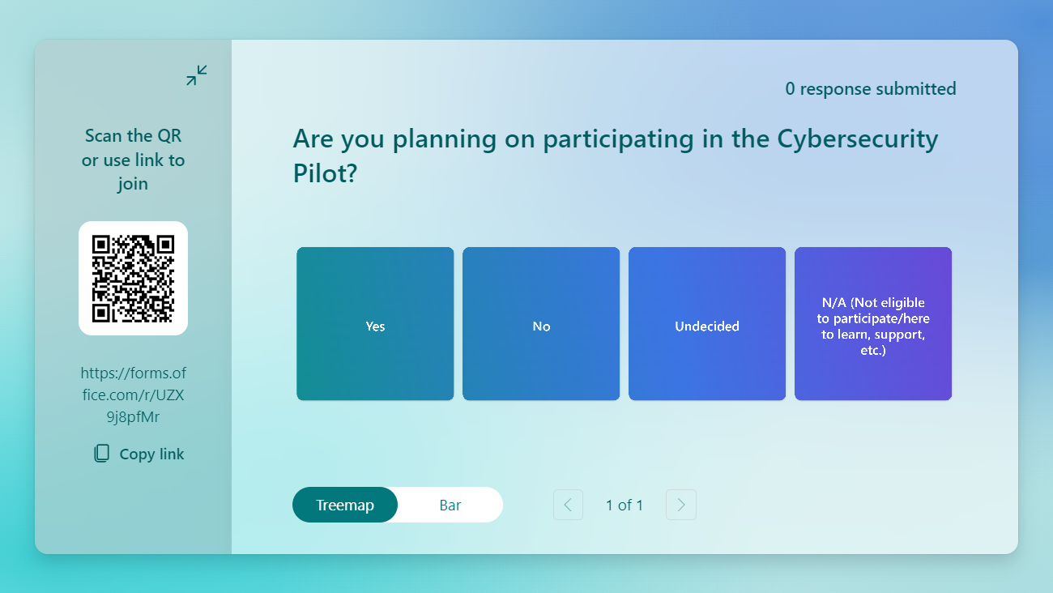

Slide 32
Next steps…
FCC Registration Number (FCC CORES)
Greenlight status with FCC
Not on the US Treasury “Do not pay” list
SAM.gov registration
Can take up to 2 weeks
USAC Access
USAC Billed Entity Number
OnePortal portal access
888-203-8100 (M-F 8 am-8 pm)
Setup Staff/Consultant permissions in the E-rate portal (E-Rate Central Newsletter Link for Instructions)
FCC Form 498 (ACH)-Can use existing!
Notes:
Some next steps you need to be taking now to ensure that you’re Pilot-ready!
FCC Registration Number and greenlight status.
SAM.Gov UEI number—warning! It takes up to 2 weeks for new accounts! A SAM.gov registration is not needed to apply for Pilot Program support but is required to receive funds and disbursements.
USAC OnePortal access and Billed Entity Number
The good news is that if you’re already an E-rate applicant, all you have to do is update permissions in the E-rate Portal!
*Note: Can only add 3 consultant staff!! I have added a link to our E-Rate Central newsletter that walks you through the process.
And you can use your existing Form 498 for disbursements!

Slide 33
FCC Resources
Cyber Email Address for Questions
CyberPilot@fcc.gov
Pilot Program Website
https://www.fcc.gov/cybersecurity-pilot-program
Getting Ready Guide | Application Guide
FCC Cyber Security Pilot Eligible Services List
https://www.fcc.gov/cybersecurity-pilot/cybersecurity-pilot-eligible-services-list
FAQs
https://www.fcc.gov/sites/default/files/Cybersecurity-pilot-FAQs_2024.pdf
Notes:
There are some great resources available from the FCC for use on the Pilot…
Keep an eye on the FAQs link at the bottom—they will be updated as new clarifications are released

Slide 34
USAC Resources
Cyber Security Website
https://www.usac.org/e-rate/cybersecurity-pilot-program/
USAC Cybersecurity Pilot Program Flier
https://www.usac.org/wp-content/uploads/e-rate/documents/Handouts/2024-Schools-and-Libraries-Cyber-Security-Pilot-Prog-Flyer.pdf
Applicant Process
https://www.usac.org/e-rate/cybersecurity-pilot-program/applicant-process/
Program E-mails
https://survey.alchemer.com/s3/7881841/E-Rate-Cyber-Pilot-Program-Email-List
Notes:
USAC also has some excellent program resources!
Be sure to sign up for those Program emails!! SO valuable to have up-to-date information!

Slide 35
Other Outside Resources
CISA’s Cybersecurity Best Practices
https://www.cisa.gov/topics/cybersecurity-best-practices
US Department of Education Resources for K-12 Districts
https://tech.ed.gov/cyberhelp/
E-Rate Central Newsletter
https://e-ratecentral.com/#subscribe
Notes:
Some other Outside Resources include:
CISA’s best practices
US ED’s Cyber Resources
And E-rate Central offers a free newsletter you can subscribe to for the latest updates in “TL;DR” type format for all things E-rate, Cyber Pilot, ECF, and more!

Slide 36
Additional Webinar Opportunities
FCC Webinar July 23, 2024
Recording I Slides
Recorded USAC Webinars & Slides
July 10: Get Started Webinar
August 6: Overview Webinar
August 13: E-Rate and EPC for Beginners Webinar
August 20: FCC Form 484 Part 1 Overview Webinar
September 10: 484 Part I Application Walkthrough
USAC Webinar Registration Links
September 17: Form 484 Part I System Walkthrough
October 15: Overview for Service Providers
Find Future Webinars
https://www.usac.org/e-rate/cybersecurity-pilot-program/learn/webinars/
Notes:
There are some webinars past and present that are must-sees whether you’re just learning about the program or are already a “seasoned veteran by now!”
The FCC has a recorded webinar from July 23
And USAC has been offering extensive, targeted training—5 so far! Slide decks and recordings are available at the link below.
Upcoming webinars include
a 484 Part I System Walkthrough
and Service Provider overview training in the future
Other future webinars will be announced at the link below!

Slide 37
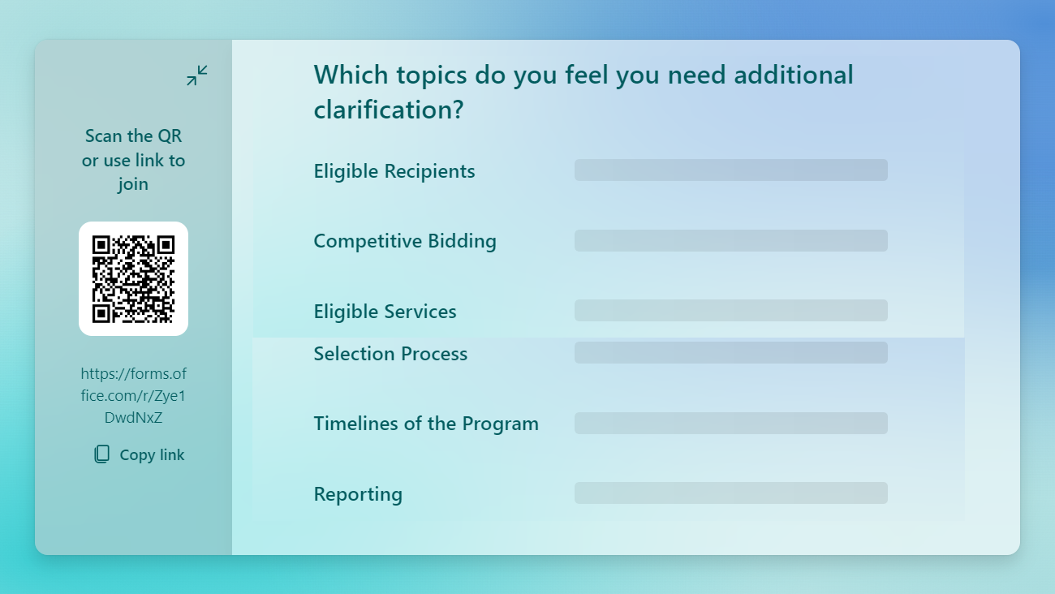
Notes:
One last survey before we head into Q&A!

Slide 38
MODERATED Q&A
Moderator: Kristen Corra, Policy Counsel, SHLB Coalition
Moderator: Julia Legg, Consultant, E-rate Central
Allison Baker, Senior Data Analytics Manager, FCC
Sue McNeil, Senior Counsel, FCC

Slide 39
Upcoming Webinar
September 25, 2024
Universal Service Reform After the Fifth Circuit Consumers' Research Decision
Register Here
For more information visit: https://www.shlb.org/webinars

Slide 40
AnchorNets Conference
Save the date: October 2-4
Crystal Gateway Marriott: 1700 Richmond Hwy, Arlington, VA 22202
http://shlbconference.org/

Slide 41
Thank You!
www.shlb.org | @SHLBCoalition
The SHLB Coalition is proudly supported by over 322 member organizations, and our generous corporate sponsors:

