Slide 1
Presentation to Santa Barbara Rental Property Association on Emergency Rental Assistance Program
September 20, 2021

Slide 2
U.S. Treasury Emergency Rental Assistance (ERAP)
American Rescue Plan Act of 2021 – $21.55 billion in emergency rental assistance (“ERA 2”)
2021 Consolidated Appropriations Act – $25 billion in emergency rental assistance (“ERA 1”)
For each ERA 1 and ERA 2 allocation round, SBCo received an allocation from U.S. Treasury and the State.
U. S. Treasury (direct to County) |  | State of California
ERA Round 1 | ERA Round 2 | ERA Round 1 | ERA Round 2
$13,275,190 | $16,610,602 | $14,287,321 | $12,453,350.90
Direct Assistance fully expended by United Way, application portal closed. | No funds drawn | Currently accepting and processing applications (Option C) | 8/17/21 Board ratified LOI to State HCD to administer the State ERA 2 allocation along with the County’s direct U.S. Treasury ERA 2 (Option B)

Slide 3
Guidelines
Qualifying renter households – 80% or less Area Median Income, priority 50% Area Median Income
Qualifies for unemployment OR has reduction in income, incurred costs, or financial hardship due to OR DURING COVID-19
Demonstrates risk of homelessness or ‘housing instability’, such as past due rent, utility notices, eviction notices, etc.
Arrears accrued after March 2020.
Rental assistance should not be duplicative of any other federally funded rental assistance (section 8 ok for tenants share after income adjustment)
Households unemployed for 90+days and households at 50%AMI are prioritized for assistance
Income based on either CY 2020 annual or monthly at time of application
Proof of rent obligation*

Slide 4
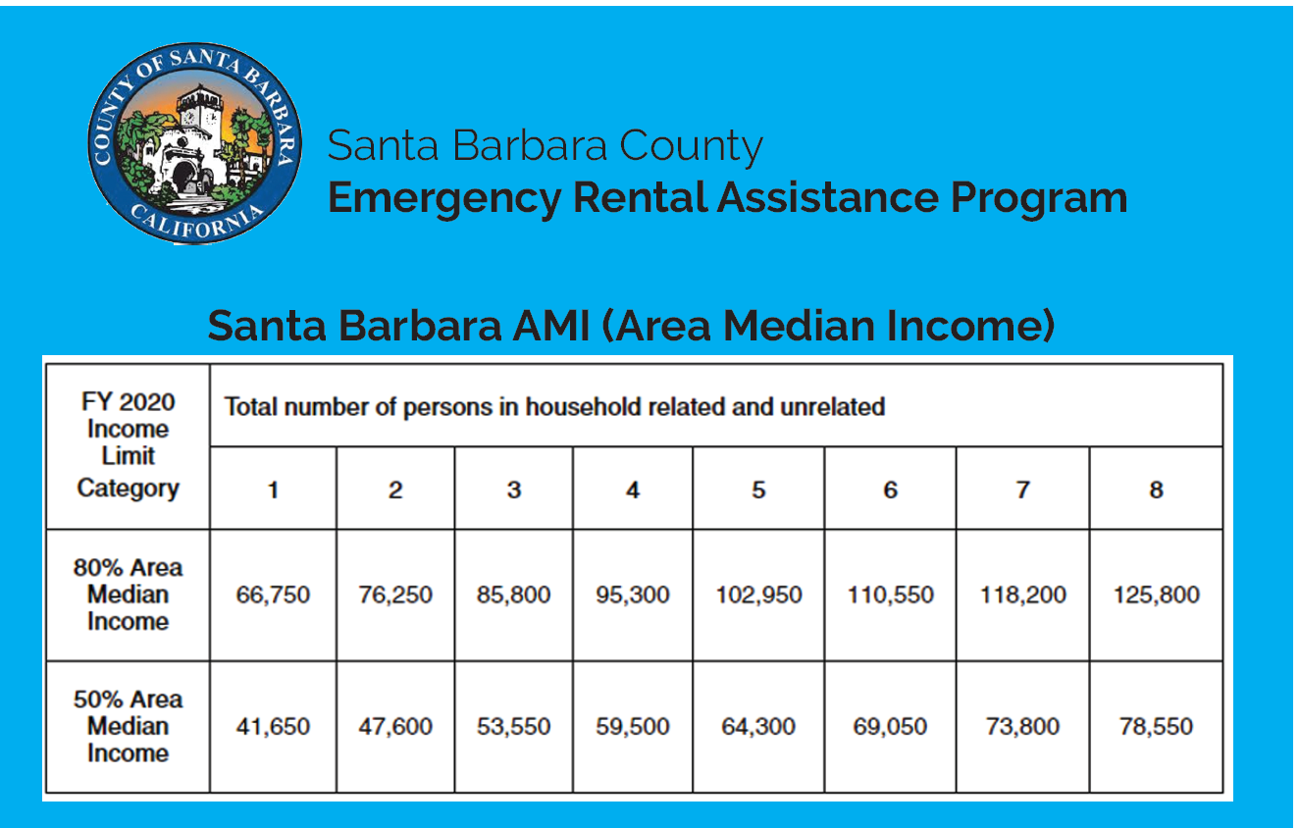

Slide 5
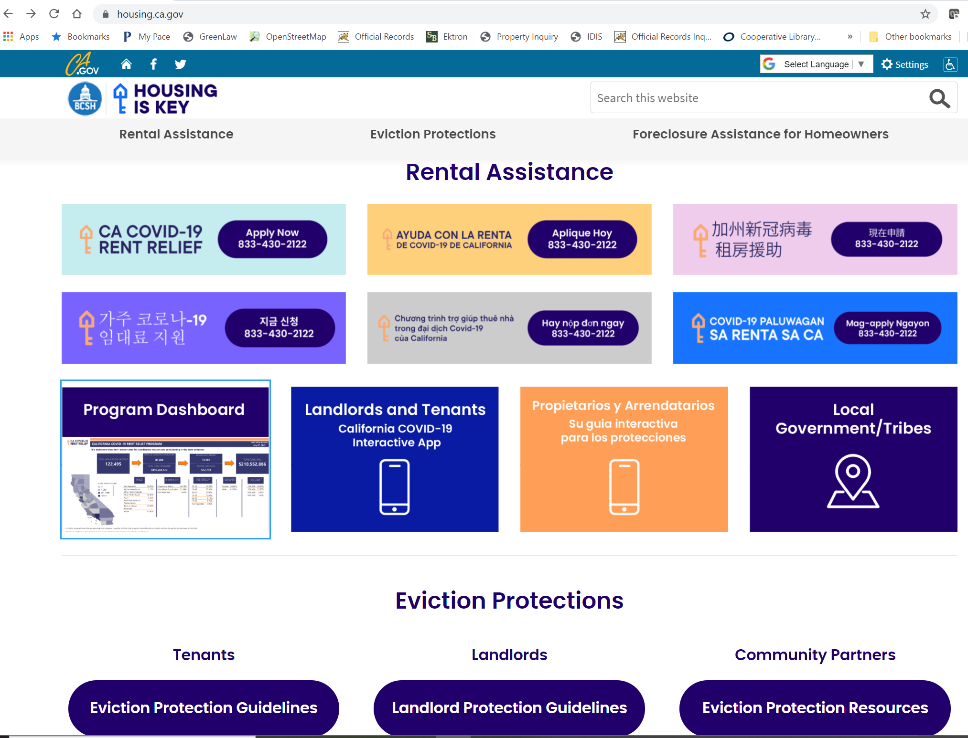
State Program ($14,287,321)
Application portal currently open
1,767 applications received
Paid over $4M of the $14,287,321 State ERA1 reservation for Santa Barbara County residents
Landlords and tenants can apply now to the State for assistance at https://housing.ca.gov/

Slide 6
County/United Way ERA 1 ($13,275,190)
Program closed, funds fully expended. Once the State exhausts its ERA 1 funds, the County will be able re-open a local program utilizing both the State and County’ ERA 2 allocations.
Once State commits all of its ERA 1 funds ($14.2M), UW will re-open its application portal using both County ERA 2 funds ($16.6M) and State ERA 2 funds ($12.4M)
# of households served | 1,413
Average rent award | $8,262.25
Below 50% AMI | 1,313
Family unit | 73%
Median household | 3
Median income | $25,728
Average Income | $64,884

Slide 7
ERA Assistance
All arrears dating back to March 2020
Current
Up to 3-months prospective
Can reapply for 3-months of current or prospective rent
Maximum of 15 months ERA1 assistance, 18 months combined ERA1 and ERA2.
Utility arrears and current
Payments will be made directly to landlords for any arrears for back-rent before any current or future rent.
Payments for utility arrearages to utility providers.
*Relocation Assistance – we will begin to cover relocation assistance costs such as security deposits and first/last months rent for new move-ins. Tenant will have a letter from UW indicating pre-approval for payment to a to-be-determined landlord. Upon signing of lease (minimum 6-mos) LL can receive payment.
Notes:
Program will be offered Countywide.
Rental Assistance will be allocated in each of the 5 County Supervisorial Districts equally.

Slide 8
Application Status
As required by AB 832, United Way of Santa Barbara County and State HCD are both staffing call centers where applicants (tenants, landlords, or Courts at their option) can check the status of an application.
Tenants or landlords that need to confirm the status of an application submitted to United Way should call (805) 965-8591.
Tenants or landlords that need to confirm the status of an application to the State HCD should call (833) 430-2122.
Notes:
Program will be offered Countywide.
Rental Assistance will be allocated in each of the 5 County Supervisorial Districts equally.

Slide 9
ERAP Questions
1. Can owners apply for ERAP or must tenant apply? How can landlord obtain "proof" that can be submitted to court?
2. How long is ERAP process taking now from application to receiving payment?
3. What is deadline for applying for ERAP? What time period is covered?
4. Can you apply for a tenant that left unit without paying rent and has left no contact information?
5. Do tenants need to provide proof of applying for rental assistance?
What documents do they provide?
What documents should I, as a landlord, request from my tenant?
My tenant doesn't have a computer to apply for themselves, but says they applied for rental assistance. How do they get proof of applying?

Slide 10
For more information:
Dinah Lockhart
Deputy Director, HCD Administration Division
(805) 568-3523
dlochart@sbccsd.org
Laurie V. Baker
Grants and Program Manager
(805) 568-3521
Lbaker@co.santa-barbara.ca.us
Ted Teyber, J.D.
Housing Program Specialist, Sr.
(805) 568-3513
eteyber@co.santa-barbara.ca.us
www.countyofsb.org/housing

