Slide 1
Truss Heel Heights and
Energy Code Requirements
Overview
Revised 2/17/2017

Slide 2
SBCA has been the voice of the structural building components industry since 1983, providing educational programs and technical information, disseminating industry news, and facilitating networking opportunities for manufacturers of roof trusses, wall panels and floor trusses. SBCA endeavors to expand component manufacturers’ market share and enhance the professionalism of the component manufacturing industry.
Copyright © 2017 Structural Building Components Association.

Slide 3
Introduction
In recent years, there has been increased interest in improving the energy efficiency of buildings throughout the United States.
Tax credits are available for homeowners who purchase energy efficient upgrades including insulation, high efficiency windows and doors, heating and cooling equipment and caulking.
Out of all these recent efforts, what may have the greatest long term effect are improvements to energy efficiency requirements in the building codes.

Slide 4
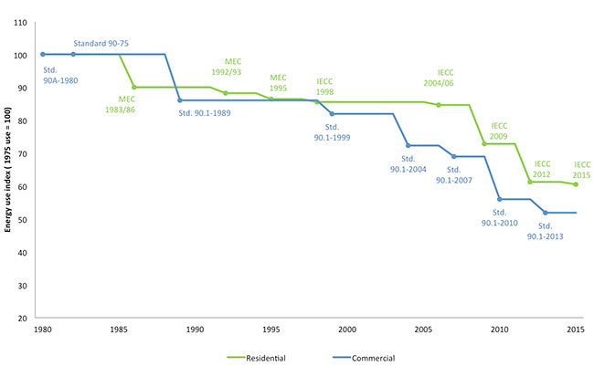
Introduction
Energy use has decreased significantly as a result of the American Clean Energy and Security Act (ACES) of 2009 which mandated overall energy savings targets to be met by the model building codes.
This presentation will address the requirements of the 2009, 2012 and 2015 International Residential Code (IRC) and International Energy Conservation Code (IECC) as they impact ceiling insulation and truss heel heights.
Source: ACEEE

Slide 5
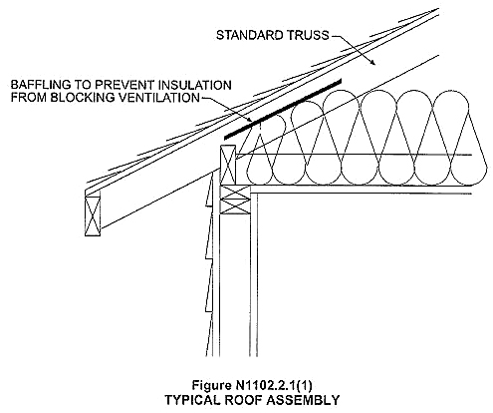
Key Definitions
Building Designer – Owner of the Building or the Per­son that contracts with the Owner for the design of the Building Structural System and/or who is responsible for the preparation of the Construction Documents. When mandated by the Legal Requirements, the Building De­signer shall be a Registered Design Professional.
Standard Truss – Any construction that does not permit the roof/ceiling insulation to achieve the required R-value over the exterior walls.

Slide 6
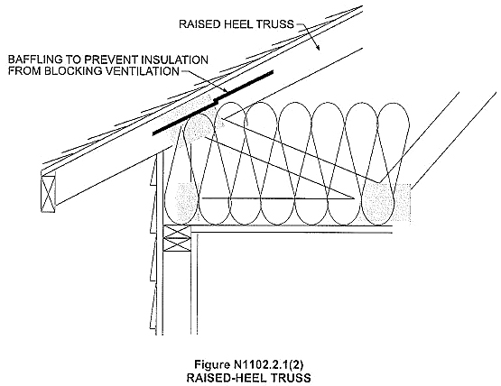
Key Definitions
Truss Heel Height – The vertical depth of the truss at the outside face of the bearing.
Standard Heel – Typical truss heel height is about 4".
Raised (Energy) Heel – Typical truss heel height is about 12" but may be designed to most any height per the Building Designer specification.

Slide 7
Background
Chapter 11 of the IRC deals with energy efficiency and is closely coordinated with Chapter 4 of the IECC (section numbers in parenthesis).
There have been a few section number changes between versions, as well as some revisions for clarity and some increases to R-value requirements.
Section/Table Reference | 2006 | 2009 | 2012 | 2015
Table: Insulation and Fenestration Requirements by Component | N1102.1 (402.1.1) | N1102.1 (402.1.1) | N1102.1.1 (R402.1.1) | N1102.1.2 (R402.1.2)
Section: Ceilings with attic spaces | N1102.2.1 (402.2.1) | N1102.2.1 (402.2.1) | N1102.2.2 (R402.2.2) | N1102.2.1 (R402.2.1)

Slide 8
Background
The following table illustrates some general insulation thicknesses to meet the 3 ceiling R-Value requirements (R-Values for similar products can vary greatly among manufacturers):
Insulation | R-Value per inch | R-30 | R-38 | R-49
Fiberglass blown | 2.2 - 4.3 | 9″-10″ | 12″-14″ | 16″-18″
Fiberglass batt | 3.1 - 3.4 | 9″-10″ | 12″-14″ | 16″-18″
Mineral wool blown | 3.1 - 4.0 | 9″-10″ | 12″-14″ | 16″-18″
Cellulose blown | 3.2 - 3.7 | 8″-9″ | 10″-12″ | 14″-16″
Open cell Spray Foam | 3.5 - 3.6 | 8″-9″ | 11″-12″ | 14″
Closed cell Spray Foam | 6.0 - 6.5 | 5″ | 6″-7″ | 8″-9″

Slide 9
Background
An air space for ventilation above the insulation is required in vented attics, which adds 1-2″ of additional height at the eaves.
Questions have been asked about the proper application of ceiling R-Value requirements when the roof framing may limit the height of the insulation at the outside face of the building.

Slide 10
Background
The ultimate aim is to answer the following questions:
  What happens at the outside of the wall where the vertical depth of the roof framing is typically less than the required depth of insulation?
  Does the depth of the framing need to increase?
  Does the building designer need to modify the profile of the building to accommodate this increased framing depth?

Slide 11
Analysis
There is also confusion as to the required height of the roof framing above the wall top plate at the eaves.
Section N1102.2.1 of the 2006 through 2015 IRC allows substitutions when full height insulation extends over the wall top plate at the eaves.
  R-30 may be used in place of R-38
  R-38 may be used in place of R-49
Note that this substitution applies only when R-values are used.
  If U-factors or the total UA alternative is used, the reduced thickness must be accounted for in the calculations.

Slide 12

Analysis
Insulation installed in a typical roof assembly is full height in the center of the assembly and tapers to less than full height at the edges.
This taper is caused by, and is proportional to the slope of the roof.
Because of the lower insulation depth, the R-value will be less at the truss heels than the rest of the span.
Compression Zone

Slide 13
Analysis
Compression
Zone
The ceiling R-value requirement assumes standard framing and thus accounts for a certain level of reduced thickness.
This area of reduced thickness is referred to in the codes as “compression”, although the insulation itself may or may not be compressed.
When insulation can be installed full thickness over the plate line of the exterior wall, the code will allow a lower level of insulation throughout.
Higher level of insulation throughout
No
Compression Zone
Lower level of insulation throughout

Slide 14

Analysis
This allowance recognizes that a partial thermal "bypass" has been made more efficient by using insulation with the full R-value at the eaves.
The full insulation R-value is sometimes achieved by what is termed an "energy heel truss" or "advanced framing."
No
Compression Zone

Slide 15
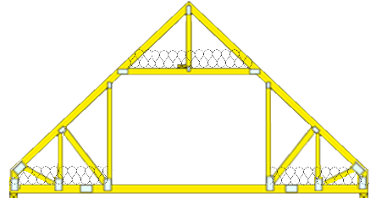

Analysis
Note that this reduction can also apply to conditioned attics if the insulation is installed directly under the roof deck, rather than on the attic floor
  The insulation would be permitted to meet the reduced R-value, if the full R-value is met all the way over the exterior walls.
  This assumes that the attic space beneath the insulation is not vented.

Slide 16
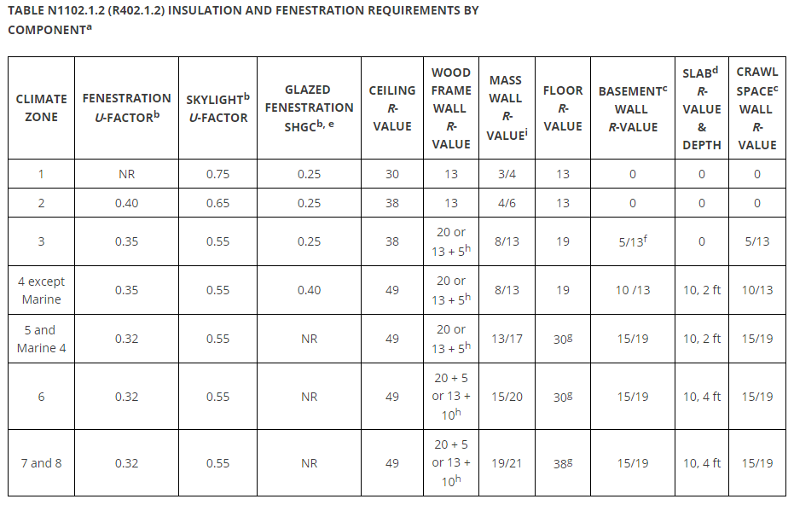
Conclusion
It is important to recognize that code prescriptive R-value requirements for ceiling insulation take into account the lower depth of insulation found in standard heel roof framing.
The ceiling R-values in the IRC, therefore, are not intended to be the minimum R-values for the attic space directly above an exterior wall but rather the rated R-value for the majority of the attic space.

Slide 17
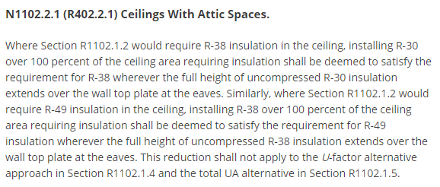
Conclusion
The exception in Section N1102.2.1, allowing R-30 where R-38 is required or R-38 where R-49 is required is a trade-off to the initial requirement.
Note that there is no similar exception given for the R-30 requirement in Climate Zone 1 to reduce the R-Value requirement if 100% of the ceiling area can be covered with a lesser R-Value.

Slide 18
Conclusion
With this information in mind, the answers to the questions posed earlier are clear:
  What happens at the outside of the wall where the vertical depth of the roof framing is typically less than the required depth of insulation?
    Nothing. The amount of insulation R-value over the remaining area has been increased to account for this very situation.
  Does the depth of the framing need to increase?
    No, not as long as the required insulation R-value is covering most of the ceiling area.
  Does the building designer need to modify the profile of the building to accommodate this increased framing depth?
    No, as there is no need for increased framing depth.
“Component Performance” versus the “Prescriptive” approach for the entire building is also a means to achieve objectives for minimal insulation levels over exterior walls.
When all of the components of the building envelope come into play, it expands the opportunity for successful tradeoffs.

Slide 19
References
International Energy Conservation Code, 2009, 2012, and 2015 by the International Code Council
International Residential Code, 2006, 2009, 2012 and 2015, by the International Code Council
TPI 1 – 2007, by the Truss Plate Institute
BCSI (Building Component Safety Information), June 2011 by Structural Building Components Association (SBCA) and Truss Plate Institute (TPI)

