Slide 1

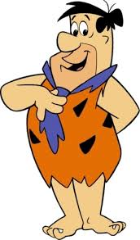
1
2
A
B

Slide 2


3
1
C
D

Slide 3


2
3
E
F

Slide 4

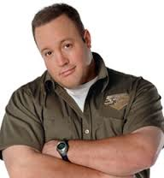
1
2
G
H

Slide 5


3
1
I
J

Slide 6
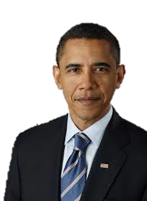

2
3
K
L

Slide 7


1
2
M
N

Slide 8
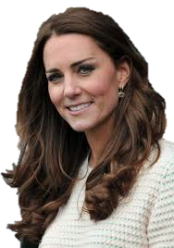

3
1
O
P

Slide 9
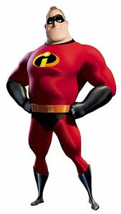

2
3
Q
R

Slide 10

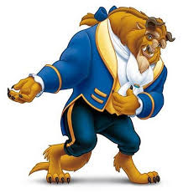
1
2
S
T

Slide 11


3
1
U
V

Slide 12

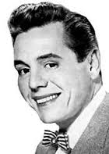
2
3
W
X

Slide 13

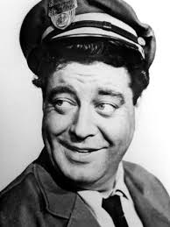
1
2
Y
Z

Slide 14
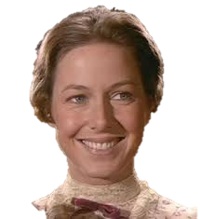

3
1

Slide 15

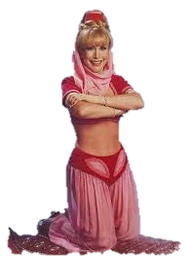
2
3

Slide 16


1
2

Slide 17

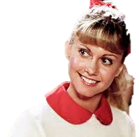
3
1

Slide 18
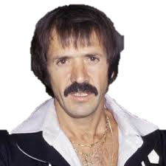

2
3

Slide 19


1
2

Slide 20


3
1

