Slide 1

2020
SAI Annual Conference
Matt Carver, J.D.
Legal Services Director
515.267.1115
mcarver@sai-iowa.org

Slide 2
Governor’s Proclamation
Key Provisions:
“In-person instruction is the presumed method of instruction”
AT LEAST HALF OF ANY GRADE LEVEL IS RECEIVING INSTRUCTION IN-PERSON OVER A TWO-WEEK PERIOD.
Districts and state agencies shall take all efforts to prepare to safely welcome back students and teachers to in-person instruction.
However, schools may provide instruction primarily through remote-learning in a number of circumstances.

Slide 3
Governor’s Proclamation
Instruction primarily through remote-learning is accepted in the following situations:
1) Parental consent – If the parent selects the remote learning option from a variety of district options.
  The district may require the parent/guardian to provide written verification from a licensed healthcare professional. Notification includes: name of person with significant health condition; the health condition; written verification of condition from a physician or licensed health care provider; and, whether the person lives with the student.

Slide 4
Governor’s Proclamation
Instruction primarily through remote-learning is accepted in the following situations:
2) Approved temporary school building or district closure – If the DE, in consultation with the IDPH, approves for the temporary move to primarily remote instruction.
[A district may make this decision on its own, but the hours or days of instruction will not count without DE approval.]

Slide 5
Governor’s Proclamation
Instruction primarily through remote-learning is accepted in the following situations:
3) Temporary remote learning for individual students or classrooms – If the district or accredited nonpublic school determines, in consultation with state and local public health departments, that individual students or classrooms, but not all students in a building, must temporarily move to primarily remote learning because of public health conditions.
[In this scenario the hours will count without DE approval, because it is just impacting a portion of the school.]

Slide 6
Governor’s Proclamation
Substitute Teaching Flexibility:
1) Temporary suspension of limit on number of consecutive days that someone may substitute teach in one position during a 30-day period.
This applies in all grades. This exemption DOES NOT apply to driver’s education.

Slide 7
Governor’s Proclamation
Substitute Teaching Flexibility:
2) Temporary suspension of bachelor’s degree requirement to obtain substitute teaching authorization.
Applicants are now required to have achieved an associate’s degree or complete 60 semester hours of college coursework from a regionally accredited institution.

Slide 8
Governor’s Proclamation
Substitute Teaching Flexibility:
3) Temporary suspension of requirement that an applicant must be twenty-one (21) years old to obtain substitute teaching authorization.
Applicants must now be at least twenty (20) years old.

Slide 9
Governor’s Proclamation
Substitute Teaching Flexibility:
4) Temporary suspension of provision limiting the holder of a paraeducator certificate with a substitute authorization to substituting ONLY in the special education classroom.
Paraeducators with a substitute authorization may substitute in any classroom, except in a driver’s education classroom.

Slide 10
Governor’s Proclamation
Substitute Teaching Flexibility:
5) Temporary suspension of provision prohibiting the holder of a career and technical secondary authorization OR an initial career and technical secondary authorization who has completed at least one year of teaching experience employed by a school district from serving as a substitute teacher in any classroom, except in a driver’s education classroom.

Slide 11
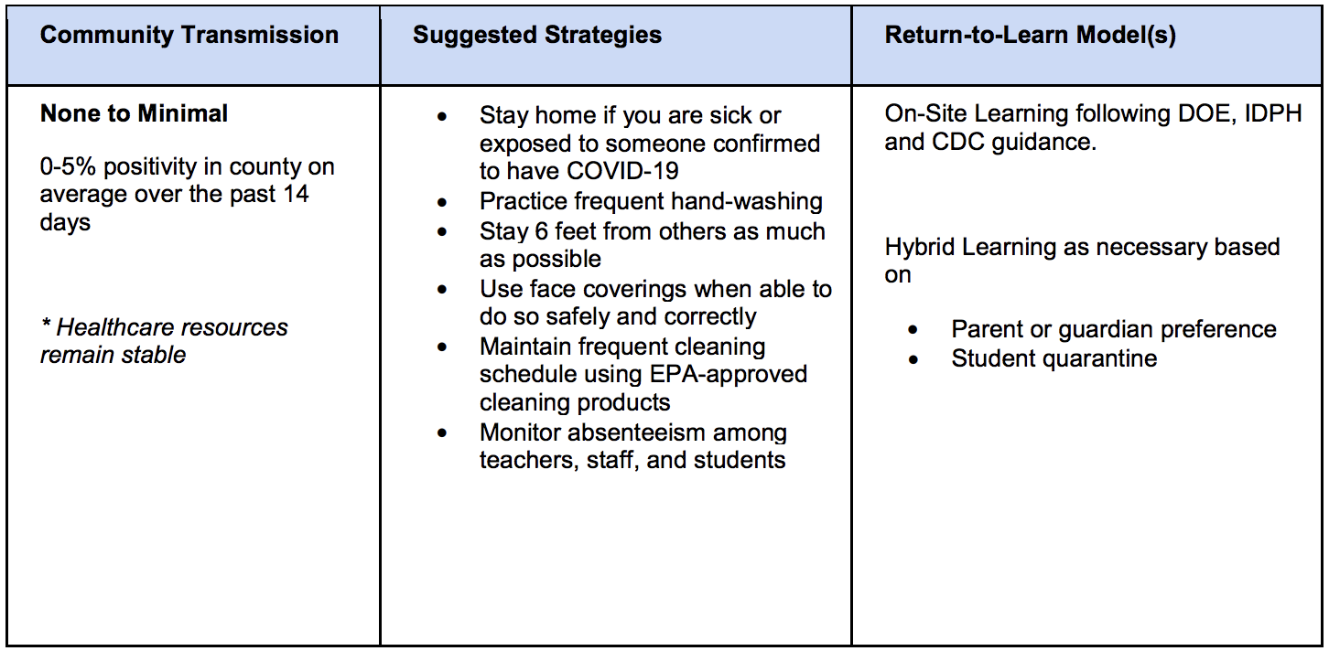
Iowa DE/IDPH Updated Guidance

Slide 12
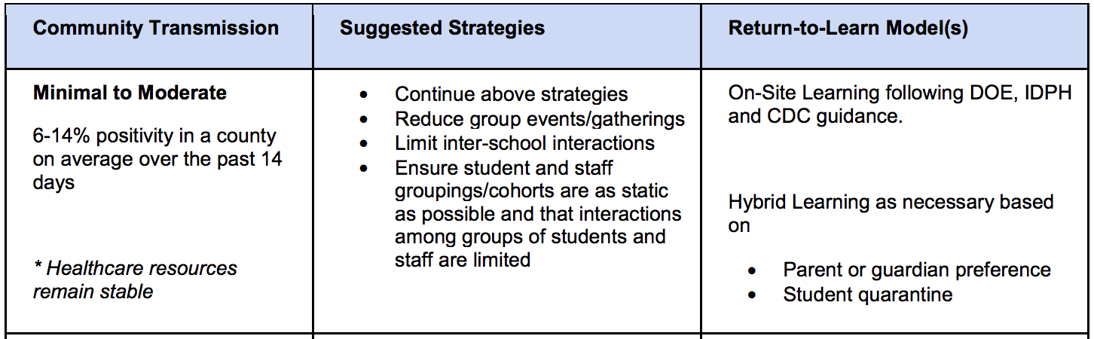
Iowa DE/IDPH Updated Guidance

Slide 13
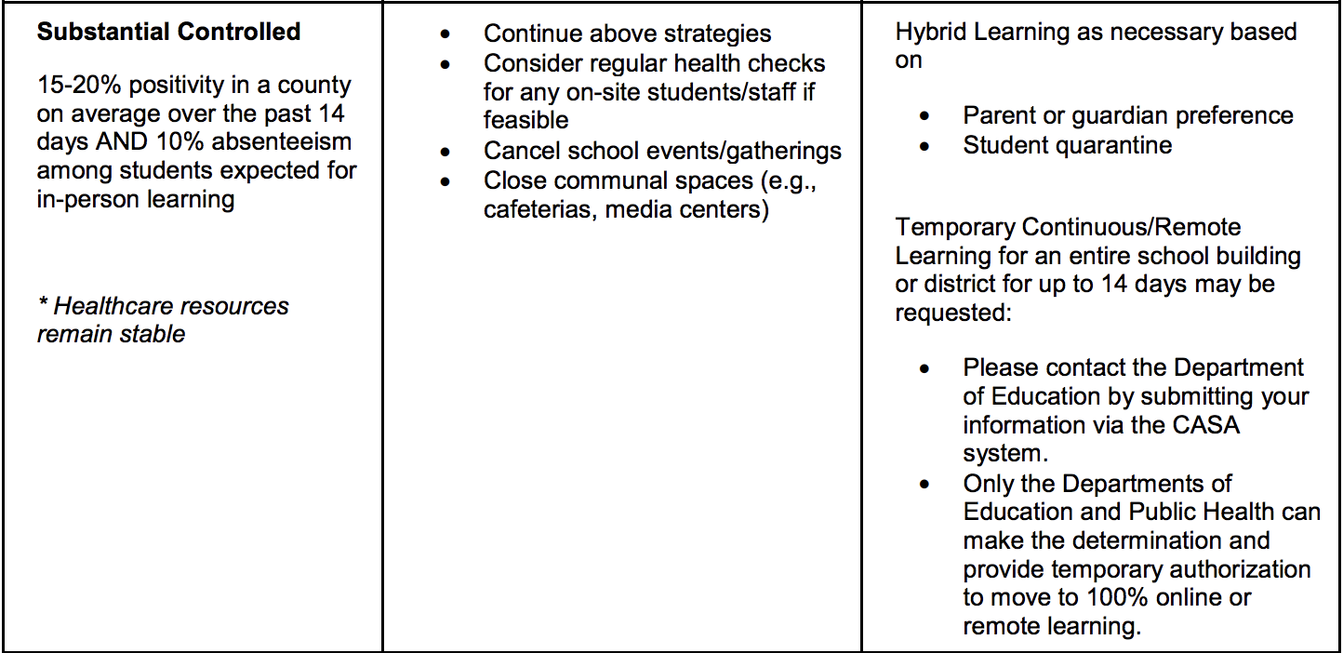
Iowa DE/IDPH Updated Guidance

Slide 14
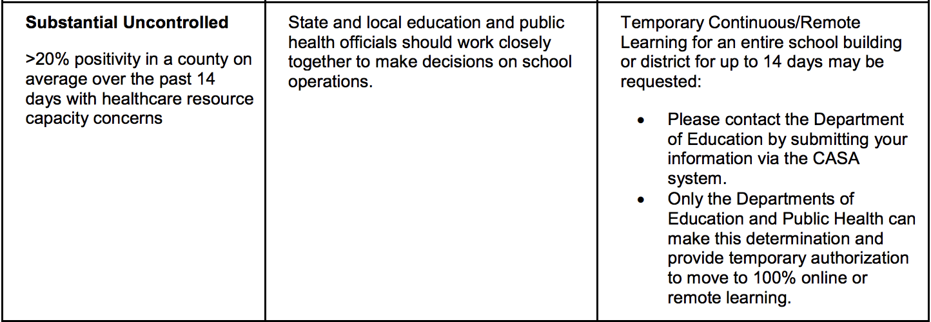
Iowa DE/IDPH Updated Guidance

Slide 15
Know Your Iowa Inventions
Trampoline
Jell-O Mold
Eskimo Pie
Sliced Bread

Slide 16
Know Your Iowa Inventions
Trampoline - George Nissen, born in Blairston, Iowa, was a gymnast and inventor who developed the modern trampoline in 1930.
Jell-O Mold
Eskimo Pie - The Eskimo Pie, America's first chocolate covered ice cream bar, was invented by Christian Nelson in Onawa, Iowa, in 1920. Originally called the "I-Scream Bar," the name changed when Nelson and chocolate maker Russell C. Stover joined to market the ice cream bar.
Sliced Bread – Davenport native Otto Rohwedder didn’t invent bread, but the engineer and inventor who was born and educated in Davenport invented and patented the automatic bread-cutting machine. It also wrapped bread. The first loaf of sliced bread was sold on July 7, 1928.

Slide 17
COVID Education Bill – SF 2310
DIVISION I - Online Learning and Coursework Requirements
The director of the DE is required to develop and maintain a list of approved online learning providers that are:
1) Taught by an Iowa teacher licensed under Iowa Code Chapter 272
2) Taught by a teacher with specialized training in delivering online instruction
3) Provide coursework that meets the standards of rules adopted by the State Board of Education

Slide 18
COVID Education Bill – SF 2310
Online Learning and Coursework Requirements
OFFER AND TEACH
WORLD LANGUAGES, PERSONAL FINANCE LITERACY, and COMPUTER SCIENCE are added to the list of subjects that may be provided by an AEA or through a DE approved online alternative
This exception also applies to science, social studies, English-language arts, mathematics, physical education, career and technical education, fine arts, and health.

Slide 19
COVID Education Bill – SF 2310
Online Learning and Coursework Requirements
OFFER AND TEACH
The offer and teach requirements do not apply for the referenced subjects IF:
1) The district/school makes every reasonable and good faith effort to employ a licensed teacher to teach the course, but is unable, OR
2) Fewer than ten students typically register for the course

Slide 20
COVID Education Bill – SF 2310
Online Learning and Coursework Requirements
OFFER AND TEACH
In addition to all other exceptions, the DE may waive offer and teach requirements for up to two additional courses, for a maximum annual number of exceptions of seven courses per district or accredited nonpublic school.
The additional annual waiver may be granted if a district or accredited nonpublic school proves to the DE that the school has made every reasonable effort but is unable to meet requirements.

Slide 21
COVID Education Bill – SF 2310
Online Learning and Coursework Requirements
OFFER AND TEACH
“GOOD FAITH EFFORT”
“Good faith effort” for the purposes of Offer and Teach is defined the same as in Iowa Code §279.19A regarding extracurricular contracts, and included: 1) advertising for the position in an appropriate publication; 2) interviewing applicants; and, 3) giving serious consideration to those licensed or authorized, and otherwise qualified, applicants. (IT DOES NOT MEAN THAT YOU ARE REQUIRED TO HIRE)

Slide 22
COVID Education Bill – SF 2310
DIVISION II - Temporary Flexibility for Use of Funds to Provide Additional Instructional Time
For the 2020-2021 school year ONLY, districts may use any of the 36 hours of required professional development outside the normal school day and the monies calculated and paid to districts for PD to supplement the number of instructional hours or days provided to students.
THIS IS ONLY PERMISSIBLE TO INCREASE the instructional hours/days beyond 1,080 hours/180 days.

Slide 23
COVID Education Bill – SF 2310
DIVISION III - Temporary Flexibility for Certain Educational Instructional and Policy Requirements
Competent Private Instruction - For the 2020-2021 school year ONLY, districts must provide students receiving competent private instruction with available texts or supplementary materials if they are dual enrolled or enrolled in the district’s home school assistance programs (HSAP) on the same basis as they are provided to regularly enrolled students.

Slide 24
COVID Education Bill – SF 2310
DIVISION III - Temporary Flexibility for Certain Educational Instructional and Policy Requirements
Instructional Time – Additional requirements if a school moves primarily to remote learning:
1) The school must ensure that staff are available to support students;
2) Staff are available to participate in professional development; and
3) Staff are available to perform other duties as assigned.
As long as mitigation measures are in place, a district may require employees to work from a school building even if students are learning remotely.

Slide 25
COVID Education Bill – SF 2310
DIVISION III - Temporary Flexibility for Certain Educational Instructional and Policy Requirements
Truancy – for 2020-21, any student who is enrolled but does not participate in compulsory remote learning must be considered truant.

Slide 26
COVID Education Bill – SF 2310
DIVISION III - Temporary Flexibility for Certain Educational Instructional and Policy Requirements
Teacher endorsement waiver – for 2020-21, if a district or accredited nonpublic school has made every reasonable good-faith effort to employ a teacher licensed under Chapter 272 who holds an endorsement for a specific grade level or subject area and cannot do so, AND the district or school also cannot provide the course through one of the permitted online means, the director of the Department may waive the teacher endorsement requirements in Iowa Code §§ 256.9(48) and 272.15(4).

Slide 27
COVID Education Bill – SF 2310
DIVISION III - Temporary Flexibility for Certain Educational Instructional and Policy Requirements
Miscellaneous Provisions –
Student Assessments – The requirements for the state summative assessments, preschool and kindergarten assessments, and early literacy assessments will not be waived. This includes: the Iowa Statewide Assessment of Student Progress (ISASP), Dynamic Learning Maps (DLM) alternate assessment, Teaching Strategies GOLD, kindergarten screening, and early literacy screening and progress monitoring assessments.

Slide 28
COVID Education Bill – SF 2310
DIVISION IV – School District Impact Report
Each district must submit a report to the DE detailing any reduction in expenditures experienced due to school closures from COVID-19. The report will be provided on a date and in a format prescribed by the DE and must include for the reporting period July 1, 2019 to June 30, 2020:
Transportation expenses; Contract employees, including certified and classified employees laid off by the school, listed by staff position; Non-contract staff laid off by the school, listed by staff position; and spring and/or summer programs canceled or impacted by COVID-19.

Slide 29
Know Your Iowa Mascots – Round 1
Canaries
Turkey Vultures
Goldfinches
Mosquitoes

Slide 30
Know Your Iowa Mascots – Round 1
Brooke Canaries
Turkey Vultures
Lester Goldfinches
Panama Mosquitoes

Slide 31
Teacher Preparation Assessment Reporting – HF 2359
This bill makes the entrance exam in teacher preparation programs optional.
However, if a teacher prep program offers this exam, it must report the assessment scores to the DE by August of each year, and the DE is required to post the results on its website.

Slide 32
School Tuition Tax Credits – HF 2641
This bill includes a phase-in procedure that will allow an increase in school tuition tax credits to $20 million.
The bill also strikes the 25% maximum amount of tax credit that a corporation can receive from a School Tuition Organization (STO) in a calendar year.

Slide 33
School Based Telehealth – SF 2261
This bill allows public schools, nonpublic schools and AEAs to contract with mental health professionals to provide voluntary behavioral health screenings to students in person or via telehealth, if the student’s parent or guardian provides written consent.
The bill also outlines specific requirements for schools and AEAs when conducting voluntary behavioral health screenings or telehealth services in schools for students and their mental health providers.
It makes schools a site of service for reimbursement from insurance companies. This allows students with health insurance coverage to see their mental health provider while in school.

Slide 34
COVID-19 Immunity – SF 2338
This bill prohibits a civil action due to COVID unless:
1) A diagnosis of COVID-19 results in hospitalization or death.
2) An act was intended to cause harm.
3) An act constitutes actual malice.
A business or governmental entity will not be liable if a person contracts or is exposed to COVID-19 if the building is in substantial compliance with all current public health, federal and state statutes, regulations, and orders.

Slide 35
School Liability 2020-2021
Matt’s Recommended Best Practice for 2020-2021:

Slide 36
School Liability 2020-2021
Matt’s Recommended Best Practice for 2020-2021:
Don’t do anything really dumb!!!
[Look up my April 2020 column concerning liability on the SAI website]

Slide 37
Extracurricular Activities 2020-2021
Academic eligibility – All students start with a clean slate and are eligible under state standards.
Good Conduct – Districts may still enforce Good Conduct violations.
Students voluntarily learning virtually – check with your legal counsel, but consider erring on allowing to participate.

Slide 38
Classroom Management – SF 2360
This bill attempted to address misbehavior in the classroom with the following FIVE main provisions:
1) Teacher Training and Preparation – Provides funding for educators to receive additional training on how to handle classroom disruptions. The DE will establish guidelines and work with AEAs on standards for professional development. Focus on Least Restrictive Environment (LRE) and research-based intervention strategies.
2) Therapeutic Classroom Funding – Creates a grant program that will equally distribute funds between all sizes of school districts to establish therapeutic classrooms. Provides additional funding to assist with transportation. FYI - reimbursement delayed one year.

Slide 39
Classroom Management – SF 2360
3) Classroom Clear Requirements – Regulates the method used to clear a classroom and strengthens communication with parents and input from teachers when this method is used. IEPs and Behavioral Intervention Plans (BIP) should not include room clears.
Communication and reporting steps:
1) Schools SHALL notify parents of students assigned to the classroom when a room clearance has occurred.
2) The principal SHALL request a meeting with the parent/guardian of the student whose behavior caused the classroom clearance.
3) If the student has an IEP or BIP, the classroom teacher may call for and participate in the meeting.

Slide 40
Classroom Management – SF 2360
This bill attempted to address misbehavior in the classroom with the following FIVE main provisions:
4) Educator Protections – Grants immunity from civil and criminal liability for educators when reasonable and necessary physical contact is used to protect students and others from potential injury.

Slide 41
Classroom Management – SF 2360
This bill attempted to address misbehavior in the classroom with the following FIVE main provisions:
5) Data Collection – Establishes data reporting and collection systems to track incidents of violence or assault by students.
  Establishes mechanisms for teacher reporting of student violence or assault to the principal.
  Incidents that result in injury, property damage or assault by a student will be reported to the DE and an annual report will go to the General Assembly.

Slide 42
Know Your Iowa Mascots – Round 2
Cattlefeeders
Cornshuckers
Charging Czechs
Claydiggers

Slide 43
Know Your Iowa Mascots – Round 2
Everly Cattlefeeders
Cornshuckers
Clutier Charging Czechs
Sheffield Claydiggers

Slide 44
Future Ready Iowa – HF 2629
This bill has a number of relevant provisions for schools:
1) Apprenticeship Training Program – Creates a renewable grants for schools with apprenticeship programs. Community colleges will create a list of high-demand jobs for the apprenticeship program for each region.

Slide 45
Future Ready Iowa – HF 2629
This bill has a number of relevant provisions for schools:
2) Computer Science Courses – Requires schools to:
  Offer at least a one-semester computer science course in high school;
  Offer a computer science course in at least one grade level in elementary and middle school by July 1, 2023, and;
  Develop a K-12 computer science plan by July 1, 2022. A work group will develop recommendations to strengthen computer science instruction statewide.

Slide 46
Dyslexia Student Curriculum and Teacher Licensure – SF 2356
Universal Licensure – HF 2627
BEDS Reporting – HF 2418
Check out Joanne Tubbs’s segment of the BoEE recorded session and/or my unabridged slides

Slide 47
OSHA Workplace Hazard Assessment
A workplace hazard assessment is performed to protect employees from all different types of risks (e.g., tripping hazards)
A distinction may be made between an effort to prevent the spreading of COVID by the wearing of masks and face coverings as opposed to a hazard requiring that an employee needs to wear a respirator, such as an N95 mask to protect them from a hazard, whether a virus or dust particles.
If Personal, Protective Equipment (PPE), such as a respirator, is required to protect an employee then OSHA requires training.

Slide 48
OSHA Workplace Hazard Assessment
OSHA only requires that employees must demonstrate an understanding of the following PPE training areas:
1) When PPE is necessary;
2) What PPE is necessary;
3) How to properly don, doff, adjust, and wear PPE;
4) The limitations of the PPE, and;
5) The proper care, maintenance, useful life and disposal of the PPE.
AGAIN, there will often be a distinction between cloth face coverings or surgical masks and PPE, such as N95 respirators.
DO not use the term PPE, unless you are intentionally doing so!

Slide 49
Employee Mask Considerations
Employers may require employees to wear masks or face coverings as long as accommodations are made for employees with certain physical or mental health conditions.
If an employee raises a religious exemption, you are encouraged to discuss the situation with your district’s legal counsel.
Consider the need for some employees to temporarily remove their mask in order to communication with a student or individual with a hearing impairment
Employee speech – districts may restrict messages from being displayed on the masks of employees.

Slide 50

Appropriate Employee Mask

Slide 51

Inappropriate Employee Mask
We have already suffered through enough anguish during 2020!

Slide 52
Student Mask Considerations
Schools may require students to wear masks or face coverings as long as accommodations are made for students with certain physical or mental health conditions, or who have a religious exemption.
Ensure families understanding that the wearing of masks may prevent quarantine and school or activity closure.
IF masks are required for students to attend school, then the district should be prepared to provide masks for students who do not have one.
Ensure students are not harassed by others for wearing or not wearing a mask.

Slide 53
Student Mask Considerations
Districts may delegate for individual teachers to require the wearing of masks or face coverings in their classroom if the teacher has a serious underlying health condition.
Student discipline – take appropriate steps, just as you would for a student who is not wearing goggles in chemistry class.
Student speech – messages on masks should be treated no different than messages on t-shirts or other clothing.

Slide 54
Employee Work Conditions
As always, the district should make reasonable accommodations for an employee with a permanent or a temporary disability
An employee’s personal opinion that it is unsafe to return to work is not enough to entitle the employee to work from home or to demand mitigation steps that are beyond what the district is providing
If the employee is unable to perform the essential functions of their job through telework, then the employee will be limited to protections under the school’s leave policy or state or federal law.
(the employee must return to work after leave is exhausted, unless the school approves an extended leave of absence)

Slide 55
Critical Infrastructure Employees
These employees are not required to quarantine due to exposure to COVID if they are asymptomatic.
However, the school should require:
1) Pre-screening;
2) Regular monitoring;
3) Wearing of a mask;
4) Social distancing, and;
5) Disinfecting of common work spaces.

Slide 56
Critical Infrastructure Employees
The current Department of Homeland Security list of critical employees includes (as of July 30, 2020):
Bus drivers Governor Reynolds and the DE
Food service workers confirmed on July 30 that
Technology services teachers and other staff
Vehicle and building maintenance members in shortage areas
Medical professional may be considered critical
Childcare workers employees and would not have
Social workers to quarantine if they are
Janitorial staff exposed to COVID but
Security asymptomatic!!!

Slide 57
Families First Coronavirus Response Act (FFCRA)
On March 18, the federal government enacted the Families First Coronavirus Response Act (Effective April 1, 2020 and through December 31, 2020). This bill includes:
(1) Emergency Family and Medical Leave Expansion Act
(2) Emergency Paid Sick Leave

Slide 58
Families First Coronavirus Response Act (FFCRA)
Two weeks (up to 80 hours) of PAID SICK LEAVE at the employee’s regular rate of pay where the employee is unable to work because the employee is quarantined (pursuant to Federal, State, or local government order or advice of a health care provider), and/or experiencing COVID-19 symptoms and seeking a medical diagnosis; or

Slide 59
Families First Coronavirus Response Act (FFCRA)
Two weeks (up to 80 hours) of PAID SICK LEAVE at two-thirds the employee’s regular rate of pay because the employee is unable to work because of a bona fide need to care for an individual subject to quarantine (pursuant to Federal, State, or local government order or advice of a health care provider), or to care for a child (under 18 years of age) whose school or child care provider is closed or unavailable for reasons related to COVID-19, and/or the employee is experiencing a substantially similar condition as specified by the Secretary of Health and Human Services, in consultation with the Secretaries of the Treasury and Labor; and

Slide 60
Families First Coronavirus Response Act (FFCRA)
Up to an additional 10 weeks of paid expanded family and medical leave at two-thirds the employee’s regular rate of pay where an employee, who has been employed for at least 30 calendar days, is unable to work due to bona fide need for leave to care for a child whose school or child care provider is closed or unavailable for reasons related to COVID-19.

Slide 61
Families First Coronavirus Response Act (FFCRA)
Emergency FMLA Expansion Act
Job Restoration
Generally, employers are required to restore employees to the jobs they had prior to taking leave.

Slide 62
Families First Coronavirus Response Act (FFCRA)
Sequencing of Paid Leave
An eligible employee may use Emergency Paid Sick Leave before employer-provided paid leave and must not be required to exhaust all employer-provided leave before using Emergency Paid Sick Leave.
Emergency Paid Sick Leave does not carry over to 2021 and does not need to be paid out upon an employee’s termination.
Expanded FMLA may be used concurrently with Emergency Paid Sick Leave or employer sick or other leave in certain circumstances. CHECK WITH DISTRICT LEGAL COUNSEL!

Slide 63
Families First Coronavirus Response Act (FFCRA)
Emergency Paid Sick Leave Act
Employer Posting Requirements
The Federal Department of Labor has made a model notice available for employers to post in conspicuous places on their premises.
Districts are encouraged to post this notice on their website as well.

Slide 64
Know Your Iowa Mascots – Round 3
Atoms
Geodes
Ramblers
Spiders

Slide 65
Know Your Iowa Mascots – Round 3
Aurelia Atoms
Geodes
Coon Rapids and 7 other schools – Ramblers
Webb Spiders

