Slide 1


Redefining Talent Recruitment: An Action Plan
September 13, 2022

Slide 2
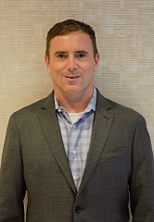
A Little Bit About NSCA
NSCA is the leading not-for-profit association representing the commercial systems integration industry.
NSCA provides benchmark studies on labor units, economic reports, vertical market trends, technology adoption, regulations and codes, etc.
NSCA is … Your voice, Your business resource, Your trusted advisor.
Executive Director:
NSCA’s Tom LeBlanc

Slide 3

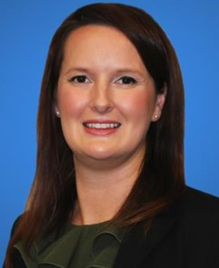
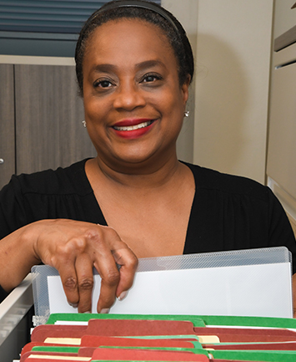
Meet the Panelists
Keri Higgins-Bigelow, CEO + Founder, livingHR
Michele Anderson, Recruiting Services Manager, Insperity
Wendy E. Feeling, Director of HR, Visual Sound

Slide 4

Why Is Talent Recruitment Particularly Challenging Right Now?
Project profitability is a challenge
Compounded by escalating labor costs
Integration job market has talent-hungry firms recruiting other firms’ key employees to higher-paying, higher-level roles
Leaves those firms scrambling for new talent or paying higher rates to keep their teams intact

Slide 5
So … What Can You Do?
Let’s talk action steps

Slide 6
Create Better Connection Between Branding and Recruiting
EVP (Employee Value Proposition)
Talent Brand Reputation Brand Inclusion
Develop your reputation
Connect via Social Media
Be authentic

Slide 7

Take a ‘Humanized Approach’ to Attracting Talent

Slide 8

Explore Non-Traditional Recruiting Methods
Passive vs. Active
Recruit Internally + Build
Diverse Recruiting Sources
Employee Referral Program
Recruit where you are
Video Interviewing

Slide 9

The Bubble Is Missing Something
We need to talk about Diversity, Equity, & Inclusion (DEI)
NSCA DEI Action Council is focused on encouraging NSCA members to rethink DEI in their company culture
New Member Advisory Council livingHR can provide DEI consulting to NSCA members

Slide 10
Addressing Business Needs: What’s Your DEIB Strategy?

Slide 11

Rethinking Technology’s Role in Recruiting
Ease of application
Make it mobile
Applicant tracking
Assessments

Slide 12

Questions & Answers
Follow Up with Our Presenters:
Insperity: nsca.org/Insperity
livingHR: nsca.org/livinghr
Wendy E. Feeling: wfeeling@visualsound.com
NSCA.org

Slide 13
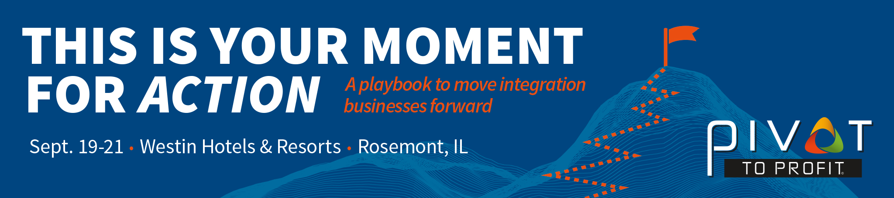

Slide 14

Michele Anderson
michele.anderson@insperity.com
www.insperity.com/nsca
Keri Higgins-Bigelow
keri@livinghr.com
www.nsca.org/livinghr

Slide 15

Thank You
Visit NSCA.org/webinars to learn about upcoming events
Tom LeBlanc
tleblanc@nsca.org
Or
Mike Abernathy (NSCA Webcast Producer)
mabernathy@nsca.org
Learn more at IgniteYourCareer.org
Contact Teresa Solorio at tsolorio@nsca.org or call 800.446.6722

