Slide 1
US Navy Talent Pipeline Program “It’s NOT a moment, It’s a Movement” Executive Summary Non-Ferrous Founders’ Society https://dibtalentpipeline.com/
Joe Barto
Program Leader
jbarto@tmgva.com
757-218-8444
February 22, 2025

Slide 3
“Winning Matters”
No Fair Fights
Special Bond
Notes:
3

Slide 4
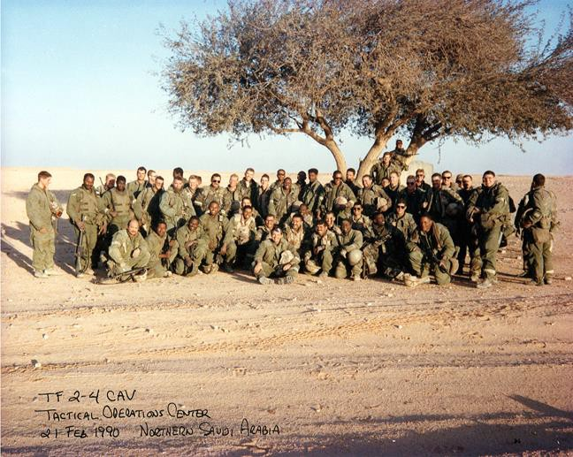
Task Force 2-4 Cavalry Tactical Operations Center Team
Feb 21, 1991 - Northern Saudi Arabia

Slide 5
TPP Performance and Growth Plan as of 01/24/25
124
910 Starts
69% 1st year
Retention
36
259 Starts
63% 1st Year
Retention
Frontier TBD Flag
Trident Maritime Systems Fairbanks Morse Defense Non-Ferrous Foundry Society
Leonardo Naval Power Systems Enterprise +

Slide 6
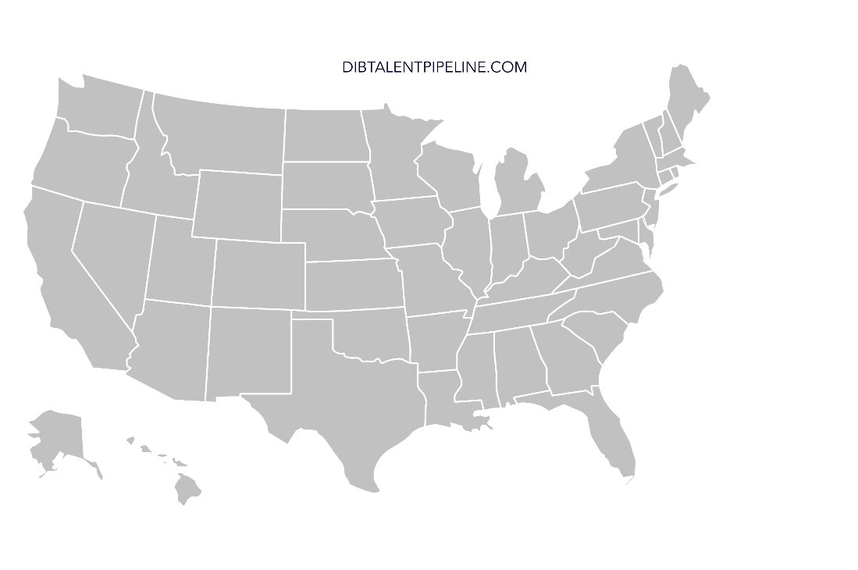
2024Talent Pipeline Program “National Reach”
Regional
Flags
Regional Flags
2021: Philadelphia
2022: Pittsburgh
Hampton Roads
2023: Boston
Long Island
2024: Southern California
Enterprise+
Fairbanks Morse Defense
Trident Maritime Systems
Non-Ferrous Foundry Society
Leonardo DRS/NPS
2026: New Regional Flag TBD

Slide 7
TPP National Coverage (All Sites Combined as of January 2025)
Enterprise Sites
+ Sites
Franchise
Regional Outliers

Slide 8
Employer Qualifying Criteria
Do you agree with and support the Talent Pipeline Program Mission?
Are you a Small or Medium Sized Employer under 1,000 people?
Do you have a Hiring Demand 12-24 months into the future?
Are Entry Level New Hires part of your Talent Acquisition and Retention Pipeline Strategy?
Do you offer Full Time Employment with benefits?
Do you accept responsibility to ensure the New Hires are productive and trained to meet your specific job requirements?
Will you be trained on the Talent Acquisition and Retention Best Practice Model?
Are you willing to substantively and actively change your internal Talent Acquisition and Retention system if it is not producing the outcome you require?
Will you participate in local Network sessions to share and learn with others?
Will you provide the Talent Pipeline Program your Talent Acquisition & Retention performance data?

Slide 9
Demand Driven Talent Acquisition & Retention (TA&R) System
Best Practice Model
Perfect Process: 1 Recruit = 1 Life Long Engaged and Productive Teammate
HIRE FOR FIT – TRAIN FOR SKILL
Pre-1st Day – HR Lead
Post Hire – Operations Lead
Recruiting
Hiring
On-Boarding
1st Year Retention
Pipelines |  | Tools
1. CTE Programs (HS & CC) 2. Employee Referral Program 3. ATDM 4. Adult Education 5. Temp Agencies 6. Social Media | 7. Recruiting Agencies 8. Military & Veterans 9. Employment Commissions 10. College Departures 11. Recovered/Returns 12. Retiree’s | 1. TA&R Value Stream Mapping and Performance Improvement Plan Development 2. Realistic Job Preview & Candidate Tracking System 3. Best Athlete Profile/Recruiter Training 4. Recruiting & Offer Day/New Hire Orientation 5. Behavioral Based “Fit” Interviews | 6. Navigator Training 7. World Class First Day 8. Common Skills Training 9. Leader New Hire Retention Training 10. 30-60-90 day & 1 Year Fit/Skills Assessment 11. 5th Metric “People” Scorecard Data Driven Program Management System

Slide 10
Navy Provided Partner Support Services
New Partner (Employer, Training Provider, Facilitator) Identification, Recruiting, & Assessment
Talent Acquisition & Retention Best Practice Model Training Workshops
Partner Talent Acquisition & Retention Values Stream Mapping, Analysis, and Performance Improvement Plans
Individual Employer & Training Provider Talent Acquisition & Retention System Tool Development, Coaching and Support
Local Partner Network “Sharing and Learning” events
Monthly All Hands Information and Best Practice Sharing
Best Practice Model Development and integration into the TPP Employer Talent Acquisition and Retention Training & Coaching process
Program Management, Data Analytics, Industry Engagement & Strategic Planning

Slide 11
2024-2025 Major Events
Philadelphia Flag
2021
Pittsburgh Flag
2022
Hampton Roads Flag
2022
Boston Flag
2023
Long Island Flag
2023
Mr. Matt Sermon
KO: 10 SEP 24
MY: 16 JAN 25
SD: 22 MAY 25
RDML Doug Adams
KO: 24 SEP 24
MY: 21 JAN 25
SD: 20 MAY 25
Mr. Justin Meyer
KO: 12 SEP 24
MY: 14 JAN 25
SD: 10 JUN 25*
Ms. Meganne Atkins
KO: 26 SEPT 24
MY: 23 JAN 25
SD: 15 MAY 25
Ms. Stefanie Link
KO: 2 OCT 24
MY: 28 JAN 25
SD: 6 MAY 25
DSRT: Demand Signal Round Table (Year 1 Only)
KO: Team Kick Off
MY: Mid-Year Networking and Team Update
SD: Signing Day
TPP 2025-2026 Kick Off Symposium and Network Coach Training:
31 MAR – 3 APR 2025
National Signing Day: 27 JUN 2025 Washington, DC
Southern California
2024
Enterprise +
2024
RDML Todd Weeks
DSRT: 26 APR 24
KO: 8 OCT 24
MY: 30 JAN 25
SD: 5 JUNE 25
RADM Casey Moton
Mr. Michael McClatchey
KO: 14 NOV 24
MY: 6 MAR 25
SD: 27 JUN 25

Slide 12
Core Outcome Metric
# of EMPLOYERS with a reliable year over year Talent Acquisition and Retention Pipelines to run a better business and increase defense industrial capacity.

Slide 13
We help Leaders who WANT to Lead;
Lead a High-Performance Team…
We Give You the Courage to Lead
We are a Program of YES!
If you want help and are willing to do something different in your Talent Acquisition and Retention System to improve your production capacity for the Navy!

Slide 14
NFFS Talent Pipeline Program
Empowering Foundries to Develop a Skilled Workforce through Proven Talent Acquisition & Retention Strategies.
Building Talent Pipelines
Improving Employee Retention
Delivering Workforce Solutions

Slide 15
Why Did NFFS Join the TPP
Our members are a significant contributor to SIB/DIB supply chains.
Our members continue to have significant labor challenges affecting ability to meet Navy & DIB demand.
Learn more about the TPP model to help educate our members on how to professionalize their TA&R strategies.
Identify best practices for foundries to help improve the process for other industry members.
Identify best practices to assist other trade associations with deployment of TPP into their own industries.

Slide 16
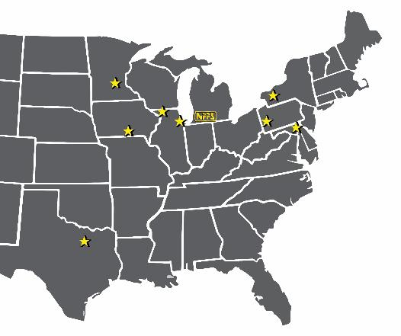
Who is Currently in the NFFS 2024-26 Cohort
A&B Foundry LLC (Dallas, TX)
Calumet Brass Foundry (Dolton, IL)
Danko Arlington (Baltimore, MD)
Harmony Castings (Harmony, PA)
Jef Scot Metal Industries (Centerville, IA)*
Olson Aluminum Castings, Ltd (Rockford, IL)
Southern Aluminum Foundry (Clinton, SC)*
TPI Arcade (Arcade, NY)
NFFS Flag Lead: Jerrod Weaver
NFFS Network Coach: Bill Padnos
TPP Support: Joe Barto & Abe Bigelow
* Deferred their involvement until the next cohort

Slide 17
TPP = Sharing Best Practices

Slide 18
What Does it Mean to be in the TPP
Time To Think
Rewatch the Video - https://tinyurl.com/3d4k8z77
Does any of the video hit home?
What does a First Day look like at your foundry?

Slide 19
Impact of a Worst 1st Day
Investment in Recruiting New Hire
Average cost per hire is $4,700
Job Postings
Recruiter time
Interview & Selection
Impact of an Open Position
Average 42 days to fill a position
Lost productivity
Increased workload for existing employees
Potential burnout and turnover
80% of new hires who receive poor onboarding plan to quit

Slide 20
Transform Traditional TA&R with TPP
The TPP creates a synchronized and integrated approach to workforce development.
Traditional Hiring Challenges:
Post and Hope: Employers post job openings and wait for candidates.
Unrealistic Expectations: Employers often demand high experience for low wages.
Train and Pray: Training providers educate students without ensuring job alignment.
The Core Issue:
Resource Gap: Small/medium employers lack the resources of larger companies but face similar hiring challenges.
Mismatch: Employer needs often don't align with training programs.
Frustration: This disconnect leads to frustration and blame from both sides.
The TPP Solution:
Employer Focused: TA&R creates a demand-driven system to improve hiring and productivity.
Talent Pipelines: Training providers supply entry-level talent; employers build their own for experienced roles.
Industry Impact: Strengthens workforce to enhance Navy ship construction and sustainment.

Slide 21
Demand Driven Talent Acquisition & Retention (TA&R) System
Best Practice Model
Perfect Process: 1 Recruit = 1 Life Long Engaged and Productive Teammate
HIRE FOR FIT – TRAIN FOR SKILL
Pre-1st Day – HR Lead
Post Hire – Operations Lead
Recruiting
Hiring
On-Boarding
1st Year Retention
Pipelines |  | Tools
1. CTE Programs (HS & CC) 2. Employee Referral Program 3. ATDM 4. Adult Education 5. Temp Agencies 6. Social Media | 7. Recruiting Agencies 8. Military & Veterans 9. Employment Commissions 10. College Departures 11. Recovered/Returns 12. Retiree’s | 1. TA&R Value Stream Mapping and Performance Improvement Plan Development 2. Realistic Job Preview & Candidate Tracking System 3. Best Athlete Profile/Recruiter Training 4. Recruiting & Offer Day/New Hire Orientation 5. Behavioral Based “Fit” Interviews | 6. Navigator Training 7. World Class First Day 8. Common Skills Training 9. Leader New Hire Retention Training 10. 30-60-90 day & 1 Year Fit/Skills Assessment 11. 5th Metric “People” Scorecard Data Driven Program Management System

Slide 22
Value Stream Mapping Session
Visualize Current TA&R Process to Identify Improvement Opportunities
Demand Signal (New Hires)
Pipeline
Recruiting
Hiring
On-Boarding
Retention

Slide 23
Determine What to Work on First
Launch 1st Tool Work
Based on Your Needs
Customized to Your Situation
Internal Process with an External Coach

Slide 24
The Tools
Realistic Job Preview
Utilize web-based tool to attract, pre-qualify & track job candidates
Best Athlete Profile
Train internal team to identify & recruit for “Fit” or “Skill”
Behavioral Based “Fit” Interviews
Focus interview assessment on finding value aligned candidates
Recruiting & Offer Day
Facilitate candidate evaluation through real-world interactions

Slide 25
The Tools
Navigator Training
Train peer mentors to develop a smooth onboarding experience.
World Class First Day
Design an event-focused structured first day to ensure new hire success
Common Skills Training
Ensure early success through essential skills development training.

Slide 26
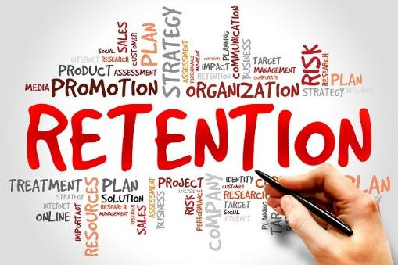
The Tools
Leader Retention Training
Empower managers through customized training to engage & retain talent.
30/60/90 & 1yr Assessment
Implement an ongoing fit & skills evaluation for employee development.
5th Metric People Scorecard
Improve workforce development through a data-driven management system.

Slide 27
Typical Consulting Charges
Talent Acquisition:
Consultants may charge between $75 to $250 per hour, depending on their expertise and the complexity of the roles to be filled.
Retention Strategies:
HR consultants often charge between $100 to $300 per hour for services related to employee engagement and retention

Slide 28
NFFS TPP Cohort Program Cost
NO COST TO YOU
Investment in time
Monthly Cohort Meetings
Monthly Work Meeting with Coach
Kick-Off, Mid-Year, Signing Day Events
Willingness to Improve
Open to Evaluation
Open to Collaboration
Open to New Practices

Slide 29
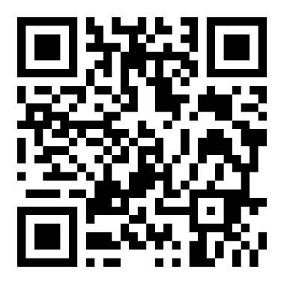
Join the Movement
READY TO GO!!!!
NFFS 2025-27 Cohort Registration
is Now Open
Signing Day Event is May 9, 2025
Start Date is Tuesday, July 1, 2025
Kick-Off Event is September 2025
Interested in Getting Started, visit NFFS.org/tpp

Slide 30
Thank You / Any Questions

Slide 31
Mission
The US Navy Talent Pipeline Program TEAM will
energize and engage the American manufacturing economy by
creating and sustaining a defense and maritime industrial base
focused talent pipelines enabling EMPLOYERS to
re-capitalize their workforce through recruiting, hiring, on-boarding, and
retaining workforce for 1-year
as productive and engaged new employees.

Slide 32
Talent Pipeline Program Flag Transition, Sustainment, and Expansion Strategy Planning
MISSION: Execute a Talent Pipeline Program National Roll Out Strategy to support the US Navy Fleet Re-capitalization Program through the Columbia/VCS construction period while retaining small and medium sized EMPLOYER focused Talent Pipeline model integrity while customizing to the local regions.
PLANNING ASSUMPTIONS:
Navy Demand for Defense Industrial Base (DIB) Capacity will continue through 2040.
American economy full employment condition is a constant for the foreseeable future.
~13,000 Small to Medium Sized Business’s in DIB (< 1,000 Employees at a Single Site)
Talent Acquisition and Retention is the sole responsibility of the DIB Employers
The Talent Pipeline model is PROVEN and model integrity will be retained during the national roll out.
Supplier Development Funding will support the Talent Pipeline Program over the Program Transition, Sustainment, and Expansion Life Cycle.

Slide 33
Talent Pipeline Employer Partner Master Scorecard
2023-2025 Cohort
AS OF:
31 Dec 24
7/1/2023 – 6/30/2024 (Hiring) 7/1/2024 – 6/30/2025 (Retention) | Employer Actual | # Employers Trained | # New Hire Demand | # New Hires Started | # New Hires Retained
RECRUITING & HIRING Current | 291 | 282 | 2,078 | 5,072 | 3,698
Philadelphia Region – Flag 1 | 772 | 66 | 216 | 1040 | 805
Pittsburgh Region – Flag 2 | 65 | 64 | 533 | 1059 | 801
HR Virginia Region – Flag 3 | 81 | 81 | 901 | 2051 | 1394
Boston Region – Flag 4 | 37 | 37 | 213 | 733 | 550
Long Island Region – Flag 5 | 36 | 34 | 173 | 189 | 148
2023-2025
In Process
Retention:
73%
Notes:
Note: DOES NOT Include 2021-2023 Archived Data from Philly

Slide 34
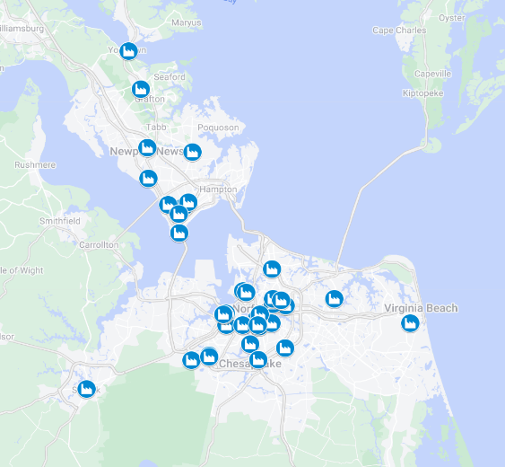
Partner Network Concept
Networks will be comprised of 10 - 20 Employers
Geographically or join any network you choose
Each network will have…
Network Employer Lead
Dedicated Network Coach
Networks meet 2X Fall and Spring to share best practices, discuss challenges, learn from each other
Training Providers are to be invited to a network by Employer Sponsor.
Facilitators to join network(s) where they see the most value added.

Slide 35
WE are on a Mission!
1 Relationship
1 Employer
1 Job
1 Lifelong, Productive,
Engaged Teammate at a Time

