Slide 1
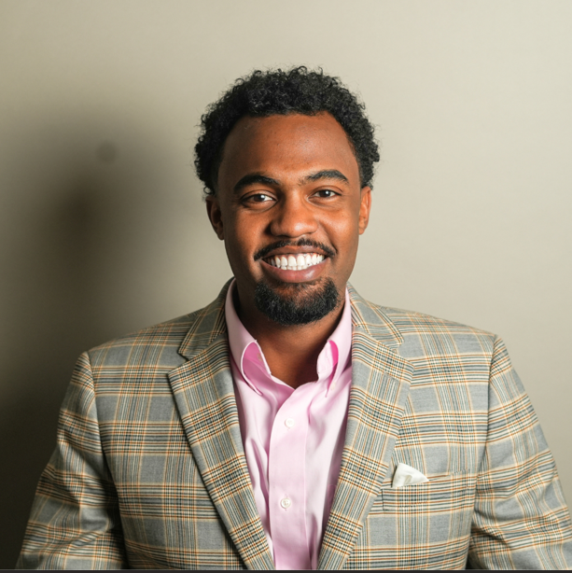
Rashaad Galloway has always been inspired by healthcare technology. At an early age, he was captivated by the cutting-edge technology he observed at the dentist’s office, which sparked his interest in pursuing a career in dentistry. While attending UNC-Chapel Hill as a communication studies major on a pre-dental track, Rashaad shadowed various dental specialties and became aware of the lack of diversity in the healthcare field. Admitted to NYU College of Dentistry, Rashaad deferred his acceptance to pursue his higher calling: transforming the healthcare field by diversifying clinical research. His personal experiences with family members who faced challenges due to the lack of diversity in clinical research, such as his mother and grandmother being subjected to ineffective blood pressure medications and improper dosages, fueled his passion. Conversations with peers revealed similar stories, highlighting the need for change in clinical research practices. As Co-Founder and COO of CliniSpan Health, Rashaad leverages his background in communication and marketing to integrate cultural competence into the clinical research process. This initiative allowed CliniSpan Health to engage a previously untapped market of diverse individuals. Rashaad's expertise in healthcare, entrepreneurship, and thought leadership has driven innovation in a traditionally static segment of the clinical research industry. Under his leadership, CliniSpan Health has positioned itself as a leader in diversity education and recruitment, making significant strides in improving the inclusivity of research and the effectiveness of medications for all communities.
RASHAAD GALLOWAY
Notes:
In the chat:
Share your favorite Holiday dish or tradition.

