Slide 1
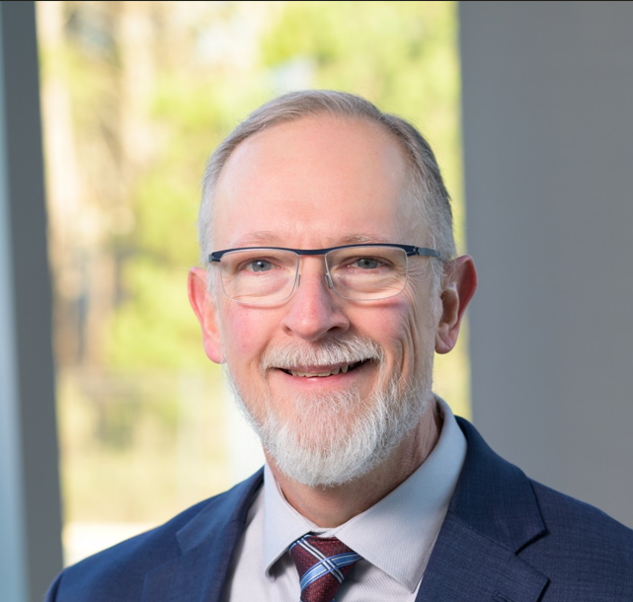
Larry is a reluctant "Boomer" having been born in 1963, 1 year before the official end of the Boomer range. He has lived in the Triangle Area since the mid 70s and is a product of Wake County Public Schools and North Carolina Universities where he earned undergraduate degrees in Zoology and Science Education from NC State, a Master's degree in Botany - Plant Physiology/Biochemistry from NC State, and an MBA from Duke concentrating on Health Sector Management. Stops along his career journey include High School Teacher, Clinical Research Monitoring, Clinical Data Management, Research Project Management, I&T Management, Software Development, Pharmaceutical Project Management, and Operational Excellence and Business Process Improvement. He currently is a member if the CSL Seqirus Site Leadership Team in Holly Springs where he leads a small team in continually improving our ways of working and our product delivery.
Outside of work, Larry is an avid fitness enthusiast, DIYer, Maker, wood worker, musician, and community garden manager. He and his wife, Karla have been married for 37 years and live in Apex, with their dog and six chickens. He has two children who are both married, one of whom recently made him a grandfather. If he were an Avenger, he says he identifies most closely with Dr. Strange. To Harry Potter fans, he says he would probably be sorted to Ravenclaw.
LAWRENCE DIENER
Notes:
In the chat:
Share your favorite Holiday dish or tradition.

