Slide 1
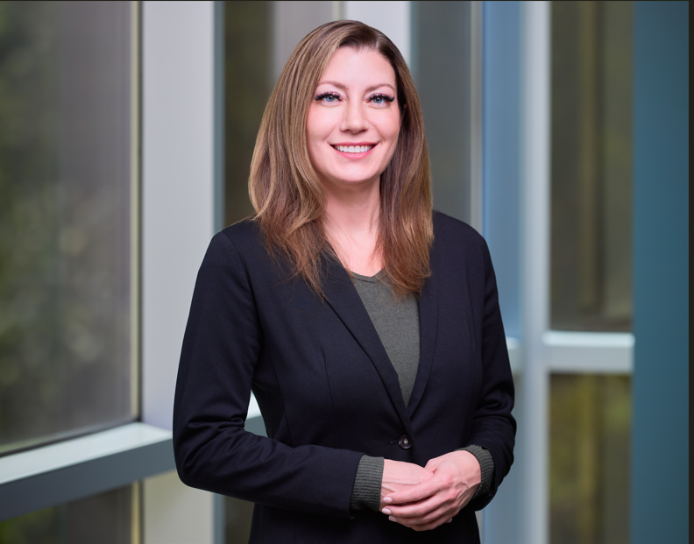
Amanda Adams joined Biogen as Head of Quality Assurance at the RTP Pharma Site in February 2024. She has a wealth of industry experience and has held leadership positions in Quality/QC, Validation, Quality Engineering and Manufacturing with a majority of her career in contract manufacturing. Amanda has extensive experience and knowledge in Aseptic Manufacturing, Tech Transfer & PPQ and Facility Qualification & Start up. Throughout her career journey, Amanda has grown and developed high performing teams by leveraging the unique perspectives, experiences, and work styles of a multigenerational workforce. She believes that by embracing age diversity, organizations can harness the unique strengths of all generations, thereby encouraging a more innovative and productive workplace. When not working, she enjoys the outdoors and travelling (46 countries so far!) and supporting local animal shelters.
AMANDA ADAMS
Notes:
In the chat:
Share your favorite Holiday dish or tradition.

