Slide 1




YOUTH
COMMUNITY
SYSTEMS
FROM ASKING TO SHARING:
EXPLORING POWER
IN NONPROFIT WORK
NONPROFIT ASSOCIATION OF THE MIDLANDS
CONFERENCE - MARCH 2026
Start Slide
snowredfern.org

Slide 2


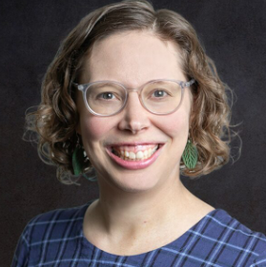
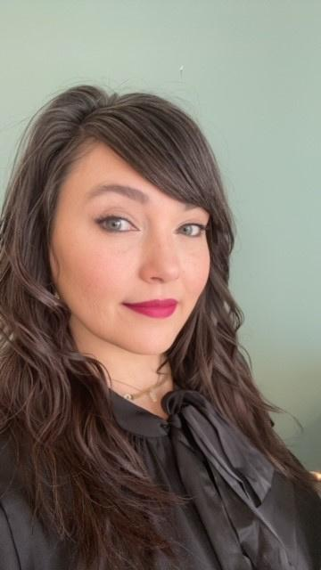
WHO’S IN THE ROOM?
SARA
STEPHANIE
MAYA
sara@snowredfern.org
svadnais@nebraskachildren.org
drmaya@blueagatecollaborative.com

Slide 3


YOUTH
COMMUNITY
SYSTEMS
ABOUT SRF
SNOW-REDFERN FOUNDATION
We believe in the potential of all young people!
VISION
Nebraska youth thrive within inclusive communities and participatory systems of care.
MISSION
To empower youth, inspire change makers and energize partnerships for impact.
INVEST IN KIDS
snowredfern.org

Slide 4
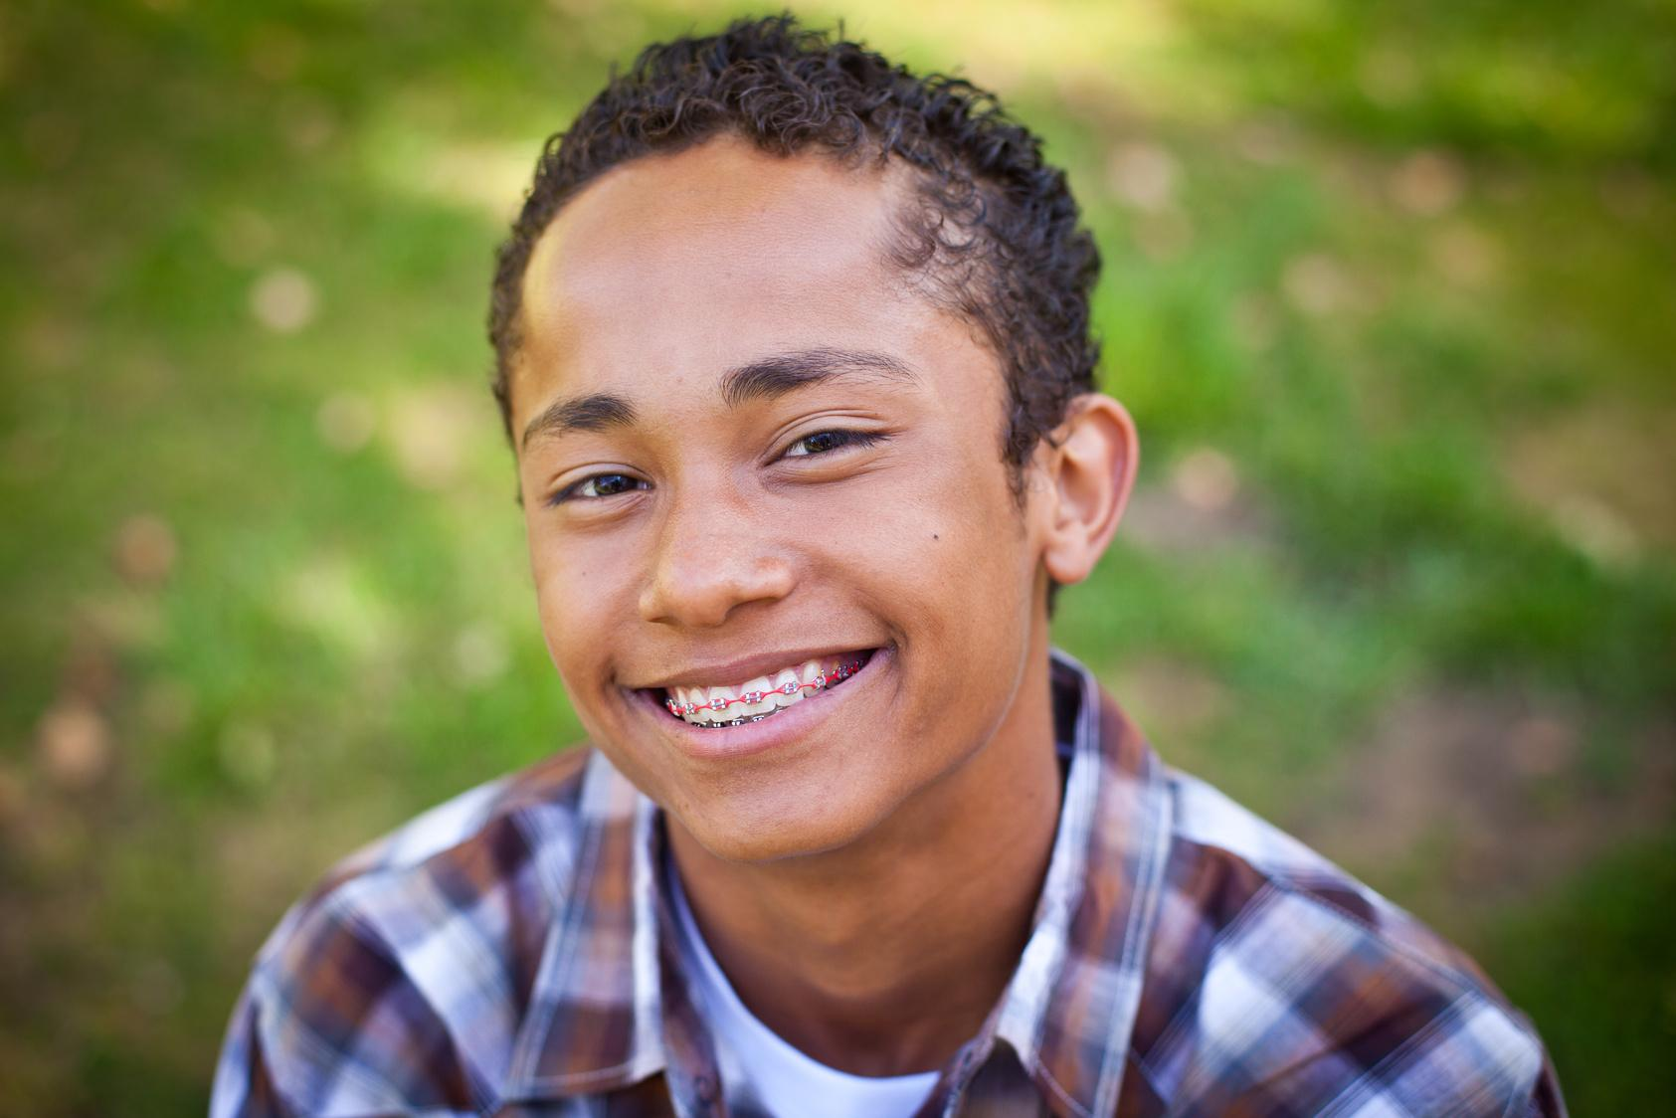
YOUTH
COMMUNITY
SYSTEMS
FROM ASKING
TO SHARING
We’re all learning and evolving.
Most systems are adult-led.
Participation grows over time.
Curiosity is enough.
snowredfern.org

Slide 5



YOUTH
COMMUNITY
SYSTEMS
AN INVITATION TO REFLECT, LEARN, AND REIMAGINE
Most of our systems were built to be adult-led.
Power isn't always visible; it lives in who sets the agenda, who gets the mic, and whose expertise is trusted.
We're here to notice the water we're swimming in, not place blame.
Small, intentional shifts in practice can create real change over time.
This is an invitation to engage in a conversation about what could be if we all made meaningful shifts.
“Our sector must reclaim its sense of imagination, hope, and optimism. We must bring back the audacity to dream big.” Vu Le, Reimagining Non-Profits and Philanthropy
snowredfern.org

Slide 6


YOUTH
COMMUNITY
SYSTEMS
TIME TO DREAM!
Think about the people your organization serves. What would it look and feel like if
they weren't just heard, but actually held
power in shaping decisions?
What excites you about that?
What feels uncomfortable?
SELF REFLECTION
2 MINUTES

Slide 7


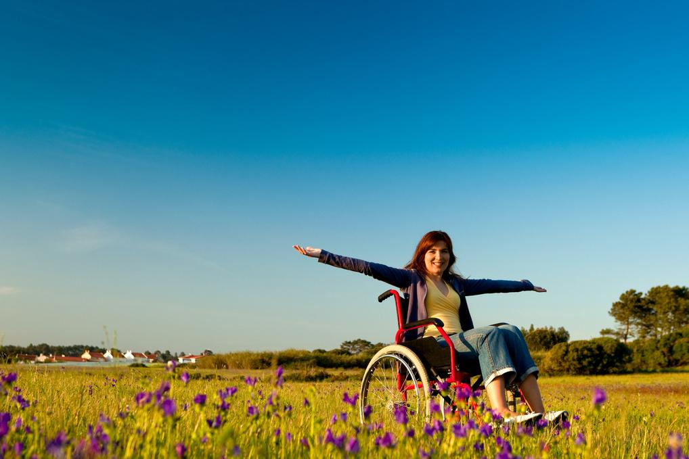

YOUTH
COMMUNITY
SYSTEMS
WHAT CAN WE BECOME
PARTICIPATORY PRACTICES
Participatory practice = posture and a commitment.
Examples: Youth surveys ⟶ Youth brainstorming sheets ⟶ Youth advisory groups ⟶ Youth-led grant-making.
Intention and structure are important.
You don’t have to start over from scratch. You can grow from where you are.
The ladder shows us where we are and where we can go.
snowredfern.org
Notes:
Participatory practices represent a posture and a commitment, not a specific program.
It exists on a spectrum: from informing youth to being led by youth.
Examples: Youth surveys ⟶ Youth brainstorming sheets ⟶ Youth advisory groups ⟶ Youth-led grant-making/Contribution Project
You have likely implemented some elements of participatory practices in your organization. The question is how intentional and well structured are your practices? what can you do to implement more structure and/or intention?
Affirmation: your organization doesn't have to start from scratch. Start where you are and join us as we dream, learn, and grow together as a system of care
The ladder shows us where we are and where we can go

Slide 8
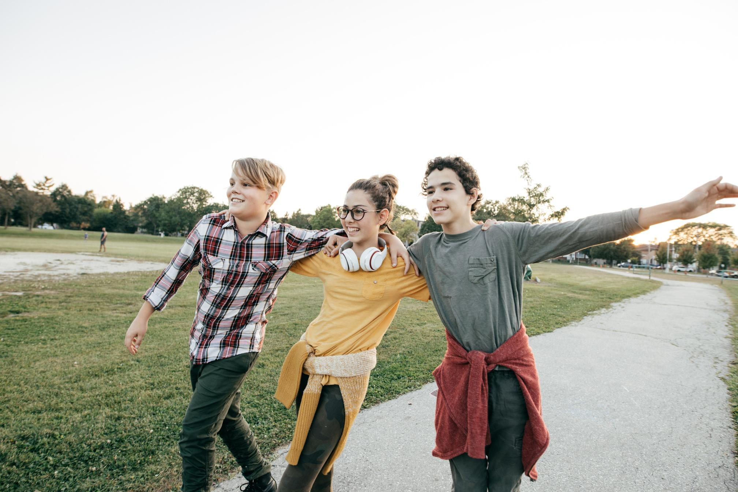
YOUTH
COMMUNITY
SYSTEMS
VALUE OF YOUTH VOICE
What’s possible?
What changes when youth have real power?
What holds us back from sharing power?
Take at look at the Ladder of Participation
VALUE OF
YOUTH VOICE
Notes:
Value of youth voice: Young people have insights that make programs more relevant and effective.
“What’s possible”- When youth are genuinely engaged, organizations see strong program outcomes, deeper community trust, and sometimes surprising levels of impact. The outcome is in the process, and it has the potential to create ripple effects for years to come.
What changes? When we embrace the value of youth voice- so many things can change: decision making processes, board composition, hiring practices, program design, etc.
What holds us back? Fear of losing control, concerns about liability or capacity, underestimating young people, and discomfort with the messiness.
Take at look at the Ladder of Participation. Not all participation looks the same. Let's take a closer look...

Slide 9

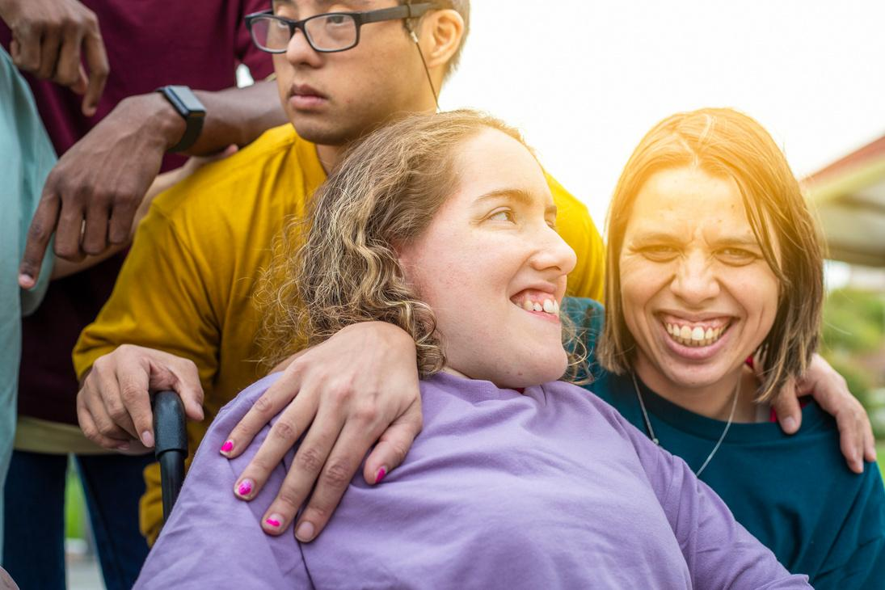

YOUTH
COMMUNITY
SYSTEMS
MOVING UP
THE LADDER
Value of empowering youth at a higher level.
If equitable youth voice were embedded, what would change?
What keeps us from advancing?
Learn about different types of participation models and methods for engagement.
Introduce and expand on the ladder.
The goal is to take the next step with intention, not jump to the top overnight.
snowredfern.org
Notes:
At higher rungs, youth aren't just consulted — they co-create, lead, and decide
When equitable youth voice is embedded: programs better reflect real needs, young people develop leadership, and organizations build genuine trust with communities
What keeps organizations from advancing: Time constraints, board discomfort, risk aversion, assumptions about youth readiness, and structures that weren't designed for shared power
Different participation models to reference:
Roger Hart's Ladder (manipulation → youth-initiated/shared decisions)
SRF's Engagement Continuum (Inform → Consult → Involve → Collaborate → Empower)
Harvard Catalyst Model (covered later by Maya)
The goal isn't to jump to the top overnight — it's to take the next step with intention

Slide 10

YOUTH
COMMUNITY
SYSTEMS
PARTICIPATORY DESIGN
This refers to structured practices that center the participation of people with lived experience relevant to the issue and utilizes a participatory decision making process.
EXPANDING INCLUSION
POWER REDISTRIBUTION
Participatory practices are intentional methods to share or shift power to those most affected and demonstrate the value of inclusion in action.

Slide 11
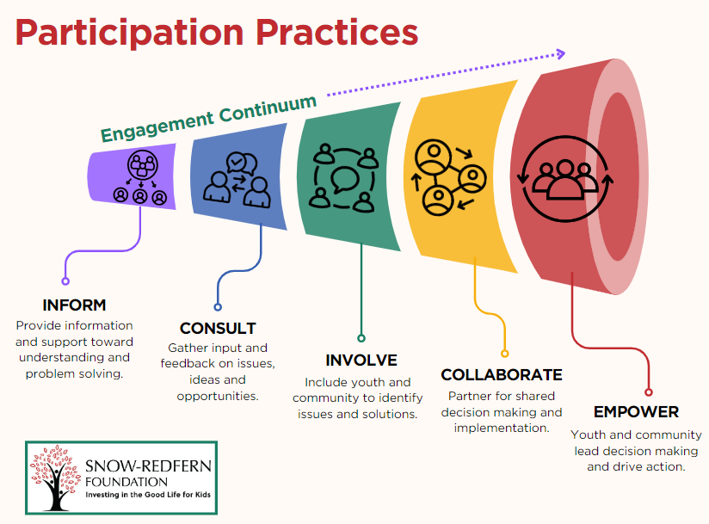
YOUTH
COMMUNITY
SYSTEMS
LADDER OF PARTICIPATION
LEVELS OF ENGAGEMENT
Consider power dynamics in relationships between those who fund, those who lead, those who serve and those who benefit from systems of care.
Sherry Arnstein 1969: A Ladder of Citizen Participation
Roger Hart 1992: Ladder of Children’s Participation
snowredfern.org
Notes:
Take some time to look at the ladders of participation.
"Where does your organization currently sit? That's what we're about to explore together"

Slide 12
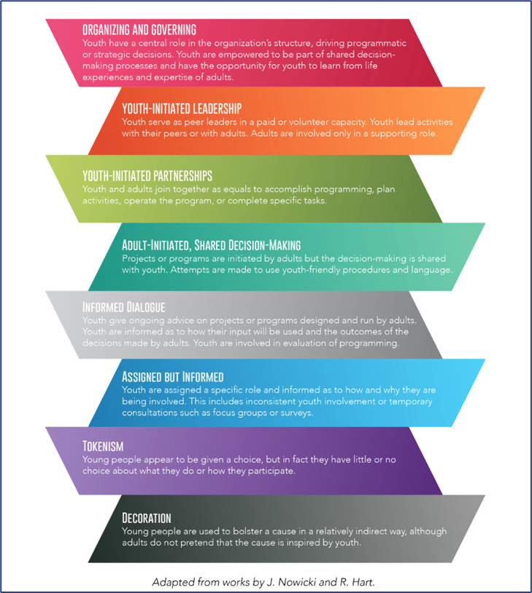
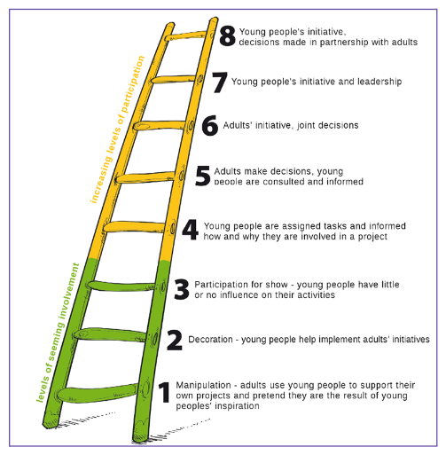

Slide 13



YOUTH
COMMUNITY
SYSTEMS
Using the Ladder model:
Where does your organization currently sit in terms of youth or community engagement?
What's the next rung up and what would need to shift to get there?
TABLE DISCUSSION
12 MINUTES
Notes:
Additional Prompts:
-What structures or policies reinforce your current level?
-Who in your organization would champion moving up? Who might resist?
-What's one small, concrete thing you could try in the next 90 days?
-What do you need to learn more about in order to make this a reality?

Slide 14

YOUTH
COMMUNITY
SYSTEMS
WHAT WE LEARNED
BY DOING
It was more uncomfortable than we expected.
Youth voice without decision-making power is limited.
Culture must shift before structure works.
Adults had to change more than youth.
Ongoing self-reflection revealed where we were holding power.

Slide 15
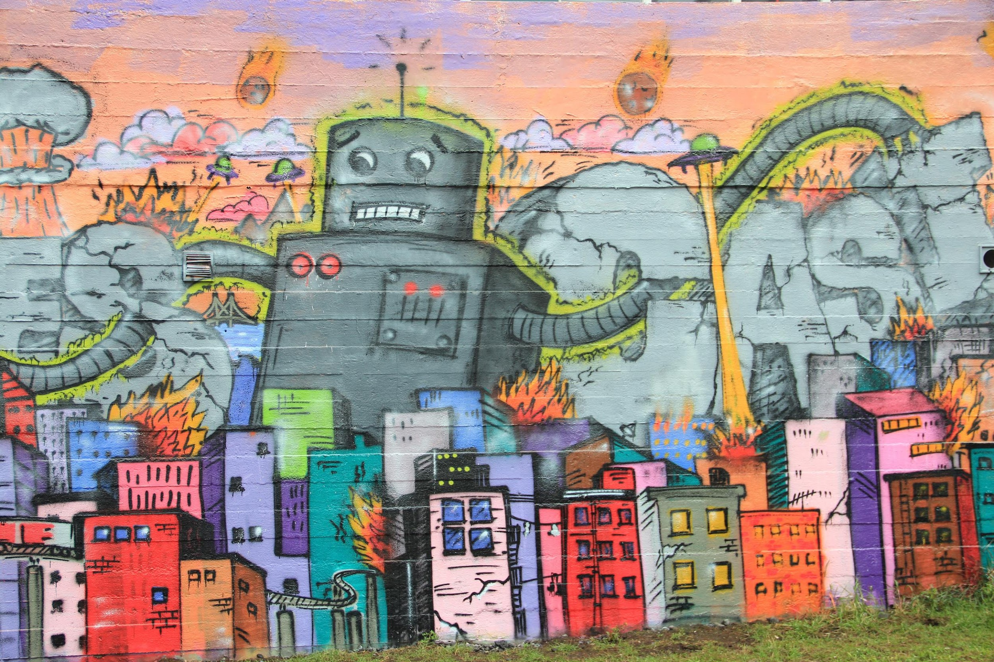
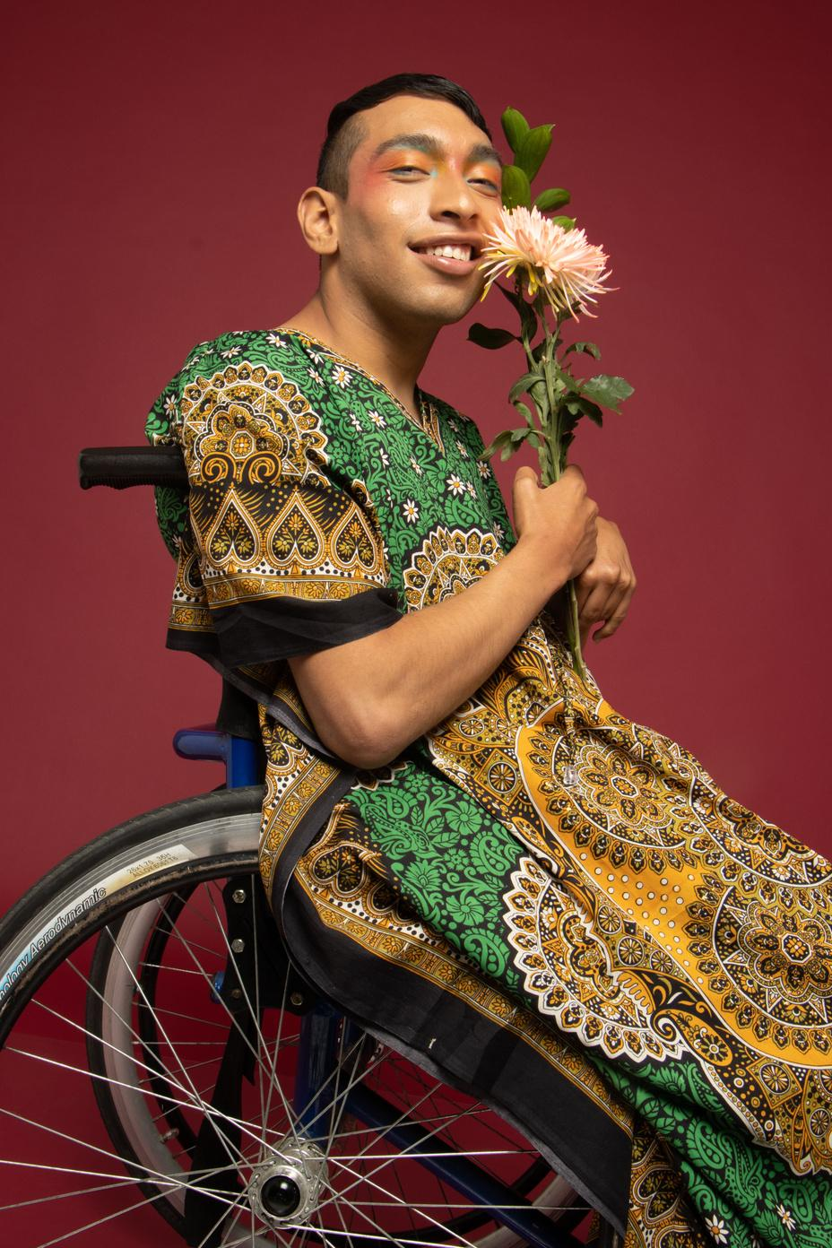

YOUTH
COMMUNITY
SYSTEMS
SHIFTING PRACTICES
It’s time to deconstruct centralized power and build structures and norms that empower local collaboratives.
To do this, we must get honest about what’s keeping us in a hierarchy of dominance.
VALUING ALL VOICES
HONORING WISDOM
WHO DECIDES
WHO DECIDES?

Slide 16
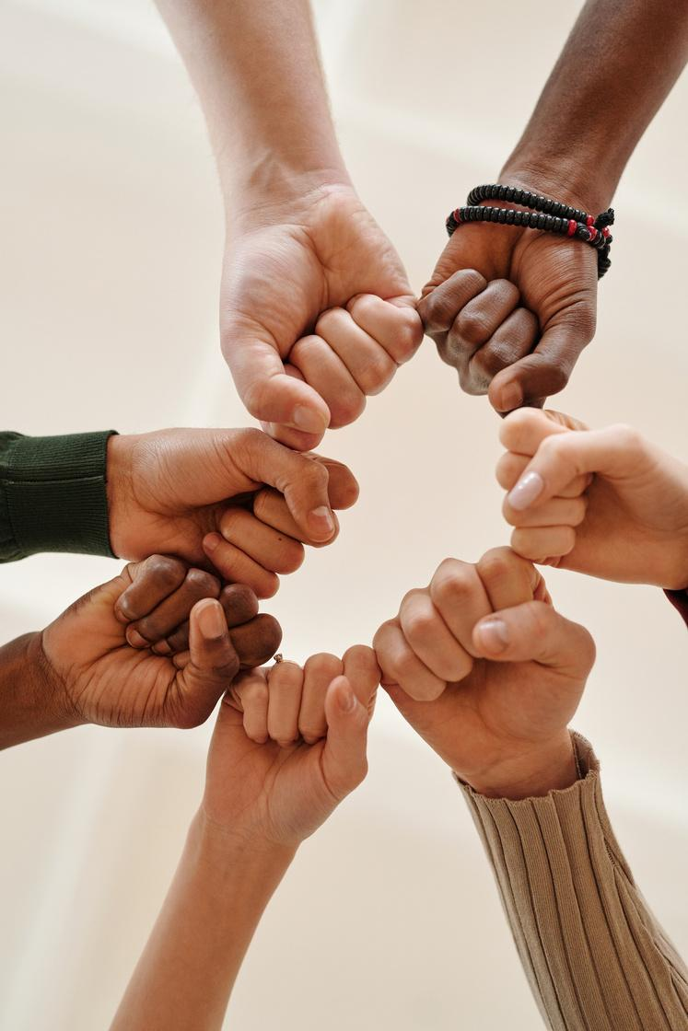

YOUTH
COMMUNITY
SYSTEMS
ADDRESSING POWER
In pursuit of organizational justice:
Distributive justice
decision satisfaction
Procedural justice
system satisfaction
Interpersonal justice
relationship satisfaction
Informational justice
inclusion satisfaction
Beyond values...
What would a system that pursues community participation look like?
What does an organization committed to power sharing look like?
snowredfern.org

Slide 17

YOUTH
COMMUNITY
SYSTEMS
How does your current organizational structure or culture hinder or support power sharing?
What steps might you take
to expand?
SELF REFLECTION
2 MINUTES

Slide 18
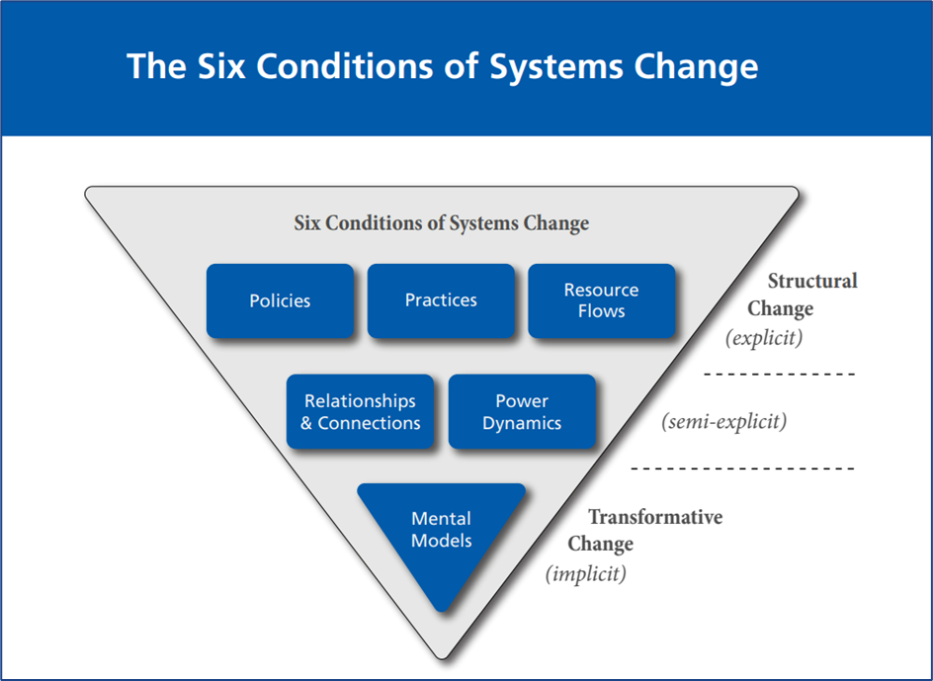
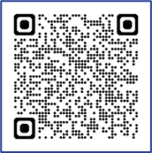
WATER FOR
SYSTEMS CHANGE

Slide 19
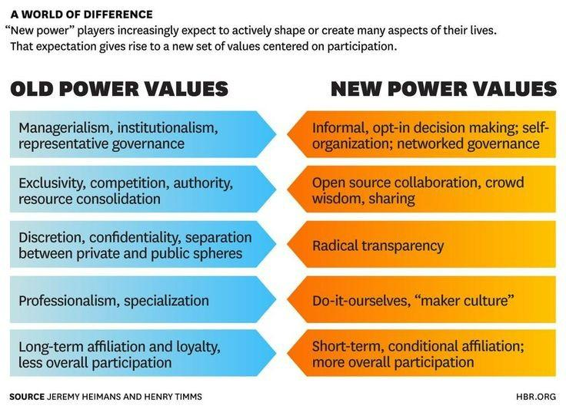
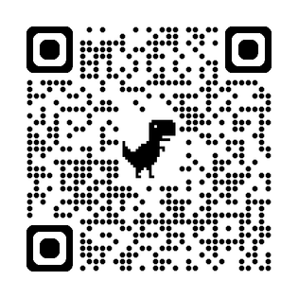

Slide 20
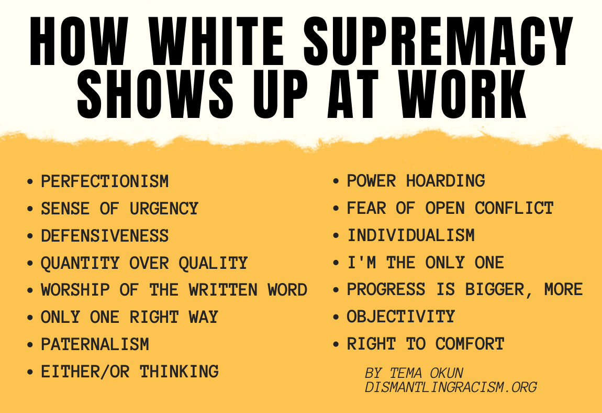
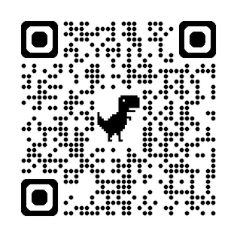
WHITE SUPREMACY CULTURE IN ORGANIZATIONS

Slide 21
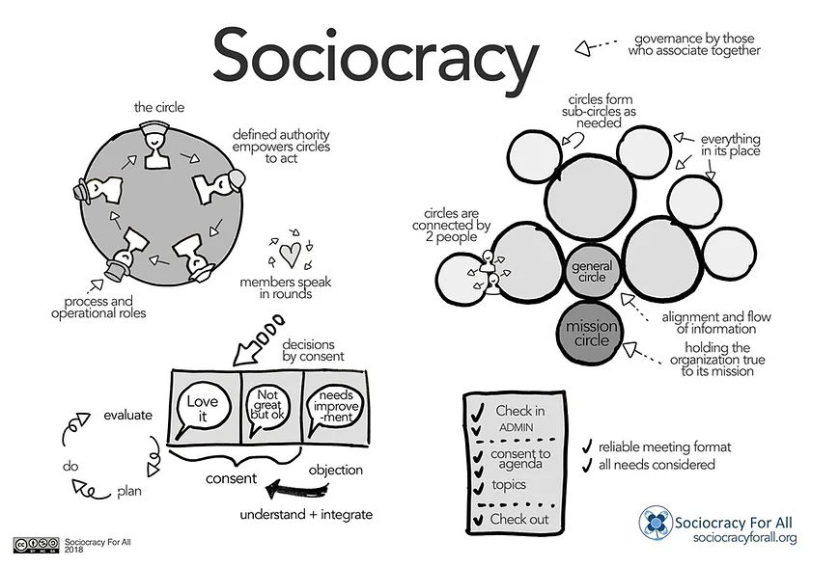
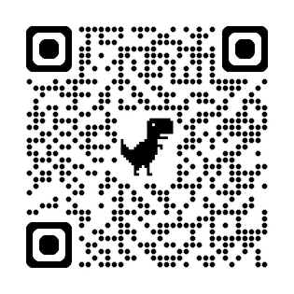
SOCIOCRACY FOR ALL

Slide 22
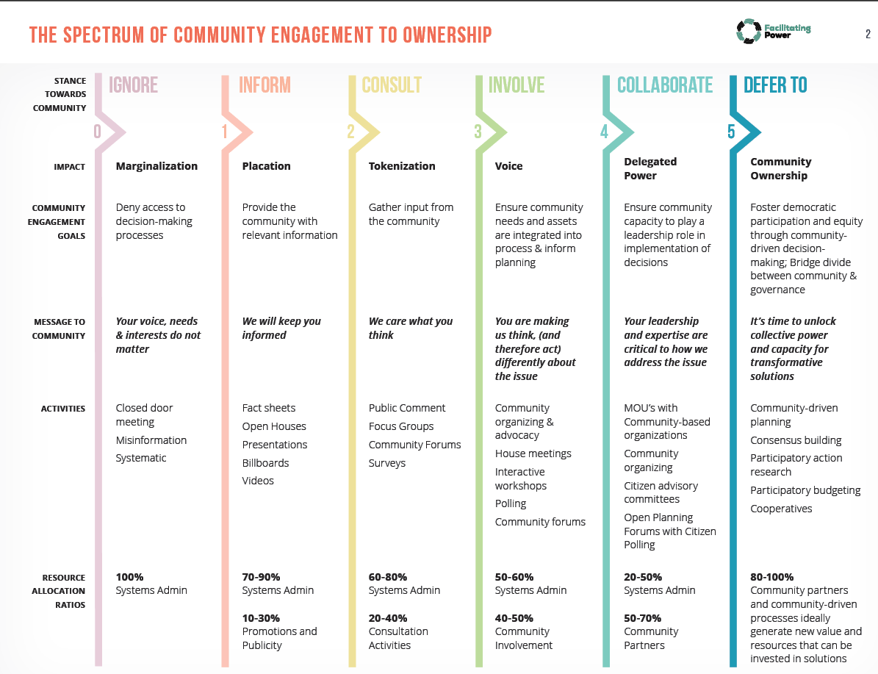
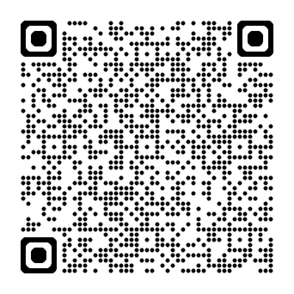
YOUTH
COMMUNITY
SYSTEMS
FACILITATING POWER
snowredfern.org

Slide 23

YOUTH
COMMUNITY
SYSTEMS
What are some practical next steps we can take to move away
from centralized power
toward shared decision making?
TABLE DISCUSSION
10 MINUTES

Slide 24


“THE FURTHER WE ARE FROM RELATIONSHIP, THE MORE WE RELY ON RULES”
POWER
PEOPLE
PRINCIPLES
PROCESS
Avoid marginalization
Be transparent
Understand history
Unpack privilege
Build relationships
Create safe spaces
Compensate everyone
Prioritize humanity
Get clear on values Examine biases
Co-create norms
Pursue justice
Allocate time
Share decisions
Stay flexible
Be persistent

Slide 25
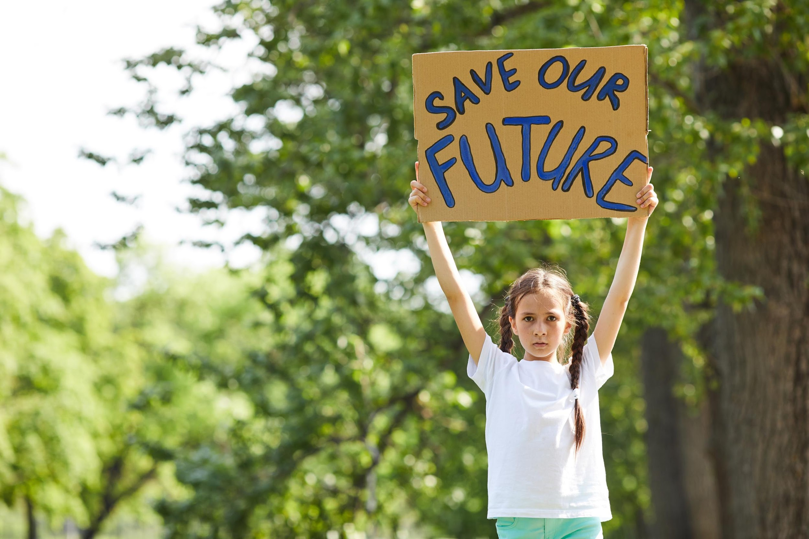
YOUTH
COMMUNITY
SYSTEMS
What did you hear today that’s going to stick with you?
What big audacious dream did this stir up?
What are you curious about?
What are you excited to try?
SHARED LEARNING
7 MINUTES

Slide 26


YOUTH
COMMUNITY
SYSTEMS
INVITATION TO LEARN, GROW AND SHARE
Dream big!
Empowerment requires structural alignment.
Small shifts matter.
Sharing power is relational and structural.

Slide 27

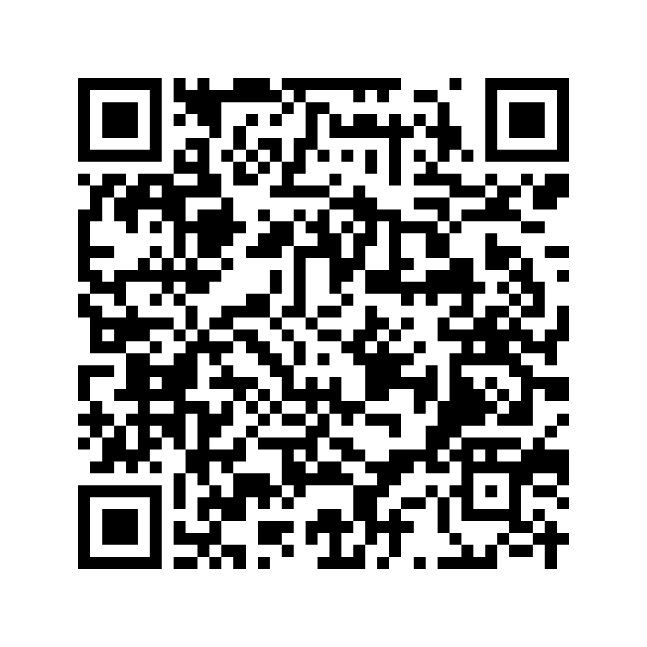
YOUTH
COMMUNITY
SYSTEMS
SCAN FOR RESOURCE FOLDER

Slide 28


YOUTH
COMMUNITY
SYSTEMS
THANK YOU
SNOW-REDFERN FOUNDATION
SARA WILCOX
EXECUTIVE DIRECTOR
We’d love to learn together!
Contact us for more information.
info@snowredfern.org
snowredfern.org

