Slide 1

Beyond Waitlists
COLLABORATIVE STRATEGIES TO MEET SURGING COMMUNITY DEMAND
NAM Central Nebraska Conference
March 26, 2026

Slide 2
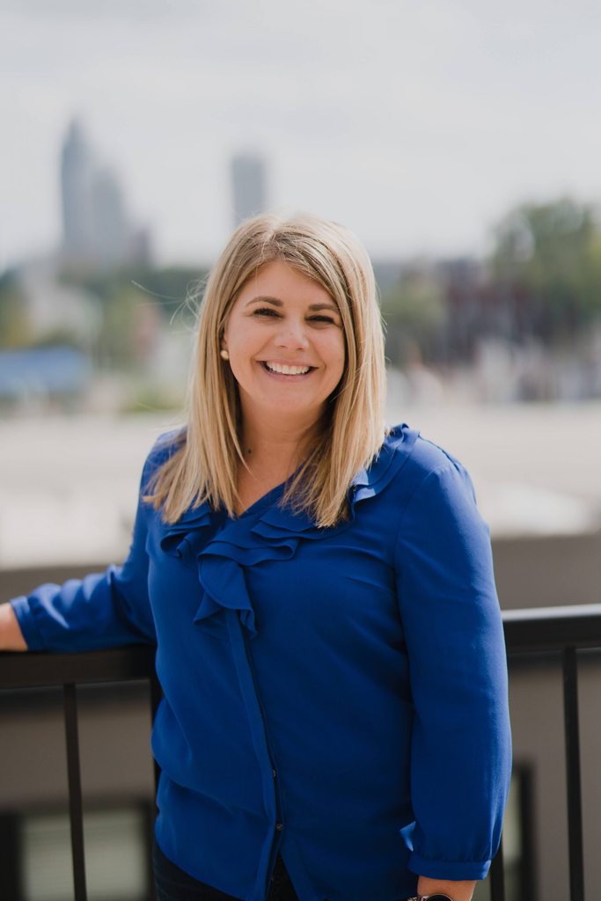
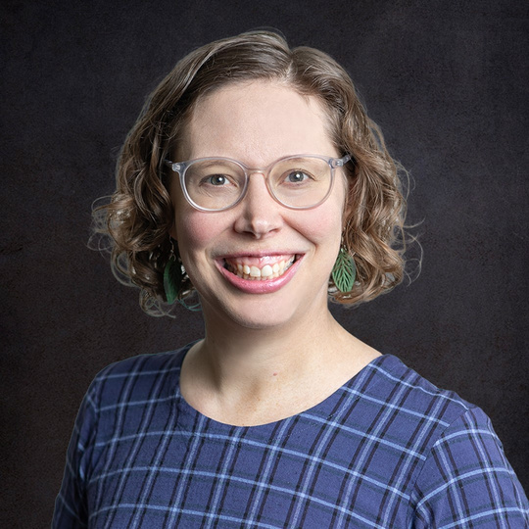
Who We Are
NICOLE EVERINGHAM
STEPHANIE VADNAIS
Development Director
AVP of Strategy & Partnerships
Collective for Youth
Beyond School Bells

Slide 3




Slide 4





How many of you have a waitlist?
Find yourself turning people away?
Are you operating at or beyond capacity?

Slide 5



The Demand Crisis
Current Nebraska Data:
For every young person currently in an afterschool program, there are 4 waiting for a spot.

Slide 6
The Demand Crisis
Mentoring
There are currently 1,431 youth in Nebraska waiting for a mentor

Slide 7



Demand Across Sectors
1 in 8 people is facing hunger,
including 1 in 5 children, 1 in 4 Hispanic individuals and 1 in 3 black individuals.
Food Bank of the Heartland, 2024
HUNGER
SUBSTANCE ABUSE
76% of Nebraka adults with substance use disorder needed treatment did not receive it
Mental Health America, 2025
1 in 4 respondents did not have access to a senior center or community center.
Nebraska State Aging Plan, 2022
SENIOR SERVICES

Slide 8
Coalition Timeline
Brought together stakeholders to form Youth Development Coalition
DEC. 2024
NOW
Meeting with former Sen. Tony Vargas- Time for youth development programs to “Speak with one voice.”
JAN. 2025
Formalized membership, have a defined mission, vision, and problem statement
WE HAVE LEARNED SO MUCH OVER THE LAST YEAR... AND THERE’S STILL SO MUCH TO LEARN!

Slide 9
EARLY WINS
STILL WORKING ON...
Early excitement and willingness to sign on to coalition across the field and across the state
Funding to build shared infrastructure and pay a consultant
Committed, solution focused members
Balancing identity with collective action
Making sure all voices are heard
Measuring collective impact and ROI of the field
Sustainable governance

Slide 10
Think of a partnership or collaboration have you have been part of.
What made it work?
What made it hard?

Slide 11







Networking
Coordination
Cooperation
Collaboration
Integration
Information sharing, staying connected.
Aligning activities, avoiding duplication
Sharing resources, joint projects
Shared governance, joint decision-making
Merger, unified structure
Minimal
Low
Medium
High
Very High
Low
Medium
Medium-High
High
Very High
(but risky)

Slide 12
Partnership Assessment Activity
Individual reflection with worksheet (3 minutes)
Share with small groups (4 minutes)

Slide 13
Partnership Concerns
We’ll lose our identity!
You can maintain your brand while collaborating.
More meetings?
I don’t have time!
Make meetings count with clear agendas, ways to contribute, and action items.
Set clear expectations from the start.
Unequal effort!
Funders prefer individual orgs!
Some do, but some prefer collaboration!

Slide 14




What collaboration could look like
Collective
Advocacy
Joint Data Collection
Resource
Pooling
Shared PD
What else??

Slide 15
Your 90-Day Action Plan
MONTH 1
Initiate & Explore
MONTH 2
Design & Commit
MONTH 3
Launch & Learn
Initial contact
Schedule meeting
Do research
Identify pilot project
Define roles
Get buy-in
Implement pilot
Evaluate
Decide next steps

Slide 16

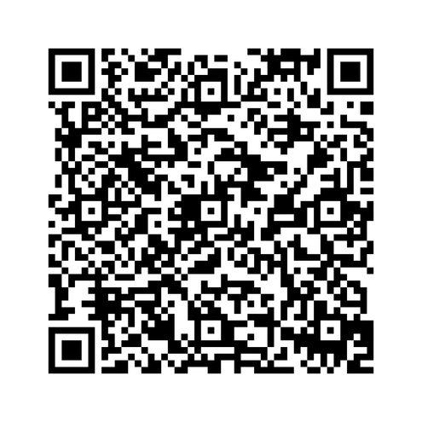
Join us!
Open to any Nebraska Youth Development Organization
Meetings: 2nd Friday of the month, 10 am-12 pm Central/9-11 am Mountain
We’re convening in person April 20-21 in Lincoln!

Slide 17
“Coming together is a beginning, staying together is progress, and working together is success.” - Henry Ford
NICOLE EVERINGHAM
neveringham@collectiveforyouth.org
STEPHANIE VADNAIS
SVADNAIS@NEBRASKACHILDREN.ORG

Slide 18
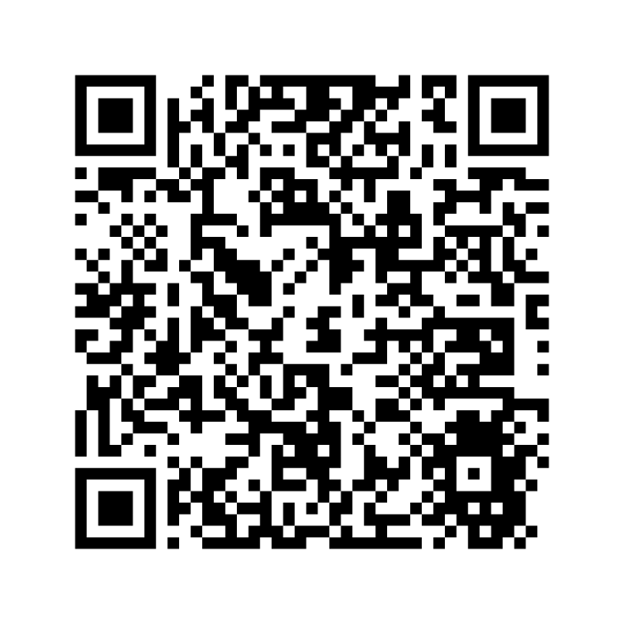
Find resources here:

