Slide 1

Access to Justice: Legal Resources for Low-Income Nebraskans
Central Nebraska Nonprofit Conference, March 2026
Notes:
Introduce self

Slide 2
Overview
Information:
Poverty and Access to Justice,
Civil in “civil legal” means,
Other commonly used legal terms, and
Limited-Scope Representation
Navigation:
Civil Legal Service Providers and Legal Resources
VLP Programs

Slide 3

Being poor makes means someone is more likely to have civil legal problems
Nationwide, 74% of low-income families had at least one civil legal issue with 39% facing 5 or more in 2022
92% received inadequate or no help
Notes:
2022 Justice Gap Study; Legal Services Corporation
https://justicegap.lsc.gov/resource/executive-summary/

Slide 4

Disclaimer
Nothing is this presentation should be construed as legal advice. The purpose of this presentation is to provide information and resources to make the best possible referrals for the people with whom you work.

Slide 5
What does “civil” mean in “civil legal”
Generally- where government is not the other party
Child custody, divorce, evictions, collections, etc.
Non-civil cases are criminal; “State v. [Defendant]”
Some overlap in juvenile and mental health cases.

Slide 6
Civil Legal
Some cases against state are civil, state employee suing a state, or if a state sues an entity
**Except, when a party is facing charges of criminal contempt of court
Litigants in civil matters are not appointed an attorney by the court
A case may have to start outside of the courts; employment and housing

Slide 7
Commonly Used Legal Terms
Debtor: A person or business who owes a debt
Creditor: A person or business who is owed money
Garnishee: A person or entity possessing property being garnished
Restitution of the Premises: The legal eviction process
Affidavit: A sworn statement of fact related to the matter at hand
In Forma Pauperis: Fee waiver
Pro Se Litigant: Self-Represented Litigant
Praecipe: Request

Slide 8
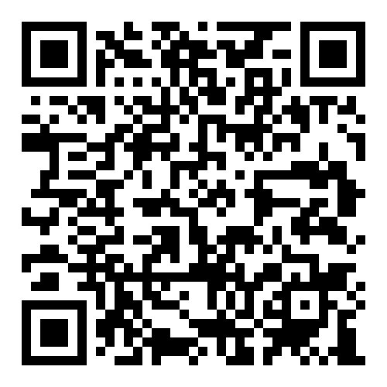
Legal Glossary
nebraskajudicial.gov/administration/public/glossary

Slide 9
Limited Scope Legal Services

Slide 10

What is Limited Scope?
An agreement between an attorney and a client that limits representation, i.e., not full-scope
Why Limited Scope?
Less expensive
Help more people

Slide 11
Limited Scope Legal Services: What caseworkers should know
Full Scope > Limited Scope
In-person > phone/digital
Attorneys have an ethical obligation to assess if limited scope representation is in the best interest of a prospective client.
Help people represent themselves
  Review forms
  Brief advice
  Opportunity to ask questions
  Referrals
  Draft simple documents
  Hearing/Trial Preparation

Slide 12
Navigating Civil Legal Service Providers

Slide 13

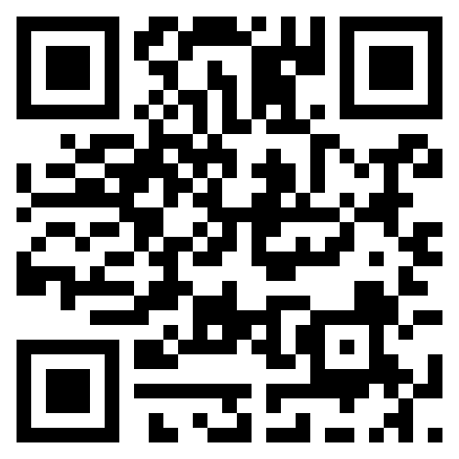
Accessline
Website
Intakes
Self Help Guides
LawHelp Nebraska
Medical Legal Partnerships
legalaidofnebraska.org

Slide 14
Case Types
Family Law (Domestic Violence)
Landlord/Tenant Matters
Guardianships and Adoption
Criminal Set-Aside
Disability benefits
Public Assistance Benefits
Collections and Garnishments
Tax
Self-Help Resources
LawHelp
Handbooks & Guides
Protection Orders
Collections
Landlord/Tenant
Divorce
Adult Name Change
Medical Legal Partnerships
Communicate with provider
Can assist with:
Housing
Disabilities
Insurance
Clinics
Set Aside Clinics
(Douglas and Sarpy County)

Slide 15

Creighton University College of Law
Douglas County
  Abrahams Legal Clinic
    Child support and custody
    Guardianship
    Divorce
    Wills and probate
    Landlord/tenant issues
  Bankruptcy Clinic
  Juvenile Justice Clinic

Slide 16

Debtors Defense Clinic*
Entrepreneurship Clinic
Estate Planning Clinic
First Amendment Clinic
Housing Justice Clinic*
*Lancaster County

Slide 17

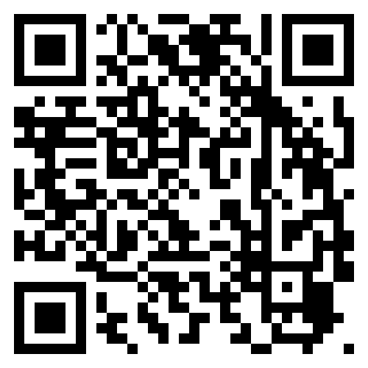
Nebraska Online Self-Help Center
https://nebraskajudicial.gov/self-help

Slide 18
Nebraska Judicial Branch
Self-Help Resource Links
Nebraska Online Self-Help Center
Legal Resources & Information
Appeals
Clean Slate - Criminal Record Rehabilitation
Court Records
Criminal
Estates
Families & Children
Financial
Fines & Court Costs
General Court Forms
Guardians & Conservators
Limited Scope Representation
Medical
Name Change
Protection Order Information
Renter|Landlord
Small Claims
Traffic
Workers' Compensation Court
Categories

Slide 19
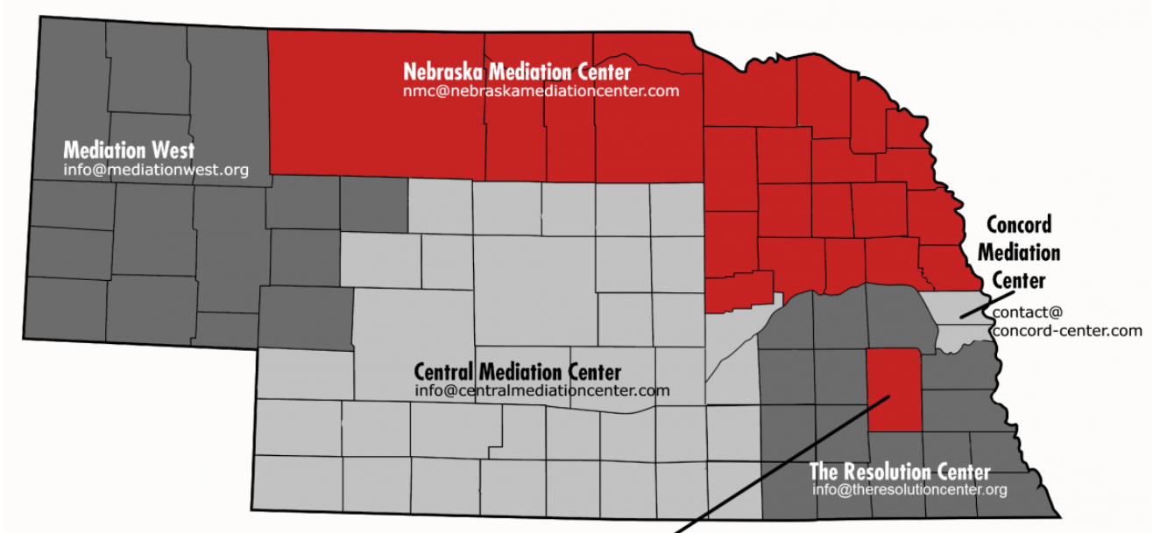
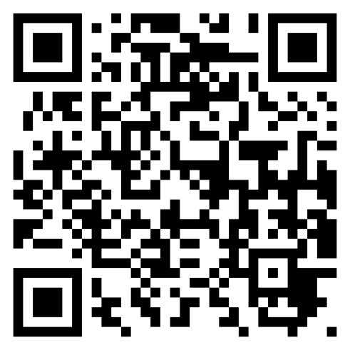
Mediation
Mediation and Modifications
nebraskajudicial.gov/mediation-centers

Slide 20
Court Approved Forms
Common Forms
Family Law
  Simple Divorce
  Uncontested Child Custody and Paternity
  Modifications
Collections
All Case Types
  Service
  In Forma Pauperis (Fee Waiver)
  Continuance
  Generic Motion
  Generic Affidavit
What to Know
Use Instructions when available
Forms can be used as a template
Print single sided
Affidavits must be signed in the presence of a notary
Available forms will not meet every legal need!

Slide 21
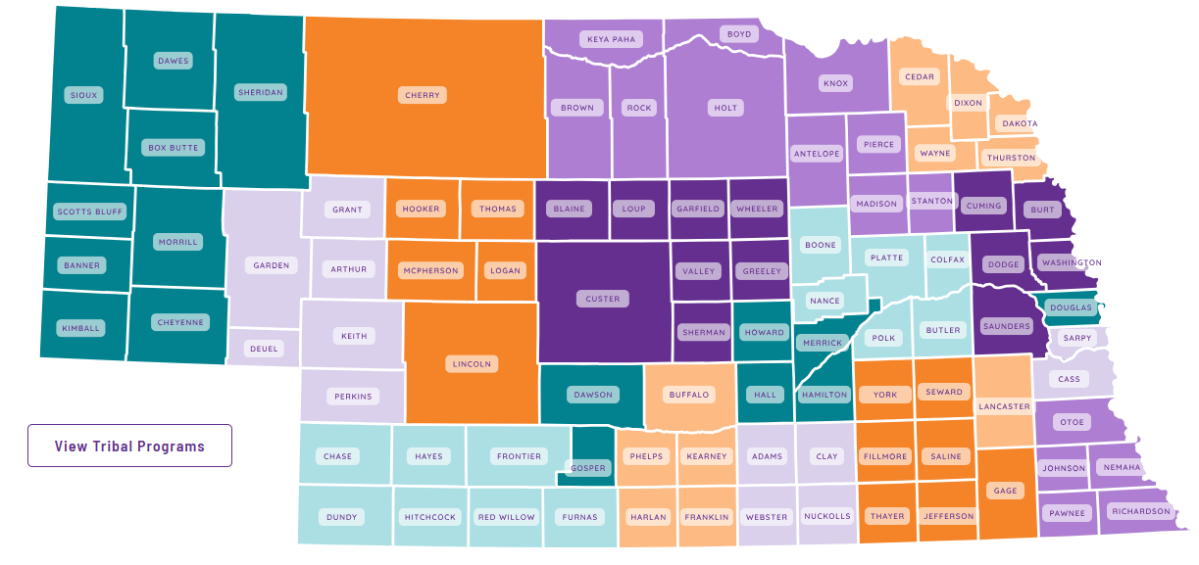
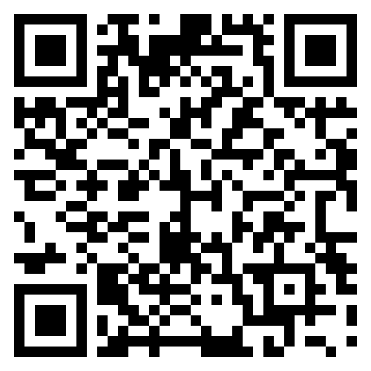
Domestic Violence & Abuse
Nebraska Coalition to End Sexual and Domestic Violence: Resources & Local Providers

Slide 22
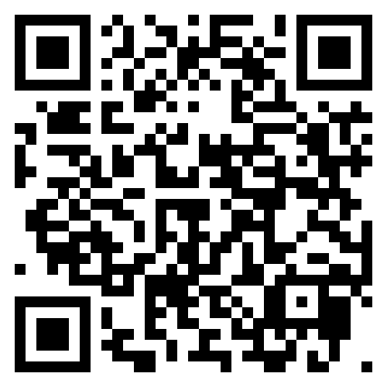
Immigration
Center for Immigrant and Refugee Advancement (CIRA): Omaha Metro Area
Lutheran Family Services
Nebraska Immigration Legal Assistance Hotline
Center for Legal Immigration Assistance (CLIA): Lincoln
Catholic Charities

Slide 23
Civil, Educational, & Disability Rights
Education Rights Counsel: resources, advocacy, & policy
ACLU of Nebraska: issue specific, cases against the government, & policy
Disability Rights Nebraska: legal and lay advocacy, policy, & investigation

Slide 24
Other Providers & Resources
Legal Libraries: UNL College of Law, Creighton, Douglas County, Nebraska Capital Building
Nebraska Appleseed: policy, advocacy, systemic litigation, public education
Nebraska Area on Aging Agencies: 60+ legal assistance
Omaha Bar Association: Private Attorney; Douglas, Sarpy, Cass and Washington Counties; $50 for legal consultation
Nebraska-Find-a-Lawyer: Private Attorney; $50 or less for legal consultation
Nebraska Equal Opportunity Commission: Investigates claims of discrimination in employment, housing, and public accommodations

Slide 25
Notes:
Introduce self

Slide 26

Nebraska State Bar Association’s VLP
The Nebraska State Bar Association works for Nebraska lawyers to help them achieve the highest standards of competence, ethics and professionalism and to protect and promote the administration of and access to justice.
50 hours of pro bono

Slide 27
Three Pillars
Case Referral
Clinics
Tenants Assistance Project (TAP)

Slide 28
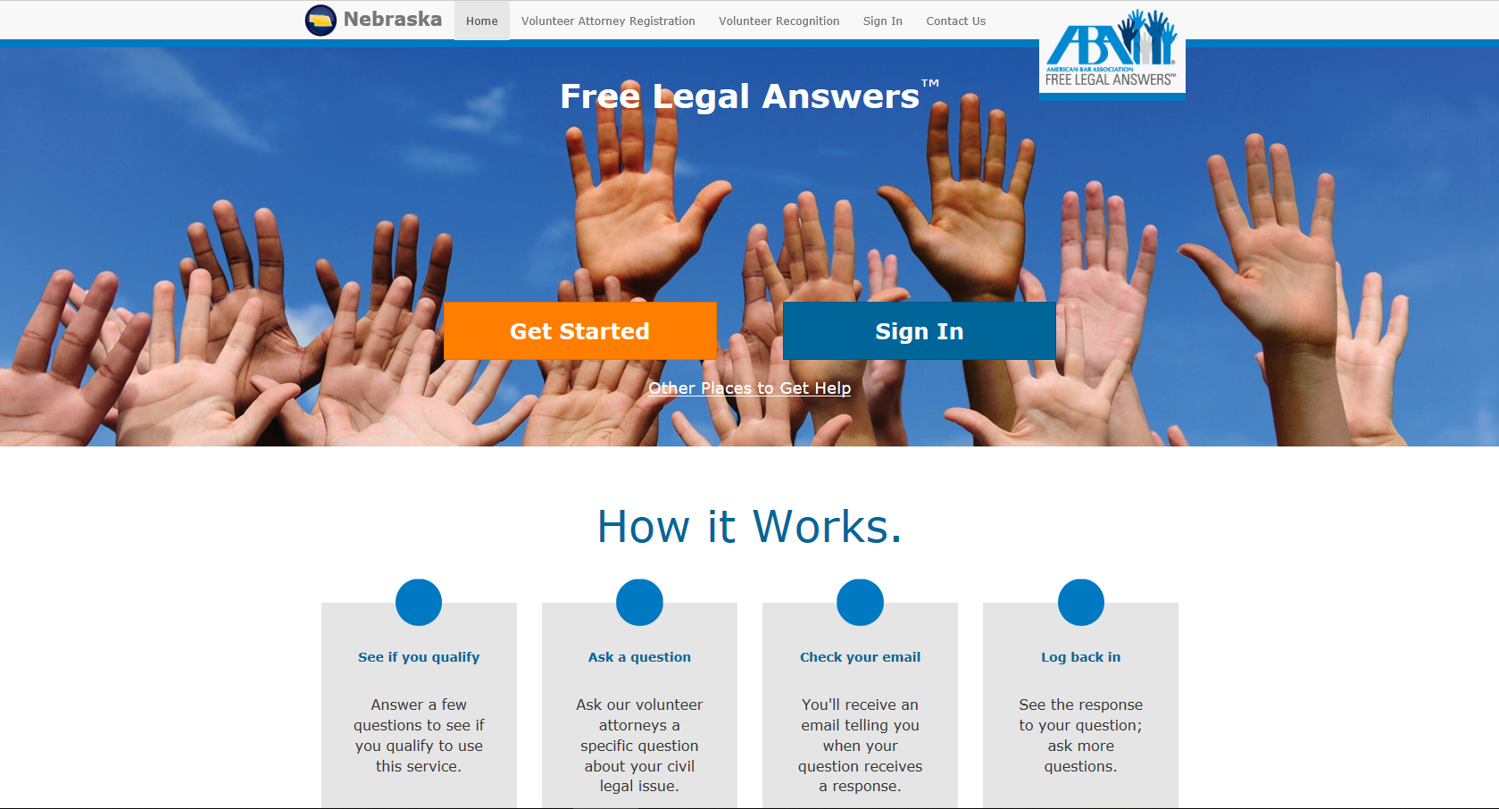
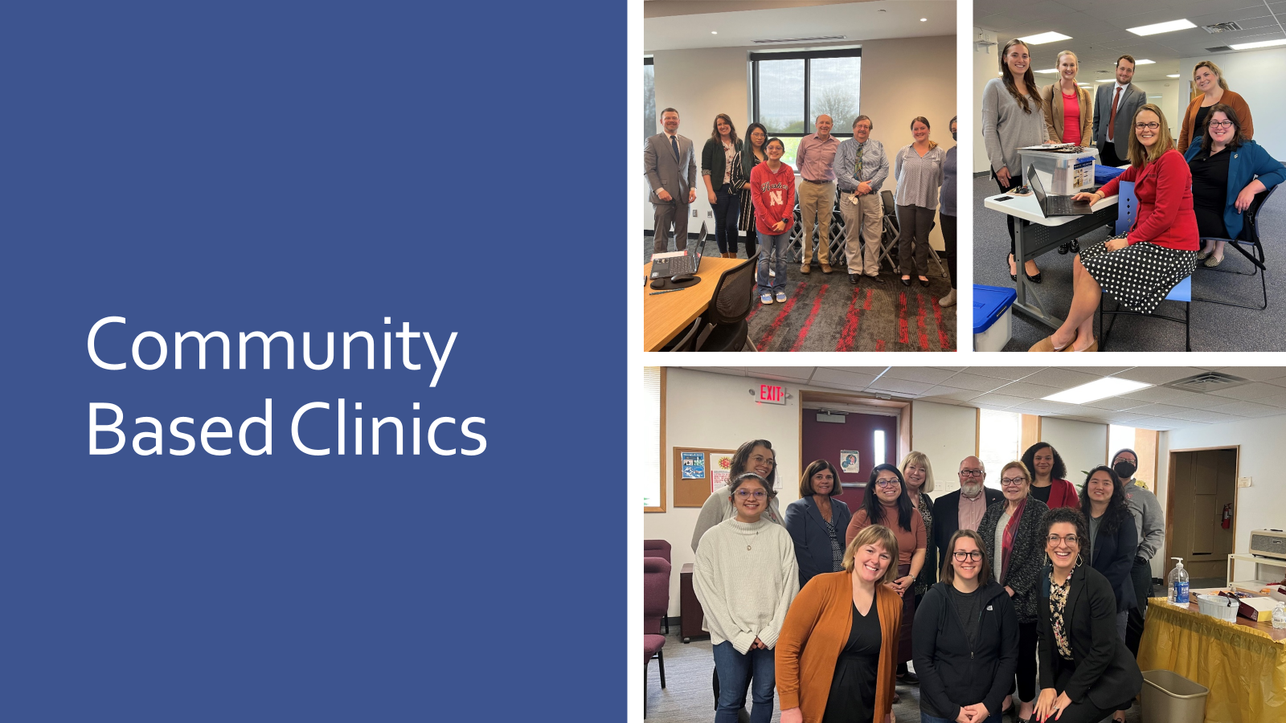
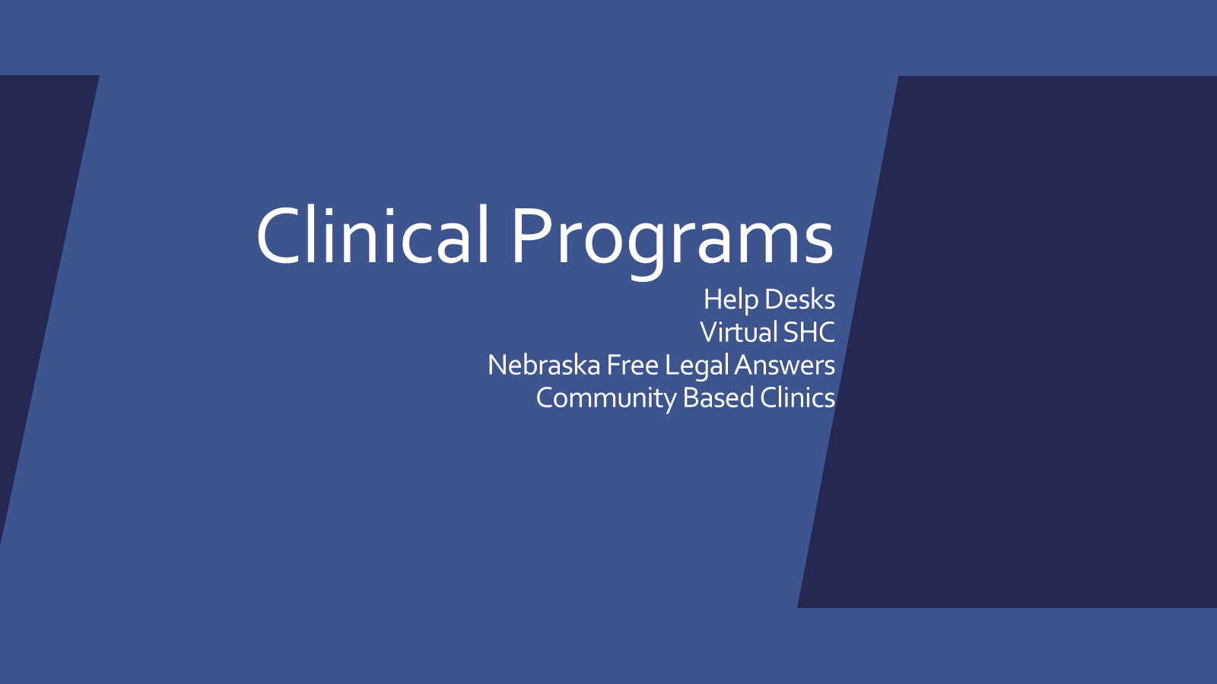
Pro Bono
PRO BONO
right thing to do
Sharing
giving back
Charity
Ethics
rewarding
paying it forward
VOLUNTEER
PAY BACK TIME
Notes:
Go through steps

Slide 29
Pro Bono
PRO BONO
right thing to do
Sharing
giving back
Charity
Ethics
ne.freelegalanswers.org
rewarding
paying it forward
VOLUNTEER
PAY BACK TIME
Notes:
Go through steps

Slide 30
Who is Eligible for
NFLA
Household income less than 250% of the federal poverty level
Liquid assets must not exceed $10,000 in value
May not request assistance with criminal law matters
May not have already hired a lawyer to help with their legal matter
May not be incarcerated
Cannot ask questions on behalf of another
Notes:
Income/assets/incarceration/criminal/lawyer

Slide 31
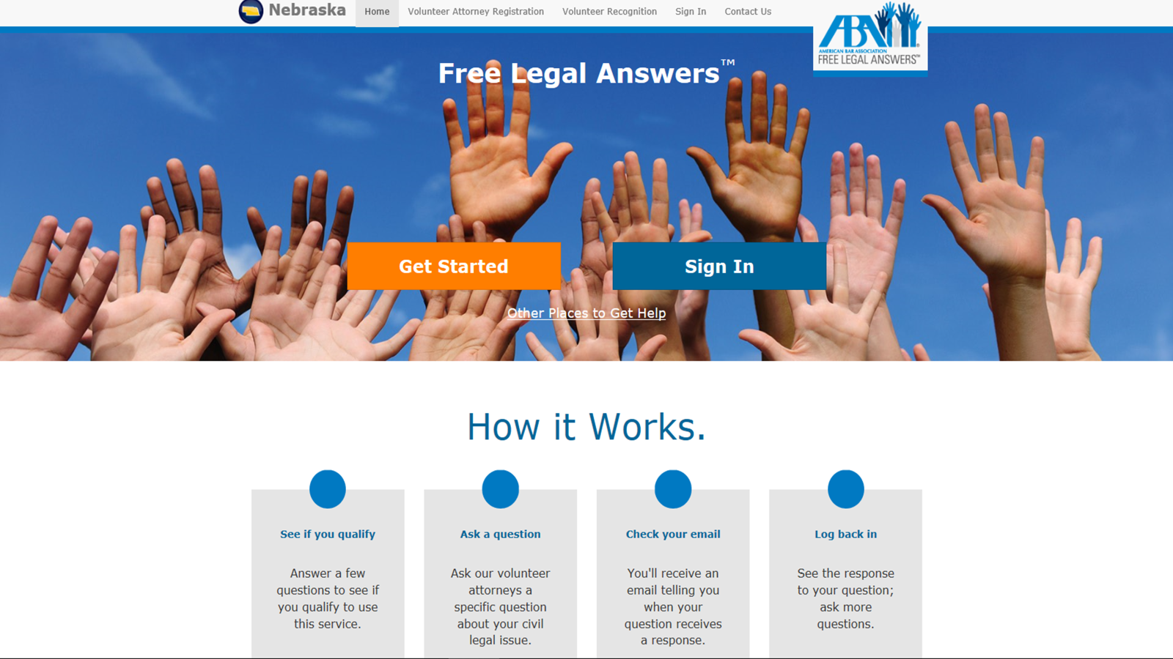

Other Places to Get Help

Slide 32
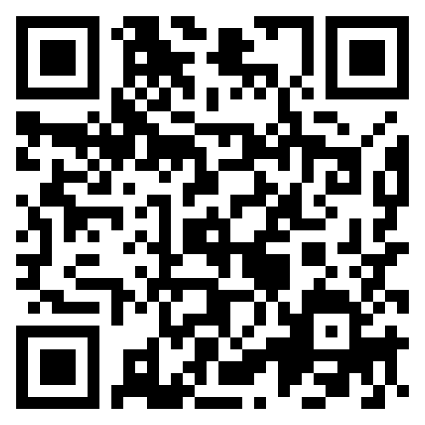
Virtual Self-Help Center
Available state-wide
Limited-Scope assistance
Priority: those living in communities where in-person legal assistance is not available
Do not refer if your client:
  Needs immediate assistance
  Is unable to represent themselves
  Wants to appeal a court judgment
Keep an eye out for updates

Slide 33
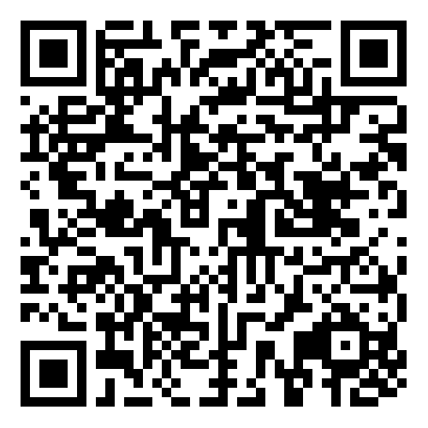
Help Desks
Buffalo County Self-Help Center
First Friday of most month, 10 am - 2 pm
Buffalo County Justice Center in Kearney (1512 Central Ave, Kearney, NE 68847)
Inquiries, contact Melodie Bellamy at cabellamy@kearneycountyne.gov cabellamy@kearneycountyne.gov
Madison County Self-help Center
Third Friday of most month, 11 am - 1 pm
Madison County Courthouse in Madison County District Court Office (1313 N Main St., Madison, NE 68748)
Inquiries, contact the Madison County District Court Office at (402) 454-3311, dial option 4

Slide 34
Pro Bono
PRO BONO
right thing to do
Sharing
giving back
Charity
Ethics
rewarding
paying it forward
VOLUNTEER
PAY BACK TIME
Notes:
Go through steps

Slide 35
Community Based Clinics
Omaha
Second Friday of most months from 10 a.m. to noon at Heart Ministry Center
Fourth Friday of most months from 10 a.m. to noon at Mt. Moriah Baptist Church
Lincoln
First Thursday of most months from 10 a.m. to noon at the Center for People
Email Mara Kellogg for seasonal flyers:
mkellogg@nevlp.org
Notes:
Go through steps

Slide 36

Tenants Assistance Project (TAP)
Douglas and Lancaster County

Slide 37
Why show up?
- Might have a defense (Again- Call Legal Aid ASAP)
- Can negotiate time to move out
- Can avoid having an eviction on record
- Can negotiate remaining causes
- Even when the tenant has moved out
- Show up regardless of legal immigration status

Slide 38
What About Other Landlord Problems?
- Legal Aid of Nebraska
Call/apply online
Handbook
- Nebraska Online Self-Help Center
- VLP legal clinics, help desks, or Virtual Self-Help Center
- Medical legal partnerships

Slide 39
How to get through to civil legal services & why is it hard?
Try, try, try again
Funding: shifting grants & policies

Slide 40
Thank You!
Mara Kellogg
Clinics Managing Attorney
mkellogg@nevlp.org
(402) 742-8132
Shannon Seim
Director
sseim@nevlp.org
(402) 610-2324

