Slide 1
ONEphoto

Slide 2
ONEphoto: The Georgian College Online Photo Submission Solution
Presented by Patricia Robinson and Jennifer McDonald
Georgian College ONEcard
Notes:
Trish: Introduce us

Slide 3
What does your ideal online photo submission tool look like?
Notes:
Trish: Take responses from the crowd

Slide 4
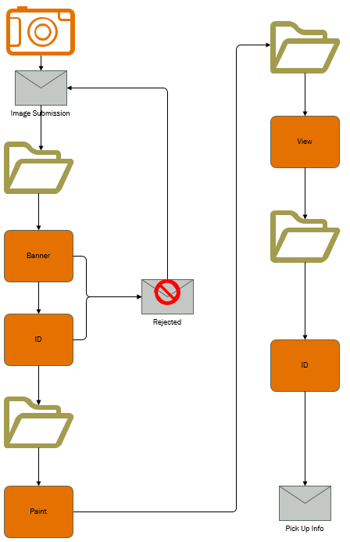
Our (painful) Old Process
Approximate Processing Time: 3 minutes per image
Automated Steps: 1
Notes:
Jen:
Steps:
Students would submit their photos which were received via an email account
The photos were then copied from the email into a folder for processing
The students were each individually looked up on multiple screens in Banner to determine if they were eligible
The students were each individually looked up in ID to determine if we already had a photo on file
If the student was eligible, the image was saved to a “good” folder for processing and the email was moved to a similar folder in outlook. If not, the image was deleted and the student was manually notified of why their image was rejected.
Each image was then manually cropped using Paint. We had a tool that was supposed to automatically crop the images, but this usually resulted in being cropped too closely or not close enough, so it was often easier to just manually do this step.
After cropping, the images were saved to a new folder and View was run to convert the images and move the files to the folder used by ID
From here, cards could be individually or batch printed.
Lastly, the students would be manually sent an email notifying them that their card was ready for pickup

Slide 5
Our wish list:
Easy to use for both staff and students
Integrated with our student information system - Banner
Save time and decrease manual processes
Decrease in-person photos
Notes:
Jen: what we wanted out of a new product

Slide 6
Great … now what?
Reviewed policies regarding acceptable images
Programming team created test version based on requests
ONEcard Office tested the software developed
Tweaks and enhancements were made
A select group of student users tested the software
Launched to all users
Notes:
Jen:
We had no money to purchase a photo tool with but our IT department said that they would be able to build something in-house
Click
We began by reviewing our policies for what types of images we would accept and who would be qualified for a card
Click
The programming team then began to build based on our wish list and criteria.
Click, click
Once they had a test version available, I tested the experience from both a staff and student perspective. Working closely with one of our programmers, we found some bugs and were able to enhance the software beyond the basic capabilities that were originally planned.
Click,
From here we released the link to only a select group of new students for them to provide feedback.
Click
When we were confident that things would run as smoothly as possible, we published the link on our card office’s homepage and began promoting its use through email campaigns and social media.
So now, lets take a look at some of these steps in our process.

Slide 7
What are your online photo submission policies?
Notes:
Trish: Now that we have a tool, we have to determine how we want the students to use it. (Take responses from the crowd)

Slide 8
The joys of selfies:
Really, that’s what you want to show your professors at exam time?
Notes:
Jen: I’m sure that these look familiar to those of you who process online submissions. Each of these represents a pretty accurate sampling of the types of images I received before our tool was in place.

Slide 9
That’s better
(most of the time)
Background must be a white or light solid colour
The photo must be in colour
You must be the only person in the picture
Include and center your full head and shoulders only (like a passport photo)
Your face must be clearly visible and facing the camera
You may not wear sunglasses, hats, or other objects in the photo (religious headwear is acceptable)
You may smile, but no other gestures are permitted
Photo must be saved as a .jpg, .jpeg or .png
Notes:
Jen: ONEphoto is set to automatically reject inappropriate / explicit submissions and encourages those who are not meeting the requirements to fix their image before submitting
Let’s take a look at the student experience.

Slide 10
Student Side Demo
Notes:
Jen:
Explain why we want people to be able to override and submit anyway (religious headwear)

Slide 11
Thank you for your submission. Please note that submission of a photo does not guarantee that it will be accepted. All submissions are reviewed before final approval is made.​ If the photo submitted is for a replacement card fees may apply. We will process your photo shortly.
Please check your email again soon for next steps.
Georgian College is compliant with the Freedom of Information and Protection of Privacy Act (FIPPA), and endeavours to protect your personal information in accordance with this law. The personal information requested on this form is collected under the legal authority of the Ontario Colleges of Applied Arts and Technology Act, 2002 and in accordance with Sections 38(2) and 41(1) of FIPPA. The information provided will not be used for any purposes other than photo ID for internal use and external Georgian partners as part of the ONEcard program; security, media services, athletics, and may be requested as student ID for transit.
For further information about the information requested on this form or the purpose for which it will be used, please contact ONEcard Officer, Office of the Registrar: 705-728-1968 ext. 1756 or ONEcard@GeorgianCollege.ca; for more information about FIPPA or your privacy, please contact the Access and Privacy Office at 705-728-1968 ext. 5770 or AccessPrivacy@GeorgianCollege.ca.
Use of the card constitutes that you agree to the Georgian College ONEcard terms and conditions available at https://www.georgiancollege.ca/student-life/campus-services/onecard/onecard-faqs/#terms​.
Regards,
ONEcard Officer, Office of the Registrar Georgian College | One Georgian Drive | Barrie ON | L4M 3X9 705.728.1968, ext. 1756 | GeorgianCollege.ca/ONEcard
Submission Confirmation Email
Notes:
Trish: This is a sample of the email that students receive upon submission of their image. (Discuss FIPPA compliance and Terms & Conditions)

Slide 12
But who qualifies for a card?
Questions to ask
What services require the use of a card?
Who should have access to those services?
How will we determine that students belong to a specific group/category?
Notes:
Trish:
Click
This helped us to determine what information we would like to be pulled from Banner for use with validating

Slide 13
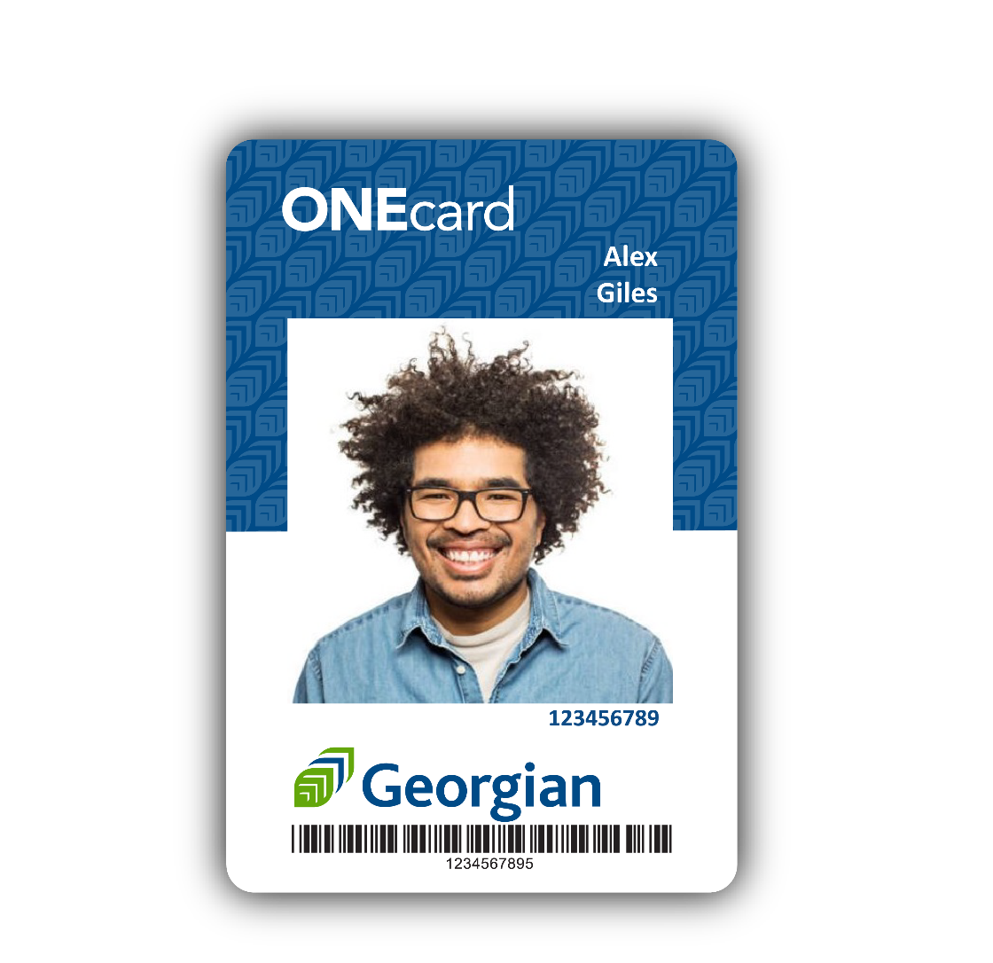
ONEcard Eligibility @ Georgian
All students who are registered in a Full-Time course load
Part-Time students who pay the ancillary fee
Part-Time students who don’t pay the fee can purchase a card
Special groups will have their card purchased by their department
Notes:
Trish:
Click
- Talk about how we are funded by an ancillary fee and are therefore a service that is currently only for students. Maybe also discuss how we have many different classifications that a student can fall into, so it was important to boil things down to the clearest and simplest definition

Slide 14
Staff Side Demo
Notes:
Jen:
Now let’s take a look at the administrative side of the software

Slide 15
Campus Deposit Registered Residency Semester Status
Notes:
Jen: Review the features of the admin screen
The icons at the bottom of each submission provide us with information so that we can make decisions regarding their eligibility at a glance.
The number beside the thumbs up icon is the amount of confidence that the AI has in its evaluation of a photo
Administration tab - Ability to immediately update the automated communications
Ability to manage large numbers of submissions very quickly

Slide 16
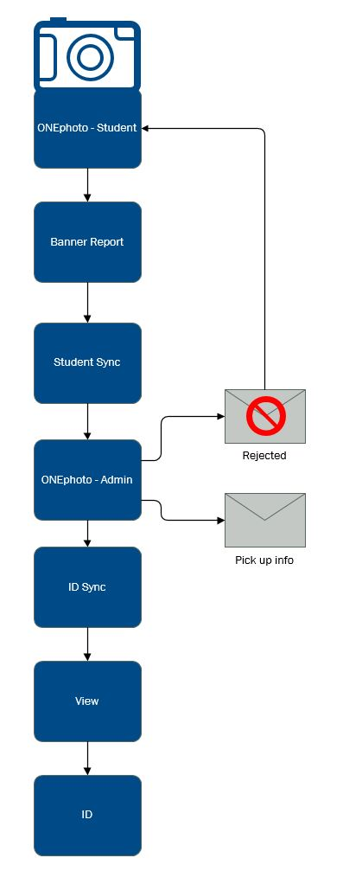
New Process
Approximate Processing Time: 15 seconds per image
Automated Steps: 4
Notes:
Jen:
Steps:
Run the eligibility report in banner
Sync the report with ONEphoto (this and the report only need to be done every once in a while, when you begin to have submissions without the data being filled in)
Login to ONEphoto and process submissions
Run ID sync to download the images
Run View to convert images and save them to the folder for ID
Print Cards
A large number of these steps are triggers for automated procedures, and once done, they complete that task for all submissions.

Slide 17
How do you validate a student’s identity?
Notes:
Trish:
Does your campus mail out cards? If so, how do you validate identity before mailing?
What forms of physical ID do you accept?
Do you accept digital ID such as pictures of ID on cellphones?

Slide 18
How do you handle card distribution?
What are we in line for anyway?
Notes:
Jen:
Take answers

Slide 19
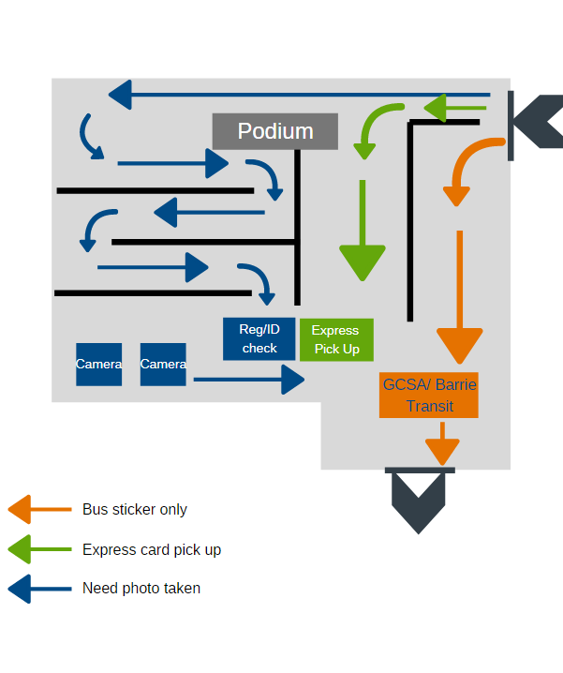
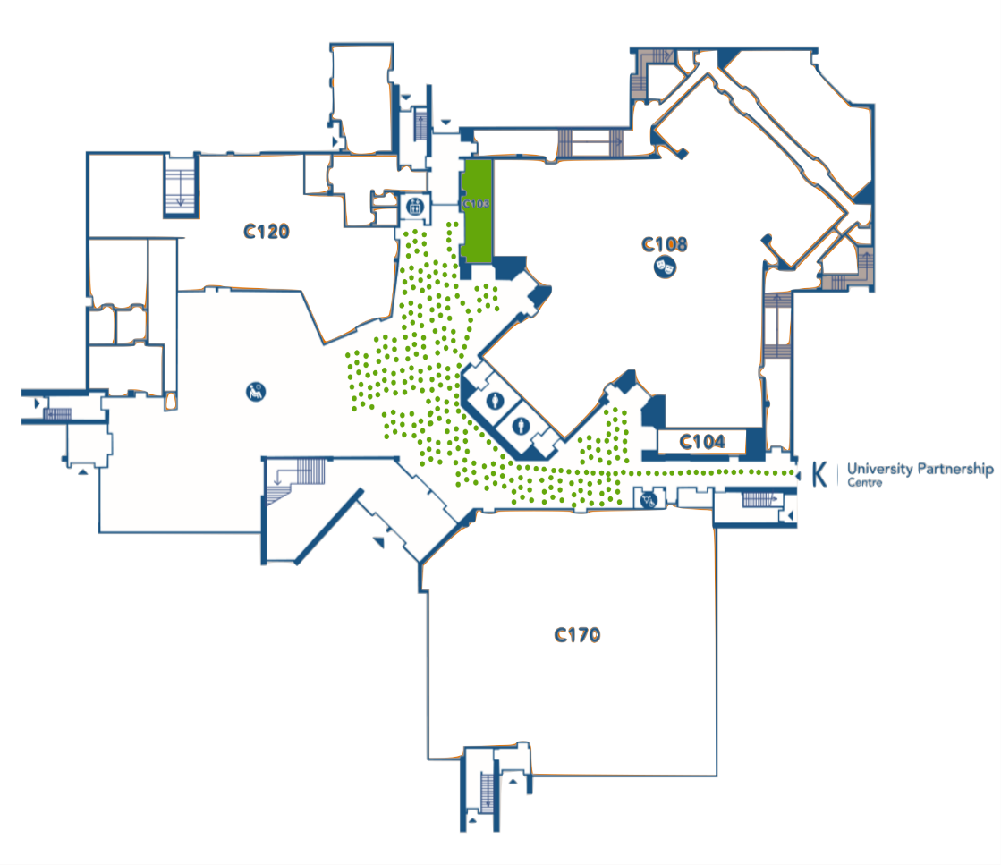
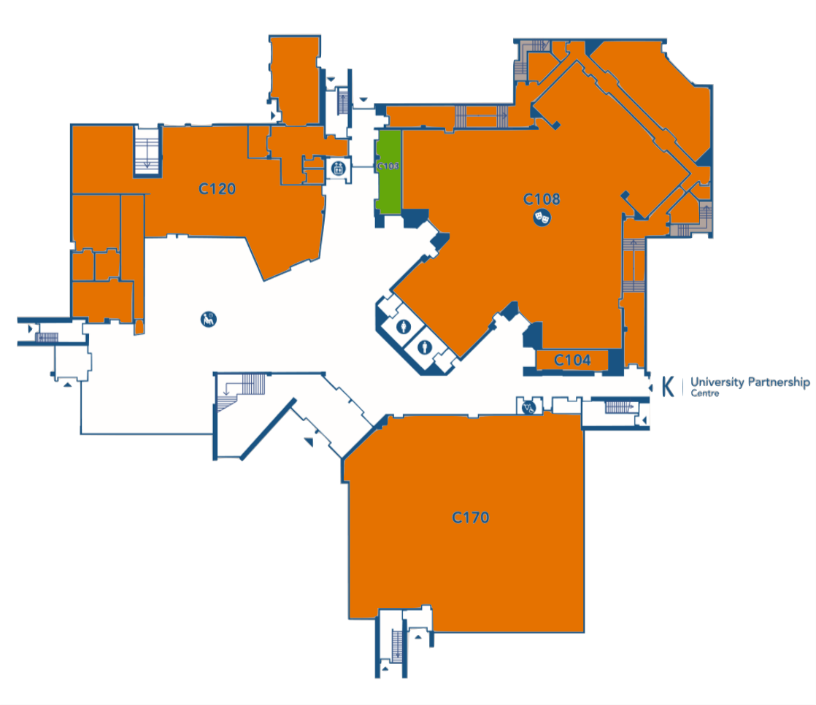
Distribution
New Flow
ONEcard Office Layout
Notes:
Jen:
Click
For our first startup in our new office we quickly discovered that our layout was not conducive to an efficient flow.
Click
This was also the semester that we implemented the change over of card technology as well as the first semester where we supplied the bus pass sticker to all eligible students. This meant that we were attempting to
Service all new students who needed their card for the first time
Re-card all existing students
And supply a bus sticker to both new and returning students
All from a space that used to be a coat check for the college theatre
Click
Not only was this not ideal, but the mass amount of students resulted in fire exits being crowded and a general displeasure at the shear length of the line.
This also happened to be my first day on the job.
Click
- Now, during each startup we relocate to a larger space in order to allow us to better handle the flow of distribution. One of the ways we encourage online submission is by telling students that they will get to “beat the lines”. Anyone who orders their card online is able to enter the express line and bypass those who still need their picture taken in person. Cards are alphabetized by last name.

Slide 20
We’re still improving
Automating the eligibility report and its sync with ONEphoto
Make ONEphoto more mobile friendly
Automate ONEphoto usage reports
Increase student use
Notes:
Jen:
Click
Enhancements we are working on (read from screen)

Slide 21
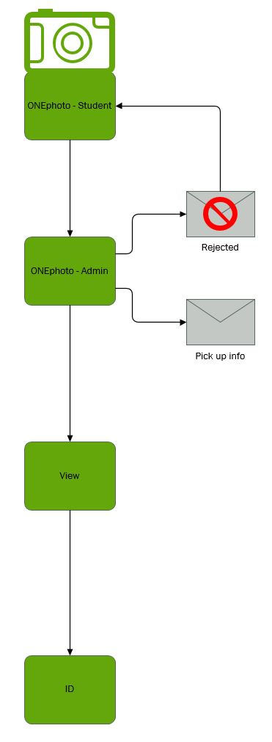
Our Ideal Process
Past
Present
Future
Notes:
Jen:
Click
Ideally, the process will be almost entirely automated with the only manual input being the acceptance/rejection of images and printing.

Slide 22
How do you encourage online photo submission?
Notes:
Trish
We work with many teams to encourage online submissions:
Email campaigns
Student Portal
International Centre
Student Advisors
Campus Tours
First Year Experience team
Social Media

Slide 23
Questions?

Slide 24
Contact us:
ONEcard@GeorgianCollege.ca
705-728-1968 ext. 1756
GeorgianCollege.ca/ONEcard
@GeorgianONEcard
@GeorgianCollegeONEcard
Patricia.Robinson@GeorgianCollege.ca
705-728-1968 ext. 1748
Jennifer.McDonald@GeorgianCollege.ca
705-728-1968 ext. 1631

