Slide 1

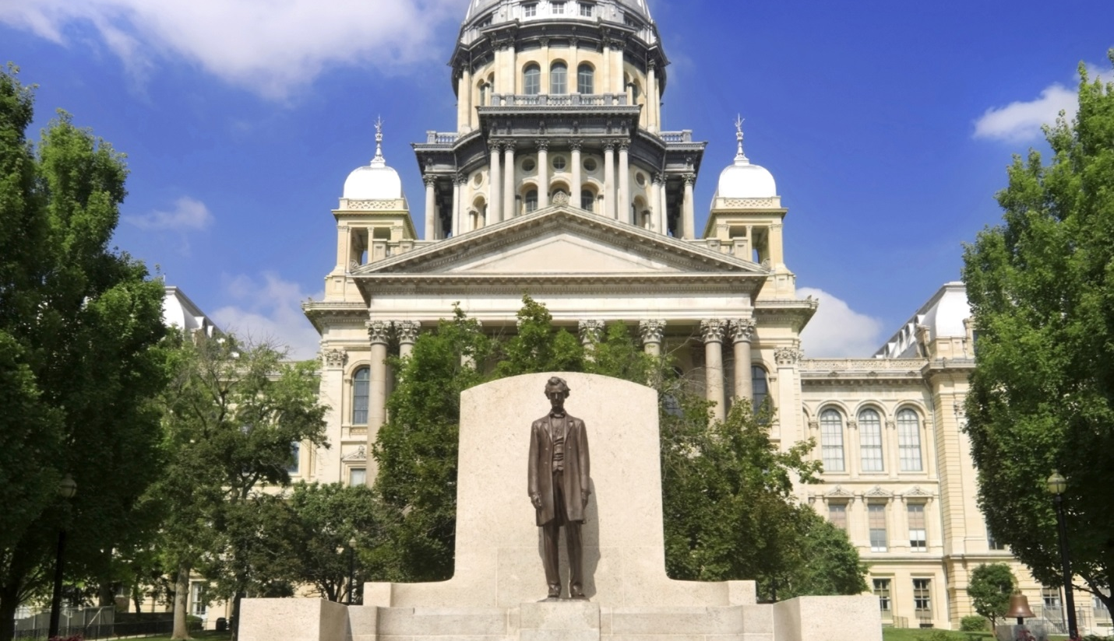

Slide 2


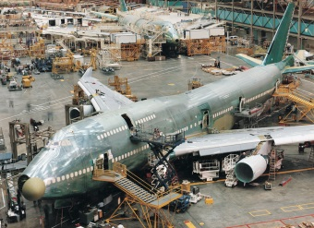



DCEO
Monica Bristow
Deputy Director
DCEO Local Governments
WOKING TOGETHER TO HELP EMPLOYERS CREATE AND RETAIN QUALITY JOBS
WORKING TOGETHER TO HELP EMPLOYERS CREATE AND RETAIN QUALITY JOBS

Slide 3
WHAT IS DCEO
The Illinois Department of Commerce and Economic Opportunity (DCEO) has evolved over several decades, founded in 2003, originating from various state agencies focused on economic and community development.
Established to consolidate these functions, DCEO aims to drive economic growth, job creation, and sustainable development across Illinois.
The department offers diverse programs, including business grants, workforce training, and infrastructure support, while adapting to modern economic challenges and opportunities.
Recent initiatives have emphasized renewable energy, technology, innovation and inclusive deployment, ensuring comprehensive support for businesses and communities statewide.
WORKING TOGETHER TO HELP EMPLOYERS CREATE AND RETAIN QUALITY JOBS

Slide 4
DCEO MISSION
Our mission is to support and maintain a business environment that enables a strong economy for our stakeholders -taxpayers, businesses, workers, and communities - by keeping, attracting, and growing businesses, maintaining a skilled workforce, and enhancing communities so that the climate here is one in which workers and businesses, small and large, can succeed to the greatest extent possible.
WORKING TOGETHER TO HELP EMPLOYERS CREATE AND RETAIN QUALITY JOBS

Slide 5
PROGRAM OFFICES
- Business Development
- Community Assistance, Office of (OEA)
- Community Development
- Employment and Training
- Entrepreneurship, Innovation, Technology
- Equal Opportunity Monitoring and Compliance
- Film
- Minority Economic Empowerment, Office of
- Regional Economic Development
- Tourism
- Trade & Investment
- Urban Assistance
WORKING TOGETHER TO HELP EMPLOYERS CREATE AND RETAIN QUALITY JOBS

Slide 6
PROGRAMS
Economic Development for a Growing Economy Tax Credit (EDGE)
Prime Sites
Rebuild Downtowns & Main Streets Capital Grant Program
Advantage Illinois
Apprenticeship Education Expense Tax Credit Program
Community Development Block Grants
Business Enterprise Program through CMS
WORKING TOGETHER TO HELP EMPLOYERS CREATE AND RETAIN QUALITY JOBS
WORKING TOGETHER TO HELP EMPLOYERS CREATE AND RETAIN QUALITY JOBS

Slide 7

ILLINOIS BROADBAND GRANT PROGRAM
Rebuild Illinois, the Illinois infrastructure program, includes $400 million to the Department of Commerce and Economic Opportunity for a statewide broadband deployment grant program. This appropriation will begin to expand access to reliable, high-speed internet service statewide. According to the USDA, fully utilizing digital technologies within the agriculture industry could create approximately $47 to $65 billion annually in additional gross benefit for the U.S. economy.
Broadband Expansion - Connect Illinois

Slide 8


OFFICE OF MINORITY ECONOMIC EMPOWERMENT (OMEE)
Committed to providing minority-, women-, persons with disabilities and veteran-owned small businesses and entrepreneurs across the state with equitable access to opportunities and resources.
Through dynamic partnerships, targeted outreach, and tailored programs and initiatives, OMEE aims to create an inclusive business ecosystem for communities that have traditionally faced systemic barriers to entry and growth.
https://www2.illinois.gov/dceo/OMEE/Pages/default.aspx

Slide 9
CDBG PROGRAMS
The Community Development Block Grant (CDBG) Program was established by the U.S. Housing and Community Development Act of 1974 ("HCD Act"). The programs assists Illinois communities that do not receive a HUD direct entitlement allocation with meeting their greatest economic and community development needs.
​Federal funding for community-based projects in non-metropolitan areas. The program consists of the following components.
Housing Rehabilitation
Public Infrastructure
Disaster Relief
WOKING TOGETHER TO HELP EMPLOYERS CREATE AND RETAIN QUALITY JOBS
WORKING TOGETHER TO HELP EMPLOYERS CREATE AND RETAIN QUALITY JOBS

Slide 10
OTHER DCEO PROGRAMS
High Impact Business Program
Research & Development Tax Credit
Site Selection Assistance
Rebuild Illinois Capital Grant Program
Workforce Innovation and Opportunity Programs
Small Business Development Centers (SBDC)
Social Equity Cannabis Loans
Procurement Technical Assistance Centers (PTAC)
First Stop Business Information Centers
Film Services Tax Credit
Tourism Attraction Development Grant
WOKING TOGETHER TO HELP EMPLOYERS CREATE AND RETAIN QUALITY JOBS
WORKING TOGETHER TO HELP EMPLOYERS CREATE AND RETAIN QUALITY JOBS

Slide 11
GRANTS
Evan Cyrulik
Michael Curry Intern
DCEO Local Governments
WOKING TOGETHER TO HELP EMPLOYERS CREATE AND RETAIN QUALITY JOBS
WORKING TOGETHER TO HELP EMPLOYERS CREATE AND RETAIN QUALITY JOBS

Slide 12
GRANT TRAININGS
DCEO is currently running a series of grant application workshops every month on the 3rd Wednesday at 9 am. Link
There is also a pre-qualification workshop hosted on the first Wednesday of every month. As well as a virtual office hour hosted every Tuesday at 2 pm.
The first of these grant application workshops is available online pre-recorded and details the process of writing a grant application. Link
Future topics include Capital Grants, Audit Submissions, Indirect Cost Rates and Completing a Budget Application.
WOKING TOGETHER TO HELP EMPLOYERS CREATE AND RETAIN QUALITY JOBS
WORKING TOGETHER TO HELP EMPLOYERS CREATE AND RETAIN QUALITY JOBS

Slide 13
GRANT DICTIONARY
CSFA – Catalog of State Financial Assistance
NOFO – Notice of Funding Opportunities
- Planning Tool
- Expectations and Considerations
- Formal Announcement
- Standard Language
- Specific Information for Applying
- Eligibility
- Application Submission Deadlines
- Contact Information
GATA – Grant Accountability and Transparency Act
UEI – Unique Entity Identifier
FEIN – Federal Employer Identification Number
GCES – Grantee Compliance Enforcement System
WOKING TOGETHER TO HELP EMPLOYERS CREATE AND RETAIN QUALITY JOBS
WORKING TOGETHER TO HELP EMPLOYERS CREATE AND RETAIN QUALITY JOBS

Slide 14
STEP 1 – PRE-QUALIFICATION
To begin the grant application process, you must register and be approved on by the federal government on SAM.gov and obtain your UEI number. This is the first step in the process and must be completed prior to any other grant writing taking place. You must also obtain a FEIN and certificate of Good Standing from the Secretary of State, unless you are a government entity.
Non-Eligible Parties:
Federal Excluded Parties
Illinois Stop Payment List
DHFS Sanctions List
WOKING TOGETHER TO HELP EMPLOYERS CREATE AND RETAIN QUALITY JOBS
WORKING TOGETHER TO HELP EMPLOYERS CREATE AND RETAIN QUALITY JOBS

Slide 15
STEP 2 – DEVELOP A PLAN
Grant Funds should be used appropriately.
Demonstrate past responsible spending.
Budget is the backbone of the proposal and inaccuracies can be the difference between receiving and not receiving a grant.
Detailed instructions are available for every step of the process.
Don’t hesitate to stop and ask questions of the contact listed on the NOFO.
Obtains quotes for goods and services prior to completing the application.
WOKING TOGETHER TO HELP EMPLOYERS CREATE AND RETAIN QUALITY JOBS
WORKING TOGETHER TO HELP EMPLOYERS CREATE AND RETAIN QUALITY JOBS

Slide 16
REQUIRED DOCUMENTS
These may vary from grant to grant but the typical application must include
UGA – uniform grant application
Program Application
Uniform Budget Template
Conflict of Interest Disclosure
Mandatory Disclosure
WOKING TOGETHER TO HELP EMPLOYERS CREATE AND RETAIN QUALITY JOBS
WORKING TOGETHER TO HELP EMPLOYERS CREATE AND RETAIN QUALITY JOBS

Slide 17
STEP 3 – APPLYING FOR A GRANT
Emphasize the importance of your program.
Show community consideration.
Illustrate and address a problem.
Answer questions with criteria in mind!
Make no assumptions as to what is known about both your organization as well as your program.
WOKING TOGETHER TO HELP EMPLOYERS CREATE AND RETAIN QUALITY JOBS
WORKING TOGETHER TO HELP EMPLOYERS CREATE AND RETAIN QUALITY JOBS

Slide 18
STEP 4 – MERIT REVIEW
NOFO outlines the process by which the grant will be reviewed and typically includes the criterion.
A 3 person review committee will be established and each person will review independently.
Scored based on need, capacity and quality as well as other factors including applicability of funding sources such as COVID-19 relief funds.
WOKING TOGETHER TO HELP EMPLOYERS CREATE AND RETAIN QUALITY JOBS
WORKING TOGETHER TO HELP EMPLOYERS CREATE AND RETAIN QUALITY JOBS

Slide 19
STEP 5 – AUDIT AND REPORTING
Audits are required of every organization receiving a grant on a yearly basis.
Regular periodic reporting is required of every grant recipient and the frequency will be determined based on the size and resources available for each organization.
Noncompliance with either of these required steps can result in the disruption of funding for your organization.
Always engage with auditors and reporting team early to avoid experiencing delays or loss of funding.
Auditing costs fall on grantees.
WOKING TOGETHER TO HELP EMPLOYERS CREATE AND RETAIN QUALITY JOBS
WORKING TOGETHER TO HELP EMPLOYERS CREATE AND RETAIN QUALITY JOBS

Slide 20
Team Red
Renee Wott
Senior Northeast Regional Manager
Office of Regional Economic Development
WOKING TOGETHER TO HELP EMPLOYERS CREATE AND RETAIN QUALITY JOBS
WORKING TOGETHER TO HELP EMPLOYERS CREATE AND RETAIN QUALITY JOBS

Slide 21

Illinois Tax Incentive Programs

Slide 22
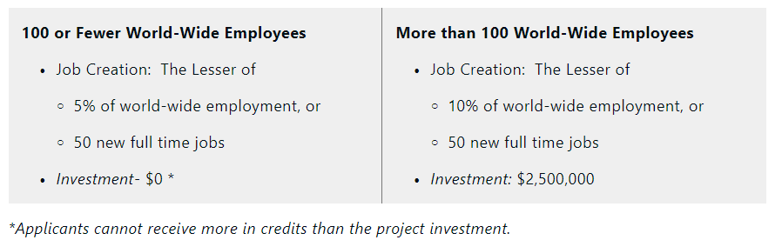
EDGE (Economic Development for Growing Economies)
Provides a tax credit equal to 50% of the new full-time employees’ payroll withholding tax and 25% withholding credits for retained jobs for 10 years to companies creating new jobs and making a qualifying capital investment.
For projects located in underserved areas, companies receive credits equal to 75% of the new full-time employees’ payroll withholding and 50% withholding credits for retained jobs.
For startups*, companies established less than 5 years before the filing of an application and that have never had any Illinois income tax liability are eligible to retain the payroll withholdings with an approved project.

Slide 23

REV (Reimaging Energy and Vehicles)
Income tax withholding is retained instead of being turned over to the state for a credit
  Up to 100 percent income tax withholding for new or retained employees
  Up to 75 percent income tax credit equivalent to construction wages
Tax credits covering up to 25 percent of employee training costs
Tax credit equal to 0.5 percent of qualified property investments
Blue Collar Job Act (BCJA) Benefits
Tier 1:
Invest in at least $2.5M and at least 50 new jobs (or 10% of WWE) in 4 years
20 year benefits (10 year plus renewal)
Tier 2:
Invest in at least $1.5B and at least 500 new jobs in 5 years
30 year benefits (15 year plus renewal)

Slide 24

Blue Collar Jobs Act
The tax credits are based on the wages paid to construction workers employed on eligible projects and may receive up to 75 percent income tax withholding credits for construction workers.
To be eligible, a company must be located in an Enterprise Zone (EZ) or a River Edge Redevelopment Zone (RERZ), designated a High Impact Business (HIB), or have an agreement under the Economic Development for a Growing Economy (EDGE) Program.
Manufacturing Machinery and Equiptment (MME) Exemption
Provides company with sales and use tax exemption all tangible personal property that is used or consumed by a purchaser in a manufacturing facility
The state also expanded the definition of production related tangible personal property to include supplies and consumables used in a manufacturing facility including fuels, coolants, solvents, oils, lubricants, and adhesives, hand tools, protective apparel, and fire and safety equipment used or consumed within a manufacturing facility.
Investment Tax Credit
Provides 0.5% tax credit on the total capital investment on a project located in an Enterprise Zone

Slide 25
Illinois Programs for Start Ups

Slide 26

EDGE for Start Ups
EDGE, the Economic Development for a Growing Economy, is a tax credit incentive program designed to encourage startups to invest, create, and retain jobs in Illinois. Businesses must be incorporated 10 years ago or less, not yet turning a profit, and ready to hire full time W2 employees to be eligible.
INVENT Illinois
The Illinois Innovation Venture Fund is a direct equity investment program funded through the U.S. Department of the Treasury State Small Business Credit Initiative (SSBCI).
The funds are expected to provide small businesses with the resources they need to sustainably grow and thrive, and to improve access to capital for traditionally underserved entrepreneurs.
Angel Investment Tax Credit
This program encourages investment in innovative, early-stage companies to help obtain the working capital needed to further the growth of their company in Illinois.
Investors in companies that are certified as Qualified New Business Ventures (QNBVs) can receive a state tax credit equal to 25% of their investment (up to $2 million).
Investors in companies that are designated Set-Aside QNBVs can receive a tax credit equal to 35% of their investment (up to $2 million).

Slide 27
Illinois Workforce Programs

Slide 28

Employer Training Investment Credit
The ETIP program is a competitive matching grant awarded to companies that provide job training to Illinois residents. The job training may be provided to both new employees and incumbent workers. The training should be a direct result of a permanent expansion, location, or retention activity. ETIP will cover up to 50% of training costs.
Apprenticeship Program
Under this program, employers are allowed a tax credit for qualified educational expenses associated with training and upskilling apprentices. Employers are eligible for a credit of up to $3,500 per apprentice against the taxes imposed by subsections (a) and (b) of Section 201 of the Illinois Income Tax Act.
This credit may be enhanced by an additional credit of up to $1,500 for each apprentice if (1) the apprentice resides in an underserved area or (2) the employer’s principal place of business is located in an underserved area. The credit is applicable to expenses such as tuition, books, and lab fees.

Slide 29
Illinois Loan Programs

Slide 30

Advantage Illinois Participate Loan Program (PLP)
The PLP offsets the risk by DCEO participating (sharing) in a portion of the loan with the Lender. There are no costs or fees to the lender or borrower. The DCEO buyout creates a lower blended rate for the borrower.
Eligible loans can be used to finance the following: equipment, real estate (must be 51% or more occupied by the business), working capital, inventory, leasehold improvements, and accounts receivable.
Advantage Illinois Loan Guarantee Program (LGP)
The LGP offsets the risk by DCEO insuring partial repayment to the Lender in case of loan default. There are origination and ongoing costs and fees to utilize the program that may affect the Lender and/or Borrower. There is no rate adjustment as we are not purchasing any portion out.
Cannabis Social Equity Loan Program
This program is an unwavering commitment to equity as the state works to ensure that entrepreneurs that have been adversely impacted by the war on drugs have a space in the growing cannabis industry.
Direct Forgivable Loans are fully financed by the State of Illinois. We offer a significant grace period, low interest rates, and full principal forgiveness upon receiving proof of eligible expenses.
Interest Rates are 4% after an 18-month grace period of no required payments and 0% interest; applicants can also pursue forgiveness prior to any interest accruing. The loan principal is 100% forgivable upon providing documentation for eligible business expense

Slide 31
Illinois International Trade Programs

Slide 32

Illinois’ State Trade and Export Program (ISTEP)
The ISTEP program provides Illinois' small businesses with both financial and technical assistance to increase their exports.
The program includes 5 options for Illinois' companies to grow their export sales: Group Trade Missions (GTM), Individual Foreign Market Sales Missions (IFMSM), and Product Compliance (PC), Website Localization (WL), and Ex-Im Bank: Export Credit Insurance (ECI).
APEX Accelerator Program
This program funds centers around the state to provide guidance for government contracting success. These centers assist Illinois businesses with all their government contracting needs whether federal, state, or local.
Foreign Trade Zones
Available to companies located in specific areas, foreign and domestic merchandise may be admitted into Zones without being subject to formal Customs entry procedures, the payment of Customs duties or federal excise taxes.

Slide 33
Illinois Grant Programs

Slide 34
Invest in Illinois
Newly created $400M closing fund that will provide discretionary grant assistance for a large project with significant job creation, retention, and capital investment.
Prime Sites Capital Grant Program
Grants assists companies with large-scale investment projects that commit to significant job creation.
Eligibility: Must have an EDGE/HIB and commit to hiring 50 new jobs and $40M in investment OR hire 100 new jobs and make $20M in investment
Grants will range from $250,000 to $10 million, up to $5,000 a job, with a 1:1 match.
Illinois Department of Transportation – Economic Development Program (IDOT-EDP)
A local government may apply for funding up to $2,000,000 for roadway improvements or construction necessary for access to industrial, manufacturing or distribution companies.
Grant funding can be up to $30,000 for every full-time job created and $10,000 for every full-time job retained.
Federal Grant Support Program
Grants assists Illinois-based businesses and organizations seeking federal grants that align with the State's economic development objectives.
DCEO may provide a 1:1 cash matching grant for capital and non-capital expenses up to $2,000,000, with prioritization based on awards that require a federal match and the number of awards an institution may have already received in the same fiscal year under this program.
Illinois Grocery Initiative – New Stores (Closes 5/24/24)
This Initiative will combat food insecurity by offering competitive grants to support the establishment of new grocery stores in food deserts. Grants will range from $160k to $2.4M
Local units of government and small businesses (with fewer than 500 employees and no more than four existing grocery stores) are eligible to apply.
Grants will provide reimbursement to eligible applicants for both capital and non-capital costs associated with establishing sustainable grocery stores located in food deserts.

Slide 35
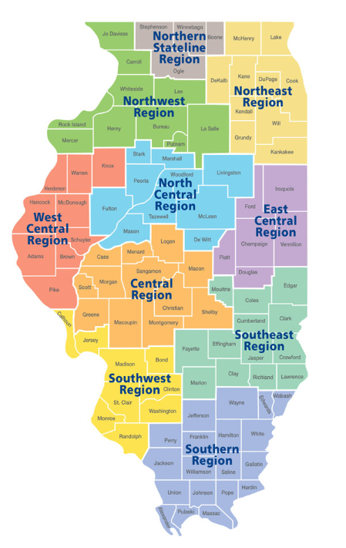
Contact information
Renee Wott, MPA
Senior Northeast Regional Manager
312.305.1892
Renee.Wott@Illinois.gov

Slide 36

THE ILLINOIS DEPARTMENT OF COMMERCE WANTS TO PARTNER WITH YOU
Questions?
www.dceo.Illinois.gov
Renee Wott, MPA
Senior Northeast Regional Manager
312.305.1892
Renee.Wott@Illinois.gov
Monica Bristow
Deputy Director
Local Government
217-685-9613
Monica.J.Bristow@illinois.gov
Evan Cyrulik
Curry Intern
Local Government
Evan.Cyrulik@illinois.gov

