Slide 1
THE HOMETOWN UTILITY ADVANTAGE
Notes:
Display this slide while the participants are coming in.

Slide 2

Notes:
Introduce yourself
Thank everyone for coming
Call out workers/particular companies you know are in the room
Thank our hosts, the local utility, and mention names and/or introduce utility people in the room

Slide 3
Hometown utilities provide …
Electricity
Gas
Water
Wastewater
Notes:
Explain that hometown utilities like those in [town you are in] provide a variety of services. Name the ones provided in [the town you are in]

Slide 4
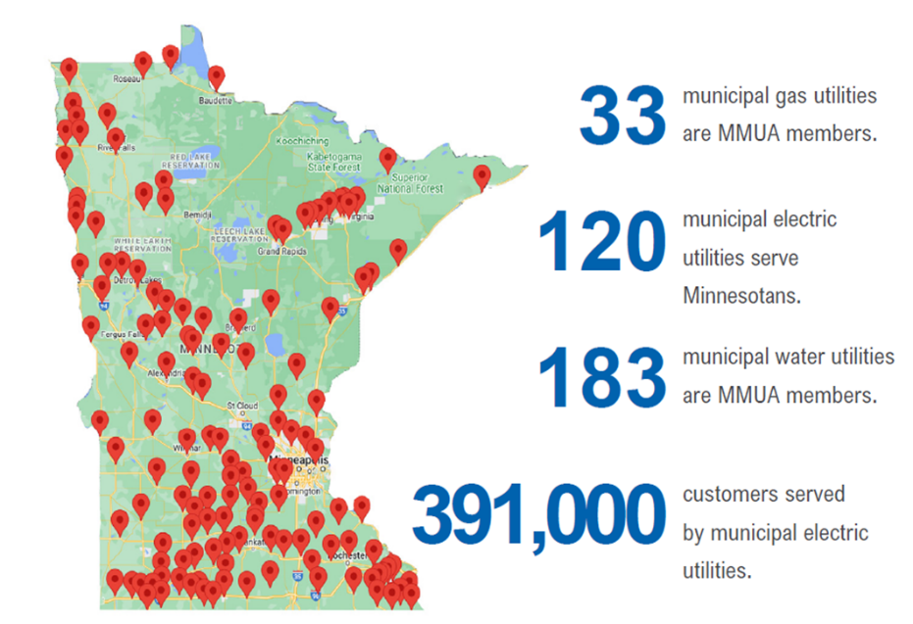
Public interest over profit
Owned by the community
Goal is serving the public interest, not maximizing shareholder profit
Notes:
Explain that everyone in town owns the utility, just as they own the streets, schools, and parks.
State that today’s training is an example of something beyond basic utility services that [name of utility] is making available because they care about their town and its citizens

Slide 5

So why is a municipal utility a benefit to your business and family today?
Notes:
I’m just going to take a minute here to make you aware of why having a municipal utility system is valuable – and compares favorably to having your services owned by outside investors.

Slide 6
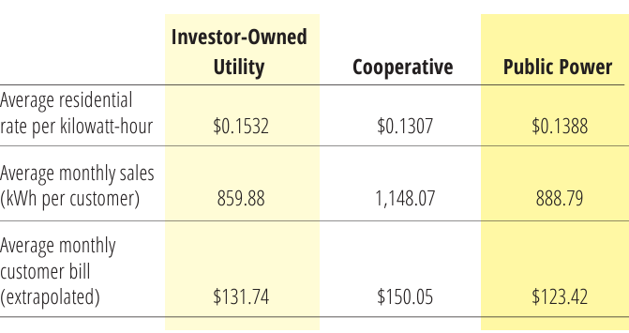
Lower rates
(2022 data from the EIA)
Notes:
In general, rates are lower in municipal towns because nobody is making a profit. This chart shows the advantages for electricity, but it is generally true across all utilities.

Slide 7
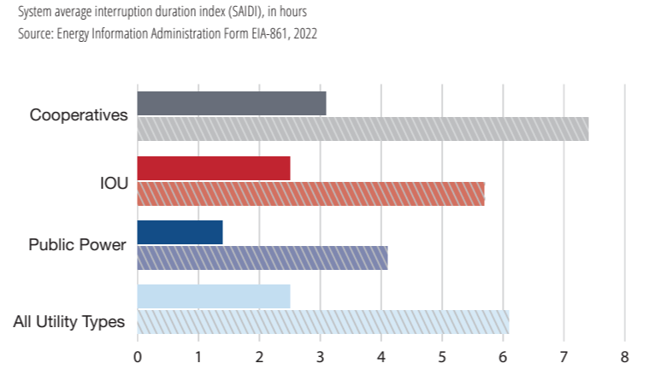
Shorter outages
(2022 data from the EIA)
Notes:
Outages tend to be shorter because of local accountability and because crews are local. There is no need to wait for assistance from far away. Even if there’s a bad storm and outside help is needed, local crews can get started immediately and the municipal utility mutual aid network will arrive shortly.

Slide 8

Accountability and local control
Elected commissioners—not a distant CEO or government body—make decisions
Local staff
Immediate and close feedback loop
Notes:
There’s nowhere to hide in [your town]. You can make your concerns known and get quick results.

Slide 9


Own the ease of your hometown utility.
Notes:
So we hope you will value your hometown utility, and own the ease of interacting with your local team. At MMUA, we support them and do everything we can to help them continue to deliver excellent service. Thanks for letting us be here talking with you today.

Slide 10

Chemical Hazards and Safety
Hazard Communication
A training course for workers and employers
funded by a Susan Harwood Training Grant

Slide 11

Acknowledgement
This material was produced under grant number SH-000138-SH4 from the Occupational Safety and Health Administration, US Department of Labor. It does not necessarily reflect the views or policies of the US Department of Labor, nor does mention of trade names, commercial products, or organizations imply endorsement by the US Government.
Notes:
Full disclaimer: Disclaimer: "This report was prepared as an account of work sponsored by an agency of the United States Government. Neither the United States Government nor any agency thereof, nor any of their employees, makes any warranty, express or implied, or assumes any legal liability or responsibility for the accuracy, completeness, or usefulness of any information, apparatus, product, or process disclosed, or represents that its use would not infringe privately owned rights. Reference herein to any specific commercial product, process, or service by trade name, trademark, manufacturer, or otherwise does not necessarily constitute or imply its endorsement, recommendation, or favoring by the United States Government or any agency thereof. The views and opinions of authors expressed herein do not necessarily state or reflect those of the United States Government or any agency thereof."

Slide 12

Welcome!
This course is designed to help you understand chemical hazards, how they affect us at work, and how they affect our daily lives.

Slide 13

Today’s agenda
Welcome/course objectives/quiz
OSHA worker rights and protections
Chemical hazards
  Where we get information about the hazards
  Related regulations and standards
Understanding the information
Working safely with chemicals
Exercise/demonstration
Quiz/course evaluation

Slide 14

Learning objectives
Recognition of chemical hazards at work and home
Understand chemical hazard routes of exposure
Principles and requirements of chemical labeling

Slide 15
Learning objectives
Understand the usage of safety data sheets
Prevention of injuries and illnesses related to chemical hazards
Creation of safer workplaces

Slide 16

Compliance and safety – a cooperation
Important components
Complimentary
Best at identifying and evaluating risk
Best at determining elimination of risks
Notes:
All too often, we believe or mistake that complying with a particular safety rule is safety. They are important components in a safety program or system, and they are complimentary of one another, our focus and objective should always be safety. Think of it this way. We are told that wearing a seat belt in the car is for our safety, and they made that the rule, the law. So, you comply with the rule, great does that make you a safe driver? According the Association of Society of Safety Engineers (2015) Safety can be defined as the control of recognized hazards to achieve an acceptable level of risk, while compliance according to OSHA is the act of complying with established safety standards, regulations, and laws. Regulatory compliance standards are great resources, and we should look to them for guidance, but they essentially “help” us stay safe. Safety principles are best at identifying risks and determining how to eliminate the risks.

Slide 17

Let’s see what we already know

Slide 18

Occupational Safety and Health Act (OSH Act)
The mission:
  To save lives
  To prevent job related injuries and illnesses
  To protect America’s workers
Notes:
The OSHAct was created in 1970 to “assure safety and healthful working conditions for working men and women.”

Slide 19

Section 11(c) 29 U.S.C. §660(c)
OSHA’s Whistleblower Protection Program protects employees from retaliation against you by taking unfavorable personnel action because you engaged in a protected activity relating to workplace safety and health.
Complaints must be filed with OSHA within 30 days after the alleged retaliation.
Notes:
The OSHA Fact Sheet “OSHA’s Whistleblower Protection Program” will be handed out and participants will be given opportunity to seek additional information.

Slide 20

OSHA?
OSH Act
General Duty Clause
  Employer requirements/responsibilities
  Employee requirements/responsibilities
  Workplace impact
Section 5(a)(1) of the Occupational Safety and Health Act
Notes:
Provide the text of the OSH act (handout) – specifically the general duty clause about providing a workplace free from hazards

Slide 21

Employer responsibilities
“Each employer –
shall furnish to each of his employees employment and a place of employment which are free from recognized hazards that are causing or are likely to cause death or serious physical harm to his employees;”
Section 5(a)(1) of the Occupational Safety and Health Act

Slide 22
Employer responsibilities (continued)
“Each employer –
shall comply with occupational safety and health standards promulgated under this Act.”
Section 5(a)(1) of the Occupational Safety and Health Act

Slide 23

Employee responsibilities
“Each employee shall comply with occupational safety and health standards and all rules, regulations, and orders issued pursuant to this Act which are applicable to his own actions and conduct.”
Section 5(a)(1) of the Occupational Safety and Health Act

Slide 24

The general duty clause has been violated when:
The employer failed to keep the workplace free of a hazard to which employees of that employer were exposed;
The hazard was recognized;
The hazard was causing or was likely to cause death or serious physical harm; and
There was a feasible and useful method to correct the hazard.
Standard Interpretation Letter December 2003
Notes:
Elements necessary for a violation of the General Duty Clause.

Slide 25

Standards, regulations, rules, other references
OSHA—Hazard Communication 1910.1200
DOT—PHMSA Title 49 CFR Parts 100–185
EPA—TSCA Title 40 CFR Part 711
NFPA—NFPA 704
ACA—American Coatings Association
CPSC—FHSA Title 16 CFR Chapter II Sub C Part 1500
Notes:
OSHA – Occupational Safety and Health Administration
DOT – PHMSA – US Department of Transportation – Pipeline and Hazardous Materials Safety Administration
EPA – Environmental Protection Agency – Toxic Substances Control Act
NFPA – National Fire Protection Association
ACA – American Coatings Association
CPSC – Consumer Products Safety Commission – Federal Hazardous Substances Act

Slide 26

Standards: regulatory or consensus
Regulatory
  Required
  Mandated
Consensus
  Recommended
  Voluntary
Notes:
When we look at standards there are two types that affect our world. Regulatory and Consensus.
Regulatory standards are required to be followed by the letter of the law or perhaps they mandated by the employer.
Consensus standars are recommended to be followed, they are most likely a standard that has been developed utilizing the most recent research.
In many instances, the regulatory authorities reference a consensus standard.
For instance, when you purchase safety toed footwear, they come with a label that states the footwear conforms to ASTM F2413-18.

Slide 27

Top 10 OSHA citations
#10: Machine guarding
#9: PPE: eye and face protection
#8: Fall protection: training
#7: Respiratory protection
Source: www.osha.gov/topcitedstandards
Notes:
For many years, OSHA has been publicizing their most cited regulations. For FY 2023, the most cited regulations were.

Slide 28
Top 10 OSHA citations
#6: Lockout/tagout
#5: Powered industrial trucks
#4: Scaffolding
#3: Ladders
Source: www.osha.gov/topcitedstandards

Slide 29
Top 10 OSHA citations
#2: Hazard communication
#1: Fall protection: general
requirements
Source: www.osha.gov/topcitedstandards

Slide 30

Chemicals are everywhere
350,000 chemical substances over past 40 years
Approximately 700 new per year added to TSCA
Notes:
Chapter 5. Chemicals. In: Compendium of WHO and other UN guidance in health and environment, 2024 update.
Geneva: World Health Organization; 2024. https://iris.who.int/handle/10665/378095
“How many chemicals in commerce have been analyzed in environmental media? A 60 year bibliometric analysis” Derek CG Muir; Gordon J Getzinger; Matt McBride; P Lee Ferguson 2023 Published by American Chemical Society
TSCA – Toxic Substances Control Act - EPA

Slide 31

Interesting fact
Of all reports to poison control centers concerning children, 10 percent involved household cleaners
For adults, 6 percent involved household cleaners
Source: National Poison Control Center
Notes:
While that may not seem significant. For children, that was the number one reason persons contacted the poison control center was for a child’s exposure to household chemicals. For adults, it wasn’t the number one reason for calling. Calls to the poison control center for adult exposure 32 percent of all reports involved exposures to drugs or medications, while just over 6 percent were for household chemicals.

Slide 32

What chemicals do you encounter?
At work
At home

Slide 33


Global Harmonized System (GHS): classification and labelling of chemicals
Developed by United Nations
Defines hazards
Harmonizes classification criteria (universally recognized around the world)
Standardizes content and format of label and safety data sheet

Slide 34

Chemical hazard identification
Labeling
  Pictograms
  Signal words
Safety data sheet (SDS)
Hazard statements
  Health hazards
  Physical hazards
Training

Slide 35

Pictograms
Hazard Communication Standard aligns with Global Harmonization System; requires pictograms on labels to caution users of chemical hazards they may be exposed to.
Source: OSHA 3491-08R 2024

Slide 36

Flame
Flammables
Pyrophorics
Self-heating
Emits flammable gas
Self-reactives
Organic peroxides
Source: OSHA 3491-08R 2024
Notes:
Associated with products, chemicals and hazardous substances that are flammable or combustible. Keep in mind, that there are also differences between flammable and combustible. Pyrophoric materials are those that when in a gaseous state will ignite spontaneously in air at temperature of 130 degrees Fahrenheit or below.

Slide 37

Skull and Crossbones
Acute toxicity (fatal or toxic)
Source: OSHA 3491-08R 2024
Notes:
This identifies a product that may be acutely and potentially fatal. It may be highly toxic/posiounous or fatal if swallowe, if contact is made with skin or if it is inhaled.

Slide 38

Corrosive
Skin corrosion burns
Eye damage
Corrosive to metals
Source: OSHA 3491-08R 2024
Notes:
These products have a corrosive effect on skin and membranes. The types of chemicals in the products may be acids, bases, inorganic salts, aldehydes, pheols and surfactants. They may be corrosive to metals thus storage of other products in metal containers must be taken into consideration. Effect can be slght irritant to highly destructive.

Slide 39

Exploding bomb
Explosives
Self-reactives
Organic peroxides
Source: OSHA 3491-08R 2024
Notes:
Products contain an explosive substance or mixture that is capable of a violent chemical reaction. They can produce gas at such a temperature, pressure and speed that it an cause damage to the surroundings. The importance of the secondary information contained in the warning statement is necessary to pay attention to. The warning statement may include handing information that if not adhered to would create an explosion, or storage of the product near flame or spark may be all that is needed to set off an explosion
Explosives – which is a solid or liquid chemical capable of a chemical reaction that cause damage to surroundings
Self-reactive – heating may cause fire or explosion without the need for air
Organic peroxides – again heat may cause fire or explosion

Slide 40

Gas cylinder
Gases under pressure
Source: OSHA 3491-08R 2024
Notes:
Presents various safety hazards. Products with this pictogram include compressed gases, dissolved gases, liquefied gases, and refrigerated liquefied gases. Container can explode when heated because gas expands as the temperature rises. May also become a projectile if they a dropped or knocked over and the valve breaks or the container is ruptured.

Slide 41

Environment
Non-mandatory
Aquatic toxicity
Source: OSHA 3491-08R 2024
Notes:
The use of this pictogram is not mandatory; however, it may be additional information that was chosen to be provided. If the pictogram is used, there are acute or chronic aquatic hazards.

Slide 42

Exclamation mark
Irritant (skin and eyes)
Skin sensitizer
Acute toxicity (harmful)
Narcotic effects
Respiratory tract irritant
Hazardous to ozone layer (non-mandatory)
Source: OSHA 3491-08R 2024
Notes:
This symbol represents the lower end of the scale of being harmful. The corrosive symbol represents serious eye or skin damage while this represents an irritant to the skin or eyes. You may see this symbol on a bottle of bleach

Slide 43

Health hazard
Carcinogen
Mutagenicity
Reproductive toxicity
Respiratory sensitizer
Target organ toxicity
Aspiration toxicity
Source: OSHA 3491-08R 2024
Notes:
This pictogram identifies chemicals and products which could lead to chronic health effects.
Carcinogen – lead to development of cancer
Mutagenicity – can lead to the altering of your DNA which can lead to defects in future generations
Reproductive – can affect the ability for health men and women to conceive healthy children
Respiratory Sensitizer – once over-exposed, you may have hyper-allergic reaction when re-exposed
Target organ toxicity – affects the normal function of a specific organ
Aspiration toxicity – may lead to the development of chemical pneumonia

Slide 44

Flame over circle
Oxidizers
Source: OSHA 3491-08R 2024
Notes:
Do not confuse this pictogram with the flammable/flame pictogram. This is specific to solids liquids or gasses that classified as oxidizers. An oxidizer is chemical that which causes any combustible material like wood, paper rubber or even flammable substance like gasoline to burn much more rapidly or intensely than normal. These substance are not flammable in and of themselves, but they make other substances much more flammable.

Slide 45
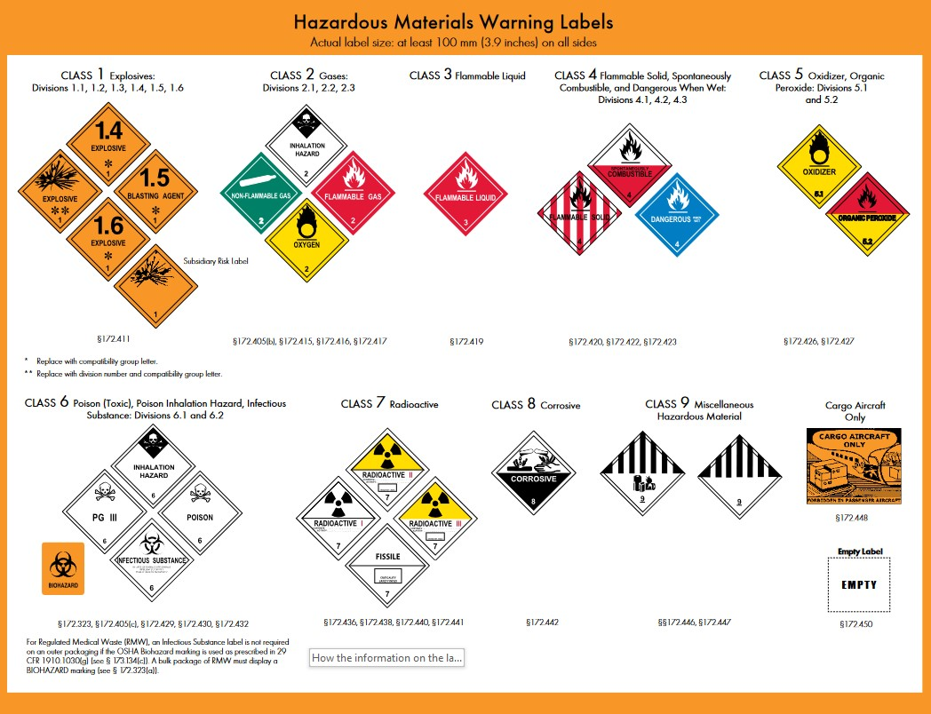
DOT labeling
Placarding
Shipping labels
Packing groups
Source: USDOT - PHMSA
Notes:
DOT placarding and labeling govern the transportation of hazardous maters in interstate, intrastate and foreign commerce. This is carried out through the Pipeline and Hazardous Materials Safety Administration. The primary goal is to ensure the safety of the public and those who prepare, offer and transport hazardous materials.
The pictograms within the labeling and placarding are similar to the GSH pictograms and contain additional pictograms such as radioactive. Additional information is contained with the shipping documentation.
Another example of a way that hazards associated with chemicals is identified and communicated.

Slide 46

Signal words
Indication of relative level of severity of hazard
Consumer use product labels
Accompanied by precautionary statement
Notes:
Consumer use products such as the cleaning chemicals that we all use at home utilize signal words to identify and communicate the hazards associated with the products use. For instance, on the label of dish soap it is common to say “CAUTION” for external use only. What exactly does that mean? Further reading will say that it may cause eye irritation.
Bring several examples of consumer use products with varying signal words to discuss

Slide 47

Signal words
Indication of relative level of severity of hazard
Consumer use product labels
Accompanied by precautionary statement
Notes:
Some consumer product labels with say “WARNING”, meaning injury will occur if not handled correctly, but what exactly may that mean. Well for some cleaning chemicals not handled correctly may mean do not mix this product with another produce such a bleach.
May cleaning chemicals have active ingredients in the ammonia classification. Mixing with bleach can create very harmful vapors.
Tell story of bleach and ammonia mixing.

Slide 48

Signal words
Indication of relative level of severity of hazard
Consumer use product labels
Accompanied by precautionary statement
Notes:
This level of hazard severity is exactly what it is say “DANGEROUS.” Look at some products in the garage that may persons use to help loosen up rusted bolts, it’s in a blue and yellow can. Says right on the label DANGER, flammable and under pressure. Serious injury will occur if it’s used in a manner that is unsafe or doesn’t follow the recommendations.

Slide 49
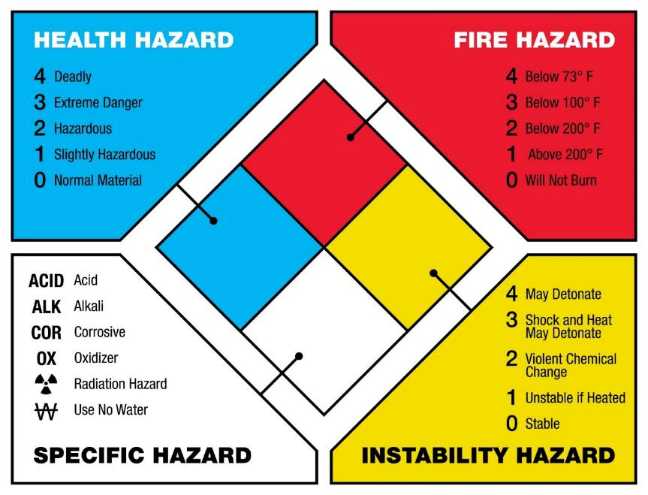
NFPA 704 labeling
Basic information for emergency personnel
Generally used when responding to fire or spill
Used in emergency response planning
Source: NFPA 704
Notes:
Purpose of this labeling system is to provide a simple, easily understood and readily recognized marking. It provides a general idea of the hazards of the materials and the severity of those hazards.

Slide 50
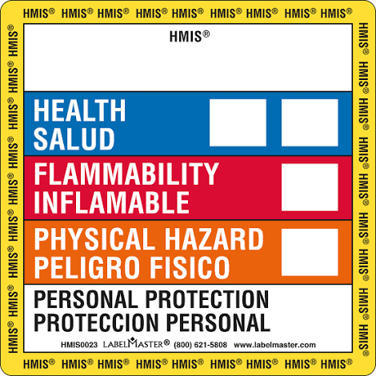
HMIS© labeling
Voluntary numerical hazard rating system
Compliance aid for the hazard communication standard (HCS)
Intended use by employers and workers
Source: American Coatings Association
Notes:
Another method of labeling products to identify the hazards associated with the hazardous materials contained within. This system communicates with the use of color, numbers and letters. Similar to the NFPA 704 label with the severity ratings of 0 -4. Additional information may be needed to create such a label as the PPE section utilizes a lettering system to indicate the type of PPE that should be used, for example the A represents that safety glasses should be used, while a B represents that safety glasses and gloves should be used.

Slide 51

Safety data sheet (SDS)
A standardized document that lists information of products with hazardous chemicals
Information is related to the properties of each chemical:
  Physical, health, and environmental hazards
  Protective measures and safety precautions for handling, storing, and transporting
Notes:
Required to be kept for all products that contain a hazardous substance. They must be available at all times to all employees. There are 16 sections on this document that
The hazard communication standard requires that the chemical manufacturer, distributor, or importer provide safety data sheets for each hazardous chemical to downstream users to communicate information on these hazards

Slide 52
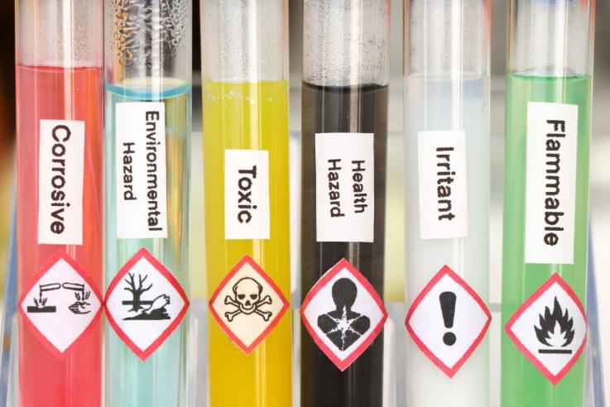
Fundamental information
What is the product and what is it used for? Section 1
What are the hazards?
Section 2
What do I do in an emergency?
Sections 4, 5 and 6
Does this product have a specific appearance? Section 9
How do I work safely with this product?
Sections 7 and 8
1910.1200
Notes:
There is a lot of information on a SDS. The fundamental information can be found in the first 9 sections. While all of the information is important the basis for our need to know and understand the hazards can be found here.
Section 1 – The name of the product or it’s common chemical name. The manufacturer and contact information and the recommendations for it’s use are here
Section 2- This is where the hazard statements, signal word, precautionary statement and pictograms appear. The information necessary for secondary container labeling is also found here.
Sections 7 & 8 – Section 7 addresses handling practices and safe storage of the chemical, including incompatible chemicals and recommended general hygiene such as eating, drinking and smoking in area where chemical is used. Section 8 lists the permissible exposure limits as established by OSHA and also the personal protective equipment necessary to be used when working with this chemical.
Sections, 4, 5 & 6 – Section 4 covers first aid measures if an exposure should occur. The measures are based upon the routes of exposure and if the symptoms may be acute. Section 5 has suggested suitable equipment for extinguishing a fire involving the chemical as well as not appropriate equipment. Also any hazardous by-product created by the fire. Section 6 list emergency procedrues and protective equipment to be used when cleaning up a spill, leak or release.
Section 9 – This section describes the physical state of appearance of the chemical including color and odor. There is also technical information such as flash pioint and vopr density.

Slide 53
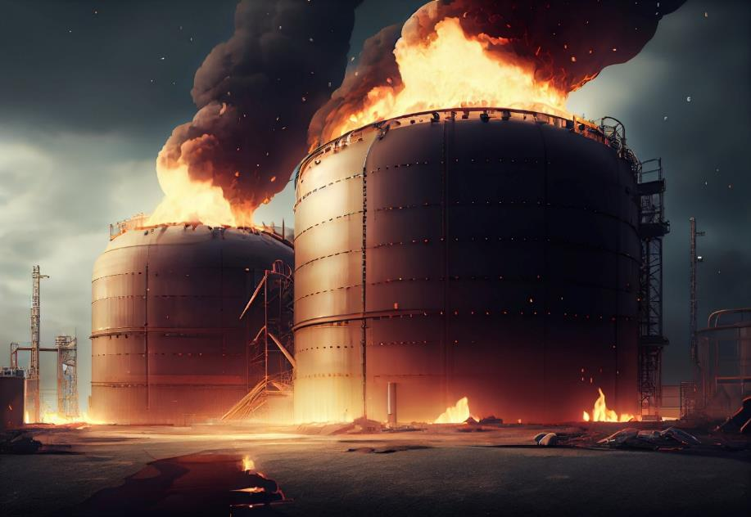
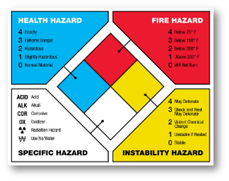






Physical hazard
Generally, these hazards can cause physical harm to anyone using them
Misuse can cause damage to the human body and or materials

Slide 54
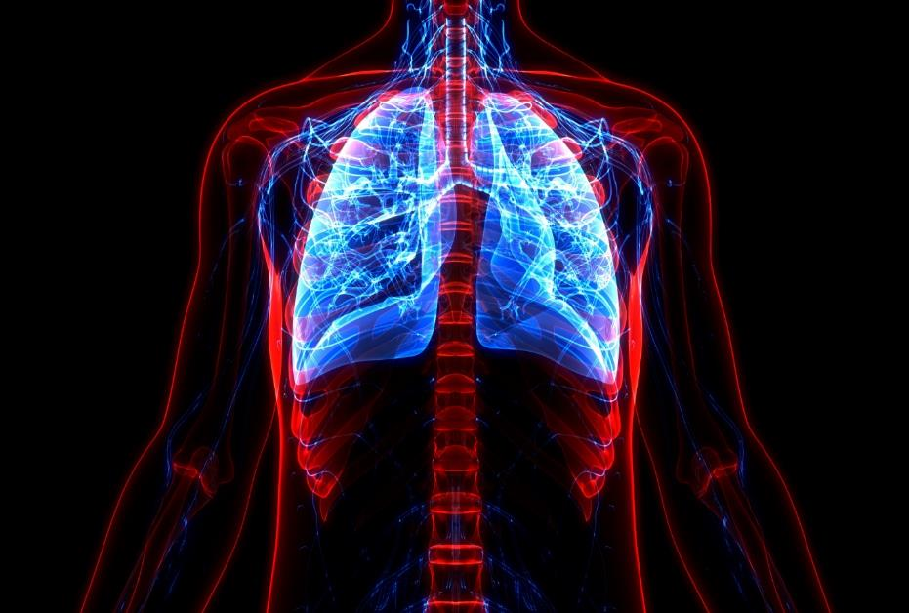





Health hazard
Generally, these hazards can cause harm to the health of anyone using them
  Acute
  Chronic
  Irritant
Notes:
There are two terms that get used interchangeably when talking about the health effects of chemical exposure, toxicity and hazard. Toxicity is more about the ability of the chemical/hazardous substance to cause harm, while hazard is the likelihood that the chemical will cause harm under the conditions of use. You could say that with proper handling, even highly toxic chemicals can be used safely. Yet, a less toxic chemical can be extremely hazardous if used improperly.
Acute – generally results from a single, short exposure. Usually reversible and appear quickly.
Chronic – generally occurs from repeated exposure of a long period of time. Delayed and gradual may be irreversible.
Think of alcohol. The acute effects of alcohol exposure a getting drunk, while the chronic effects ma be cirrhosis of the liver.
Irritant – upon contact, result is reversible inflammation or irritation to a body surface including eyes, respiratory tract, skin or mucous membrane.

Slide 55

Routes of exposure
Inhalation
Breathing in vapors, mists, dusts, particulates
Ingestion
Swallowing or smoking
Injection
Absorption
Puncturing skin
Skin contact, non-intact skin
Through skin via forced air
Eye contact
Notes:
Inhalation – The lungs are the most common way for chemical substance to enter the body. Gases, vapors and particles (mist, dust, fumes) may harm the tissues of the lungs or enter into the blood stream. Many chemicals have a distinct odor that is perceptible at specific level of concentration (odor threshold). However, over loading your sense of smell can result in fatigue of the system and over exposure may occur. That odor threshold may be of a level that the hazardous concerntration level is exceeded before the odor threshold is reached. Smoking in areas where chemicals are used or when cigarettes become contaminated by unclean hands, also has the possibility of occurring.
Ingestion – The gastrointestinal tract is another possible route of entry. It is unlikely that anyone would intentially eat a chemical, it is possible for the exposure to occur as a result of eating or drinking. Contaminated hands can be the cause of food or drink contamination.
Injection – Accidental injection may occur through mishaps with needles, broken glass or other sharp objects. Using pressurized air to clean skin or clothing may cause a chemical to be injected through the skin into the bloodstream. Do not use an air nozzle to clean off skin or clothes. All air nozzles must have pressure reducing tips to main tain less than 30psi at the tip.
Absorption – one of the quickest and simplest ways for chemicals to enter the body is through direct contact with skin and eyes. The skin contact can result in a localized reaction such as a rash or burn, or possible drying of the skin. Absorption into the bloodstream is possible via non-intact skin resulting in toxic effects on other parts of the body.

Slide 56

Protection from exposure
Hand washing
Laundering of clothes
Cleanup of spills
Don’t mix
Proper storage
Notes:
Give demonstration of wearing rubber gloves and using shave cream to illustrate how chemicals can move about without taking care of personal hygiene practices
Follow instructions on labels when using and storing chemicals
Don’t mix products. Deadly gases can result or even fire may start.
Store products in their original container. If changing containers is necessary, label the secondary container.
Do not store incompatible products together
Store products out of reach from children
Clean up spills immediately

Slide 57

Protection from exposure
Hand protection
Eye/face protection
Respiratory protection
Body protection
Notes:
Talk about the differences in the PPE and that importance of utilizing the SDS to determine the proper PPE that is recommended/needed/required.
Hand protection – refer to label and SDS for information regarding hand protection. Not all hand protection is the same. There are some materials that hand protection is comprised of that provide zero protection for certain chemicals. The chemical may actually destroy or be absorbed through the hand protection and expose yourself to the hazard.
Eye/face protection – safety glasses can provide adequate protection from splashes, normal prescription glasses may not however provide enough protection. Glasses, do not however provide adequate protection from some mists, fumes and vapors. Goggles provide an increased level of protection. Face protection provides exactly that, face protection and it should be accompanied with eye protection.
Respiratory protection – refer to the label, SDS and other information regarding the appropriate respiratory protection. If it is required to use air purifying respirator, you need to know the correct one as the hazardous chemical may have specific properties that the carbon filter must meet. Adequate ventiliation must also be considered. Adequate venilation itself may be the sole necessary respiratory protection.
Body protection – chemicals can destroy clothing if exposed. Appropriate aprons and or over clothes may be necessary. Again, refer to the sds and label for the correct information.

Slide 58

Steps to take
Keep a list of all chemicals
Label all containers
Make available SDS
Train employees on chemicals and personal protective equipment and use
Notes:
All containers both original and secondary must be labeled with the information necessary to notify employees about the chemical (product), the hazards, and protection necessary to minimize exposure. It is easy to for one product to look like another. Think of window cleaner and Gatorade? Or RV anti-freeze and kool-aid. Not granted that requires someone to purposely put a food stuff into a chemical container, but if you can’t read the label – just imagine.

Slide 59

Question and answer

Slide 60

Session wrap-up
Post test
Course evaluation
List of references

Slide 61


Slide 62

What’s next?
Employer and Supervisor Training
This is a continuation of the initial training in Chemical Hazards and Chemical Safety. This material was produced under grant number SH-000138-SH04 from the Occupational Safety and Health Administration, US Department of Labor. It does not necessarily reflect the views or policies of the US Department of Labor, nor does mention of trade names, commercial products, or organizations imply endorsement by the US Government.

Slide 63

Employer responsibilities – hazard communication
Written hazard communication program
In Minnesota – Employee Right to Know program
Chemical inventory
All chemical containers labeled
Maintenance of Safety Data Sheets (SDSs)
Training employees

Slide 64

Written program
Responsibilities:
Implementation of program
Training
Coordination of elements
Hazard Communication Manual

Slide 65

Chemical inventory
Present in the workplace
Product/common/chemical name
Labeling
Safety Data Sheets (SDSs)

Slide 66
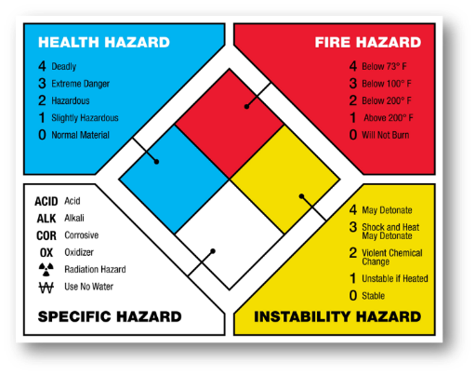
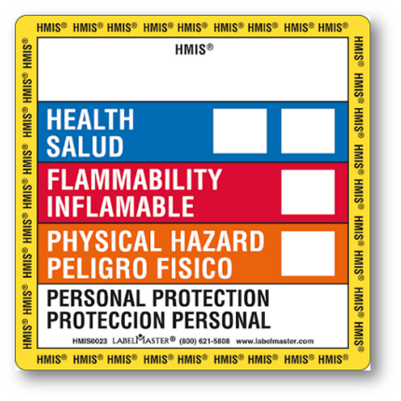
Chemical labeling
Maintained in legible condition
Secondary containers
Product identification
Hazard information
Protection

Slide 67

Safety data sheets
Each hazardous chemical/substance
Readily accessible
Chemical inventory cross-reference

Slide 68

Employee training
Initial assignment
Protective measures
Labeling
SDS
Additional information
Repeat/Refresher

Slide 69

Review and update
Periodically review program
New chemicals
New hazards
Remain current

Slide 70

Model Plans for Hazard Communication
https://www.osha.gov/sites/default/files/publications/osha3186.pdf

Slide 71

Everything you need
Presentations
Trainer manual
Whistleblower fact sheet
Job Safety and Health poster
Sample Hazard Communication Plan
Various other informational documents

Slide 72


