Slide 1
Presented by:
Deborah Shepherd
Teresa Grace

Slide 2
Agenda- What is your Vision of Success?
Understanding the Makeup of a Good Credit Score
Practice Buy Ins, Buy Outs, and Startups
Your Team
Financing a Veterinarian Practice

Slide 3
Associate? Partner? Owner? What is your “Why”?
Depending on what your “Why” is can help to determine your position, it all begins with the basics as your “Why” may change over time.
Associate:
9 to 5 position, no management responsibilities, lower bonus and or incentive
No funds needed to buy a practice, not building for retirement
Flexibility to practice in various locations and relocation

Slide 4
Partner / Owner
Partner
Share financial/ management responsibility
Have backup within the practice for time off, and shares your focus for growth
Divide profits and future growth with someone
Provides more work life balance
Owner
Responsible for all decisions and future growth
Greater benefit for retirement and sale of practice
Less work life balance
Reliance on your management team

Slide 5
What is credit?
A credit score (FICO score) is a numerical score credit reporting agencies assign to you. Lenders use these to measure “risk”.
*Determines the interest rate you pay for home mortgages, auto loans, credit cards, business loans, etc.
*Lenders use the scores to help determine if you are a good “risk” or not. This could make the difference between an approval or decline of a loan application.

Slide 6
The Reporting Agencies “Big 3”
Equifax-Beacon Score
Experian-Fair Issac Score
Transunion-Empirica Score

Slide 7
What does a credit score reflect?
Credit Score Range | Rating | What It Means
720 and above | Excellent Credit | Eligible for the most favorable interest rates and loan terms from lenders.
675 to 719 | Good Credit | May not qualify for the absolute best rates, but still likely to receive competitive loan offers.
620 to 674 | Fair Credit | Fewer loan options available; may face higher interest rates or stricter terms.
Below 620 | Poor Credit | Considered “sub-prime”; limited loan options and higher interest rates are likely.

Slide 8
Practices in Transition
Veterinarian practices experience ownership transitions due to a variety of factors. Buying and selling can take many forms.
Starting up a new practice
Involves the greatest risk unless part of a well-developed expansion plan.
Thoughtful business plan with professionally developed Performa helps mitigate the risk
Become a partner in an existing practice (buy-in)
Associate leading to a partnership
Ownership transition seamless to staff and to customers
Practice purchase (buy-out or acquisition) the practice at some point in the future.
Planned (practice succession plan)
Un-planned (death or disability)
Solo or with a partner
Ownership transition visible to staff and customers
.

Slide 9
Start with a Team of Trusted Advisors
Becoming a practice owner starts with identifying a team of professionals, each playing a critical role in the ownership process. There will be many questions needing answers prior to “jumping into” practice ownership. Below are some thoughts to consider:
How much is the practice worth and who’s licensed to render a reliable value?
What procedures will be provided and how much revenue can be derived from these procedures?
What are the geographic, demographic, and competitive considerations?
If you are looking at an existing practice, what is the existing fee schedule, and will patients be able to tolerate change?
And so on . . . .

Slide 10
What Makes Economic Sense?
Before you agree to become an owner, dive into the numbers (something an accountant can help you with).
Does the transaction you are analyzing make clear economic sense?
Is there sufficient cash flow to meet the overhead, debt service and to pay the new owner a reasonable return?
Are the revenue and expense considerations reasonable, in a reasonable time horizon, for the type of Veterinarian practice the new owner plans and is trained to practice?
Is the value of the practice professionally established and not just a simple “rule of thumb valuation”?

Slide 11
Your Professional Team!
It is important to have a team to assist you through the beginning phase and beyond. Start early to identify and select a team of trusted advisors you are comfortable working with and understand the Veterinarian business. Below is a list that may not be all inclusive.
Legal Counsel- Highly encouraged to have through the practice opening/transition and beyond
Agreement of Sale/Letter of Intent
Bill of Sale
Lease agreements (property and equipment)
Employment contract for Seller
Corporate Resolution
Planned exit strategies documentation
Financing Documents
And More . . .
Accountant/CPA- Help negotiate and determine if the numbers make sense if purchasing or starting a practice. May also provide referrals upon request.
Practice consultant/coach/broker- Assist with practice management aspects of the practice to include metrics, staff, processes, Human Resources, etc.
Financial services specialist- Loan, credit, accounts, processing services, insurance, etc.

Slide 12
Agreement of Sale
Although a seller’s attorney usually prepares this document, legal counsel that works for you can be of significant help.
Agreement of Sale is frequently similar but never exactly the same.
A legally binding contract that spells out all key points of the transaction.
Specifies the sales price of the practice.
Exhibits add detail to the contract-be as granular as possible.
Consider a host of variables, not all inclusive-
What happens with the Seller of the Practice is staying as an associate?
Can last months to years
Days/House/Compensation/Benefits
What happens with the Seller of the Practice not staying on?
How long before they leave?
What functions must they perform before they leave?
If the Seller’s spouse is an employee, how is that handled?

Slide 13
Phases of becoming an owner of a Veterinarian Practice
Phase I Finding your practice and negotiating terms
Phase II Documenting and financing your purchase
Phase III Taking ownership
Phase IV Creating an economically viable and sustainable practice

Slide 14
Financing Lender Documentation
Copy of detailed business plan including practice demographics (financial projections included with start-ups)
Copy of Dental license & Resume (CV)
Personal Financial Statement on each owner/guarantor
Three complete years of personal tax returns for each owner including all schedules and K 1’s
Copy of corporate Tax returns for the last three years of the seller
New Lease Agreement or Lease letter of intent to match the term of the financing
Evidence of life insurance, if required (loans $1,000,000 or higher)
Evidence of disability and malpractice insurance

Slide 15
Things to know about Loan Structure and Terms
How to determine the dollar amount of loan-
Is there an option of the loan being 100% financed?
Does the actual loan payment cash flow?
Will a down payment be needed if purchasing real estate associated with practice or lease?
Is working capital/line of credit needed to run the practice?
May depend on purchase price
Interest rate, fixed or variable, prepayment options
Term of the loan up to 15 years
Does the actual loan payment cash flow?
Down payment may be needed if purchasing real estate associated with practice or lease

Slide 16
Taking Ownership, the day has arrived
Loan signing- review all terms before hand with a commitment letter, legal document
Term sheets are not legal documents
Review everything with the attorney before you sign, to understand what you are signing
All bank accounts and Merchant account should be set up and ready to receive payments
You should have your checks for your operating account
Do you know how to work with the software of the office?

Slide 17
Working with your team for future success
Banker that understands the Veterinarian business and protecting your assets within the bank?
Do you have a program, which the bank offers for free as a business coach that is an outside advisor?
Do you have advisors that will help guide you once you are the owner and into the future?
Do you have a business plan on growing the practice now that it is yours? (Marketing / community involvement / referrals
Do you have an individual to help with HR issues, retaining employees, coaching, and the importance of understanding employee law?

Slide 18
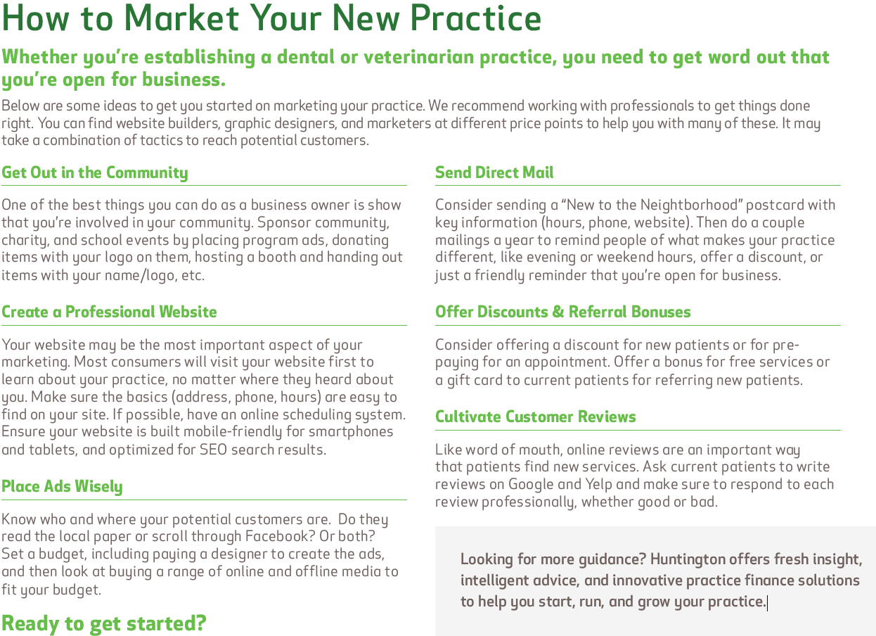

Slide 19
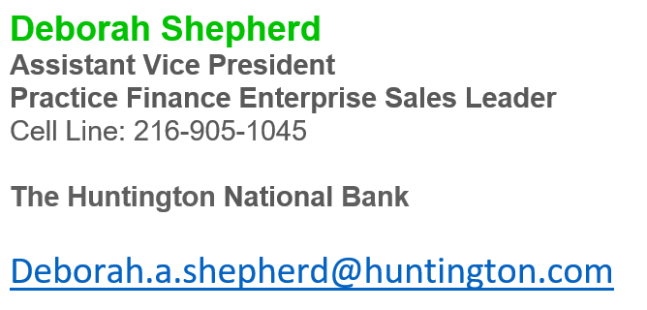

Slide 20
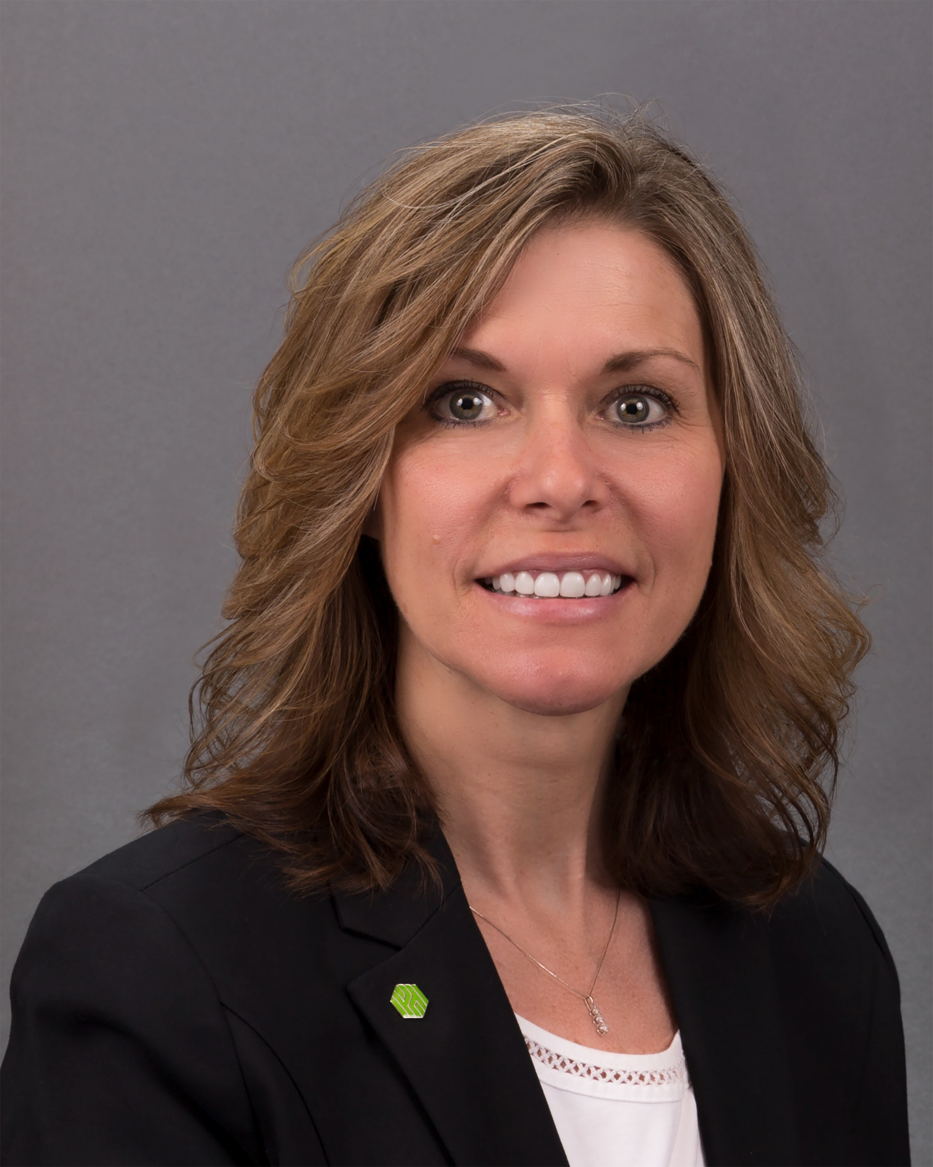
Teresa Grace
Assistant Vice President
Sr. Financial Pulse Specialist
Office: 248.655.5635
The Huntington National Bank
Teresa.L.Grace@huntington.com

Slide 21
