Slide 1
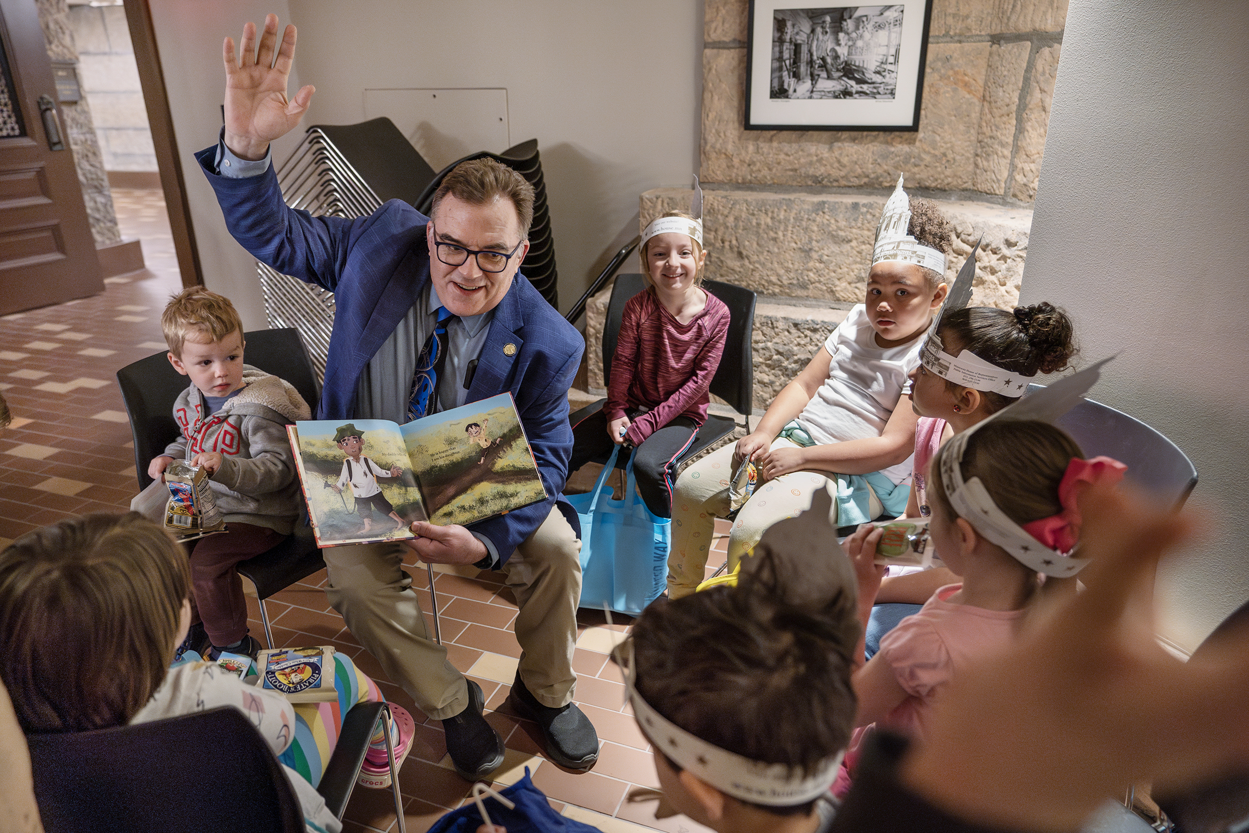
Communicating and Engaging with Legislators

Slide 2
Objectives
Understand the value and impact of advocacy
Build confidence when engaging with legislators
Hear directly from a legislator how advocacy influences policy
Prepare for effective conversations with legislators

Slide 3
Perceived Barriers
Government can be frustrating, complicated, hard to navigate
People have other demands and live very busy lives
People don’t believe their voice can make a difference
If you don’t speak up – others will, and you might not like the outcome
We have a lobbyist

Slide 4
The Role of the Lobbyist
Amplify clients’ voices with policymakers
Ensure decision-makers hear and understand all sides of an issue
Connect stakeholders to share information and develop solutions
Guide clients through the legislative and regulatory process
Advise clients on when and how to engage effectively
Track policy and legislative activity, alerting clients to relevant developments

Slide 5
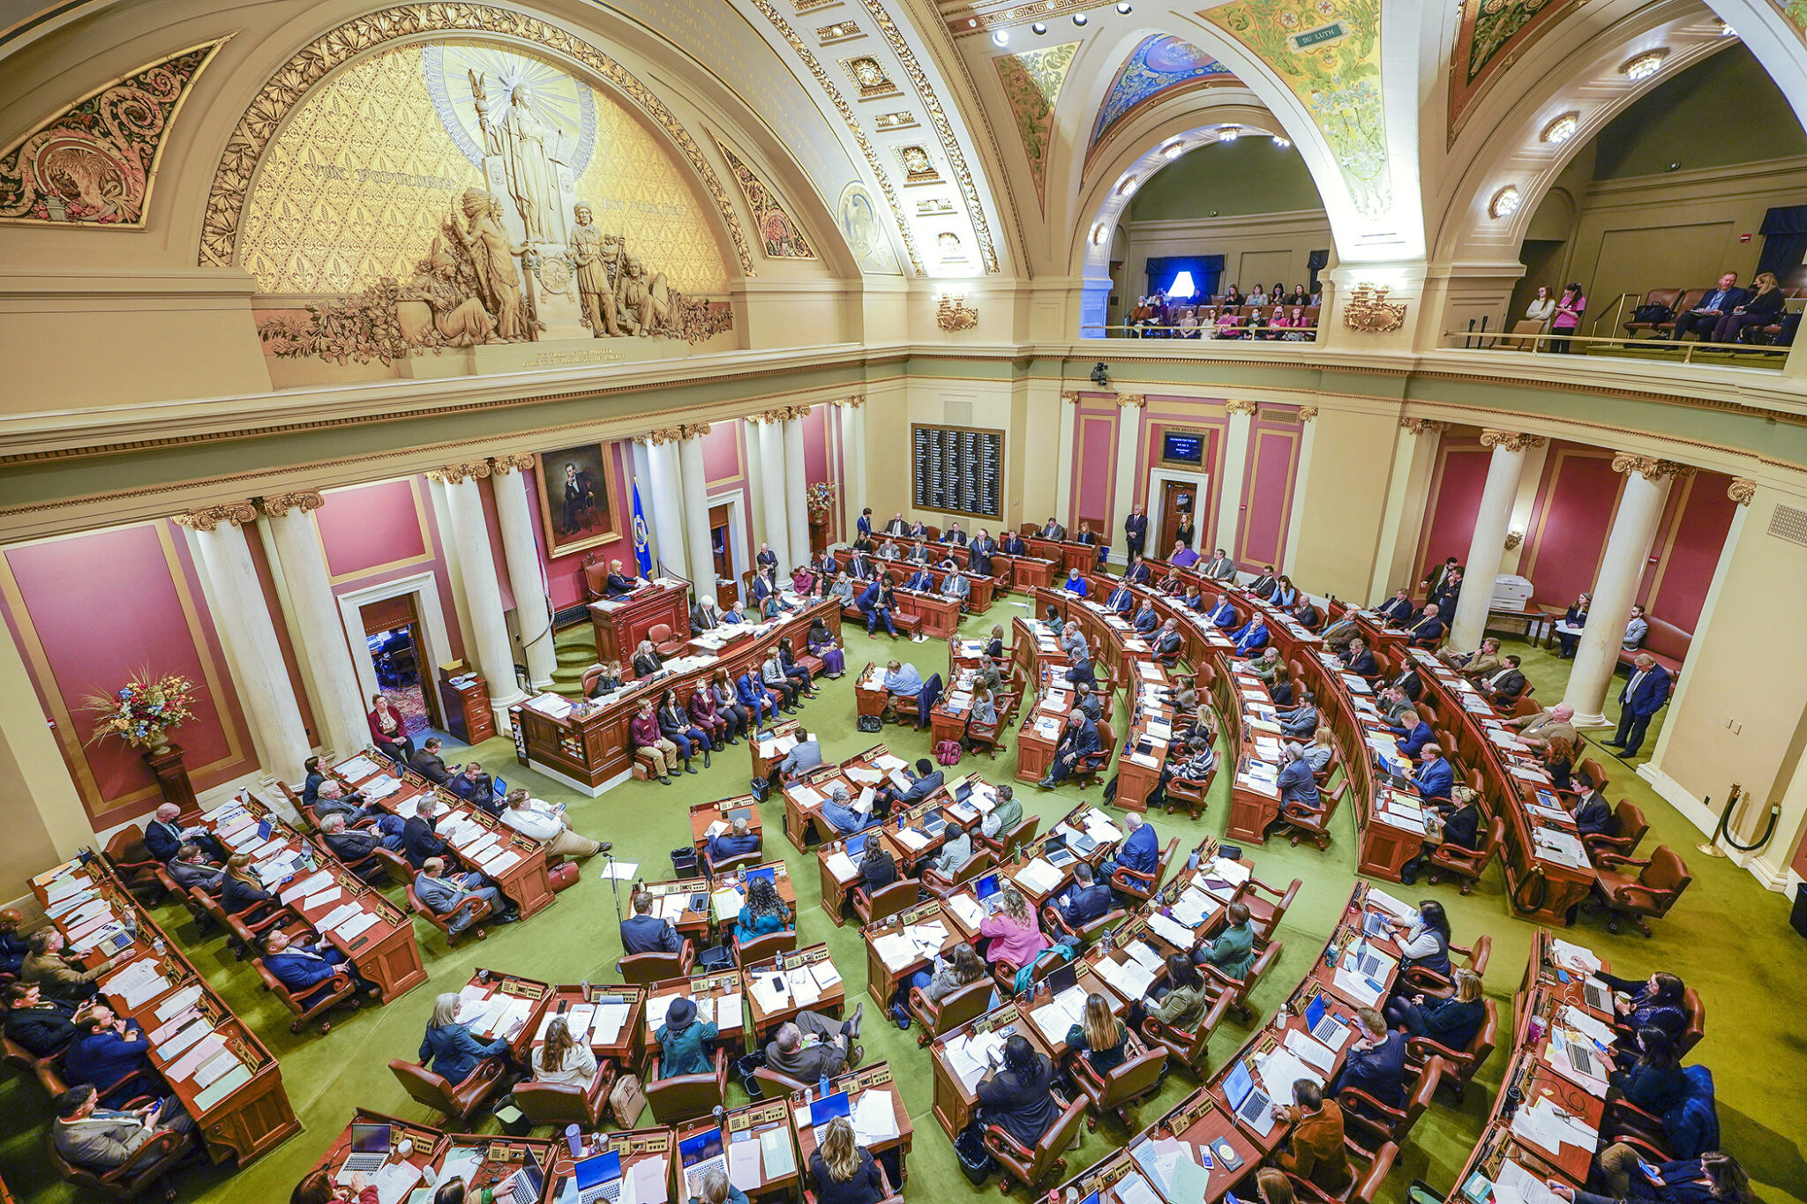
About Minnesota Legislators
Are regular people and lead everyday lives outside of the capitol
Work hard to get elected
Want to represent their communities
Have general knowledge on a wide range of issues
Have their own policy interests and respond to information uniquely
Have enormous demands on their time

Slide 6
Why Advocacy Matters
Legislators need information and expect to hear from constituents
Legislators can gain increased awareness and knowledge on issues
Legislators like to connect issues to real people
If you don’t speak up – others will, and you might not like the outcome
You can have an impact and be a resource

Slide 7
Ways to Engage with Legislators
Visits at their Capitol office
Participate in days at the capitol
Host EVENTS, visits and meetings in their district
Attend legislative town hall events hosted by elected official
Connect with them at community events
Contact them about a specific issue
Involve yourself in your professional organization

Slide 8
How to Connect

Slide 9
Preparing to Meet
Learn about your legislators’ background
www.leg.mn.gov
See what committees they serve on
Know bills they have authored/co-authored
Read/sign up for their newsletter
Search the internet/social media to find the issues they care about
Ask your network if they have relationships with the legislator

Slide 10
Preparing to Meet
Plan for logistics
Set up the meeting in advance
Be flexible with timing and location
Confirm the appointment and be punctual
If you cannot meet the legislator, meet with their relevant staff

Slide 11

Preparing for a Successful Discussion
What is your goal?
Raise awareness on your issue or concern?
Show what is happening in your community?
Ask the legislator to support or oppose a specific bill?
Get to know the legislator?
Remember:
Give your message in a positive way
Stay on message and be succinct
State all the facts but share a personal story or example

Slide 12
Engaging with Legislators
Share your connection to the elected official’s legislative district
Explain why the issues are important to their community
Let the legislator know what they can do to support your issue
Notes:
Add in testimony

Slide 13
Engaging with Legislators
Stay away from jargon, acronyms and technical details
You’re not expected to know everything - follow up with information later
Provide straight-forward handouts
Follow up with a thank you note
Notes:
Add in testimony

Slide 14
Remember
Legislators are ordinary people with everyday experiences, responsibility, and concerns
Connect throughout the year
Be patient and don’t give up
What might seem like a simple interaction could have a big impact
Maintaining the relationship is important. It’s not just one and done

Slide 15

Looking to 2026
February 17, 2026
Not a budget-setting session
Budget outlook not promising
MASE Day at the Capitol – March 4, 2026
Seclusion Working Group
Developmental Delay Working Group
Blue Ribbon Commission on Special Education

Slide 16
Thank you!

