Slide 1
MDE Office of Special Education MAASE Updates
April 11, 2018
Teri L. Chapman, Director
Janis Weckstein, Assistant Director

Slide 2
Annual Public Reporting
The federal regulations implementing the Individuals with Disabilities Education Act (IDEA) require annual public reporting on the performance of each local education agency on the targets established in the State Performance Plan/Annual Performance Report (SPP/APR).
For a two-week period beginning approximately May 9, 2018, local educational agencies, public school academies, and intermediate school districts will be able to preview district level data.
By June 1, 2018, the district level data will be publicly available at: www.mischooldata.org

Slide 3
IDEA Part B LEA Maintenance of Effort
Completing 2015-16 Compliance
Coming mid-May 2016-17 Compliance
Completing 2-17-18 Eligibility
Coming mid-June 2018-19 Eligibility

Slide 4
FINANCE CONTINUED
The IDEA 2018-19 Flowthrough application will be available in MEGS+ in the first week of May with a due date of July 1, 2018.
The new ISD General Supervision Grant application will be available in MEGS+ on May 14, 2018 with a due date of July 1, 2018.
There will be a Webinar on April 18th at 2:30 PM. Those interested can contact Scott Kemmer-Slater at KemmerSlaterS@Michigan.gov for details.

Slide 5
Medicaid
Regional Meetings:
MDHHS/MDE/PCG
To determine regional and state priorities and needs for SBS Medicaid
To provide support and assistance to SBS Medicaid programs per the Interagency Agreement
Encourage conversation and new connections while problem solving
Build relationships and provide opportunities to give regions a voice

Slide 6
Medicaid continued
Those ISDs completed:
Saginaw ISD March 22nd
Huron ISD March 22nd
Washtenaw ISD February 20th
Wayne RESA February 20th
Upcoming:
Van Buren ISD April 20th
Ottawa Area ISD April 20th
Traverse Bay Area ISD (TBD)
COOR ISD (TBD)
Charlevoix-Emmet ISD May 15th
Eastern Upper Peninsula ISD May 3rd
Marquette-Alger May 4th

Slide 7
Medicaid continued
School Based Services Summer Conference
August 16th & 17th Shanty Creek
Details coming…

Slide 8
OSE Staff Updates
Name change!
Ashley Kemmer now Ashley Reed
New Staff
Ruth Oda, Administration Unit, Secretary 9
Debra Schultze, Performance Reporting Unit, Secretary 9

Slide 9
MI-Access Updates
Thank you for submitting your 1% justification forms. We have received data from all ISD, with just a few LEAs outstanding.
All justification forms are being reviewed and a response with recommendations will be sent back to the contact listed on each ISD justification summary.
Other updates are included in What’s New?

Slide 10
System Coordination and Alignment Creating a New System of Support
Understanding Michigan’s Top 10 in 10

Slide 11
Theory of Action

Slide 12
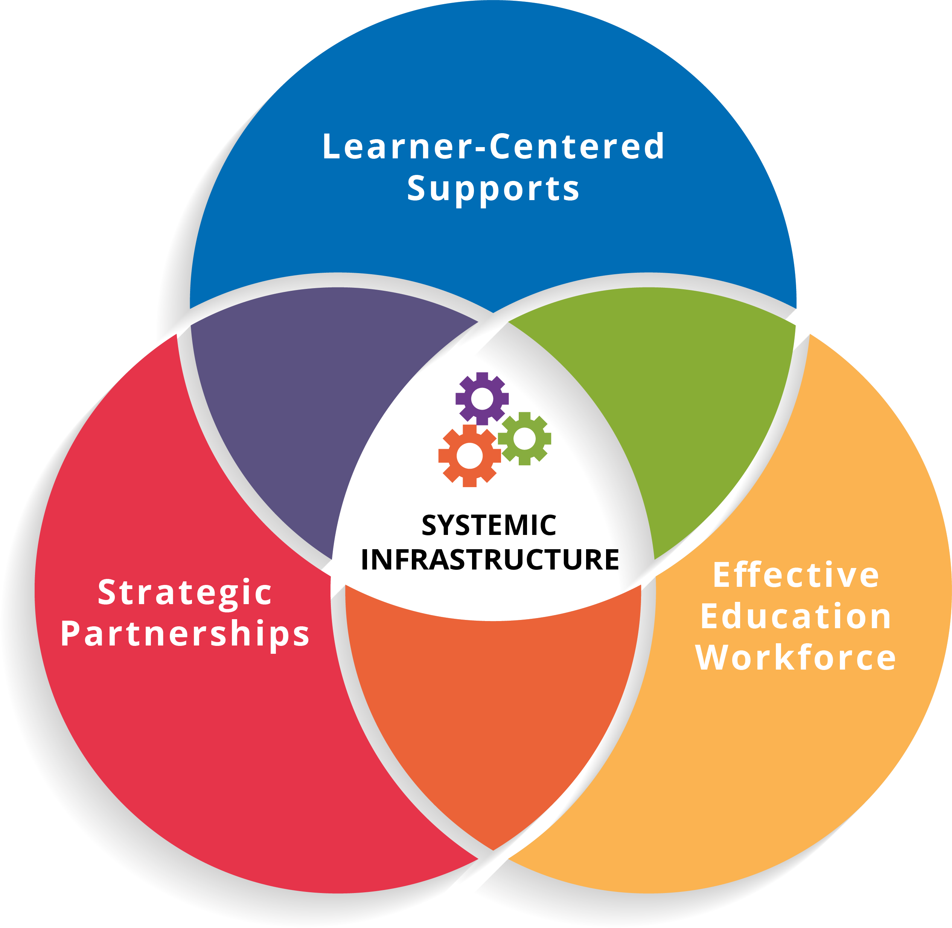
The State Systemic Improvement Plan (SSIP) Theory of Action was embedded in the Top 10 in 10 Strategic Goals (goal 7) and the center of the Focus Area Framework

Slide 15
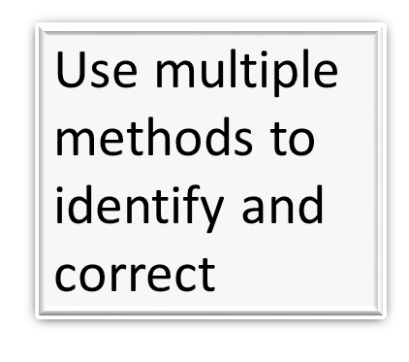
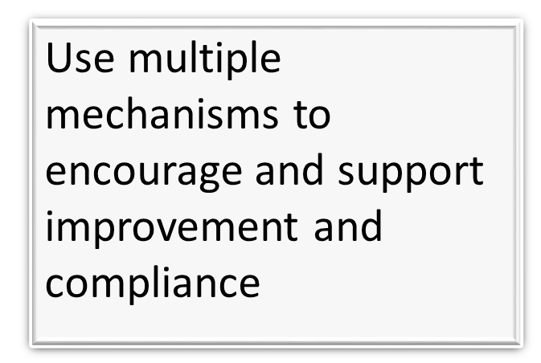
Effective Systems of General Supervision

Slide 16
Components of General Supervision and IDEA Accountability Systems
State Performance Plan, including the State Systemic Improvement Plan
Professional Learning and Development and Technical Assistance
Policies, Procedures, and Effective Implementation of Evidence-based Practices
Data on Results
and
Processes
Fiscal Management and Accountability
Integrated Monitoring Activities
Effective Dispute Resolution
Improvement, Correction, Incentives, and Sanctions
Original Source: Concepts of General Supervision: Accountability for Implementation & Improved results. National Center for Special Education Accountability Monitoring (NCSEAM), 2007. Adapted and Updated Source: Jane Nell Luster, Ph.D., Com-Link, LLC
Notes:
The State Performance Plan or SPP has indicators of both results and compliance. Note the pillars in the middle of the graphic are predicated on personnel having learned and had their knowledge and skills developed of procedures and practices, to use data, be fiscally responsible, and integrate these components into the monitoring activities. The pillars are also grounded in the protection of the individual rights of parents and students with disabilities through effective dispute resolution processes, as well as improvement and correction activities that include incentives and, as necessary, sanctions.
NCSEAM cited the monitoring definition from What is Monitoring and Evaluation that says, monitoring is “a continuing function that uses systematic collection of data on specified indicators to provide management and… intervention with indications of the extent of progress and achievement of objectives and progress in the use of allocated funds.”

Slide 17
The Sub-recipient Role
Receipt of IDEA Part B Funds
Obligation to Ensure FAPE
General Supervision System
General Supervision
Grant
Notes:
Teri & John
The GSG is meant to enhance or provide supplemental funding (separate from flow-through funding they already receive) to develop and implement a system of Gen Sup at ISD. Increase capacity to ensure FAPE.

Slide 18
New Grant for ISDs
Support to design the ISD system of General Supervision
Initial development of a plan to implement a General Supervision System at the ISD
Provide a mid-year progress report on the development and implementation of the General Supervision System plan (formative)
State the selected priority area
Describe the data that will be used as a measurement to demonstrate improved student outcomes (summative)
Notes:
Teri
Identify priority {area of need/focus – discipline, etc}
Meaningful/Purposeful
What process or activity(ies) will be used to monitor the progress of the implementation of this plan?
What data will be used to monitor improved student outcomes? This can be tied to SPP Indicator data – long term progress
This grant is to be used for the purpose of building their general supervision system.
This system will then be in place to address other general supervision priority areas moving forward.

Slide 19
Timelines
Grant template released – March 30, 2018
Webinar – April 18, 2018
ISD Director Meeting – May 9, 2018
Grant Application live in MEGS+ – May 14, 2018
Application due – July 1, 2018
Funds – available September 1, 2018
Mid-year Progress Report – Due January 31, 2019
End of Year Report – Due August 29, 2019
Notes:
Teri & John (Funds available @ 100% at grant open on 9/1/18)

Slide 20
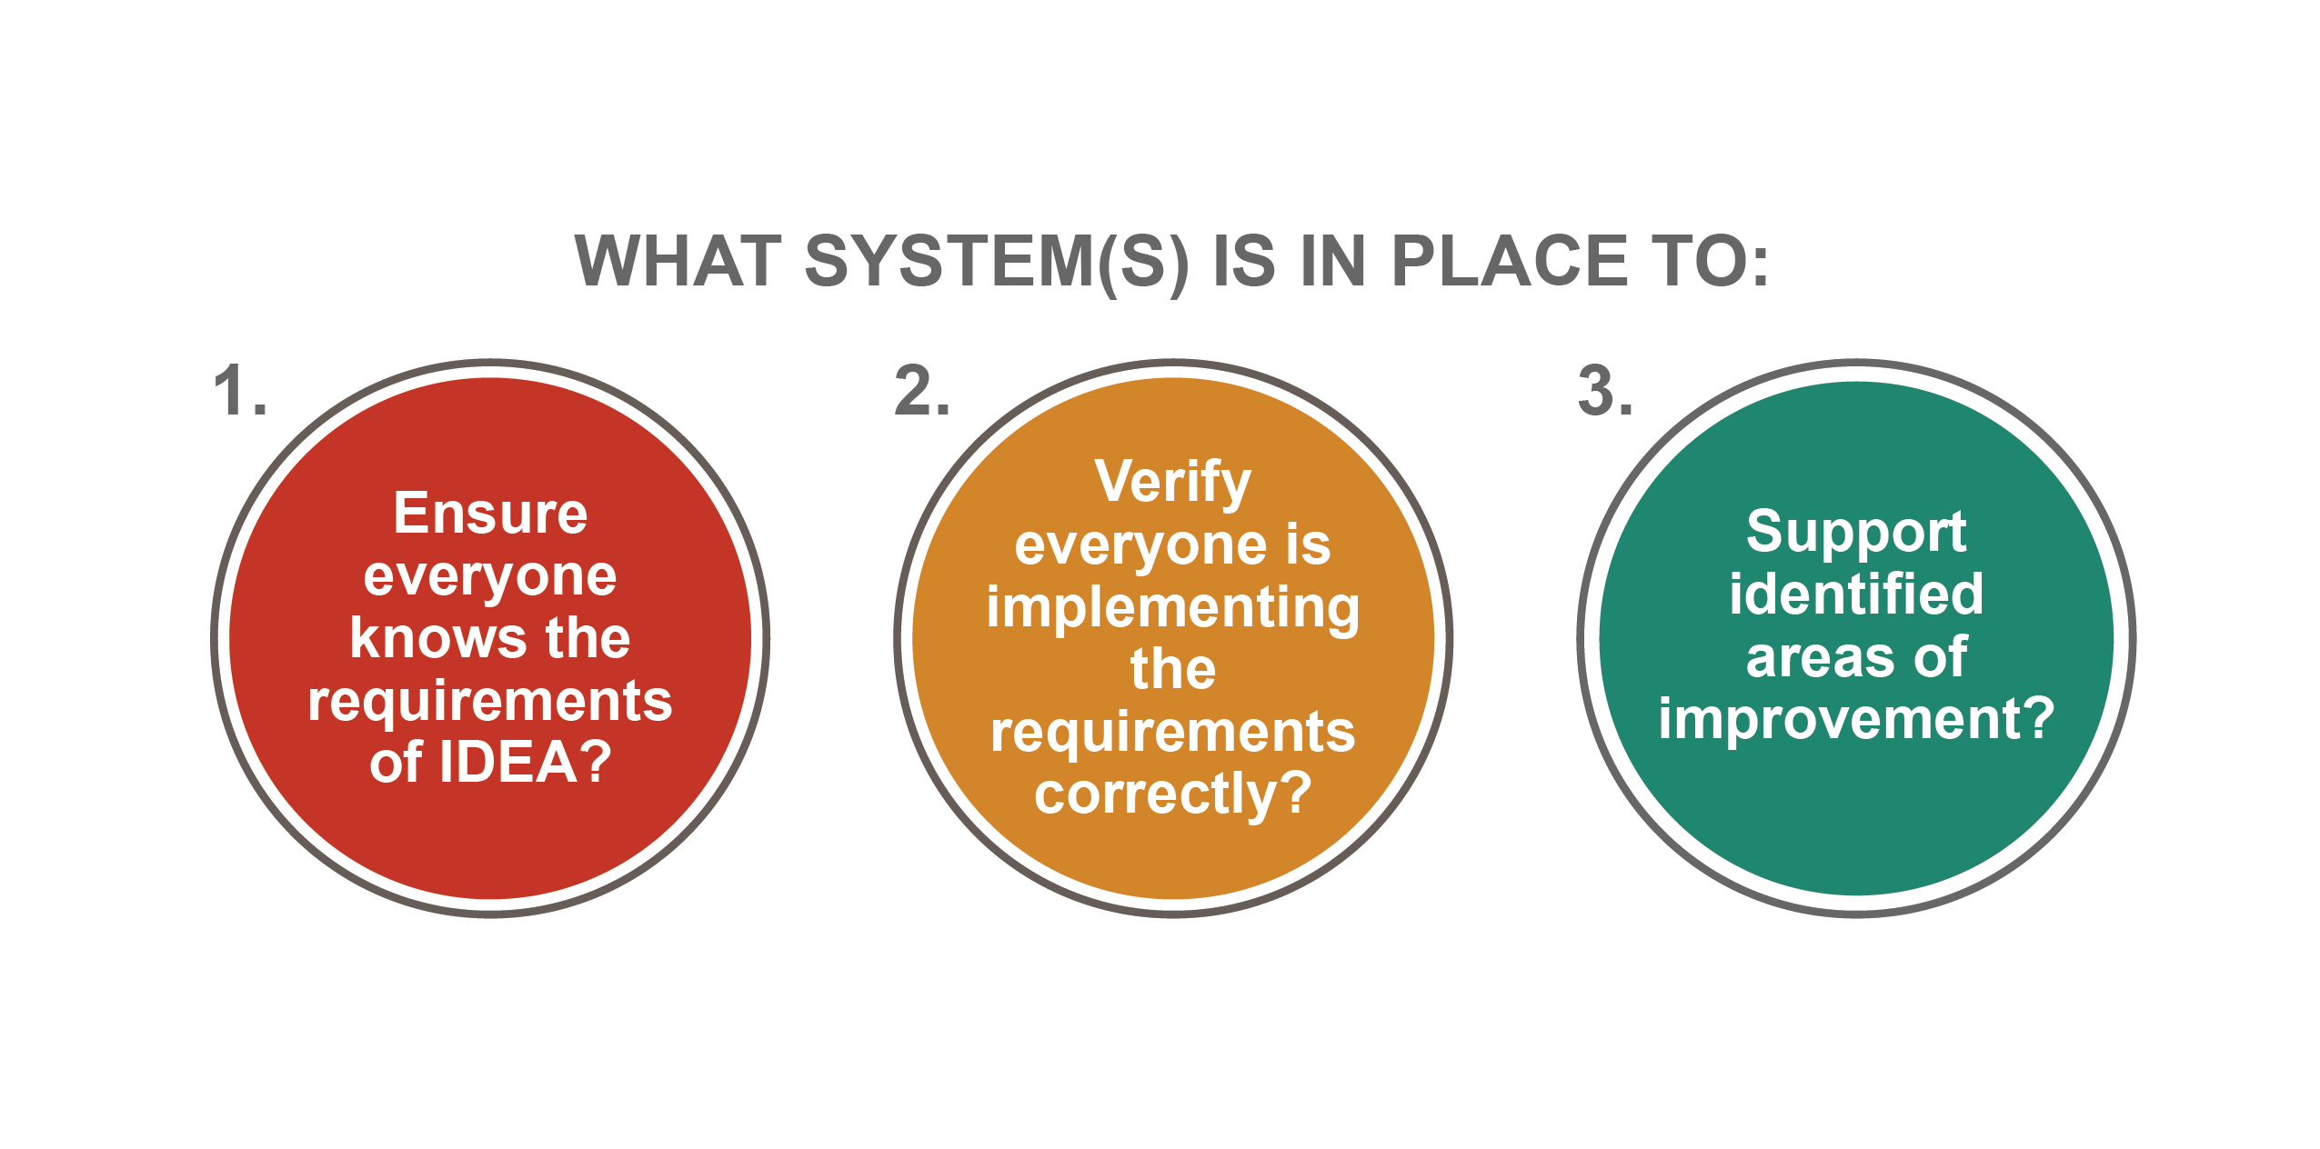
The Three Questions…at every level
Notes:
To start, at each level, leaders must ask these three questions. What system(s) is (are) in place to:
Ensure everyone knows the requirements of IDEA?
Verify everyone is implementing the requirements correctly?
Support identified areas of improvement?

Slide 21
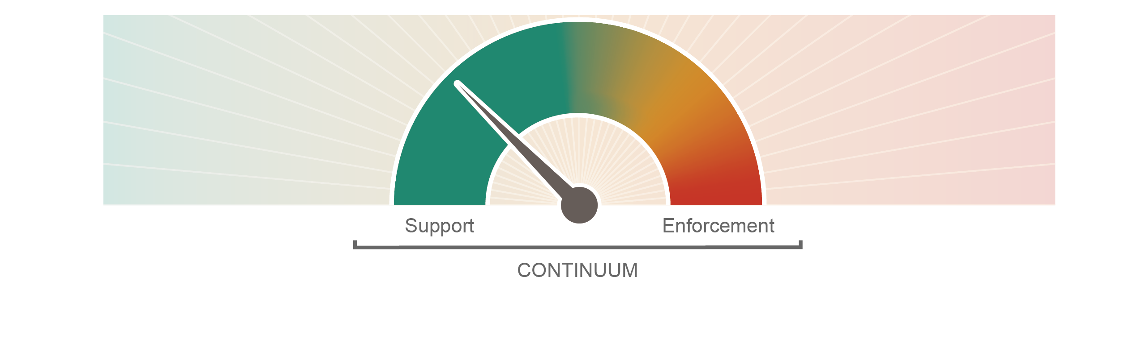
Ensure a Provision of a FAPE
Notes:
However, the state must do more to support all partners in understanding the requirements. In other words, systems were built to respond to problems rather than prevent them. The OSE must maintain compliance efforts, and in collaboration with partners across the state, build a system that is intentionally designed to ensure everyone serving students with disabilities understands all IDEA requirements and implements them correctly. This proactive work will also include identifying and supporting best practices related to critical requirements, such as least restrictive environments.
At all levels, we strive to have a continuum of support and enforcement. At the state level, we have spent much of our time on the enforcement side. As we work to clarify roles and assess systems, a major component of that work will be identifying resources to provide more support around the requirements and opportunities for improvement. At the state level, we will be collecting those resources and sharing them broadly.

Slide 23
MDE OSE
Contact us!
Email us!
OSE Information Line
1-888-320-8384
Monday-Friday
9:00 AM-4:00 PM
mde-ose@michigan.gov
Teri L. Chapman, Director
517-335-0455
chapmant2@michigan.gov
Janis Weckstein, Asst. Director
517-241-4521
wecksteinj@michigan.gov

