Slide 1
MDE Office of Special Education MAASE Updates
October 10, 2018
Joanne Winkelman, Ph.D., Supervisor
Jessica Brady, J.D., Supervisor

Slide 2
Federal Updates

Slide 3
Office of Special Education and Rehabilitation Services (OSERS)
New Framework
Office of Special Education and Rehabilitative Services (OSERS) Assistant Secretary Johnny Collett has released a framework that communicates the way OSERS will focus its work to advance the Secretary of Education’s priorities and continue to make progress toward achieving its mission to improve early childhood, educational, and employment outcomes and raise expectations for all people with disabilities, their families, their communities, and the nation.

Slide 4
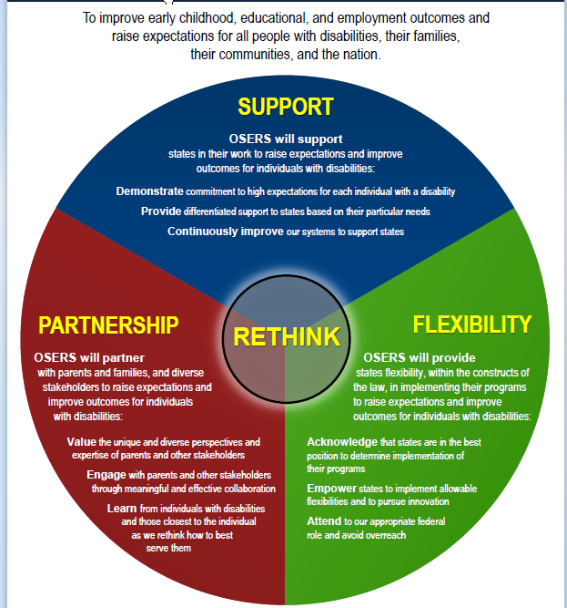

Slide 5
Every Kid in a Park
Interior Secretary Ryan Zinke recently authorized the “Every Kid in a Park” program for another year. Therefore, fourth-graders nationwide may now obtain a pass for free access to all federal lands and waters. The pass is valid for the 2018-19 school year, granting entry for one student and up to three accompanying adults -- or an entire car for drive-in parks -- at more than 2,000 national parks, forests, wildlife refuges, and marine sanctuaries. (Note: The web site offers educators and parents activities, trip planning books, safety and packing tips, and other helpful information.) Read more.

Slide 6
Department Updates

Slide 7
MDE Annual Review
The 2017-18 MDE Annual Review and accompanying Appendix: Measuring Our Progress is available
For an electronic copy visit https://www.michigan.gov/documents/mde/2017-18_MDE_Annual_Review_and_Appendix_631432_7.pdf

Slide 8
MDE Priorities
In support of the Top 10 in 10, the following are the established priorities for MDE
Prenatal-8 years old (P-8); Lead is Scott Koenigsknecht
Focusing on the Whole Child; Lead is Kyle Guerrant
Literacy; Lead is Venessa Keesler
School Visits
Each department administrative lead will visit 5-7 school districts in 2018-19

Slide 9
2018 Part B Results-Driven Accountability Matrix
Results and Compliance Overall Scoring
Results 8 of 24 Points 33.33%
Compliance 17 of 20 Points 85%
“Needs Intervention” in implementing the requirements of IDEA

Slide 10
The MDE Response
Improvement planning is in process
Opportunity!
This has been a long time coming and is systemic
Across multiple offices of MDE
Stakeholder informed
Multi-dimensional approach to solutions
Every level of the educational system has a responsibility

Slide 11
Seclusion/Restraint Data
Public reporting of data early this fall
Type of data to post is still being determined
Approximately 161 districts reported data
Students with Disabilities (seclusion and restraint data)
Students without Disabilities (seclusion and restraint data)
State level v. ISD level v. local district level?
Concerns and Challenges

Slide 12
Adverse Childhood Experiences (ACEs)
NEAR Training (Neuroscience Epigenetics Adverse Childhood Experiences Resilience)
Relationship of Childhood Abuse and Household Dysfunction to Many of the Leading Causes of Death in Adults
The Adverse Childhood Experiences (ACE) Study
How can state agencies supporting children and families incorporate this understanding in a coordinated approach?

Slide 13
Office of Special Education Updates

Slide 14
New staff!
Program Finance
JL Purves
Shawn Sinawe
Program Accountability
Nicole Dungey
Michigan School for the Deaf
Charles Thomas, Campus Manager
Emily Radewahn, Dormitory Manager

Slide 15
U. S. Department of Education has announced…
Michigan’s Integrated Behavior and Integrated Support Initiative (MIBLSI)has been awarded the School Climate Transformation Grant once again
The funding period will be through September 2023
To assist state agencies in developing, enhancing and expanding their statewide systems of support for, and technical assistance to, local educational agencies (LEAs) and schools implementing an evidence-based, multi-tiered behavioral framework (MTBF)
e.g. Positive Behavior Interventions and Supports (PBIS), for improving behavioral outcomes and learning conditions for all students.

Slide 16
OSE Grant Funded Initiatives
Alt+Shift
With a focus on collaboration and impact, Alt+Shift, encompassing Michigan's Integrated Mathematics Initiative (Mi)2, offers professional learning, including training, technical assistance, and co-constructed implementation planning, that strives to shift adult mindsets and provide alternative options to improve outcomes for every student. Alt+Shift has been in place since 2002.
Director: Jeff Diedrich, jeff.diedrich@gmail.com

Slide 17
OSE Grant Funded Initiatives
Michigan Alliance for Families
Michigan Alliance for Families works through regional sites that offer individual support, mentoring, and learning opportunities for parents of children with disabilities. Education partners and parent mentors are available to deliver supports and services to parents in their area. Michigan Alliance for Families has been in place since 2002.
Director: Sherri Boyd, Executive Director, The Arc Michigan, sherri@arcmi.org

Slide 18
OSE Grant Funded Initiatives
MIBLSI
Michigan's Integrated Behavior and Learning Support Initiative (MiBLSI) helps districts implement an integrated behavior and reading Multi-Tiered System of Support (MTSS) in its schools. The MTSS helps students become better readers and use appropriate behavior, which results in increased student success in the school and the community. MiBSLi has been in place since 2002.
Director: Steve Goodman, Ph.D., sgoodman@miblsimtss.org

Slide 19
OSE Grant Funded Initiatives
Michigan's Integrated Mathematics Initiative
Michigan's Integrated Mathematics Initiative (Mi)2 assists the state in creating a cohesive and collaborative system of support and professional development among existing mathematics resources. The initiative identifies and promotes factors that facilitate improved outcomes for all students in mathematics. Mi2 has been in place since 2002
Director: Jeff Diedrich, jeff.diedrich@gmail.com

Slide 20
OSE Grant Funded Initiatives
Michigan Special Education Mediation Program
The Michigan Special Education Mediation Program (MSEMP) provides trained, neutral facilitators to assist with individualized family service plan (IFSP) meetings, IEP team meetings, and resolution sessions. MSEMP also offers various workshops on special education related topics, including conflict resolution. MSEMP has been in place since 2000.
Director: David Gruber, resolve@drer.org

Slide 21
Statewide Autism Resources and Traning
The Statewide Autism Resources and Training (START) supports the education and transition needs of students with Autism Spectrum Disorders (ASD). START provides technical assistance, including year-long intensive training, at the district level to implement best practices for students with ASD. START has been in place since 2002.
Director: Amy Matthews, Ph.D., matthewa@gvsu.edu

Slide 22
Upcoming Travel
National Association of State Directors of Special Education (NASDSE) Annual Business Meeting and Conference
Omaha, NB
October 6-9, 2018
National Indian Education Association (NIEA) Convention and Business Meeting
Hartford, CN
October 9-13, 2018
National Center for Systemic Improvement (NCSI)
Phoenix, AX
October 23-25, 2018

Slide 23
Part C
Vanessa Winborne

Slide 24
Section 54d of the State School Aid Act for Early On® - Summary
$5M state funds for Early On (Allocated to Intermediate School Districts (ISDs) using the same formula as the federal IDEA Part C funds)
Increase Early On services and resources
Ensuring appropriate levels and types of services
Ensuring services are delivered by qualified personnel
Must meet the requirements of the Early On Michigan State Plan
Must not be used to supplant existing services or resources
Capture of Medicaid funds to support Early On early intervention services to the extent possible
http://eotta.ccresa.org/ (Recorded webinar detailing application specifics)
Notes:
Vanessa
Listed on this slide are the main points pulled from Section 54d of the State School Aid Act. (review bullet points)
Section 54d of the State School Aid Act is new this year and provides $5M in state funding for Early On. The funds are to be distributed to ISDs using the same formula as used for the federal Part C funds.
The language of the legislation is very clear that these funds are intended to increase Early On services. It makes mention of both levels and types of services. Along with increasing services, the legislation talks about ensuring delivery by qualified personnel. Any use of Section 54d funds must meet the requirements of the Early On Michigan State Plan.
Included in the legislation is a clause regarding non-supplanting. Guidance is being developed regarding how this requirement will be implemented and monitored. Section 54d funds cannot be used in place of any other funds (federal, state or local) that have been used previously to support Early On. SSAA Section 54d funds can be used to cover the additional cost of increasing the FTE or number of hours for an Early On provider. SSAA Section 54d funds cannot be used in place of local funds that an ISD has used in previous years to support the local Early On system. ISDs will be expected to continue to maintain use of all other state and local funds previously used for supporting the local Early On system. The total funds from all sources expended by the ISD during the 2018-19 program year will need to be increased from the total expended during the 2017-18 program year by at least the amount expended from funds allocated by SSAA Section 54d. Monitoring for compliance with this non-supplanting requirement will be tied to the Part C Level of Effort monitoring currently being done using the Financial Information Database (FID) and MEGS+.
Another clause in the legislation talks about capturing Medicaid to the extent possible. A workgroup of the MICC Fiscal Ad Hoc Committee has formed around Medicaid and Part C. This workgroup is exploring the alignment of Part C and Medicaid. Watch for guidance and tools to support capture of Medicaid for Part C children.

Slide 25
Contact Us!
OSE Information
OSE Administration Team
888-320-8384
Monday-Friday
9:00-4:00
Email Us!
mde-ose@michigan.gov
Teri Chapman, Director
chapmant2@michigan.gov
Jan Weckstein, Assistant Director
wecksteinj@michigan.gov
Joanne Winkelman, Supervisor
winkelmanj@michigan.gov
Jessica Brady, Supervisor
bradyj@michigan.gov
John Andrejack, Supervisor
andrejackj@michigan.gov

