Slide 1
MAASE
October 11, 2017
MDE
Office of Special Education

Slide 2
Teri Chapman, Director

Slide 3
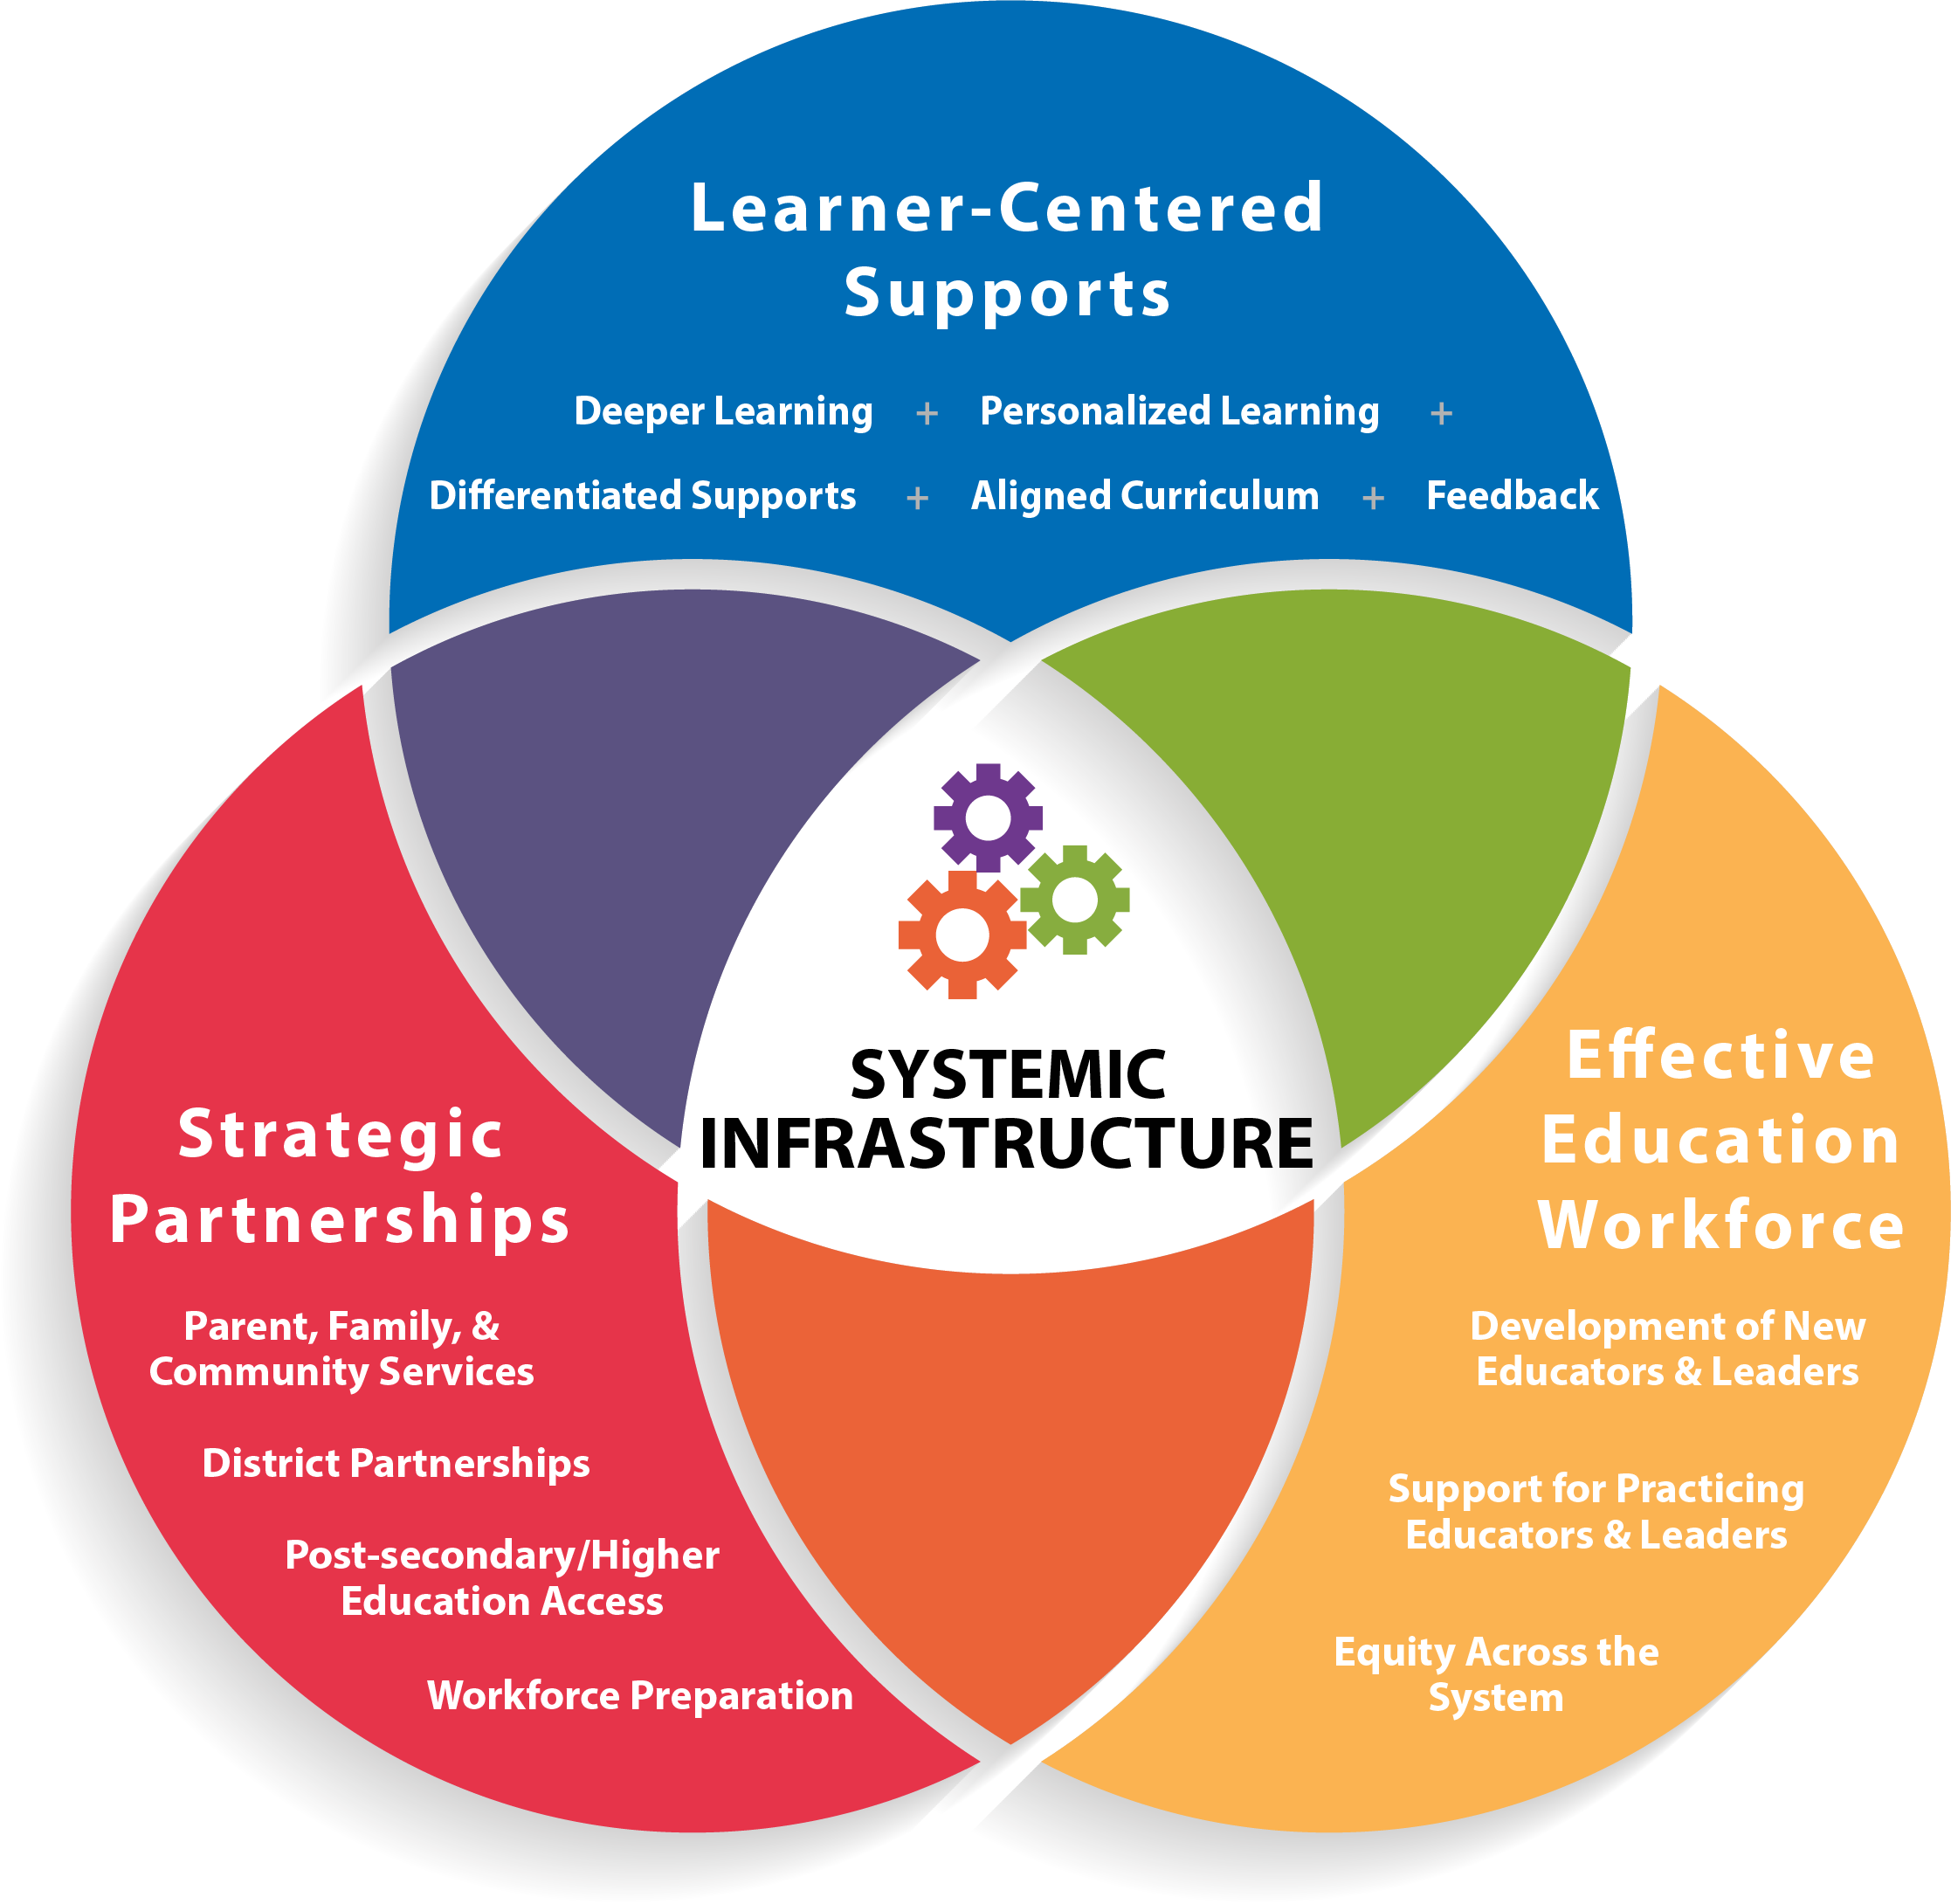
Focus Areas Components
Notes:
Strategies for each focus areas -- includes strategies

Slide 7
New Accountability System Design
Jane Nell Luster, National Technical Assistance Consultant
Reviewed General System Components
Discussed SEA monitoring obligations
Forecasting the design work for future accountability system
Next steps
Return visits throughout 2017-18 to meet with various OSE staff, as well as PSC to incorporate Catamaran
Alignment with coordinated technical assistance resources for improvement

Slide 8
ISD Directors’ Meeting
September 13th at the Kellogg Center
Framing the Work/Setting the Context/Systems Alignment Effort
Top 10 in 10
Way of Work
OSE accountability system design
Data Exploration
Sample of 6 SPP indicators
LEA and ISD aggregate scores provided
Grounding Assumptions Activity
Addresses adaptive challenges in implementation
New Accountability System

Slide 9
Janis Weckstein, Assistant Director

Slide 10
August 2017 OSE Information Line Data
Total Calls: 181
100 Parents/Grandparents
46 School Personnel
7 Government Employees
7 Physician’s Office
19 Other/Unknown
2 Advocates
Common Topics
Teacher Certification
Seclusion and Restraint
Child Find (ages 3-5 years old)
Placement
Complaint Information
Rule Interpretation
Schools of Choice
Suspension/Expulsion/Discipline
Home School/Nonpublic

Slide 11
Family Matters Overview
New family resource program rolled out this fall
Response to parent engagement recommendation in the Special Education Task Force and need for family resources
Outreach effort by the Michigan Department of Education Office of Special Education
Increase transparency from the OSE to parents and families
Availability of resources to parents and families
Special education information will be both distributed and accessible online
Working with the Michigan Alliance for Families to assure no duplication

Slide 12
Family Matters Resources
Family Matters web page (accessible from OSE web page).
Family Matters Fact Sheets related to special education topics--grouping in future.
Family Matters Updates (distribution targeted every 2-3 months to begin in January 2018)
Family Matters one-page flyer describing resources
Additional resource links and references on material produced
Opt-in for electronic communication from MDE OSE to receive Family Matters newsletters and other communications (link to sign up is on the Family Matters web page); distribution currently being created.
MDE, Office of Special Education

Slide 13
Family Matters Fact Sheets
Sample: Procedural Safeguards
Fact Sheet
Goal: publish 2-3 per month over the next year

Slide 14
Family Matters Fact Sheets
Published
In-Process
Confidentiality and Privacy (FERPA)
Educational Placement and LRE
Family Matters Overview
Free Appropriate Public Education (FAPE)
Individuals with Disabilities Education Act
(IDEA)
Procedural Safeguards
Special Education Process
504 Plans
Advocacy
IEPs
Seclusion and Restraint

Slide 15
Family Matters Next Steps
2017
Build distribution lists/listservs
Communication with internal and external agencies
Create, review and finalize content for fact sheets
Continue adding fact sheets and resources to web page
Spanish and Arabic fact sheets now available

Slide 16
MiEducator Showcase Website
Part of Michigan’s Top 10 in 10 Strategic Plan to support educators in sharing and collaborating on what is working for their learners
Peer-to-peer hub where Michigan educators can learn about successful practices and how they are being implemented across the state
MDE is recruiting educators to submit and showcase their existing high quality practices to the site
Share what’s working for their learners
MDE is not vetting the content of the practices. The MDE’s only role is to ensure the submitted practices are complete and appropriate to share.
Instructions and tools on how the showcase works and how to submit promising practices

Slide 17
Guidance for submission
Evidence, preferably with data, on how the practice has excelled your learners
Details of your situation that drove creation or implementation of the practice, in addition to challenges and problems you sought to solve
Details on how the practice was implemented
Details of lessons learned or planned improvements
Information of any resources to share with other educators
Website:
www.mi.gov/MiEducatorShowcase

Slide 18
Michigan Alliance for Families
Promotional campaign to begin October 2017
Target audience: Families
MAF as a resource support and family mentoring/advocacy
Billboards, TV spots, Facebook promotion and other social media, written communication for statewide distribution
PBS
Local news stations

Slide 19
MDE OSE
Contact us!
Email us!
OSE Information Line
1-888-320-8384
Monday-Friday
9:00 AM-4:00 PM
mde-ose@michigan.gov
Teri L. Chapman, Director
517-335-0455
chapmant2@michigan.gov
Janis Weckstein, Asst. Director
517-241-4521
wecksteinj@michigan.gov

