Slide 1
Federal and state updates
Maase membership meeting
June 14, 2017
Teri L. Chapman, Director MDE OSE

Slide 2
Federal Update
United States Department of Education (USED)
Office of Special Education Programs (OSEP)

Slide 3
Hiring Announcement
U.S. Secretary of Education Betsy DeVos Announces Additional Senior Staff Hires
Assistant Secretary for The Office of Special Education Rehabilitation Services (OSERS) nominee Kimberly Richey
  Attorney who specializes in education law and policy development, and government affairs
  See more at: https://www.nsba.org/staff/lucy-gettman#sthash.UKtQoyCP.dpuf
  Her nomination must be approved by Congress

Slide 4
New IDEA Website!
U.S. Department of Education Launches Revamped IDEA Website
Please visit the website at https://sites.ed.gov/idea/?utm_content&utm_medium=email&utm_name&utm_source=govdelivery&utm_term
New resources and events!

Slide 5
MDE Update

Slide 6
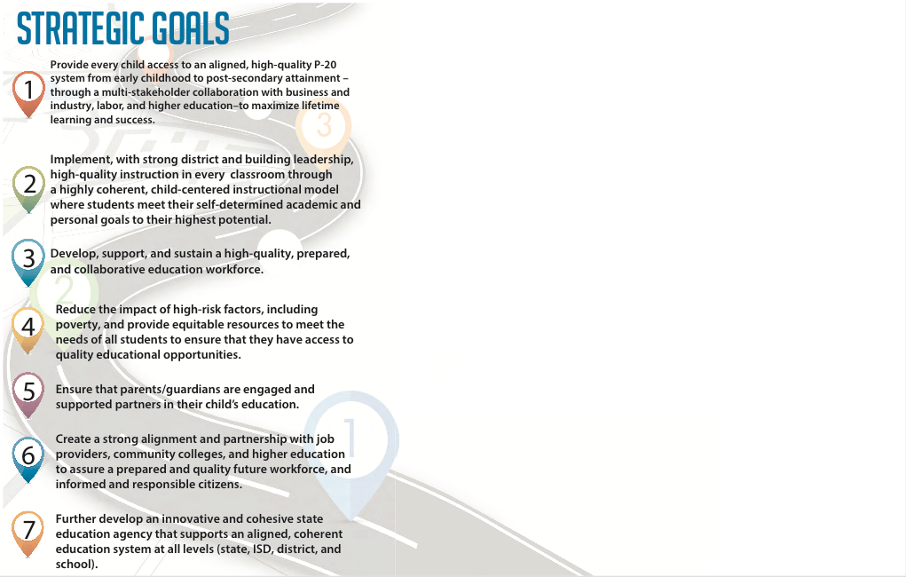
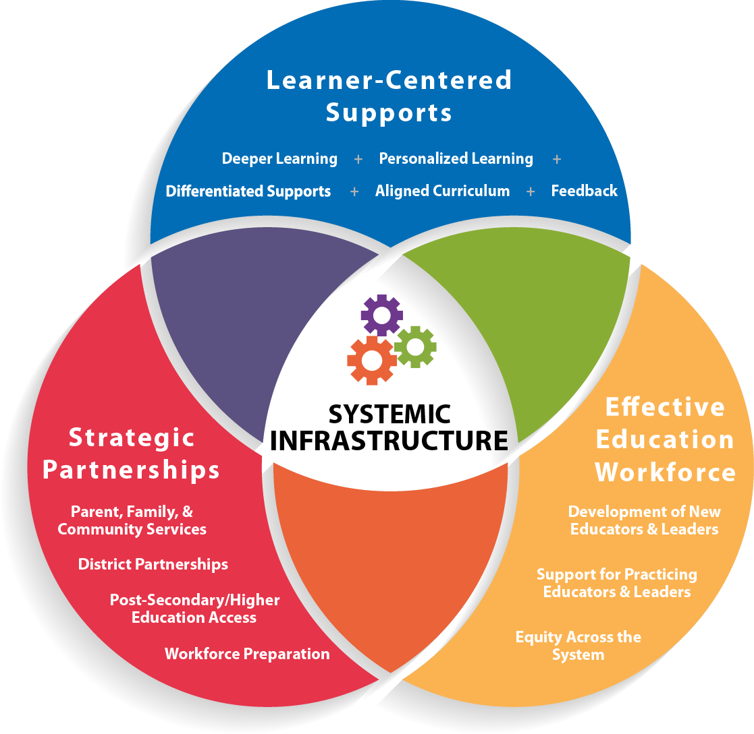
Focus Areas
Top 10 in 10 Focus Areas

Slide 7
Top 10 in 10 Metrics
State-to-State Comparison Data
State Level Data
District/School Level Data
  Measuring The SIX “E”s
    Early Literacy
    Exit Ready
    Engagement
    Effective Education
    Equity
    Efficacy
Information will be posted on the MDE Dashboard
Top to Bottom, A-F and Scoreboards are eliminated

Slide 8
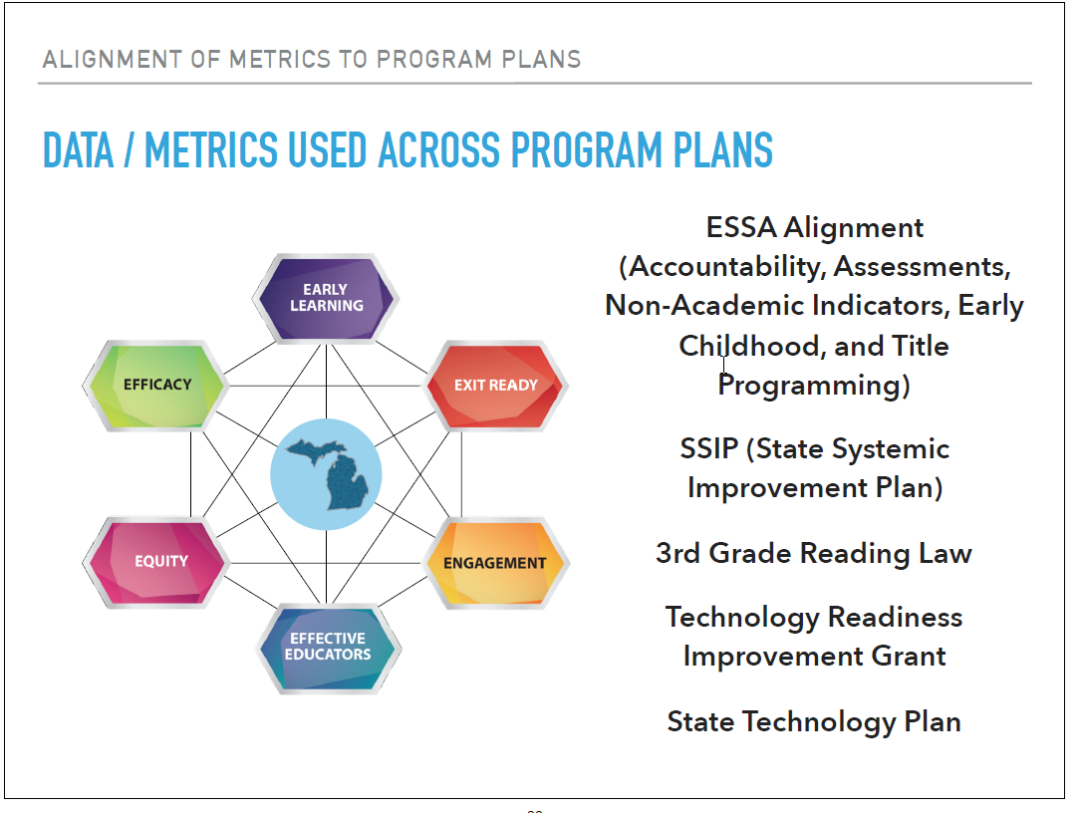

Slide 9
MI Educator Showcase
MDE website as part of the Top 10 in 10 Strategic Plan to support educators in sharing and collaborating on what is working for their learners
MDE is NOT vetting the content of the practices
MDE role is to ensure the submitted practices are complete and appropriate to share
Information regarding a quality submission and how to submit can be found at www.mi.gov/MiEducatorShowcase

Slide 10
Recognition
MDE (Early On/OSE), GISD and the Güd marketing firm, is being awarded the prestigious national award for the "Don't Wait, Evaluate"/Build Up MI work in Flint!
  The Silver Anvil Award
  Industry's Most Prestigious Award with a 70 year history
  Only three of these are awarded nationally

Slide 11
Seclusion/Restraint Guidance
The MDE OSE is working to develop and release guidance to the districts regarding the recently approved State Board of Education Policy on the Emergency Use of Seclusion and Restraint
A diverse group of stakeholders is working to draft the language
Additional stakeholder input will be requested throughout the development
The goal is to release the guidance prior to the beginning of the 2017-18 school year

Slide 12
Tribal Update
The Ziibiwing Center of Anishinabe Culture and Lifeways of the Saginaw Chippewa Indian Tribe of Michigan hosted a Listening & Learning Forum for the MDE superintendent and his administrative team
In commemoration of the annual “Honoring, Healing and Remembering” walk on the grounds of the former Mt. Pleasant Indian Industrial Boarding School
  The event took place June 5th and 6th

Slide 13
Shared Educational Entities
For ACCOUNTABILITY reporting for the 16-17 school year, the Sending Scores Back Program is being discontinued
Currently, 19 of 271 (~7%) center programs identified in the Educational Entity Master (EEM) are participating in the SEE program.
The majority of SEEs are also not center programs:
  54 SEEs are not center programs
  19 SEEs are center programs

Slide 14
OSE Updates

Slide 15
IDEA Grant Information Released
Released to ISDs
  Estimated Fiscal Year 2017-2018 Allocations for the IDEA, Part B, Section 611, Special Education Flowthrough Grant, Enhancing Opportunities for Students with Disabilities (EOSD) Grant, and Transition Coordination Grant
  Applications are due to the OSE no later than July 31st
  To view the estimated amounts made available please use the following link:
    https://content.govdelivery.com/attachments/MIMDE/2017/06/01/file_attachments/825365/Estimate%2BAllocations%2BMemo%2BAttachments.pdf

Slide 16
Program Finance Update
IDEA Grants
Estimated allocations for the FY 2017-2018 IDEA Flowthrough, EOSD, and Transition Coordination grants were emailed to the ISD Special Education Directors and Business Officials on June 1, 2017
The FY 2017-2018 IDEA Flowthrough, EOSD, and Transition Coordination grant applications are available in MEGS+
  All three applications are due on July 31, 2017.

Slide 17
OSE Hiring
The OSE has coordinated with the Clinton County RESA to post and hire 2-3 additional OSE monitors
  These staff members will work to support the OSE in the design and implementation of a new approach to supporting ISDs in their work to support local district improvement
  Postings will be up until June 21st
The MDE-Low Incidence Outreach (Civil Service) has posted a Consultant for Students who are Deaf or Hard of Hearing (DHH) position.
  Please contact Collette Bauman at baumanc@michigan.gov

Slide 18
OSE Hiring
Special Education Consultant (Civil Service)
  Medicaid responsibilities
  Technical Assistance in other special education topics & issues
  Knowledge and/or limited experience of Medicaid and State and Federal special education requirements
    Posting going up today or tomorrow

Slide 19
Retirement Announcement
After 37 years at the OSE, Dianne Easterling has announced her upcoming retirement.
Dianne has provided support to the department and districts regarding special education funding
She is our resident historian regarding the reasons so many of our systems are designed as they are
We wish Dianne well and will truly miss her in our work

Slide 20
Emerging and Collaborative Work
Designing a System to Improve Outcomes for Students with Disabilities!!

Slide 21
The shared obligation to ensure the a provision of a FAPE
  What system(s) is in place to:
    1. Ensure that all member districts know the requirements of IDEA?
    2. Verify that member districts are implementing the requirements correctly?
    3. Support identified areas of improvement

Slide 22
“Ensuring” a Provision of a FAPE
Proactive Planning
Continuum of
Support and Enforcement
Reactive Response

Slide 23
Where to begin
Data Review. SPP Indicator Connections. State-Identified Focus Area.
Notes:
Together we’re doing (and have done) a lot of work to rethink the requirements we have, the structures we use to address those structures, and the obligations we all share. I’m going to start today by briefly reviewing slides you’ve seen before. This is to ground our discussion and give you space to ask questions about the bigger picture.

Slide 24
Indicator B-5A
Educational Environments - % of 6-21 year old children served inside the regular class 80% or more of the day
Educational Environments Target
2011 | 2012 | 2013 | 2014 | 2015
63.00% | 63.00% | 63.00% | 63.25% | 63.50%
3/30/17
2012-2015 Targets: Met

Slide 25
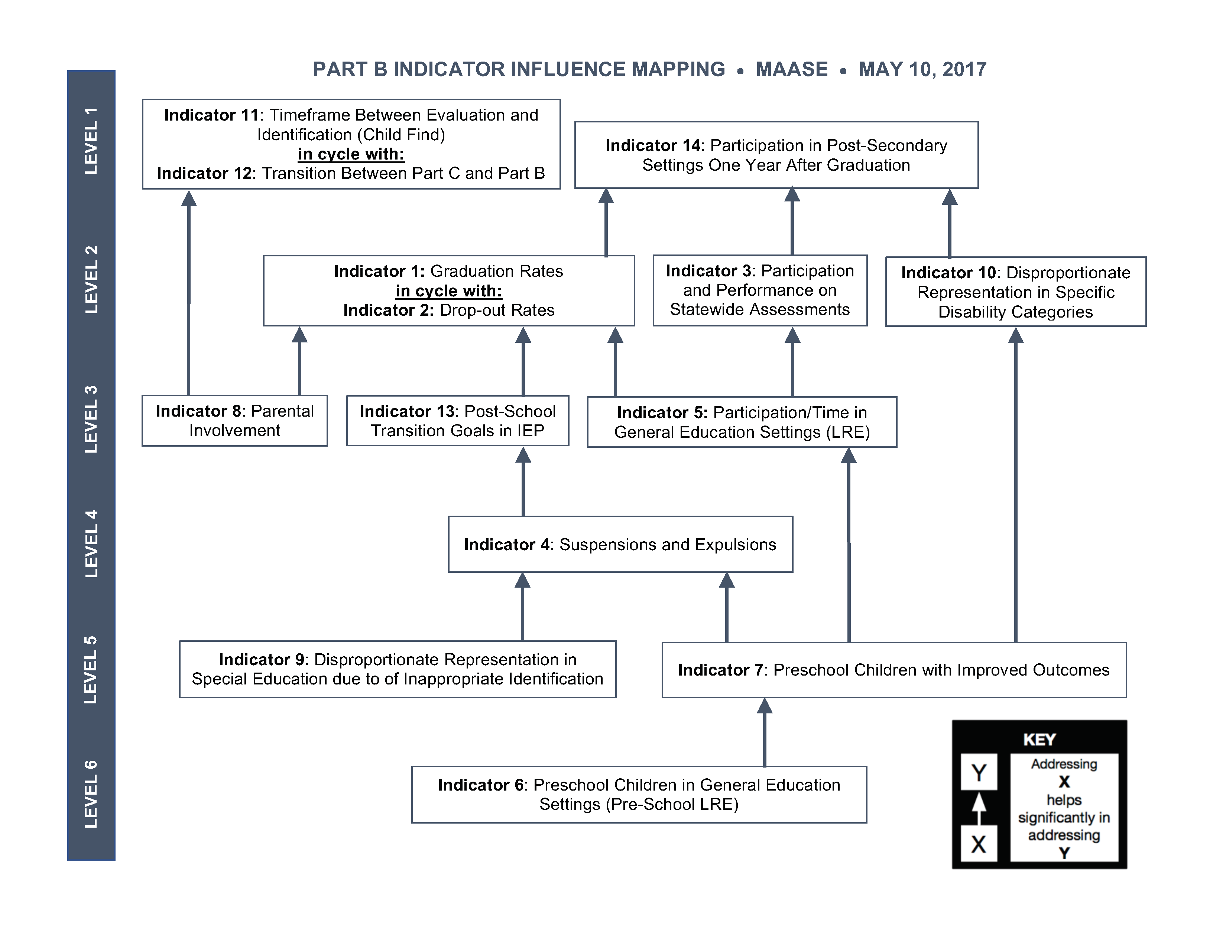






Slide 26
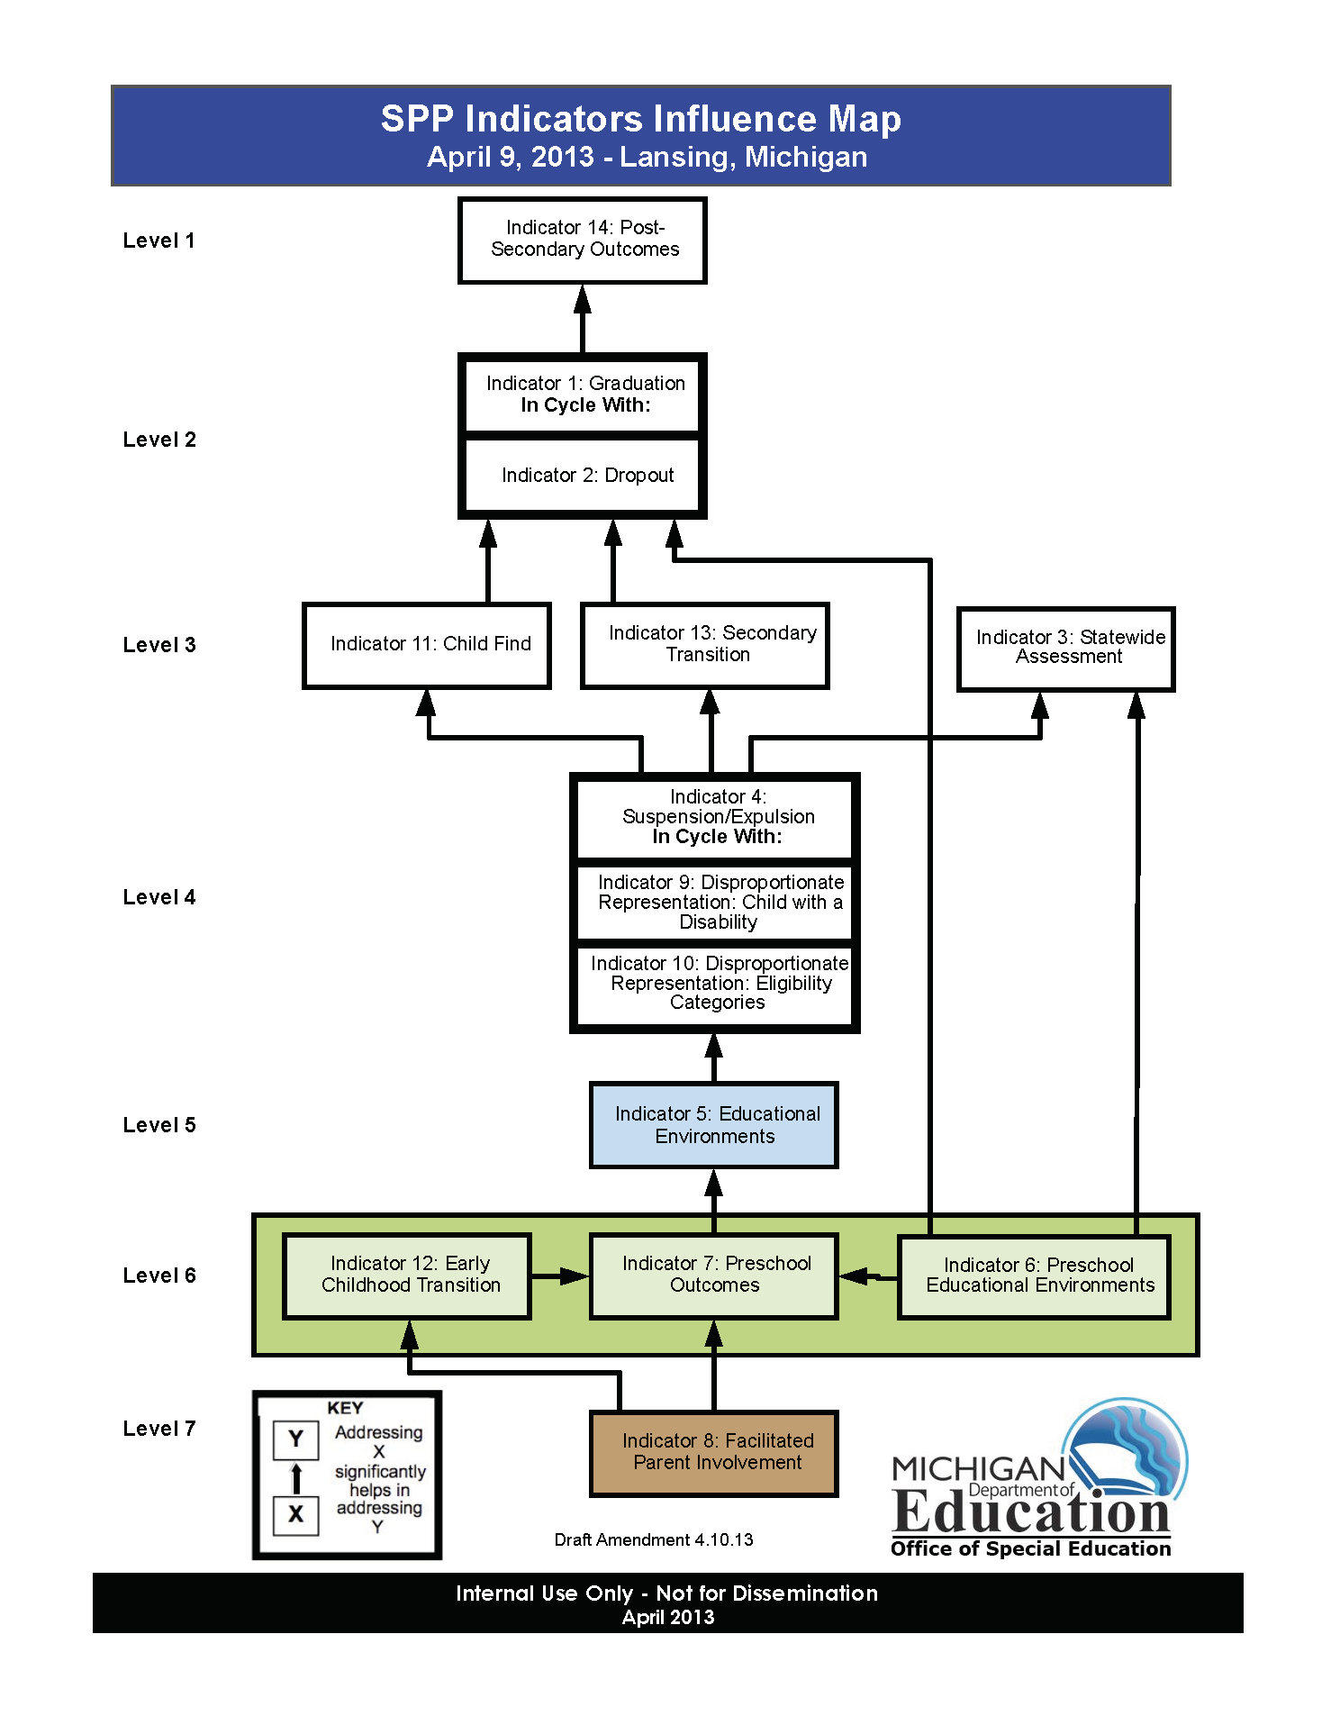



Slide 27
Why did Congress enact I.D.E.A.?
The Individuals with Disabilities Education Act (IDEA) is the nation’s federal special education law that ensures public schools serve the educational needs of students with disabilities.
  IDEA requires that schools provide special education services to eligible students as outlined in a student’s Individualized Education Program (IEP).
  IDEA also provides very specific requirements to guarantee a free appropriate public education (FAPE) for students with disabilities in the least restrictive environment (LRE).
  FAPE and LRE are the protected rights of every eligible child, in all fifty states and U.S. Territories.

Slide 28
Least Restrictive Environment
Sec. 300.114 LRE Requirements
The State must have in effect policies and procedures to ensure that public agencies in the State meet the LRE requirements of this section…
Each public agency must ensure that—
  To the maximum extent appropriate, children with disabilities, including children in public or private institutions or other care facilities, are educated with children who are nondisabled; and
  Special classes, separate schooling, or other removal of children with disabilities from the regular education environment occurs only if the nature and severity of the disability us such that education in regular classes with the use of supplementary aids and services cannot be achieved satisfactorily.

Slide 29
Opportunities
Scope: All students
Partnerships with General Education
  School Improvement Plans
  Multi Tiered Systems of Support
  Positive Behavior Interventions and Supports
    Functional Behavioral Assessments
    Behavior Intervention Plans
Notes:
In addition to having a need, I see several opportunties.
This issue affects all students with IEPs – not a subset. Each and every child is placed in a classroom environment. By making improvements in this work, we can make improvements for every child.
There are significant opportunities to partner with general education. Explain MTSS and PBIS work at the state level.
This is also a topic that blurs the lines between compliance and results. We want to do more of that!

Slide 30
Connections
Using Compliance to inform Improvement
  Child Find/Identification/Eligibility Determinations
  Placement
  Suspension and Expulsion
  Dropout
  Graduation
  Secondary Transition
  Postsecondary Outcomes
  State Assessments
Notes:
We also know that other topics that affect our ability to provide LRE and where LRE affects our ability to achieve outcomes in related topics.
Teri – Walk through each of these.

Slide 31
OSE Support
The OSE will be preparing a suite of materials to share with the ISDs to:
  Create a consistent message regarding the role and responsibility of the ISD in the administration of the IDEA grant
  The suite will include:
    Podcast
    PowerPoint
    Written documents
  ISDs will have the option of using them with ISD personnel, and local districts
  The OSE will make these available during the MAASE Summer Institute in August

Slide 32
CrEAG for sub recipient attached to IDEA flow through grant application
Initiate mutual selection process for Cohort 1 onsite review
Redefine the Transition Coordination and EOSD grant criteria on the Application
MAY 2017
JUNE
2017
FALL 2017
SPRING2018
MAY
2018
FALL 2018
SPP Influence Mapping
Identify the state priority area for system improvement
Meet with LEAs to refine role and responsibility of sub recipient work with LEA
Onsite review with Cohort 1

Slide 33
"The difference between the right word and the almost right word is the difference between lightning and a lightning bug." - Mark Twain
Contact us!
Email or Call!
OSE Information Line
  1-888-320-8384
  Monday-Friday
  9:00 AM-4:00 PM
mde-ose@michigan.gov
Teri L. Chapman, Director
  517-335-0455
  chapmant2@michigan.gov
Jan Weckstein, Assistant Director
  517-241-4521
  wecksteinj@michigan.gov

