Slide 1
Federal and state updates Maase membership meeting
February 8, 2017
Teri L. Chapman, Director MDE OSE

Slide 2
Federal Update
United Stated Department of Education (USED)
Office of Special Education Programs (OSEP)

Slide 3
Every Student Succeeds Act (ESSA)
Government-to-Government consultation agreement with each of our 12 federally recognized tribes where:
50% of a district’s student body is Native American or
The district is in receipt of $40,000 or more annually in Title VI funds
The MDE and the Michigan Tribal Education Directors have participated in two full days of learning
The MDE will be meeting with each tribe to determine the consultation process

Slide 4
Every Student Succeeds Act (ESSA)
Executive Summary to be released on February 14, 2017
ESSA Final Plan is due to be submitted to USED on April 3, 2017

Slide 5
New Report on Medicaid and Schools
Full report: http://aasa.org/uploadedFiles/Policy_and_Advocacy/Resources/medicaid.pdf
The Executive Summary http://aasa.org/uploadedFiles/Policy_and_Advocacy/Resources/AASAMedicaidExecutiveSummaryFinal.pdf
“8 Facts about Kids on Medicaid and the Services They Receive in Schools”
http://aasa.org/uploadedImages/Policy_and_Advocacy/Resources/medicaid-graphic.jpg?n=9588

Slide 6
OSEP
The State Performance Plan/Annual Performance Report was submitted on January 26, 2017
The State Systemic Improvement Plan will be submitted April 1, 2017

Slide 7
Michigan Department of Education

Slide 8
MDE Leadership Change
Effective March 2017, Norma Jean Sass will retire as the Chief Deputy Superintendent
Beginning March 2017, Sheila Alles, Chief Academic Officer for Livonia Public Schools, will assume the Chief Deputy Superintendent position.
41 years in public education serving as a classroom teacher, curriculum director, and administrator

Slide 9
New Legislation!
Emergency use of Seclusion and Restraint
Signed by Lt. Governor Calley on December 29, 2016
Statute effective March 29, 2017
The MDE is in the process of developing new policy to meet the requirements of the new mandate
The policy is being develoed by a team of professionals from the MDE OSE, grant funded project staff, behavior specialists, school psychologist and other ISD professionals with expertise in Multi-tiered Systems of Support (MTSS) and Positive Behavioral Interventions and Supports (PBIS)

Slide 10
New Legislation!
Emphasis on PBIS and Crisis Training
Funds have been allocated for four (4) ISDs to begin the training for implementation of PBIS
5-7 additional ISDs will be trained in each of the next four (4) years, by application
Additional funds will be provided for crisis training:
2 trainers in each ISD
2 staff trained in each building in each district
Other requirements include:
Documentation and reporting
Data collection and reporting

Slide 11
ISD PBIS Support
The four ISDs include:
Lewis Cass ISD
Ingham ISD
Char-Em ISD
Eastern UP ISD
Training for leadership/implementation teams at the ISD levels and
Schools who need a refresher for implementation begin this winter
New implementation schools will be trained this summer

Slide 12
Office of Special Education

Slide 13
OSE Regional Leadership Meetings
OSE Leadership Regional Meetings
Region 3 November 18, 2016
Region 2 January 6, 2017
Region 4 January 18, 2017
Region 1a January 20, 2017
Region 1 January 23, 2017
UPDATE:
The ISD Special Education Directors are working with the OSE to define the role and responsibilities as the sub recipient of the IDEA federal grant

Slide 14
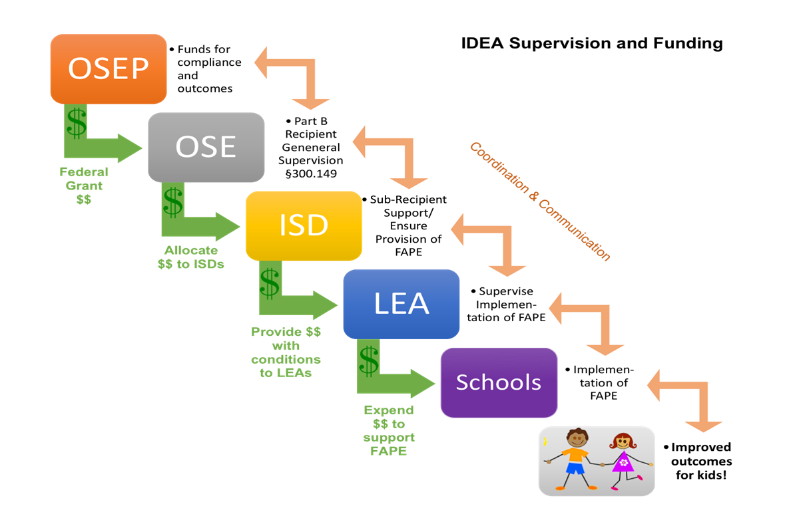
State Accountability Structure

Slide 15
Ensuring a Provision of a FAPE
What is the process for informing all districts within the jurisdiction of the ISD, of ALL the requirements of the IDEA?
What is the system in place to determine whether all districts are implementing the requirements correctly?
What is the response when the ISD has reason to believe the district(s) is not meeting the requirements?

Slide 16
Critical Elements Analysis Guide (CrEAG)
OSEP process used with States to demonstrate the way in which each state meets the requirements of IDEA
The OSE and the ISD Directors of Special Education are working through a process to develop a CrEAG for the sub recipient
The final document will be an attachment with the IDEA flow through application in May 2017
The CrEAG for the sub recipient will be loaded into the new Catamaran electronic system

Slide 17
CrEAG Continued
During 2017-18
The OSE will support ISDs in responding to the questions outlined in the CrEAG
The OSE will support ISDs in working with the local districts to develop a CrEAG for local districts
The final document will be loaded into the Catamaran electronic system
Redefining of the relationship between the State and the sub recipient will require both the State and the sub recipient to make changes to the process and practices currently in place

Slide 18
OSE Special Education Stakeholder Survey & Input
Special Education Stakeholder Survey and Input
Public Sector Consultants has submited a draft report of survey and stakeholder input
Additional input obtained from the Regional meetings will be added to the draft
Survey input regarding the state complaint investigation process will also be added
The final report will be made available to the State Superintendent at the end of February

Slide 19
Accessible Documents Available
Supporting Student Behavior: Standards for the
Emergency Use of Seclusion and Restraint
Notice of Cessation of Special Education Programs and
Services
Revocation of Parental Consent for Special Education
Programs and Services
Standards for Extended School Year Services
MARSE with IDEA Regulations
Due Process Complaint Procedures
Surrogate Parent Decision Making Guidance

Slide 20
OSE Staff Updates
NEW Staff:
Amy Hurst
Performance Reporting Unit
Lynsey Wilmers
Program Accountability Unit
Moving on:
George Kobreek
Performance Reporting Unit
Upcoming retirement:
Jane Reagan, Medicaid

Slide 21
New Posting!
Executive Secretary E-10 position (3103-17-058), Office of Special Education
This permanent full-time position is located in Lansing and is open to internal employees and outside applicants.
To apply and/or view the position description, click on the link below.
https://www.governmentjobs.com/careers/michigan
Clink on “Filter” (right-hand side near top)
Click on “Department” select “Education.” This will list all jobs in the Department of Education.
Click on “Executive Secretary E-10.” This will pull up the electronic application information.

Slide 22
Progress is not achieved by luck or accident, but by working on yourself daily.” ~Epictetus

Slide 23
Please contact us!
Information
OSE Leadership
888-320-8384
9:00 AM-4:00 PM
mde-ose@michigan.gov
chapmant2@michigan.gov
517-335-0455
wecksteinj@michigan.gov
517-241-4521
andrejackj@michigan.gov
517-241-4386

