Slide 1
MDE Office of Special Education
Updates for MAASE
December 7, 2016

Slide 2
USED OSEP
Federal ESSA Regulations:
  To implement the accountability,
  data reporting, and
  state plan provisions of the Every Student Succeeds Act (ESSA), with a focus on
    supporting states in using their flexibility to provide a high-quality, well-rounded education, and
    ensure equity remains at the core of implementation.
  The regulations will help states, districts and educators seize the opportunity ESSA provides to ensure a high-quality, well-rounded education that sets every student in America…including students with disabilities, up for success in college and career.

Slide 3
USED OSEP
ESSA Federal Regulations:
  https://www.federalregister.gov/documents/2016/11/29/2016-27985/elementary-and-secondary-education-act-of-1965-as-amended-by-the-every-student-succeeds
Fact sheet:
  http://www2.ed.gov/policy/elsec/leg/essa/essafactsheet1127.pdf
Timeline for identification of schools for support and improvement:
  http://www2.ed.gov/policy/elsec/leg/essa/essacctchart1127.pdf

Slide 4
USED
The U.S. Department of Education announced the release of new guides and resources to help justice-involved youth transition back to traditional school settings.
  The resources include:
    a guide written for incarcerated youth;
    a newly updated transition toolkit and resource guide
  http://www.ed.gov/news/press-releases/fact-sheet-reducing-recidivism-justice-involved-youth?utm_content=&utm_medium=email&utm_name=&utm_source=govdelivery&utm_term=

Slide 5
USED OSEP
Web-based toolkit on Improving Outcomes for Youth with Disabilities in Juvenile Corrections
    https://www.osepideasthatwork.org/jj
  To better support and improve the long-term outcomes for youth with disabilities in juvenile correctional facilities
  The toolkit includes:
    topical briefs, family engagement strategies, and resources that summarize evidence- and research-based practices in juvenile corrections.
  The site also includes linked resources to support the use of the State Correctional Education Self-Assessment
    https://osep.grads360.org/#communities/pdc/documents/10095

Slide 6
USED OSEP
Understanding the Confidentiality Requirements Applicable to IDEA Early Childhood Programs Frequently Asked Questions (FAQs).
  http://www2.ed.gov/policy/speced/guid/idea/memosdcltrs/idea-confidentiality-requirements-faq.pdf
Use in conjunction with the 2014 side-by-side guide of the IDEA and FERPA Confidentiality Provisions
  https://www2.ed.gov/policy/gen/guid/ptac/pdf/idea-ferpa.pdf

Slide 7
USED OSEP
Non-regulatory guidance on supporting early learning through the Every Student Succeeds Act (ESSA)
  To help ensure young children from birth through third-grade get the strong start they need to achieve success in school and in life.
  Highlights how agencies can:
    expand access to high-quality early learning opportunities;
    encourage alignment and collaboration of early learning programs from birth through third grade; and
    support early learning educators
  http://www2.ed.gov/policy/elsec/leg/essa/essaelguidance10202016.pdf

Slide 8
USED
Recently released reports from Institute of Education Sciences (IES)
  Executive Function: http://ies.ed.gov/ncer/pubs/20172000/pdf/20172000.pdf
  Use of private loans to pay for post-secondary education: http://nces.ed.gov/pubs2017/2017420.pdf
  RTI implementation in Milwaukee public schools: http://ies.ed.gov/ncee/edlabs/regions/midwest/pdf/REL_2017192.pdf

Slide 9
USED
Summary of impact of elections on education
  http://www.newamerica.org/education-policy/edcentral/5-questions-about-education-implications-2016-elections/
  To learn more about New America:
  http://www.newamerica.org

Slide 10
USED
President-Elect Trump’s nominee for Secretary of Education, Betsy DeVos
  Education Week’s information about her
  http://blogs.edweek.org/edweek/campaign-k-12/2016/11/betsy_devos_education_secretary_five_things_to_know.html?utm_source=feedblitz&utm_medium=FeedBlitzRss&utm_campaign=campaignk-12

Slide 11
MDE Updates

Slide 12



Michigan’s Approach to ESSA

Slide 13

Michigan’s Journey
Strategic Vision Development
Top 10 in 10
Vision committees (accountability, assessment, funding)
Initial Plan Development
May-October 2016
Cycles of development and feedback
Finalize and Submit
November-December 2016
Interact with federal guidance
Implementation
Official USED plan due in Spring 2017; we will be ready before then
Implementation planning begins January 2017
A detailed MI ESSA Timeline is located on the ESSA web page at www.michigan.gov/essa under the State Plan Development button.

Slide 14
Structure of our Work

Slide 15
Online and Virtual Feedback
Visit:
www.michigan.gov/essa
Click on “Get Involved” to sign up for ESSA Notes

Slide 16



Conceptual Framework for Improving Results for Children
Building Capacity
Coherent Infrastructure
Quality
Data
Improved
Learner Outcomes
Supporting Improvement
Effective Practices

Slide 17




State Systemic Improvement Plan
Data & Infrastructure Analysis
that
guided selection of coherent improvement strategies
to
increase the State’s capacity to lead meaningful change with Local Educational Agencies (LEAs)
to
improve results for ALL children.

Slide 18
State Systemic Improvement Plan (SSIP)
Phase I - Analysis
Phase II - Plan

Slide 19
Formula for Success
State Implementation & Scaling-up of Evidence-based Practices (SISEP)
X
Effective
Implementation
Methods
X
Effective
Innovation
Enabling
Contexts
=
Educationally
Significant
Outcomes
Notes:
Too often, effective programs are not implemented as intended, not sustained, or not used on a sufficient scale to impact all learners. This is known as the implementation gap.
In order for all learners to benefit, we must support both WHAT innovations have been selected and the implementation strategies that ensure HOW to do it. Students cannot benefit from innovations they do not experience. Not only do we need effective programs, we need effective implementation strategies to make sure WHAT we are trying to do is actually put into practice and used as intended.

Slide 20
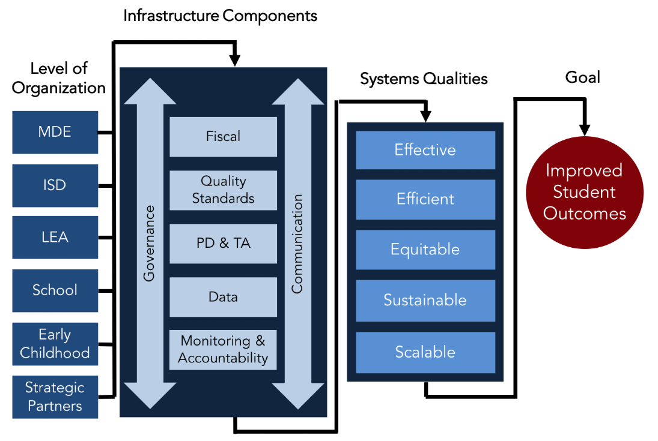
Aligned Education Infrastructure

Slide 21
OSE Updates

Slide 22
OSE
Accessible Michigan Administrative Rules For Special Education
  Supplemental document includes related Individuals with Disabilities Education Act (IDEA) federal regulations
  Now meets accessibility standards
  Most current MARSE, which became effective October 8, 2015
  Posted to the OSE website
    http://www.michigan.gov/mde/0,4615,7-140-6530_6598---,00.html

Slide 23
OSE
The OSE is conducting a website usability study in an effort to better organize the information on its website
  The study looks to understand how these topics currently exist on the MDE website
  A second study will be conducted in January to test ideas for improvements.
  The current study will close Monday, December 21, 2016. The study should take about 10-15 minutes to complete
  https://52ca1eb.optimalworkshop.com/treejack/mde-2016-12

Slide 24
OSE
OSE Special Education Problem Solving Process, August 2015
Error!
  A written request submitted to the OSE indicating both parties agree to extend the timeline for a state complaint investigation and allow the complaint to be put aside during this informal dispute process
  The request would be for an extension of the 60 calendar day timeline in order to engage in an “informal meeting.”

Slide 25
OSE
Clarification:
  If the State choses to utilize an alternative dispute resolution process, the State must establish a process that uses a disinterested party who is under contract with an appropriate alternative dispute resolution entity, or a parent training and information center or community parent resource center in the state
  Mediation is the only “formal” dispute resolution process that can allow a state complaint investigation to be set aside as long as BOTH parties agree to mediation
    The State will also establish the length of time the investigation will be set aside

Slide 26
OSE
OSE Leadership Regional Meetings
  Region 3, November 18, 2016
  Region 2, January 6, 2017
  Region 1a, January 20, 2017
  Region 1, TBD
  Region 4 January 18, 2017

Slide 27
OSE
ISD Transition Coordinator Conference
Save the DATE!
  January 24 & 25, 2017
  Traverse City
  Details to follow

Slide 28
OSE
Special Education Stakeholder Survey and Input
  Public Sector Consultants released a survey in October to obtain input from the community on views regarding the special education system in Michigan
    Spanish and Arabic versions are open until December 9
  Additional phone calls and face-to-face meetings are being scheduled to obtain further input regarding the state complaint investigation process and the additional component of the accountability system being designed
  The final report will be made publically available when complete

Slide 29
OSE
Information Desk
Contact us!
888-320-8384
  Monday-Friday
  9:00-4:00
mde-ose@michigan.gov
Teri Chapman, Director
  517-335-0455
  chapmant2@michigan.gov
Jan Weckstein, Assistant Director
  517-241-4521
  wecksteinj@michigan.gov

Slide 30

Have a wonderful holiday!!

