Slide 1
MAASE update
December 9, 2015
Teri L. Chapman, Ed.S., Director

Slide 2
Federal Happenings

Slide 3
USED
ESEA Reauthorization
  The House Education and Workforce Committee has posted the conference report, e.g., final version of the Every Student Succeeds Act (also known as ESEA reauthorization) (1069 pages)
    http://edworkforce.house.gov/uploadedfiles/every_student_succeeds_act_-_conference_report.pdf
  Conference Report (385 pages)
    http://www.ed.gov/news/press-releases/fact-sheet-congress-acts-fix-no-child-left-behind

Slide 4
USED
IDEA Grant Funds
  The OSE will be receiving the IDEA Part B and Part C Grant Application Packages for Federal Fiscal Year (FFY) 2016
  The completed Part B application, with supporting information, must be submitted to OSEP on or before May 12, 2016.

Slide 5
USED
Public Comment Review of Proposed Medicaid Policy
  The proposed policy will now allow for ABA services, among others, for children under 21 years of age
    Contingent on federal Medicaid agency approval
    NOT INCLUDED IN SCHOOL BASED SERVICES POLICY
  Comments on this proposed policy are due January 5, 2016.
  Comments may be forwarded to Matthew Hambleton at HambletonM@michigan.gov or
  Mail comment to:
              Bureau of Medicaid Policy and Health System Innovation
              Medical Services Administration
              P.O. Box 30479
              Lansing, Michigan 48909-7979

Slide 6
U.S. Dept. of Justice (DOJ)
Testing Accommodations for Individuals with Disabilities Who Take Standardized Exams And High-Stakes Tests
  http://www.ada.gov/regs2014/testing_accommodations.html
The obligation of testing entities, both private and public,
  Ensure that the test scores of individuals with disabilities accurately reflect the individual's aptitude, achievement, or the skill that the exam purports to measure, rather than his or her disability.
  The document discusses:
    who is entitled to testing accommodations
    what types of testing accommodations must be provided, and what documentation may be required of the person requesting testing accommodations.
  The document also discusses prohibited flagging policies and how test scores for test-takers receiving disability-related accommodations should be reported.

Slide 7
USED and DOJ
English Learner Tool Kit
A companion to the EL Guidance released jointly by the USED and DOJ in January 2015.
  10 chapters, and each chapter is aligned to one of the 10 sections of the guidance
  Each chapter contains easy-to-use tools and resources relevant to the topic of the chapter
    Accessible to the public and can easily be downloaded and printed here: http://www2.ed.gov/about/offices/list/oela/english-learner-toolkit/index.html

Slide 8
Office of Special Education Program(OSEP)& Rehabilitative Services (OSERS)
OSERS policy on FAPE
  Policy letter clarifies that IEPs for children with disabilities must be aligned with state academic content standards for the grade in which a child is enrolled.
  This guidance does not impose any new requirements beyond those required under applicable law and regulations
  https://www2.ed.gov/policy/speced/guid/idea/memosdcltrs/guidance-on-fape-11-17-2015.pdf
  If you are interested in commenting on this guidance, please e-mail iepgoals@ed.gov

Slide 9
OSERS
Policy Guidance Clarifying Use of Terms Dyslexia, Dyscalculia, and Dysgraphia in IDEA
  Dyslexia and the OSEP memo:
  http://www2.ed.gov/policy/speced/guid/idea/memosdcltrs/guidance-on-dyslexia-10-2015.pdf

Slide 10
OSEP
Melody Musgrove will be stepping down as OSEP Director December 31, 2015
  Assume Ruth Ryder will fill in as interim director
OSEP onsite support to states is scheduled for February 2016
Support to State staff and their stakeholders on the development of States’ Phase II SSIPs, due April 1, 2016
  Discuss the SSIP Phase 2 work
  Forecast the monitoring activities for the dispute resolution system

Slide 11
State of Michigan Happenings
The Governor’s Task Force to Reform Special Education

Slide 12
5 Key Findings
Lt. Governor Brian Calley, Chair
Result of 9 Listening Tour Stops
  Develop a more inclusive and transparent rulemaking process
  Increase access to, and improve the scope and quality of, services
  End the practices of restraint and seclusion
  Create a better dispute resolution system
  Support parents with resources and options

Slide 13
MDE Happenings
TOP 10 in 10 YEARS
  Putting Michigan on the map as a premier education state

Slide 14
(7) Strategic Goals
Provide every child access to an aligned, high-quality P-20 system from early childhood to post-secondary attainment-through a multi-stakeholder collaboration with business and industry, labor, and higher education-to maximize lifetime learning and success.
Implement, with strong district and building leadership, high-quality instruction in every classroom through a highly coherent student-led instructional model to meet their self-determined academic and personal goals.

Slide 15
Strategic Goals continued…
Develop, support, and sustain a high-quality, prepared, and collaborative education workforce.
Reduce the impact of high-risk factors, including poverty, and provide equitable resources to meet the needs of all students to ensure they have access to quality educational opportunities.
Ensure that parents/guardians are engaged and supported partners in their child’s education.

Slide 16
Strategic Goals continued…
Create a strong alignment and partnership with job providers, community colleges, and higher education to assure a prepared and quality future workforce.
Further develop an innovative and cohesive state education agency that supports an aligned, coherent education system at all levels (state, ISD, district and school).

Slide 17
Early Literacy Initiative
Early Literacy Initiative Specifics
  $35.5 million in Fiscal Year 2016 funding to support the initiative to be distributed to LEAs, ISDs and other stakeholders
  20+ focus areas to be implemented in support of the workgroup-identified strategies

Slide 18
Early Literacy Initiative
Working Together within the State’s Educational System
  Leadership/Cabinet establishes the goals and outcomes
  Tactical Planning Team works to identify Action Teams to support all necessary work to coordinate and implement activities to achieve the goals and outcomes
  Action Teams made of members from MDE and our P-20 partners perform the tasks and activities

Slide 19
Early Literacy Initiative
Action Teams and Focus Areas
  Home Visitation
  Parent Education Programs
  Research-Supported Diagnostic and Screening
  Extended Learning Time and Targeted Literacy Instruction and Interventions
  Literacy Coaches
  Professional Learning for Teachers and Leaders
  Teacher Certification

Slide 20
Joint Core Team Meeting
MDE (OSE & OEII) School Climate Transformation Grant in collaboration with:
  Michigan Dept. of Health & Human Services
  Early Childhood
  Mental Health
  Parent, Family & Community Engagement
    Alternatives to Suspension and Expulsion Toolkit link
    http://www.michigan.gov/mde/0,4615,7-140-43092_72831---,00.html

Slide 21
Office of Special Education

Slide 22
The NEW Assistant Director for the
Office of Special Education
Janis Weckstein!
  MAASE Past President
  MAASE Murray O. Batten Humanitarian Award
  Extensive professional work experience in special education and general education throughout the state in various positions up to Assistant Superintendent for Special Education.
  Business administration, HR work, budget/fiscal work, grants management, and working in political environments in government at the county level
  MDE OSE Complaint Investigator

Slide 23
The New SUPERVISOR for the
Program Accountability Unit!
Joanne Winkleman!
  20 years in OSE policy work
  “Crafter” many of the rules in the Michigan Administrative Rules for Special Education
  Oversight of special education teacher endorsements
    Develop the endorsement program for autism and the online consortium for DH/H and VI teacher endorsement
  Acquisition and implementation of the CEEDAR Grant
  Connection to multiple MDE offices
  Governor’s Council for Autism
  Resident historian on special education in Michigan

Slide 24
ISD Plans
The OSE will not be requiring submission of the plans according the schedule that was released on July 30, 2015
  The electronic submission process is currently not yet available
  When the system becomes available, the OSE will provide guidance on the process for submitting plans.
ISDs that currently want to revise their plans can continue to submit them via email.

Slide 25
OSE Corrective Action
In response to a complaint filed against the MDE with OSEP which identified the OSE in noncompliance for its failure to investigate state complaints re: BIPS as a part of the IEP,
  MiBLSi conducted a training this Monday on the FBAs and BIPs.
  The purpose: To develop a common understanding of research that identifies the process and core components of a Functional Behavioral Assessment and Behavior Intervention Plan.
  The information provided at this training will be used for further discussions about how state complaints re: FBA and BIPs will be addressed.

Slide 26
OSE Opportunities
As part of the OSE creating a more cohesive and coordinated system approach to support district improvement
Vacancies are and will be opening up across the office
  Policy & complaints
  Monitoring, Catamaran & Transition
Emphasis on acquiring personnel with local or ISD experience
Go to www.michigan.gov Job Postings for more information

Slide 27
Transition in Transition
Four themes have been identified for development
  Compliance requirements
  Meaningful transition planning process
  Office of Disabilities Employment Program
    The Federal 2020 Youth Transition Plan
  Requirements for Transition Coordinators
Small stakeholder group being convened
Systemic approach to support transition will be part of the TC grant application June 2016

Slide 28
Balancing Compliance & Results
“Balance is not something you FIND…Its something you CREATE.”
~Jana Kingsford

Slide 29
Contact us!!
Information & Help Desk
Teri and Janis
1-888-320-8384
Monday-Friday
8:00 AM- 5:00 PM
chapmant2@michigan.gov
1-517-335-0455
wecksteinj@michigan.gov
  517-241-7507

Slide 30
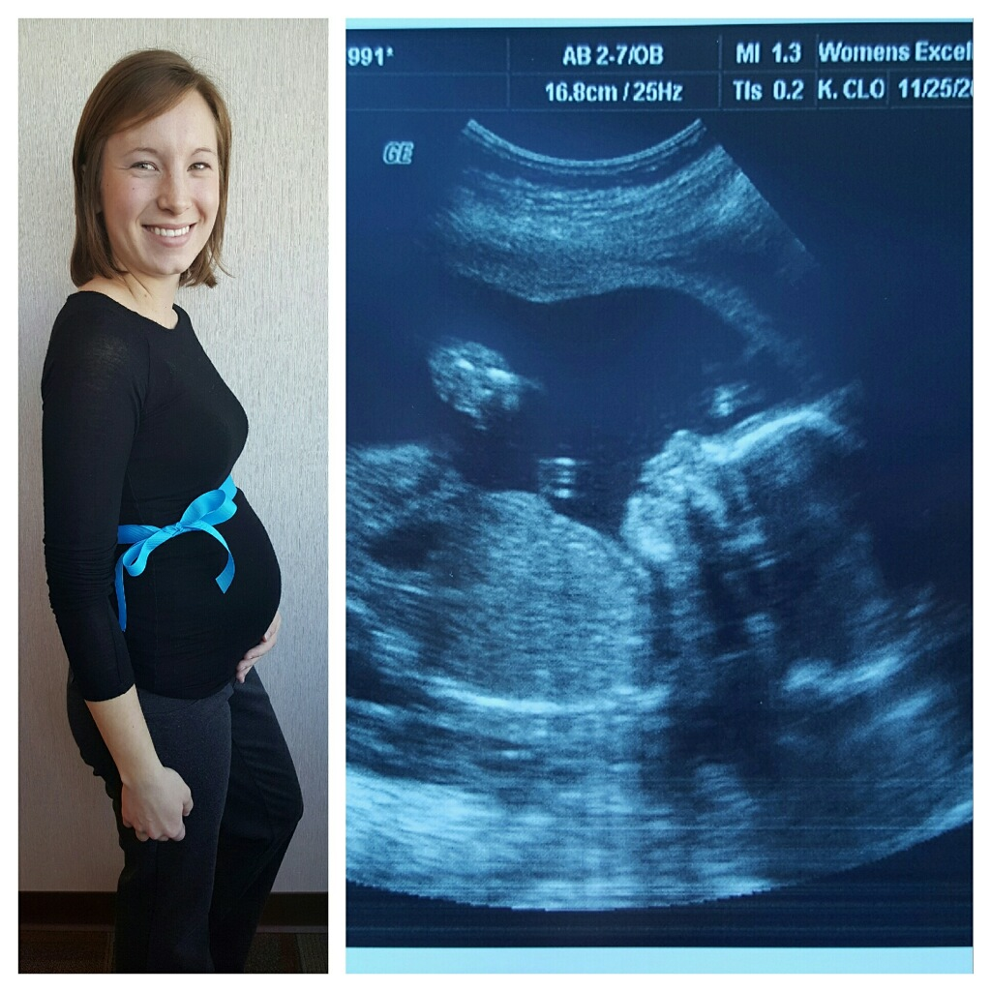
Meet my soon-to-be GRANDSON!!

Slide 31

Enjoy the holiday break!!
Some changes look negative on the surface, but you soon realize that space is being created for something new to emerge.
~Eckhart Tolle

