Slide 1
The Office of Special Education
MAASE Summer Institute
August 2014
Notes:
This presentation demonstrates the new capabilities of PowerPoint and it is best viewed in Slide Show. These slides are designed to give you great ideas for the presentations you’ll create in PowerPoint 2010!
For more sample templates, click the File tab, and then on the New tab, click Sample Templates.

Slide 3
WHAT’s NEW?
State Assessments
All summative assessments will be given in Spring of 2015
General Assessments based on current Michigan standards and will be online
Paper/Pencil and Braille version will be available

Slide 4
WHAT’s NEW?
State Assessments
MEAP Access is no longer available
Dynamic Learning Maps - delayed for one year
Alternate Assessments based on Alternate Achievement Standards (MI-Access) will remain
Social Studies will be added to the Functional Independence (FI) level only.
All FI Assessments will be online. Paper/Pencil versions are available.

Slide 5
WHAT’s NEW?
Accountability
Early On/Part C of IDEA received a Meets Requirements in its determination

Slide 6
WHAT’s NEW?
Data Collection
Part B IDEA Requirement –
Collect and exam data to determine if significant disproportionality based on race and ethnicity is occurring in local education agencies with respect to:
Identification
Education Environments
Discipline

Slide 7
WHAT’s NEW?
Data Collection
Significant Disproportionality warning letters will be in the August 15 CIMS Electronic Workbook
Warning letters are for Identification and Educational Environments
Discipline is based on a single year of data, therefore, no warning is possible

Slide 8
WHAT’s NEW?
Monitoring
CIMS workbook will open September 15
Acknowledge the workbook
Read monitoring messages

Slide 9
WHAT’s NEW?
Low Incidence Outreach
The Braille Authority of North America (BANA) announced that the United States will adopt the new Unified English Braille (UEB) Code in January 2016
Current braille code is not obsolete
Transition to the new code will be take several years
MDE-LIO will announce workshops

Slide 10
WHAT’s NEW?
Early Childhood Special Education
Part B of IDEA, Section 619, 2014-15 estimated allocations are posted at www.michigan.gov/ecse
New online trainings for Indicator B-6 – Educational Environments Ages 3-5. Information can be found at http://eotta.ccresa.org/Training.php?Cat=21

Slide 11
WHAT’s NEW?
Michigan Special Education Reference
The following documents have been placed on the MI-SER:
United States Laws and Regulations> USDOE> Letter to Chief State School Officers and State Attorneys General>Incarcerated Youth (June 9, 2014)
United States Laws and Regulations>USDOE> Letter to Chief State School Officers>English Learners with Disabilities (July 18, 2014)

Slide 12
HOT TOPICS
Visual Impairment and Deaf and Hard of Hearing (VI & DHH) Consortia for Teacher Preparation
An online endorsement program will permit certified teachers to obtain an additional endorsement on their Michigan teaching certificate in either deaf/hard of hearing or visual impairment
Currently there are 9 VI students and 6 DHH students in the Consortium.

Slide 13
HOT TOPICS
Visual Impairment and Deaf and Hard of Hearing (VI & DHH) Consortia for Teacher Preparation
New students are welcome. They must have a bachelor’s degree, a valid or pending Michigan teaching certificate. Partial tuition reimbursement is available
For more information: www.mictp.org

Slide 14
HOT TOPICS
State Determination
OSEP annually issues a determination status to each state – Michigan has been notified that we are a “Needs Assistance” state
Thirty one states in “Needs Assistance” category

Slide 15
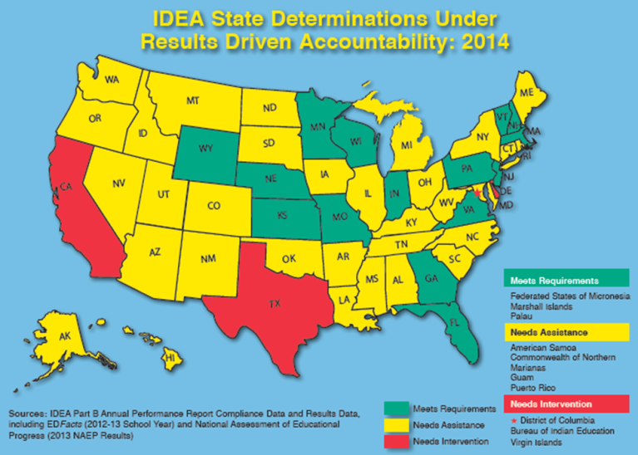
HOT TOPICS

Slide 16
HOT TOPICS
State Determination
Determinations has two parts:
Compliance
Results
Compliance requirement was met
Results was not met
Reading and mathematics – newly added
Graduation will be added next year to the process

Slide 17
HOT TOPICS
OSEP Proposal for FFY 2013 to FFY 2018
Combine SPP/APR into one document.
Eliminate 2 indicators: 15 and 20
New Indicator: State Systemic Improvement Plan
Online submission via GRADS360

Slide 18
HOT TOPICS
New resource of OSEP documentation and related information
GRADS360
Repository for ALL OSEP documentation
https://osep.grads360.org/#program

Slide 19
HOT TOPICS
Indicator 17: State Systemic Improvement Plan
Major undertaking for MDE and OSE
Long-Range Plan
Comprehensive review & analysis
Identify a student outcome that will be improved.
SSIP phase 1 plan by mid-January 2015

Slide 20
LEARNING OPPORTUNITIES
Camp Tuhsmeheta (Camp T) – Greenville, Michigan is for children and youth with visual impairments
Camper Registration and Information: http://mde-lio.cenmi.org/News/tabid/392/articleType/ArticleView/articleId/689/Camp-Tuhsmeheta-Summer-Camps.aspx
Scholarships are available: http://mde-lio.cenmi.org/Services/VisualImpairmentServices/Scholarships.aspx

Slide 21
LEARNING OPPORTUNITIES
Professional Development Opportunities -Camp T
Meet VI teachers and specialists
PD opportunities for DHH Professionals:
2014 EIPA testing dates –
August 22, LIO, Lansing
August 26, Kent ISD
August 27, Traverse Bay ISD
September 4, Kent ISD
September 15, Kent ISD
September 17 & 26, LIO, Lansing
September 29, Oakland Schools

Slide 22
LEARNING OPPORTUNITIES
Annual Conference for Professionals Supporting Students Who are Deaf or Hard of Hearing
October 2-3, 2014, Winding Brook Conference Center, Shepherd, Michigan
Sign Language Proficiency Interview (SLPI)/ American Sign Language Proficiency Interview (ASLPI)
MDE-LIO will work directly with SLPI students and staff who work directly with these students at no cost.
Also offering ASLPI in lieu of SLPI
For information: http://mde-lio.cenmi.org

Slide 23
LEARNING OPPORTUNITIES
Early Childhood Special Education
There are several face-to-face trainings scheduled for Child Outcomes 0-5 Training: Early On and Preschool Special Education – Information and registration: http://eotta.ccresa.org/Training.php?Cat=2&ID=43
Online training for Preschool Childhood Outcomes http://eotta.ccresa.org/Training.php?cat=21

Slide 24
FROM THE DIRECTOR’S DESK

Slide 26
CIMS Redesign
CIMS will be redesigned - Fall 2015
Integration
Office of Great Start
MSDS
Focus will Shift
Information Search to Analysis
http://cims.cenmi.org/

Slide 27
Michigan Administrative Rules - Special Education
Public Hearings
March 10, 2014
Agency Report Developed
Office of Regulatory Reinvention
June 6, 2014
Legislative Service Bureau
Joint Committee on Administrative Rules (JCAR)

Slide 28
Determinations
August 2015
Results Indicators
SSIP
Assessments

Slide 29
RESULTS DRIVEN ACCOUNTABILITY
OSEP

Slide 30
Outcomes by Design
OSEP

Slide 31
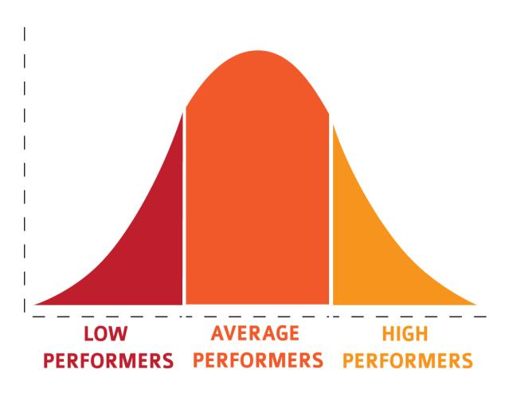
OSEP

Slide 32
OSEP

Slide 33
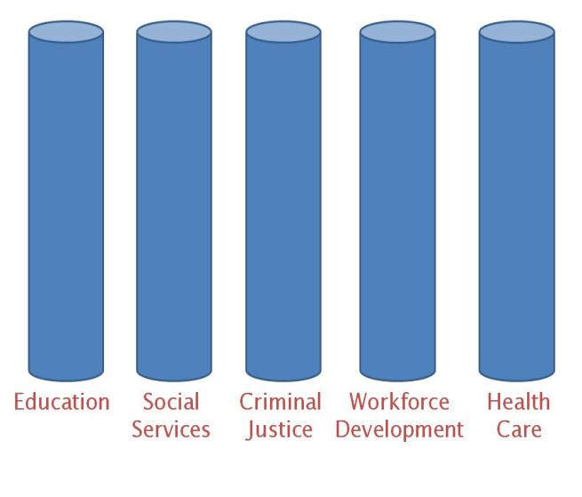
OSEP

Slide 34
OSEP
TITLE I
SIG
ELL

Slide 35
Special education is NOT about “fixing children”… “developing functioning systems
OSEP

Slide 36
Statewide Systemic Improvement Plan Indicator # 17
OSEP

Slide 37
SSIP: Point of Emphasis
The SSIP B-17 Indicator is about REPORTING on the results outcomes for Students with Disabilities
However, the State Systemic Improvement Plan (SSIP) is an EDUCATION PLAN designed to improve outcomes for ALL students.

Slide 38
SSIP Activities by Phase
Year 1— FFY 2013 Delivered by April 2015 | Year 2— FFY 2014 Delivered by Feb 2016 | Years 3-6— FFY 2015-18 Feb 2017- Feb 2020
Phase I Analysis | Phase II Plan | Phase III Evaluation
Data Analysis; Infrastructure Analysis; State-identified measureable result; Coherent Improvement Strategies; Theory of Action. | Multi-year plan addressing: Infrastructure Development; Support EIS Program/LEA in Implementing Evidence-Based Practices; Evaluation Plan. | Reporting on Progress including: Results of Ongoing Evaluation; Extent of Progress Revisions to the SPP

Slide 39
SSIP Phase I
Detailed Analysis
that
guides selection of coherent improvement strategies
to
increase the State’s capacity to lead meaningful change in Local Educational Agencies (LEAs) to
to
improve results for children with
disabilities.

Slide 40
The Office of Special Education
MAASE Summer Institute
August 2014
Notes:
This presentation demonstrates the new capabilities of PowerPoint and it is best viewed in Slide Show. These slides are designed to give you great ideas for the presentations you’ll create in PowerPoint 2010!
For more sample templates, click the File tab, and then on the New tab, click Sample Templates.

