Slide 1
Office of Special Education UPDATES
MAASE
June 11, 2014

Slide 2
WHAT’s NEW?
Publications
State Performance Plan/Annual Public Reporting has been updated. https://www.mischooldata.org/
Michigan Assistive Technology Guidelines for Teachers of the Blind and Visually Impaired guides for teachers K-12. http://mde-lio.cenmi.org

Slide 3
WHAT’s NEW?
Data Collection
Michigan Student Data System 2014 End-of-Year Collection
Certification deadline is June 30
Registry of Educational Personnel End-of-Year Collection
Submission deadline is June 30

Slide 4
WHAT’s NEW?
Data Collection
The Special Education data on the Michigan School Data website is NOT the official child count.
The Center for Educational Performance and Information (CEPI) will remove all 2012-13 school year data on July 1, 2014.

Slide 5
WHAT’s NEW?
Monitoring
Sixteen (16) on-site visits were completed this monitoring cycle.
There were no B-5 on-site visits.
August 2014 Workbook
New letters may be in the Report page
Data alerts for B-5

Slide 6
WHAT’s NEW?
Medicaid School Based Services (SBS) Program
Mark your calendar for Upcoming Meetings – Ingham ISD 1:00-3:00
September 30, 2014
January 13, 2015
March 24, 2015

Slide 7
WHAT’s NEW?
Early Childhood
Early Intervention; Early On® Part C of IDEA
Application for funds is due July 1, 2014 -MEGS
Early Childhood Special Education; ECSE (Part B of IDEA, Section 619) Preschool
Applications are due by July 18, 2014 - MEGS
2014-15 allocations are posted: www.michigan.gov/ecse

Slide 8
WHAT’s NEW?
(MI-SER)
Michigan Special Education Reference
OSEP Letters
Letter to Chief State School Officers, LEA Maintenance of Effort, March 13, 2014
Letter to Breton, Use of Electronic Mail, March 21, 2014

Slide 9
HOT TOPICS?
Part B State Performance Plan/Annual Performance Report has been finalized and disseminated by OSEP
Details in August
Jane Reagan from the Office of Special Education was named to the School Nurse Shortage Task Force
For more information: http://www.mischoolnursetaskforce.org/

Slide 10
HOT TOPICS?
SAVE THE DATE! – November 17 & 18
OSE Fall Forum will be incorporated into the School Improvement Conference – Lansing Center
Continuous Improvement: Sustaining Student Success
Topics
Instructional Practices Across the Content Area
Educator Effectiveness
School Culture and Climate
Assessment for Learning
Special Education

Slide 11
UPCOMING LEARNING OPPORTUNITIES
The first one-day statewide school based services conference sponsored by The Michigan Medicaid agency
August 22 in Traverse City
Documents for use with students who are DHH
Secondary Transition document
Early Childhood document
http://mde-lio.cenmi.org

Slide 12
UPCOMING LEARNING OPPORTUNITIES
MDE-LIO Sponsored Professional Development Opportunities and services for Deaf and Hard of Hearing - Testing Dates
June 9 – Oakland Schools
June 27 – MDE-LIO
July 18 – Traverse Bay Area ISD
July 23 – Kalamazoo RESA
August 8 – Traverse Bay Area ISD
August 13 – Kent ISD
September 4 – Kent ISD
September 26 – MDE-LIO

Slide 13
UPCOMING LEARNING OPPORTUNITIES
Low Incidence Outreach Training:
American Sign Language Proficiency Interview
Camp T summer camps
Braille Class is now forming in Lapeer
Camp Chris Williams
For More Information: http://www.mde-lio.cenmi.org

Slide 14
UPCOMING LEARNING OPPORTUNITIES
Early Childhood Special Education trainings:
Early On and Preschool Special Education face-to-face trainings available. More information: http://eotta.ccresa.org/Training.php?Cat=2&ID=43
Online - Information for Training on Preschool Child Outcomes: http://eotta.ccresa.org/Training.php?cat=21

Slide 15
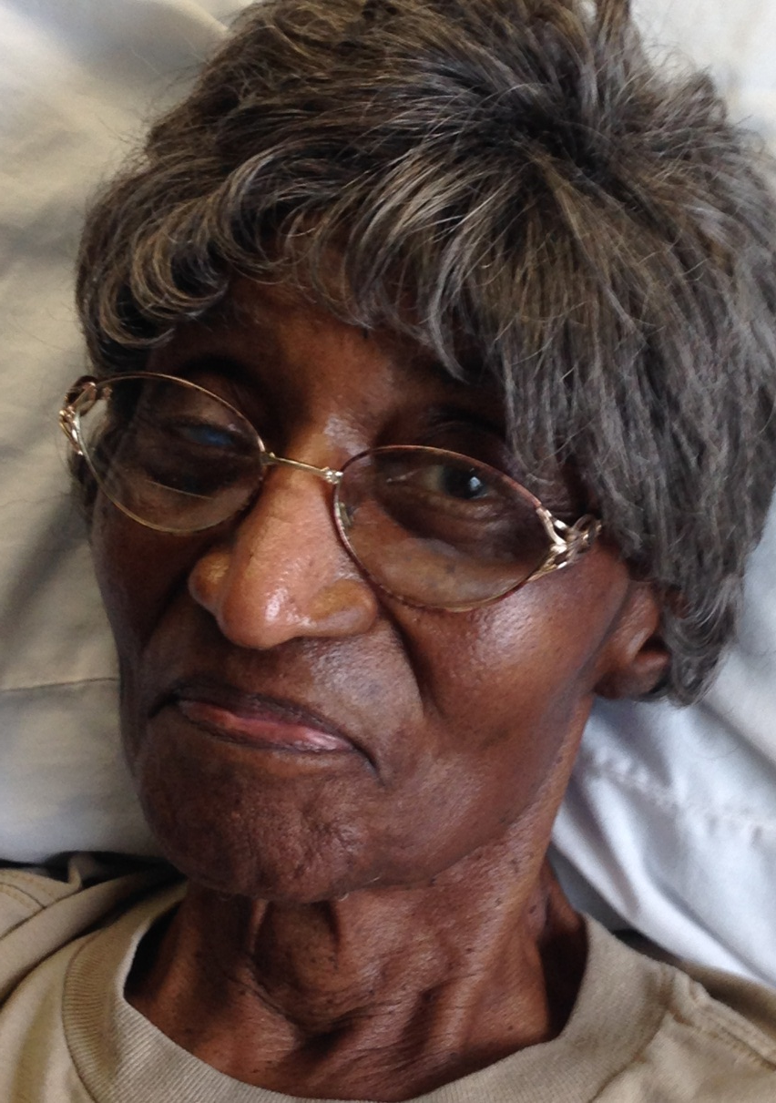
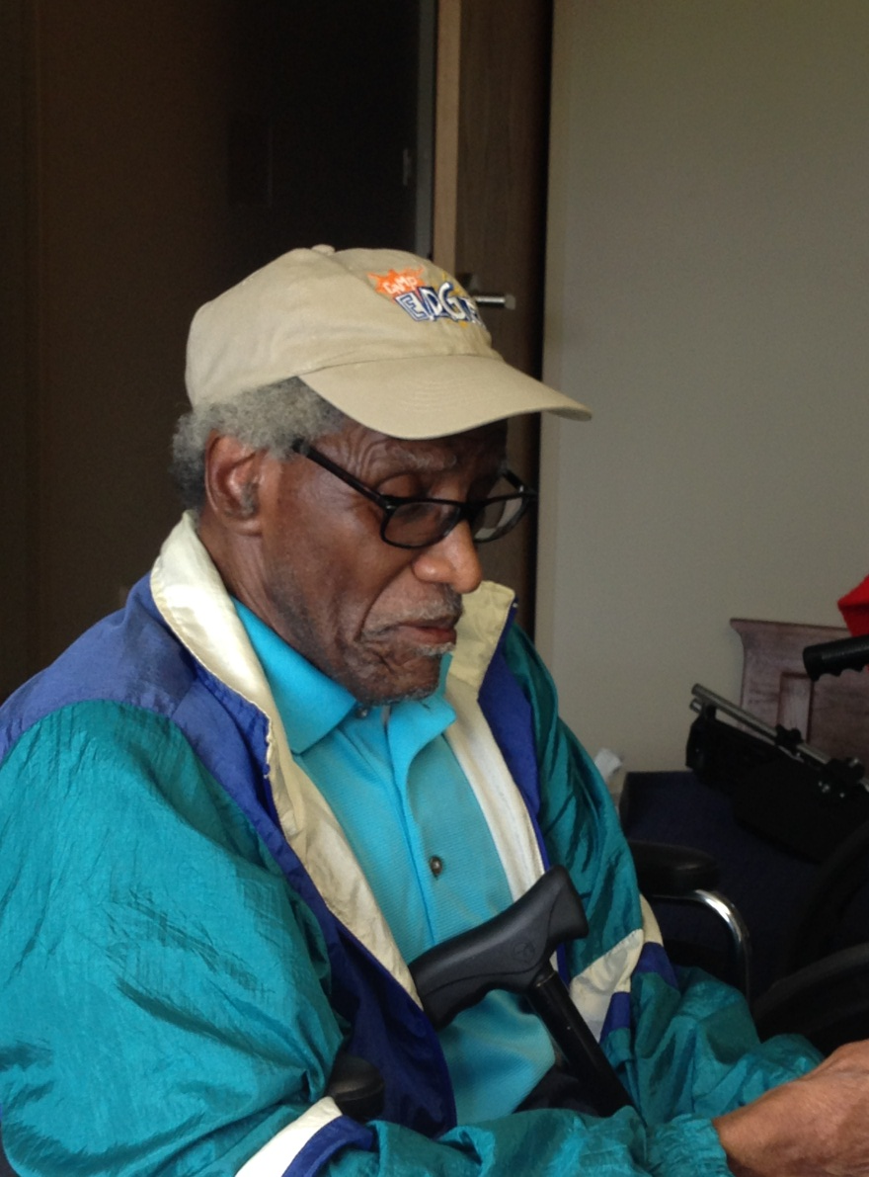
FROM THE DIRECTOR’S DESK

Slide 16
FROM THE DIRECTOR’S DESK
Special Education Part B 611 - Flowthrough
Application DUE Date - July 18, 2014
MEGS
Special Education EOSD & Transition Coordination
Application Due Date – July 1, 2014
MEGS

Slide 17
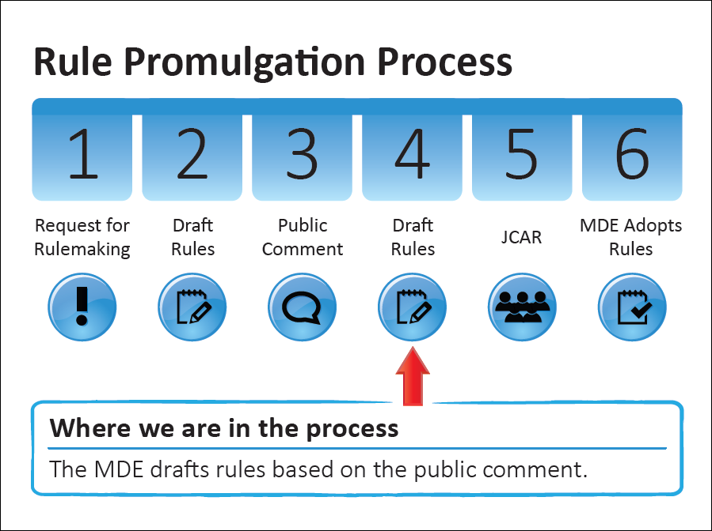
FROM THE DIRECTOR’S DESK
JCAR Report & Rule package sent to ORR

Slide 18
FROM THE DIRECTOR’S DESK
Interpreter Rules - UPDATE: June 4, 2014
Deaf Persons Interpreters' Act
The Joint Committee on Administrative Rules (JCAR) took the last step in the process, regarding the rules governing the Deaf Persons' Interpreters Act
The rule will take effect on July 2, 1014

Slide 19
FROM THE DIRECTOR’S DESK
Data Check
20 LEAs – students with SLD under 6
Called 20 LEAs
Only 1 LEA actually had student under 6 years of age identified as SLD
Are you checking your data, looking for data discrepancies?

Slide 20
Significant Disproportionality
Significant Disproportionality Presentation (May 2014)
2014 Significant Disproportionality List
39 LEAs (2 LEAs identified for two areas)
27 LEAs for Discipline
13 LEAs for Identification
1 for Educational Environments

Slide 21
Warning List Significant Disproportionality
August Workbook
Warning Letters
(over-identification and educational environments ONLY)
for
Significant Disproportionality

Slide 22
Warning List Significant Disproportionality
Alpena-Montmorency-Alcona ESD
Alpena Public Schools
Berrien RESA
Berrien Springs Public Schools
Cheb-Otsego-Presque Isle ESD
Gaylord Community Schools *
Delta-Schoolcraft ISD
Manistique Area Schools

Slide 23
Warning List Significant Disproportionality
Genesee ISD
Madison Academy *
Swartz Creek Community Schools
Gratiot-Isabella RESD
Renaissance Public School Academy
Ingham ISD
Windemere Park Charter Academy

Slide 24
Warning List Significant Disproportionality
Ionia ISD
Belding Area School District
Lakewood Public Schools
Jackson ISD
Jackson Public Schools
Kent ISD
Byron Center Public Schools
Kenowa Hills Public Schools
Rockford Public Schools
Vista Charter Academy

Slide 25
Warning List Significant Disproportionality
Macomb ISD
East Detroit Public Schools *
Fraser Public Schools
Lake Shore Public Schools
Roseville Community Schools
Newaygo County RESA
Fremont Public School District

Slide 26
Warning List Significant Disproportionality
Oakland Schools
Arts and Technology Academy of Pontiac
Berkley School District *
Holly Area School District
Huron Valley Schools
Novi Community School District
Pontiac Academy for Excellence
Walled Lake Consolidated Schools
West Bloomfield School District

Slide 27
Warning List Significant Disproportionality
Ottawa Area ISD
Black River Public School
Zeeland Public Schools
Van Buren ISD
Decatur Public Schools

Slide 28
Warning List Significant Disproportionality
Wayne RESA
Cesar Chavez Academy
Detroit School District
Ecorse Public Schools
Grosse Pointe Public Schools *
Hanley International Academy *
Northville Public Schools
Plymouth Scholars Charter Academy
Plymouth-Canton Community Schools
Romulus Community Schools
Westwood Community School District
Wyandotte District

Slide 29
Warning List Significant Disproportionality
West Shore ESD
Hart Public School District
State of Michigan
Education Achievement Authority of Michigan

Slide 30
CTE

