Slide 1


Leveraging the Working Genius Model
Improving Team Efficiency, Collaboration, & Job Satisfaction
Kim Gaskell ~ Vice President, Operations
The RiverWoods Group
WorkingGenius.com | © Copyright 2023 The Table Group, Inc.

Slide 2

Notes:
What is Working Genius?
It is based on two core factors: how people think and how they approach work

Slide 3




Raise Your Hand If….
You have ever sat in a meeting and thought “Well that’s all well and good, but how are we gonna get that done on top of everything else?
You’ve ever judged a team member because you expected they would get something over the finish line and they didn’t?
You’ve ever judged a team member for jumping to action without fully thinking through their idea?
As you’re about to implement something, you’re like “Oh! Wait! I have a better idea!”
If you feel like people don’t listen to you or ask your advice often enough… or at the right time

Slide 4
Raise Your Hand If….
If you’ve ever thought “can’t we just get done what we’ve already talked about before moving on to something else?”
If you’ve ever thought “there’s a better way to do that…why aren’t they asking me?”
If checking things off your to-do list makes you gleeful?
If you’ve ever left a meeting having no idea what’s been decided
If the day after a meeting, you’re amazed that people didn’t understand what was decided
If you’ve ever felt like some days fill your cup and other days drain all your energy, and you might not be sure why?

Slide 5

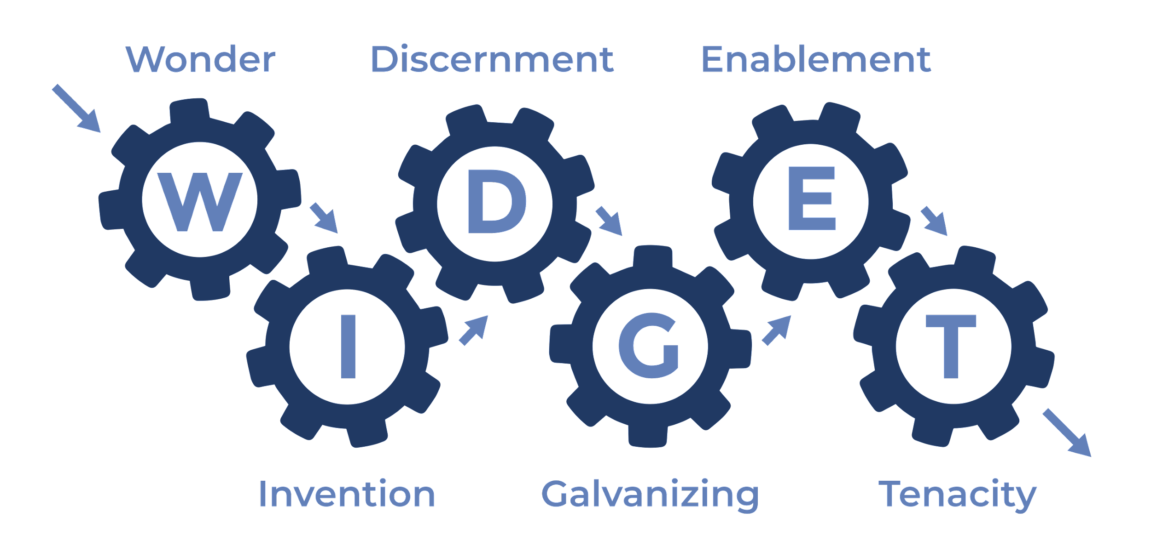
Notes:
Developed by Patrick Lencioni, the model identifies six distinct types of working genius.
It’s designed to help individuals and teams understand their strengths, weaknesses, and how to collaborate more effectively.
Explain that the Working Genius model is based on two core factors: how people think and how they approach work.
The six types are: Genius of Wonder, Genius of Discernment, Genius of Completion, Genius of Enablement, Genius of Implementation, and Genius of Execution.
The model helps identify what type of work energizes individuals, what drains them, and how that contributes to overall team dynamics.

Slide 6

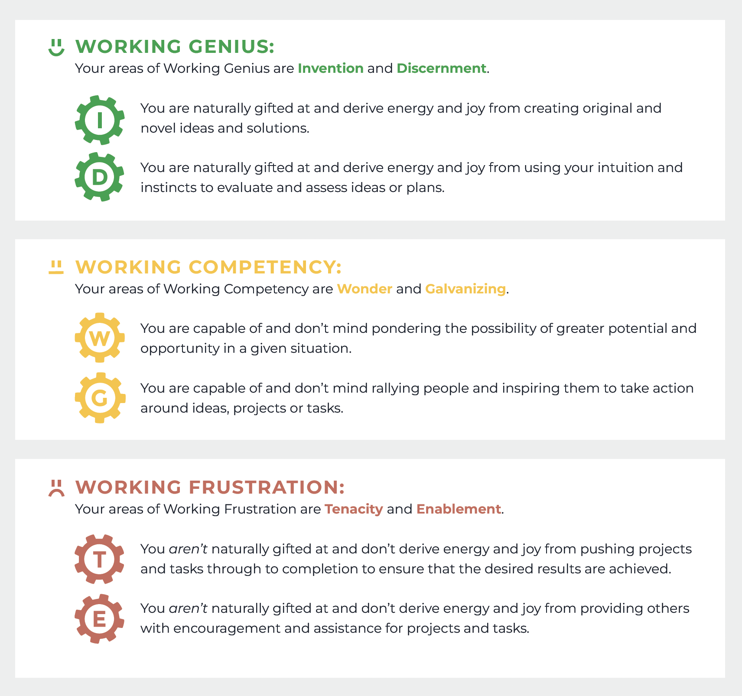
Genius Categories
Working Genius
Working Competency
Working Frustration

Slide 7
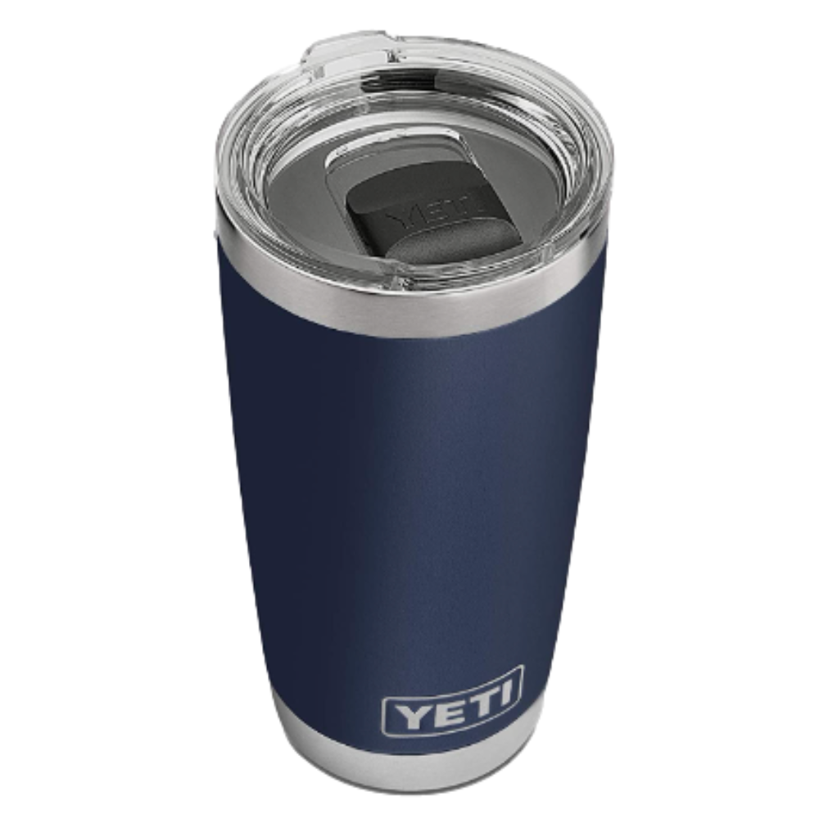
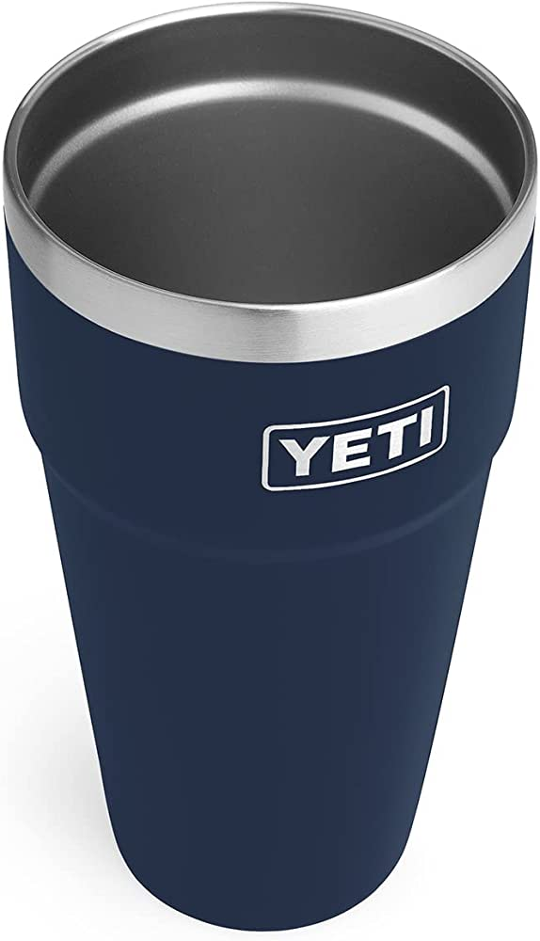
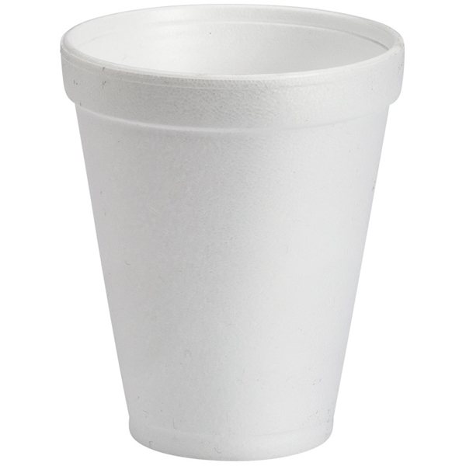


Slide 8
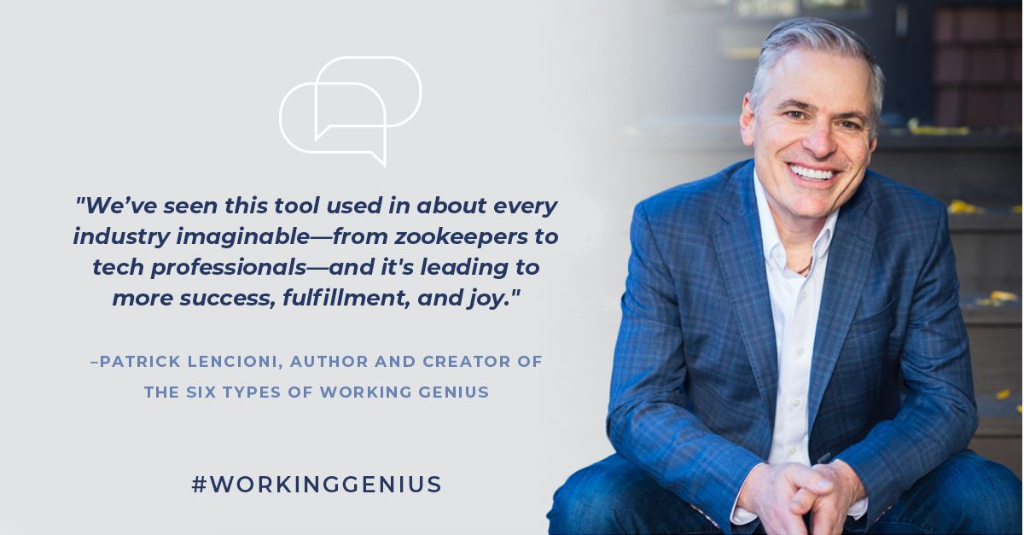

Slide 9
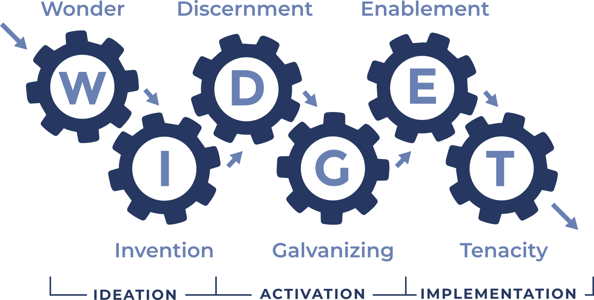
Three Stages of Work

Slide 10
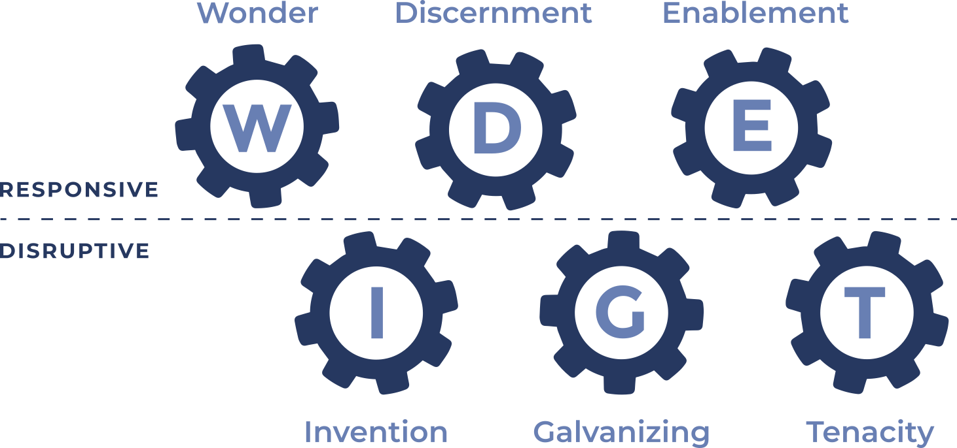
Responsive vs Disruptive

Slide 11


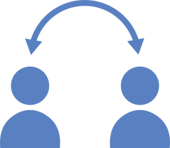
Guilt and Judgment
Self
Others – Fundamental Attribution Error

Slide 12
Kim’s WIDGET

Slide 13
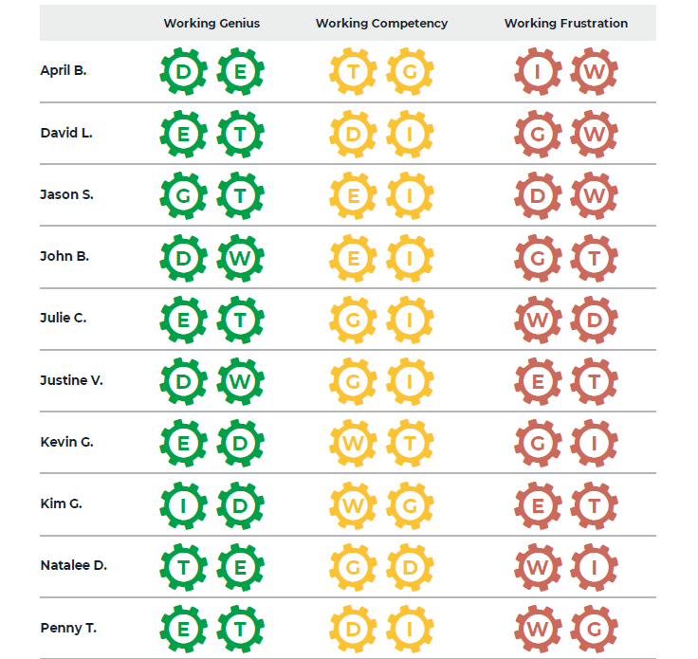
Kim’s WIDGET

Slide 14
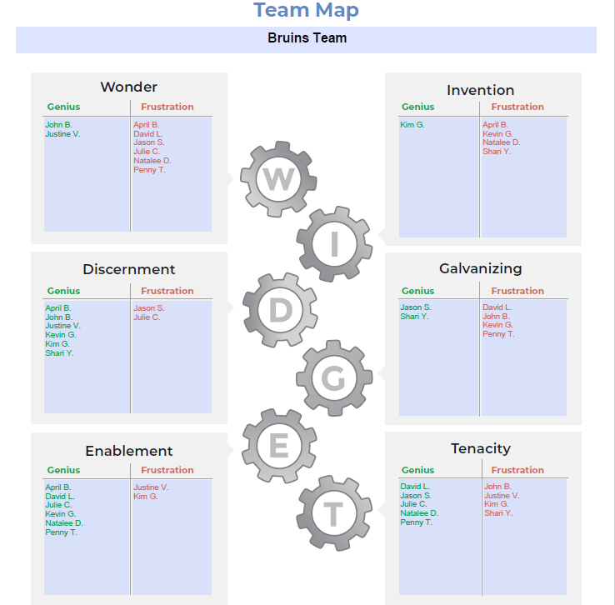
Kim’s WIDGET

Slide 15
Three Phases of Work & the Altitude of Genius

Slide 16
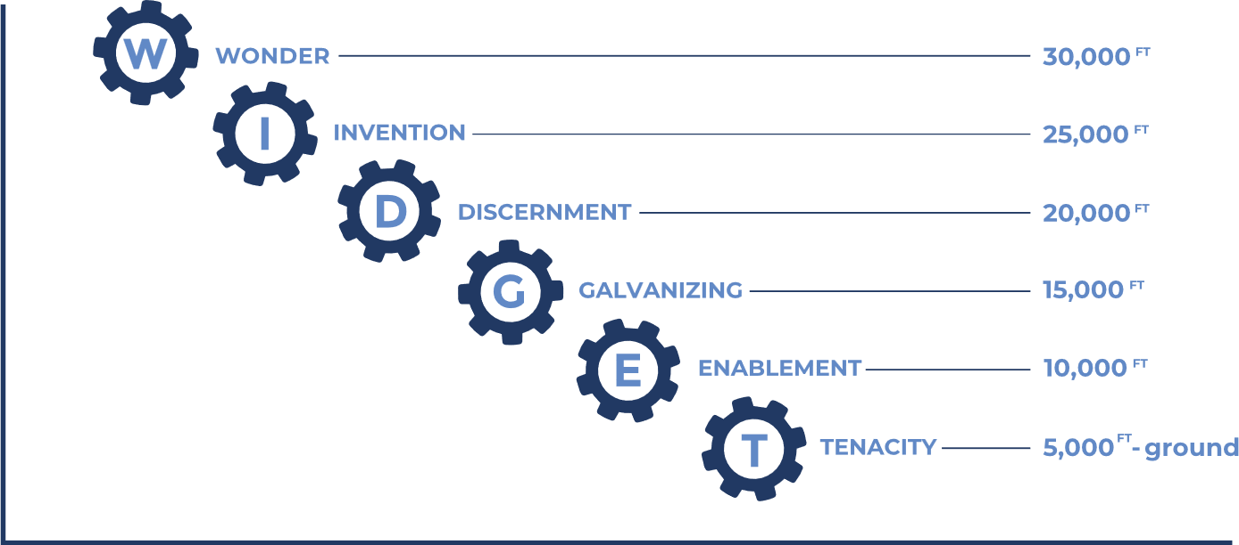
The Altitude of Geniuses

Slide 17

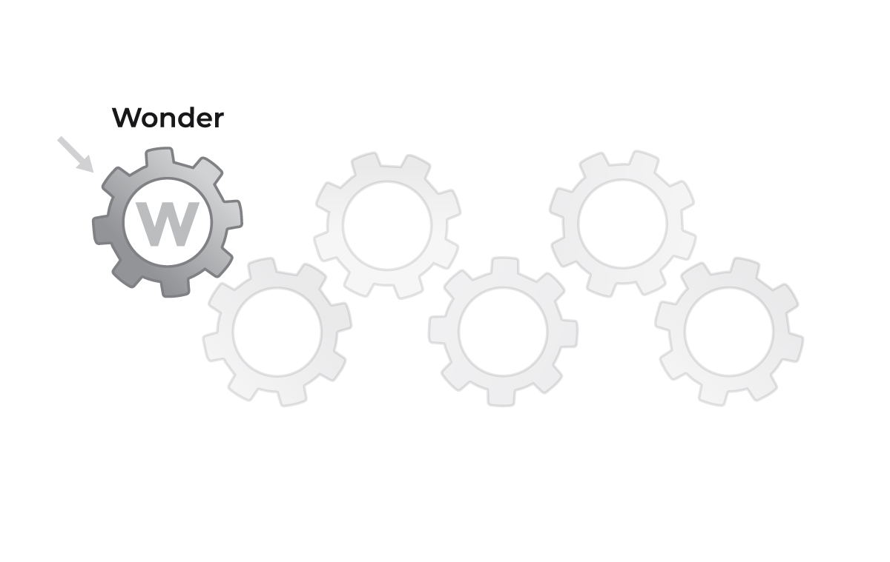
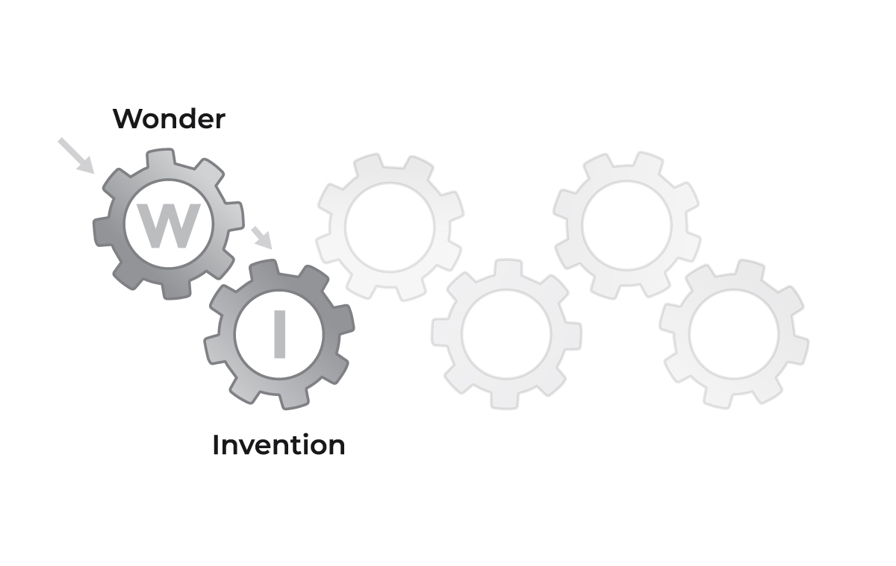
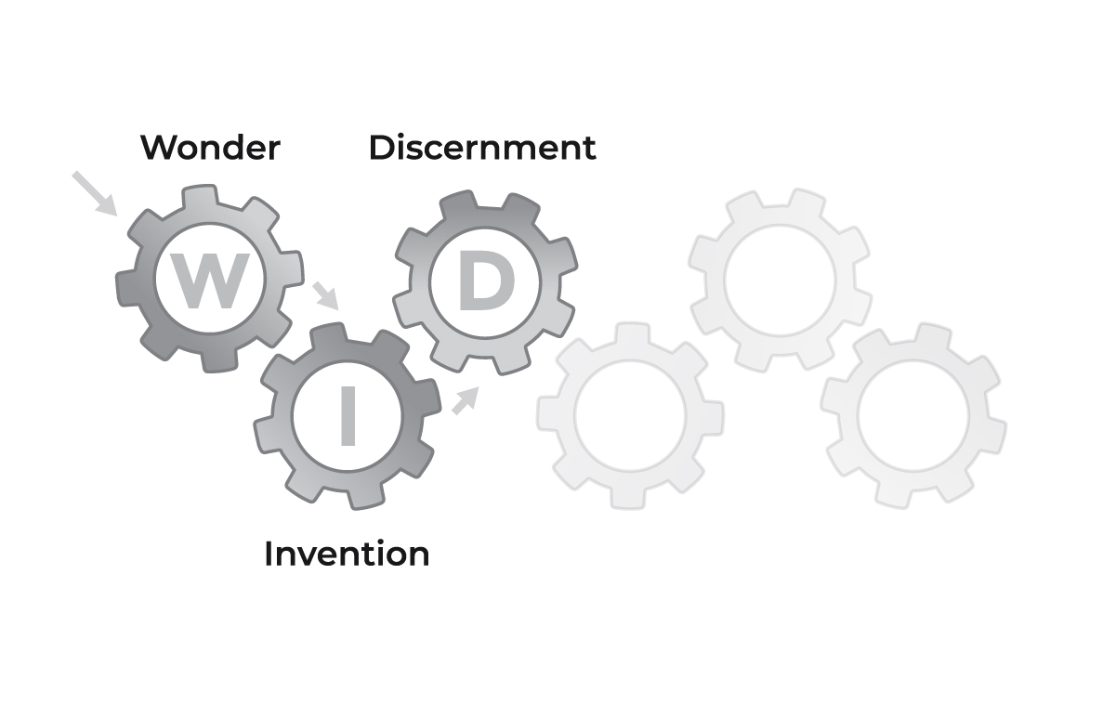
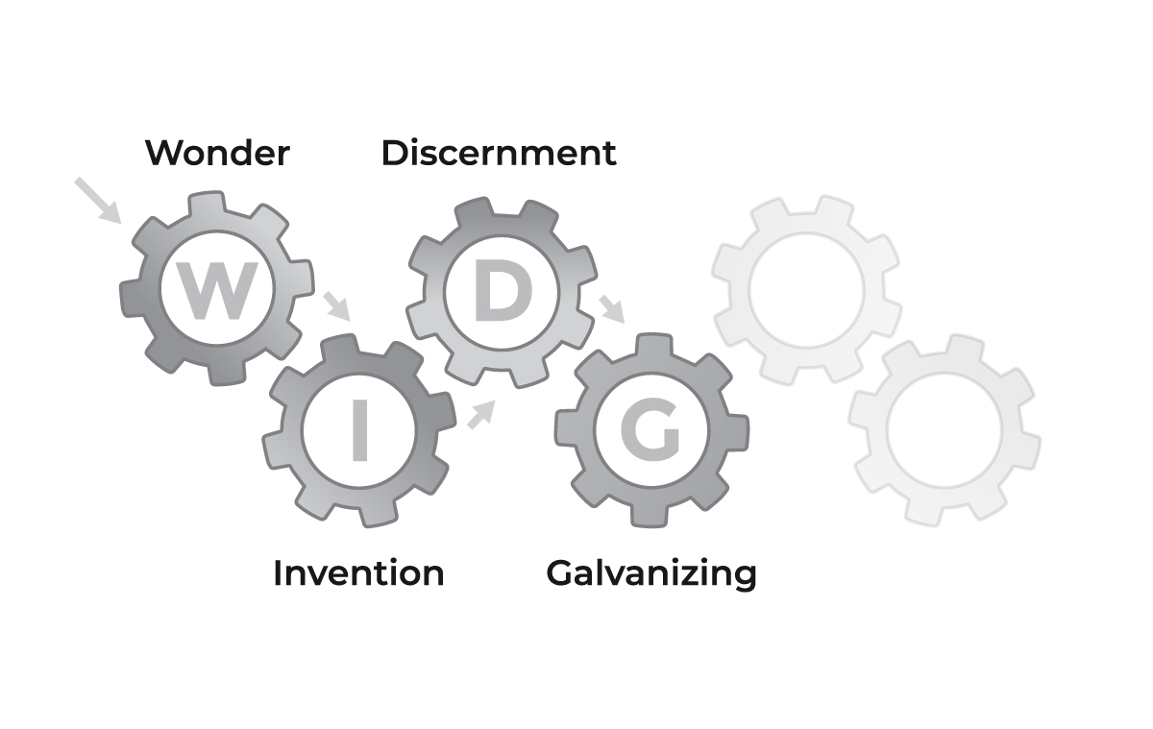
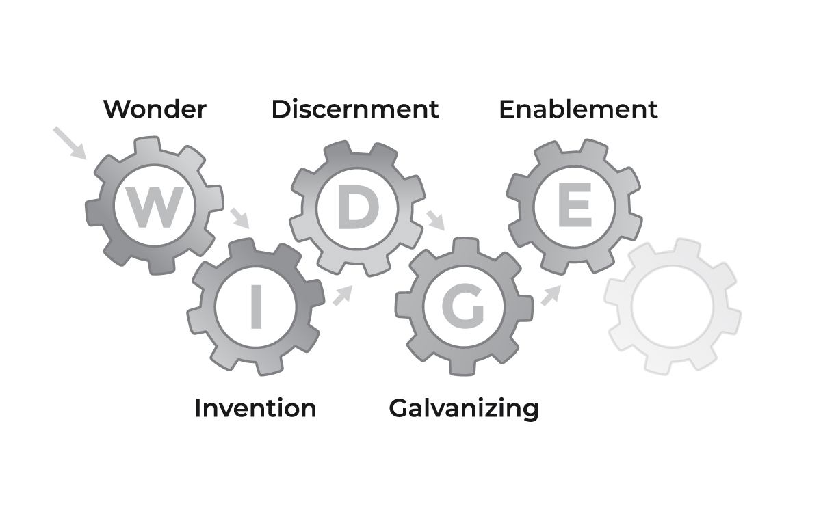
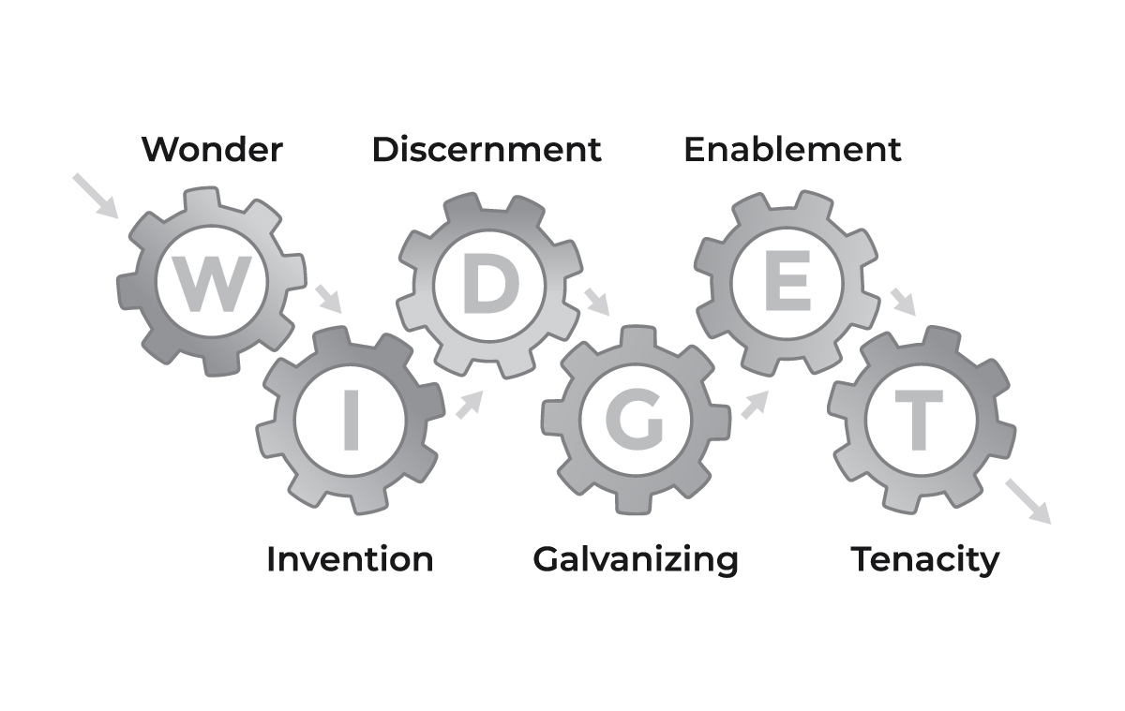

The Three Stages of Work

Slide 18
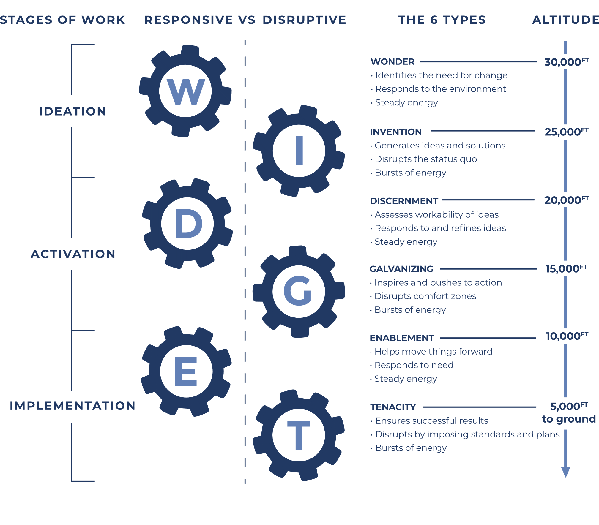
All-In-One
Model
Notes:
Check lower case ft vs all caps elsewhere

Slide 19
Application at RiverWoods

Slide 20

Training Analysis
2 certified Working Genius facilitators
225 assessments
Conducted (9) four-hour training sessions between 2023-2025
Offer monthly “deep dive” webinars

Slide 21
Team Benefits
Allows us to tap into one another’s talents
Changes how we staff projects
Creates a common language for the team
Provides a framework for innovation and work
Reduces guilt and judgment
Improves productivity and morale

Slide 22
Individual Applications
Job/Career Planning
Employee Development
Job Adjustments

Slide 23
Coaching Leaders
How do you leverage and/or regulate your Working Genius?
How do you tap into the geniuses of others to fill your gaps?
How do you show your appreciation and reward others?
How do you lead meetings?

Slide 24
Working Genius
And Meetings

Slide 25
Productive Meetings
Brainstorm or Offsite
Solutions Oriented or Ad Hoc Strategic
Rally and Tactical or Weekly Staff Meeting
Task Oriented or Daily Standup
Notes:
Pulled the new questions from our current meetings doc in CG

Slide 26
Productive Meetings
Understand the meeting purpose
Lead the meeting at the right altitude
Borrow a genius
Regulate your genius
Notes:
Pulled the new questions from our current meetings doc in CG

Slide 27
Problems/Questions
“But this is part of my role/job.”
“I don’t like my results.”
“Do our geniuses change over time?”
“Should I develop my Working Frustrations?”
“I retook the assessment and the results changed.”

Slide 28
5 Signs of Success
Teams using Working Genius successfully do 5 things:
Integrate the Working Genius vocabulary regularly
Know their geniuses and frustrations, which increases productivity and trust
Reference the Altitude of Geniuses to orient meetings, projects, and conversations
Tap into one another’s geniuses
Use the model to inform hiring needs and job descriptions

Slide 29
Q & A

Slide 30
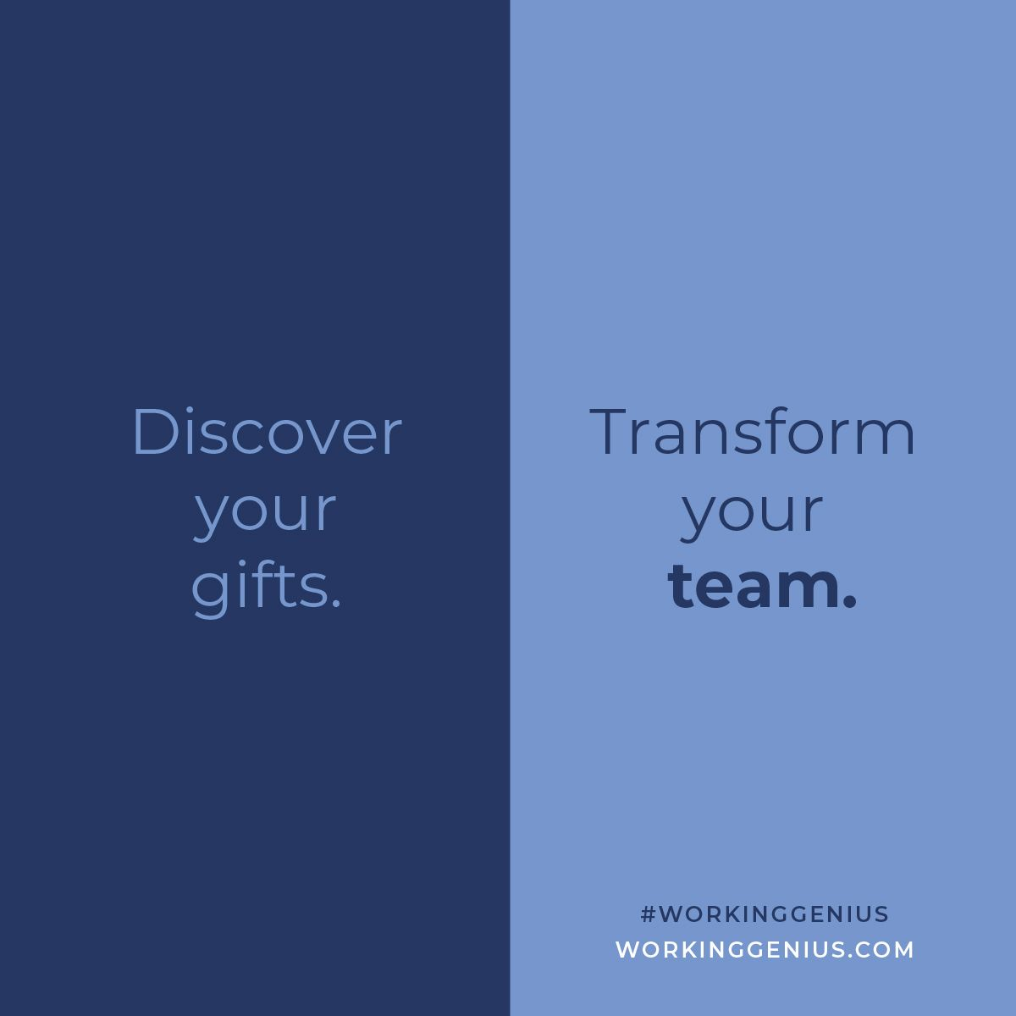
Genius
Misconceptions

Slide 31

Thank You!

