Slide 1

8th ANNUAL WATER LAW SERIES
October 26, 2023

Slide 2


HOT LEGAL TOPICS
Damon R. Talley
Stoll Keenon Ogden PLLC
damon.talley@skofirm.com
October 26, 2023

Slide 3

DISCUSSION TOPICS
PSC Filings
Comply with PSC Orders
Minutes
Notable PSC Orders
Borrowing Money
Cases to Watch

Slide 4
DISCLAIMER

Slide 5

PSA for
PSC

Slide 6
Reporting Requirements
  Must Notify PSC if . . .
      Vacancy Exists
      Appointment Made
  When? Within 30 Days
  Consequences

Slide 7
Vacancy
  Inform CJE 60 Days Before Term Ends (KRS 65.008)
  CJE / Fiscal Court – 90 Days
  Then, PSC Takes Over
    CJE Loses Right To Appoint

Slide 8
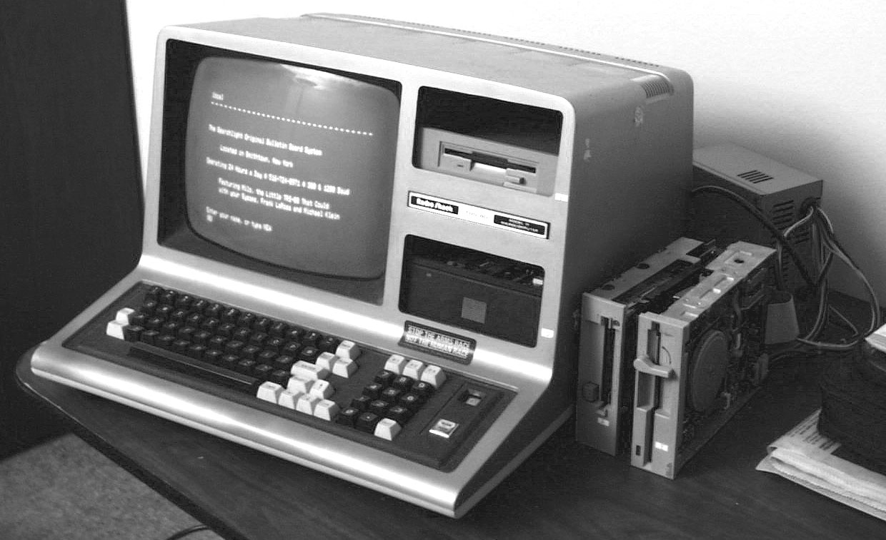
You’ve Got Mail!
Check It!

Slide 9
E-Mail Address Regs.
All PSC Orders Served by E-mail
Duty to Keep Correct E-mail Address on file with PSC
    Default Regulatory E-mail Address
Duty to List E-mail Address in Application & All Other Papers
    Utility Official
    Its Attorney

Slide 10
E-Mail Address
  Who is Covered?
    Water Districts
    Water Associations
    Investor Owned Utilities
    Municipal Utilities

Slide 11
Why Municipals?
  Contract Filing
  Tariff Change (Wholesale Rate)
  Protest Supplier’s Rate Increase
  Acquiring Assets of Another Utility
  Avoid Delays

Slide 12

Tips
Talley’s

Slide 13
Default Regulatory E-mail Address
  Send E-mail to PSC
      psc.reports@ky.gov
      PSCED@ky.gov
  Send Letter to PSC
      Linda C. Bridwell,
    Executive Director

Slide 14



Slide 15
No More Paper Copies
Case No : 2020-085 (COVID)
Order: 07-22-2021
Holding: Electronic Filings Only
      Utilities
      Lawyers
      Complainants
      Everyone

Slide 16
Tips
Talley’s

Slide 17
Electronic Filing
  Don’t Procrastinate
      Must Register to File
      2 Step Process (1 or 2 Days)
  Go Ahead and Register Now
  Call KRWA
  Call SKO Attorneys
  No Originals

Slide 18
Comply
With All
PSC
Orders

Slide 19
PSC Case No. 2021 - 343
Filed: 12-14-2021
Type: Failure to Comply
with PSC Order
Issue: Did Not Timely File
Rate Application &
Failure to File PSC
Annual Report
Decided: 07-15-2022

Slide 20
PSC Case No. 2021 - 343
  Result: WD Fined $5,000
      WD Pay $250
      Board Members & GM Attend 12 Hours of PSC Training
      Balance of Fine Suspended for 12 Months
      No More Violations
(cont.)

Slide 21
“. . . for allegedly failing to comply with the Commission’s March 10, 2020 Order in Case No. 2019-00458. The willful failure to comply presents prima facie evidence of incompetency, neglect of duty, gross immorality, or nonfeasance, misfeasance, or malfeasance in office sufficient to make [the District’s] officers and manager subject to the penalties of KRS 278.990 or removal pursuant to KRS 74.025. The Commission finds that a public hearing should be held on the merits of the allegations set forth in this Order.”

Slide 22
PSC Case No. 2022 - 228
Date: 08-22-2022
Type: Failure to Comply
with PSC Order
Issue: Did Not Timely File
Rate Application
RD Case: Filed 09-29-2022
Decided: 12-08-2022

Slide 23
PSC Case No. 2022 - 228
  Facts:
      PWA Case 2 Penny
      Must File Rate Case by 04-15-2022 (6 Months)
      Nothing Filed by 08-22-2022
      PSC Opened Case
(cont.)

Slide 24

PSC Case No. 2022 - 228
  Manager’s Defense:
        Honesty
        I Never Read the Order
        I Never Told the Board
        Fell on His Sword
(cont.)

Slide 25
PSC Case No. 2022 - 228
  Board’s Defense:
      Ignorance is Bliss
      Manager Never Told Us
      Manager’s Job to Tell Us
      Acknowledged Ultimate Responsibility
(cont.)

Slide 26
PSC Case No. 2022 - 228
  Affirmative Steps to Mitigate:
        Adopt New Procedure
          All PSC Orders Forwarded to Board Members
        Engaged Services of RCAP to File Rate Case
(cont.)

Slide 27
PSC Case No. 2022 - 228
    Affidavit: RD Rate Case
        31% Increase
    District is Getting CJE to Re-appoint Commissioners
(cont.)

Slide 28
PSC Case No. 2022 - 228
  Outcome:
  RD Rate Case 31%
  No Hearing
  Commissioners & GM
      Fined $250
      Waived
          12 Hours PSC Training
          Good Behavior
          . . . (cont’d)

Slide 29
PSC Case No. 2022 - 228
  Outcome:
  File Rate Case: 06-30-2023
  Proposed
  Increase: 5.18%
  Rate Case: Discovery

Slide 30

PANDORA’S
BOX
? ? ?

Slide 31

MINUTES

Slide 32
What Are MINUTES?
Official Record
Much, Much More . . .

Slide 33
AN OUNCE OF PREVENTION
=
A POUND OF CURE

Slide 34
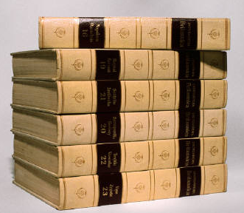
How much information SHOULD be included in the MINUTES?

Slide 35
Minutes
How MUCH is too MUCH?
No definitive answer
Art not a science
Cont.

Slide 36
Minutes …
How MUCH is too MUCH?
  Guidelines . . .
  Minutes are NOT a transcript
  Minutes are NOT the Congressional Record
  Include rationale for action taken if it might avoid lawsuit

Slide 37
“Conversations are NOT official actions of the Board.”
Virginia W. Gregg
Former PSC Staff Attorney

Slide 38
WHY Include Summary of Conversations in Minutes?
Document Board’s Due Diligence
  (e.g. Water Loss)
Document Board’s Oversight Role (e.g. Compliance with PSC Orders)
Avoid or Win Litigation

Slide 39
TALLEY’S
TIPS

Slide 40
Talley’s Tips
Prepare Minutes for a Reader . . .
Who did not attend the meeting.
Who will not read the Minutes until at least one year later.
Who is employed by PSC.
Who will access Minutes via www.

Slide 41
Notable
PSC
Orders

Slide 42
PSC Case No. 2023-306
Filed: 09-15-2023
Utility: Bullock Pen WD
Type: Declaratory Order
Issue: Is CPCN Needed To Buy Land?
Decided: 10-06-2023

Slide 43
PSC Case No. 2022 - 065
Filed: 3-29-2022
Utility: Southeastern Water Assoc.
Type: CPCN – New Office Bldg.
Issue: Reasonable Alternatives
Considered
Decided: 8-30-22

Slide 44
PSC Case No. 2022-065
  CPCN: Standard of Review
      Need
      Absence of
      Wasteful Duplication

Slide 45
PSC Case No. 2022-065
  Proving Lack of Wasteful Duplication:
      All Reasonable Alternatives Considered
      Cost is Not Sole Criteria
        Initial Cost
        Annual Operating Cost

Slide 46
PSC Case No. 2023 - 192
Filed: 6-09-2023
Utility: Ohio Co. WD
Type: CPCN – Raw Water
Intake Rehab
Issue: Reasonable Alternatives
Considered
Decided: 7-31-23

Slide 47
PSC Case No. 2023-192
  Preliminary Engineering Report
      Alternative 1: Cadillac
      Alternative 2: Chevrolet
  Final Engineering Report
      Only Discussed Alt. 2

Slide 48
PSC Case No. 2023-192
  Extensive Discovery Alt. 1
      Initial Cost
      Depreciation Expense
      Annual Operating Cost
      Rate Increase Needed
  Comparison of Both Alternatives

Slide 49
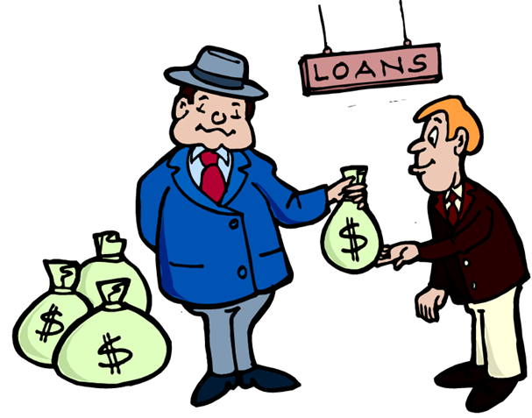
Borrowing
Money

Slide 50
KRS 278.300(1)
  No utility shall issue any securities or evidences of indebtedness . . . until it has been authorized to do so by order of the Commission.

Slide 51
Practical Effect
  Must Obtain PSC Approval Before Incurring Long-term Debt (Over 2 Years)
  Exception:
      2 Years or Less
      Renewals
        (3 X 2 = 6 Years)
      (6 X 1 = 6 Years)

Slide 52

Violation

Slide 53
Show
Cause
Cases

Slide 54
2022 Show Cause Cases
Borrowing Money
First Case: 2022-061
Second Case: 2022-197

Slide 55
2022 Case # 1
Case No. 2022 - 061
Opened: 04 - 08 - 2022
Issue: KRS 278.300 (2 Violations) Repeat Offender - 2013
Decided: 11-14-2022

Slide 56
2022 Case # 1
  Facts: (1) Refinanced RD Loans w/o PSC Approval 07-23-2021
  Facts: (2) Bought Truck w/o PSC Approval
              Bank Loan
              75 Months
  Discovered: PSC Staff – Rate Case

Slide 57
2022 Case # 1
  Corrective Action:
    Filed Application for Retroactive Approval (Case No. 2021-465)
          PSC Denied
          No Retroactive Approval

Slide 58
2022 Case # 1
  Defenses:
      Ignorance
      Lawyer Said No PSC Approval Needed
      Relied on Bank
      New Manager

Slide 59
2022 Case # 1
  Case Status:
      Switched Lawyers
      Discovery Stage
          2 Rounds
      Hearing Date: None

Slide 60
2022 Case # 1
  Outcome:
    Chairman
        Fined $500
        12 Hours of Training
        Previous Offender (2012)
        Tongue Lashing

Slide 61
2022 Case # 1
  Outcome:
    Other Commissioners
        No Fine
        12 Hours of Training
    Bond Lawyer
        Reimburse Utility
        for Lawyer Fees

Slide 62
2022 Case # 2
Case No. 2022 - 197
Opened: 08- 11 - 2022
Issues: Violated:
              KRS 278.300
              KRS 278.020
Hearing: 07-06-2023
Decided: Pending

Slide 63
2022 Case # 2
  Background Facts:
    11-18-21: Purchased Office Bldg.
    11-18-21: Financed Portion of Cost with a 7 year Loan
    03-15-22: Applied for Retroactive Approval of Loan
  … continued

Slide 64
2022 Case # 2
  Background Facts (continued):
    05-13-22: PSC Issues DR
    05-19-22: Bank Loan PIF
    05-27-22: PSC Application Withdrawn by Utility
  … continued

Slide 65
2022 Case # 2
  Background Facts (continued):
    06-20-22: PSC Dismisses Case & States Intent to File Show Cause Case
    08-11-22: PSC Opens Show Cause Case

Slide 66
2022 Case # 2
  Utility’s Defenses:
    Loan Paid Off
    No CPCN Needed Since Building was Purchased & Not Constructed
    Relied Upon Advice of Counsel
    Good, Honest & Decent People

Slide 67
2022 Case # 2
  Case Status:
    Multiple Rounds of DR
    Hearing: 07-06-23
    Post Hearing Data Request
    Brief Filed: 09-08-2023
    No Decision Yet

Slide 68
2023 Show Cause Case
Borrowing Money
First Case: 2022-252
Second Case: 2022-344

Slide 69
2023 Case # 1
Case No. 2022 - 252
Opened: 02 - 16 - 2023
Issue: KRS 278.300 (4 Violations)
Hearing: 08-01-2023
Decided: 10-17-2023

Slide 70
2023 Case # 1
Facts: Leased 4 Trucks 4 & 5 Year Terms
Issue: Is Long Term Lease An evidence of Indebtedness
Holding: Yes

Slide 71
2023 Case # 1
  Outcome:
    GM & Directors (Water Assoc.)
        Fined $250 (Waived)
        12 Hours of Training
        6 More Hours Annually
    Future Directors
        6 Hours Training Annually

Slide 72
2023 Case # 2
Case No. 2022 - 344
Opened: 04 - 14 - 2023
Issue: KRS 278.300 (4 Violations)
Hearing: 07-06-2023
Decided: Pending

Slide 73
2023 Case # 2
  Defenses:
      Advice of Counsel
        No Opinion Letter from Counsel
      No Answer Filed
      Lawyer Mea Culpa Letter

Slide 74
2023 Case # 2
  Case Status:
      3 Rounds of DR
      Hearing: 07-06-2023
      Very Interesting Hearing
      Post Hearing DR
      Brief Due: 08-31-2023
      (Mot. for Ext. of Time)

Slide 75


QUESTIONS?
damon.talley@skofirm.com
270-358-3187

