Slide 1

8th ANNUAL WATER LAW SERIES
October 26, 2023

Slide 2


2023 Kentucky General Assembly
Cameron F. Myers
Stoll Keenon Ogden PLLC
cameron.myers@skofirm.com
October 26, 2023

Slide 3

Notable Bills
  HB 360: Sales tax exemption for materials purchased by construction contractor for water or sewer projects
  HB 360: Clarifications to the “residential utility” sales tax exemption recently modified by HB 8 (2022)
  HB 522: Increases spending threshold for which bids must be advertised for local gov’t contracts from $30,000 to $40,000

Slide 4
Notable Bills (Cont.)
  SB 263: Provides numerous incentives for regionalization/consolidation of water and sewer systems

Slide 5
HB 360: Background
KRS 139.470. Exempt Transactions.
Exempts from KY Sales and Use Taxes:
  “Gross receipts from sales to any cabinet, department, bureau, commission, board, or other statutory or constitutional agency of the state and gross receipts from sales to counties, cities, or special districts as defined in KRS 65.005. . .”
  IF the property sold is for use “solely in the government function.”

Slide 6
HB 360: The (Prior) Problem with Construction Contracts
Hypothetical: Water District A and Water District B are each planning to expand their water systems. They will each need to purchase $10 million of ductile iron pipe to do so.
Water District A plans to purchase the pipe directly from the vendor and manage the project itself
Water District B plans to use a contractor to purchase the pipe on the District’s behalf, store it, install it, and manage the project

Slide 7
HB 360: The (Prior) Problem with Construction Contracts
Prior to HB 360, the sale of the pipe directly to Water District A would be exempt from sales tax
The sale of the pipe to Water District B’s contractor would not be exempt from sales tax, and would cost Water District B an additional $600,000 ($10M x 6% = $600,000), unless Water District B . . .

Slide 8
HB 360: The (Prior) Problem with Construction Contracts
  Purchased the materials and installation labor under separate contracts;
  Advertised separate bids for materials and labor;
  Prepared and submitted its own purchase orders;
  Paid the suppliers directly; and
  Had the materials delivered directly to Water District B’s property.

Slide 9
HB 360: The (Prior) Problem with Construction Contracts
Result: governmental water utilities looking to expand their systems were forced to choose between:
  (A) incurring substantial added costs in taxes (e.g., $600,000), or
  (B) foregoing the use of a contractor and managing the project directly (tracking each invoice, coordinating scheduling, assuming liability for storage of materials, etc.)

Slide 10
HB 360: The Solution
HB 360 eliminates this prior discrepancy in KY sales tax law by extending the sales tax exemption to:
  Building materials, fixtures, or supplies
  Purchased by a contractor
  Pursuant to a contract
  With an eligible utility (gov’t entity)
  For a water or sewer project

Slide 11
HB 360: The Solution
Exemption now applies irrespective of:
  Whether materials and labor are advertised or bid separately
  Type of construction contract (e.g., lump sum, materials and labor, materials only, etc.)
  Place of delivery for the materials
  Payment arrangement between the utility, the vendor, and the contractor (e.g., who pays who for the materials)

Slide 12
HB 360: The Solution
Eligible Utilities - governmental utilities that would be exempt under the prior law had they purchased the materials directly from the vendor:
    Municipally Owned Utility
    Water District
    Water Commission
    Sanitation District
    Joint Sewer Agencies
    Chapter 58 Utility
    Any other “governmental agency”

Slide 13
HB 360
  Not Eligible:
      Water Associations
      Investor Owned Utilities
          Ky. American Water
          Water Service Corp. of Ky.
          Privately Owned Utilities

Slide 14
HB 360
  Codified in KRS 139.480(34)
  Effective Date: Retroactive to 1-1-23
  New Certificate of Exemption Form available on Kentucky DOR website - Form 51A383 (4-23)

Slide 15
HB 360
New DOR Certificate of Exemption Form - Form 51A383 (4-23)
Who Signs Form
  Utility
  Contractor
  Subcontractor
  (if it Purchases Materials)
Submit Form to Vendor
Handout

Slide 16
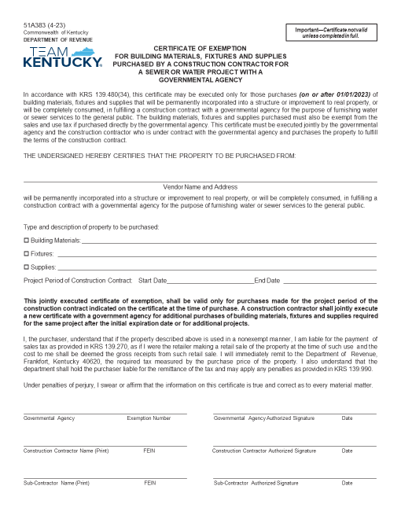
https://revenue.ky.gov/Forms/51A383%20(4-23).pdf

Slide 17

Practice
Points

Slide 18
Practice Points
Educate
  Engineer
  Contractors
  Vendors
Bid Specs
Pre-Bid Conference
Contract Signing
Stored Materials Invoice

Slide 19
HB 360: Modifications to Residential Utilities Sales Tax Exemption
2022 HB 8 replaced the prior tariff-based rules for determining residential use with a new “Declaration of Domicile” requirement
HB 360 modifies the “Declaration of Domicile” requirement for:
  Multi-Unit Apartments,
  Mobile Home Parks, and
  RV Parks

Slide 20
HB 360: Modifications to Residential Utilities Sales Tax Exemption
More user friendly:
  Owner or operator signs new D of D form on behalf of all tenants of multi-unit apartment, mobile home park, or RV park
  Not applicable to owners/operators of condo associations or other residential property memberships (individual D of D forms still required)
Additional Requirements:
  All occupants must be KY residents and be domiciled in KY
  New DoD Form: 51A382 (4-23)

Slide 21
Form 51A382 (4-23)
Only Owner/Operator Signs
Tenants do not sign
Must include 100% of the rental units served by master meter
Required for each meter that measures utility service to multiple rental units
Effective: When Form 51A382
          Is Submitted
See DOR FAQ webpage
Handout

Slide 22
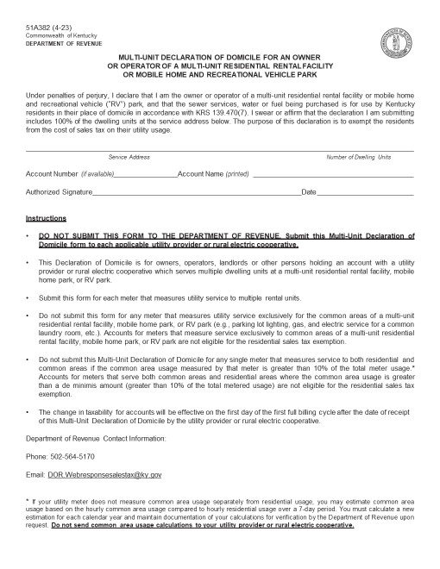
https://revenue.ky.gov/Forms/51A382%20(4-23).pdf

Slide 23
HB 522: Procurement
Local governments (cities, counties, boards, or commissions) may not enter into a contract for an expenditure above a certain threshold without first advertising for bids.
    Previous threshold: $30,000
    New Threshold: $40,000
    Effective: June 29, 2023

Slide 24
SB 263 - Regionalization
  Numerous Incentives for regionalization / consolidation
      Available to both Water & Sewer Systems
        Regionalization by:
            Ownership or
            Common Management

Slide 25


QUESTIONS?
cameron.myers@skofirm.com
502-568-5410

