Slide 1
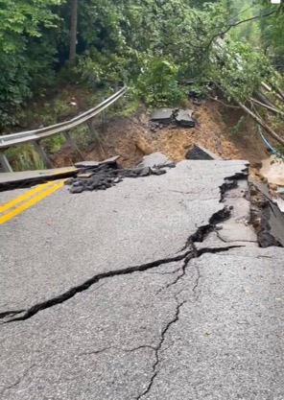
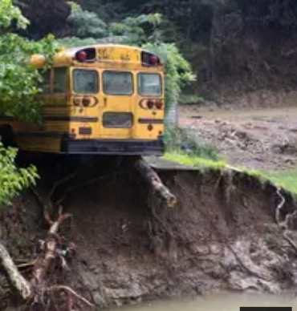
Disaster Preparedness for Water Systems Lessons Learned from Eastern Kentucky Flooding.
Water Law Seminar
Sloan Convention Center
Bowling Green, KY
October 26, 2022
Presenters:
Greg Heitzman – Bluewater KY
Joe Burns – Ky Rural Water

Slide 2
Abstract
Disaster Preparedness for Water Systems - Lessons Learned from Eastern Kentucky Flooding.
By Greg Heitzman (BlueWater KY) and Joe Burns (KRWA)
Small water systems in Kentucky are often not prepared for a natural disaster like the December 2021 Western Kentucky tornados affecting Mayfield and Dawson Springs, or the August 2022 Eastern Kentucky flooding impacting water systems in Breathitt, Floyd, Knott, Letcher, and Perry Counties. This presentation will provide a summary of the challenges faced by small, remote water systems, and how Kentucky Rural Water Association and Kentucky WARN responded with mutual aid resources from utilities, state agencies and non-profit organizations. Participating utilities provided support for infrastructure assessment, repair and operations. WaterStep worked with Kentucky Division of Water and Kentucky Public Health to provide mobile water treatment to remote communities without access to potable water. A summary of lessons learned from this experience will help utilities prepare for future natural disasters.

Slide 3
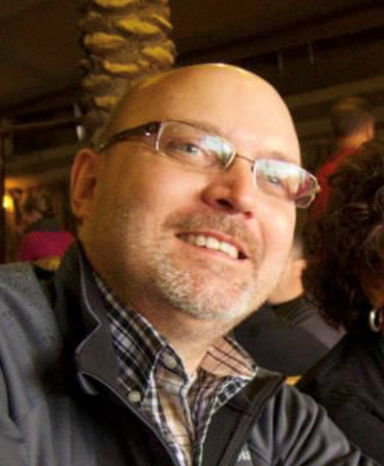
Presenter
Greg C. Heitzman │ Contact: Gheitzman@bluewaterky.comr a G
Greg Heitzman is President of BlueWater Kentucky, a management consulting firm serving the water industry. From 2011 to 2015, Greg served as Executive Director/CEO of the Louisville Metropolitan Sewer District (MSD). Prior to MSD, he worked 31 years with the Louisville Water Company serving as Chief Engineer from 1991 to 2007 and President/CEO from 2007 to 2013. Greg obtained his Bachelor and Master’s degrees in Civil Engineering from the University of Kentucky and an MBA from the University of Louisville. He is a licensed Professional Engineer in Kentucky. He currently serves on the boards of Louisville Water Foundation, Kentucky Water Resources Research Institute, WaterStep, and the University of Kentucky Civil Engineering Advisory Board.

Slide 4
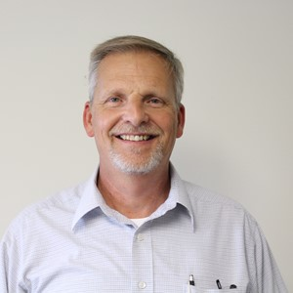
Presenter
Joe Burns│ Contact: j.burns@krwa.org
Joe Burns has been with Kentucky Rural Water Association since April 1994. In his present position as Program Coordinator, Joe is responsible for the oversight and implementation of the Small Water System Assistance program. This is program in partnership with KY Division of Water targets public water systems in non-compliance to provide the technical, financial, and managerial assistance needed to meet water quality goals and operational compliance. Joe also serves as the point of contact for Kentucky’s water/wastewater Agency Response Network (KYWARN). Joe holds Bachelor of Science and Master of Science degrees in Geology from Eastern Kentucky University.

Slide 5
Presentation Outline
Introductions - Greg
The Challenge with Increasing Natural Disasters - Greg
Mutual Aid Program through Kentucky WARN – Joe
Mobile Water Treatment Systems - Greg
Regional Lily Pad of Resources – Greg
Credit to Partners

Slide 6
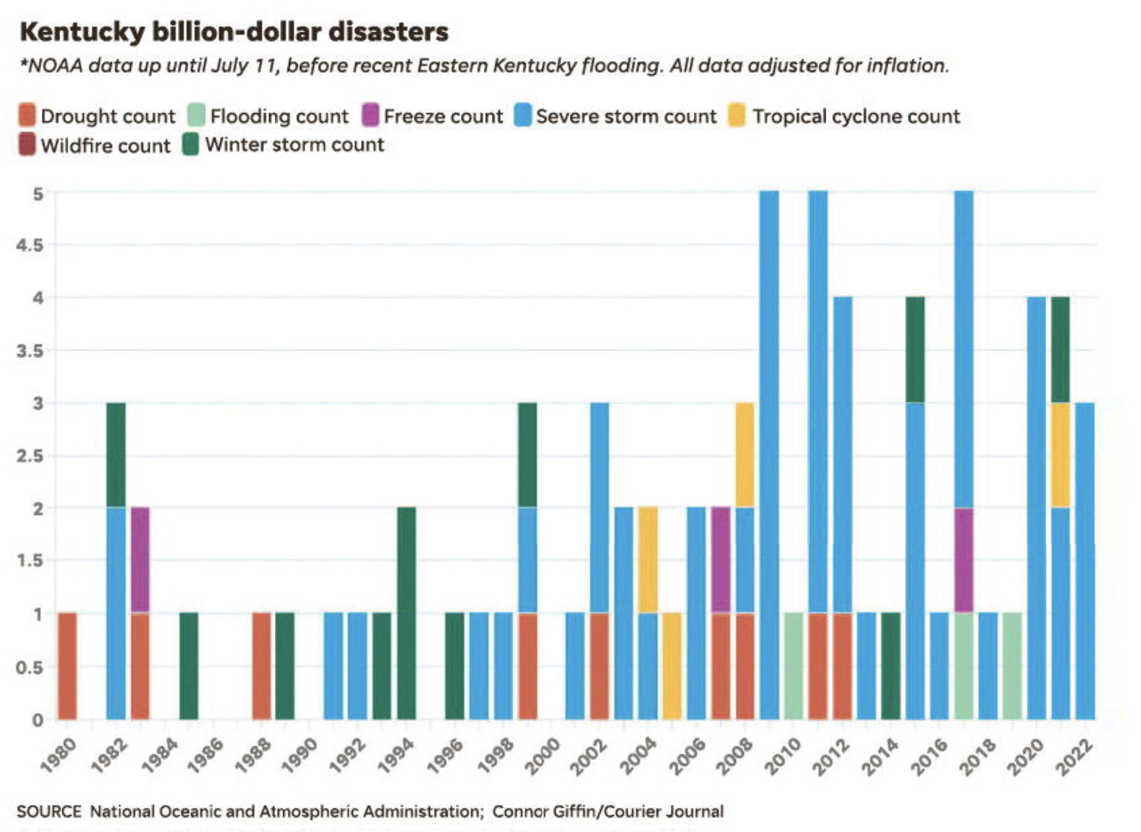
Kentucky’s Natural Disasters

Slide 7
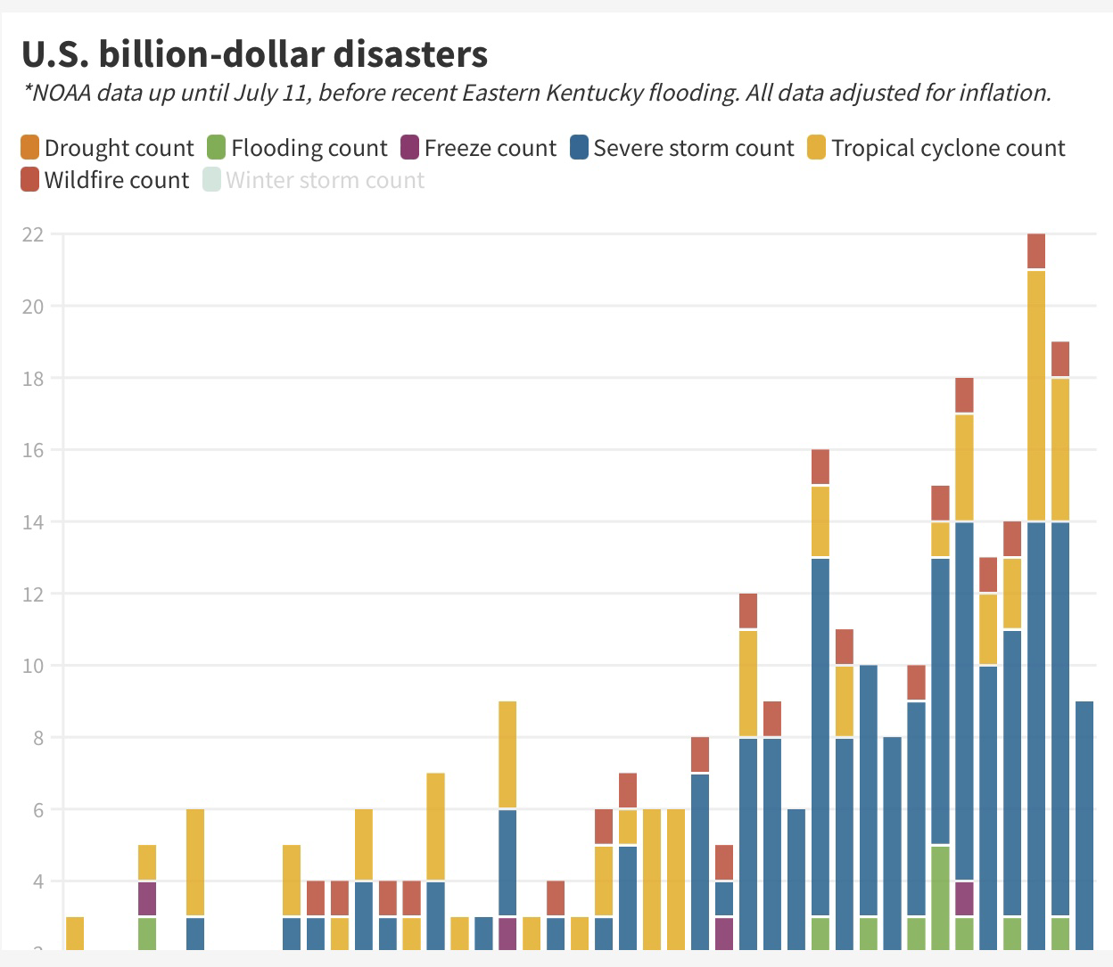
US Natural Disasters

Slide 8
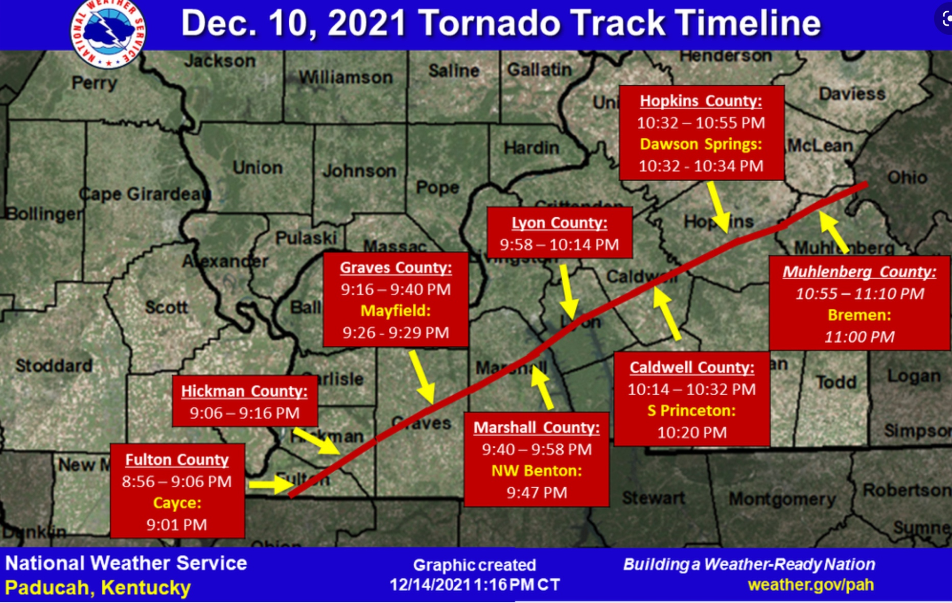
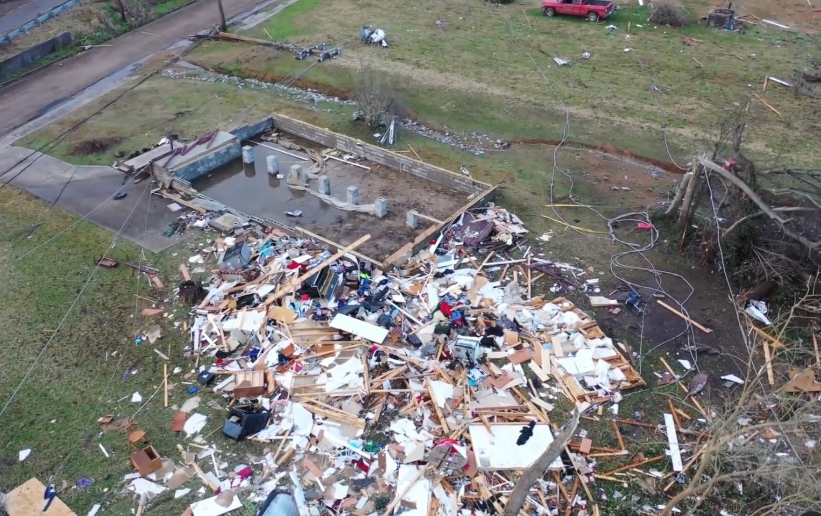
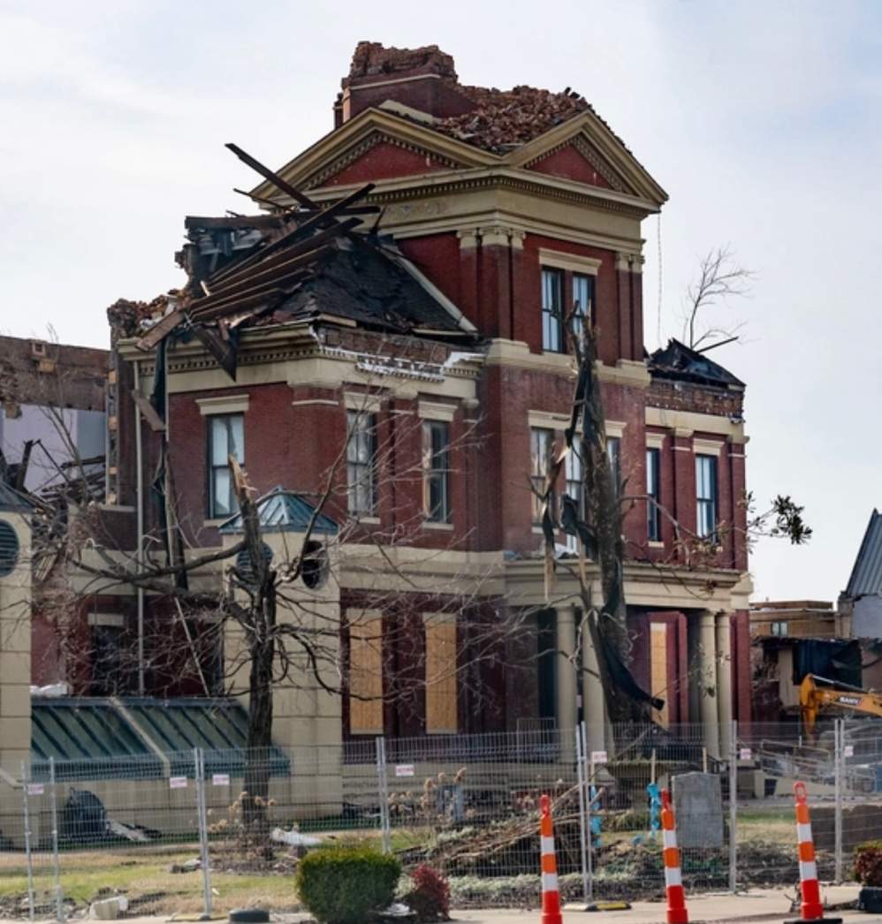
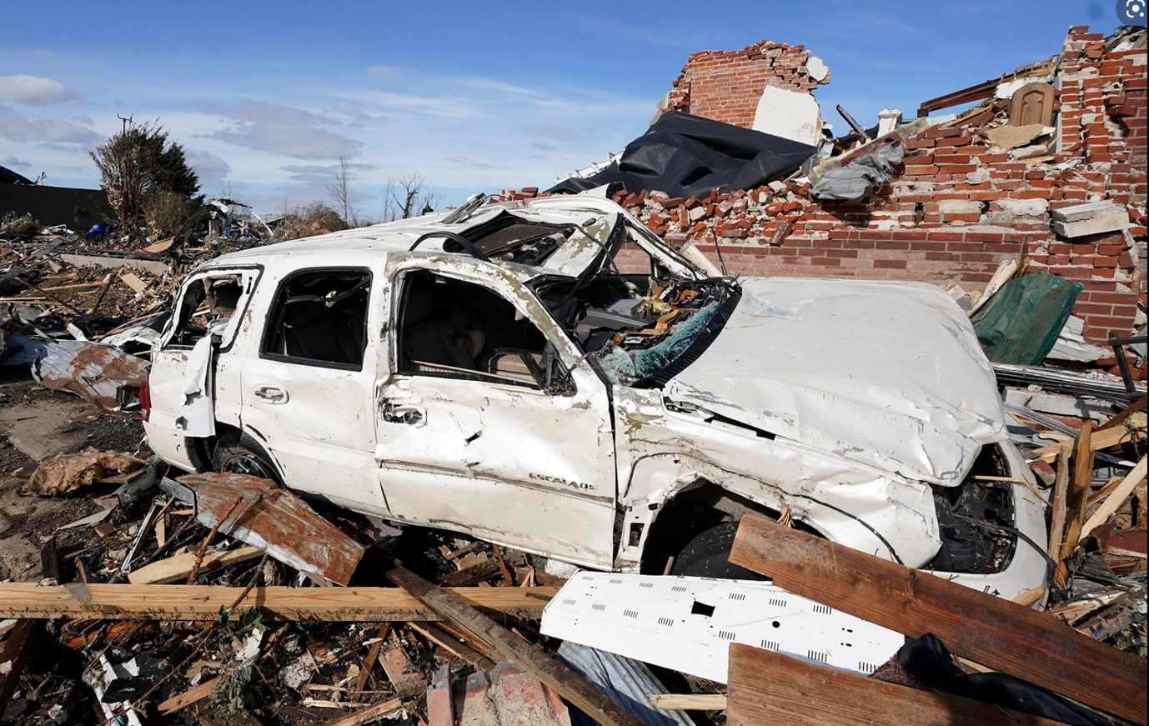
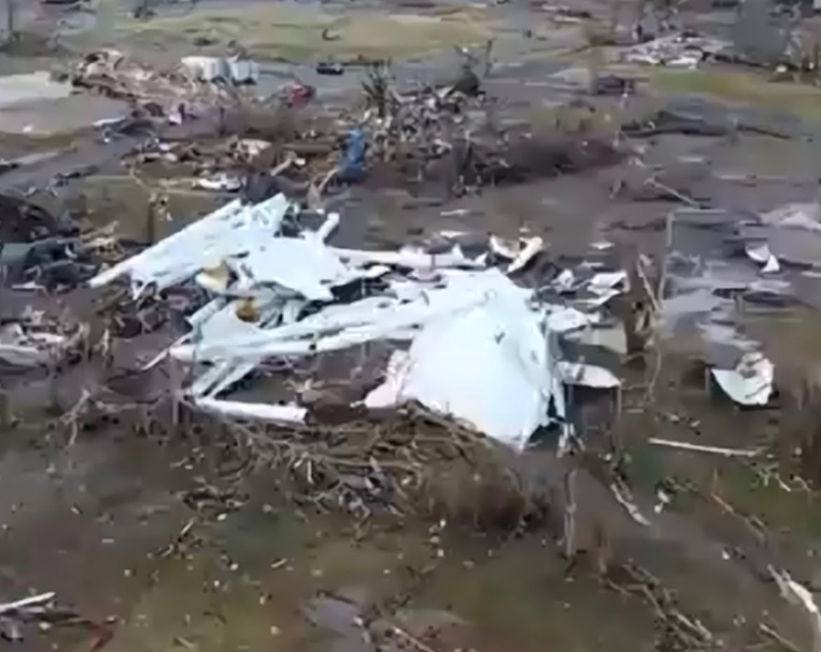
Western Kentucky Tornados – December 2021

Slide 9
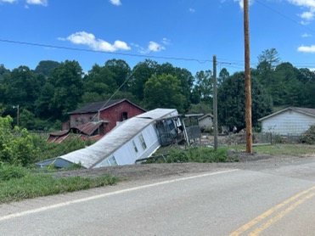
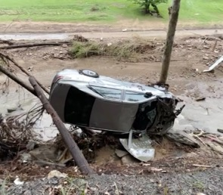
Eastern Kentucky Floods – August 2022

Slide 10
Kentucky Water Agency Response Network (KY WARN)
KY WARN’s Emergency Response to Eastern Kentucky Flooding
Joe Burns
Kentucky Rural Water Association

Slide 11
Recent Disasters in Kentucky
July Flash Flooding - Central KY
Loss of life
Significant property damage
Significant damage to wastewater treatment plant
December Tornado – Western KY
78 fatalities
24 water & wastewater facilities impacted
Over 55,000 without power
Over 10,000 without water or under BWA
Mobilized generators and personnel
KYEM coordinated bottled water
2021
February Ice Storm – Eastern KY
Over 70,000 without power
Over 5,300 without water & 38,500 under BWA
Mobilized generators and personnel
KYEM coordinated bottled water
March Flooding – Eastern KY
Over 3,000 without power
Over 1,700 without water & 16,000 under BWA
18 STPs bypassing & 19 overflows
Mobilized pumps, material and personnel
KYEM coordinated bottled water

Slide 12
Recent Disasters in Kentucky
2022
January Severe Storms Straight Line Winds / Tornado – South Central KY
Power outage
Flash flooding
Property damage
Minimal water utility damage
February Ice Storm / Flooding – Western KY
Under 10,000 without power
No water outages
Generators procured at two water utilities
3 WWTPs bypassing & 2 SSOs
Overflows at three wastewater plants
July-August Flash Flood - Eastern KY
40 fatalities
Over 23,500 without power
38,530 without water
Over 46,100 under BWA
5 WWTPs bypassing and multiple SSOs
Fall 2022 – Emerging Drought in KY

Slide 13
What Does The Future Hold For Us
Natural Disaster
Tornados
Ice Storm / Extreme Winter Weather
Flooding
Drought
Severe Storm / Lightning
Forest Fire
Pandemic
Manmade Disaster
Cyber Threat / Ransomware Attack
Accidental Contamination
Vandalism
Supply Chain Disruption
Terrorism
Pandemic
Operational Disaster
Catastrophic Equipment Failure
Line Breaks
Staffing

Slide 14
Lessons Learned
Develop and update an Emergency Response Plan
Adopt the KYWARN mutual aid agreement
Implement a GIS based asset inventory from source to customer
Know the exact power requirements for your facilities
Install permanent generators at treatment facilities
Install a safety transfer switch at facilities without a permanent generator
Locate rental companies that can source generators and pumps
Set adequate rates & fund depreciation because nothing drains your accounts faster than a disaster

Slide 15
What Is KYWARN?
Water/Wastewater Agency Response Network
Simply an Agreement between two Utilities
Statewide Resources from all other Utilities and other entities
Utilities united by a Common Enemy
Natural Disasters
Manmade Disasters
Utilities Organized within Kentucky
Private
Public
What KYWARN is Not
Not a Corporation
Not Federal Government (FEMA)
Not State Government
Not Connected to any Funding Source
Not Required for any Utility to Participate

Slide 16
What Constitutes a WARN Event
Any occurrence that is, or is likely to be, beyond the control of the services, personnel, equipment, or facilities of a utility.
A declaration of an emergency issued by a utility’s authorized official or alternate
Natural Disasters, Manmade Disasters, Operational Disasters
Participation in KYWARN does not create any duty to respond to a request for assistance.
When a Member receives a request for assistance, the Authorized Official shall have absolute discretion as to the availability of resources.

Slide 17
How Does My Utility Participate?
Participation in KYWARN is voluntary and membership is free.
To participate in KYWARN, simply fill out the Membership Information Form and submit to KYWARN along with the Mutual Aid Agreement.
The governing entity must adopt the Mutual Aid Agreement.
KYWARN also recommends that a sample equipment schedule of fees be adopted by your governing entity.
In the event of a KYWARN response, if a schedule of charges is not agreed upon, the default will be FEMA rate of reimbursement.
Please visit www.kywarn.org for membership information.

Slide 18
Mobile Water Treatment Pilot Program for Kentucky
Partnership between WaterStep, KY Rural Water, KY Public Health, US EPA
Greg Heitzman

Slide 19
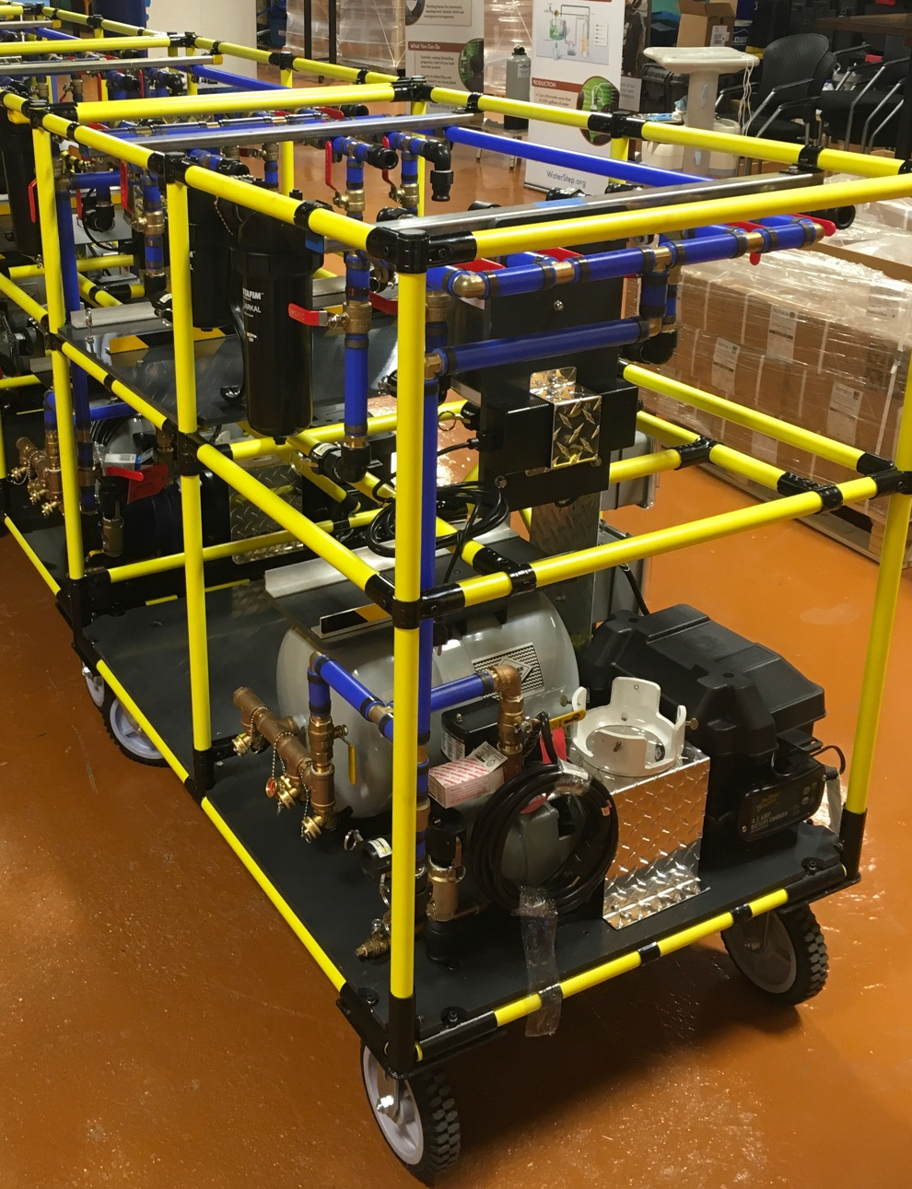
What is the WOW Cart?
WOW Cart Mobile Water Treatment System: In 2018, WaterStep partnered with US EPA to assist in developing a mobile water treatment system to help communities following natural disasters or contamination of the public drinking water supply. The treatment unit has the following attributes:
Must be portable (fit in a pickup truck and less than 750 pounds)
Operate on 110 volt AC power or generator
Multiple treatment methods (micro-filtration, carbon, UV, disinfection)
Setup and deployment time within 1-3 hours
Produce 10,000 to 80,000 gallons per day of safe water
Treat any source water (river, lake, rainwater, groundwater, etc)
In 2016 WaterStep and EPA were recognized with the Teddy Roosevelt Government Leadership Award National Recognition for the WOW Cart.

Slide 20
What is the WOW Cart?
WOW = Water on Wheels
Mobile Water Treatment System developed by US EPA and WaterStep
Developed using EPS’s Cooperative Research Program – CRADA
Four basic water treatment components:
Filtration
Carbon treatment
UV disinfection
Chlorine disinfection
4. Capacity 10,000 gallons a day
5. Runs on battery, solar, generator, or AC power

Slide 21
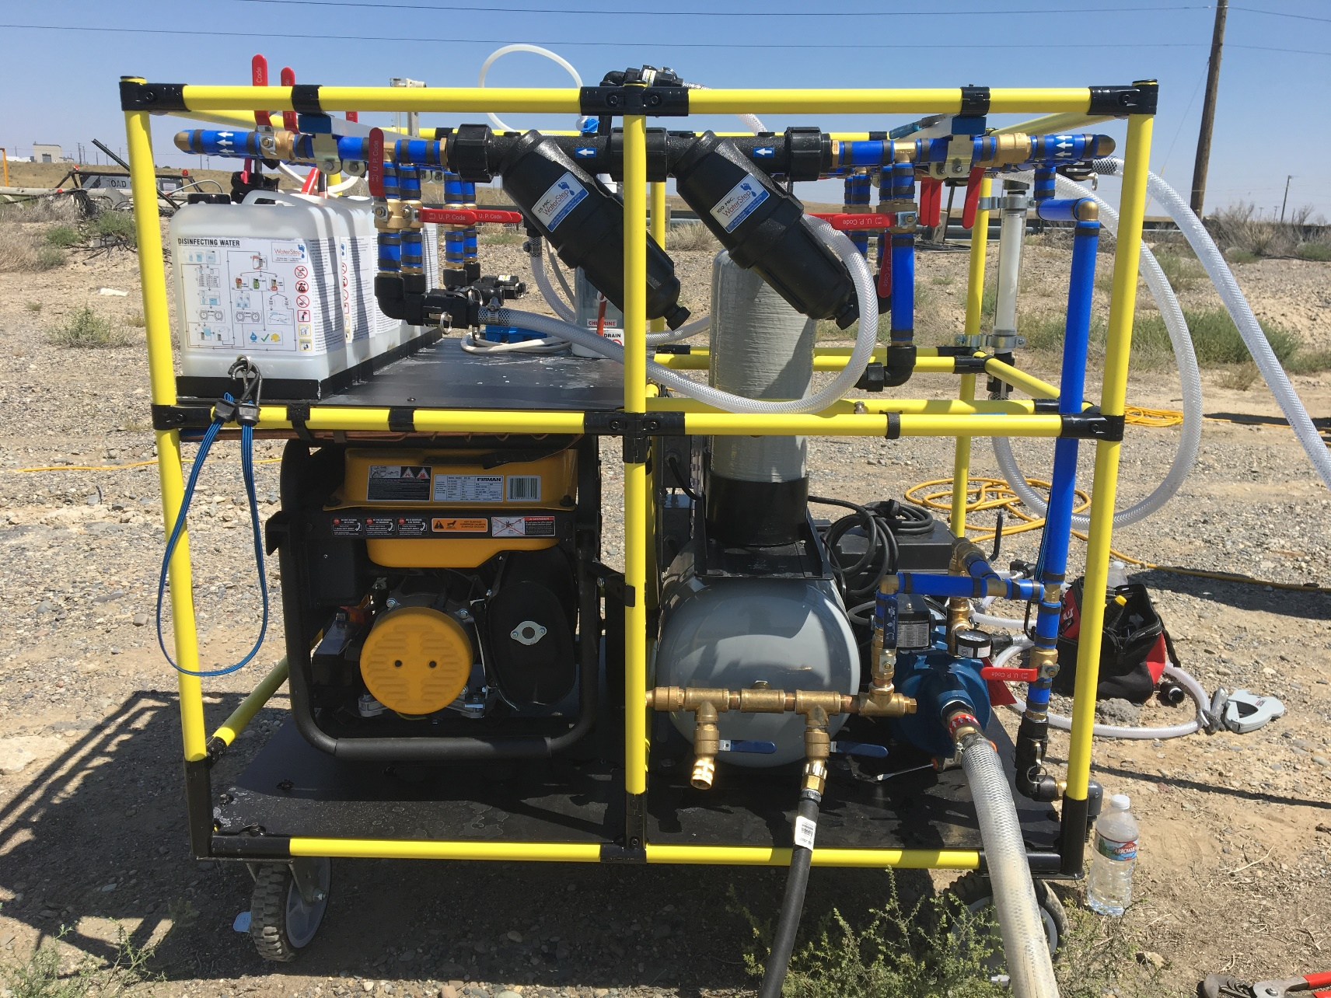
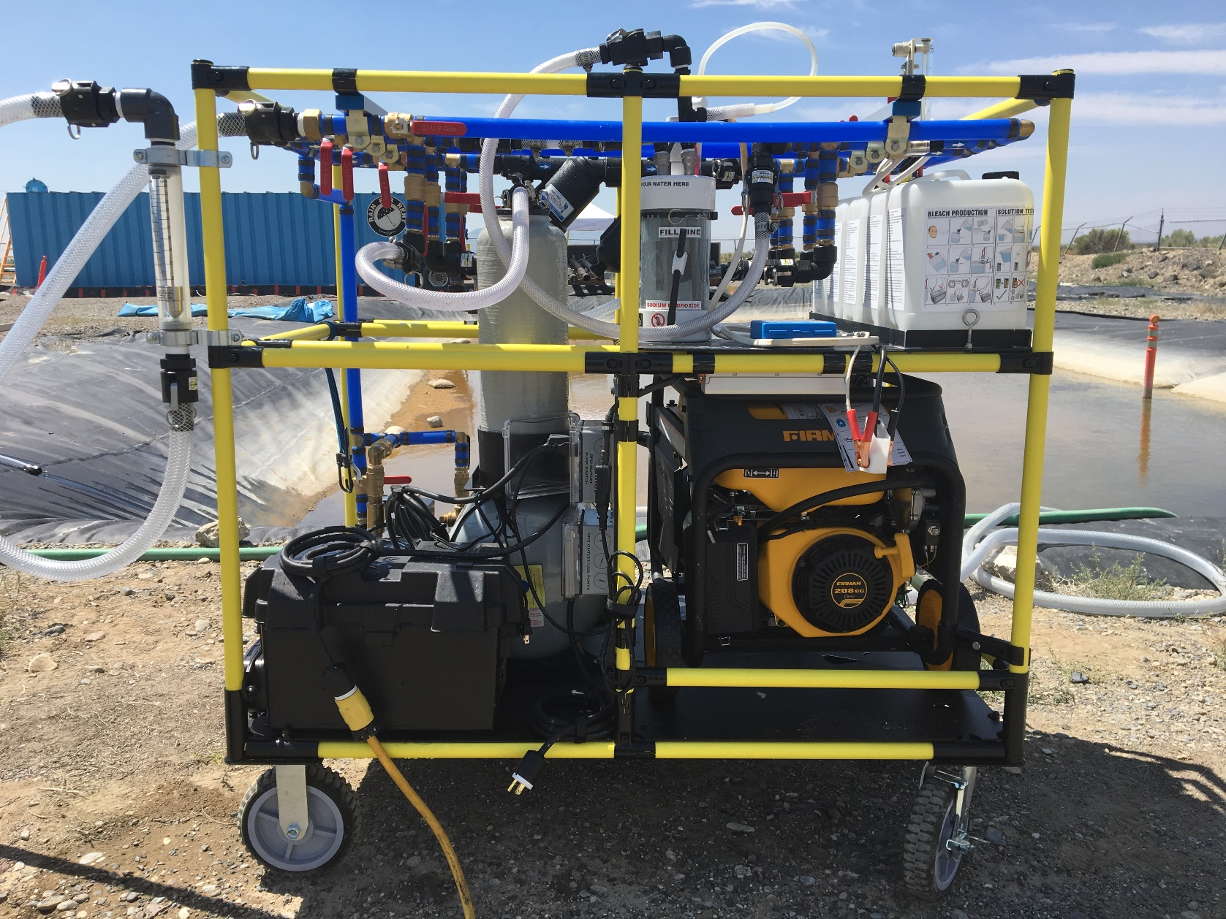
The WOW Cart
Pre-Filters
Chlorinator
Liquid Bleach Maker
Carbon Tanks
Pressure Tank
Deep Cycle Battery
Dual Fuel Generator
Outlets and USB Ports
Raw Water Inlet

Slide 22
How can the WOW Cart be used?
By:
Emergency Response Agencies
State Water Agency Response Networks (WARN)
Rural Water Associations
Public Water Utilities
NGOs
Corporate Disaster Relief Teams
Where:
Satellite Neighborhood Locations
Community Centers
Local fire/police stations
Jails and Prisons
Forest Firefighter Camps
Hospitals, Clinics, and Nursing Homes
Part of a comprehensive Lily pad Network

Slide 23
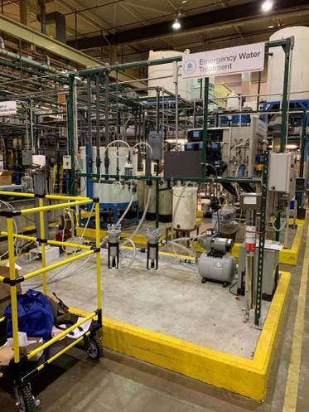
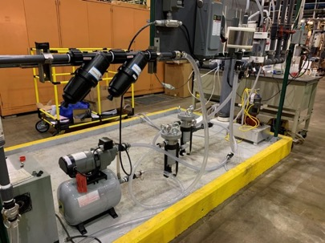
Development of the WOW Cart
Utilized a Cooperative Research and Development Agreement (CRADA) with WaterStep at the USEPA Test & Evaluation Facility in Cincinnati, Ohio

Slide 24
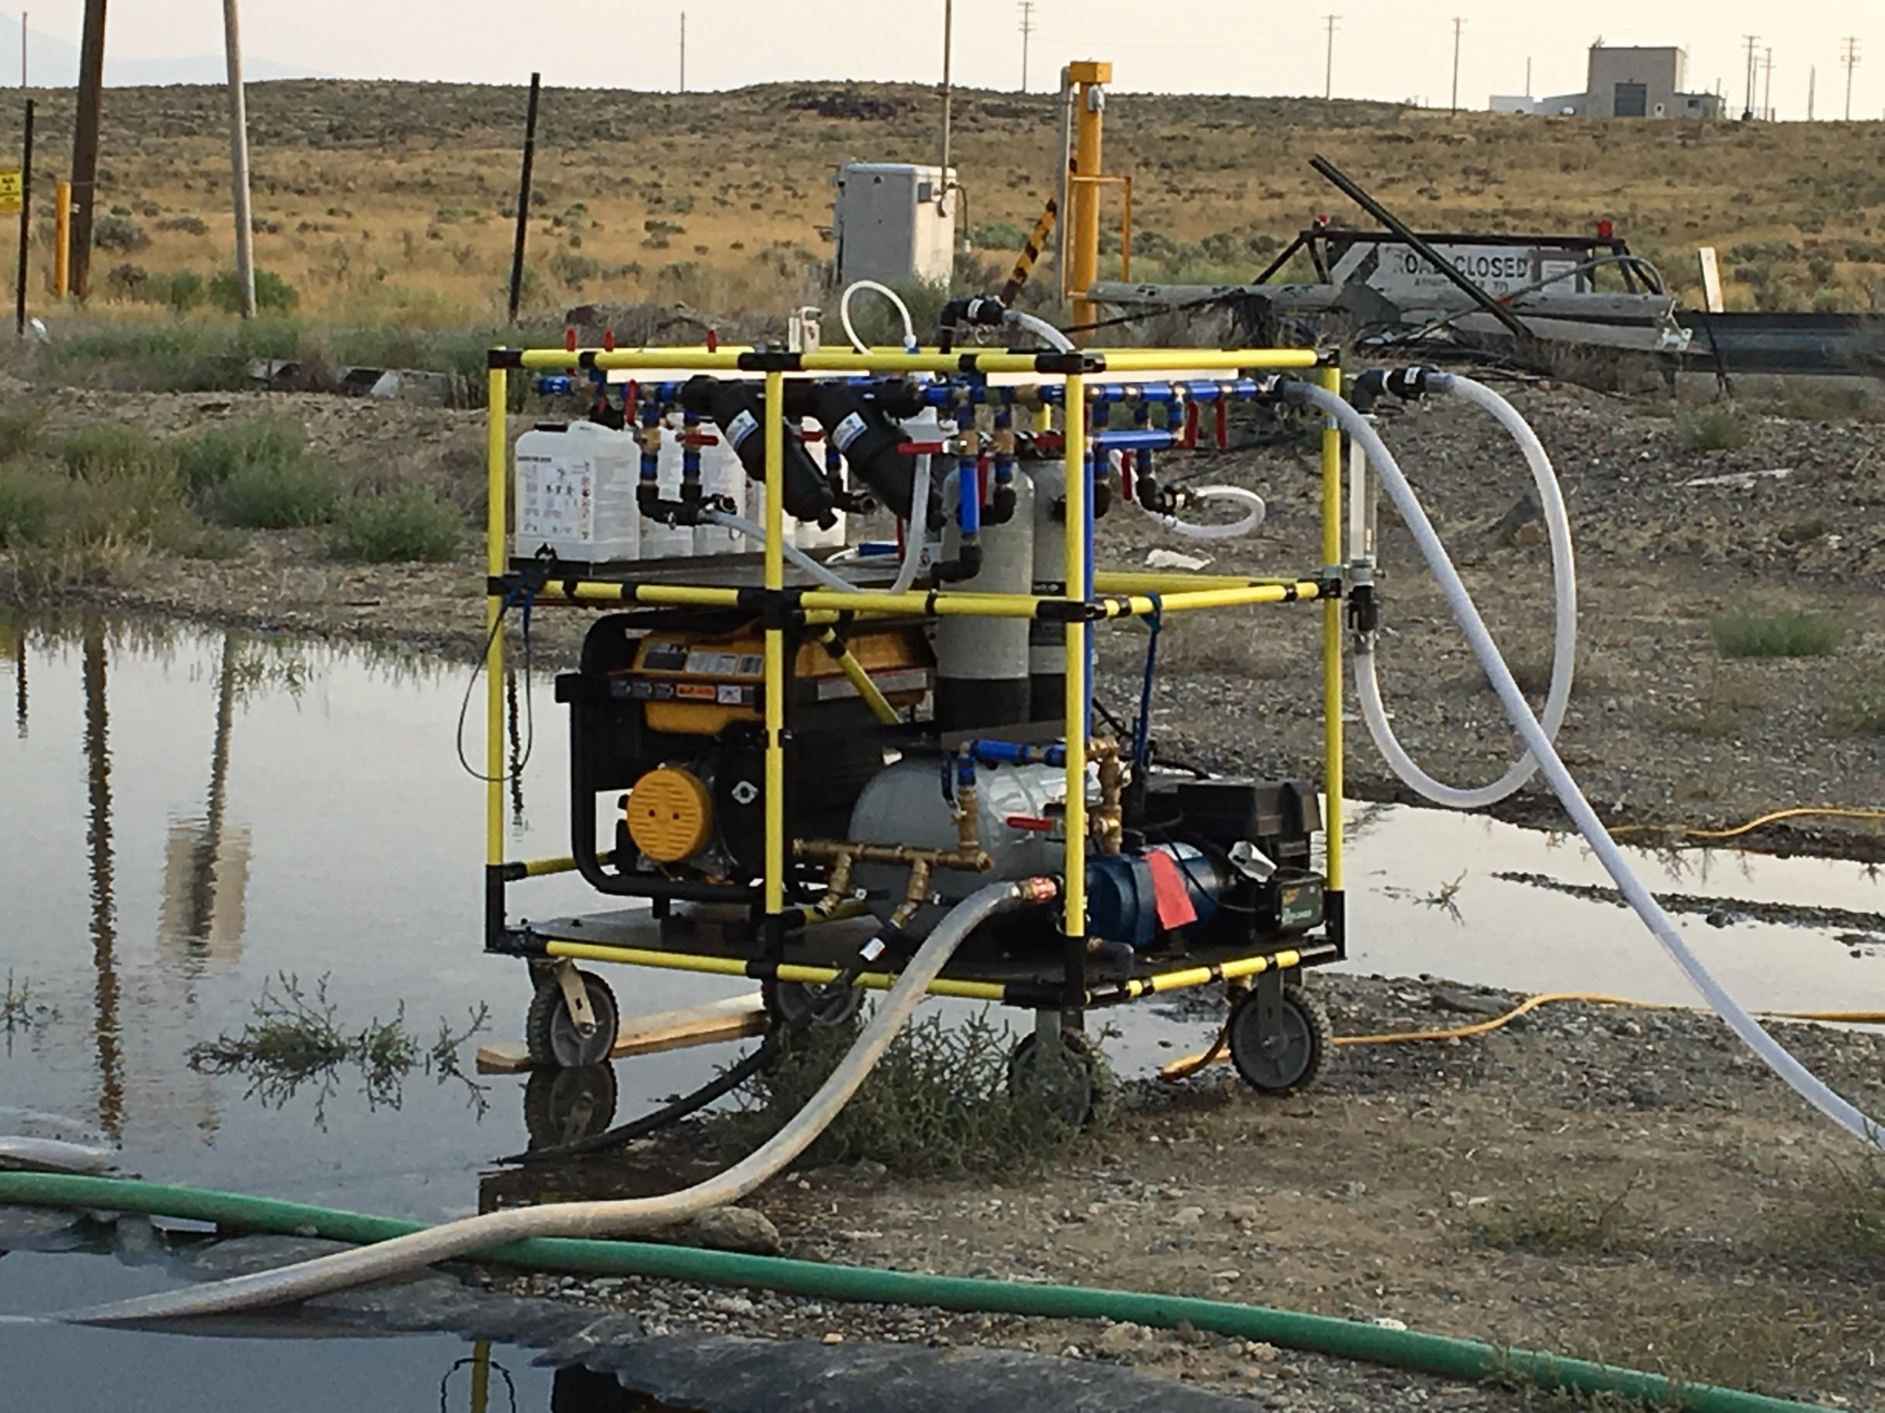
Development Approach
Bench-scale:
Microbial disinfection challenges undertaken at the Test & Evaluation (T&E) Facility in Cincinnati, OH
Pilot-scale:
Anthrax surrogate challenge at the Water Security Test Bed at Idaho National Lab
Components deployed in Puerto Rico hurricane response
Full-scale:
Secondary wastewater at the T&E Facility
Microbial and diesel challenges at the Water Security Test Bed

Slide 25
Performance Summary
EPA ORD Conducted laboratory and short-term field evaluations
Results demonstrated disinfection and removal of:
Difficult organisms like Anthrax,
E. coli in very dirty water
Diesel fuel
Future Developments Underway
Pretreatment
Ozone
On line GPS and Remote Telemetry

Slide 26
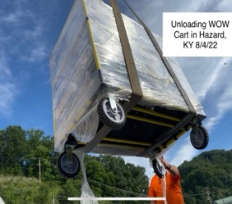
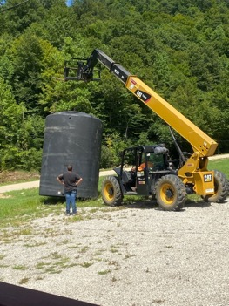
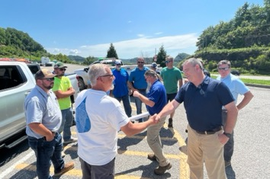
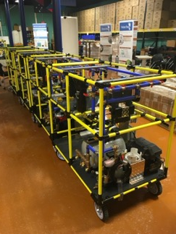
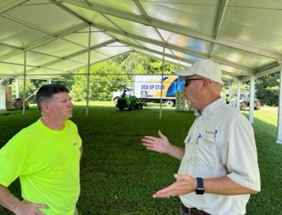
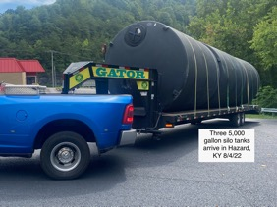
Eastern Kentucky Flooding – August 2022
Deployment and Site Assessment Begins August 4, 2022

Slide 27
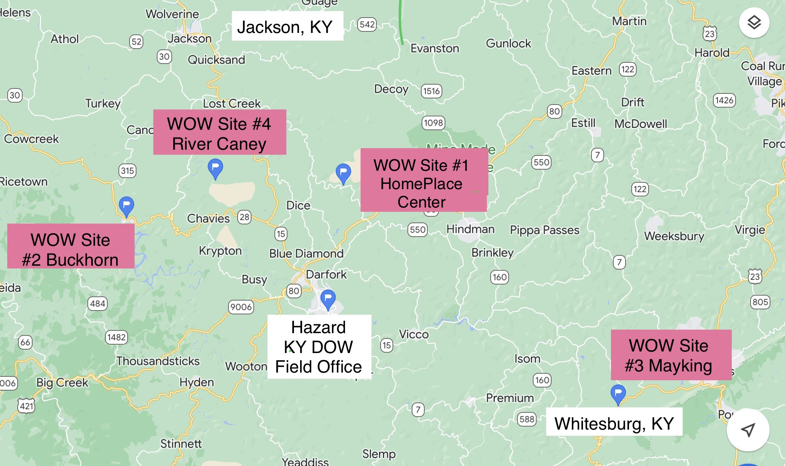
Eastern Kentucky Flooding – August 2022
Four WOW Cart Deployments in Breathitt, Perry, Letcher Counties
August 4-20, 2022

Slide 28
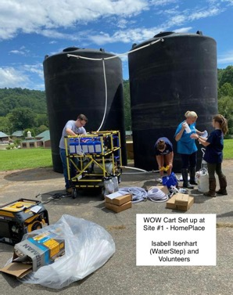
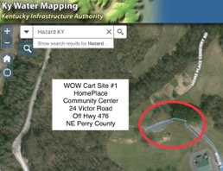
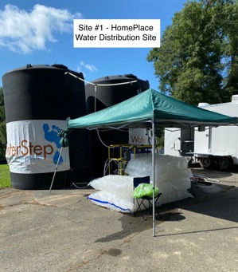
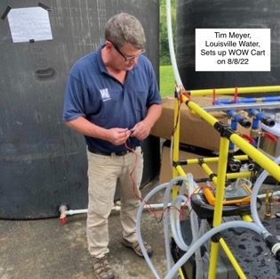
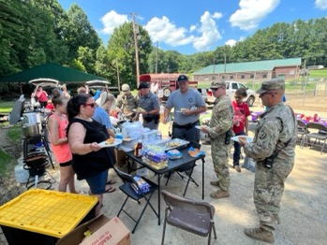
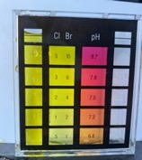
Eastern Kentucky Flooding – August 2022
Site # 1 – HomePlace Community Center
Perry County, Kentucky

Slide 29
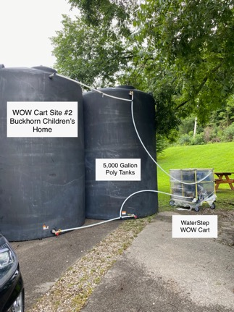
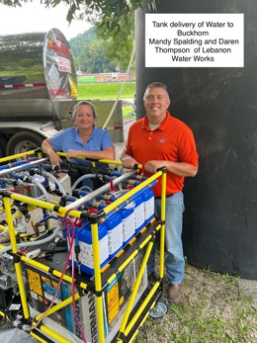
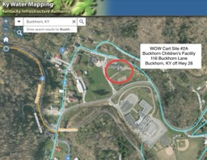
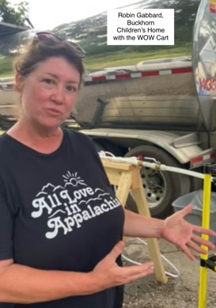
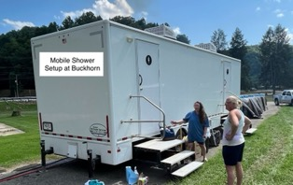
Eastern Kentucky Flooding – August 2022
Site # 2 – Buckhorn Children’s Home
Perry County, Kentucky

Slide 30
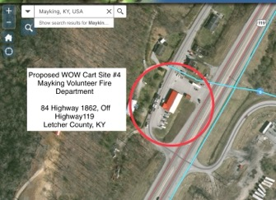
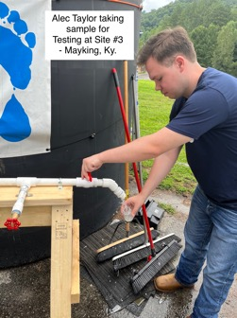
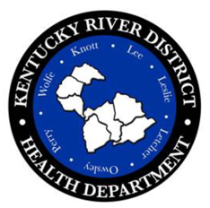
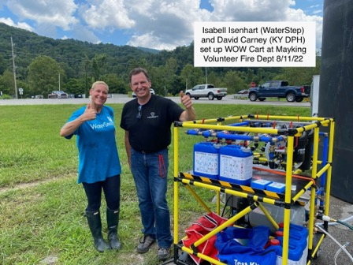
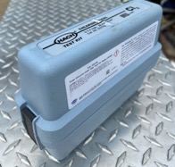
Eastern Kentucky Flooding – August 2022
Site # 3 – Mayking Fire Department
Letcher County, Kentucky

Slide 31
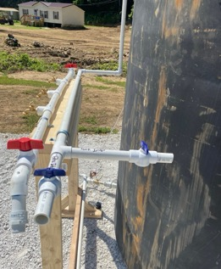
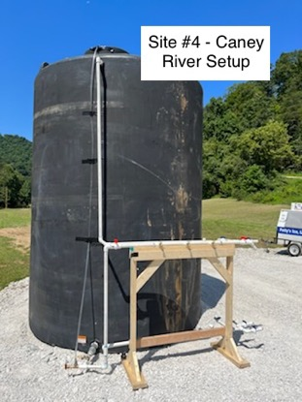
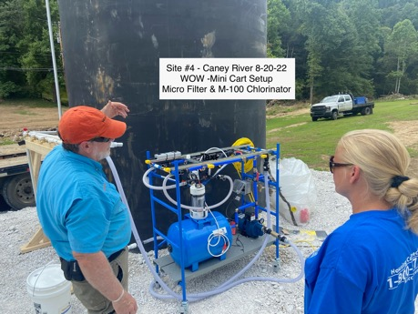
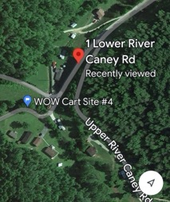
Eastern Kentucky Flooding – August 2022
Site # 4 – River Caney Staging Area
Breathitt County, Kentucky

Slide 32
The Kentucky Lily Pad Network
Proposed WOW Cart Deployment
for Kentucky
Greg Heitzman – BlueWater Ky
Joe Burns – KY Rural Water Association

Slide 33
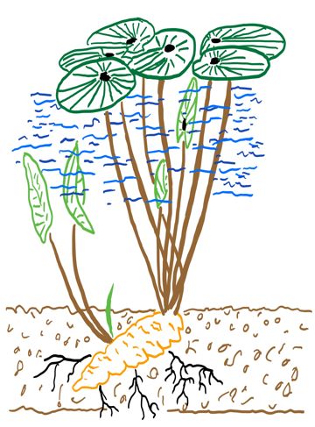
WHAT IS A LILY PAD NETWORK?
Lily pads are strong, resilient hubs for pond ecosystems.
This is a good analogy for a supported network of emergency responders and volunteers managing prepositioned water and disinfectant equipment.
The result is a resilient, expandable footprint that can support health and safety more

Slide 34
THE LILY PAD NETWORK
Emergency workers and equipment can respond independently or gather together to meet a larger need.
Public health departments, fire stations, churches, rural water associations, corporations and others all invest in leadership and develop strategies for locations to support the network.
Funding, regular trainings, growing more operators and expanding capacity create a foundation.

Slide 35
THE LILY PAD NETWORK
For any community, responding to a disaster, medical assistance, potable water and disinfectant are of the highest priority.
Historically, safe water and disinfectant are brought into disaster areas from outside sources.
However, these resources can be produced simply, effectively and in vast quantities on-site.

Slide 36
THE LILY PAD NETWORK
Following an natural disaster, a common source for potable water is bringing in pallets of bottled water.
Bottled water is heavy, difficult to distribute and not a practical resource for bathing, cooking or cleaning. Empty plastic bottles litter our streams, rivers and landfills. There has to be a better, more sustainable solution for potable water.

Slide 37
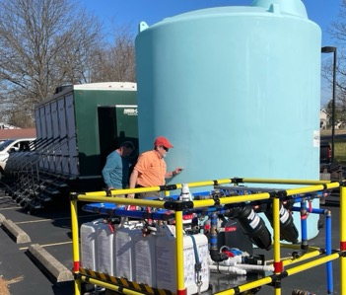
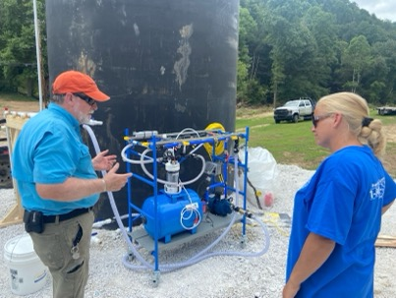
THE LILY PAD NETWORK
WaterStep WOW (Water On Wheels) Carts are essential tools for the Lily Pad Network for providing immediate access to water and disinfectant. They stay on-site or mobilized and sent place to place.
One WOW cart produces 10,000 gallons of potable water a day, equivalent to 80,000 bottles of water.

Slide 38
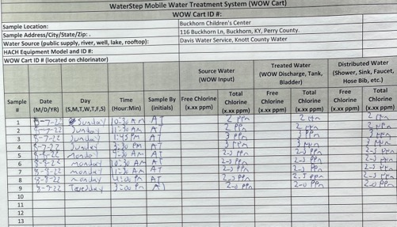
THE LILY PAD NETWORK
Trained operators set up and manage the WOW Cart to assure compliance with Kentucky drinking water regulations.
Water is distributed through a temporary distribution piping network to supply food trucks, mobile showers, laundry and potable water fill stations.
The result is a resilient, expandable footprint that can support health and safety more quickly throughout the community during a disaster.

Slide 39
PROPOSED KENTUCKY LILY PAD NETWORK
Propose 20 WOW Carts:
15 locations in Kentucky
5 in reserve
Partner with Cities/Water Utilities for locations
Partner with Health Departments for locations
Coordinate thru Kentucky WARN Program through KY Rural Water

Slide 40
PROPOSED KENTUCKY LILY PAD NETWORK

Slide 41
KENTUCKY LILY PAD NETWORK PLAN OF ACTION
Deploy 20 WOW Carts across KY
Obtain approval with State Agencies (KY DPH and DOW)
Develop partnerships with key organizations
Train certified/licensed operators thru Kentucky WARN/KRWA
Recruit and train volunteer organizations for assistance with deployment
Prepare Standard Operation Procedures/Guidelines
Conduct annual training exercises
Deploy program beginning Fall 2022-Spring 2023
14 Carts Funded through August 2022 ($40,000 each)
8 from W. KY Tornado Funding
3 from KY Public Health
3 from E. KY Flooding Funding

Slide 42
Proposed Kentucky Partners

Slide 43
Questions and Discussion

Slide 44
Thank You!
Join the Water Disaster Network
www.waterstepwowcart.com
Kurtis Daniels
502-568-6342
kurtis.daniels@waterstep.org
Greg Heitzman
502-533-5073
gheitzman@bluewaterky.com
Jim Goodrich
US EPA
Office of Research and Development
513-569-7605
Goodrich.james@epa.gov
Joe Burns
606-231-1818
j.burns@krwa.org

