Slide 1
Sexual Harassment and Respectful Workplace Training Elizabeth S. Muyskens elizabeth.muyskens@skofirm.com Stoll Keenon Ogden PLLC October 26, 2022

Slide 2
Agenda
Unlawful Workplace Behavior
No Retaliation
Best Practices for Creating a Respectful Workplace

Slide 3
Duty to Provide Respectful Workplace
Organizations of all sizes and in all industries have a duty to provide a safe, respectful workplace free from unlawful discrimination, harassment, or retaliation for all employees.
A respectful workplace can be achieved by adopting and enforcing policies outlining these expectations.

Slide 4
Unlawful Discrimination
Unlawful discrimination occurs when an employee is treated less favorably because of his or her protected class(es).
Persons may be members of multiple protected classes.

Slide 5
Employment Protection Laws
Title VII of the Civil Rights Act of 1964
Prohibits discrimination because of race, color, national origin, religion, or sex.
Pregnancy Discrimination Act (PDA)
Requires employers to treat pregnancy just like any other medical condition with regard to benefits and leave policies

Slide 6
Employment Protection Laws
Americans with Disabilities Act (ADA)
Prohibits discrimination in terms or conditions of employment against individuals with disabilities who, with or without reasonable accommodation, can perform the essential functions of the job.
Age Discrimination in Employment Act (ADEA)
Prohibits age discrimination in employment for employees age 40 and over.
Family and Medical Leave Act (FMLA)
Provides eligible employees with up to 12 weeks of job protected leave annually for certain family and medical reasons.

Slide 7
Unlawful Discrimination
Reminders
Do not allow members of one protected class to be treated different from members of another.
Do not permit comments based on a person’s protected class.
Do not permit comments that might be offensive to a protected class.

Slide 8
Report Unlawful Discrimination
Employees should be required to report all instances of unlawful discrimination.
Anti-retaliation laws protect persons who make good faith complaints of discrimination, as well as persons who participate in an internal investigation of a discrimination complaint. All entities should have a non-retaliation policy.

Slide 9
What is Sexual Harassment?
Form of sex discrimination that violates Title VII of the Civil Rights Act and the Kentucky Civil Rights Act.
The victim, as well as the harasser, may be a man or a woman.
The victim and the harasser do not have to be of the opposite sex.

Slide 10
What is Sexual Harassment?
Unwelcome sexual advances,
Requests for sexual favors, or
Other verbal or physical conduct of a sexual nature.
And, the conduct must:
Explicitly or implicitly affect a term or condition of an individual’s employment;
Unreasonably interfere with an individual’s work; or
Create an intimidating, hostile or offensive work environment.

Slide 11
Unwelcome Sexual Advances and Conduct
As a general rule, conduct is “unwelcomed” if the employee did not solicit or incite it, and the employee regarded the conduct as undesirable or offensive.
It can be difficult to distinguish between conduct that is:
invited,
uninvited but welcome,
offensive but tolerated, and
flatly rejected.

Slide 12
Does this Constitute an Unwelcome Sexual Advance or Conduct?
Would the conduct take place if a spouse were present?
Does the conduct exclude, ridicule or belittle a person because of his or her gender?
Has the victim expressed his or her distaste for the conduct?
Does the conduct involve intentional physical conduct of a suggestive/sexual nature?

Slide 13
Is It a Hostile Environment?
Frequency of the conduct
Severity of the conduct
Whether it is physically threatening or humiliating
Whether the conduct is “merely offensive”
Whether the conduct unreasonably interferes with an employee’s work performance
Whether the conduct was directed at the complaining party

Slide 14
Is It a Hostile Environment?
Often requires careful consideration of social context in which behavior occurs and/or circumstances surrounding behavior.

Slide 15
Is It Quid Pro Quo Sexual Harassment?
Quid Pro Quo is Latin for “this for that”
Generally it involves a person in power pressuring a subordinate employee for sexual favors in exchange for advancement in the workplace or under the threat of adverse employment action.
May be specific or implied threat or promise regarding the victim’s job

Slide 16
What do I do?
Ensure your organization has adopted equal employment opportunity, anti-discrimination, anti-harassment, and anti-retaliation polices. More importantly, review whether those policies are being enforced consistently.

Slide 17
Guiding Principles of the Harassment-Free Workplace
Think before you speak.
Respect the workplace. (If you wouldn’t do or say it in front of a loved one, you probably shouldn’t do or say it at work.)
Keep your hands to yourself.
Speak up if you have a complaint.

Slide 18
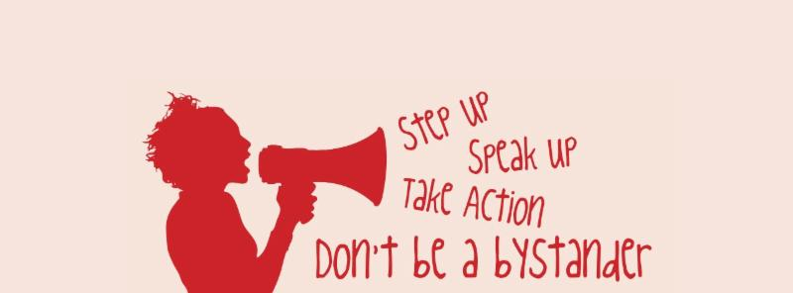
If you see something, say something.
This is the message we want to send employees. Both your policies and practices should strongly encourage or require employees to report issues to management.

Slide 19
Retaliation
Federal and state law prohibit any type of retaliation against any person for making a good faith, legitimate complaint of sexual harassment or for participating in the investigation of a complaint.

Slide 20
Which of the following could be retaliation if an employer acts because of the employee’s activity?
Reprimand the employee or give a performance evaluation that is lower than it should be
Treat a family member negatively (ex. cancelling a contract with the employee’s spouse)
Threaten to make, or actually make reports to authorities (ex. reporting immigration status or contacting the police”)
Spread false rumors
All of the above

Slide 21
Which of the following could be retaliation if an employer acts because of the employee’s activity?
Reprimand the employee or give a performance evaluation that is lower than it should be
Treat a family member negatively (ex. cancelling a contract with the employee’s spouse)
Threaten to make, or actually make reports to authorities (ex. reporting immigration status or contacting the police”)
Spread false rumors
All of the above

Slide 22
Benefits of a Respectful Workplace
Respect Contributes to Job Satisfaction
Respect Increases Employee Engagement
Respect Creates a Fair Environment
Respect Improves Knowledge Sharing
Respect Improves the Bottom Line

Slide 23
Respectful Workplace
75% of people are hired for their technical skills.
75% of people are let go because of their people skills.

Slide 24
Demographics Exercise
First, we are going give you a description of an individual.
Next, we will give you 10 seconds to write down as many demographics about the individual as you can based on your mental picture of them. Try to list their age, race, sex, religion, and anything else your mental picture includes.

Slide 25
Individual One
Individual One’s parents divorced when they were a child. Individual One dropped out of college to do administrative work in a law firm. They also worked as a waitress, house painter, bartender, comedian, and went on to win the Presidential Medal of Freedom. Individual One got married at fifty years old. Individual One is dedicated to animal rights and is a vegetarian.

Slide 26
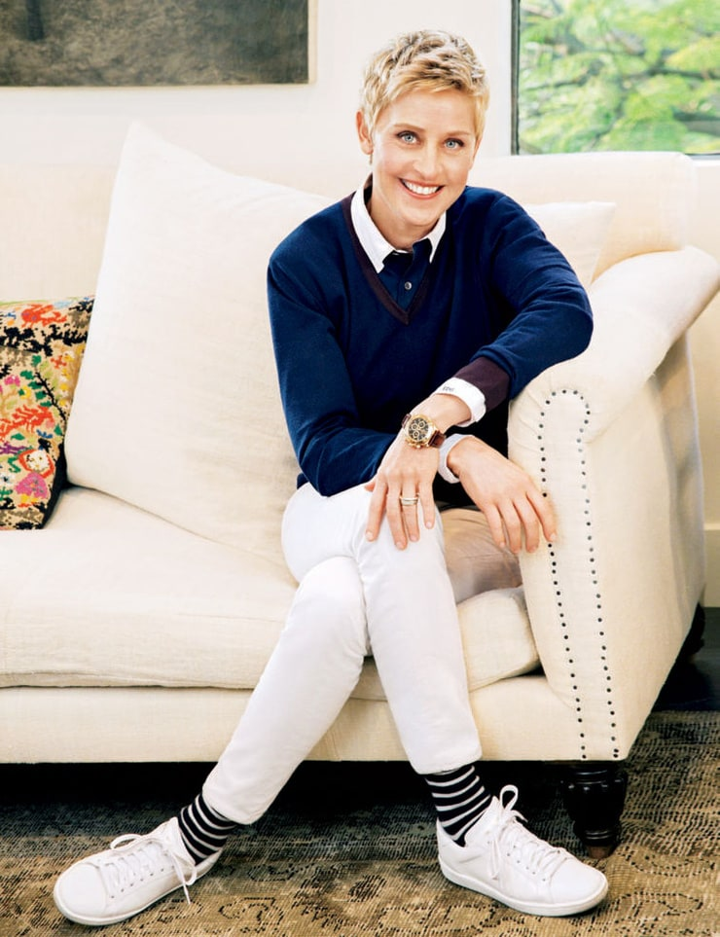
Individual One is …
Ellen DeGeneres

Slide 27
Individual Two
Individual Two’s father worked for the US Department of Labor and their mother worked for the Illinois Attorney General. Individual Two is a Christian musician. Individual Two has volunteered on various political campaigns at the state and national level. Individual Two recently made a one million dollar donation to a local school system.

Slide 28
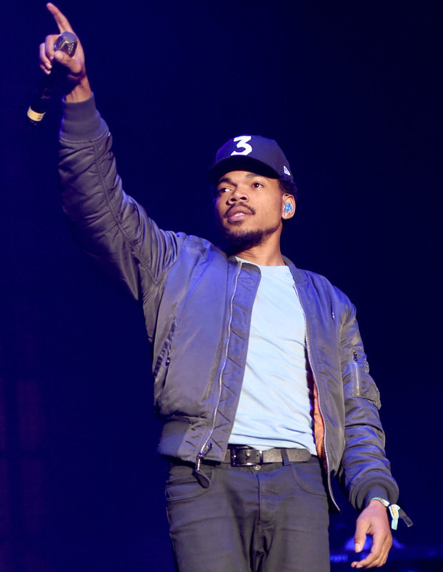
Individual Two is …
Chance the Rapper

Slide 29
Individual Three
Individual Three was born in Israel to a homemaker and a Doctor. Individual Three attended Harvard University and spoke to its 2015 graduating class. Individual Three is part-owner of a professional sports team. Individual Three has two published research papers and speaks six languages.

Slide 30
Individual Three is …
Natalie Portman

Slide 31
Scenario
A father and son were involved in a car accident in which the father was killed and the son was seriously injured. The father was pronounced dead at the scene of the accident and his body was taken to a local morgue. The son was taken by ambulance to a nearby hospital and was immediately wheeled into an emergency operating room. A surgeon was called. Upon arrival and seeing the patient, the attending surgeon exclaimed “Oh my God, it’s my son!”
Explain what happened.

Slide 32
Scenario
A father and son were involved in a car accident in which the father was killed and the son was seriously injured. The father was pronounced dead at the scene of the accident and his body was taken to a local morgue. The son was taken by ambulance to a nearby hospital and was immediately wheeled into an emergency operating room. A surgeon was called. Upon arrival and seeing the patient, the attending surgeon exclaimed “Oh my God, it’s my son!”
Explain what happened.
ANSWER: The doctor is the child’s mother.

Slide 33
Unconscious / Implicit Bias
Implicit bias occurs because, over time, our brains create associations between things. This forms actual pathways in our brain, which are unconsciously strengthened every time the association is confirmed.
Implicit biases come from media, family, friends, school, experiences, work, and more.
The exercise we just did demonstrated some of our own implicit biases.

Slide 34
How to Address Implicit Bias in the Workplace?
Recognize we all have biases.
Stop & think. Don’t always trust your first impression.
Be curious about people’s differences.
Don’t try to suppress your biases.
Don’t be too hard on yourself.
Keep processes simple.
Schedule demanding work separate from “people decisions”.
Make sure you keep yourself well rested and well fueled.
Challenge negative stereotypes and assumptions.

Slide 35
Implicit Bias in the Workplace
It is important that employees are aware of their own implicit biases and recognize when they impact our actions.
We want all employees to treat everyone in the workplace, including co-workers and customers, with respect.
Encourage employees to listen to the people around them.

Slide 36
Disrespectful and Offensive Behaviors
Examples:
Consistently getting someone’s name wrong
Passive aggressive comments
“You are acting like a girl”
Failing to acknowledge someone’s presence

Slide 37
Keep Certain Discussions Out of the Workplace
There is no constitutional right to free speech in a private workplace.
Certain speech may violate anti-harassment and discrimination laws
Certain speech may violate company policies
Certain speech may violate best practices and exhibit poor judgment

Slide 38
End Result
If employees Respect others and
take Responsibility for their behavior
then they will be more Relaxed at work
and Rest at night.
R & R

Slide 39
QUESTIONS? Elizabeth S. Muyskens (859) 231-3960 elizabeth.muyskens@skofirm.com Stoll Keenon Ogden PLLC September 26, 2022

