Slide 1

7th ANNUAL WATER LAW SERIES
October 26, 2022

Slide 2


HOT LEGAL TOPICS
Damon R. Talley
Stoll Keenon Ogden PLLC
damon.talley@skofirm.com
October 26, 2022

Slide 3

DISCUSSION TOPICS
PSC Filings
Comply with PSC Orders
2022 General Assembly
Borrowing Money
Continued . . .

Slide 4
DISCUSSION TOPICS
5. Notable PSC Orders
Minutes
Cases to Watch

Slide 5
DISCLAIMER

Slide 6

PSA for
PSC

Slide 7
Reporting Requirements
  Must Notify PSC if . . .
      Vacancy Exists
      Appointment Made
  When? Within 30 Days
  Consequences

Slide 8
Vacancy
  Inform CJE 60 Days Before Term Ends (KRS 65.008)
  CJE / Fiscal Court – 90 Days
  Then, PSC Takes Over
    CJE Loses Right To Appoint

Slide 9
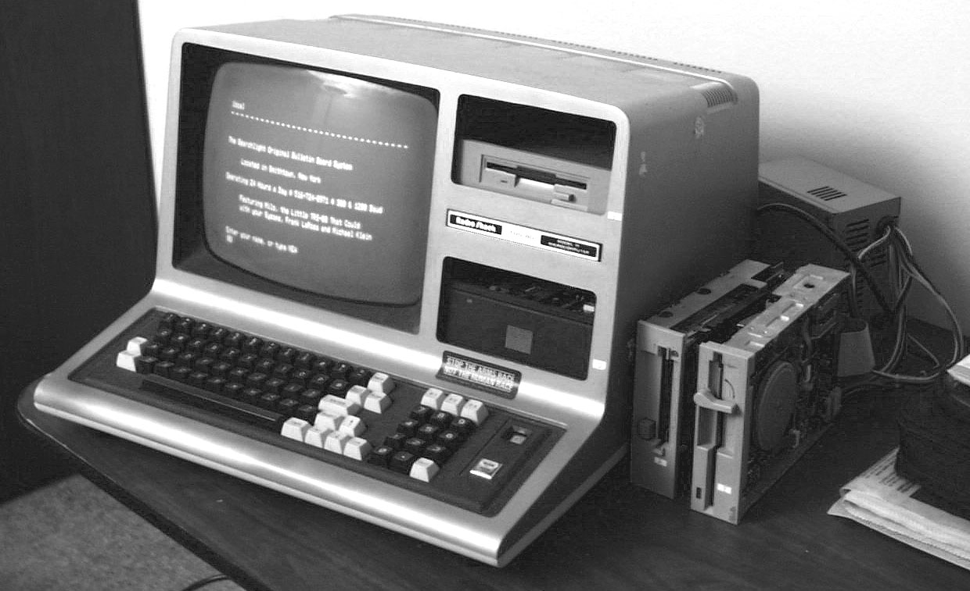
You’ve Got Mail!
Check It!

Slide 10
E-Mail Address Regs.
All PSC Orders Served by E-mail
Duty to Keep Correct E-mail Address on file with PSC
    Default Regulatory E-mail Address
Duty to List E-mail Address in Application & All Other Papers
    Utility Official
    Its Attorney

Slide 11
E-Mail Address
  Who is Covered?
    Water Districts
    Water Associations
    Investor Owned Utilities
    Municipal Utilities

Slide 12
Why Municipals?
  Contract Filing
  Tariff Change (Wholesale Rate)
  Protest Supplier’s Rate Increase
  Acquiring Assets of Another Utility
  Avoid Delays

Slide 13

Tips
Talley’s

Slide 14
Default Regulatory E-mail Address
  Send E-mail to PSC
      psc.reports@ky.gov
      PSCED@ky.gov
  Send Letter to PSC
      Linda C. Bridwell,
    Executive Director

Slide 15



Slide 16
No More Paper Copies
Case No : 2020-085 (COVID)
Order: 07-22-2021
Holding: Electronic Filings Only
      Utilities
      Lawyers
      Complainants
      Everyone

Slide 17
Tips
Talley’s

Slide 18
Electronic Filing
  Don’t Procrastinate
      Must Register to File
      2 Step Process (1 or 2 Days)
  Go Ahead and Register Now
  Call KRWA
  Call SKO Attorneys
  No Originals

Slide 19
Comply
With All
PSC
Orders

Slide 20
PSC Case No. 2021 - 343
Filed: 12-14-2021
Type: Failure to Comply
with PSC Order
Issue: Did Not Timely File
Rate Application &
Failure to File PSC
Annual Report
Decided: 07-15-2022

Slide 21
PSC Case No. 2021 - 343
  Result: WD Fined $5,000
      WD Pay $250
      Board Members & GM Attend 12 Hours of PSC Training
      Balance of Fine Suspended for 12 Months
      No More Violations
(cont.)

Slide 22
PSC Case No. 2022 - 215
Filed: 07-18-2022
Type: Failure to Comply
with PSC Order
Issue: Did Not Timely File
Rate Application
Decided: Pending

Slide 23
PSC Case No. 2022 - 215
  Facts:
      Must File Rate Case by 03-10-2021
      Got Extension Until 05-31-2022
      Nothing Filed by 07-18-2022
      PSC Opened Case
(cont.)

Slide 24
“. . . for allegedly failing to comply with the Commission’s March 10, 2020 Order in Case No. 2019-00458. The willful failure to comply presents prima facie evidence of incompetency, neglect of duty, gross immorality, or nonfeasance, misfeasance, or malfeasance in office sufficient to make [the District’s] officers and manager subject to the penalties of KRS 278.990 or removal pursuant to KRS 74.025. The Commission finds that a public hearing should be held on the merits of the allegations set forth in this Order.”

Slide 25
PSC Case No. 2022 - 215
(cont.)
  Manager’s Defense:
      I Told Board
      I Called PSC and
        Got Another Extension

Slide 26
PSC Case No. 2022 - 215
  Board’s Defense:
      Manager Told US
      Knew We Got an Extension
      Thought Manager
      Was Taking Care of It
      Manager Assured Us That He
        Got Second Extension
(cont.)

Slide 27
PSC Case No. 2022 - 215
  Status:
      Discovery Stage
          Multiple Rounds
          Pandora’s Box Opened
              Commissioners’ Appointments
              Prove Fiscal Court Has Approved Your Salary
              ? ? ?
(cont.)

Slide 28
PSC Case No. 2022 - 228
Date: 08-22-2022
Type: Failure to Comply
with PSC Order
Issue: Did Not Timely File
Rate Application
Decided: Pending

Slide 29
PSC Case No. 2022 - 228
  Facts:
      PWA Case 2 Penny
      Must File Rate Case by 04-15-2022 (6 Months)
      Nothing Filed by 08-22-2022
      PSC Opened Case
(cont.)

Slide 30

PSC Case No. 2022 - 228
  Manager’s Defense:
        Honesty
        I Never Read the Order
        I Never Told the Board
        Fell on His Sword
(cont.)

Slide 31
PSC Case No. 2022 - 228
  Board’s Defense:
      Ignorance is Bliss
      Manager Never Told Us
      Manager’s Job to Tell Us
      Acknowledged Ultimate Responsibility
(cont.)

Slide 32
PSC Case No. 2022 - 228
  Affirmative Steps to Mitigate:
        Adopt New Procedure
          All PSC Orders Forwarded to Board Members
        Engaged Services of RCAP to File Rate Case
(cont.)

Slide 33
PSC Case No. 2022 - 228
  Status:
    Discovery Will Soon Begin
    District is Getting CJE to Re-appoint Commissioners
(cont.)

Slide 34

PANDORA’S
BOX
? ? ?

Slide 35
2022
General
Assembly

Slide 36
Notable Bills
  HB 1 – ARPA Funds $250,000,000
  HB 8 – Residential Sales Tax Exemption for Utility Customers Modified

Slide 37
Notable Bills (cont.)
  HB 758 – “Martin County Bill”
        $10,000,000 for Water & Wastewater Assistance Fund
        Troubled Utilities
        Water Associations Now Eligible to Obtain Funds from KIA
              Borrow
              Grant
              ARPA

Slide 38
HB 8
Modifies Residential Sales Tax Exemption for Utility Customers
  Water
  Sewer
  Electric
  Natural Gas
Codified in KRS 139.470(7)

Slide 39
HB 8
BEFORE
Water Dist. & Water Assoc.
PSC Tariff Controlled
Cities
    Ordinance Controlled

Slide 40
HB 8
AFTER 1-1-2023: KRS Controls
Must be a Ky. Resident
Only One (1) Meter Exempt per Customer
“New” Customers Must Sign Declaration of Domicile (D of D)

Slide 41

51A380 (1-23)
Commonwealth of Kentucky
DEPARTMENT OF REVENUE
DECLARATION OF DOMICILE FOR PURCHASE OF RESIDENTIAL UTILITIES
In accordance with the provisions of KRS 139.470(7) this declaration may only be executed for the purchase of sewer services, water, and fuel by Kentucky residents for use in heating, water heating, cooking lighting and other residential uses. “Fuel” shall include but not be limited to natural gas, electricity, fuel oil, bottled gas, coal, coke, and wood.
I, ,
Name
declare that
Service Address
is my place of domicile and the purchase of residential utilities for use at this address meets the qualifications for exemption from Kentucky sales and use tax under KRS 139.470(7). Accordingly, I request the account associated with the above listed service address be classified as exempt from sales and use tax as of the date of this declaration in connection with the purchase of any residential utilities detailed in KRS 139.470(7).
Under penalties of perjury, I swear or affirm that the information on this certificate is true and correct as
to every material matter.
Name (printed) Signature Date
Pursuant to KRS 139.470(7)(b)(2), “place of domicile” is defined as “the place where an individual has his or her legal, true, fixed and permanent home and principal establishment, and to which, whenever the individual is absent, the individual has the intention of returning.”
DRAFT

Slide 42
HB 8
“Grandfather” Protection
Existing “Residential” Customers Will Remain Tax Exempt UNTIL a “Trigger” Event Occurs After 1-1-2023
What is the “Trigger Event?”

Slide 43
HB 8
      Move
      Change Account Name
      Move – In
      New Construction
      Customer Has 2 Meters
          Check Records
Trigger Event

Slide 44
Declaration of Domicile
(D of D)
If “Trigger” event Occurs
Customer Must Sign D of D
Keep D of D on File
Do Not Send to Dept. of Revenue (DOR)
All Utilities Use Same Form (Write Water & Sewer on D of D)

Slide 45
What Happens if Utility Does Not Comply?
DOR Audit
Utility is Responsible for Paying Sales Tax
Unless Customer
    “Grandfathered” or
    D of D on File

Slide 46
Stay Tuned . . .
  D of D Template Still in Draft Form
  KRWA Will Notify When D of D is in Final Form
  DOR FAQs on Website

Slide 47

Any QUESTIONS
About HB 8 ?

Slide 48
Notable Bills
2021 General Assembly
  HB 312 – Open Records Act
  HB 393 – Commissioner
              Training

Slide 49
Open Records Request
Standardized Form
https://ag.ky.gov
Resources
Open Records / Open Meetings
Request Form

Slide 50
Open Records Request
  No Form or AG Form
  Written Request Submitted By:
      Hand Delivered
      Mailed
      Fax
      E-mail

Slide 51

Borrowing
Money

Slide 52
KRS 278.300(1)
  No utility shall issue any securities or evidences of indebtedness . . . until it has been authorized to do so by order of the Commission.

Slide 53
Practical Effect
  Must Obtain PSC Approval Before Incurring Long-term Debt (Over 2 Years)
  Exception:
      2 Years or Less
      Renewals
        (3 X 2 = 6 Years)
      (6 X 1 = 6 Years)

Slide 54

Violation

Slide 55
Show
Cause
Cases

Slide 56
2022 Show Cause Cases
Borrowing Money
First Case: 2022-061
Second Case: 2022-197

Slide 57
2022 Case # 1
Case No. 2022 - 061
Opened: 04 - 08 - 2022
Issue: KRS 278.300 (2 Violations) Repeat Offender - 2013
Decided: Pending

Slide 58
2022 Case # 1
  Facts: (1) Refinanced RD Loans w/o PSC Approval 07-23-2021
  Facts: (2) Bought Truck w/o PSC Approval
              Bank Loan
              75 Months
  Discovered: PSC Staff – Rate Case

Slide 59
2022 Case # 1
  Corrective Action:
    Filed Application for Retroactive Approval (Case No. 2021-465)
          PSC Denied
          No Retroactive Approval

Slide 60
2022 Case # 1
  Defenses:
      Ignorance
      Lawyer Said No PSC Approval Needed
      Relied on Bank
      New Manager

Slide 61
2022 Case # 1
  Case Status:
      Switched Lawyers
      Discovery Stage
          2 Rounds Thus Far
      Hearing Date: ? ? ?

Slide 62
2022 Case # 2
Case No. 2022 - 197
Opened: 08- 11 - 2022
Issues: Violated:
              KRS 278.300
              KRS 278.020
Decided: Pending

Slide 63
2022 Case # 2
  Background Facts:
    11-18-21: Purchased Office Bldg.
    11-18-21: Financed Portion of Cost with a 7 year Loan
    03-15-22: Applied for Retroactive Approval of Loan
  … continued

Slide 64
2022 Case # 2
  Background Facts (continued):
    05-13-22: PSC Issues DR
    05-??-22: Bank Loan PIF
    05-27-22: PSC Application Withdrawn by Utility
  … continued

Slide 65
2022 Case # 2
  Background Facts (continued):
    06-20-22: PSC Dismisses Case & States Intent to File Show Cause Case
    08-11-22: PSC Opens Show Cause Case

Slide 66
2022 Case # 2
  Utility’s Defenses:
    Loan Paid Off
    No CPCN Needed Since Building was Purchased & Not Constructed
    Relied Upon Advice of Counsel
    Good, Honest & Decent People

Slide 67
2022 Case # 2
  Case Status:
    Discovery Stage
        1st DR Issued 09-07-22
    Hearing Date: ? ? ?

Slide 68
Notable
PSC
Orders

Slide 69
PSC Case No. 2020 - 028
Filed: 2-24-2020
Utility: Bluegrass Water Utility Operating Co.
Issue: Is PSC Approval Needed to Acquire 4 sewer “Utilities”?
Decided: 6-19-20

Slide 70
Bluegrass Water
Holding: Yes
PSC Approval Required
Rationale: 24 - Page Order
    8 Pages Devoted to
    This Issue
    Implied Authority
    Plenary Power

Slide 71
Southgate 1954
In Public Service Commission v. Cities of Southgate and Highland Heights, 268 S.W.2d 19 (Ky. 1954), this Court concluded that the PSC’s power included not only powers expressly provided by statute but could also encompass powers necessarily implied to take action to meet its statutory duties. Specifically, in that case this Court concluded that the PSC had the implied power to approve or disapprove a utility systems sale, despite the lack of express statutory authority to do so, because of the PSC’s general statutory authority under KRS 278.040 to regulate utility service.

Slide 72
Bluegrass Water
O/R Precedents:
          Ky. American – Owenton
          PSC Case 2005-206
          Order Dated 7-22-05
          Many Others

Slide 73

Talley’s
Take Aways
Damon

Slide 74

Seek PSC Approval
      WD, WA or IOU Buying
      City Assets
      WD, WA or IOU Buying
      N-hood Assoc. Assets
Talley Rescinds Prior Advice to the Contrary

Slide 75
PSC Case No. 2022 - 065
Filed: 3-29-2022
Utility: Southeastern Water Assoc.
Type: CPCN – New Office Bldg.
Issue: Reasonable Alternatives
Considered
Decided: 8-30-22

Slide 76
PSC Case No. 2022-065
  CPCN: Standard of Review
      Need
      Absence of
      Wasteful Duplication

Slide 77
PSC Case No. 2022-065
  Proving Lack of Wasteful Duplication:
      All Reasonable Alternatives Considered
      Cost is Not Sole Criteria
        Initial Cost
        Annual Operating Cost

Slide 78
PSC Case No. 2021 - 222
Filed: 6-9-2021
Utility: Southeastern Water Assoc.
Type: CPCN - AMI
Issue: Reasonable Alternatives
Considered
Decided: 8-12-21

Slide 79
PSC Case No. 2021-222
  CPCN: Standard of Review
      Need
      Absence of
      Wasteful Duplication

Slide 80
PSC Case No. 2021-222
  Need:
      Substantial Inadequacy of Existing Facilities
          Substantial Deficiency or
          Inability to Render Adequate Service

Slide 81
PSC Case No. 2021-222
  Absence of Wasteful Duplication:
      Excess Capacity Over Need
      Excess Investment
      Unnecessary Multiplicity of Physical Properties

Slide 82
PSC Case No. 2021-222
  Proving Lack of Wasteful Duplication:
      All Reasonable Alternatives Considered
      Cost is Not Sole Criteria
        Initial Cost
        Annual Operating Cost

Slide 83

MINUTES

Slide 84
What Are MINUTES?
Official Record
Much, Much More . . .

Slide 85
AN OUNCE OF PREVENTION
=
A POUND OF CURE

Slide 86
Board Minutes
A Board “speaks only through its minutes.”
War Stories:
Ownership of water line and service of disputed territory
Careless Conversations

Slide 87
Preparation of Minutes
Who prepares minutes?
Board Secretary or Staff
Who edits minutes?
Staff or legal counsel
Are meetings recorded on audio and/or video?
Signing of Minutes
Approval of Minutes

Slide 88
Board Minutes
A complete set of APPROVED Minutes SHALL be maintained at the utility office for inspection by the general public, regulators, customers, and the media.

Slide 89
Board Minutes
When are the Minutes considered in “final form” and available for public inspection?

Slide 90
Minutes
What MUST Be Included?
Board Member Attendance
Official Actions

Slide 91
Minutes
What SHOULD Be Included?
Board Member Attendance
Acknowledge Guests (Visitors)
Official Actions
Acknowledge Receipt of Reports
  PSC Inspection Report Cont.

Slide 92

Minutes
What SHOULD Be Included?
Summarize Some Discussions
Provide Context
Toot Your Own Horn

Slide 93
Minutes
Tooting Your Own Horn
Give Yourself Credit
  “Best Tasting Water”
  Wooden Bucket Award
  AWOP Award
  Governor’s Safety Award

Slide 94
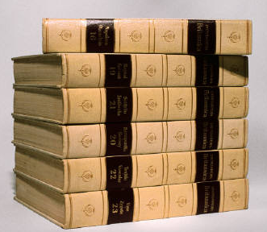
How much information SHOULD be included in the MINUTES?

Slide 95
Minutes
How MUCH is too MUCH?
No definitive answer
Art not a science
Cont.

Slide 96
Minutes …
How MUCH is too MUCH?
  Guidelines . . .
  Minutes are NOT a transcript
  Minutes are NOT the Congressional Record
  Include rationale for action taken if it might avoid lawsuit

Slide 97
“Conversations are NOT official actions of the Board.”
Virginia W. Gregg
Former PSC Staff Attorney

Slide 98
WHY Include Summary of Conversations in Minutes?
Document Board’s Due Diligence
  (e.g. Water Loss)
Document Board’s Oversight Role (e.g. Compliance with PSC Orders)
Avoid or Win Litigation

Slide 99
TALLEY’S
TIPS

Slide 100
Talley’s Tips
Prepare Minutes for a Reader . . .
Who did not attend the meeting.
Who will not read the Minutes until at least one year later.
Who is employed by PSC.
Who will access Minutes via www.

Slide 101

Cases
to
Watch

Slide 102
PSC Case No. 2021 - 422
Filed: 11-22-2021
Utility: Madison County Utilities
Type: Investigation by PSC
Issue: Fiber Optic in Water Lines
Hearing: 08-24-2022
Decided: Pending

Slide 103


QUESTIONS?
damon.talley@skofirm.com
270-358-3187

