Slide 1



WATER COMMISSIONER
TRAINING SEMINAR

Slide 2
HOT LEGAL TOPICS
Damon R. Talley
Stoll Keenon Ogden PLLC
damon.talley@skofirm.com

Slide 3

DISCUSSION TOPICS
Notice to PSC
Franchises & Contracts
Sovereign Immunity
Filed - Rate Doctrine 101
Open Meetings Act
Continued . . .

Slide 4
DISCUSSION TOPICS
Borrowing Money
2020 General Assembly
Surcharges
Recent PSC Orders
10. Cases to Watch

Slide 5
DISCLAIMER

Slide 6

PSA for
PSC

Slide 7
Reporting Requirements
  Must Notify PSC if . . .
      Vacancy Exists
      Appointment Made
  When? Within 30 Days

Slide 8
Vacancy
  Inform CJE 60 Days Before Term Ends (KRS 65.008)
  CJE / Fiscal Court – 90 Days
  Then, PSC Takes Over
    CJE Loses Right To Appoint

Slide 9
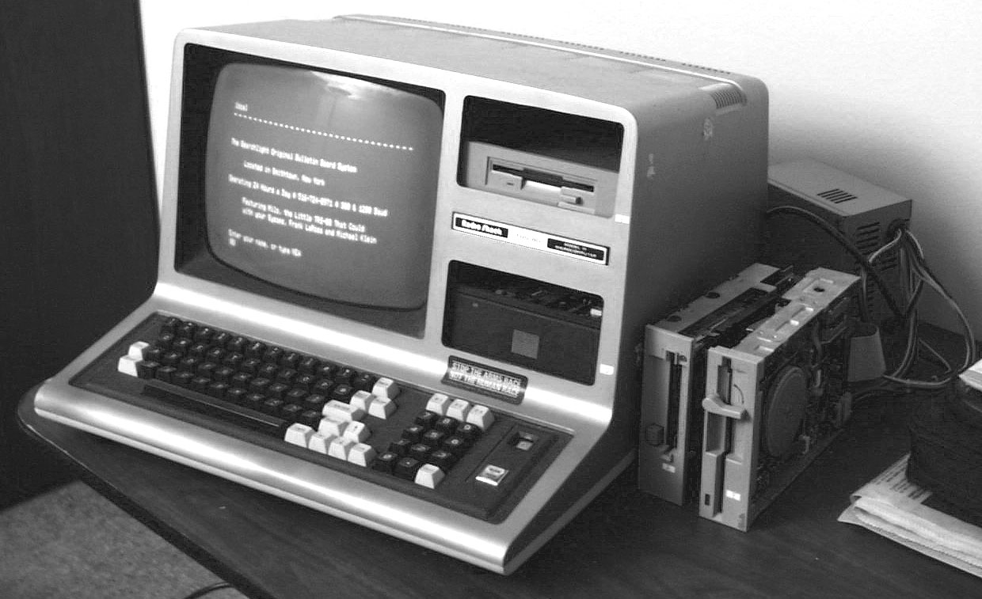
You’ve Got Mail!
Check It!

Slide 10
E-Mail Address Regs.
All PSC Orders Served by E-mail
Duty to Keep Correct E-mail Address on file with PSC
    Default Regulatory E-mail Address
Duty to List E-mail Address in Application & All Other Papers
    Utility Official
    Its Attorney

Slide 11
E-Mail Address
  Who is Covered?
    Water Districts
    Water Associations
    Investor Owned Utilities
    Municipal Utilities

Slide 12
Why Municipals?
  Contract Filing
  Tariff Change (Wholesale Rate)
  Protest Supplier’s Rate Increase
  Acquiring Assets of Another Utility
  Avoid Delays

Slide 13

Tips
Talley’s

Slide 14
Default Regulatory E-mail Address
  Send E-mail to PSC
      psc.reports@ky.gov
      PSCED@ky.gov
  Send Letter to PSC
      Kent A. Chandler,
    Executive Director

Slide 15
Franchises
and
Contracts

Slide 16
Franchise
  Definition
    Private
      Rights granted by company to individual or business to sell a product
      Examples

Slide 17




Franchises

Slide 18
Franchise
  Definition
    Government
      Privilege granted by government to utility to provide specific utility service
      Permission to erect facilities over & under streets, alleys, & sidewalks
      Fee: 3%
      Examples

Slide 19




Franchises

Slide 20
LEGAL ISSUE
40-year
Water Supply Contract
Between 2 Water Districts
Valid or Invalid
Why? Contract = Franchise
Over 20 Years
Basis: Kentucky Constitution Section 164

Slide 21
Ky. Constitution Section 164
  No county, city, town, taxing district or other municipality shall be authorized or permitted to grant any franchise or privilege, or make any contract in reference thereto, for a term exceeding twenty years. Before granting such franchise or privilege for a term of years, such municipality shall first, after due advertisement, receive bids therefor publicly, and award the same to the highest and best bidder; but it shall have the right to reject any or all bids.

Slide 22
Court of Appeals
  Crittenden-Livingston WD
  Ledbetter WD
  Case No. 2017-CA-000578
  Oral Argument: 4-24-18
  Decided: 8-17-18
  Holding: No Franchise
vs.

Slide 23
Court of Appeals @ Page 4
  A franchise is generally defined as a right or privilege granted by a sovereign power, government or a governmental entity to a party to do some act which such party could not do without a grant from the government. A franchise is a grant of a right to use public property or at least the property over which the granting authority has control.

Slide 24


Time to
Celebrate !
MDR

Slide 25
Ky. Supreme Court
  Ledbetter W.D.
  Crittenden-Livingston WD
  Case No. 2018-SC-000494-DG
  Motion DR: 09-12-18
  DR Granted: 02-07-19
  Oral Arguments: None
  Decided: 02-20-20
vs.

Slide 26
Ky. Supreme Court
  Ledbetter W.D.
  Crittenden-Livingston WD
  Decided: 02-20-20
  Petition for Rehearing: 03-10-20
  Decision Final: 07-09-20
  NOT TO BE PUBLISHED
vs.

Slide 27
Ky. Supreme Court Holding
  Reversed C/A by 4-2 Vote
  Contract is Franchise
  Section 164 of Const.
      Must Advertise
      20 Years or Less

Slide 28



The SKY IS FALLING

Slide 29
Ky. Supreme Court Rationale
  Ky. AG Opinion - 1981
  KRS 96.120 (City)
  Broad Definition of Franchise
  Unique Facts

Slide 30
Dissents by 2 Justices
  Justice VanMeter
    2 Pages
    “Simple contract for the sale of water from one district to the other . . .”
    Explained Meaning of Franchise in Context of Utilities
        Delivering Water to Retail Customers
        Billing Customers Directly

Slide 31
Dissents by 2 Justices
  Chief Justice Minton
    3 Pages
    Agreed with J. VanMeter
    Look at Big Picture
        Nature of Right Being Conveyed
        No Special Privilege
        Supplier Already Had Right to Produce and Sell Water

Slide 32
Why?
  340 Water Utilities
  169 WTPs
  50% Buy Water
  Need Water Supply Contract
  Long Term
  . . .

Slide 33
How Long Is Long Term?
  Lender
    RD: 40 years
    KIA: 20 or 30 years
    Bonds: Length of Bonds

Slide 34
Significance
  If Franchise . . . 20 Year Limit
    Can’t Borrow $ from RD
    Other Sources – Only if < 20 years
        KIA
        Bonds
        KRWFC

Slide 35
What’s Next
  Rural Development Response
    20 - Year Contract and 40 - Year Loan ? ? ?
    OGC Opinion
  PSC Response ? ? ?

Slide 36
FAQ
  My Utility's Contract Was Originally a 40 - Year Contract. Is It Null and Void?
  Answer: NO
    Opinion Did Not Void All Such Contracts
    Someone Must File Suit

Slide 37
Unique Facts in Ledbetter
  Supplier Constructed 6 Miles of Water Line Inside Purchaser’s Service Area
  Master Meter Located on Purchaser’s Property (Water Tank)
  Building Constructed to House Master Meter on Purchaser’s Property

Slide 38
FAQ
  Our Utility is a City. We Supply Water to a Water District. Does This Court Case Affect Us?
  Answer: YES

Slide 39
FAQ
  Our Utility is a City. We Supply Water to Another City. Does This Court Case Affect Us?
  Answer: YES
  But . . . Don’t Have to Worry About PSC

Slide 40
FAQ
  Our Utility’s Contract Was Only for 15 Years. Does This Court Case Affect Us?
  Answer: NO

Slide 41
FAQ
  Our Utility’s Contract Was Originally for 40 Years, But It Only Has 15 Years Left. Does This Court Case Affect Us?
  Answer: YES
  Same Facts as in Ledbetter Case

Slide 42
FAQ
  What is the Significance of the Supreme Court Opinion Being an Unpublished Opinion?
  Answer:
  It Cannot Be Cited as Authority in Another Case Without Providing Copy to Judge and Opposing Attorney. Judge Can Still Rely on the Case as Authority.

Slide 43
KRWA’s Role
  Filed Amicus Brief in C/A & S/C
      “Friend” of Court
  Protect Validity of Contracts
  Protect Ability to Obtain $
  Working With RD

Slide 44


QUESTIONS?

Slide 45
Sovereign
Immunity

Slide 46

The King Can Do No Wrong

Slide 47
Campbell County Case
  Kate Carucci
  Northern Ky. WD
  Circuit Court
  Case No. 2016 - CI - 00476
  Decided: 04-12-17
  Ruling: Case Dismissed
  Why? S/I Defense
vs.

Slide 48
Court of Appeals
  Kate Carucci
  Northern Ky. WD
  Case No. 2017-CA-000941-MR
  Decided: 01-18-19
  Holding: Abolished S/I
  For Water Districts
vs.

Slide 49
The SKY IS FALLING

Slide 50
Ky. Supreme Court
  Northern Ky. WD vs. Carucci
  Case No. 2019-SC-000105-DG
  Citation: 600 S.W.3d 240
  Motion DR: 02-19-19
  DR Granted: 08-29-19
  Affirmed: 08-29-19
  Final: 02-20-20

Slide 51
Court of Appeals
  South Woodford WD vs. Byrd
  S.W.3d 340 (Ky. App. 2011)
  Holding: WD Immune from
  Negligence Suit
  Because of S/I

Slide 52
Supreme Court
  Coppage Construction Co., Inc.
  Sanitation District No. 1
  459 S.W.3d 855 (Ky. 2015)
  Holding: SD Not Entitled to
  S/I Because It Was
  Not a County-Created Entity
vs.

Slide 53
Ky. Supreme Court
  Northern Ky. WD vs. Carucci
  DR Granted: 08-29-19
  Oral Arguments: None
  Decided: 08-29-19
  Final: 02-20-20
  Holding: No S/I for
  W.D.

Slide 54
Holding
  O/R South Woodford Case
  No S/I for W.D.
  Adopted by Sup. Court
  Providing Drinking Water Is NOT Integral State Function

Slide 55


Slide 56
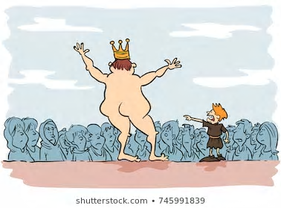


Slide 57
EXPOSED

Slide 58
Tips
Talley’s

Slide 59
Talley’s Tips
  Exercise Reasonable Care
  Use Best Practices
  Adopt Policies
  Follow Policies

Slide 60
QUESTIONS?

Slide 61
Filed - Rate
Doctrine
101

Slide 62
Filed – Rate Doctrine
Definition: No utility shall charge a greater or less rate for any service than the rate contained in its filed schedules (Tariff).
KRS 278.160

Slide 63
Filed – Rate Doctrine
Application - 2 Aspects
  If it is in your Tariff, you must charge it.
  If it is not in your Tariff, you can not charge it.

Slide 64
Filed – Rate Doctrine
Requires Filing of:
  Rates
  Rules & Conditions of Service
  Contracts

Slide 65

Talley’s
Take Aways
Damon

Slide 66

Filed – Rate Doctrine
  File Wholesale Contracts with PSC
      War Stories (2)
        Length of Contract
        Buy All Water
  Check PSC Website When You Return

Slide 67
Open
Meetings
Act

Slide 68
Attending Board Meeting
Via Zoom
  KRS 61.826 Amended: 2018
  Now Easier to Conduct Meeting via
  Video Teleconference (VTC)
      All Meetings
      Board Member Attend Remotely
        Count in Quorum Call
        Fully Participate
        More Than One

Slide 69
Special Rules - VTC
  Identify Primary Location
  Everyone Must Be Able to See
  and Hear Everyone Else
  Notice Requirements
    Meeting Will Be VTC
    Primary Location

Slide 70
Tips
Talley’s

Slide 71
Notice of VTC Meetings
  Regular Meetings
    Adopt Schedule (61.820)
    Some or All of the Regular Meetings Will Be VTC
    Primary Location at ________
    Public May Attend at Primary Location

Slide 72
Notice of VTC Meetings
  Special Meeting
    Normal Rules (61.823) Plus
      May Be VTC Meeting
      Primary Location at ________
      Public May Attend at
      Primary Location
  Minutes
    Comm. _____ Attended via VTC

Slide 73
QUESTIONS?

Slide 74
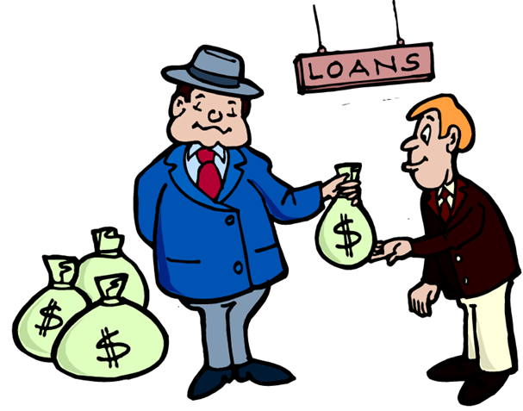
Borrowing
Money

Slide 75
KRS 278.300(1)
  No utility shall issue any securities or evidences of indebtedness . . . until it has been authorized to do so by order of the Commission.

Slide 76
Practical Effect
  Must Obtain PSC Approval Before Incurring Long-term Debt (Over 2 Years)
  Exception:
      2 Years or Less
      Renewals
        (3 X 2 = 6 Years)
      (6 X 1 = 6 Years)

Slide 77

Violation

Slide 78
Show
Cause
Cases

Slide 79
Show Cause Case # 3
Case No. 2017 - 469
Opened: 01- 11 - 2018
Hearing: 02 - 27- 2018
Issue: KRS 278.300
Decision: 09 - 17 - 2018

Slide 80
Show Cause Case # 3
  This is the third case in the last year and a half involving a show cause order against a water district utility and/or its commissioners for violating KRS 278.300 by obtaining a loan, the term of which is in excess of two years, without prior approval of the Commission. To date the Commission has assessed, but not sought, to collect civil penalties against individual water district commissioners for essentially two reasons.
  (Continued)

Slide 81
Show Cause Case # 3
  First, the Commission's goal has been to obtain compliance with the requirements of the statute and not to exact a penalty and, second, the Commission was determined to send a message to these utilities and their local commissioners that they were out of compliance and future violations could result in individual penalties as well as a separate penalty against the utility. (Continued)

Slide 82
Show Cause Case # 3
  The Commission also intended to place all other water districts on notice that obtaining loans in violation of KRS 278.300 could subject both the utility and its commissioners to civil penalties, and to provide fair notice that strict enforcement could be expected in future cases.

Slide 83
Show Cause Case # 3
  Water districts and their commissioners are hereby put on final notice that unauthorized debt incurred after the date of this order may well result in substantial civil penalties being assessed and collected against both in future show cause cases.
  Pages 7 and 8 of Order

Slide 84
Show Cause Case # 3
  District Fined $2,500
      Pay $500
      $2,000 Suspended
      Good Behavior
      One Year
  Commissioner Matthews Dissented

Slide 85
Show Cause Case # 3
  Commissioners Fined $2,000
      Pay Zero
      Entire $2,000 Suspended
      Good Behavior
      One Year
  12 Hours Training

Slide 86
Show Cause Case # 3
  Develop Written Policy
      Borrow $
      Hire Lawyer
  Adopt Policy
  File Policy with PSC

Slide 87
2019 Show Cause Cases
  WD # 1
    All Commissioners Resigned
    General Manager Resigned
    PSC Dismissed Case

Slide 88
2019 Show Cause Cases
  WD # 2
    Commissioners Settled with PSC
    $500 Fine (suspended)
    12 Hours Training Per Year
    WD Not Fined
    See Timeline

Slide 89
Timeline
    09-27-17 Staff Report
    01-11-18 Show Cause Order
    02-27-18 Hearing (Rescheduled)
    04-08-19 Offer of Settlement
    06-19-19 Order Accepting Offer of Settlement

Slide 90
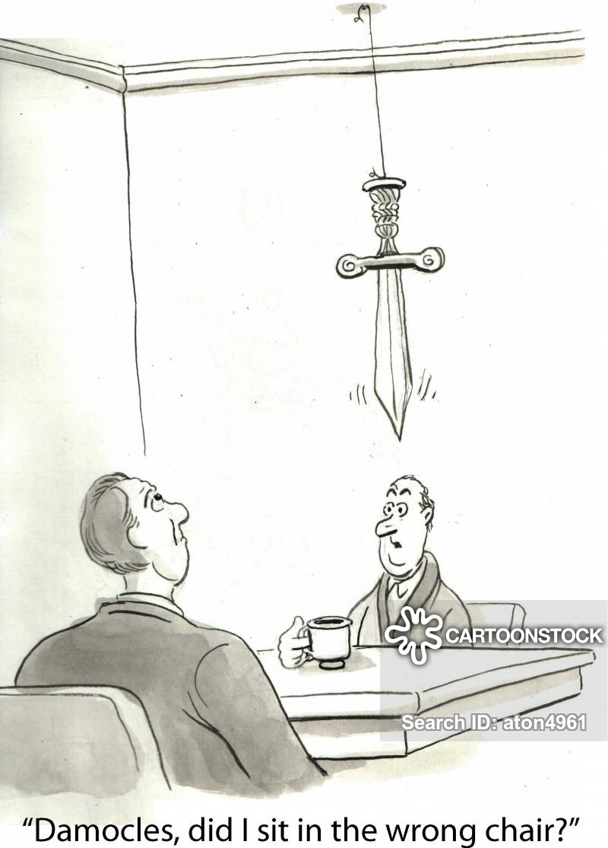

Slide 91
QUESTIONS?

Slide 92
2020
General
Assembly

Slide 93
Notable Bills
  SB 165 – Ky. 811
  SB 228 – Ky. 811
  HB 446 – Commissioner
              Training
  HB 570 – Interlocal
              Cooperation Act

Slide 94
Surcharge
Cases

Slide 95
W.D. Surcharges
Cannonsburg 2014-267 & 2018-376
Martin Co. 2018-017
Estill Co. 2019-119
Graves Co. 2019-347
Farmdale 2020-021
Southern 2019-131

Slide 96
Water Loss Reduction Surcharge
    Mechanism to Recover Reduction in Revenue Requirement Because of Unaccounted for Water Loss over 15%
    Time Limit: 36 or 48 Months
    Monetary Limit
    Restrictions

Slide 97
Restrictions
    Separate Bank Account
    Water Loss Reduction Plan
    Prior PSC Approval
    Monthly Reports

Slide 98
How to Get Surcharge
    File ARF Case
        Staff Report
        Motion for Surcharge
    File Separate Application

Slide 99
QUESTIONS?

Slide 100
Recent
PSC
Orders

Slide 101
Thou Shall File a Rate Adjustment Case
  Over 2 Dozen Utilities . . .
  Case Type
      PWA
      Refinancing
      .023 cont.

Slide 102
Rate Adjustment
  Case Type
      Defending Wholesale Rate Increase
      Intervention
      Deviation
      Any Application

Slide 103
Rate Adjustment
  Reasons
      No Recent General Base Rate Adjustment
      Negative Cash Flow
      Decreasing Depreciation Reserves

Slide 104


Slide 105

This Photo by Unknown Author is licensed under CC BY-NC-ND

Slide 106
PSC Case No. 2019 - 041
Filed: 03-12-2019
Utility: 11 Water Utilities
Type: Investigation
Issue: Excessive Water Loss
Hearings: 11 Separate Hearings
Decided: 11-22-19

Slide 107
Leaky 11 Cases
Findings:
      High Water Loss is Symptom
      of Larger Problems
      Poor Board Oversight
      Poor Management
      Poor Financial Health
      Need Rate Increase

Slide 108
Leaky 11 Cases
Utilities Ordered to:
      Develop Water Loss Reduction Plan
      Perform Water Loss Audit
      Adopt Policies
      Adopt Procedures
      Board Training

Slide 109
Leaky 11 Cases
PSC Published
Comprehensive Report:
    November 22, 2019
    82 Pages
    Summarized Findings
    Legislative Recommendations

Slide 110
PSC Case No. 2019 - 080
Filed: 02-21-2019
Seller: Pikeville
Buyer: Mountain WD
Type: Municipal Wholesale
Rate increase
Hearing: 09-11-2019
Decided: 12-19-19 & 01-31-20

Slide 111
Pikeville
Issues:
      COSS: M1 vs. M54 Manual
      Discovery
      Rate Case Expense

Slide 112
Pikeville
Holding:
      COSS: Invalid
      Wholesale Rate Increase
      Rate Case Expense
          No COSS Expert $
          Attorney Fees OK

Slide 113
Pikeville Holding (cont.)
  Other Wholesale Customer
      Settled Before Case Filed
      PSC Reduced Rate
      Must Pay ½ of Rate Case Expense

Slide 114
Pikeville Status
Decided: 12-19-19 & 01-31-20
Appealed: Franklin Cir. Court
Status: Pending

Slide 115
PSC Case No. 2019 - 444
Filed: 11-27-2019
Seller: Princeton
Buyers: Caldwell Co. WD & Lyon Co. WD
Type: Municipal Wholesale
Rate increase
Hearing: 05-05-2020
Decided: 06-15-2020

Slide 116
Issues:
      Unit Cost Approach
      No True COSS
      Allocation of Expenses
      Rate Case Expense
Princeton

Slide 117
Princeton
Holding:
      Unit Cost Approach: Invalid
      Wholesale Rate Increase
      Rate Case Expense
          Reduced
          Attorney Fees OK

Slide 118
Princeton Holding (cont.)
  Rate Case Expense Shared by Princeton & Wholesale Customers
  Criticized for No Negotiations
  Both Wholesale Customers Must File Rate Adjustment Application

Slide 119
PSC Case No. 2019 - 268
Filed: 07-31-2019
Seller: Knott Co. WD
Type: ARF Case
Hearing: 01-22-2020
Decided: 01-31-20

Slide 120
PSC Case No. 2019 - 268
    Utility Requested 48%
    Staff Recommended 70%
    PSC Granted Increase:
        Year One 46%
        Year Two 15%
    Hearing Noteworthy

Slide 121
PSC Case No. 2019 - 268
    No Rate Increase – 17 Years
    Commissioners’ Benefits
    Open Meetings Act Violation
    Other Issues

Slide 122
PSC Case No. 2019 - 115
Filed: 4-11-2019
Utility: Grayson Co. WD
Type: Deviation
Issue: 15 Year Meters
Sample Testing
Decided: 4-28-20

Slide 123

Cases
to
Watch

Slide 124
PSC Case No. 2020 - 137
Filed: 6-8-2020
Utility: West Daviess Co.
Type: Deviation
Issue: 15 Year Meters
Sample Testing
Decided: Pending

Slide 125
PSC Case No. 2020 - 138
Filed: 6-8-2020
Utility: Southeast Daviess Co.
Type: Deviation
Issue: 15 Year Meters
Sample Testing
Decided: Pending

Slide 126
QUESTIONS?
damon.talley@skofirm.com
270-358-3187

