Slide 1
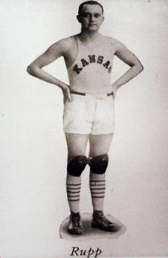
Asset Management and Financing
Kentucky Rural Water Association
Robert K. Miller

Slide 2
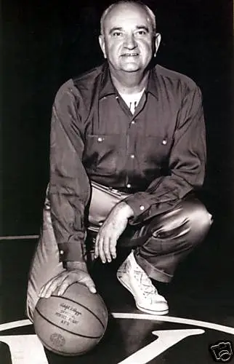
The Fundamentals of Asset Management and Financing using a Notepad, a Pencil, a Calculator, and Your Own Judgment

Slide 3
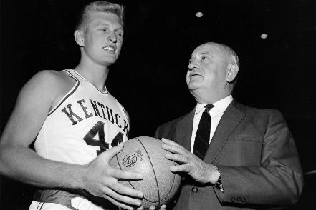
Explaining Asset Management
Asset management is a process to make sure that:
Planned maintenance can be conducted
Assets can be repaired, rehabilitated, or replaced on time
That there is enough money to pay for it.
Because assets installed while Adolph Rupp was coaching eventually need to be replaced.

Slide 4
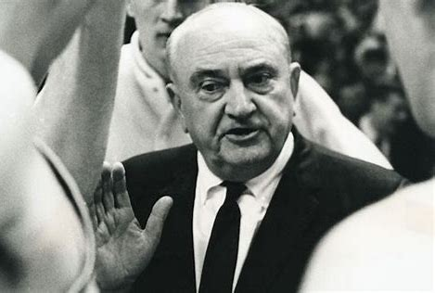
Selling the Benefits of Asset Management
Prolonging asset life
Improving decisions about asset rehabilitation and replacement
Setting rates based on sound operational and financial planning
Meeting regulatory requirements
Improving responses to emergencies
Reducing overall costs for both
operations and capital

Slide 5
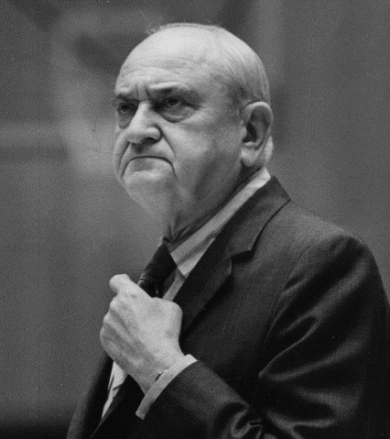
Five Core Questions
What is the current state of my assets?
What is required level of service?
Which assets are critical?
When to repair or rehabilitate or replace?
What is long-term funding strategy?

Slide 6
1. What is the current state of my assets?
What do I own?
Where is it?
What condition is it in?
What is its remaining useful life?

Slide 7
1. What is the current state of my assets?
Plan on multi-year effort to identify assets
Use what you already have: maps, accounting records, and as-built drawings
Focus on “what wakes you up at night”
Identify what will need attention during the next five years

Slide 8
1. What is the current state of my assets?
Source of Supply
Treatment Plant
Pumping Plant
Chemical Feeds
Transmission Pipes
Storage Tanks
Booster Stations

Slide 9
1. What is the current state of my assets?
Distribution Pipes
Valves
Hydrants
Meters
Vehicles and Equipment

Slide 10
1. What is the current state of my assets?
Don’t forget your back-office assets.
Telemetry System
Mapping System
Accounting System
Billing System
Communications System

Slide 11
1. What is the current state of my assets?
Don’t attempt it alone.
Get advice and assistance from retirees and field personnel.

Slide 12
1. What is the current state of my assets?
Gather identifying information:
Make
Model
Serial Number
Location
Take photos.

Slide 13
1. What is the current state of my assets?
Develop your own evaluation scale:
Routine maintenance needed.
Rehabilitation needed.
Replacement needed.

Slide 14
2. What is required level of service?
What do my customers expect?
What do regulators require?
What is my actual performance?

Slide 15
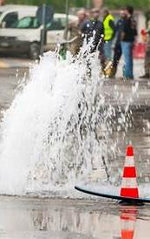
2. What is required level of service?
Example: Water Main Break Frequency
What do my customers expect?
What do regulators require?
What is my actual performance?

Slide 16
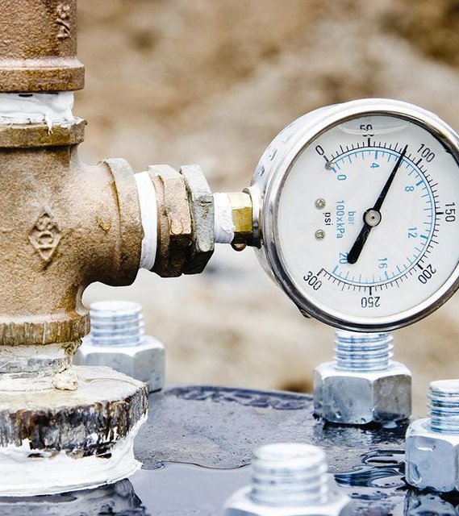
2. What is required level of service?
Example: Water Pressure
What do my customers expect?
What do regulators require?
What is my actual performance?

Slide 17
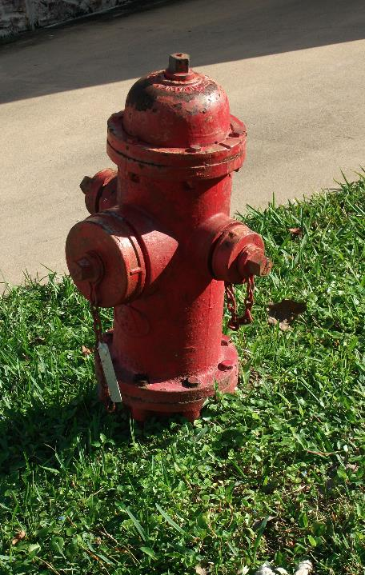
2. What is required level of service?
Example: Fire Hydrants
What do my customers expect?
What do regulators require?
What is my actual performance?

Slide 18
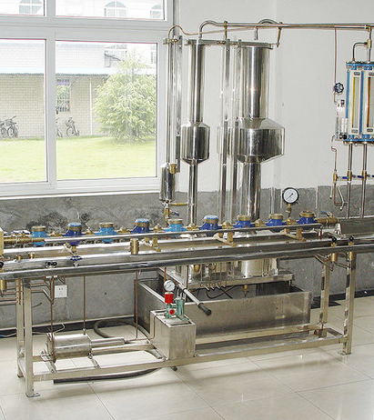
2. What is required level of service?
Example: Meter Accuracy
What do my customers expect?
What do regulators require?
What is my actual performance?

Slide 19
3. Which assets are critical?
How does it fail?
What is the likelihood of failure?
How much advance notice is there of imminent failure?
What are the consequences of failure?

Slide 20
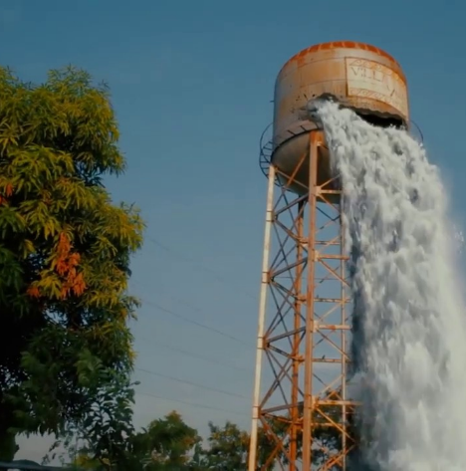
3. Which assets are critical?
How does it fail?
It rusts.
It just stops.
Slowly at first,
then rapidly.
It bursts into flames.

Slide 21
3. Which assets are critical?
What is the likelihood of failure in next five years?
Not Likely
Possible
Likely

Slide 22
3. Which assets are critical?
How much advance notice is there of imminent failure?
Like a tornado, less than one hour
Like a hurricane, three to five days
Like climate change, several years

Slide 23
3. Which assets are critical?
What are the consequences of failure?
Routine
Emergency
Extreme
Catastrophic

Slide 24
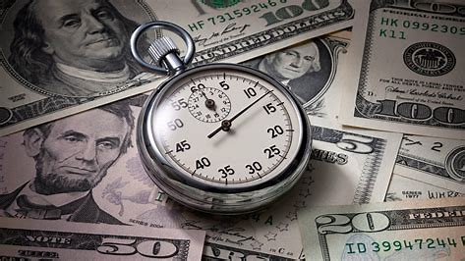
4. When to repair, rehabilitate, or replace?
How much time and money does repair take?
How much time and money does rehabilitation take?
How much time and money does replacement take?

Slide 25
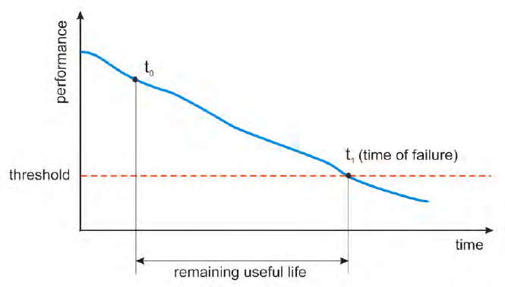
4. When to repair, rehabilitate, or replace?
How long does repair last?
How long does rehabilitation last?
How long does replacement last?

Slide 26
Building an Asset Management Plan
Considering:
Current state of assets
Level of service required
Which assets are critical
When to repair, rehabilitate, or replace
Build a Five-Year Plan:
What new maintenance needs to be scheduled
What assets need to be rehabilitated
What assets need to be replaced

Slide 27
5. What is long-term funding strategy?
Transaction Approach: Lump as much as possible into a “capital project” for grants and loans and accompanying rate increase.
Asset Management Approach: Look at revenues and requirements over multiple years using mix of debt and rates.

Slide 28
KY PSC Approach to Ratemaking
Utilities are being ordered to perform rate studies.
Rate studies compute revenues required to recover operating expenses, debt service, and depreciation.
Current rates typically recover operating expenses and debt service.
New rates include depreciation.
Depreciation funds can be used reactively or proactively.

Slide 29
How to Use Depreciation Funds

Slide 31
KY PSC Approach to Ratemaking
New rates may also include a water loss reduction surcharge.
Established during a rate case at request of utility.
Cost of purchased water, power, and chemicals above 15% water loss excluded from rates.
May be recovered via fixed amount per bill for 48 months.
Use limited to certain projects.
Expenditures subject to prior approval by KY PSC.

Slide 32
Recommended Approach
Build a five-year asset management financing plan using:
Sources and Uses of Funds | Maintenance Budget | Water Loss Surcharge * | Depreciation Funds | Loan Proceeds
Maintenance
Rehabilitation
Replacement
* Subject to prior approval by KY PSC

Slide 33
5. What is long-term funding strategy?
Start with the Income Statement from most recent PSC Annual Report.
Make known and measurable adjustments to revenues and maintenance expenses.
Project out for five years.

Slide 34
5. What is long-term funding strategy?
Determine Cash Generated from Operations for next five years.

Slide 35
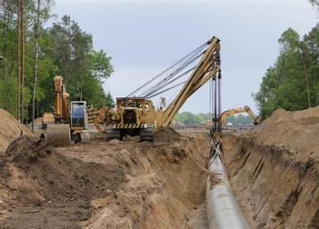
5. What is long-term funding strategy?
Identify and sequence planned capital improvements.

Slide 36
5. What is long-term funding strategy?
Assign to targeted year and increase for inflation.

Slide 37
5. What is long-term funding strategy?
Assign useful lives and compute new depreciation.
Link to Income Statement.

Slide 38
5. What is long-term funding strategy?
Pull it all together into a financial plan.

Slide 39
5. What is long-term funding strategy?
Determine how much borrowing is necessary to ensure funding of operating reserve with positive ending cash balance.

Slide 40
5. What is long-term funding strategy?
Reduce size of capital program if necessary. Plan on preparing multiple iterations of financial plan.

Slide 41
Is There a Spreadsheet Model Available?
Beta version available from KRWA!

Slide 42
What Does KY PSC think of this?
Commission supports asset management approach.
Commission has not yet considered a rate case for a rural water utility based on asset management approach.
Discussions underway!

Slide 43
Questions?

