Slide 1
Challenges facing KentuckY’s WATER SYSTEMS
Presented by
Greg C. Heitzman, PE, MBA
BlueWater Kentucky
ZOOM Webinar
2020 Water District Commissioner Training
August 27, 2020

Slide 2
2019 Kentucky Infrastructure Report Card
“Mediocre”
Drinking Water = C+
Waste Water = C-
https://www.infrastructurereportcard.org/state-item/kentucky/

Slide 3
Kentucky's success since SB 409 authorized in 2000
15 Regional Water Management Councils to coordinate planning
State-wide water GIS database => KY WRIS
Drinking Water coverage at 95%
Water and Wastewater system consolidation
Water System interconnections through regional cooperation
Improved compliance record in water and wastewater
Industry Collaboration through KY Water Advisory Council
Active Industry Associations (AWWA, KMUA, KWWOA, Rural Water, etc.)
Coordinated Agency Funding (KIA, RD, DLG, AML, ARC, CDBG, etc.)
Training from AWWA, KDOW, RCAP, Rural Water, UK, etc.
R&D support from UK, UL, WKU
Partnerships among Best Practice Water/WW systems

Slide 4
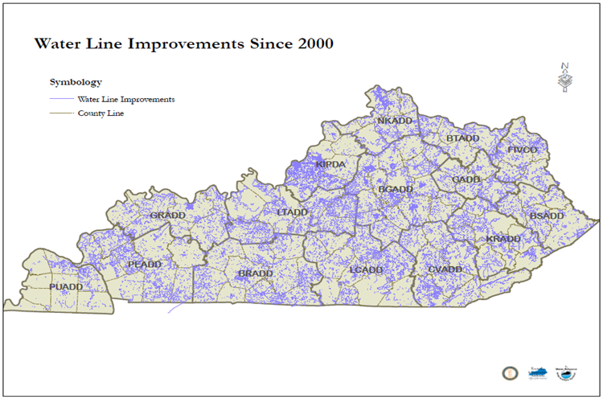
Kentucky Water Systems
435 Public Water Systems
213 Water Treatment Plants(average age 36 years)
1,842 Water Storage Tanks (average age 26 years)
58,783 Miles of Water Main
Average age 38 years
20% over 50 years
Estimated 25,000 lead service lines
Source: KY Infrastructure Authority and KY Division of Water

Slide 5
KY Public Water Service Availability
2000 - Governor Paul Patton’s 2020 Water Vision thru Senate Bill 409
435 Kentucky Public Water Systems serve 4.5 million people
95% of Kentuckians have access to public water system (top 5 in US)
Recognized nationally for regional planning and consolidation
Source: KY Infrastructure Authority and KY Division of Water

Slide 6
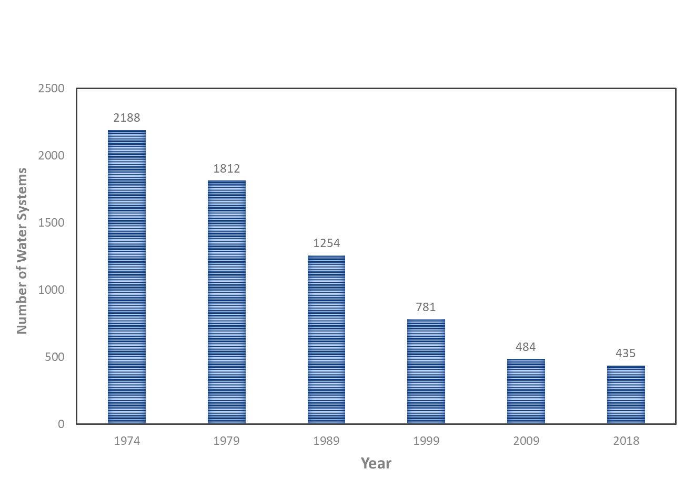
Consolidation of KY Water Systems
80% decline in number of water systems over 45 years (one of best in US)
Source: KY Division of Water

Slide 7
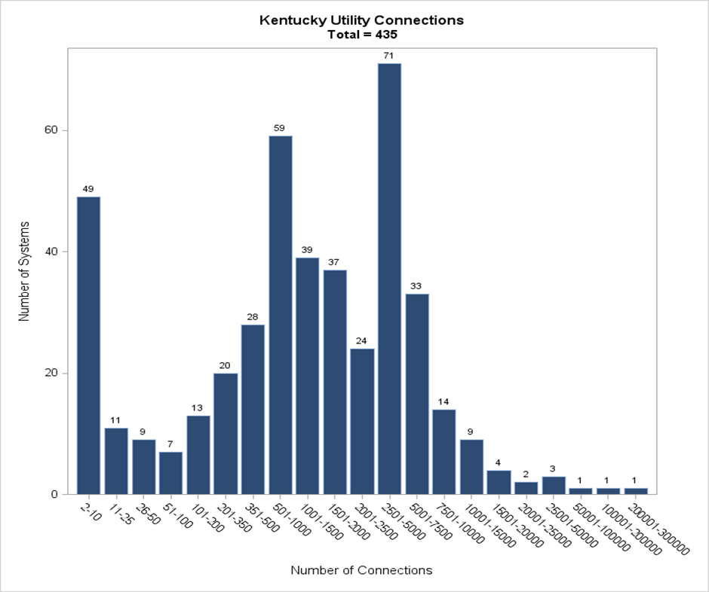
Kentucky Water System Profile
Top 12 Systems Serve:
37 % of KY Population
54% of Water Produced
296 Small Systems
Louisville Water Company
Kentucky-American Water Co
Northern Kentucky Water District
Bowling Green Municipal Utilities
Owensboro Municipal Utilities
Ashland Water Works
Paducah Water Works
Frankfort Plant Board
Somerset Water Service
Logan-Todd Regional Commission
Glasgow Water Company
Hardin County Water District No. 2
Top 12 Large Systems
Source: KY Division of Water

Slide 8
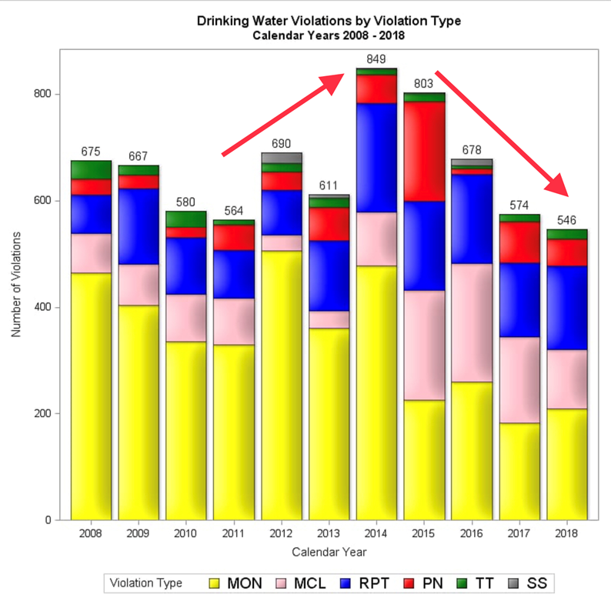
KY Drinking Water Regulations
Decline in Violations last 5 years from 849 in 2014 to 546 in 2018
Increase in 2014 for Disinfection By-Product Violations
DBPs have declined through 2018 with technical assistance from KY DOW and KY Rural Water
Expect improvement again in 2019
Source: KY Division of Water

Slide 9
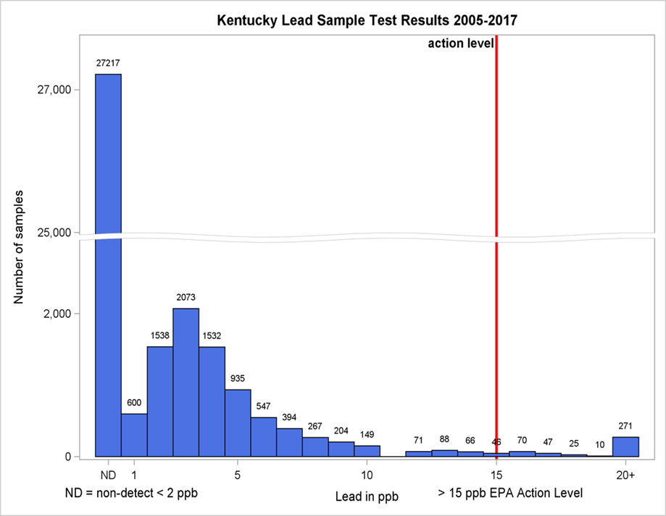
Lead Compliance Record
All 435 Public Water Systems are compliant with EPA Lead and Copper Rule
Kentucky in generally in good shape if EPA sets “Target” Level at 10 parts per billion (ppb)
EPA estimates KY has 53,000 Lead Service Lines
KY estimate is less than 25,000 Lead Service Lines, since Louisville has reduced lead service line inventory from 70,000 in 1940 to less than 500 in 2019
Need State-wide Lead Inventory
Proposed EPA Target Level
10 ppb
Current EPA Action Level of 15 ppb
Source: KY Division of Water

Slide 10
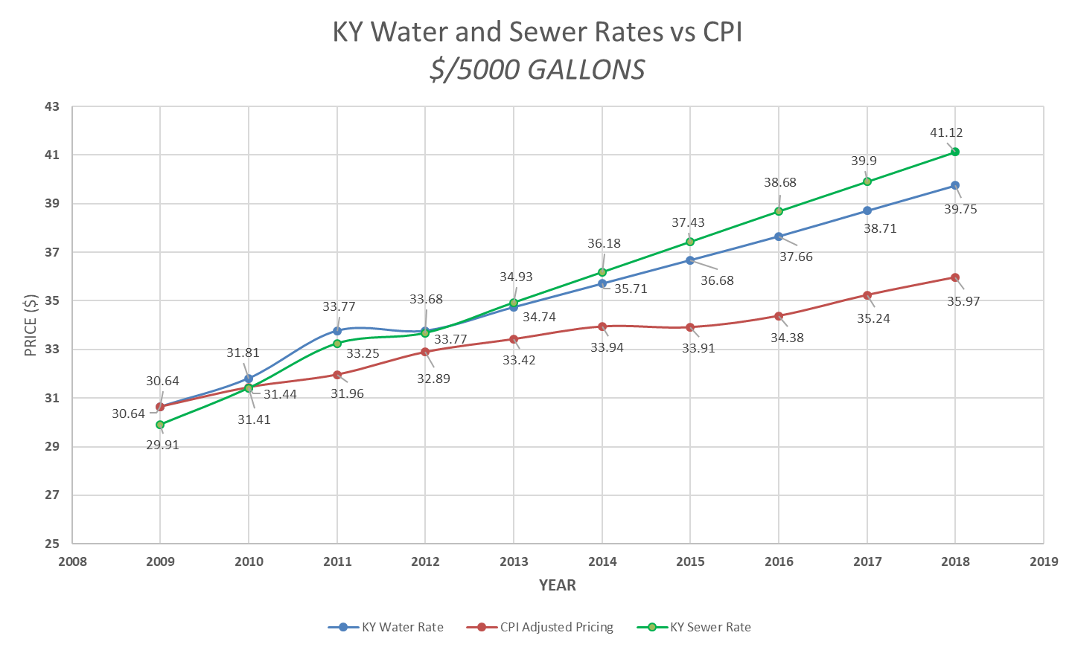
KY Water and WASTEWATER RATES
Average KY Water Bill for 5,000 gallons/month
2012 - $33.77
2018 - $39.75
2.75% average annual increase (CPI about 2%)
Average KY Wastewater Bill for 5,000 gallons/month
2012 - $33.68
2018 - $41.12
3.0% average annual increase (CPI about 2%)
Total W/WW Bill Averages $80.87/month or $970/Year
Some KY communities exceed $100 per month or $1,200/Year
Averages 2% of KY Median Household Income of $48,375
Some KY communities at 2.5% of KY MHI
Source: KY Rural Water/Cannon & Cannon Rate Survey

Slide 11
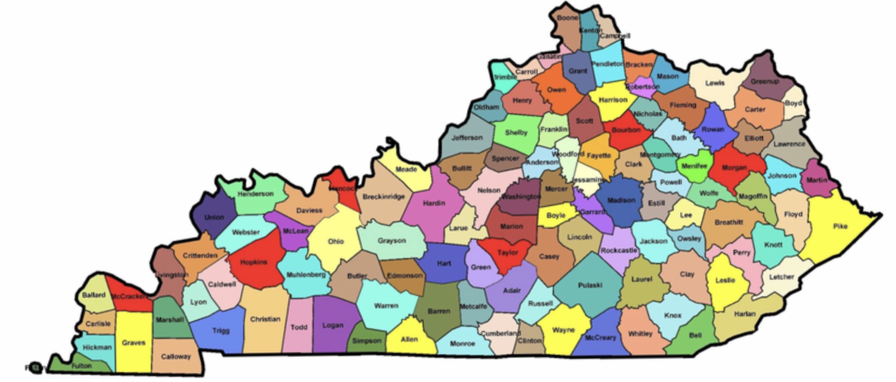
Top challenges for Kentucky wateR SYSTEMS

Slide 12
Top challenges for KY wateR SYSTEMS
#1 COMPLIANCE WITH REGULATIONS
Especially Impacting Small Systems
Disinfection By-Products (DBP) in drinking water
Lead and Copper ➔ Focus is now on Lead In Schools
America’s Water Infrastructure Act of 2018 (AWIA)
Algal Toxins and PFAS (perfluoroalkyl) compounds
Pesticides and Herbicides

Slide 13
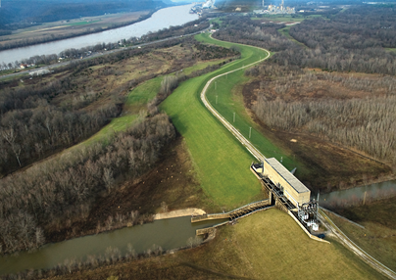
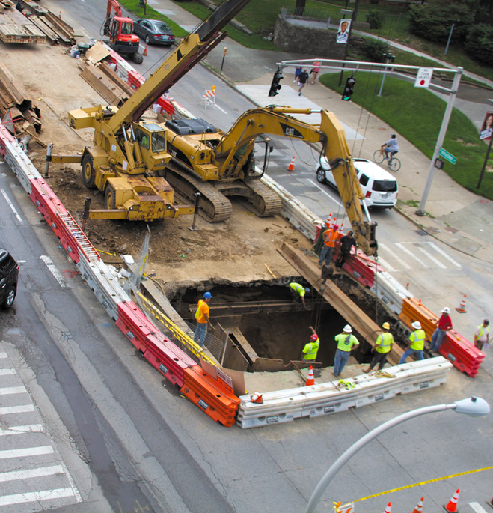
Top challenges for KY water SYSTEMS
# 2 AGING INFRASTRUCTURE
Water - Aging treatment, storage, pumping, distribution
Wastewater – Aging collections, storage, treatment, pumping, flood protection
Growing deferred maintenance
Slow adoption of Asset Management and Life Cycle Analysis
Lack of capital planning (5,10,20 years)
Funding and Procurement Cycle
48” Water Main Break
Flood Protection Pumps and Levees
Sewer Collapse

Slide 14
Top challenges for KY water SYSTEMS
$8.2 Billion Funding Gap for KY Drinking Water ($1,800/person) over next 20 years
$6.2 Billion Funding Gap for KY Wastewater ($1,400/person)
#3 INFRASTRUCTURE FUNDING
Current customer rate base is not adequate to fund infrastructure needs
Funding focus has been on new infrastructure and not on repair, maintenance and replacement
Loans are replacing grants (systems waiting on grants)
Limited funds available for soft costs (planning, new technology, best practice, life cycle analysis)

Slide 15
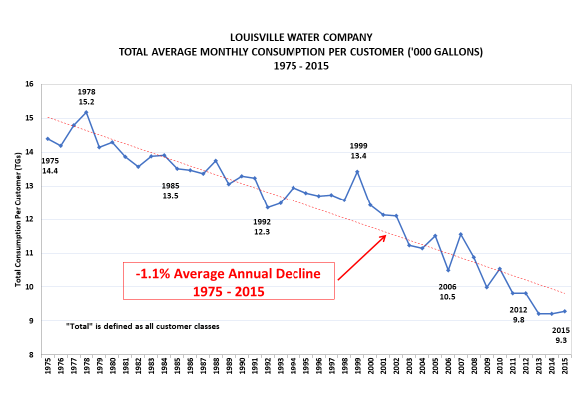
Top challenges for KY water SYSTEMS
#4 CONSUMPTION & RATES
Kentucky is generally a slow or no-growth economy
Water consumption is declining:
transition to service economy
recycling/reuse
low-flow plumbing fixtures
therefore …. fixed costs are spread over fewer gallons sold
Different rate approval methods (PSC -regulated vs Municipal)
Reluctance by elected officials and appointees to raise rates due to public pressure
Affordability of water becomes a concern in some communities when full-cost pricing is implemented

Slide 16
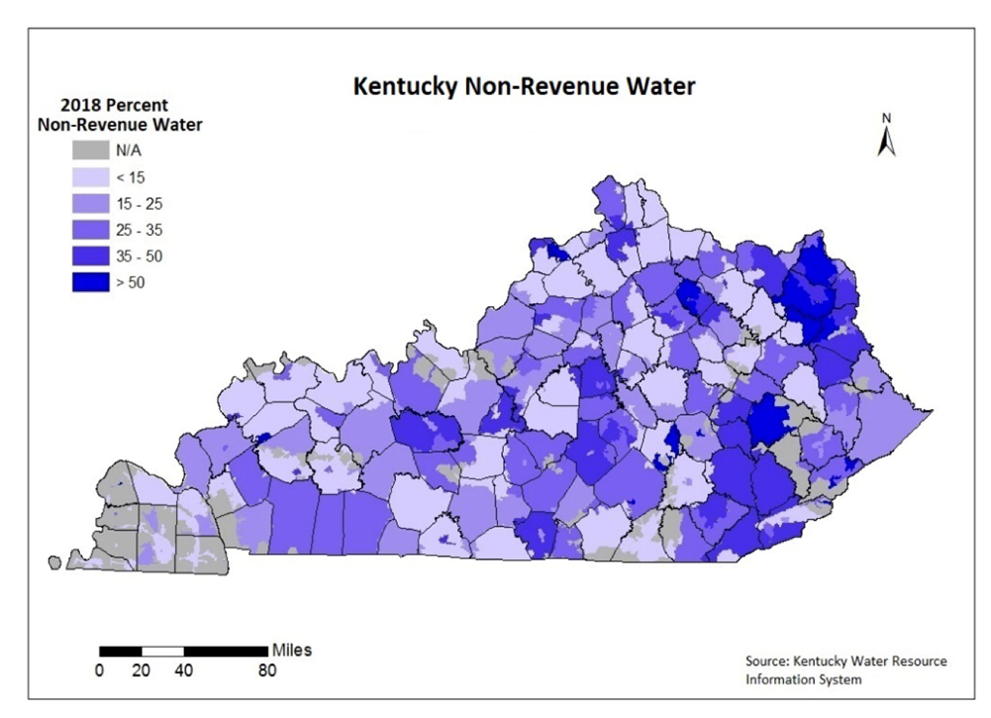
Top challenges for KY WateR SYSTEMS
#5 Water Loss
KY Water Loss averages over 30 percent
Inconsistent methods of measuring water loss
No statewide standard practice
PSC method vs municipal methods
Extensive use of estimates
Percent water loss not industry best practice
Need economic approach to water loss ($ value of water)

Slide 17
Top challenges for KY wateR SYSTEMS
#6 WORKFORCE
Retiring Boomer workforce
Projected gap in licensed operators and technical staff
Non-competitive salary and benefits in robust economy
State pension crisis impact on workforce and balance sheet
Agency staff shortage (DOW, KIA, PSC)
Changing expectations of millennial workforce
Teamwork
Mobility
Technology

Slide 18
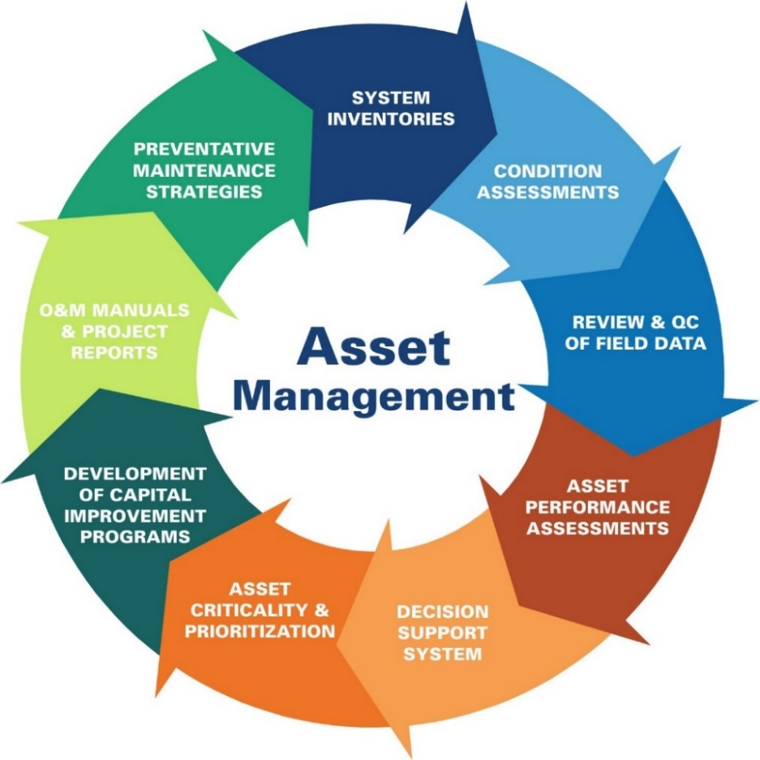
Top challenges for KY water SYSTEMs
#7 Planning & Best Practices
Lack of Business/Strategic Planning
Lack of Asset Management & Capital Planning
Best Practices slow to adopt
Slow to adopt new technology (IoT)
Outdated procurement regulations (slow/inefficient)
Life cycle costing rarely evaluated

Slide 19
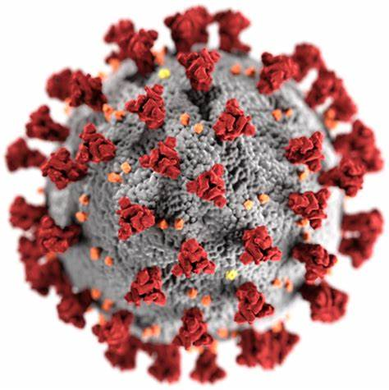
Top challenges for KY water SYSTEMs
#8 COVID19 Impacts on Water
Major impact on economy, first since 2008 Economic Collapse
Governor’s Executive Order Suspending Shut offs for Non-Payment
Decline in commercial water sales (increase in residential)
Impact on customers who have lost jobs, ability to pay utility bills
Impact of working remotely on productivity (to be determined)

Slide 20
Recommendations by BlueWater Kentucky
Continue Kentucky Drinking Water and Clean Water Advisory Councils.
Continue to enhance water planning in Kentucky required under SB 409:
Improve accuracy and consistency of WRIS data
Engage local Water Management Planning Councils
Fully fund staff and technology resources

Slide 21
Recommendations by BlueWater Kentucky
3. Leverage federal funds with state funding (i.e. Indiana WIFIA approach).
4. Establish Kentucky Water Infrastructure Fund:
Provide an annual funding of $25 million
To assist water/wastewater/stormwater systems in planning, engineering, design and construction
Revolving loan program with up to 30% annually for grants

Slide 22
Recommendations by BlueWater Kentucky
5. Develop Kentucky uniform performance criteria and rating system for water utilities:
Include technical, managerial and financial criteria
Collaborate with industry to develop rating system and key performance metrics
Develop peer review process to improve performance
Recognize and award and top-rated systems
Publish water system ratings
Take corrective action on failing water systems
6. Create financial incentives (principal forgiveness) for assessing capacity and achieving performance levels in areas of:
Technical - regulatory compliance/operations
Finance - financial capacity, cost of service rates, audits
Managerial – asset management, planning, water loss, customer service, system reliability, consolidation, interconnects, risk management plans

Slide 23
Recommendations by BlueWater Kentucky
Adopt full cost pricing of water using industry standards (AWWA M1):
Adopt rate indexing to W/WW based CPI
Use infrastructure surcharges to address funding gaps
Use system development charges to fund growth infrastructure
Adopt industry standard for water audits and loss control programs (AWWA M36)
Utilize water balance methodology
Utilize an economic basis to set water loss targets
Water producer vs purchaser

Slide 24
Recommendations by BlueWater Kentucky
9. Establish “Centers for Excellence in Water” through partnerships with utilities, water industry associations and academic institutions:
Water quality/operations
Infrastructure/asset management
Water loss
Finance
Customer service
Innovation/Best Practices in water
Conduct state-wide studies on the following:
Water loss
Lead service/plumbing inventory
System interconnections for reliability and drought relief
Affordability of water/wastewater for low/fixed income households

Slide 25
Recommendations by BlueWater Kentucky
Revise administrative regulations to:
Define technical, managerial and financial roles for KY PSC, DOW and KIA to eliminate duplication and streamline processes
Provide authority to DOW/KIA/PSC to address failing water systems (technical, managerial financial) and ability to intervene and take corrective action
Establish water and wastewater rate indexing allowing annual rate adjustments. (CPI or equivalent)
Require water systems to prepare Capital Improvement Plans for Asset Management and Infrastructure Renewal.
5-Year CIP for Small Systems serving <10,000 pop
10-Year CIP for Medium Systems 10,000 to 50,000
20-Year CIP for Large Systems > 50,000

Slide 26
SOURCES AND REFERENCES
ASCE Infrastructure Report Card – Drinking Water 2019
ASCE Infrastructure Report Card – Wastewater 2019
2018 KY Rural Water/Cannon & Cannon Rate Survey
Kentucky Division of Water
Kentucky Infrastructure Authority/WRIS
Kentucky Rural Water Association
KY-TN AWWA
Louisville Water Company

Slide 27
DISCUSSION AND QUESTIONS
Greg C. Heitzman, PE, MBA
www.bluewaterky.com
502-533-5073

