Slide 1
ALL YOU EVER WANTED TO KNOW ABOUT DEPRECIATION …. AND THEN SOME
Katelyn Brown
Stoll Keenon Ogden PLLC
katelyn.brown@skofirm.com
(502) 568-5711

Slide 2
ORDER OF PRESENTATION
What is Depreciation?
What Does it Mean to “Fully Fund” Depreciation?
Consequences of Not Fully Funding Depreciation
Reading Financial Statements

Slide 3
ORDER OF PRESENTATION
PSC Concerns with Depreciation
Analysis of Various WDs and Cities
How to Increase or Improve Depreciation Funding

Slide 4
WHAT IS DEPRECIATION?

Slide 5
Definition of Depreciation
The process of allocating the cost of a utility plant asset to expense over its service (useful) life in a rational and systematic manner
Think of initial capital investment as a prepaid expense with a portion of that expense systematically recorded as Depreciation Expense in subsequent accounting periods

Slide 6
Depreciation Formula
Annual Depreciation Cost =
(Cost – Salvage Value)
Useful Life in Years

Slide 7
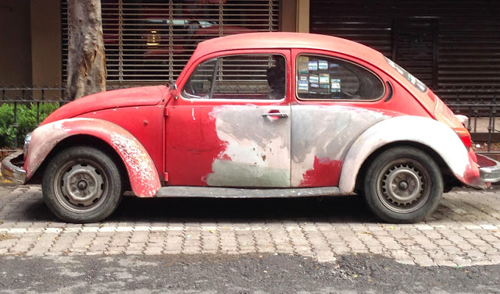
https://www.2020volkswagenusa.com/volkswagen-beetle-2019-configurations-price-interior/;
http://ripsreviews.blogspot.com/

Slide 8
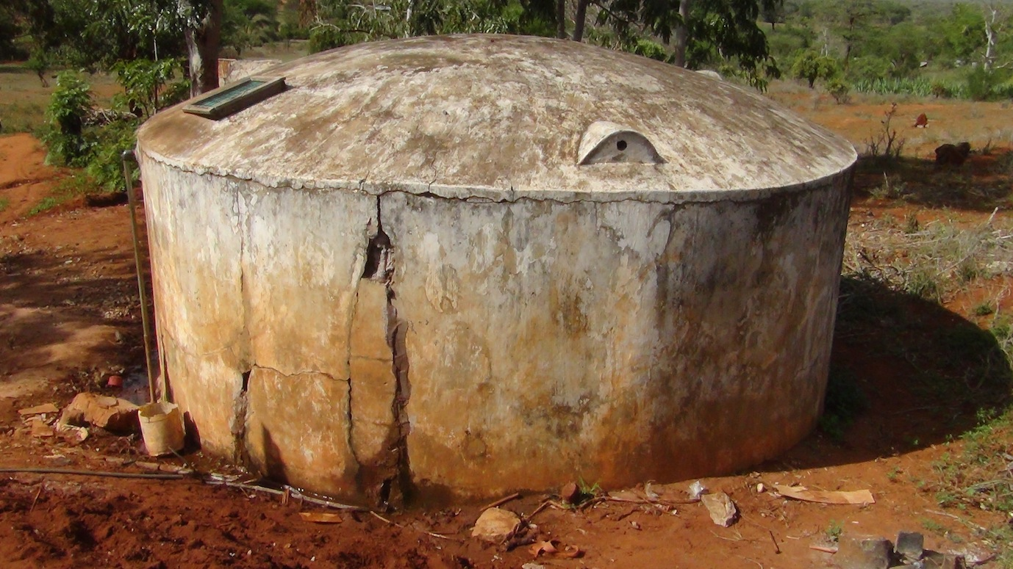
https://www.deltacountyindependent.com/news/hotchkiss-new-water-tank-almost-ready-for-use/article_00b5cdc4-d41b-11e9-8146-dfc6507f21ef.html; http://46nkzm3opvsl369ekn4eouto.wpengine.netdna-cdn.com/wp-content/uploads/sites/3/2012/11/water_tank1.jpg

Slide 9
Why is Depreciation Important?
Although non-cash, depreciation expense creates cash flow in regulated entities (like WDs & WAs) and municipal utilities
Informs management, creditors, investors, and others of the utility’s cost of operating
Helps to more accurately match revenues with expenses
Who determines your utility’s depreciation?

Slide 10
Typical Ways that Useful Lives are Determined
Rural Development (RD)
Kentucky Infrastructure Authority (KIA)
CPA
Engineer
PSC (NARUC Guidelines)
Board

Slide 11
WHAT DOES IT MEAN TO “FULLY FUND” DEPRECIATION?

Slide 12
“Fully Funding” Depreciation means….
Setting aside cash equivalent to the utility’s annual depreciation expense in order to purchase replacement assets in the future
Set aside in a safe investment (CD or money market account)

Slide 13
CONSEQUENCES OF NOT FULLY FUNDING DEPRECIATION

Slide 14
Not Fully Funding Depreciation will….
Cause the utility to have to borrow $$ to purchase the replacement asset
Cause the utility to seek outside funding (added interest)
Cause the utility to use funds budgeted for other purposes

Slide 15
READING FINANCIAL STATEMENTS

Slide 16
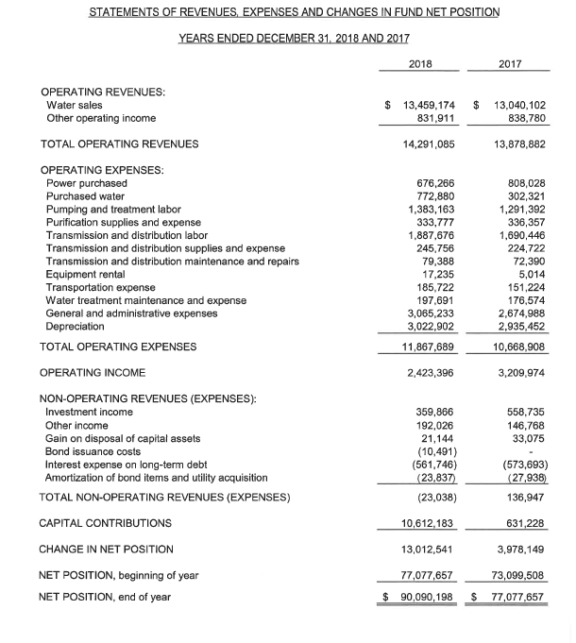
“Income Statement”

Slide 17
“Balance Sheet”

Slide 18
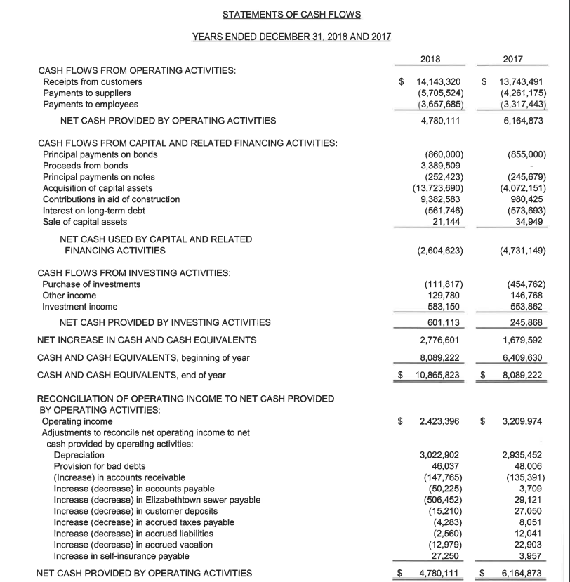

Slide 19
Financial Statements
Depreciation Expense is an Income Statement account
Income Statement only accounts for Interest Expense, does not take into account the principal of loans/bonds that must be paid
Accumulated Depreciation is a Balance Sheet account
Shown on Statement of Net Position
Statement of Cash Flows
Reflects principal payments

Slide 20
PSC CONCERNS WITH DEPRECIATION

Slide 21
The PSC is concerned with:
Long-term financial health of utilities
Utility’s aging infrastructure
Frequency of rate cases

Slide 22
ANALYSIS OF VARIOUS WATER DISTRICTS AND CITIES

Slide 23
Revenue Requirement
The total amount of money a utility must collect from its customers in a calendar or fiscal year:
To pay all non-capital costs, including operating expenses, depreciation, and debt service expense (principal & interest); and
To enable the utility to meet the debt service coverage requirement set forth in the utility’s covenants to its bondholders and other lenders.

Slide 24
Revenue Requirement Components

Slide 25
Analyzed 12 WDs and Cities
Labeled utilities #s 1-12 for anonymity
Based on 2018 numbers
Looked at:
Level of Depreciation Funding (% and $)
# of customers
Depreciation Expense compared to other operating expenses
$ of Debt Service Expense (P & I) and Debt Service Coverage

Slide 26
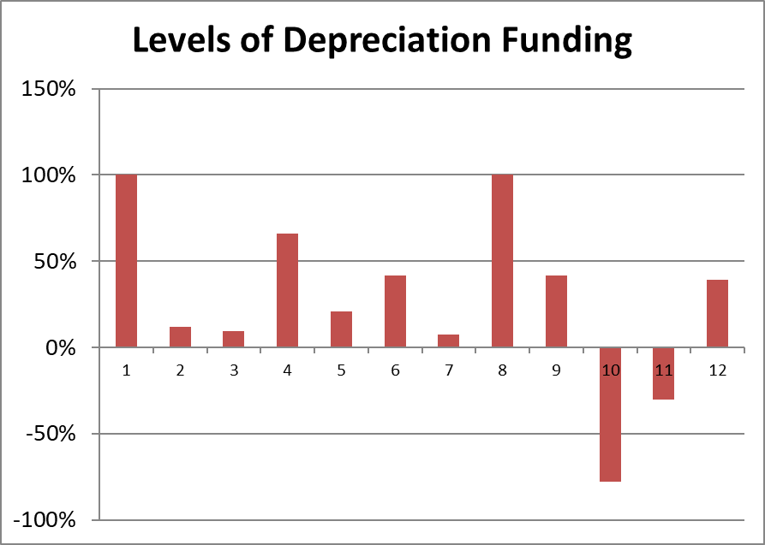
2018
High – Utility 1 & 8 at 100%
Median – 30.14%
Low – Utility 10 at -77.64%

Slide 27
Utility | Depreciation Expense
1 | $ 958,570
2 | $ 392,152
3 | $ 635,761
4 | $ 455,008
5 | $ 274,374
6 | $ 315,697
7 | $ 908,262
8 | $ 3,022,902
9 | $ 190,955
10 | $ 404,363
11 | $ 227,638
12 | $ 217,039
High – Utility 8 at $3,022,902
Median - $398,258
Low – Utility 9 at $190,955

Slide 28
Utility | Customer Count
1 | 8,401
2 | 3,573
3 | 4,969
4 | 3,425
5 | 5,168
6 | 7,452
7 | 7,029
8 | 28,620
9 | 3,523
10 | 3,712
11 | 2,655
12 | 1,180
High – Utility 8 at 28,620
Median – 4,341
Low – Utility 12 at 1,180

Slide 29
Depreciation Expense Compared to Other Operating Expenses
For 8 of 12 of the WDs and cities analyzed, Depreciation Expense was either the highest operating expense or 2nd highest operating expense

Slide 30
Debt Service Expense vs. Debt Service Coverage
Bond Ordinance or Bond Authorizing Resolution dictates the DSC
Different funding agencies have different DSC requirements
KIA: 1.1
RD: 1.2
Some cities: 1.25 or higher
LWC: 1.5

Slide 31
Utility | Debt Service Expense | Debt Service Coverage
1 | $ 1,177,701 | $ 235,540
2 | $ 186,750 | $ 37,350
3 | $ 515,223 | $ 103,045
4 | $ 210,206 | $ 42,041
5 | no debt | no debt
6 | no debt | no debt
7 | $ 1,004,459 | $ 200,892
8 | $ 1,674,169 | $ 334,834
9 | $ 94,563 | $ 18,913
10 | $ 314,767 | $ 62,953
11 | $ 79,281 | $ 15,856
12 | $ 95,231 | $ 19,046
X 0.2 =
Debt Service Coverage
High – Utility 8 at $334,834
Median - $52,497
Low – Utility 11 at $15,856

Slide 32
2017 vs. 2018 Depreciation Funding

Slide 33
2017 vs. 2018 vs. 2019
Depreciation Funding

Slide 34
How to Increase or Improve Depreciation Funding
Create a separate fund in which to deposit depreciation expense for future replacement of utility assets
FDIC concerns
Evaluate whether or not you need to request a rate increase
Discuss useful life of assets with the person/entity who decides your annual Depreciation Expense

Slide 35
CONCLUSION/SUMMARY
Evaluate your own water utility’s depreciation practices
Determine whether or not current rates are sufficient
Board Commissioners/Members must be good stewards

Slide 36
QUESTIONS?

