Slide 1
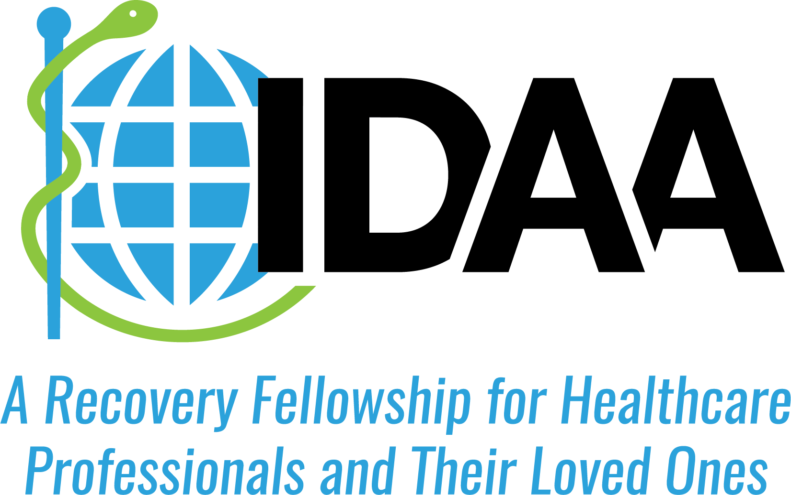

Slide 2
What Is IDAA?
A worldwide support system of healthcare professionals, families and significant others striving to help one another attain and maintain recovery from addiction
Notes:
> Get a better map with N-America

Slide 3
Membership
Physicians, dentists, veterinarians, psychologists, pharmacists, podiatrists, chiropractors, and other doctoral level healthcare providers
Advanced registered nurse practitioners, certified registered nurse anesthetists, physician assistants
Family members of these professionals
A confidential, non-compulsory fellowship for healthcare professionals, not affiliated with any disciplinary entity, treatment center, or monitoring organization

Slide 4
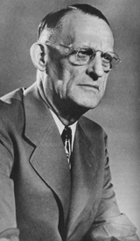
History of IDAA
Physicians have always been part of 12 Step recovery, including co-founder of Alcoholics Anonymous, Robert H. Smith, M.D. (Dr. Bob).
In 1949, Clarence Pearson, M.D., a physician who found recovery in AA, sought out other doctors in an ad in AA’s monthly magazine, The Grapevine. He hosted 34 members at the first IDAA meeting with his wife Polly, in Cape Vincent, NY.
IDAA annual meetings are now attended by 500-1000 healthcare professionals, family members and guests.
“Physician, heal thyself (Medice, cura te ipsum)”
Notes:
Second bullet point – suggest adding “AA’s monthly magazine, The Grapevine.

Slide 5
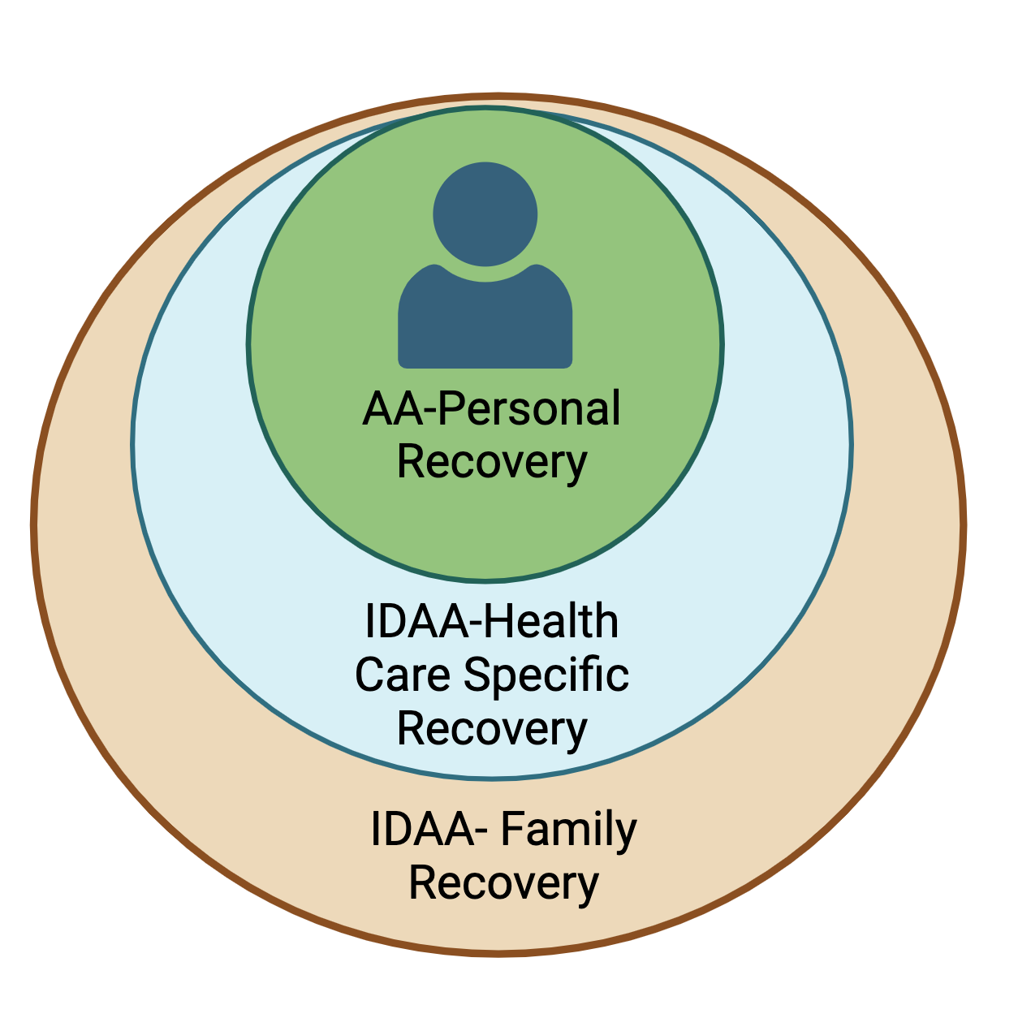
What Does IDAA Do?
IDAA programming includes recovery from all substance use and process disorders with the focus on individual and family recovery.
IDAA is a separate entity from Alcoholics Anonymous; it was and continues to be inspired by 12-Step principles.
The mission of IDAA is to carry the message of recovery to health care professionals and their families.
We celebrate diversity and are committed to equity and inclusion of people from all racial, ethnic, cultural, sexual/gender and spiritual identities.
Notes:
First bullet point: should be “inspired by AA principles.”
Fourth bullet point: remove first sentence because it is copied from bullet point 3.

Slide 6
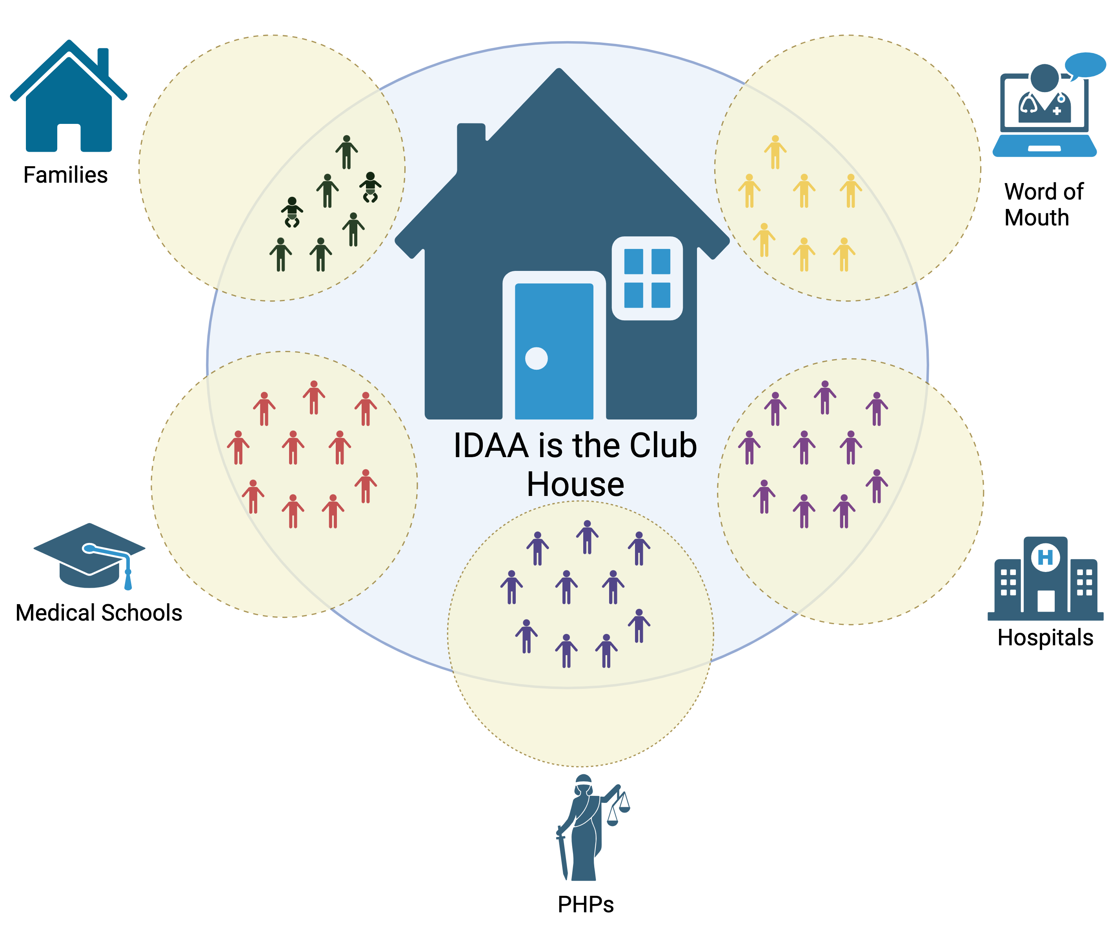
Notes:
Needs to include the loved ones and the youth services
Combine medical schools and Hospital
Include peer professions (Referrals from places like Local AA meetings) Make less formal with the word of outh

Slide 7
What does IDAA look like?
Support for members throughout the year
Weekly virtual/in-person meetings with specific focuses (i.e. subspecialty and location)
Bulletin board with posting of topics and announcements in the community
Member directory
Archives of previous speakers from conferences including CE track topics
Email listserv
Notes:
Bullet point one: aren’t we now calling the continuing medical education simply CE, not CME?
Changed Al-Anon to Adult Partners and Family Members (use that or something like that. We are not using “Al-Anon” any longer.
I did a few things – enlarged the conferences font, enlarged the family groups font, switched locations of the family groups and recovery conferences.. The flow seemed to make sense to me since the other conferences also have family recovery programs.
Be sure to have a speaker’s note that spells out the meaning of all the abbreviations OR create another slide with them.
Regional Professionals’ Recovery Conferences:
WDR, NEPG, BDDG, ADR

Slide 8
IDAA Annual Conference
For health care professionals:
12-Step recovery meetings in person
Breakout meetings: women; couples; LGBTQ; medical subspecialties
CE presentations on topics in addiction and recovery
Scholarships for those in need
Expansion of CE Credits offered:
AMA PRA Category 1 Credits™ for Physicians (MD/DO)
ANCC CE for Nurses (RN, NP)
ACPE Credit for Pharmacists
APA CE for Psychologists
ASWEB CE for Social Workers
ADA CERP CE for Oral Health Professionals
NAADAC CE for Addiction Professionals

Slide 9
IDAA Annual Conference
Family Recovery
Spouses and loved ones
Meetings held in parallel with AA at annual meetings
IDAA Children’s Program: Ages 7 -12
Structured 3-day experience with leaders who are specialists in adolescent/family recovery
IDAA Teen Program: Ages 13 -19
Structured 3-day experience
Leaders are specialists in adolescent/ family recovery
IDAA Twenties:
Started by graduates of IDAA Teen Program
Self-structured

Slide 10
Upcoming Conferences
July 10-14, 2024 - Baltimore, Maryland USA – Marriott
July 9-13, 2025 - Spokane, Washington USA - Spokane Convention Center
July 8-12, 2026 - Chicago, IL USA
Notes:
Put the next three conferences up to Chicago and then put (Contact IDAA if interested) At the bottom.

Slide 11
Personal Experiences
“I was welcomed with open arms. I immediately felt at home. My life has never been the same.
“IDAA is the one place where, not only can I be my true self, but I can also meet and connect with others whose experiences are like my own.”
“For the first time in my life, I found hope, friendship, love, and a place to belong. At IDAA , I had found my people.”
“The true gift of IDAA - a safe place for our whole family to shed shame and fear to find solutions, contentment and even serenity.”

Slide 12
How to Contact IDAA
www.IDAA.org
IDAA Central Office 5123 W 98th St, #1110 Minneapolis, MN 55437
Michelle Van Alst – Executive Director executive@idaa.org
IDAA Central Office: 651-299-3452
Notes:
A few formatting changes.

