Slide 1



Slide 2
MISSION STATEMENT
The mission of IDAA is to carry the message of recovery ​
to healthcare professionals and their families.
VISION STATEMENT
IDAA envisions recovery for all health care professionals and their families impacted by substance use disorders.

Slide 3

WHAT IS IDAA?
A worldwide support system of healthcare professionals, families and significant others striving to help one another attain and maintain recovery from addiction

Slide 4
MEMBERSHIP
  Physicians, dentists, veterinarians, psychologists, pharmacists, podiatrists, chiropractors, and other doctoral level healthcare providers
  Advanced registered nurse practitioners, certified registered nurse anesthetists, physician assistants
  Family members of these professionals
A confidential, non-compulsory fellowship for healthcare professionals, not affiliated with any disciplinary entity, treatment center, or monitoring organization

Slide 5
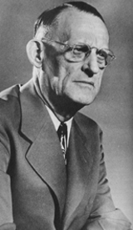
HISTORY OF IDAA
  Physicians have always been part of 12 Step recovery, including co-founder of Alcoholics Anonymous, Robert H. Smith, M.D. (Dr. Bob).
  In 1949, Clarence Pearson, M.D., a physician who found recovery in AA, sought out other doctors in an ad in AA’s monthly magazine, The Grapevine. He hosted 34 members at the first IDAA meeting with his wife Polly, in Cape Vincent, NY.
  IDAA annual meetings are now attended by 500-1000 healthcare professionals, family members and guests.
“Physician, heal thyself (Medice, cura te ipsum)”

Slide 6
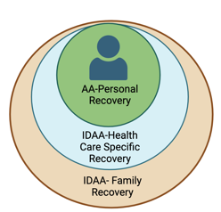
WHAT DOES IDAA DO?
  IDAA programming includes recovery from all substance use and process disorders with the focus on individual and family recovery.
  IDAA is a separate entity from Alcoholics Anonymous; it was and continues to be inspired by 12-Step principles.
  The mission of IDAA is to carry the message of recovery to health care professionals and their families.
  We celebrate diversity and are committed to equity and inclusion of people from all racial, ethnic, cultural, sexual/gender and spiritual identities.

Slide 7
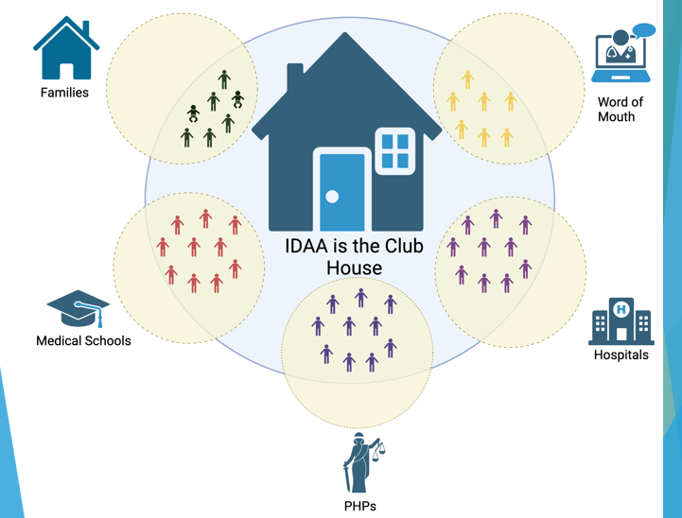

Slide 8
WHAT DOES IDAA LOOK LIKE?
  Support for members throughout the year
  Weekly virtual/in-person meetings with specific focuses (i.e. subspecialty and location)
  Bulletin board with posting of topics and announcements in the community
  Member directory
  Archives of previous speakers from conferences including CE track topics
  Email listserv

Slide 9
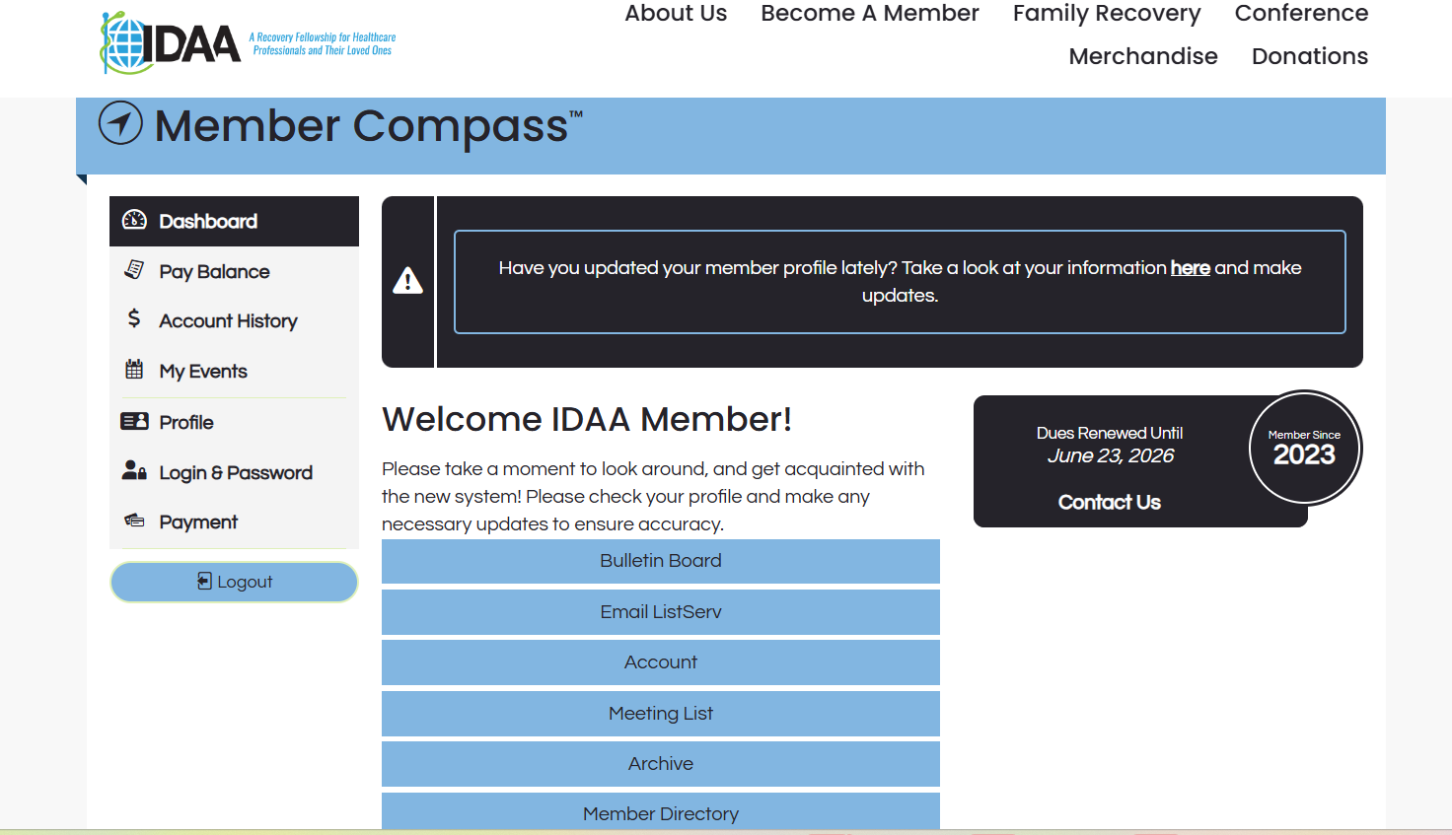

Slide 10
IDAA ANNUAL CONFERENCE
For health care professionals:
  12-Step recovery meetings in person
  Breakout meetings: women; couples; LGBTQ; medical subspecialties
  CE presentations on topics in addiction and recovery
  Scholarships for those in need
Expansion of CE Credits offered:
  AMA PRA Category 1 Credits™ for Physicians (MD/DO)
  ANCC CE for Nurses (RN, NP)
  ACPE Credit for Pharmacists
  APA CE for Psychologists
  ASWEB CE for Social Workers
  ADA CERP CE for Oral Health Professionals
  NAADAC CE for Addiction Professionals

Slide 11
IDAA ANNUAL CONFERENCE
Family Recovery
  Spouses and loved ones
  Meetings held in parallel with AA at annual meetings
IDAA Children’s Program: Ages 7 -12
  Structured 3-day experience with leaders who are specialists in adolescent/family recovery
IDAA Teen Program: Ages 13 -19
  Structured 3-day experience
  Leaders are specialists in adolescent/ family recovery
IDAA Twenties:
  Started by graduates of IDAA Teen Program
  Self-structured

Slide 12

UPCOMING CONFERENCES
  July 8-12, 2026 - Chicago, IL Marriott Magnificent Mile
  July 21-25, 2027 - Orlando, FL Renaissance at Seaworld

Slide 13
PERSONAL EXPERIENCES
  “I was welcomed with open arms. I immediately felt at home. My life has never been the same.
  “IDAA is the one place where, not only can I be my true self, but I can also meet and connect with others whose experiences are like my own.”
  “For the first time in my life, I found hope, friendship, love, and a place to belong. At IDAA , I had found my people.”
  “The true gift of IDAA - a safe place for our whole family to shed shame and fear to find solutions, contentment and even serenity.”

Slide 14
CONTACT IDAA
  www.IDAA.org
  IDAA Central Office
5123 W 98th St, #1110
Minneapolis, MN 55437
  Michelle Van Alst – Executive Director executive@idaa.org
  IDAA Central Office: 651-299-3452

