Slide 1
Optimizing Injury Outcomes
Using Recovery Guides
Brian Allen, Harvey Warren, Doug Amend
CENTRAL STATES ASSOCIATION
2020 Spring Seminar | June 4-5, 2020

Slide 2
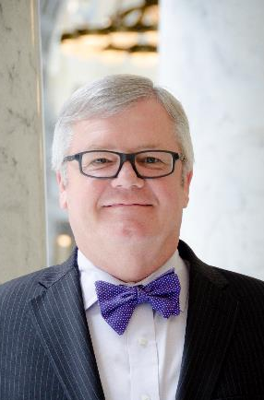
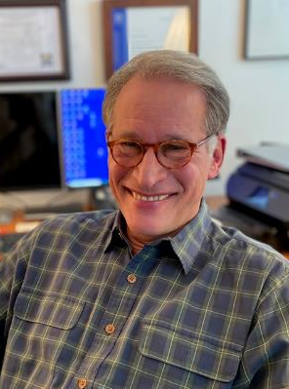
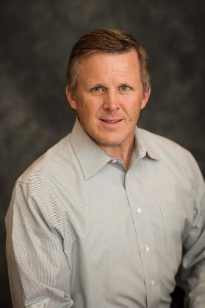
Brian Allen
Harvey Warren
Doug Amend

Slide 3
Genesis of the Optimized Program
Co-Morbidity Issues
Claims Going “Off the Rails”
2007 Duke University Study of 11,728 Employees
Workers with BMI greater than 40
11.65 claims per 100 workers
Average claim cost $51,019
Workers with normal range BMI
5.8 claims per 100 workers
Average claim cost $7,503
2016 Harbor Health System study of 7,000 workers’ comp claims
76% higher durations for multiple co-morbidity issues
67% higher durations when addiction is present
55% higher durations for obesity
Costs per claim were 341% higher for multiple co-morbidity issues

Slide 4
Genesis of the Optimized Program
Brian’s Dinner with Harvey
Harvey’s Workers’ Comp Injury
Surgeries
Struggles
“The Optimized Patient” Book
Convergence of Ideas
4 year journey
How Can We Help Injured Workers
Get Better Faster and Stay Better Longer?

Slide 5
Isolation of Injury
Commoditization of Care
Doug’s Story
The fall off the mountain
Void of education/expectations
Setting the bar with Nathan “Rock” Quarry
Other Success Stories
Bill Walton
Brian Allen
Journal of General Internal Medicine Study, July 2018
“Physicians give patients 11 seconds to explain reasons for visit before interrupting”

Slide 6
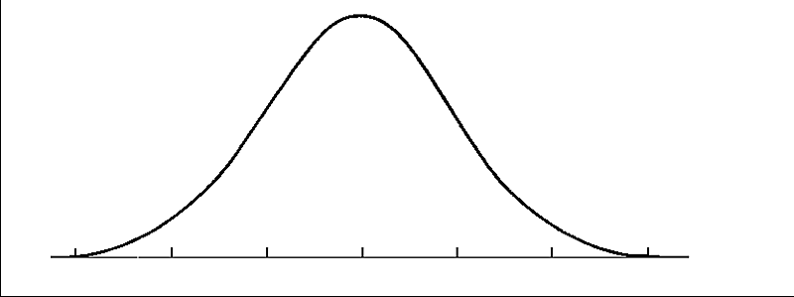
Education, Engagement, Encouragement, Accountability
The Bell Curve
Self-Optimizers
Non-Optimizers
Most people want to get better, they just don’t know how

Slide 7
Education, Engagement, Encouragement, Accountability
The Importance of Mindset
Thinking you can!
Maintaining the belief throughout recovery
Personal Interaction
Commitment on a one-to-one level
Encouragement through the recovery
Knowing those who have “been there”
“Your body is used to doing what your brain is used to viewing. Create the image of how you want your life to be in the future and visit it with passion and joy every day. That’s how you make real magic.”
Joseph McClendon III

Slide 8
Education, Engagement, Encouragement, Accountability
Foods That Heal
Body of research emerging on the importance of nutrition in healing
Combating co-morbidity issues
Readily available foods-easy to prepare
Courtesy of Abbott Nutrition Health Institute

Slide 9
Education, Engagement, Encouragement, Accountability
Keep the Body Moving
Newton’s First Law of Motion
“The best thing to do for pain is to move.” (Vermon Esplin, MD)
Moving before surgery will help you move afterward
Proper Rest is Also Important
Medications should aid rest – not immobilize
“An object at rest stays at rest and an object in motion stays in motion…”

Slide 10
Education, Engagement, Encouragement, Accountability
Accountability
Measuring results breeds success
Accountability to results reinforces commitment
Winners Keep Score!

Slide 11
The Optimized Outcome Solutions Program
Injured Worker Selection
Preparing for surgery
Co-morbidity issues
Potentially stalled recovery
Serious, but not serious enough for a nurse case manager
Support efforts of nurse case manager
Enrollment
Gather necessary information
Introduce to Optimized program
Introduce “Recovery Guide”
Secure commitment from participant

Slide 12
The Optimized Outcome Solutions Program
Program Basics
“The Optimized Patient” book provides foundation
Motivational videos
Nationally recognized behavioral psychologist
Sports figures who used the program
Every day patients who used the program
Educational materials
Research
Articles
Daily Nutritional Guidance
Access to meal plans
Educational support from Recovery Guide
Developed by a PhD in nutrition and a celebrity chef
Daily Activity Reporting
Weekly, personal call with Recovery Guide
Anticipate a six-month time frame for supporting recovery
Affordable, monthly fee

Slide 13
The Optimized Outcome Solutions Program
Assessing Progress
Partnering with OutcomeMD
Self-assessment tool
Injury specific
Measures progress overtime
Provides intant feedback to injured worker and Recovery Guide
Our Commitment to Outcomes
Initial Phase will include a study to measure our results

Slide 14
QUESTIONS?
Thank You for Attending!
Brian Allen – brian@evvivaent.com
Harvey Warren – harvey@harveywarren.com
Doug Amend – dougamend@gmail.com
www.optimizedoutcome.com

