Slide 1
The Economic outlook
June 18th , 2021
Terry J. Fitzgerald
Vice President & Assistant Director, Economic Analysis

Slide 2
Disclaimer
The views expressed are my own and not necessarily those of the Federal Reserve Bank of Minneapolis or the Federal Reserve System.
Minneapolisfed.org

Slide 3
Today’s talk
Overview of the Federal Reserve
Output: collapse and robust recovery
Jobs: collapse and incomplete recovery
Inflation: recent price rises
Q&A
Notes:
Economic decline was historically unprecedented
Very uneven impact – will highlight that as we go
Output – very strong ongoing recovery
Labor – focus on incomplete recovery and reasons
Inflation – are recent increases transitory (likely) or will the 70s replay?

Slide 4
The federal reserve system

Slide 5
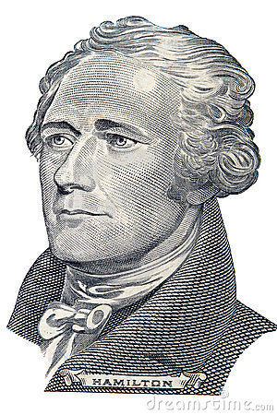
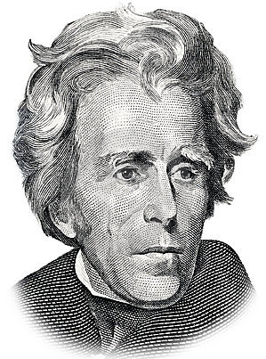
Overview of The federal reserve system
Central bank of the U.S.
Established by Act of Congress in 1913
Two previous U.S. central banks:
First Bank of the United States (1791-1811) Promoted by Alexander Hamilton, the first Secretary of the Treasury
Second Bank of the United States (1816-1836)
Ended when President Andrew Jackson
vetoed reauthorization of the bank

Slide 6
Responsibilities of the federal reserve system
Supervise and regulate banks
Mainly large bank holding companies
JPMorgan Chase, Wells Fargo, Goldman Sachs, Citigroup
Provide financial services
Manage (‘clear’) financial payments
Help banks meet short-term demands for cash
“Lender of Last Resort”
Set monetary policy

Slide 7
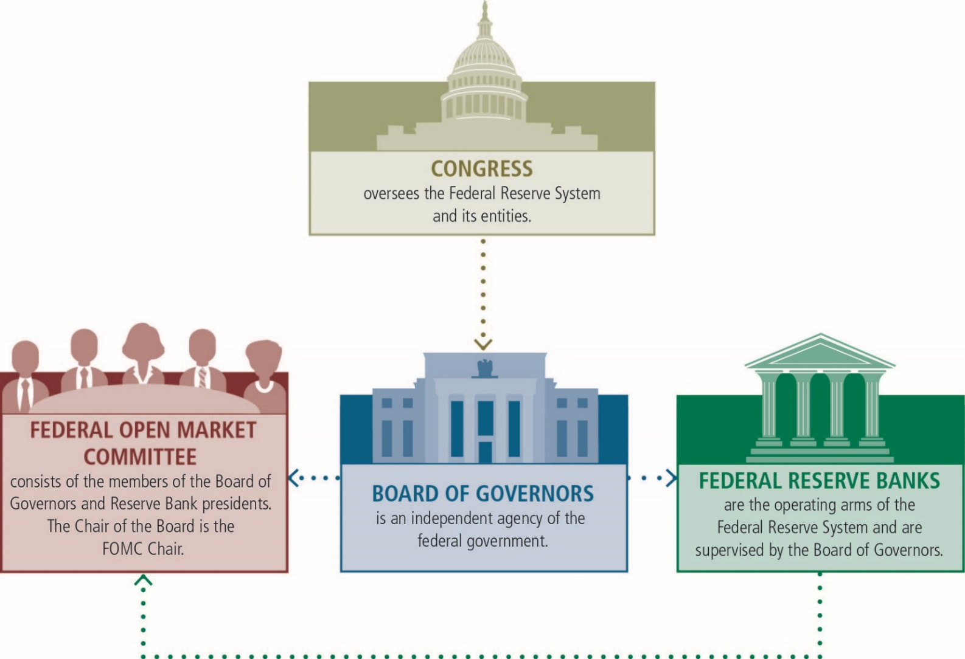
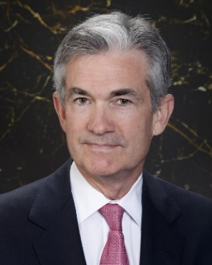
Structure of the federal reserve system
12 “District” banks carry out operating duties of Federal Reserve
Monetary policy
BOG Chair, Jerome Powell

Slide 8
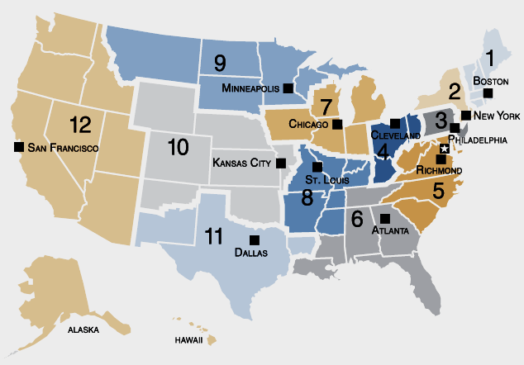
The federal reserve banks

Slide 9
Minneapolis fed’s ninth district
The Minneapolis Fed’s job is to:
Supervise banks & offer financial services in this district
Monitor developments in this regional economy
Represent the interests of the 9th district when monetary policy is set in Washington D.C. 8 times per year

Slide 10
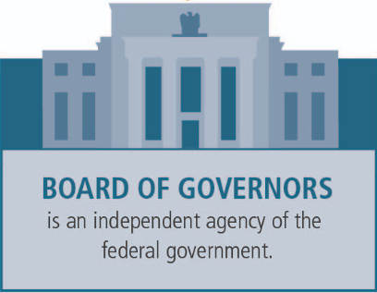
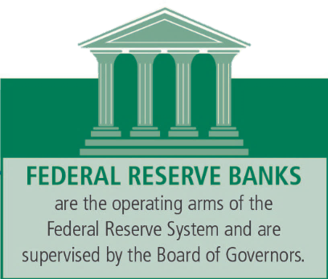
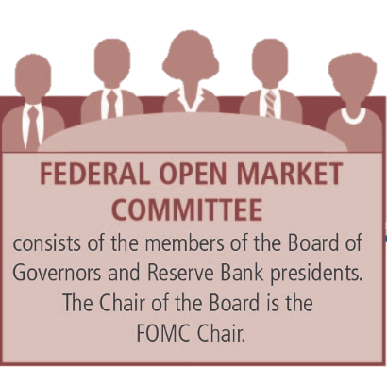
The federal open market committee
(12 voting members)
Board of Governors
7 Governors = 7 votes
1 seat currently unfilled
District bank presidents
= 5 votes
NY Fed permanent vote
4 rotating votes among remaining 11 District banks
Minneapolis Fed President
Neel Kashkari not voting in 2020
FOMC = 7 + 1 + 4
Currently: 6 + 1 + 4

Slide 11
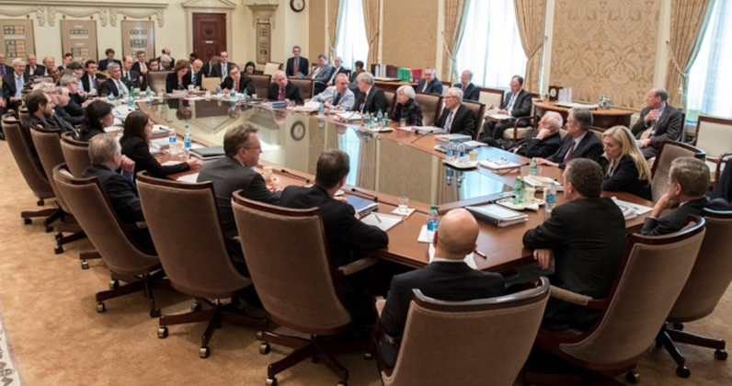
The federal open market committee

Slide 12
Monetary policy: the dual mandate
In 1977, Congress directed the Board of Governors of the Federal Reserve System and the Federal Open Market Committee to set monetary policy in order to promote the goals of:
“maximum employment”
“stable prices”
Known as the “dual mandate”

Slide 13
Today’s talk
Overview of the Federal Reserve
Output: collapse and robust recovery
Jobs: collapse and incomplete recovery
Inflation: recent price rises
Q&A
Notes:
Economic decline was historically unprecedented
Very uneven impact – will highlight that as we go
Output – very strong ongoing recovery

Slide 14
Change in U.S. output
SA, percent
Notes:
Record shattering drop in output in 2020 – 6 week period
Dashboard at Minneapolisfed.org (Recession in Perspective)
10% decline – way bigger than 2007 or 1981 (for old folks)
But strong output recovery – now ahead of 1981, 2007

Slide 15
Output: Collapse and robust recovery
Very strong growth expected throughout 2021 and into 2022
Vaccinations driving reopening
Pent-up demand
Fiscal stimulus boosting incomes and spending
Supply bottlenecks restraining some growth

Slide 16
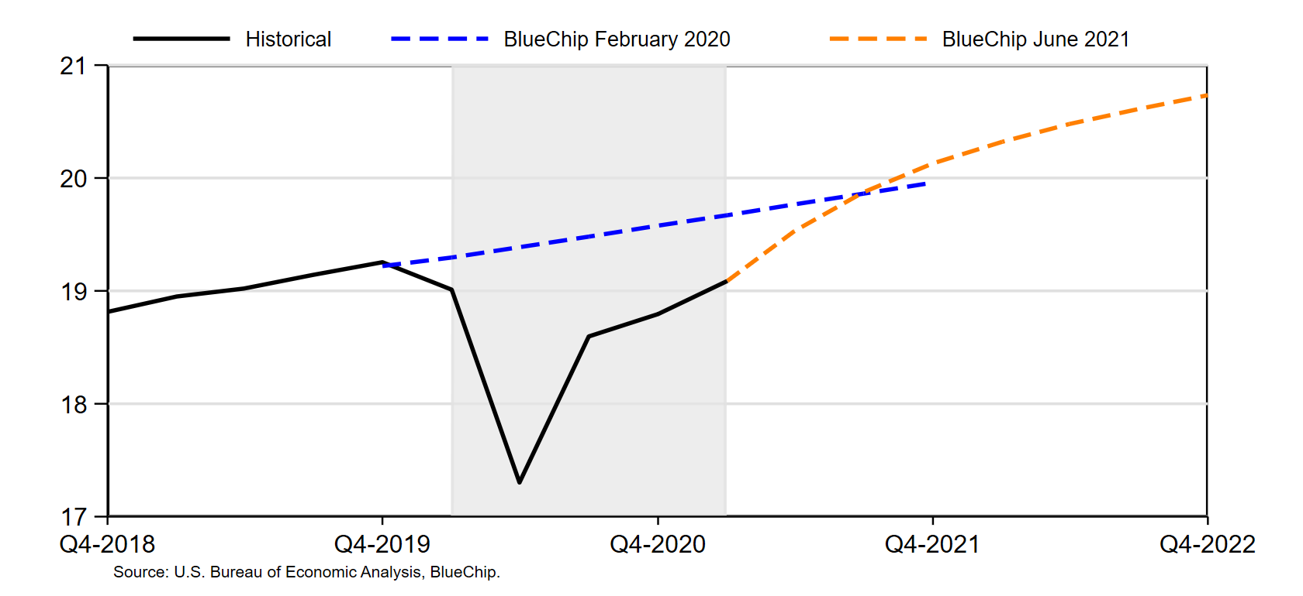
Real GDP
trillions of chained 2012$
Notes:
Blue line – forecast of real GDP just before COVID hit
Orange line – current forecast
surpass 2019Q4 this quarter, above pre-COVID forecast by end of year (vaccinations/reopening + huge fiscal stimulus + disparate impact)
7% in 2021, 3% in 2022
Blue Chip Q1 Q2 Q3 Q4 2022
June 2021 6.4 9.6 7.3 5.2 3.9, 3.1, 2.6, 2.4

Slide 17
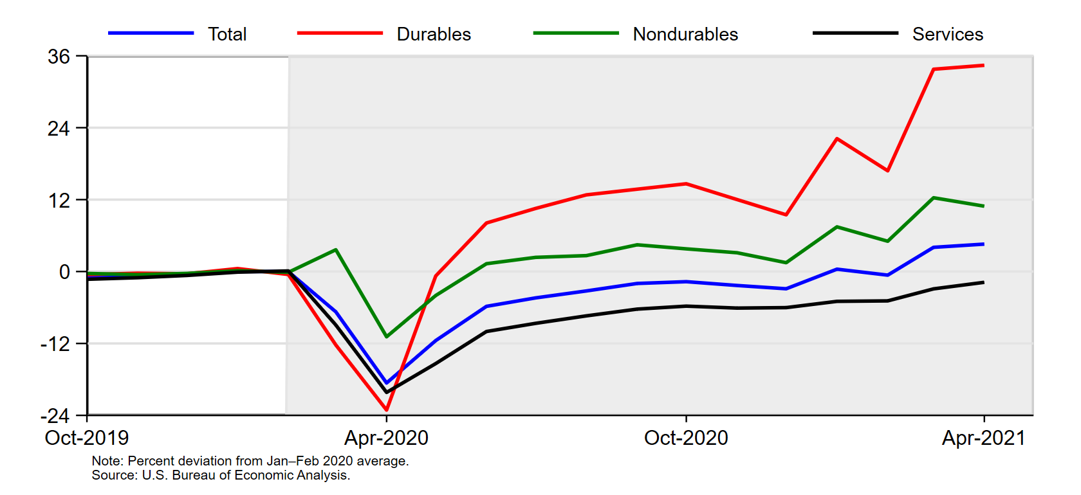
Household spending
Percent, saAR
Notes:
Durable goods boomed
Supply bottlenecks concentrated in those sectors (cars, bikes, goods)
Also had implications for labor markets – what groups suffered

Slide 18
Today’s talk
Overview of the Federal Reserve
Output: collapse and robust recovery
Jobs: collapse and incomplete recovery
Inflation: recent price rises
Q&A
Notes:
Labor – focus on incomplete recovery, uneven impact, and reasons for slow recovery

Slide 19
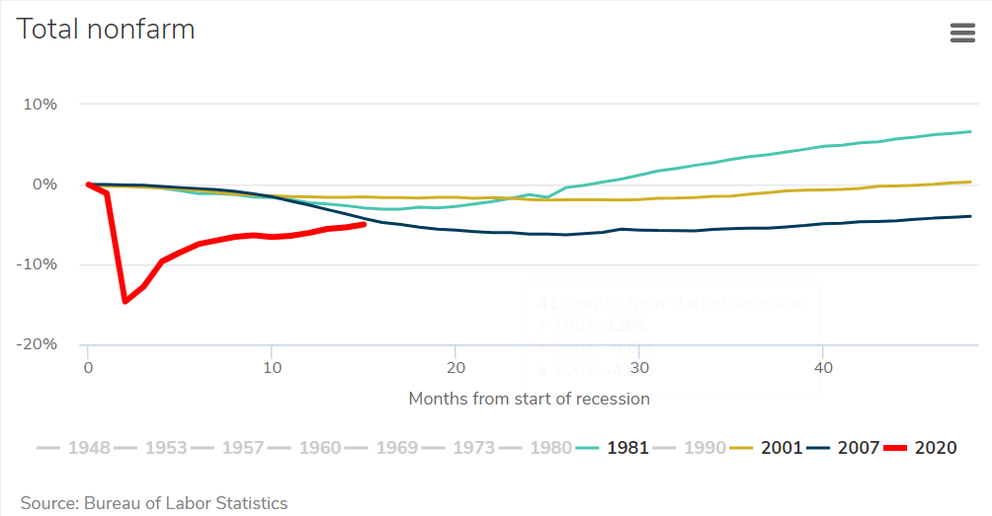
Change in U.S. employment
SA, percent
Notes:
Massive drop; incomplete recovery – still below previous recession (unlike output)

Slide 20
Jobs: Collapse and incomplete recovery
Very strong job growth in summer 2020, but slowed in the fall and winter
Still have huge loss in jobs
Unemployment rate provides very incomplete picture
Many people remain on sidelines
Low-wage workers bearing brunt of recession

Slide 21
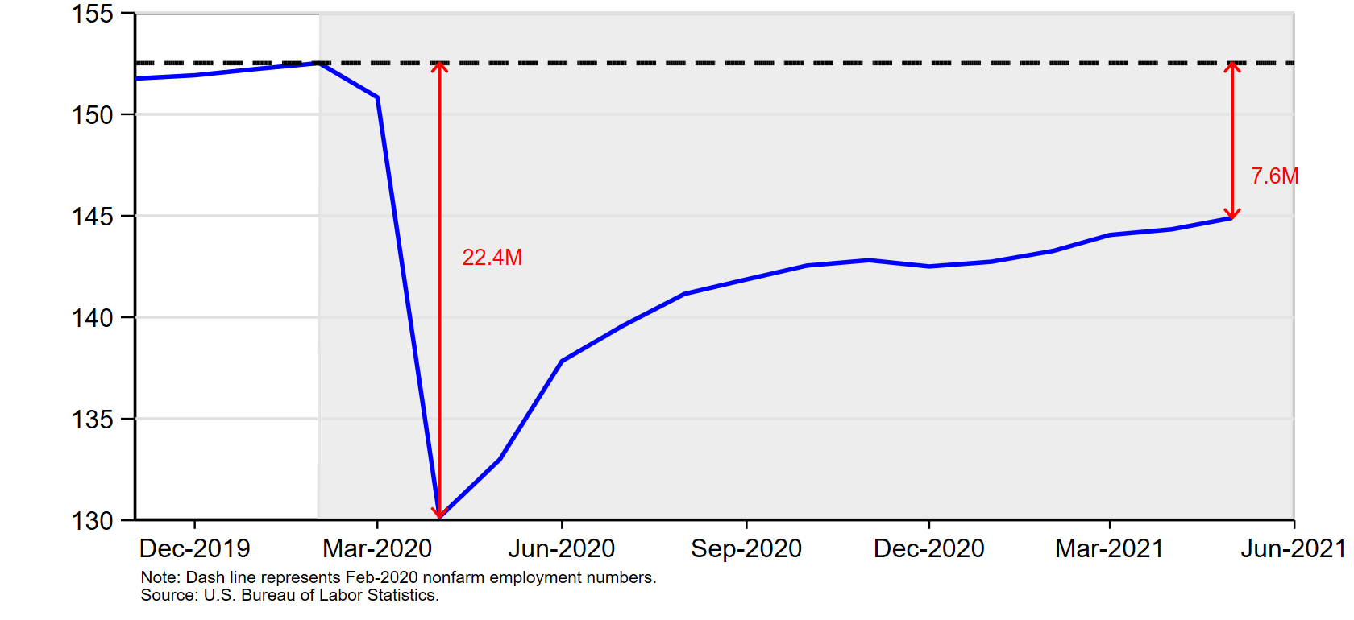
Nonfarm employment
Millions, Level
Notes:
While GDP is projected to reach pre-crisis level in 2022, employment hole is much deeper
Fell 22.41m in roughly 6 weeks (shattered postwar record)
At first, recovery very strong; flattened out over the fall and winter – now picking up again
Still down 7.6m jobs – more than 8.7m decline at peak of Great Recession

Slide 22
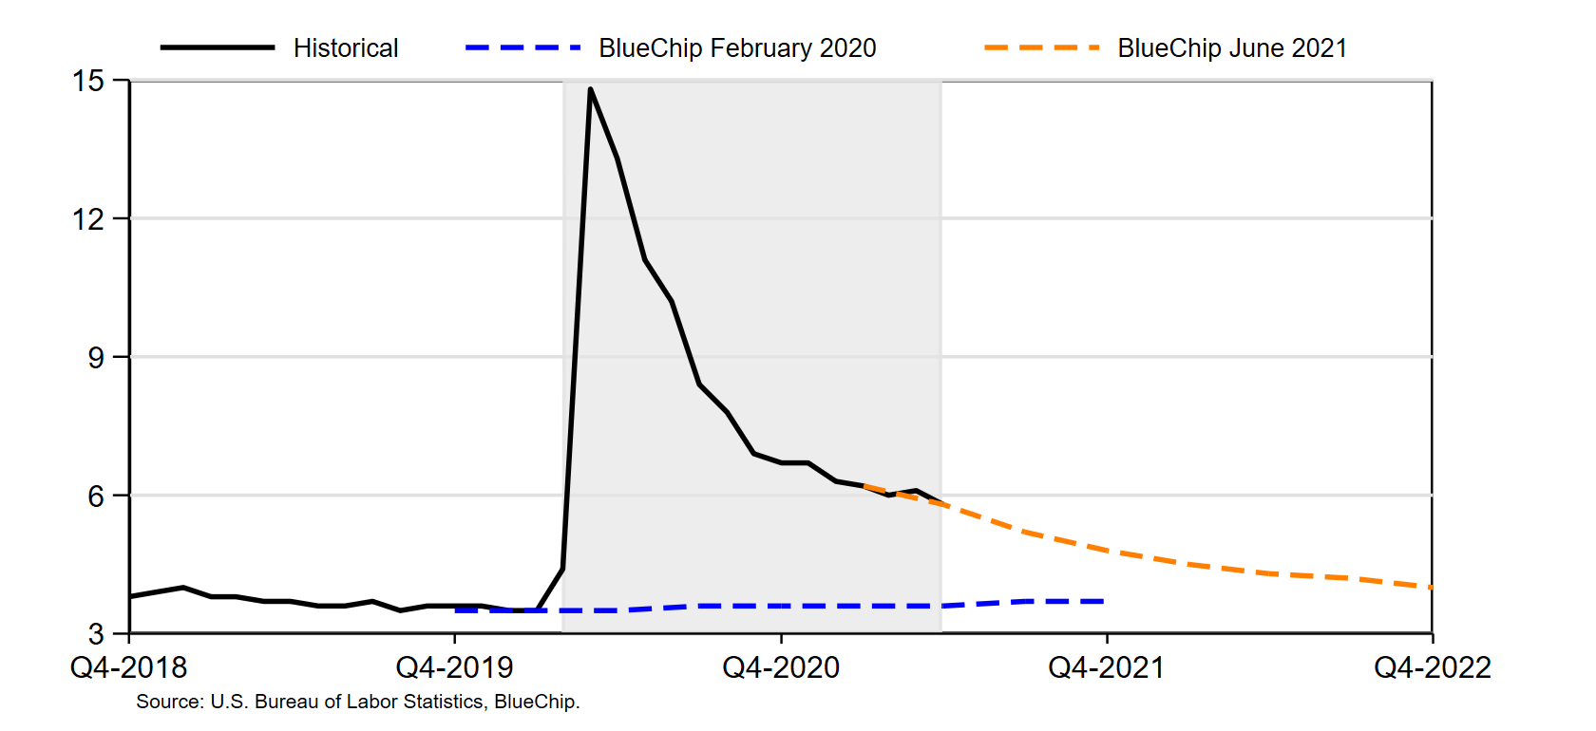
Unemployment rate
percent
Notes:
UR at 5.8 in May – expected to be below 5% at end of year; 4% or lower
overstates recovery in labor market; labor force has declined – doesn’t show here
MN UR 4.0%; upper 7s if include those who left LF
Single measure ignores “broad and inclusive” features of new max employment language
Misleading on health of labor markets – look at employment

Slide 23
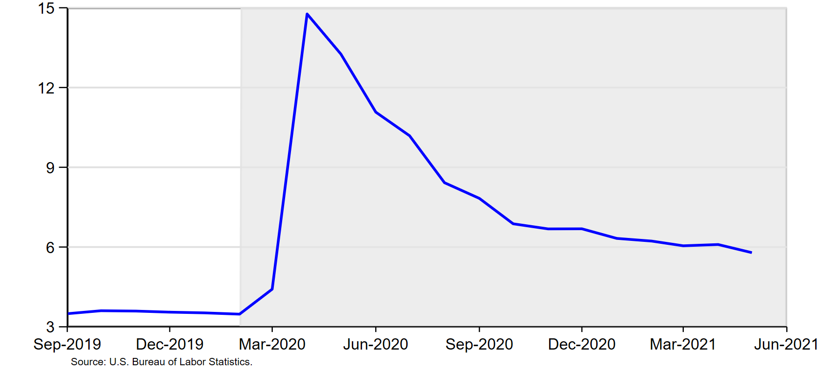
Unemployment rate
percent

Slide 24
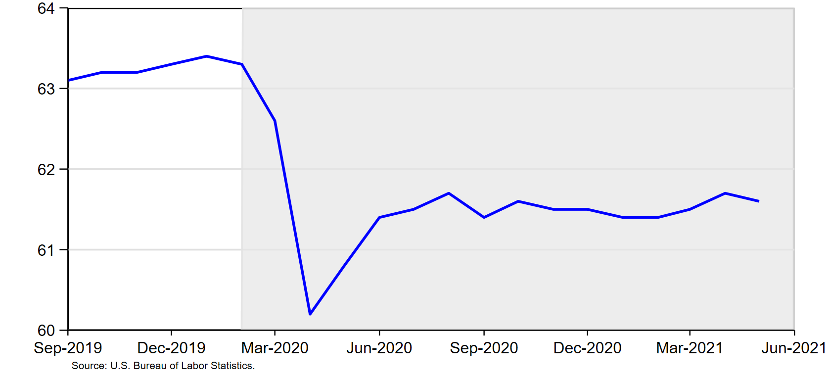
participation rate (16+)
percent
Notes:
LFP has fallen. 5.m people still out of labor force. Not counted as unemployed.

Slide 25
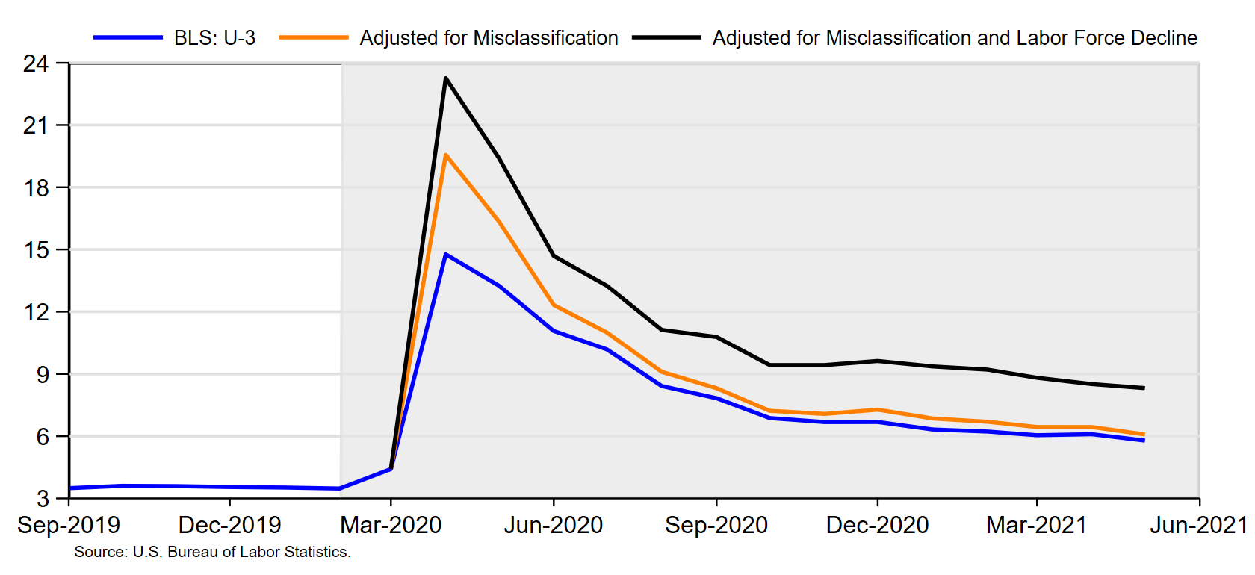
Unemployment rate
percent
Notes:
Adjust for LFP decline and misclassified workers (laid off workers mistaken counted as employed). True UR reached 24% in April; now at 9.6%

Slide 26
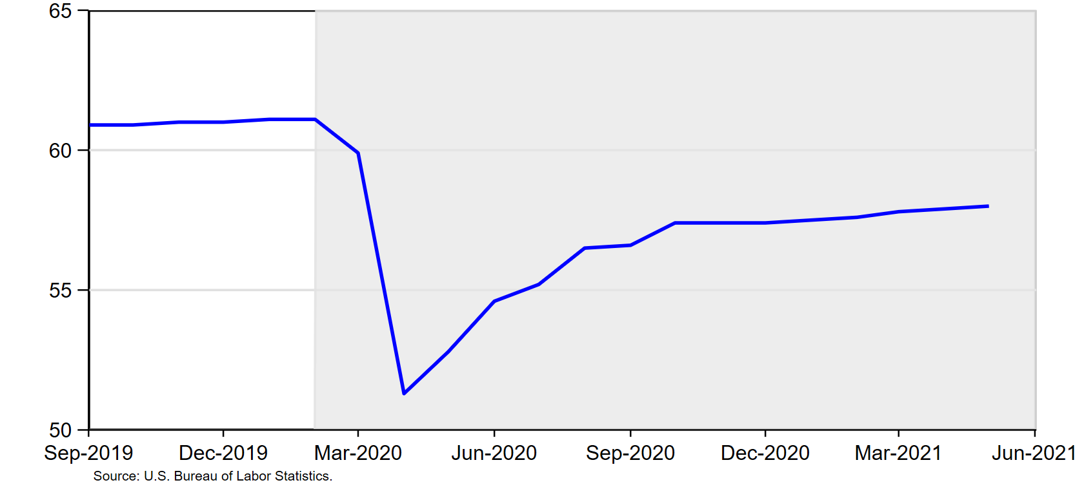
Employment-population ratio (16+)
percent
Add epop 16+ chart

Slide 27
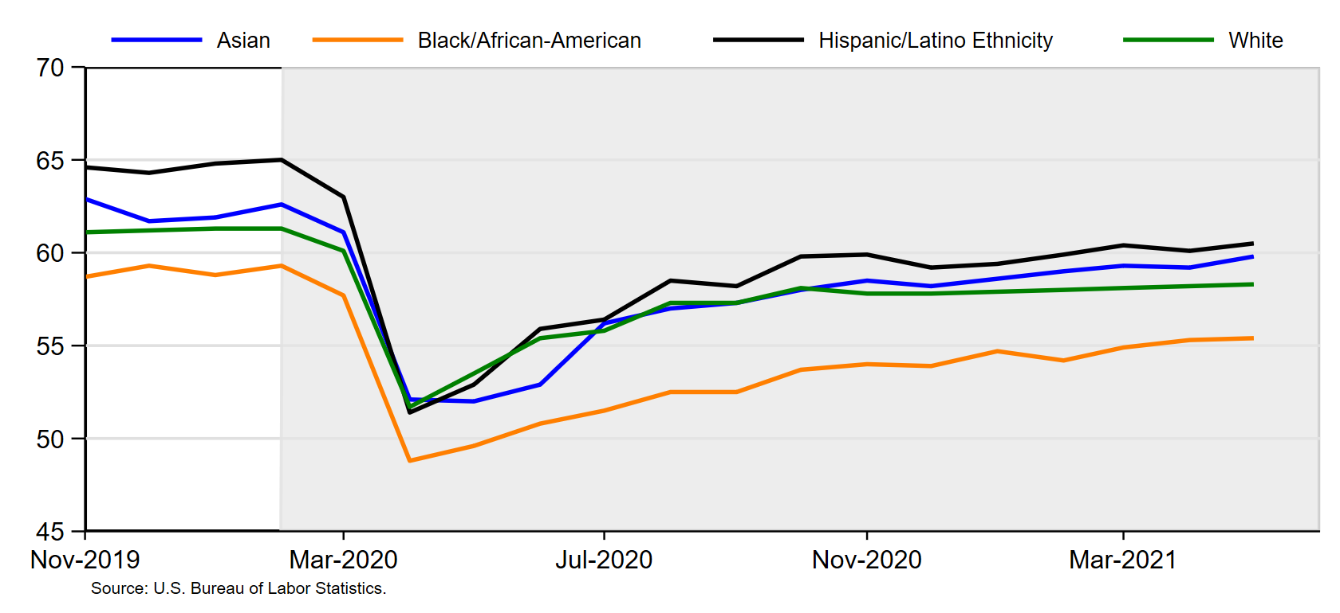
Employment–population ratio (16+)
SA, percent
Notes:
Comment on FOMC use of broader (more inclusive) set of statistics to gauge maximum employment – here by race
E/P still will below pre-crisis for all races and growth has stalled
But even return to pre-crisis isn’t satisfying – still significant disparities suggesting more labor availability in some communities
FOMC will look at many indicators in future – much less focus on total UR

Slide 28
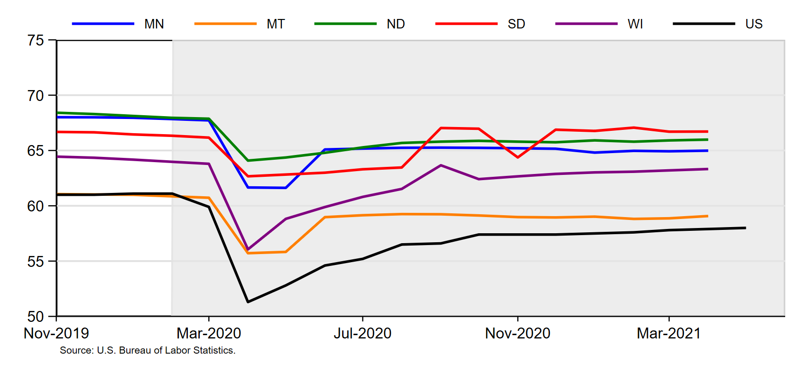
Employment–population ratio by state (16+)
SA, percent

Slide 29
Change in Employment by wage
Percent, 7-day moving average

Slide 30
Change in US Employment by Industry: 2020 Recession
SA, percent

Slide 31
Change in employment: Leisure & hospitality
SA, percent

Slide 32
Jobs: Collapse and incomplete recovery
Data and anecdotes indicate large unsatisfied demand for labor
Notes:
Puzzle – lots of unemployed people; lots of unfilled jobs

Slide 33
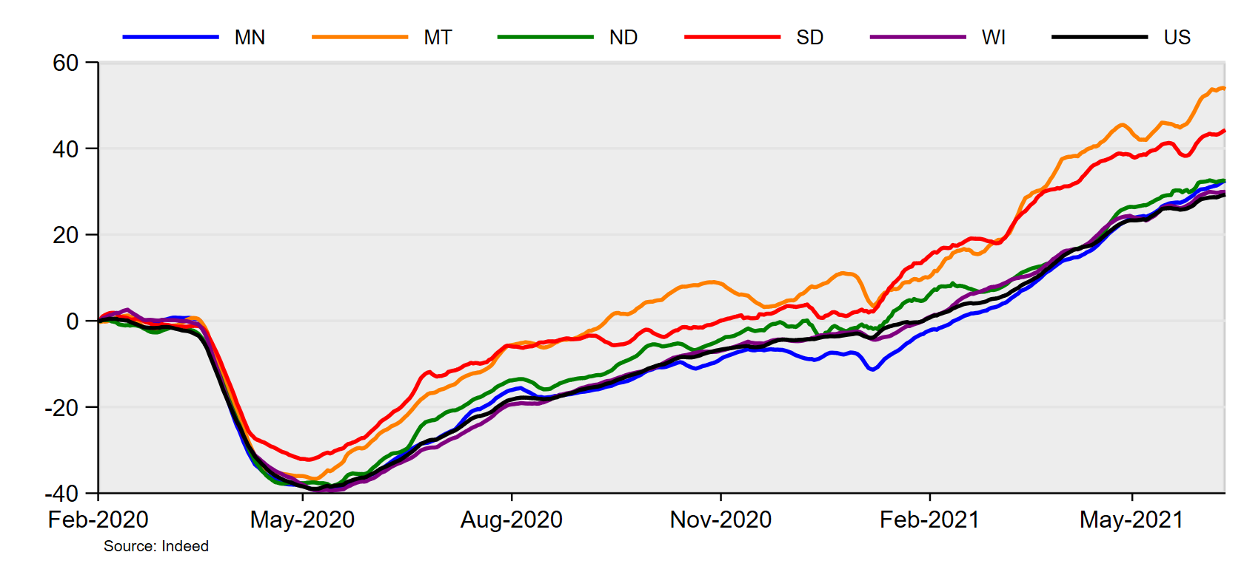
Change in online job postings
Relative to Feb-1-2020, 7-day Moving Average SA

Slide 34
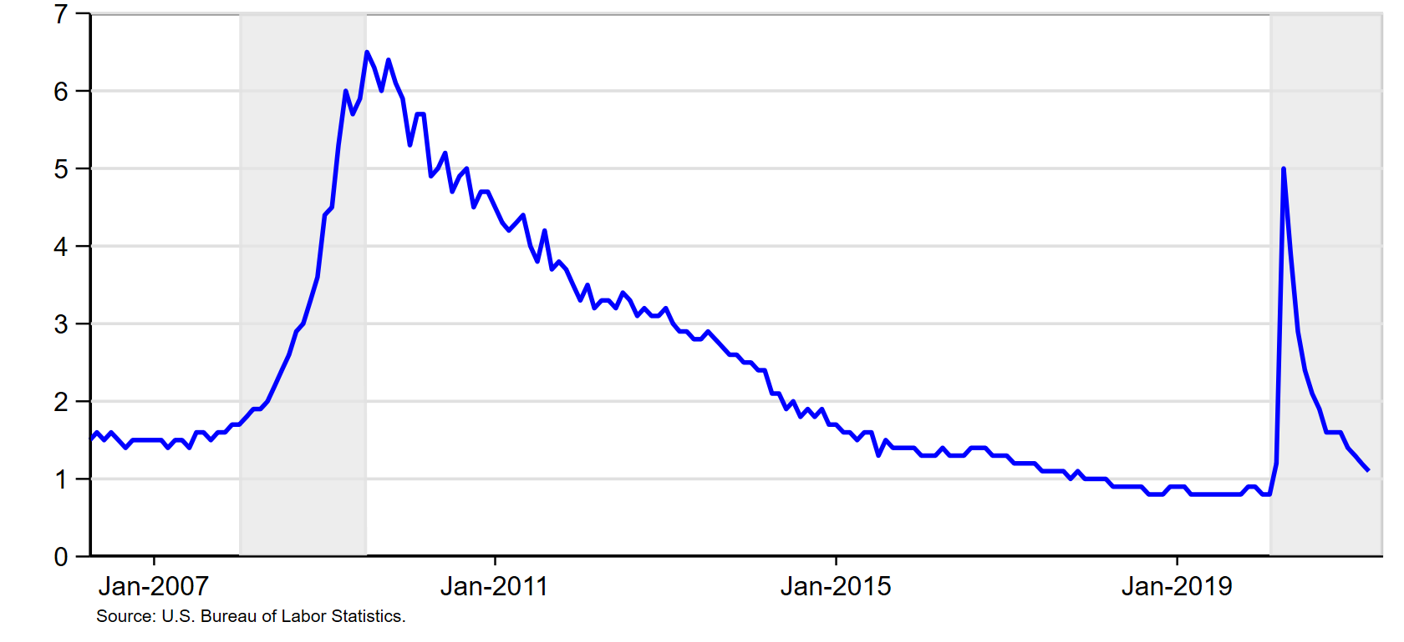
Unemployed Persons per Job opening
Sa, Levels

Slide 35
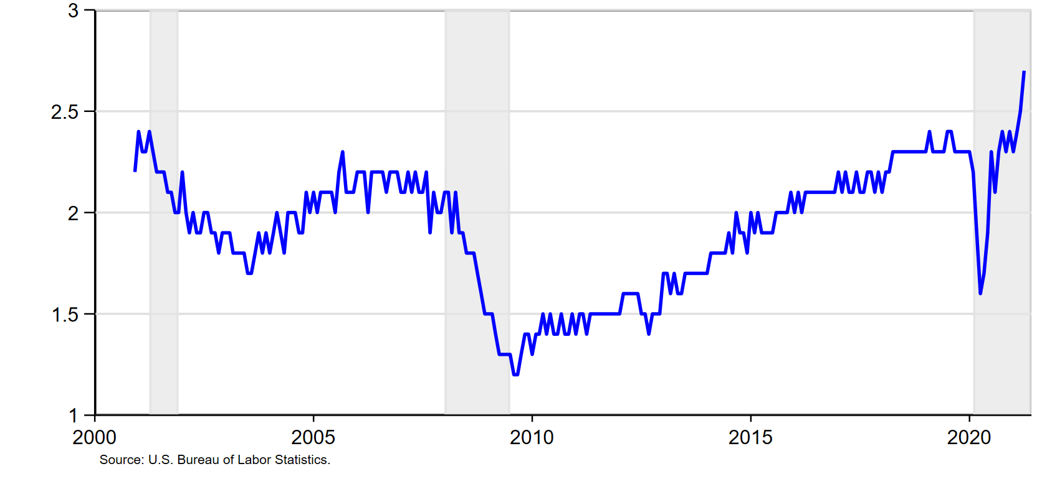
Total Quits Rate
Sa, Percent

Slide 36
Jobs: Collapse and incomplete recovery
Data and anecdotes indicate large unsatisfied demand for labor
Why aren’t workers taking jobs?
Some still fear COVID
Schools/summer camps not fully open
Lack of available/affordable childcare
Job matches more difficult to make
UI Benefits
Expect labor supply to pick up through summer

Slide 37
Today’s talk
Overview of the Federal Reserve
Output: collapse and robust recovery
Jobs: collapse and incomplete recovery
Inflation: recent price rises
Q&A
Notes:
Inflation – are recent increases transitory (likely) or will the 70s replay?

Slide 38
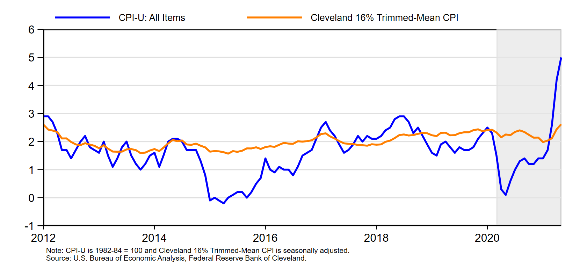
CPI
12-Month percent change
Notes:
Rising inflation concentrated in limited categories – associated with bottlenecks and surging demand. Airfare, hotels, cars, ..

Slide 39
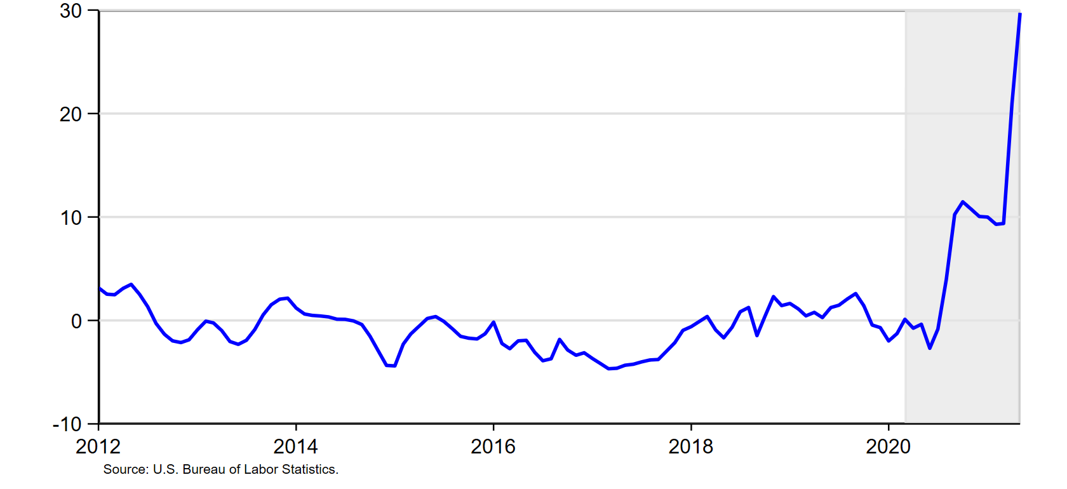
CPI-U: Used Cars and Trucks
1982-84=100, 12-Month percent change

Slide 40
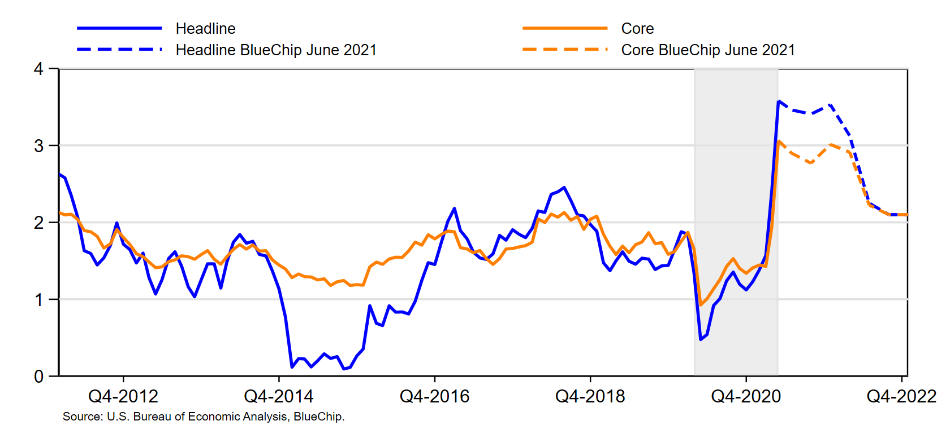
PCE Inflation
12-month percent change or q4/q4 Percent Change
Notes:
Headline PCE inflation now 3.6, core 3.1
Inflation had run persistently below 2% since 2012 (when 2% target was explicitly announced)
Headline avg 1.3% since Jan 2012; core 1.6%
Recent surge – transient or persistent

Slide 41
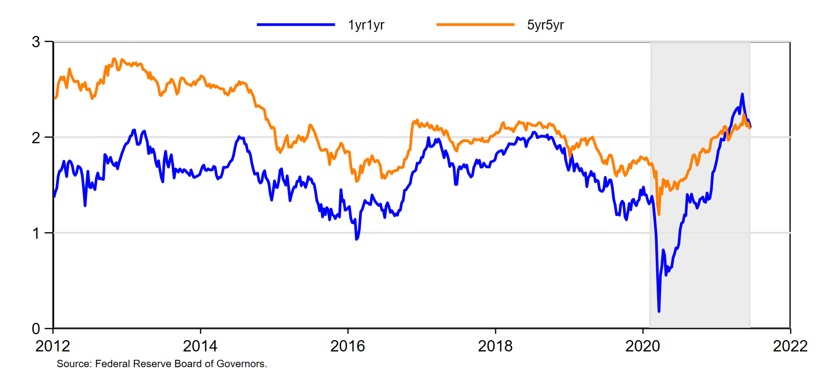
Market-based inflation expectations
percent

Slide 42
Today’s talk
Overview of the Federal Reserve
Output: collapse and robust recovery
Jobs: collapse and incomplete recovery
Inflation: recent price rises
Q&A

Slide 43
Thank you!
Questions?

