Slide 1


Speak Up!
Indiana Housing Conference
August 28, 2025
Notes:
lori

Slide 2
CSH (Corporation for Supportive Housing) Mission
CSH works to advance affordable housing aligned with services as an approach to help people thrive. We do this by advocating for effective policies and funding, investing in communities, and strengthening the supportive housing field.
Notes:
Lia 2:00-3:00

Slide 3
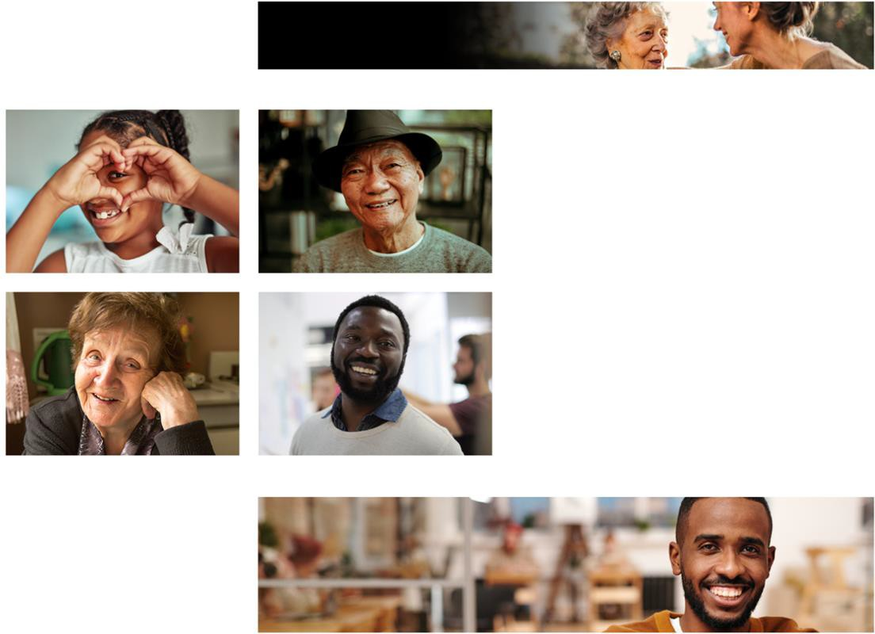

About CSH
CSH collaborates to advance solutions that use housing as a platform for services to improve the lives of the most vulnerable people, maximize public resources and build healthy communities.
csh.org
Notes:
lia

Slide 4




How We Are Building Thriving Communities
Guided by our 2023-2027 Strategic Plan, CSH focuses on building thriving communities with universal access to housing and services, and opportunities to achieve economic security.
FOCUS AREAS
HOUSING
SERVICES
ECONOMIC SECURITY
csh.org
Notes:
Lia
Supportive housing is affordable housing where supportive services providers actively engage tenants in flexible, voluntary and comprehensive services and work with property and housing management to support tenant stability and ensure that the housing remains a positive community asset for the long-term.
Supportive housing is an innovative and proven solution to some of communities' toughest problems
Supportive housing is the scaffolding for the delivery of more effective and responsive public services.

Slide 5
Speak Up! Indiana
Leadership & advocacy program for people with lived experience and expertise of supportive housing and homelessness
Centering people with lived experience & their expertise to advocate for solutions to homelessness
Notes:
Lori

Slide 6
Speak Up! Indiana
Mission:
Our mission is to create a program that empowers individuals who have experienced homelessness in the Indianapolis area to speak to the realities of homelessness, challenge the narrative about how people come to experience homelessness, and advocate for policy reform through evidence-based supportive housing.
Notes:
Lori

Slide 7
What Participants Should Expect
Collaborations between advocates and coaches will ensure that advocates with lived experience have the support and tools they need to share their stories with confidence, reframe their experiences as a source of strength, and advocate for meaningful change.
By blending the power of storytelling and the arts with advocacy, Speak Up! Indiana aims to build public understanding, increase legislative support for supportive housing, and create lasting social impact.
Speak Up! is rooted in trauma-informed principles that prioritize emotional and psychological safety, healing and engagement, and peer support and community building.
Notes:
Lori

Slide 8
What Participants Should Expect
At the completion of this program:
Advocates, with the support of coaches, will have created a 3-5 minute story that can be used to impact policies, programs, and decisions related to supportive housing and homelessness
Opportunity to develop professional and leadership skills, such as consulting opportunities, community leadership roles
Create system change through community engagement, public policy advocacy, and participation in legislative initiatives
Graduates become community educators, policy influencers, and leaders in the housing sector
Notes:
Lori

Slide 9
Practice Sessions
One-on-one practice time between coach and advocate for up to two hours each month/between sessions (not required)
Time and place coordinated by coach and advocate
csh.org
Notes:
Lori

Slide 10
Speak Up! Sessions (meet twice a month)
June 8th: Orientation/Introduction
June 25th; 3p-7p: Self Care: Choosing Stories that Serve Us
July 13th; 1p-5p: The Power of Narrative
July 30th; 3p-7p: Story of Self
August 10th; 1p-5p: Story Rounds (practice)
August 20th; 3p-7p: Legislative & Public Policy & Leadership Opportunities
September 3rd; 3p-7p: Story Rounds (practice)
September 21st; 1p-5p: Know and Build your Audience
October 5th; 1p-5p: Pursuing Professional & Community Opportunities
October 22nd; 3p-7p: Polishing your Story
November 12th; 3p-7p: Putting it All Together
November 30th: Holiday show (optional group outing @ the Phoenix); evening-time to be determined
December 3rd; 3p-7p: Graduation
Notes:
Lori

Slide 11
Speak Up! Resources
The CSH website, www.CSH.org has additional resources, videos and information about Speak Up!
Speak Up! Resources page: Corporation for Supportive Housing - CSH Speak Up! - A Lived Experience Advocacy Initiative
Speak UP! Video: Learn about CSH Speak Up!
Notes:
Lori/Lia

Slide 12
Contact Information
Lori Phillips-Steele
Director, CSH Indiana
Lori.Phillips-steele@csh.org
317-319-9202
Lia Hicks
Senior Program Manager, CSH Indiana
Lia.hicks@csh.org
317-499-4773

Slide 13
Thank you!
csh.org

Slide 14

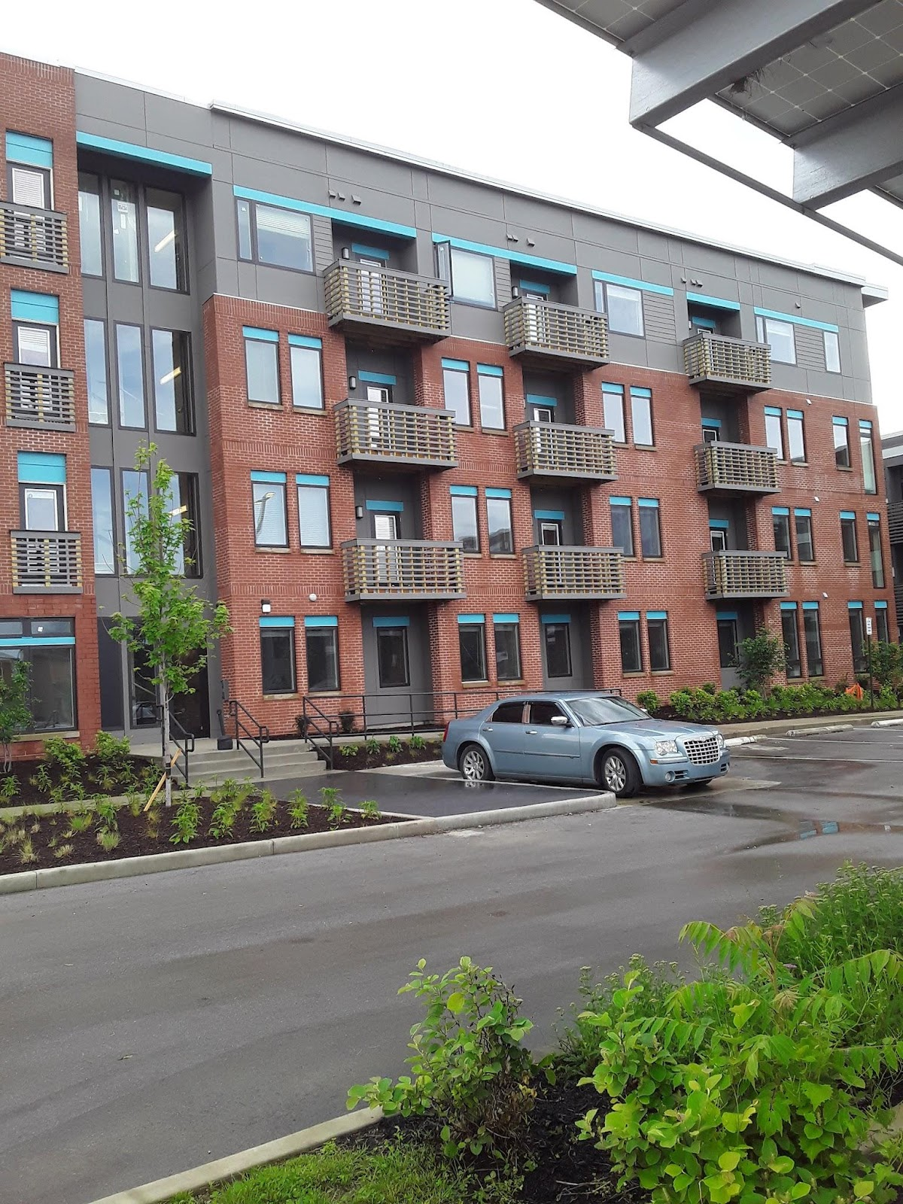
PSH MY LIVED EXPERIENCE
PARKER PLACE
SENIOR APARTMENTS
Notes:
I moved into Parker Place Senior Apartments on May 9th, 2019. That date marks a turning point in my life. Permanent Supportive Housing (PSH) has provided me with an evidence-based, well-organized platform that profoundly impacted my life and significantly aided my recovery journey. For me, it’s more than just a place to live—it’s a space where new ideas are born and futures are shaped. PSH gave me the stability to heal, grow, and rediscover purpose.

Slide 15
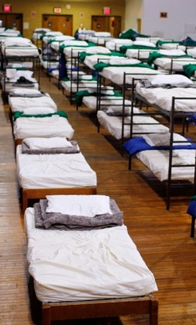
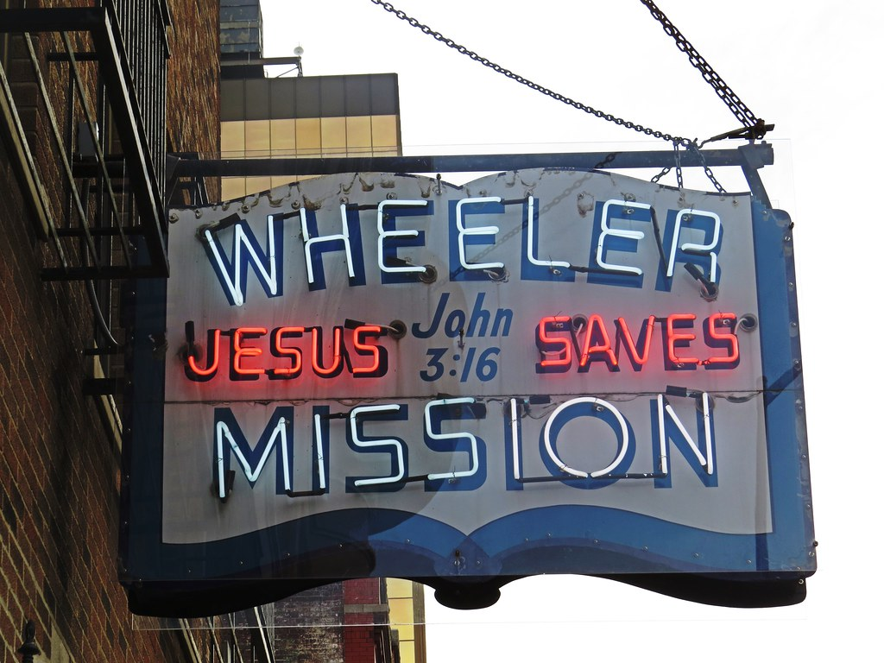
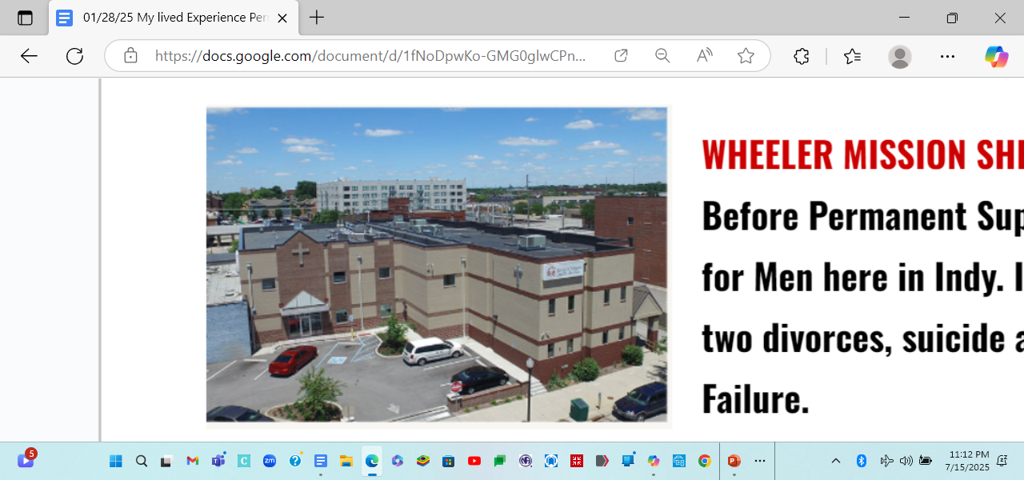
Wheeler Mission – Men's Homeless Shelter, Indianapolis
Notes:
My journey toward stability began at Wheeler Mission Men's Residential Center, located at 245 N Delaware St in Indianapolis, and continued through the Wheeler Mission Shelter for Men at 520 E Market St. These places gave me more than shelter—they gave me a chance. I was one of many who walked through those doors with nothing but hope. From there, I transitioned into permanent supportive housing, and that’s where real healing began. I’m living proof that emergency shelters and long-term housing solutions work. They don’t just change lives—they save them.

Slide 16
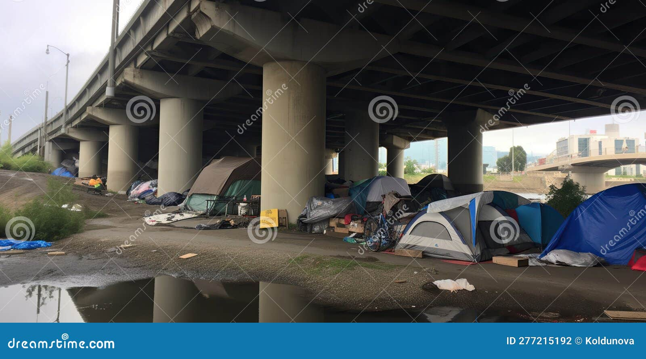
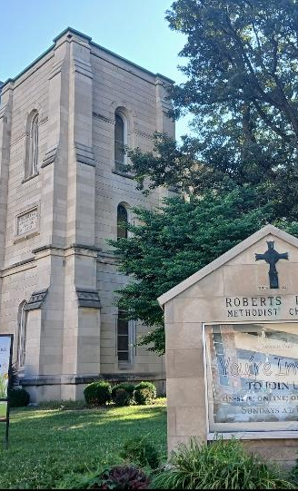
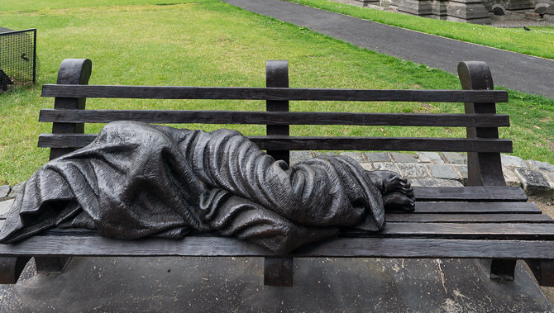
It can be unbearable and almost impossible to find that hope shot or empowerment while living under a bridge, in a tent, or sleeping on a park bench.
Notes:
When someone is forced to sleep under a bridge, in a tent, or on a park bench, hope doesn’t just fade—it becomes nearly inaccessible. In those conditions, empowerment isn’t a choice—it’s a distant dream. Without stable shelter, individuals are locked out of opportunity, dignity, and the very systems designed to help them thrive. If we want to talk about equity, recovery, or resilience, we must first ensure that no one is left to survive in spaces unfit for human habitation.

Slide 17
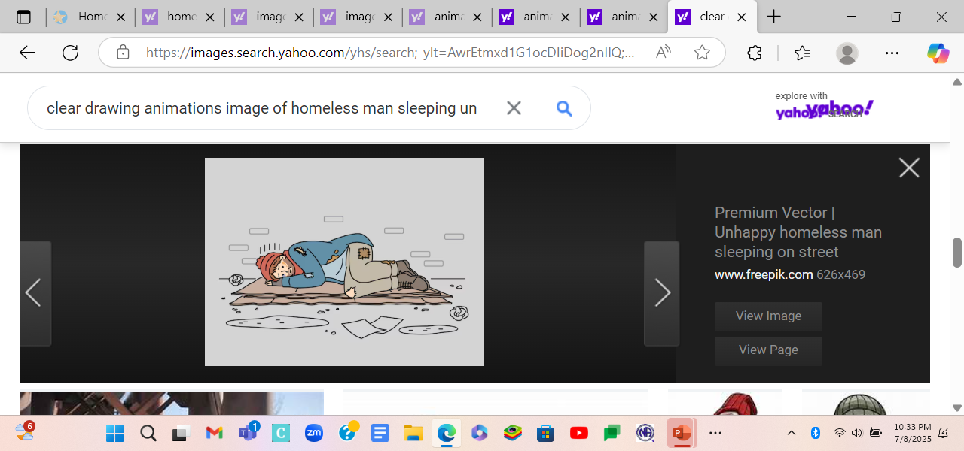


There were times when my bed was nothing more than a piece of cardboard to separate my body from the cold hard concrete.
My life possessions were often fitted into a backpack
.
Notes:
There were nights when my only barrier from the freezing concrete was a piece of cardboard. My entire life—every possession I had—fit into a single backpack. This wasn’t a temporary setback. It was survival. When basic shelter is out of reach, the conversation about opportunity, employment, or recovery becomes irrelevant. If we want to build a society rooted in equity and resilience, we must start by ensuring that no one is left to sleep on the streets.

Slide 18
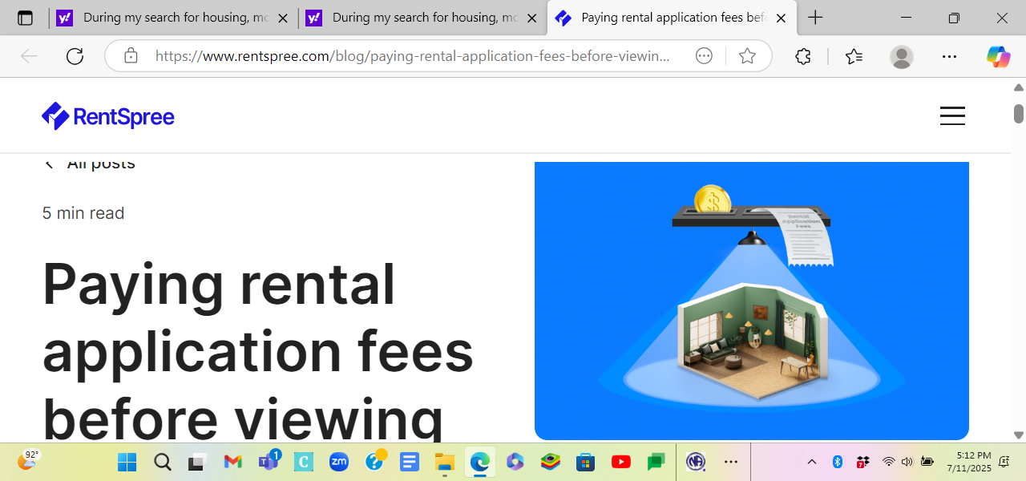



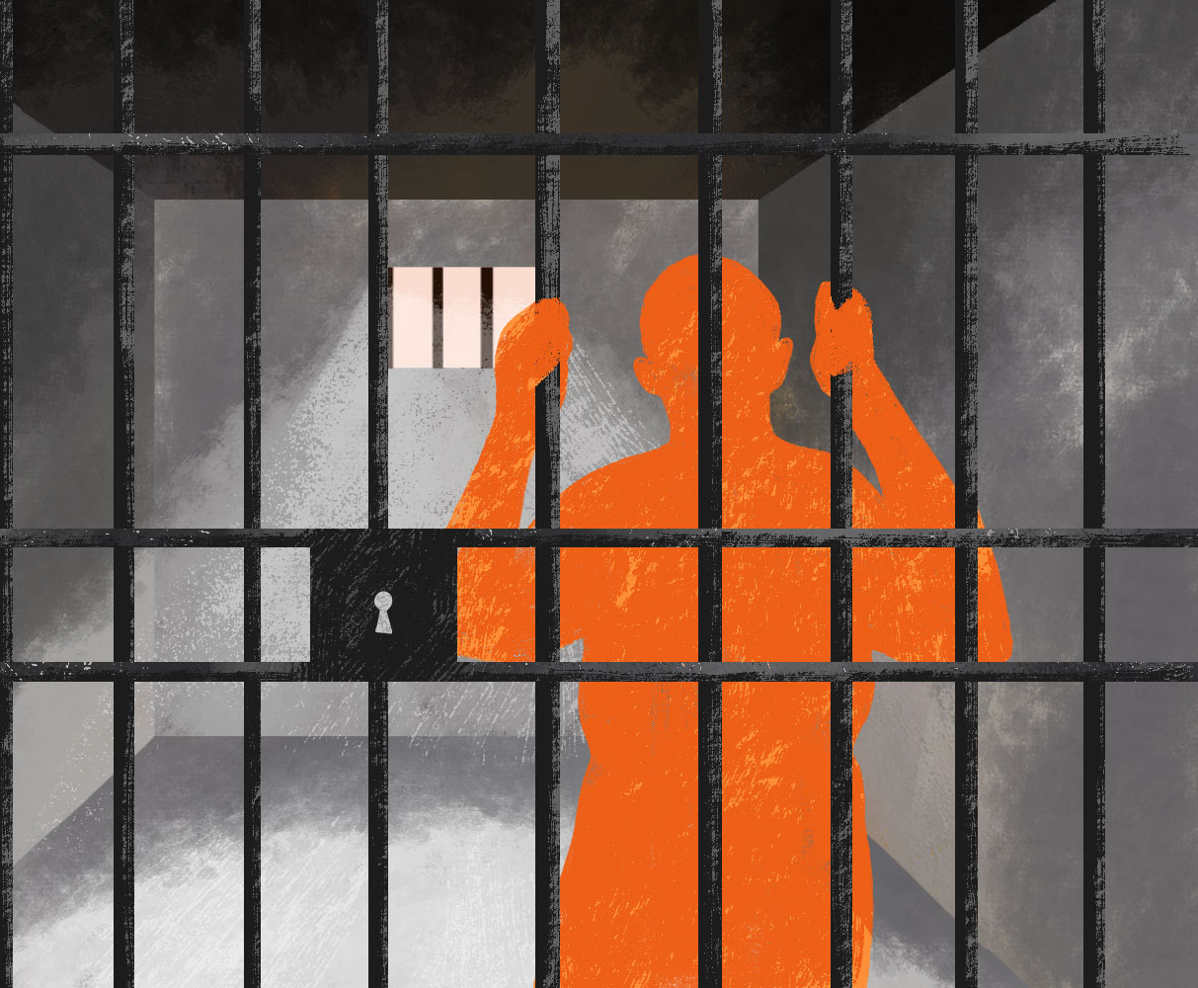
DURING MY SEARCH FOR HOUSING MOST POTENTIAL RENTALS REQUIRED A
NON-REFUNDABLE APPLICATION FEE RANGING FROM $15 TO $50, WHICH SEEMED LIKE A WASTEFUL EXPENSE GIVEN MY LESS-THAN-IDEAL CREDIT SCORE, RENTAL HISTORY, AND CRIMINAL RECORD.
Notes:
To those in positions of power—lawmakers, funders, developers, and legislators—thank you for supporting Housing First. Without this approach, I would have remained stuck in a cycle of rejection, unable to overcome the barriers of application fees, credit checks, and my past. Housing First didn’t ask me to prove I was worthy of housing—it gave me a chance to stabilize, heal, and rebuild. That opportunity changed everything.

Slide 19
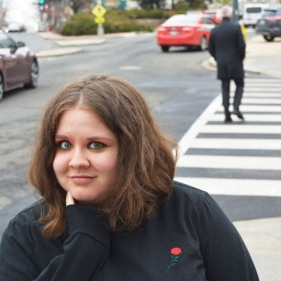
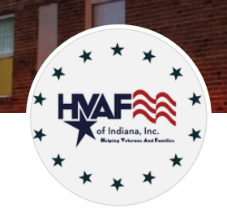
Ms. Sara Alrajabi,
Passionate individual who utilizes professional and lived experience to create equity on local and national levels.
CPSP|HVAF – Helping Veterans and Families – Ivy Tech Community College Indianapolis, Indiana United States
Notes:
Ms. Sara Alrajabi, former Supportive Housing Case Manager and now HVAF Case Manager, is the kind of advocate who sees beyond paperwork and past mistakes. When many had written me off as a lost cause — judged me by my rental history and the barriers I faced — she saw my determination. She recognized the fight in me to change, even when the odds were stacked against me. In a system that often overlooks people like me, Sara made sure I wasn’t invisible. She stood up for me when few others would, not because it was easy, but because she believed in the possibility of transformation.
Her work isn’t just about housing — it’s about restoring dignity, rebuilding lives, and reminding people that they matter.
Thanks to her, I found more than support. I found someone who believed in me when I needed it most.

Slide 20

Mrs. Stephanie Metzger
Former Community Services Coordinator / Manager
Notes:
Stephanie’s legacy is one of compassion, leadership, and unwavering dedication. She began her journey as the Community Services Coordinator, where her empathy and tireless work made her a trusted advocate for residents. Her natural ability to connect, uplift, and lead quickly propelled her into the role of Manager. In every position she held, Stephanie didn’t just fulfill a job description—she transformed lives. Her work build bridges between people and resources, restored dignity, and created pathways to healing and hope. Stephanie is proof that when service is rooted in heart, it leaves a lasting imprint on an entire community.

Slide 21
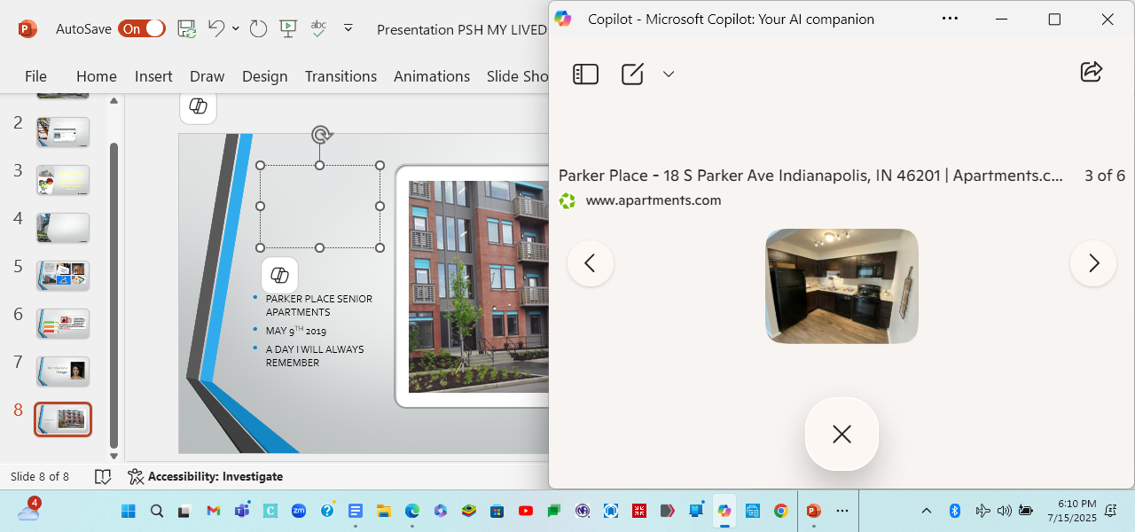
PARKER PLACE
SENIOR APARTMENTS
MAY 9TH 2019 !!!
A DAY I WILL ALWAYS REMEMBER
Notes:
May 9th, 2019—Parker Place Senior Apartments. That day marked more than just a move-in date. It was the beginning of stability, safety, and dignity after years of uncertainty. For me, it wasn’t just a new address—it was a turning point. A day I will always remember, because it gave me the foundation to heal, rebuild, and reclaim my life.

Slide 22
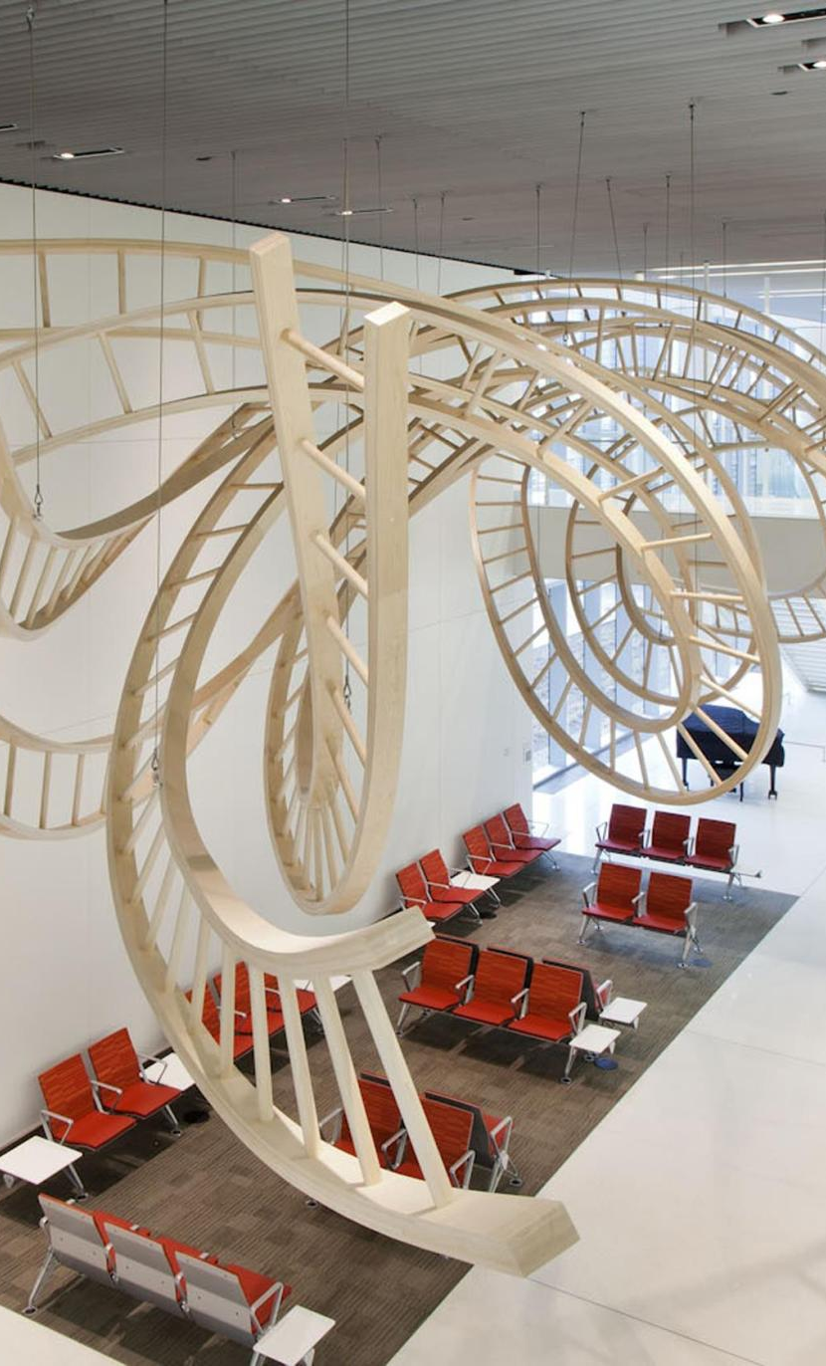
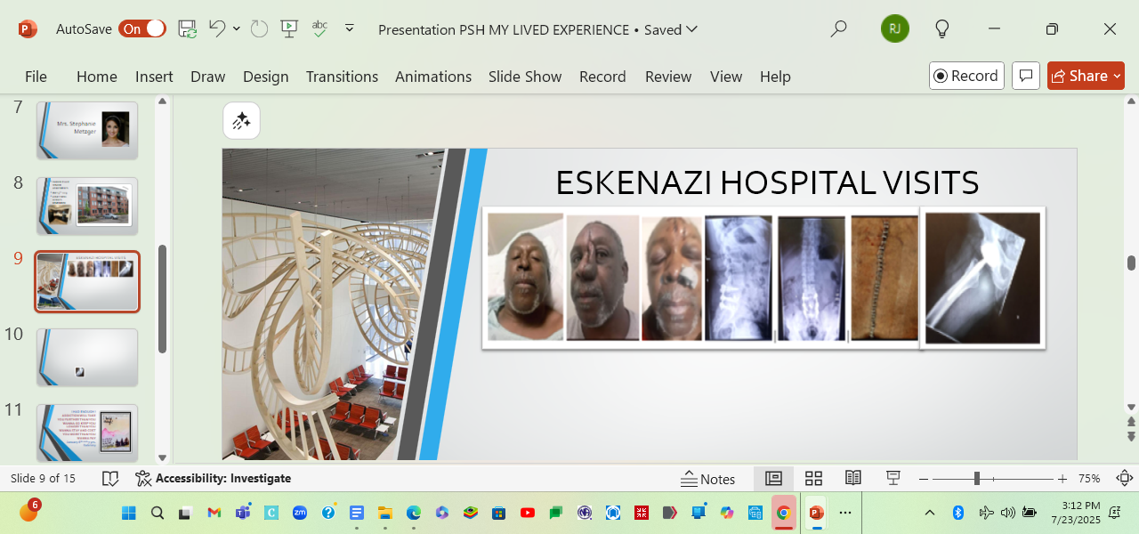

ESKENAZI HOSPITAL
"I’ve undergone six facial surgeries, overcome Hepatitis C, endured a major back operation, and received a total hip replacement.
Notes:
Since becoming a resident of PSH, "I’ve undergone six facial surgeries, overcome Hepatitis C, endured a major back operation, and received a total hip replacement. These weren’t just medical procedures—they were acts of restoration. PSH didn’t just give me shelter; it gave me access to healing, dignity, and the chance to rebuild a life that had been fractured by years of hardship. Without stable housing and support, these surgeries and procedures might never have happened. This is what real recovery looks like—and it starts with housing.

Slide 23
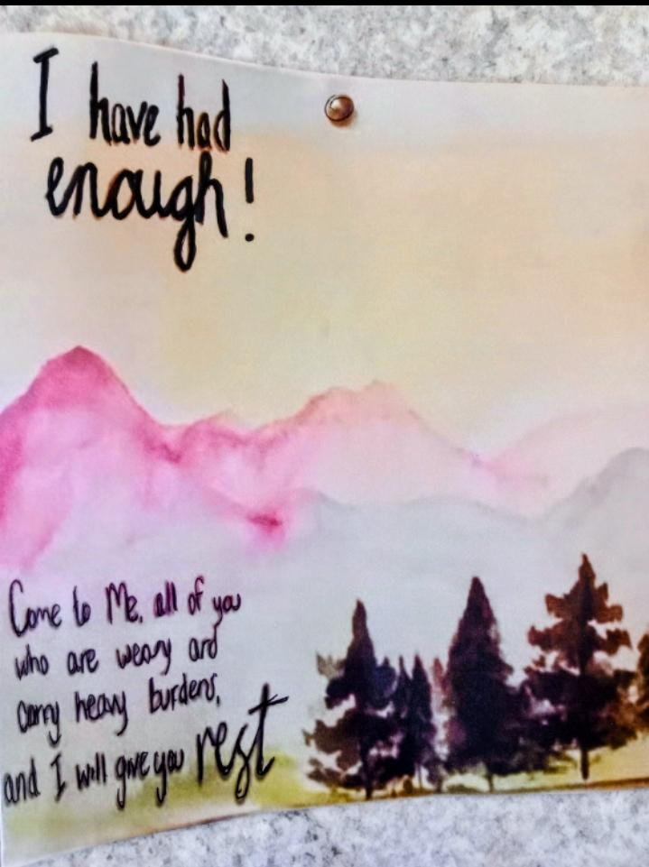
I HAVE HAD ENOUGH
Addiction will take you further than you wanna go keep you longer than you wanna stay and cost you more than you wanna pay
Notes:
Addiction isn’t just a personal struggle—it’s a relentless force that drags people deeper than they ever intended to go, traps them longer than they ever thought they’d stay, and extracts a price far greater than they ever imagined paying. The cost isn’t just measured in dollars—it’s measured in lost potential, fractured families, and lives cut short. If we want to break this cycle, we must invest in housing first, treatment, and recovery—not punishment followed by rigid demands.

Slide 24
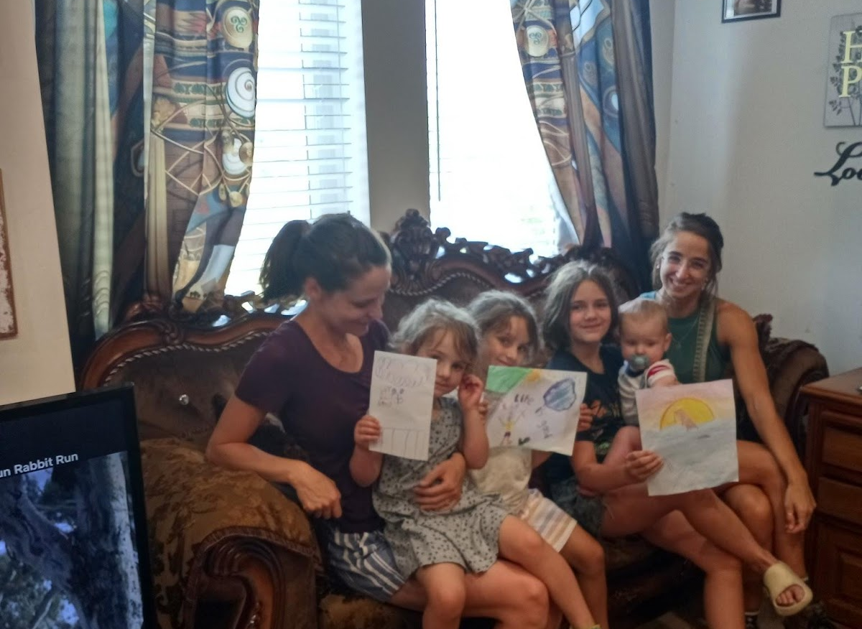
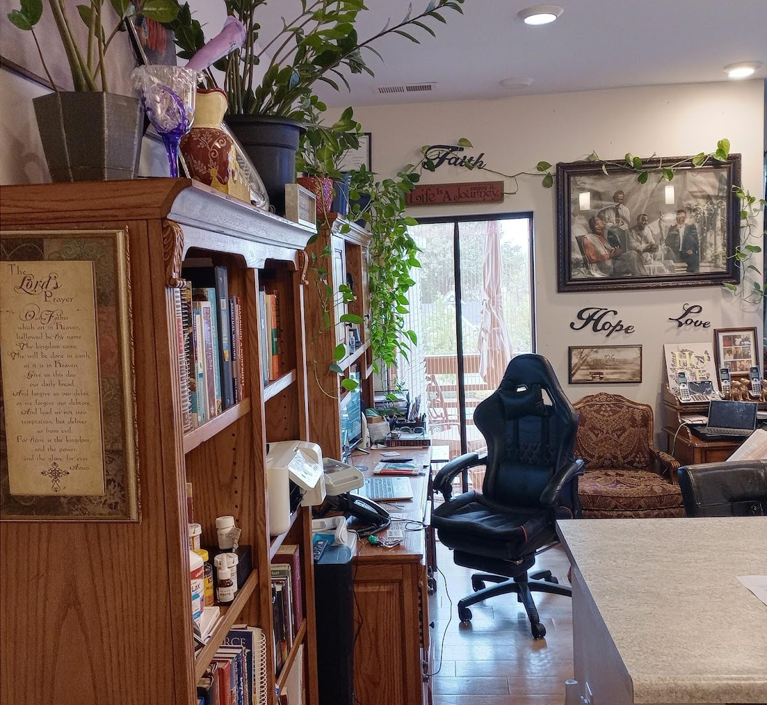
🌿 A Legacy of Compassion: Mrs. Stephanie Metzger
Among the many remarkable individuals who have touched my life, Mrs. Stephanie Metzger stands out as a beacon of kindness and unwavering support. As a former Community Services Coordinator and Manager, she played an instrumental role in helping me navigate a critical chapter of my journey.
A pivotal moment was when Stephanie provided me with a Certified Recovery Specialist / Community Health Worker application, which has now evolved into a Certified Peer Support Professional (CPSP).“
Notes:
Every Milestone I crossed she celebrated with me. Whether it was a warm meal or a gifted plant, each gesture was a testament to her belief in my growth and resilience. Her affirming words—always rich with encouragement and genuine compliments—lifted me during moments of doubt and reminded me of my worth.

Slide 25
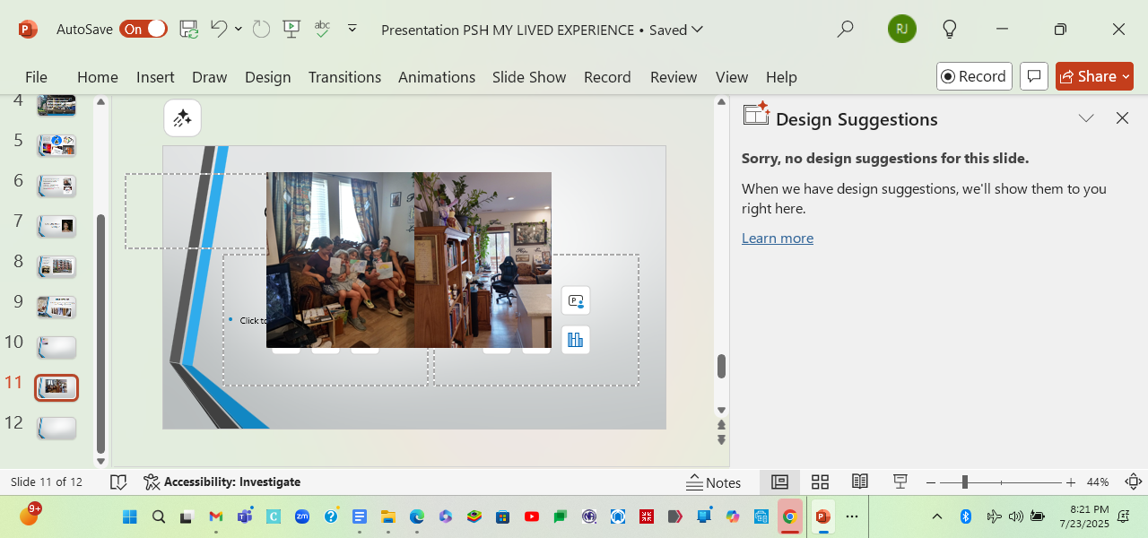
Notes:
Together with her niece, she created artwork that now adorns my home, serving as a constant reminder that there is hope beyond addiction and chronic homelessness. These pieces are more than art; they are symbols of transformation and dignity. The plants she graced me with continue to thrive, stretching across the walls and ceiling of my apartment. They are living emblems of growth—of how far I’ve come, and the life that continues to bloom in spaces once marked by struggle.

Slide 26
CSH
SPEAK-UP AVOCATE TRAINING
AND COACHES
✨ Honoring My Coach: Mira Cassidy
As I grow through the Speak Up! program, I’m deeply grateful for the guidance of Mira Cassidy—an empowerment coach, religious trauma specialist, author, and actress whose work radiates compassion and resilience. Her journey inspires me: from self-publishing Let Mia Tell It in 2018 (now a stage play) to earning her degree in Psychology of Human Relations, Mira is deeply committed to healing and human connection.
Mira leads with empathy and purpose, using storytelling as a tool for transformation. Her belief in the power of lived experience has helped me find strength in my own voice. Through her mentorship, I’m learning not just how to speak up—but how to speak truth with courage, clarity, and heart.
💬 Speak Up! Advocate Statement
As a Speak Up! advocate in training with the Corporation for Supportive Housing, I am committed to bringing my lived experience to the forefront—working alongside policymakers, community leaders, and service providers to influence housing policy and funding decisions. By sharing my story and collaborating with grassroots organizations, I aim to ensure that supportive housing remains a priority for those who are stigmatized and marginalized.
Through the Speak Up! program, I am gaining the tools, confidence, and platform to elevate voices too often left unheard. This journey empowers me to transform personal experience into a force for change—amplifying struggles, challenging systems that criminalize homelessness, and shaping solutions that move beyond traditional frameworks toward equity and dignity.

Slide 27
I am a living witness that those struggling with mental health challenges, chronic Homelessness, addictions, and a criminal history have the resilience to bounce back from any adversity, seize the opportunity to rise, shake off the dust, change the trajectory of their life, and embark on a fresh new path.
Notes:
People facing mental health challenges, homelessness, addiction, and a criminal record can recover and thrive—but only when they have a stable foundation. Permanent Supportive Housing makes that possible. It’s not just a roof over my head; it’s a launchpad for healing, dignity, and long-term success. These outcomes aren’t rare—they’re what happens when housing is treated as healthcare and support is built into the solution.

Slide 28
I would like to thank everyone who has devoted their time and uncharted effort to those suffering from drug addiction, mental health issues, and chronic homelessness.
Because of you guys, I have found a peaceful place in society.
And for that I am grateful
Thank You and Thank God

