Slide 1
4% vs 9%
70% PV / 9% / Competitive credits:
Allocated to states based on population
  2024 allocations ($2.90 per capita or $3.36M minimum per state)
Reservations received based on a competitive application process
9% deals receive more equity because of higher % (70% PV)
10% Test (covered in future slide)
30% PV / 4% / Tax-exempt (“TE”) bond credits:
Allocated to developments financed with TE bonds
Reservations received based on Private Activity Bond (“PAB”) allocation from state
  2024 state PAB volume caps ($125 per capita or $378,230,000)
  Not only for affordable housing, used for schools, hospitals, airports, etc.
4% deals - less equity & more debt because of lower % (30% PV)
50% Test (covered in future slide) & 95-5 Tests (good cost/bad cost analysis)

Slide 2
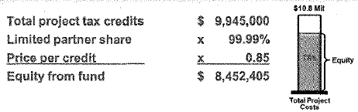
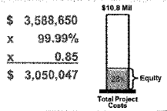
4% vs 9%
9% Deal Example
4% Deal Example
9% deals
Capital going negative isn’t typically a concern due to significant LP equity
More concerned with driving capital account down by year 15 so positive capital doesn’t change economics of the deal
4% deals
Capital going negative is concern – must have sufficient minimum gain

Slide 3
50% Test
Applicable to 4% TE bond deals
(TE financing + Interest earned on bonds) / Aggregate Basis
  Aggregate Basis = Depreciable basis + land
    Watch out for items over QAP limits that are still depreciable (dev fee/architect)
    Watch out for items allocated to land (non-EB sitework, title & recording, legal)
If you fail the 50% Test, say 49.5%, then you would only get 49.5% of the credits
  This would cut equity in half and make the project not feasible
  Generally, the LPA will require the reduction of the developer fee by the amount needed to meet the 50% test.
  If potential 50% Test issue foreseen, owner can request additional bonds

Slide 4
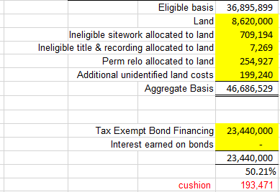
50% Test Example

