Slide 1


Eviction Prevention: Keys to Keeping Tenants Housed
August 27, 2025
Lia Hicks, CSH
Zach Gross, IHCDA
Notes:
Lia
Often those with the greatest need for affordable housing are also residents and families with multiple barriers and needs that if left without intervention, can jeopardize ongoing tenancy. We know that eviction comes at a high cost for everyone involved. Today’s session will focus on looking at housing stability with a fresh lens through the use of an Eviction Prevention Plan developed for your property using guidance from CSH and IHCDA. We hope this information will help you and your staff look at eviction as a last resort and identify strategies to mitigate lease violations.

Slide 2
Eviction: What’s the big deal?
Tenant
Property Management
Service Provider
Loss of housing/possessions
Risk of homelessness
Trauma
Self-esteem, identity
Loss of supports/connections
Effect on future
Damages relationships
Feelings of failure
Time consuming/relocation
Pressure to advocate
Loss of rent
Cost of flipping unit
Legal fees
Marketing unit & securing new tenant
Notes:
Lia

Slide 3
Who are your Tenants?
What barriers are they faced with?
Notes:
Lia
Ask Audience
Age, race, income, education, system involvement (DCS, legal, etc.), SSI/SSDI, inconsistent work or income, physical and/or MH, substance use, relationship issues/poor communication skills, lack basic needs on a consistent basis, live day to day w/o sense of security/safety, don’t trust others, racism, TRAUMA!!! --some people experience many/most of these factors. Past and present trauma and its impact

Slide 4

Setting the Stage: Indiana Housing Need
For every 1 unit of available affordable housing in the U.S., there are 4 households in need; federal rental assistance only covers 24% of those households who qualify for/need it
In Indiana, at $7.25/hr., a household must work 101 hours/week (2.5 FTE jobs) to afford a 1-bedroom unit at Fair Market Rent of $956; 122 hrs/wk (3.1 FTE jobs) for a 2-bedroom at $1153
Rent affordable with full time job paying $7.25/hr is $377
A household must earn a minimum of $22.18/hr at 40 hours/week to afford a 2-bedroom unit (without paying more than 30% of income on housing)
Average renter wage is $18.05
Rent affordable with full time job paying $18.05/hr is $939
Rent affordable at 30% AMI is $722
27% of Hoosier renters are below 30% AMI; 43% below 50% AMI
Out of Reach: Indiana | National Low Income Housing Coalition
#11
Notes:
Lia
Https://nlihc.org/oor/state/in stats on costs of rental housing in Indiana compared to income
For every 100 units of affordable housing needed for extremely low income (30% AMI) households, there are only 36 units available; for those at 50%, there are only 58 available for every 100 needed.

Slide 5

Eviction Prevention Plan Components
Eviction Prevention Philosophy
Resident Engagement Approaches
Community Partnerships Connecting Households to Resources
Roles and Responsibilities of Property Management Staff and Services Staff and Identify Mechanisms for Coordination and Communication
Tenant Knowledge of Roles and Responsibilities
Housing Retention Plans
Strategies for Mitigating and Responding to Common Lease Violations
Eviction Protocols
CSH Issue Brief, March 2021: How to Develop an Eviction Prevention Plan in Affordable, Supportive and Integrated Housing for Property Owners and their Partners.
Notes:
Lia
Discuss CSH Issue Brief
Disclosure that these slides and presentation will refer to the role of the service provider throughout, as this was developed with both affordable and PSH in mind. We recognize that all of your affordable properties don’t have onsite supportive services or connection and referral to services like PSH does. Hopefully you either have some connections or ability to refer/make connections, or this discussion today can help you ID and think about ways to incorporate supports.

Slide 6
Eviction Prevention Philosophy
Your “why” statement. The philosophy should be developed first because it will guide the rest of the plan.
How to develop the philosophy:
Convene with all parties (owner, property manager, and service provider) to work through expectations and reach agreement
Discuss how your approach with be unique to this property - is your eviction process/timeline realistic and appropriate for the target population?
Commit to using eviction only as a last resort
Reinforce through onboarding, periodic trainings, etc. to develop an organizational culture that matches the philosophy.
Notes:
Lia

Slide 7
An Ongoing Process
Help tenants build skills necessary to stay housed
Coordinate with property management staff and any other partners to identify solutions for tenants that are at risk of eviction
Create interventions that help tenants before they are at risk of eviction
Notes:
Lia
Eviction prevention in practice is really the art of coordinating proactive and reactive tactics by property management, service providers, and tenants, to help the tenant stay housed. This begins right at move in, or maybe before, and really continues for the life of the tenancy, although the frequency of the touchpoints and coordination and the intensity of the education and interventions may vary depending on what’s happening in the tenant’s life.
Three components of eviction prevention 1) helping tenants build skills to avoid eviction and 2) create interventions that help tenants before they’re at risk and 3) work with housing/property management to identify solutions for tenants that are at risk.
But the reason it’s a never-ending process is because first, it can take a long time to stabilize and we know that change is hard, and second, things happen. You know, everything can be going fine and then something can happen that just disrupts the process. A change in the property composition that maybe unsettles people and causes some behaviors to come up, changes in medication, death of a family or friend, a relapse, loss of a job, so it’s important to always be engaged in these efforts to proactively to make sure that when something does happen, the tenant and the team are as well-equipped as possible to respond.

Slide 8
Stages of Eviction Prevention and Opportunities for Intervention/Diversion
Move-in
Ongoing
Lease Violation
Eviction Notice & Filing + Alternatives
Notes:
Zach

Slide 9
Stages of Eviction Prevention and Opportunities for Intervention/Diversion
Move-in
At lease-signing, PM should walk through key parts of the lease with tenant:
  Payment schedule and payment method
  Visitor policy and quiet hours
  Notification process for maintenance issues
  Consequences for lease violations and notification policy
This is PMs first opportunity to make a positive connection with new tenant
Establish opportunities for tenants to connect with staff immediately, such as office hours, open door policies/be accessible, community meet and greets, etc.
Notes:
Zach
Additional things to discuss:
Information sharing and trust-building opportunity – add, pm obligations for providing notice prior to entering
With this follow-up, they can meet with the tenant and ask did anything stand out to you? Do you think anything is going to be difficult? Have you lost housing in the past for any of these things?
Ending lease early, adding household members – emphasizing that this is something that can be done, we just have to know about it
This is a meeting where there’s a lot of opportunity for positive interaction – welcoming the tenant to the property, rather than framing everything as you can’t have visitors more than 7 days a month or that can get you evicted, you can ask if they have any friends or family, if they’ve been out to see the property yet (unless you know for sure that’s not a good idea), and then you can say well we allow you have to visitors for up to 7 nights a month. After that, it could be a lease violation or you could come talk to me about why they need to be here so much and maybe we can see if there are options for adding this person to your household.
This follow-up meeting can be very valuable because moving in can be a whirlwind
The housing stability plan may be separate from the services plan and focus specifically on those areas of the lease that the tenant thinks they may struggle with. You know, if they do have a payment every month and think that they’re really going to forget to pay, this will be a good opportunity to discuss how to mitigate this right away.
Figure out how to ensure that there is a warm and immediate hand-off to services staff. For many of these clients, they will already be connected to the CMHC. However, if you’re considering another referral source, such as an institution or transitional housing or another where the client will not necessarily remain connected to those supports, ensure that the tenant is immediately informed of what services are available and where to access them.
Additionally, creating opportunities for tenants to interact with staff, including security guards, maintenance staff, front desk staff, etc. can be helpful because the clients can become more comfortable and are more likely to reach out if they’re experiencing issues in the unit.

Slide 10
Stages of Eviction Prevention and Opportunities for Diversion
Ongoing
Identify services you can refer residents to
Provide ongoing training to staff in eviction prevention practices
Identify and address concerns before they become major problems
Notes:
Zach

Slide 11
Stages of Eviction Prevention and Opportunities for Intervention/Diversion
Lease Violation
Most common lease violations and causes for eviction include:
  Non-payment of rent
  Disruptive behaviors
  Guest policy violations
  Neglect/damage to the unit
  Illegal activity on the property
Notes:
Zach

Slide 12
Stages of Eviction Prevention and Opportunities for Intervention/Diversion
Lease Violation
Notification process:
Notice of lease violations should be in writing and provided to the tenant promptly
  Consider barriers the tenant may experience when issuing violations
  Consider severity of the issue-is a formal violation needed vs. a discussion with tenant
The notification should list only facts and avoid personal statements/opinions
State the consequences of the violation and potential consequences of future violations
Considerations:
How often are you issuing lease violations and how does this effect their impact?
Is it always necessary to schedule a meeting to discuss lease violations, or are there times when a notice is sufficient?
Notes:
Zach
Frequent issuance of lease violations for violations that are minor will likely lessen the impact of receiving a notice of lease violation. For minor issues, can property management or supportive services reach out and have a discussion. If it’s a first time violation or something that isn’t threatening to others, is there a way to approach it that can help build rapport, frame it as a check-in, rather than you’re in trouble?

Slide 13
Sample Violation Letter
________________ received a complaint and/or witnessed a concern about one or more of the following reasons:
Noise level coming from your apartment
Violation of pet policy
Health/safety risk to self or others
Destruction of "xyz" property
Violation of quiet, peace, and enjoyment
Other ______
Please call to schedule a time when you and your Case Manager can come into our office at _____________ to help resolve these complaints. Failure to schedule this appointment may lead to a 30- day eviction notice.
If you have any questions or concerns, contact me at _______.
Notes:
Zach

Slide 14
Stages of Eviction Prevention and Opportunities for Diversion
Lease Violation
The problem should be “solved” as a team – property staff and tenant
This is an engagement opportunity
  Understand the issue → Address the issue
Together define the problem, focusing on the lease violation
Discuss:
  What are potential solutions?
  What resolution does the property need to see, and can they make any adjustments?
  Are there service needs?
  What are some measurable actions that the tenant is willing to take?
Develop an action plan (housing retention plan)
Document every meeting
Notes:
Zach
This is an engagement opportunity not just for the tenant, but also for the case manager and landlord.
Acknowledge that there is conflict between PM and services
Service providers are there to advocate for the tenant, while the property management team is there to support the operations of the property.
Lean into this conflict. Discuss your concerns, and your obligations to your respective organizations, and discuss what commitments you might be able to make to each as a team to do things differently.
Lia will talk more about this relationship in the afternoon I think. Or maybe next session.
How much progress will you accept? – Think about harm reduction, how much is the tenant able to do at this time – is a reduction or positive change in the behaviors enough?

Slide 15
Housing Retention Plan
The housing retention plan is an individualized strategy (an “action plan”) for addressing lease violations, with the goal of resolving the issue and preventing future issues
Simple and straightforward description of action(s) to be taken by the tenant, property staff, and/or other partners to address/correct each lease violation
Complete and updated history of lease violations
Notes ongoing resources that the tenant will utilize for continued stability, if applicable (e.g., emergency rental assistance)
Has a clear timeline or completion date
Documentation of follow-up meetings, if applicable
Confirms in writing if/when the tenant has resolved issue leading to lease violation
Notes:
Zach
Ask tenant “what steps can you take to address ________________________________in order to maintain your housing?”
Have a beginning date and ending date – set time boundaries
Goals should be realistic and obtainable – don’t set people up for potential failure
Identify who is responsible for what – what does tenant do, what does service staff do
Staff should be accountable for their part of the plan – model that behavior
Be flexible – in all of this work, really, it’s important to be flexible.

Slide 16
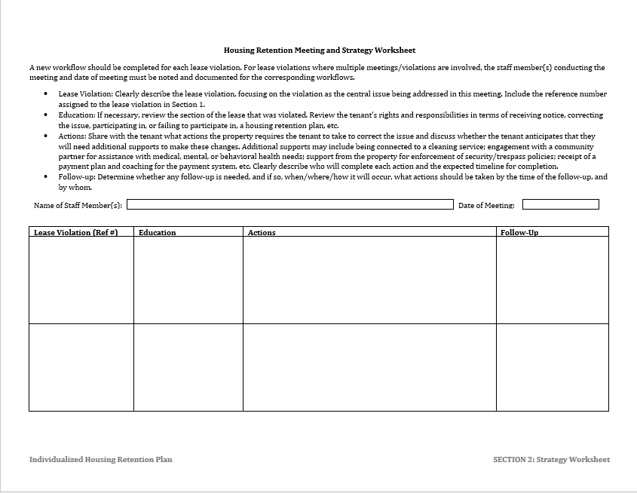
Jodie Foster
10/1/25
Reviewed debt with tenant. Discussed rent due date and late fees
Tenant agrees to pay $500 balance by paying an extra $100 over the next five months. Will be asking for overtime to get extra income. Tenant will set-up automatic payments
Check-in with tenant on 10/28 to remind them of agreement and upcoming rent due date
2025-1
Notes:
Zach

Slide 17
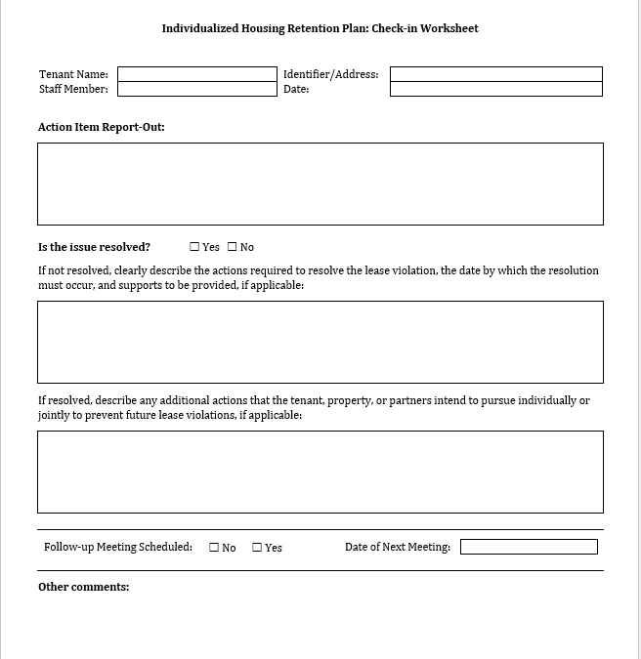
Tom Cruise
Unit 202
Jodie Foster
10/1/25
Housekeeping issues – unit has significant amounts of clutter and garbage causing safety and pest concern.
X
All garbage must be removed from unit before follow-up inspection on 10/15. Tenant is being referred to Mental Health, Inc. for assistance. After inspection, we will discuss status of apartment and next steps.
X
10/16/25 at 2:00 PM
Tenant is willing to work to resolve the issue. Due to the nature of the problem, it will need to be tackled in phases over time. Property will continue to work with tenant as long as we see positive progress
Notes:
Zach

Slide 18
Mitigating Non-Payment of Rent
Understand the issue – why hasn’t the tenant paid rent?
    Can’t vs. won’t pay
Address the issue – what can be done now?
    Walk through rent collection process with tenant (are there multiple ways to pay rent that do not create barriers for tenants?)
    Connect tenant to rental assistance or legal aid programs
    Create housing retention plan that describes the meeting, education efforts by the property
    Provide payment or re-payment plan options until tenant is caught up, finds new employment, etc.
    Early on, talk to tenant about the importance of communicating early with landlord when income changes
Notes:
Lia
Facilitator Guide:
1st issue I talked about as a risk for eviction:
I'm going to briefly touch on some strategies to temper some of these risks for eviction.
Let's talk about non-payment of rent. If you know that a tenant missed a payment but you don’t respond promptly, risk for eviction skyrockets.
First step is to truly understand why the tenant portion of the rent has not been paid. This dictates how you will work with both the tenant and the landlord.
One is they can’t pay
Financial reasons (too expensive)
Other debts (utilities, cell phone)
Personal reasons such as life being too chaotic—they may be struggling with serious physical or behavioral health symptoms
Other financial management issues
The next is they Won’t pay.
Tenants wants money for other things
Tenant thinks they shouldn’t have to pay
Grievance with landlord
Unhappy with unit (need repairs, location, safety)
Regardless of whether there is separate property management, or the service provider and property management are one in the same, the property management staff enforces the lease, NOT the service provider.
However, unlike in traditional housing, when the provider is also the property manager typically they allow for more flexibility when a tenant falls behind on rent.
As providers It is important to act quickly, with compassion, and ideally available resources.
So what do you do? Traditional route is for both PM and SS to work together with the tenant negotiate a payment plan, a tool which allow a tenant to pay back rent in installments.
Housing providers can be flexible when a tenant provides evidence that they are seeking outside resources to assist with back rent. For private landlords, sometimes just showing an effort to catch up on rent is enough to keep a landlord from filing for eviction.
Be assertive and consistent from the outset. Be clear with all parties that clients tenants are responsible for their rent. It is important that amounts and timescales set out in any repayment plans are realistic
This info can also be a part of a toll called a Housing Support Plan which will talk about in a minute
Consider a Rep Payee- a helpful tool for those with recurring payment issues. Some of your organizations, or other organizations in your community often offer this service, and when it is done well, it allow the tenant to get additional budgeting support and still maintain some control over their income—but makes sure rent is paid on time.
Lastly accessing agency, community, or state resources to assist with arrears. I find as budgets continue to tighten across the board, these resources are becoming more an more scarce in communities, so providers are becoming more and more creative, and really supports the idea for many reasons to avoid an arrearage situation that can turn to quicksand quite quickly.

Slide 19
Mitigating Tenant Actions & Guest Issues
Notify/revisit with tenant their lease obligations, quiet hours, community expectations, etc. that they might not be aware of
Is it a safety or accessibility issue? Explore moving to a new unit or enforcing trespassing rules
Has household composition changed? Discuss options for an amendment
If applicable, connect tenant to community partners who can provide support for specific issues
Create a housing retention plan that describes the meeting, issues addressed, and solutions to be pursued moving forward
Notes:
Lia
Facilitator Guide:
Okay, lets talk about behaviors that are disruptive to the apartment, neighbors, and landlord experience: So complaints about the behavior of the tenant, noise, illegal activity, etc.
First step is to talk to tenant-Early intervention to address the issue will show both the landlord you take their concerns seriously and the tenant that they should take it seriously.
Revisit agreements- Go through the lease agreement and any communication agreements and ensure everyone, specifically the tenant understand their responsibilities. Remind the tenant they are at risk of losing the unit- work into a housing support plan
Schedule a mediation meeting- behavior issues are sometimes resolved by talking them through and coming up with alternatives that are acceptable to all parties.
Guests:
Help tenants define:
Who can visit?
When can they visit?
For how long?
What behavior is okay?
What can you do if people break your ‘house rules’?
Teach refusal skills
Partner with services and landlord to create “visitor plan or schedule”

Slide 20
Mitigating Neglect or Damage to Unit
If applicable, connect tenant to community partners who can provide support with maintain unit or other challenges driving this behavior
Agree on periodic unit inspections
Discuss payment plan for damages, if applicable
Create housing retention plan the describes the meeting, issues addressed, and solutions to be pursued and by whom moving forward
Notes:
Lia
Facilitator Guide:
Lastly, thinking through dealing with neglect or damage to the unit:
The best cure is prevention. Providers should support tenants in documenting any existing damage to the unit at move-in. Landlords cannot claim tenant responsibility for existing issues.
Additionally, providers should be in the unit regularly to review the condition, health, and safety. Regularly will vary depending on your program, funding source etc. In CT, our state funded PSH providers are required to document evaluating the health and safety of the unit every 6 months. LLs and PMs should communicate any damage or neglect issues to tenant and service provider (with appropriate release) as soon as they are discovered so that they can be addressed immediately.
If damage to the unit occurs, carry out an assessment of the client needs and arrange for additional/alternative care if circumstances have changed.
If client has neglected the issues, this could be the prompt that they need. Work repairing damage or reversing neglect into service plan (if tenant willing). Can you negotiate tenant repayment for damages? Does your agency have any flexible funding for small repairs that may preserve the tenancy/ relationship with the landlord?
If neglect occurs due to client disability, consider Reasonable Accommodation request. They may need additional property management assistance to look after the unit, such as help taking out the trash. HUD has some pretty clear guidance and resources on RA if you want/need some additional information

Slide 21
Lease Violations and Substance Use
Substance use alone may not be a lease violation*, but can lead to actions by tenants that violate the lease (noise, guests, etc.)
Property Management can focus on the lease violation and how the tenant will resolve it, as opposed to naming substance use as the violation, which could be an assumption or value statement/judgement.
If applicable, connect tenant to community partners who can provide support for specific issues
* Except in instances when illegal drug/substance use activity is clearly occurring, and property manager has proof of such
Notes:
Lia
Facilitator Guide:
Lastly, thinking through dealing with neglect or damage to the unit:
The best cure is prevention. Providers should support tenants in documenting any existing damage to the unit at move-in. Landlords cannot claim tenant responsibility for existing issues.
Additionally, providers should be in the unit regularly to review the condition, health, and safety. Regularly will vary depending on your program, funding source etc. In CT, our state funded PSH providers are required to document evaluating the health and safety of the unit every 6 months. LLs and PMs should communicate any damage or neglect issues to tenant and service provider (with appropriate release) as soon as they are discovered so that they can be addressed immediately.
If damage to the unit occurs, carry out an assessment of the client needs and arrange for additional/alternative care if circumstances have changed.
If client has neglected the issues, this could be the prompt that they need. Work repairing damage or reversing neglect into service plan (if tenant willing). Can you negotiate tenant repayment for damages? Does your agency have any flexible funding for small repairs that may preserve the tenancy/ relationship with the landlord?
If neglect occurs due to client disability, consider Reasonable Accommodation request. They may need additional property management assistance to look after the unit, such as help taking out the trash. HUD has some pretty clear guidance and resources on RA if you want/need some additional information

Slide 22
Stages of Eviction Prevention and Opportunities for Diversion
Alternatives to Eviction
If the housing retention plan has been unsuccessful and the tenant can no longer reside at the property, consider alternatives to eviction:
Non-renewal of lease
Early lease termination with other housing identified, if possible
Problem solve with tenant (and service provider) other short-term options to help keep tenant from experiencing homelessness
Conversion to tenant-based voucher
Considerations:
How often and under what circumstances will alternatives be considered?
Who will make the decision to offer an alternative?
What action plan can the team create to ensure housing stability upon departure?
Notes:
Lia

Slide 23
Stages of Eviction Prevention and Opportunities for Diversion
Formal Eviction/Eviction Prevention Protocol
If the strategies pursued in the housing retention plan are ultimately unsuccessful, the tenant’s departure is necessary, and informal eviction avenues have been pursued/eliminated:
Consider establishing an Eviction Prevention Committee to review cases on an individualized basis, ensure organizational protocol was followed, hear appeals, and make recommendations for resolutions.
The Eviction Prevention Plan should:
Transparently describe the process for initiating an eviction
Detail the appeals process, which includes documentation and all possible resolutions (mediation or arbitration avenues, legal aid eviction prevention programs, etc.)
The role and responsibilities of an Eviction Prevention Committee
Comply with all mandatory legal requirements and notices, Fair Housing, VAWA, and related nondiscrimination requirements
Notes:
Lia
All possible resolutions: mediation or arbitration, legal aid/eviction prevention programs, etc.
Emphasize that the eviction prevention committee is a good accountability mechanism → least biased party in the EP process, can view trends over time in diversion tactics, racial equity lens
Some roles of the eviction prevention committee could include reviewing all eviction cases where no alternative could be found, only hearing appeals, making final decisions or only making recommendations, semi-annually or annually reviewing all eviction cases, so this would include the housing retention plan documentation, to ensure that the property’s protocol is being uniformly followed and if any changes need to be made. It’s interesting to continuously review these cases to see if all staff are applying protocols equally, if there’s bias towards any groups of people, etc.
The process should be accessible and straightforward, and supportive services should be offered to tenants on the day of the appeals/eviction hearing.
You should be very conscious to ensure that your process is not so confusing or burdensome that tenants are inclined to just allow the eviction to go to judgment or to give up, especially if they really think they’re in the right. Remember, we are trying to prevent an eviction from going on the record AND affording these tenants all the rights and considerations of any other tenant.

Slide 24
Sample Protocol
Lease violation occurs
Property Manager and/or Case Manager speak with tenant about issue
Lease violation continues to occur
Property Manager issues notice of lease violation
Meeting occurs to discuss lease violation; if all parties are not confident that tenant can resolve issue independently or with services, housing retention plan is created
Property Manager, service partner, and Tenant meet according to schedule described in housing retention plan
  Team determines whether sufficient change has occurred – have any additional issues arisen? What has been the severity?
  If the issue isn’t resolved but is improving or not worsening, what additional supports can be in place with additional time?
If additional lease violations occur and no remedy is found, property may proceed with eviction or identifying alternative housing solutions
Resident appeals process
Notes:
Zach
We are often asked how this process aligns with fair housing. As long as you are offering the same process to all residents (exception-emergency evictions)-where you issue a warning/violation and they work with you on how to remedy, and you document then you are fine.
Lia-describe a scenario that would start out the same with 2 tenants but then “split” based on tenant involvement, etc.

Slide 25
Putting Eviction Prevention into Practice
Putting Eviction Prevention into Practice
Common Pitfalls
Opportunities
Feeling overwhelmed
•
Stick to the process while identifying areas for future
improvement
There is a tendency to want to abandon the
•
Remind yourself that this is why you
made a plan
process when you are dealt with a truly
•
Think outside the box to identify possible solutions
difficult case
•
Get on the same page with your project team and ask for
input from outside parties
Feeling that improvement is impossible
•
Get together with your project team and decide the
smallest improvement you will accept to show progress and
“How could this ever get better?”
work with the tenant to implement a plan
“I don’t know how to help them”
•
Celebrate every accomplishment. Everything you do keeps
people housed
•
Have a long view. Sometimes it takes time to see progress
Skepticism that the plan will not allow you to
•
Trust your plan and trust your partners
respond in dangerous situations
•
Sometimes eviction is the only option for the safety of
everyone else at the property.
As long as
your plan covers
this, you have nothing to worry about
Notes:
Zach

Slide 26
Eviction Prevention – 2026-2027 QAP
Eviction Prevention Plan – 2 Points
Two points will be awarded if the Applicant commits to creating an Eviction Prevention Plan for the property. A qualifying Eviction Prevention Plan must be drafted prior to initial lease-up and submitted to IHCDA for review and approval. The plan must address how the property will implement management practices that utilize eviction only as a last resort and must describe strategies that will be taken with tenants on an individualized basis to attempt to prevent evictions when issues arise. The plan will be reviewed as part of IHCDA ongoing compliance monitoring to ensure it remains in place. In addition, the Applicant must agree to submit data on evictions as part of the Annual Owner Certification of Compliance reporting.
Prior to lease-up and issuance of Form 8609, the owner must receive a letter from IHCDA approving the eviction prevention plan. This approval letter must be submitted with the Final Application. IHCDA will not issue 8609s until the eviction prevention plan has been approved.
Note: Eviction prevention plans are required for all IHCDA-funded PSH developments
Notes:
For properties that received these points in the QAP. This was added in the 2020-2021 QAP. Make sure you are compliant with this and maintain an eviction prevention plan for your property if required. If you submit plans please communicate anticipated lease-up so we can prioritize accordingly

Slide 27
Eviction Prevention Plan Review
IHCDA Eviction Prevention and Low-Barrier Screening Webpage
Template Eviction Prevention Plan
Template Housing Retention Plan
Webinar Recording
Plans should be submitted to EvictionPrevention@ihcda.in.gov
When reviewing an eviction prevention plan, IHCDA/CSH looks for:
  Property-specific information, not general company-wide policy
  Clear and robust strategies for avoiding eviction
  Staff positions responsible for reviewing and approving potential evictions
  Potential for eviction-avoidance at every step of the process
  Housing retention planning is incorporated
If the plans don’t contain all necessary components, we will send them back with requested changes. This process may repeat several times before IHCDA or CSH gives final approval.

Slide 28
Questions or Thoughts?
Notes:
Zach

Slide 29
Resources And Contact Information
IHCDA Eviction Prevention and Low-Barrier Screening Webpage
Template Eviction Prevention Plan
Template Housing Retention Plan
Webinar Recording
Please reach out to us if you want to receive input on developing an eviction prevention plan or if you would like help brainstorming solutions to avoid an eviction
Lori Phillips-Steele CSH
Director, Indiana Program
Lori.phillips-steele@csh.org
Zach Gross, IHCDA
Supportive Housing Manager
zagross@ihcda.IN.gov
Notes:
Zach

