Slide 1
Indiana Affordable Housing Conference
LIHTC Operating Expenses
August 27, 2025

Slide 2
Sample size and categories
Results from IHCDA survey, Cinnaire, and CREA
total of 242 properties (35%), including 17,354 units (34%)
Operating Expense Increases for Insurance, Property Taxes, & Utilities
Comparisons of current Expenses within:
Occupancy Type
    Multifamily
    Age Restricted
    PSH
Construction Type
    New Construction
    Rehab
Project Size
    <60 units
    60-199 units
    200+ units
Location
    Urban
    Rural

Slide 3
insurance
$613
Average PUPY Cost 2024
$187-989
Range
12,697 units

Slide 4
Property Taxes
5,042 - 9,019 units
*No PUPY due to differences in reporting

Slide 5
Utilities
4,645 - 7,931 units
*No PUPY due to differences in which utilities are owner paid

Slide 6
Pupy expenses by Occupancy type
*includes all 17,354 units
Notes:
Median in survey = $7,830
Range $4,258-$13,062
Does not include Affordable Assisted Living

Slide 7
PUPY Expenses by construction type
*includes 9,882 units
Non-sufficient data for Adaptive Reuse or Historic Rehab
Notes:
Average is typically within the range of all categories. Adaptive Reuse and Historic Rehab likely push the average higher.

Slide 8
Pupy Expenses by project size
*includes 12,588 units

Slide 9
Pupy Expenses by location
*includes 9,606 units

Slide 10
National Comparison from Novogradac
Novogradac oversees 175,000 LIHTC homes across the US.
Compounded Annual Growth Rate for 2016-2023
Income – 4.6%
Expenses – 6.5%
NOI – 2.1%
Nationwide, Metro locations operating expenses were 59.3% of income versus 65.2% in Rural locations
Operating Expenses were 70.9% of income in Midwest compared to 61% of income nationwide
Nationwide, Acq-Rehab operating expenses were 56.4% of income versus 61% for New Construction
Likely due to Acq-Rehab being in metro
areas, larger apartments, & rental subsidy
Notes:
CAGR 2023 Increase
Prop Insurance 13.6% 22.2%
Maint/Repairs 8.3% 10.5%
Utilities 5.4% 8.7%
Admin 5.0% 6.3%
Mgmt Fees 4.9% 6.3%
Payroll 4.9% 7.3%

Slide 11
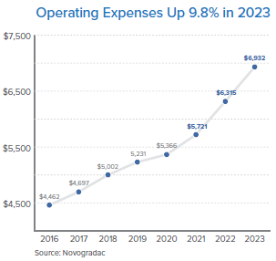
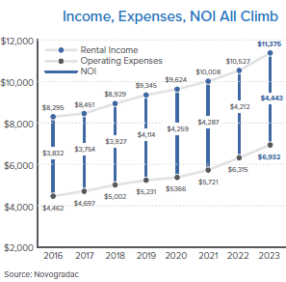
National Comparison from Novogradac
Notes:
2023 Net increase
Income 8.1% $848
Expenses 9.8% $617
NOI 5.5% $4,443 (record high NOI in these eight years)

Slide 12
Topics for discussion
How have you responded as owners and property managers to these rising expenses?
How will you take these increases into account as you prepare proformas for future developments?
Have you tried any innovative methods to reduce insurance premiums?
Each year, 25-40% of properties (included in the survey) had their property taxes lowered.
Have you requested an audit of your property’s assessed value or tax bill?
Novogradac recommends using current excess operating income for efficiency upgrades, such as low-flow toilets, high efficiency HVAC & appliances, etc. Have you as owners and property managers had good experience with these options?

Slide 13
Future opportunity:
We would like to gather a much more comprehensive history and analysis of the LIHTC properties in Indiana.
We are looking into using IRS Form 8825 for more complete, consistent, and accurate information.
What ideas do you have to allow this to happen? What concerns might you have about this process?

Slide 14
Thank you for participating in today’s discussion!

Slide 15
Stephen Enz senz@ihcda.in.gov
Kevin Tsoi ktsoi@ihcda.in.gov

Slide 17
Insurance Companies
Companies currently being used:
AJ Gallagher
American National
Assured Partners
*Auto-Owners Insurance
Central Insurance
CV Starr
Erie Insurance
Great America Assurance
Hub
*Philadelphia
State Auto
Traveler's Insurance
Virtus
Companies switched from:
*Auto-Owners
Cincinnati Insurance
EPIC
Lloyds of London
NFP
*Philadelphia
Selective Insurance

