Slide 1



State of Homelessness in Indiana
Abe Roll (he/him), HMIS Data Narrator, Coalition for Homelessness Intervention & Prevention
Abigail Kornberger (she/her), HMIS Data Analyst, IHCDA
Daniella Jordán Gonzales (she/her), HMIS Data Analyst, IHCDA
August 27th, 2025
Notes:
Daniella – Hello and welcome to the first Indiana Balance of State Continuum of Care session at the 2025 Indiana Housing Conference. My name is Daniella Jordan Gonzales, and along with Abe Roll and Abigail Kornberger, we will be presenting our session titled State of Homelessness in Indiana. This session is a partnership between the Indianapolis Continuum of Care, the Indiana Balance of State Continuum of Care, the Coalition for Homeless Intervention and Prevention, and the Indiana Housing and Community Development Authority. This presentation aims to provide a picture of what homelessness looks like in our state so we can think of ways to help address the housing crisis in our communities.
We want to get a sense of our audience, would you Raise your hand if you are:
Homeless services
Affordable Housing
Thank you.

Slide 2


Two Organizations – One Goal
An organization that “leverage(s) public and private funds to invest in financially sound, well-designed projects that will benefit communities for many years to come.”
  HMIS Lead
  Collaborative Applicant
  Coordinated Entry Lead
IHCDA
Indiana Housing and Community Development Authority
An organization that “Partners with the Indianapolis community to advance a shared vision to end homelessness by inspiring collective action and advocating for permanent housing solutions.”
  HMIS Lead
  Coordinated Entry Lead
  Project Management
CHIP
Coalition for Homelessness Intervention and Prevention
Notes:
I want to start by saying that this is the first time that IHCDA and CHIP collaborate to create a presentation on what we learned from the Point-IN-Time and Housing Inventory COunt

Slide 3

Introductions
- CHIP HMIS Data Narrator (2.5 years)
- Loves a solid dashboard or newsletter
- Cannot cook but knows the restaurants!
- IHCDA HMIS Data Analyst (1 year)
- Passion for the intersection of health and homelessness
- I love to read (7,000 pages this year)
- IHCDA HMIS Data Analyst (6 yrs.) M.S.D.A
- Mom to a son, a cat, and a dog
- Loves watercolor and making crafts
Abe Roll
Abigail Kornberger
Daniella Jordán Gonzales
Notes:
Daniella – Now, I will let Abe and Abigail present themselves.
(Abe and Abigail present themselves)
Hi! My name is Daniella Jordan Gonzales, and I have been an HMIS Data Analyst for almost 6 years at IHCDA and I graduated with a Masters in Data Analytics from Butler University a couple of months ago.
I am a mom to my toddler, a cat, and a dog, ad we have lots of fish at home that my husband loves.
When I am not thinking about numbers and data analysis, I love to spend time using my hands to do watercolor and make all sorts of fun little projects.

Slide 4
Agenda
Data: Who Is and Is Not Counted in the PIT Count
What Is the Point-IN-Time?
Numbers Represent People
PIT Analysis
Resources
HIC Analysis
Beyond the PIT and HIC
Notes:
Daniella -

Slide 5
Where Does the Data Come From?
HMIS
Homeless Management Information Systems
DV
Domestic Violence comparable systems
HUD Federal Reports Archive
HIC, PIT, LSA, SPM
HIC: Housing Inventory Count
PIT: Point-IN-Time Count
LSA: Longitudinal System Analysis
SPM: System Performance Measures
Notes:
Daniella – Before we start talking about the state of homelessness, let’s talk about the sources we used to paint a picture of homelessness in our state.
The 3 main source groups we used are:
The HMIS or Homeless Management Information System. This is a system that all HUD-funded projects must use to do intakes for their clients that stores data about how the people they serve move through the homeless response system in the state.
The Domestic Violence ClientTrack or comparable data system, is like HMIS with the exception that DV ClientTrack is a closed system, meaning that people outside of the organization that generate a record, do not have access to that record.
Finally, there are four federal reports submitted to Congress as part of the AHAR or the Annual Homeless Assessment Report. These reports are:
The Housing Inventory Count tracks the number of projects and beds to serve people experiencing homelessness
The Point-IN-Time tracks the number of people experiencing homelessness in one point-in-time
The Longitudinal System Analysis tracks how long households remain homeless, the percentage of households that return to homelessness after a period, and the percentage of people exiting to permanent destinations
And the System Performance Measures that evaluates how the homeless response system performs in serving individuals experiencing homelessness based on 7 measures including the number of first-time homeless, the number of sheltered homelessness, and the length of time a person remains homeless
We also used Census data as well as other resources that will be mentioned later in the presentation to give context to our data.

Slide 6
HUD’s Definitions of Homelessness
Literally Homeless
Living somewhere not meant for habitation or in a shelter
Category 1
Category 2
Imminent Risk
Can be reasonably assumed to be homeless in the next 14 days AND no resources to obtain new housing
Category 3
Runaway and Homeless Youth
Unaccompanied youth under the age of 25 or families with children and/or youth who do not otherwise qualify as homeless
Category 4
Fleeing Domestic Violence
Individual or family considering, attempting to, or fleeing domestic violence AND has no other residence or the resources to obtain housing
Notes:
Daniella
Like the broad examples of what comes to mind when we talk about Housing Insecurity, there are many definitions of what homelessness can look like.
There is informal homelessness, like when someone is couch-surfing or doubled up (or staying with another friend or family), in a hotel/motel while between permanent housing options, or other unique circumstances.
The Department of Housing and Urban Development maintains four categories of homelessness. These can include literal homelessness (staying somewhere not meant for human habitation or in a shelter) or being at imminent risk of homelessness (can be reasonable assumed to be homeless in the next 14 days and lacking resources to obtain new housing. Category three means homeless under other federal statutes (such as the McKinney Vento definition) where someone who meets another federal homeless definition may qualify as homeless under this category. In Indiana, this largely refers to runaway and homeless youth under the age of 25. Importantly, the final Category of HUD’s definition of homelessness is for individuals fleeing domestic violence (including those considering or attempting to flee).

Slide 7
Who is – and is not - Included in the PIT?
Included (Federal Definition of Literally Homelessness)
Emergency Shelters (crisis shelters)
Transitional Housing (longer term shelter)
Unsheltered Neighbors (streets, cars, abandoned buildings)
Excluded
Couch-surfing
Overcrowding
Hospital Stays or Incarceration
Temporary Hotel Stays
Student Homelessness
Domestic Violence (outside of shelters), Human Trafficking, Survival Sex
Permanent Supportive Housing, Rapid Rehousing, Recovery Housing
Individuals who decline participation in the PIT survey
Note: PIT Counts capture data for individuals meeting the US Department of Housing and Urban Development’s definition of homelessness. Other federal departments (e.g., the US Department of Education) have different definitions.
Notes:
Daniella
So, who is and is not included in the Point-IN-Time count?
People who are included in the PIT must be Literally Homeless per HUD’s definition. This includes people sleeping in crisis shelters and long-term shelters as well as places not meant for human habitation on the night of the count.
On the other hand, people who were couch-surfing, hospital stays or incarceration, people in doubled-up situations, student homelessness, DV survivors not staying in shelters, people in housing projects such as PSH, RRH or Recovery Housing, and people who decline to participate in the count are excluded from the count.
Now that you know where the data comes from and who is and is not included in the Point-IN-Time count, I will pass it on to Abe to talk more about what the PIT count is. Abe.

Slide 8






What is the Point-IN-Time Count?
Balance of State Jan. 29th, 2025
Indianapolis CoC Jan. 22nd, 2025
94%
Annual
Census
Federal
Report
AHAR
Last 10 days
in January
of the population of Indiana represented
Surveys
and HMIS
227
Participating organizations
587
Volunteers
Notes:
Abe
With that context of who is included, want to talk about how we get this data and why it’s collected. At a high-level, the Point-in-Time or PIT Count, is a federally mandated census of everyone in a community experiencing homelessness. Community’s who receive federal continuum of care grants for their homeless response system are required to do a PIT count in the last 10 days of January. And this is a requirement tied to federal funding, because all the data collected is part of the Annual Homeless Assessment Report, which is presented to Congress to inform determine housing and homelessness policy.
In Indiana, there are two PIT counts: the Indianapolis+Marion County PIT Count was January 22, while the balance of state (the remaining 91 counties) took place on the 29th. Based on county participation, as a State we had about 94% of Hoosier population represented. This data came from two sources – it was electronically submitted through the response system database, and there were also surveys conducted for unsheltered residents.
And across the state, this is an extremely collaborative effort each year. We had nearly 600 volunteers and over 220 unique organizations involved in helping ensure we have the data you’ll see today.

Slide 9
Housing is a human need and right.
Data presented today reflects real, sacred human lives.
Notes:
Abe
And before we get into the numbers themselves, I want to ground us in the why. These aren’t just numbers and charts, these are actual Hoosiers, real human lives. And every single person reflected in today’s numbers both need and deserves housing. Which is why we are all here today.

Slide 10




PIT: More Than Just a Count
Connection to services
Reunification of runaway youth
Medical care services
Mental health responders
Notes:
Abe
To that end, I want to reemphasize that this isn’t a simple “1, 2” count. It is a community effort to connect with folks experiencing homelessness. And each community collects the same essential information, but does it a little differently – some use it as a time to get folks connected to services, like medical or mental health care. Some use it work on getting folks housing resources. So, we see a lot of people and hear a lot of stories.
Some of the stories really do our hearts good. In the 2024 Count, a team surveying in Indy met a young teen who had run away from an unsafe living situation. They were able to work with the teen to get them connected to care, and ultimately, they reunified them with grandparents and into safe housing. So that teen was not included in the numbers for that year’s PIT because of that work.
Other stories aren’t so uplifting. In this year’s PIT, a team was surveying and met a man who had not been admitted to the hospital but was sleeping in the lobby to have a warm place to stay. They tried to get him connected to shelters and warming centers, but every single bed that he was eligible for was full. They had to drop him back off at the hospital on a cold, Indiana January night because there was literally nowhere else for him to go.
And I tell these two stories in the hopes that, as we talk about numbers and trends, we all hold to the truth that every single person has their own story, and those stories can and should address how we inform how we address homelessness.
[turn over to Daniella]

Slide 11









Snapshot of 2025 PIT Result
5,143 individuals in sheltered locations
At least 6,675 individuals
At least 1,532 people in unsheltered locations
Notes:
Daniella
On one point-in-time in January 2025, there were at least 6,675 people experiencing homelessness in Indiana. Of those, at least 5,143 individuals were sleeping in sheltered locations and at least 1,532 individuals were sleeping in unsheltered locations.
These individuals are not necessarily the same people year over year. Many of them are first time homeless or chronically homeless individuals. People experiencing homelessness are families with young children, youth, people with disabilities, young and middle-aged adults, single mothers/fathers, and elderly people. In other words, people experiencing homelessness look like many of us; they are among us and they deserve to be seen.

Slide 12
The number of individuals experiencing homelessness in Indiana reached a new high in 2025 increasing by 19.1% since 2019.
Notes:
Daniella
The number of people experiencing homelessness in Indiana has been on the rise for the last few years, with state numbers increasing by 19.1% between 2019 and 2025.
Although the IN-BoS saw a higher percentage change in the number of people experiencing homelessness between 2019 and 2025, they saw the smallest change in their numbers between 2024 and 2025 compared to the state and to the Indianapolis Continuum of Care at 5.5% compared to 5.9% and 6.7% respectively.
There was an increase in state PIT count of 10.4% between 2022 and 2023, 4.8% between 2023 and 2024, and 5.9% between 2024 and 2025
There was an increase in BoS PIT count of 19.3% between 2022 and 2023, 4.7% between 2023 and 2024, and 5.5% between 2024 and 2025
There was a decrease in Indy CoC PIT count of 8% between 2022 and 2023, an increase of 5% between 2023 and 2024, and an increase of 6.7% between 2024 and 2025
CHIP 2024-2025 more comprehensive
Indy:
2019 – 1567
2020 – 1588
https://www.huduser.gov/portal/sites/default/files/pdf/2024-AHAR-Part-1.pdf – source for getting national PIT numbers
Between 2009 and 2024, national PIT numbers increased by 22.4% and BoS numbers increased by 13.4%

Slide 13
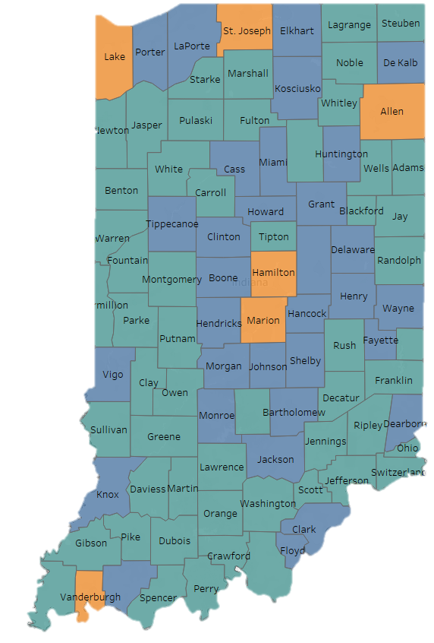

Rural counties saw an increase of 16.6% in the number of people experiencing homelessness between 2023 and 2025, higher than urban counties that saw an increase of 9.4%.
Notes:
Daniella –
Despite numbers rising in Marion Co., it is worth looking at rural counties since they represent 54 out of 92 counties in the state. To identify rural vs semi-urban vs urban counties, we used a metric called Index of Relative Rurality. What we found is that despite numbers of people experiencing homelessness in rural counties are small compared to semi-urban and urban counties, they saw an increase of 16.6% in the PIT count compared to an increase of 9.4% for urban counties.

Slide 14
Increased efforts in outreach and awareness are making it possible to have a more accurate picture of what unsheltered homelessness looks like.
Notes:
Daniella –
Another way to look at the Point-IN-Time count is to differentiate between people who were sleeping in shelters vs people who were sleeping in unsheltered locations on the night of the count.
Between 2023 and 2025, the sheltered count increased by 5.9% whereas the unsheltered count increased by 31.9%. This means that between 2023 and 2025, there were almost 6 more people for every 100 people sleeping in sheltered locations, and there were almost 32 more people for every 100 people sleeping in unsheltered locations.
However, it is important to notice that between 2024 and 2025, the sheltered count increased at a higher rate than the unsheltered count. To understand why the unsheltered count increased by 29% between 2023 and 2024 and by 2.3% between 2024 and 2025, we need to provide some context.
In 2023 more people were losing shelter due to ESG-CV funded shelters closing, rental assistance programs ending, and more people feeling more comfortable being volunteers on the night of the count, which could explain the big jump.
The slight increase in the number of unsheltered individuals between 2024 and 2025 could suggest that increased efforts in outreach and awareness are making it possible to have a more accurate picture of what unsheltered homelessness looks like.
- After covid we have folks not wanting to go back to a shelter again
People
Unsheltered vs. sheltered
Household makeup/composition
family vs. single adults HHs
Year over year trends

Slide 15






Why Beds May Not Be Utilized
Families split between different projects or agencies
Geographical barrier or lack of transportation
Personal choice or not the right fit
Chronic health conditions/individualized medical needs
Potential high-barrier requirements
Pets
Notes:
Daniella
Talking about the unsheltered count is an important topic, but it is key to understand that there are many reasons why someone might not enter a shelter, project, or program. Some of those reasons are shown on the screen:
The program may serve a specific population and might require a household to split between different projects or agencies.
A Geographical barrier or lack of transportation may impact an individual’s decision
Sometimes someone remains in an unsheltered location due to difficulty finding a program or bed that allows their pet to reside with them.
Certain programs or shelters might have higher-barrier enrollment requirements
Or it could simply be a matter of personal choice or that the shelter, project, or program is not the right fit for them.

Slide 16



PIT Analysis Takeaways
The number of people experiencing homelessness reached a new high in 2025 with at least 6,675 people counted in Indiana
More than half of the counties in Indiana are rural. Rural counties saw an increase of 16.6% in their homeless count between 2023 and 2025, higher than non-rural counties.
More outreach and awareness are helping paint a more accurate view of unsheltered homelessness throughout the state.
Notes:
Daniella

Slide 17
The PIT fails to capture unstably housed youth, couch surfers, or youth in doubled-up situations. This makes youth homelessness seem insignificant, when it is a significant issue.
Notes:
Daniella - People
Unsheltered vs. sheltered
Household makeup/composition
family vs. single adults HHs
Year over year trends
Youth homelessness is different than adult homeless
Indianapolis
2023
A+C – 424
CO -
AO -
2024
A+C – 419
CO – 3
AO – 1279
2025
A+C – 491
CO – 2
AO – 1322
Working on pulling the original data for families w/o children.

Slide 18
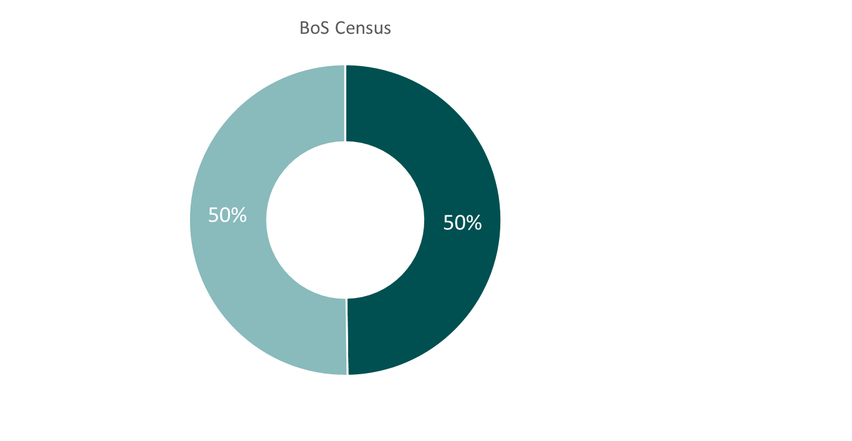

Men and Boys were Overrepresented in Indiana’s 2025 PIT Data, Compared to the Overall Population
Indiana Census
Notes:
Abe
As we’ve talked about where folks are experiencing homelessness, I want to talk about the who, the demographics of the 6000+ folks we’re talking about.
Other was not a collected field for the 2023 ACS survey.
Indy 2025
Gender Diverse – 22 (1%)
Men + Boys – 1102 (61%)
Women + Girls – 691 (38%)

Slide 19
In 2025, Hoosiers Aged 35 to 44 Years Old Were the Most Overrepresented Age Group on the Night of the Count
Indiana Census
Notes:
Abe
These visuals are showing the breakdown by age of the folks who were in the 2025 PIT count, compared to census estimates. The biggest overrepresentation here is among Hoosiers between the age of 35 and 44. About 12% of all Hoosiers are between age 35 and 44, but 21% of folks experiencing homelessness were in that range on the night of the Count. We also see some slight overrepresentation in folks who are age 25-24 or between ages 45-64.
It is important to note here, that the underrepresentation for youth and young adults age 24 and below is likely due to the nature of youth and young adult homelessness. Very transient population, does not lend itself to single night snapshots as readily.
Indy 2025
Under 18: 316 (17%)
18 – 24: 134 (7%)
25 – 34: 297 (16%)
35-44: 390 (21%)
45-54: 286 (16%)
55-64: 302 (17%)
65+: 90 (5%)

Slide 20
Hoosiers of Color, Especially Black Hoosiers, Were Overrepresented on the Night of the Count
Notes:
Abe
Indy 2025
Black or African American (alone): 1000
White Alone: 626
Hispanic or Latino only: 52
Hispanic or Latino + another race: 29
Multiracial (non-Hispanic/Latino): 40
Multiracial + Hispanic/Latino: 28
Other single race: 40

Slide 21
We Are Seeing More Hoosiers with Long-Term Homelessness and at Least One Disabling Condition.
Notes:
Abe
Another population that PIT Counts look at is folks experiencing chronic homelessness. What this is folks who are experiencing long-term homelessness, as well as a disabling condition (e.g., a chronic health condition such as cancer or diabetes). As you can see here, there was an increase in this experience of homelessness across the state. This means we have more people experiencing homelessness who have done so for a long time, and they have some kind of condition that makes getting and staying in a shelter or housing unit more difficult.
24% increase for Indy
52% increase for BoS

Slide 22
Indiana is Successfully Reducing Homelessness Among our Veterans
Notes:
Abe
It is not all sad news. Indiana has done a particularly excellent job at reducing homelessness for our veteran population. While nationally, homelessness is on the rise, here in Indiana we have seen a reduction in veteran homelessness since COVID. The Balance of state has seen a 29% reduction, and Indianapolis has seen a 54% reduction. This is largely due to the fact that Indiana’s veteran service providers do really exemplary work, and this makes them even more competitive for veteran-targeted funding, which helps them to further scale the excellent work they are doing.
So do keep that in mind – when folks are doing excellent work, and there is funding they can go for that helps them scale and sustain that work, Indiana gets results.
Funding pays off – this is what fully funding a program looks like
[Turn to Abigail]

Slide 23
Why Beds May Not Be Utilized
Families split between different projects or agencies
Geographical barrier or lack of transportation
Personal choice or not the right fit
Chronic health conditions/individualized medical needs
Potential high-barrier requirements
Pets
Notes:
Abigail
Talking about bed utilization is an important topic, but it is key to understand that there are many reasons why someone might not enter a shelter, project, or program. To reiterate,
The program may serve a specific population and might require a household to split between different projects or agencies.
A Geographical barrier or lack of transportation may impact an individual’s decision
Sometimes someone remains in an unsheltered location due to difficulty finding a program or bed that allows their pet to reside with them.
Certain programs or shelters might have higher-barrier enrollment requirements
Persons with chronic health conditions or individualized medical needs may wish to avoid congregate living settings.
Or it could simply be a matter of personal choice or that the shelter, project, or program is not the right fit for them.

Slide 24
Housing Inventory Chart Snapshot
13,850 Total Beds
12,976 Year-round Beds
195 Organizations
366 Projects
284 Projects HMIS or DV Comparable Participating
5,143 Sheltered Count
(ES, TH)
82% Year-round Bed Utilization
(ES, TH, PSH)
Notes:
Abigail
This is a snapshot of the 2025 Housing Inventory Chart results for the State of Indiana.
We can see that there were 13,850 total beds. 12,976 of these beds being available throughout the entire year.
195 organizations and 366 projects were included on the HIC this year. 284 or 78% were HMIS or DV Comparable database participating. 82 projects being those not currently participating in either environment but were identified as serving individuals experiencing homelessness in your communities.
The total sheltered count for ES and TH projects was 5,143. We will look at this number with PSH projects included later in the presentation.
We also saw an 82% year-round bed utilization rate among ES, TH, and PSH projects across the BoS.

Slide 25
With a total of 12,976 year-round beds, emergency shelter beds make up the majority of project beds
Notes:
Abigail
Looking now at a bed count breakdown across project types. Emergency shelter beds make up the majority of year-round project beds at 5,480 beds. This tells us that that the majority of our beds across the state are serving people with immediate shelter needs.

Slide 26
Seasonal beds are only available during the coldest months of the year (typically November – April) and overflow beds are only available if shelters are at full capacity
737 Seasonal beds
129 Overflow beds
866
Beds that are not available year-round
Notes:
Abigail
You may be asking what is the difference between the total and year-round bed count data. Total bed count includes seasonal and overflow bed counts for TH and ES projects. Seasonal beds are only available during the coldest months of the year (typically November through April). Overflow beds are only available if shelter locations are at full capacity.
In this years HIC, 866 beds were identified as combination of seasonal and overflow beds.
This means that a community may be able to meet their capacity need in January but not have enough beds in June.
For today’s analysis we will be looking at year-round beds to more accurately reflect project capacity outside of the winter months.

Slide 27

The immediate shelter needs of over 5,000 persons were met by the Indianapolis CoC and IN BoS CoC on the night of their PIT
5,143 people in Sheltered Locations (ES and TH)
Notes:
Abigail
Before we take a look beyond the PIT and HIC, I want to highlight the tremendous work that you, our service providers are doing for our unhoused neighbors. On the night of their respective PIT Counts, the agencies that make up our Indianapolis and Balance of state CoCs met the immediate shelter needs of over 5,000 persons.
Without you all there to meet that need these neighbors may have very well been sleeping in places not meant for human habitation.

Slide 28
Looking Beyond the PIT and HIC – Which Programs are Housing Hoosiers
Notes:
Abigail
Now let’s transition into a look beyond the PIT and the HIC at which programs are housing and keeping Hoosiers housed in our communities.

Slide 29

What is Considered a Permanent Destination?
Owned by client
Staying or living with family, permanent tenure
Staying or living with friends, permanent tenure
With ongoing housing subsidy
Without ongoing housing subsidy
Rental by client
Rental by client:
Without ongoing housing subsidy
VASH subsidy
With Other (non-VASH) on going subsidy
Permanent Supportive Housing (PSH) for formerly homelessness persons
Notes:
Before we talk about the positive permanent destination outcomes we are seeing, it is important that we touch on what is a permanent housing destination is as defined by HUD. A permanent housing destination can include any of the situations you see here on the slide. These outcomes range from a client living in a rental or home with or without an ongoing subsidy, a permanent tenure with friends or family, and/ or a placement into permanent supportive housing.
These will be important to keep in mind as we discuss permanent housing destinations next.

Slide 30
Consistently, HH Exiting RRH are Moving into Permanent Housing Destinations
Over 90% housing stability rate seen among RRH clients who exited to PH in Indianapolis CoC over the last five years
Note: reflects RRH clients who exit to PH and remain housed in a year
Source: IN BoS CoC and Indianapolis CoC Longitudinal Systems Analysis (LSA)
Notes:
Abigail
With that understanding of permanent destinations, let’s take a look at a bit of data available to us from our Systems Performance Measures. Year after Year, we are seeing that the vast majority of HH exiting rapid rehousing programs are moving to permanent housing destinations.
For 2024, we saw this percentage at 79% and 72% for the IN BoS CoC and Indianapolis CoC respectively.
Additionally, the Indianapolis CoC has seen an over 90% stability rate among RRH clients who have exited to permanent housing destinations over the last 5 years. They are seeing clients who are housed, stay housed.

Slide 31
Clients who move into permanent housing stay in PH or exit to other permanent destinations
Note: reflects PSH/OPH clients who remain in their unit or exit to other permanent housing and remained housed in a year
Source: IN BoS CoC and Indianapolis CoC Systems Performance Measures (SPM)
Notes:
Abigail
Clients that have moved into permanent housing, we are seeing that they are staying in their PH unit or exiting to other permanent destinations. From 2021, we have seen this percentage rate be over 90% for both the Indy CoC and BoS CoCs.
This calculation does not include RRH.
There will be a separate session on tomorrow that highlights the lived experience of those who have participated in the PSH program.

Slide 32
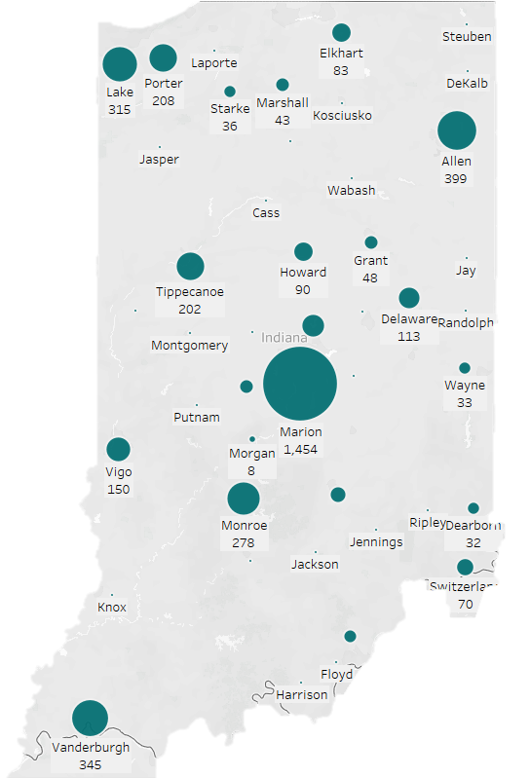
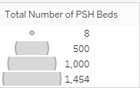
Marion, Allen, Lake, and Vanderburgh have the greatest number of PSH beds
Notes:
Abigail
While permanent supportive housing units make up only a portion of the outcomes considered a permanent housing destination, let's take a look at where we are seeing these beds across the state.
We see that Allen, Lake, Monroe, and Vanderburgh have the greatest number of total PSH beds. We see that there are number of geographical areas that do not have any PSH beds.

Slide 33
Our inventory of RRH and PSH beds remains stagnant while the number of people experiencing homelessness continues to increase
Note: data reflects housing inventory available on the night of the Housing Inventory Count (a single-night count in the last 10 days of January, happening concurrently with the Point-in-Time Count).
Notes:
Abigail
Although we are seeing overwhelmingly positive outcomes associated with rapid rehousing and PSH programs, we see that our overall inventory of beds for these projects year to year remains stagnant. As we see an increase in individuals experiencing homelessness, limited program capacities may inhibit the ability of these programs to scale to meet the current need in their communities.

Slide 34
The total number of vacant housing units continues to decrease across the state
-16%
-17%
-28%
Notes:
Abigail
Looking now at the data available to us from the United Census Bureau, we are seeing an overall decrease in the availability of total vacant, for rent, and for sale units. From 2019 to 2023, we have seen a decrease of 17% in “for rent” units.
With a decrease in the availability of for rent units, it is important to note that the 50,000 units we see represented in 2023 are not all affordable units.
There will be a session later today, “Housing Affordability, Availability, and Need: Using Available Data to Advocate for Affordable Housing” that will dive into the housing availability data via the united states census and Indiana housing dashboard.

Slide 35

As Housing Inventory Falls, Costs Rise
Apartment Bedroom Count | Hours Per Week Required (Min. Wage) | Housing Wage Needed
0 Bedrooms | 91 | $16.48
1 Bedroom | 101 | $18.39
2 Bedrooms | 122 | $22.18
3 Bedrooms | 156 | $28.24
4 Bedrooms | 180 | $32.64
US Census Bureau, American Community Survey
National Low Income Housing Coalition
Notes:
Abe
We also know that as our availability of housing is decreasing, it is simultaneously becoming more expensive to stay housed. Both for renters and for homeowners. Minimum wage has not kept pace. There are literally not enough hours in the week for a single parent to work if they have 2 kids and need a 3 bedroom on a minimum wage position.

Slide 36

With Limited & Increasingly Expensive Housing, Wages Remain Consistently Insufficient
38%
39%
38%
39%
40%
37%
38%
38%
Resource: The State of ALICE in Indiana
Notes:
Abe
As housing costs rise, we consistently see that Indiana households are struggling. What this visual shows is (in orange) the percent of househodls in poverty and (in blue) the percent who are not in poverty, but are employed and still unable to cover costs of living for where they live.
Consistenly these two groups account for about 40% of all Hoosiers. We are struggling. So it should be no surprise – housing inventory is down, housing costs are up, consistently 4 out of 10 households cannot cover costs of living with their wages. No one should be surprised by PIT numbers. However – I want to reiterate that there are programs that work, we just need to see them scaled to meet the need.

Slide 37
How YOU can get Involved in the IN BoS CoC
Attend your local Regional Planning Council’s meetings. The list of regional contacts can be found here.
Volunteer with your local PIT Count
Talk about local agency needs
Share this information
Direct people to your Regional Planning Council
Participate in your local dialogues
Notes:
Abe – mention connection to local government session
We’ve talked about the State of Homelessness, but want everyone to leave with a sense of where they can plug in.
- Across the state, you can connect with your Regional Planning Council, get connected into the PIT Count. Volunteer for the PIT – hear the stories first hand of folks experiencing homelessness. And also spread the word. The data is out there and it’s clear – we know what works to address housing, we need what works to be scaled and resourced.

Slide 38
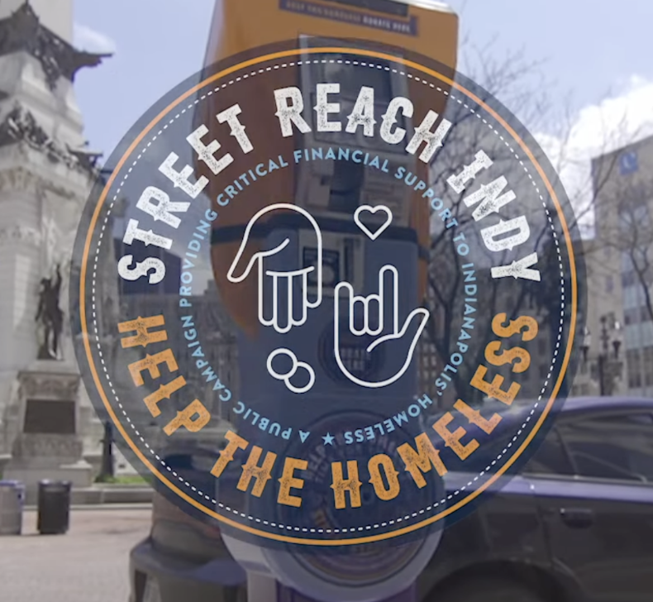


How to Engage in Indianapolis
https://www.chipindy.org/streetreach/
https://www.chipindy.org/hoh/
https://www.chipindy.org/streetstohomeindy
Notes:
Abe

Slide 39
Acronyms Used in This Presentation
AHAR: Annual Homeless Assessment Report
ALICE: Asset Limited, Income-Constrained, Employed
BoS: Balance of State (91 out of 92 counties in Indiana)
CE: Coordinated Entry
CHIP: Coalition for Homelessness and Prevention
CoC: Continuum of Care
DV: Domestic Violence
ES: Emergency Shelter
HIC: Housing Inventory Count
HMIS: Homeless Management Information System
HUD: Housing and Urban Development
LSA: Longitudinal Systems Analysis
OPH: Other Permanent Housing
PIT: Point In Time [Count]
PSH: Permanent Supportive Housing
RRH: Rapid Re-Housing
SPM: System Performance Measures
TH: Transitional Housing
Notes:
David
As Daniella stated, we used several acronyms in today’s presentation, so here is a list of those acronyms and what they stand for should you need a reference.

Slide 40
Thank you for joining us today!
For any questions please email:
cocnetwork@ihcda.in.gov
aroll@chipindy.org
Notes:
Abe

