Slide 1
HR Open JSON and XSD 4.X Specifications

Slide 2
Specifications and Projects
Assessments
Compensation
Contingent Staffing
Data Protection
Employee Benefits
Employee Referrals
Employee Wellness
Employer and Earnings Record
Indicative Data
Interviewing
Payroll
Recruiting
Screening
Time Management

Slide 3
Assessments
Schema: Assessment Catalog, Assessment Order, Assessment Report
Use Cases: Pre-Hire Assessment, Employee Development Assessments
PERSONS:
Hiring Manager Assessments Provider
ORGS: 3rd Party Test Centers
SYSTEMS: LMS Recruiting

Slide 4
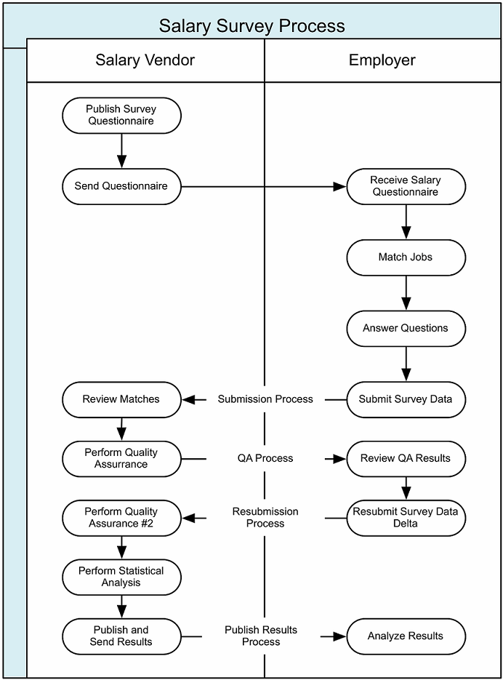
Compensation
Specifications: Salary Survey Submission, Salary Survey Report
Use Cases: Submit Questionnaire, Survey Vendor to Participating Client

Slide 5
Contingent Staffing 3.3 XML
Specifications: Order, Assignment, Human Resources, Timecard, Invoice
Use Cases: Intermediate and
Traditional Staffing Order,
Resource, Assignment
Staffing Standards
Contractors, Freelancers
Staffing Agency
Clients,
Company
VMS
ICM
Online Marketplace
Job Boards
MSP
ATS

Slide 6
Data Protection
Includes method to restrict countries to view, edit, and store personally identifiable information (PII). Incorporated in every HR Open top-level schema that contains PII.
Security Permissions:
Read: allows specified country the authority to view the data
Modify: allows specified country the authority to edit the data
Store: allows specified country the authority to store the data
Full Control: allows specified country the authority to view, edit, and store the data

Slide 7
Employee Benefits
Specifications: Spending Accounts, Plan Setup, Rate Based Coverage, Voluntary Benefits
Use Cases: Enrollment, Census Change, Plan Setup
ORGANIZATIONS:
Carriers & Service Providers
Gov’t Compliance Agency
HMO
Plan Admin
Plan Sponsor
PPO
PEO
PERSONS:
Carriers & Service Providers
Gov’t Compliance Agency
HMO
Plan Admin
Plan Sponsor
PPO
PEO
SYSTEMS:
Front End System

Slide 8
Employee Referrals (on Hold)
Specification: Provide guidance on how to structure exchanges of information impacting employee referral program
Use Cases: Transfer a Position from the Hiring System to ERS, Transfer a Connector from the Payroll System to the ERS
SYSTEMS:
ERS
Hiring System
Payroll System
Social Networking System
ORGS:
Hiring Company or Staffing Client
Public Employment Service
PERSONS:
Connector
Hiring System Admin
Payroll Systems Admin
Program Admin
Prospect Recruiter

Slide 9
Employee Wellness
Exchange of data between systems involved in the management of corporate wellness programs
Use Cases: Personal Activity Tracking
SYSTEMS:
Activity Tracking Device
Activity Tracking System
Payroll Service or System
Wellness Management System
ORGANIZATIONS:
Employee
Benefits Administrator or Manager
Payroll Director

Slide 10
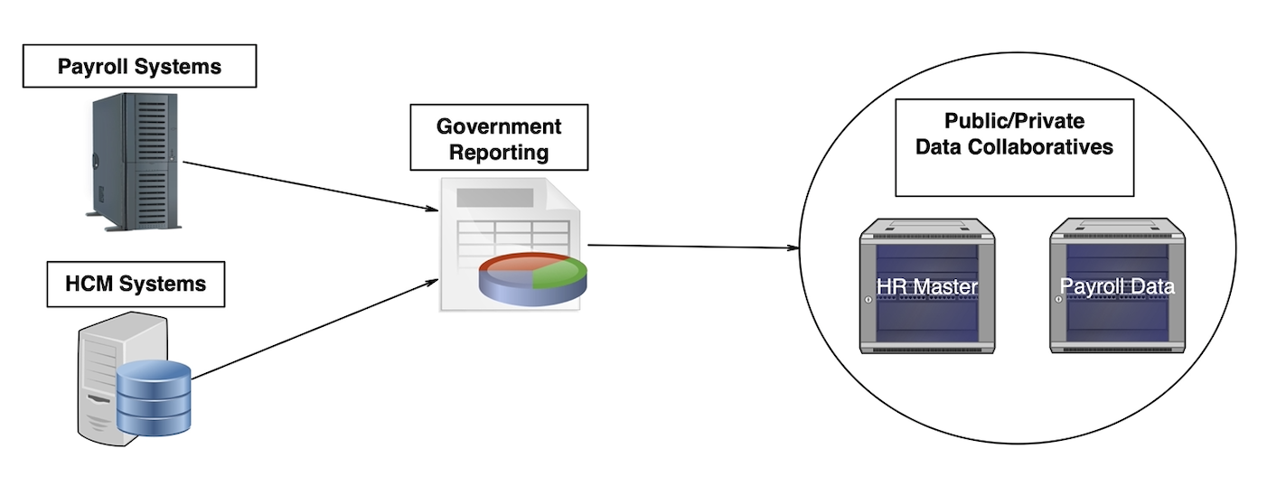
Employer and Earnings Record
Develop employee employment and earnings records standards for use in the public and private sectors
Use Case: Produce Labor Market Information

Slide 11
Interviewing
Specifications : Interview Position, Asynchronous and Synchronous Orders, Status Notification
Use Cases: Create Interview Position, Order Interview for Defined Position (Asynchronous), Self-Schedule Synchronous Interview (Synchronous)
ORGANIZATIONS:
Interview Provider
PERSONS:
Candidate
Evaluator
Hiring Manger
Interviewee
Interviewer
Interview Participant
Recruiter
User
SYSTEMS:
ATS
CRM
Interview System
Recruiting System
VMS

Slide 12
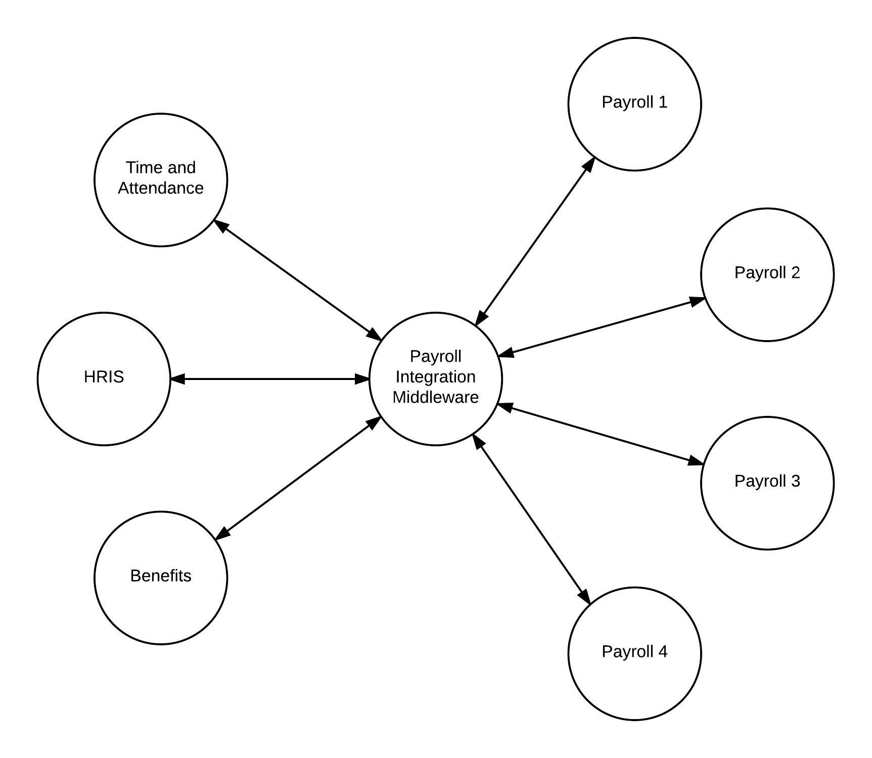
Payroll
Specifications: Deployment Information, Payment Methods, Garnishments and Other Deductions
Use Cases: Life Events, Personal Data Change, Recurring Payments & Deductions, Adhoc Payments/Deductions, Local Information

Slide 13
Recruiting
Specifications: Candidate, Position Opening, Search Document, Search and Match
Use Cases (examples): Transfer from ATS to HRIS, Position Opening to a Job Board, Recruiter Federated Search
Systems
Aggregators
Job Board
Job Repository
Social Media Properties
Resume/CV Parser
Recruiting System
Search Application
SFO System
Cloud Based Storage
LMS

Slide 14
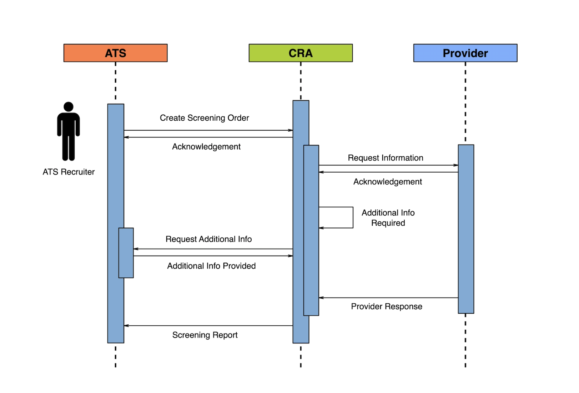
Screening
Specifications: Screening Subject, Order, Catalog, Report
Use Cases: Screening Subject, Screening Position, Screening Order, Packages, Reports

Slide 15
Time & Attendance
Specifications: Timecard
Use Cases: Belgium Requirement, Multiple Pay Rates, Costing/Lending Rates, Expenses, Approvals, Time Event, Breaks, Straight Cost Allocation, Expense Cost Allocation, Piecework, Communication
PERSONS: Approver Employer Person Submitter
ORGS:
Staffing Supplier
SYSTEMS: Billing Expense
Labor Tracking Payroll

Slide 16
Get Involved
Become a member to network with other like-minded technologists
Join a workgroup to determine industry standards
Be an industry leader by adopting the standards
Learn about real-life implementations by attending an annual meeting
Develop and strengthen relationships with your strategic partners

Slide 17
Connect with Us!
facebook.com/hropenstandards
@hropenstandards

