Slide 1
Your one source for property and facility management education

Slide 2
About Us
BOMI’s world-renowned professional educational programs make perfect business sense. Our industry-standard designations ensure that property and facility professionals have the critical knowledge and skills needed for personal and organizational success.
400,000+ 43,000+
courses taken
credentials earned

Slide 3
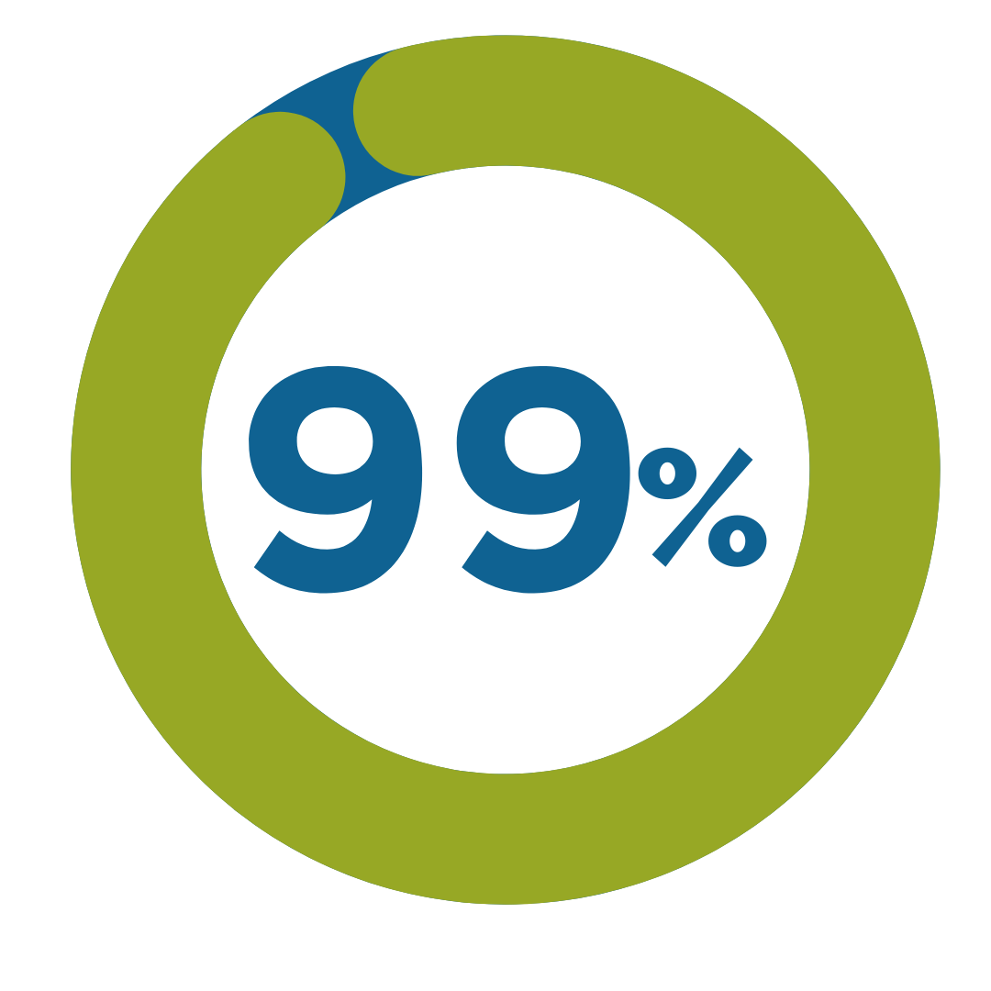
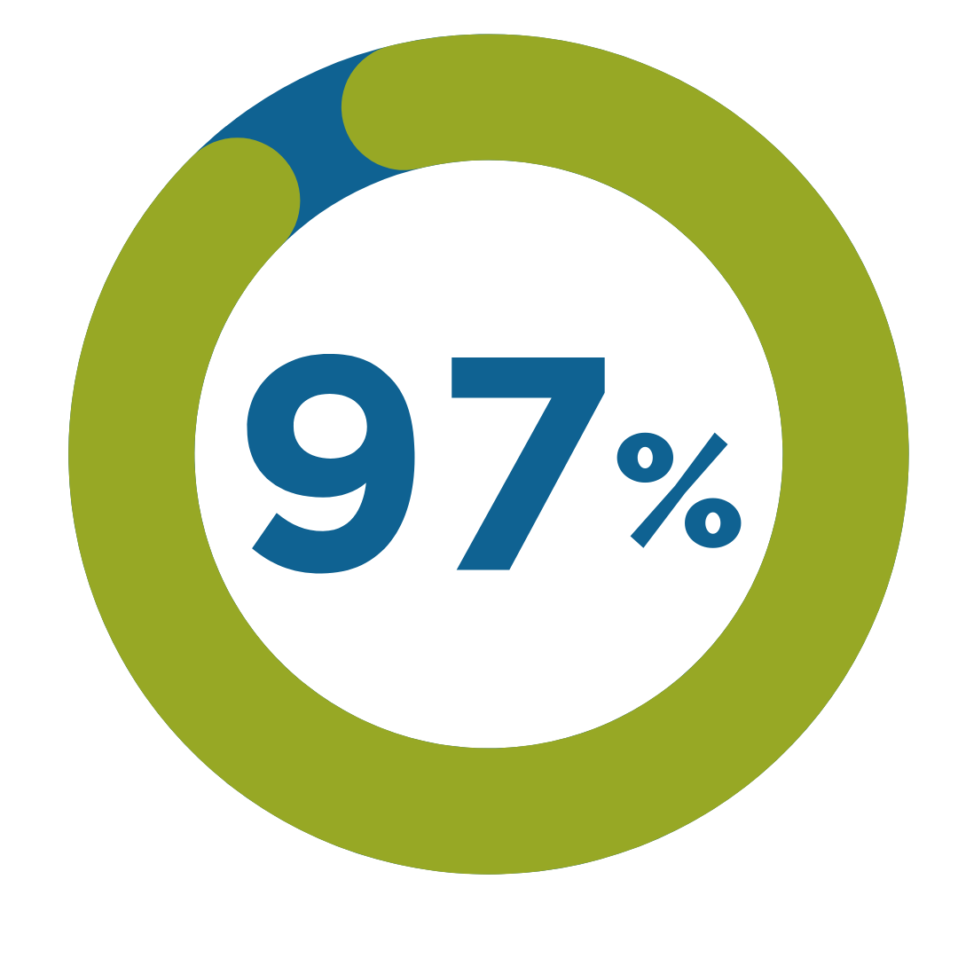
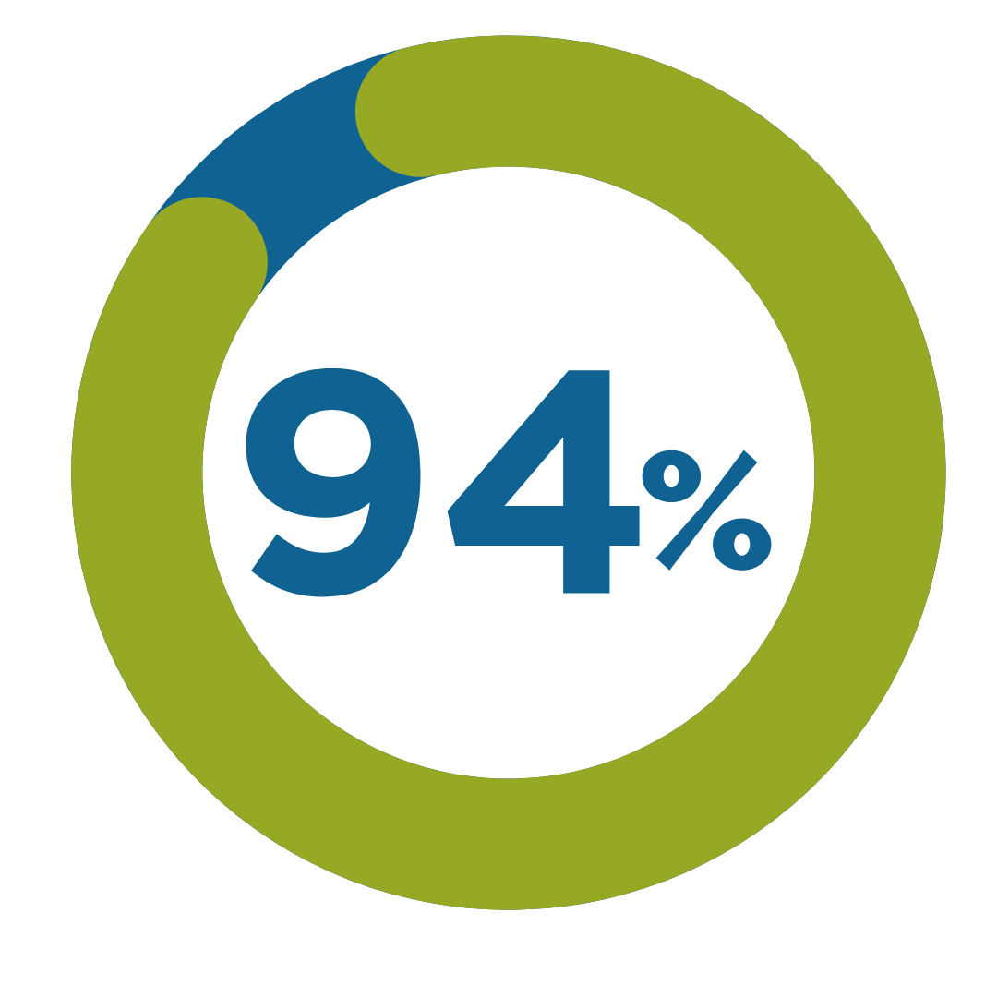
Survey Says…
But don’t just take our word for it. The BOMI learner survey says it all:
improved their subject knowledge
improved their job performance and career overall
said BOMI programs met or exceeded their expectations
would recommend BOMI programs to a colleague

Slide 4
The BOMI Difference
The ONLY organization that offers education in property, facility and building management
We offer education in distinct career paths for ALL your employees
Our stackable credentials build on each other, reducing redundancy
The program content is developed and delivered by leading professionals in the industry
BOMI programs increase teamwork, efficiency, client satisfaction, cost savings, and employee retention
We have more than 50 years of experience training building engineers, property and facility managers

Slide 5
Learn More. Earn More.

Slide 6
Our areas of expertise
Property Management
Facility Management
Systems Management
Sustainability

Slide 7
Our clients
Property & Facility Management Companies
Federal & Local Governments
Healthcare – Hospitals & Senior Living Facilities
Industrial Complexes
Associations, Banks, Insurance Companies
Education – K-12 School Districts, Colleges, Universities
Hospitality – Hotels, Theme Parks, Sports Complexes

Slide 8
Property
Management
“The knowledge I have gained as a result of my BOMI education has propelled me to advance my career path to all new levels. The lessons have helped me understand my career better, as well as be more productive.”
-Daniel J. Gallagher, RPA®
CAREER PATHS – STACKABLE CREDENTIALS
Start with a course
Earn a certificate – two additional courses
Achieve a designation – five additional courses + Capstone exam
Maintain a designation – complete 18 CPD credits over three years
Notes:
When starting our property management career path you can basically start with a course and then complete 2 additional courses to earn your certificate, then you complete 5 additional courses and take the Capstone exam to earn your RPA. Once you have earned your designation you maintain it by submitting 18 CPD credits every 3 years.

Slide 9
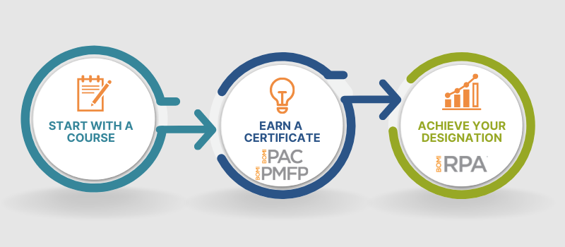
Property
BUILDABLE CREDENTIALS
Management
Property Administrator Certificate
Property Management Financial Proficiency
Budgeting & Accounting
Design, Operation & Maintenance, I
Design, Operation & Maintenance, II
Asset Management
Budgeting & Accounting
Real Estate Investment & Finance
+
+
Environmental Health & Safety
Ethics is Good Business
Law & Risk Management
Real Estate Investment & Finance
One elective
Design, Operation & Maintenance, I
Design, Operation & Maintenance, II
Environmental Health & Safety
Ethics is Good Business
Law & Risk Management
=
=
Real Property Administrator
Real Property Administrator

Slide 10
Got your CPM®?
Now get your RPA®!
4
courses
only
Have you earned your CPM® within the past seven years?
If so, you are well on your way to earning your RPA® designation and gaining a better understanding of how to increase the value of commercial properties and operate facilities at peak efficiency.
with proof of current CPM®
Once your application is approved, you only need to complete these four RPA® courses and pass the RPA Capstone Experience Exam:
Budgeting and Accounting
Environmental Health and Safety Issues
The Design, Operation, and Maintenance of Building Systems, Part I
The Design, Operation, and Maintenance of Building Systems, Part II

Slide 11
Facilities
Management
“The FMA® Designation program taught me the core principles of building management and has broadened my functional capabilities. As a result, I have been able to confidently assert myself in more of a leadership role.”
-Samuel F. McFadden, FMA®
CAREER PATHS – STACKABLE CREDENTIALS
Start with a course
Earn a certificate – two additional courses
Achieve a designation – five additional courses + Capstone exam
Maintain a designation – complete 18 CPD credits over three years

Slide 12
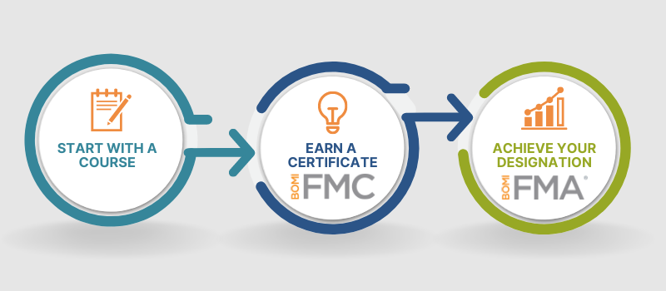
Facilities
BUILDABLE CREDENTIALS
Management
Facilities Management Certificate
Design, Operation & Maintenance, I
Design, Operation & Maintenance, II
Fundamentals of Facilities Management
+
Environmental Health & Safety
Ethics is Good Business
Facilities Planning & Project Management
Electives (choose two):
Asset Management
Managing the Organization
Real Estate Investment & Finance
=
Facilities Management Administrator

Slide 13
Systems
“Utilizing BOMI education helped me reach my goal of becoming a chief engineer. I found it to be so useful that I recommended my engineers begin the SMT® courses and have noticed great improvements.”
-Joe Guillen, SMT
Management
CAREER PATHS – STACKABLE CREDENTIALS
Start with a course
Earn a certificate – two additional courses
Achieve a designation – two additional courses for the SMT or five additional courses for the SMA
Maintain a designation – complete 18 CPD credits over three years for the SMA

Slide 14
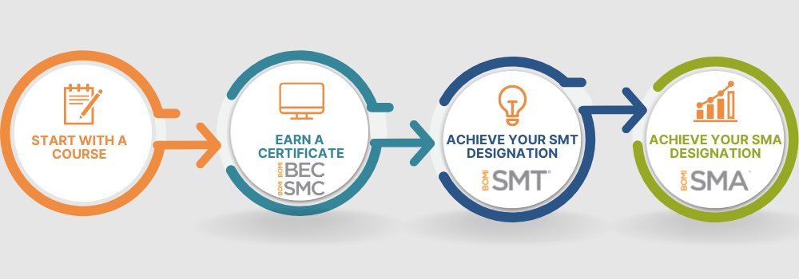
Systems
BUILDABLE CREDENTIALS
Management
Building Energy Certificate
Building Systems Maintenance Certificate
Air Handling, Water Treatment & Plumbing Systems
Electrical Systems & Illumination
Energy Management & Controls
Air Handling, Water Treatment & Plumbing Systems
Energy Management & Controls
Elective (choose one): Boilers OR Refrigeration
+
=
+
=
Boilers
Refrigeration
Boilers OR Refrigeration
Electrical Systems & Illumination
+
=
Building Design & Maintenance
Environmental Health & Safety
Managing the Organization

Slide 15
Contact Us
Tindy Henderson
thenderson@bomi.org
443-306-3874

