Slide 1




@ProStart
/ProStartProgram
/ProStartProgram
/GoProStart
ChooseRestaurants.org

Slide 2
Agenda
State of the Program
Program Specifics
  Annual Timeline
  Exams
  COA
  Competition
  Special Programs
CTE Community in Mobilize

Slide 3
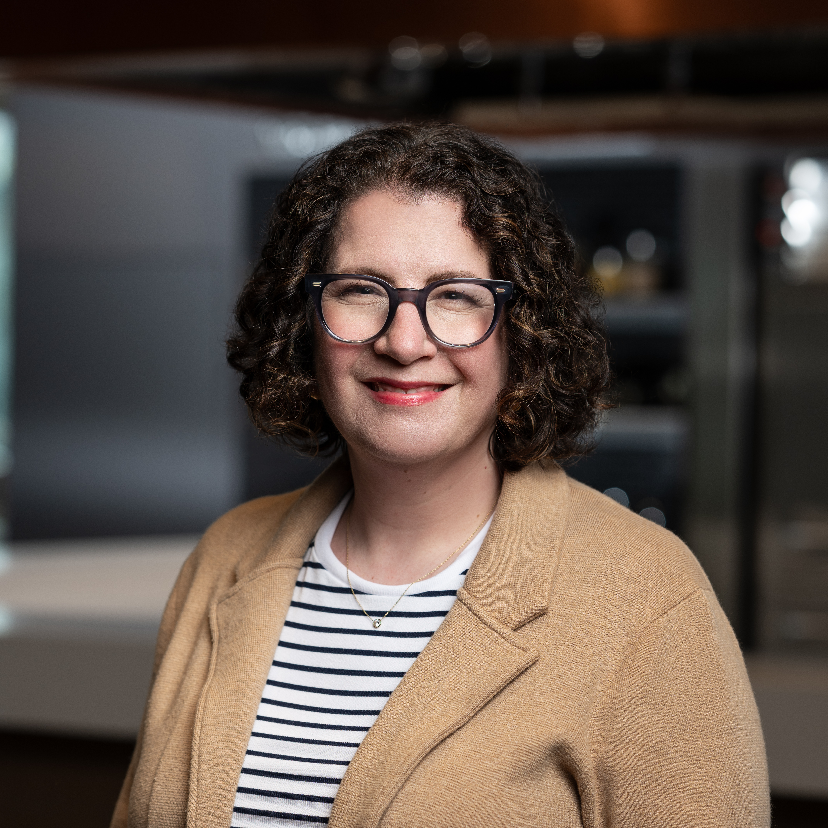
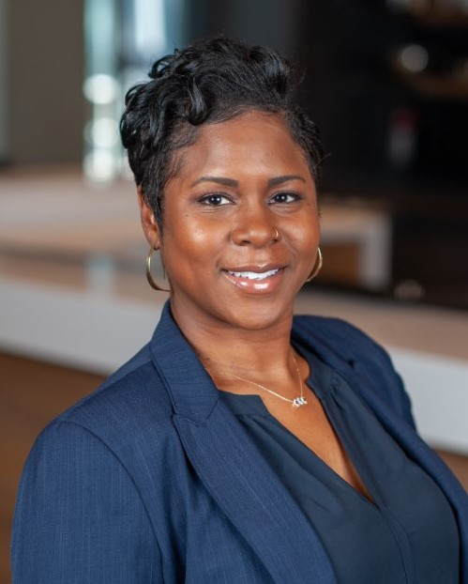
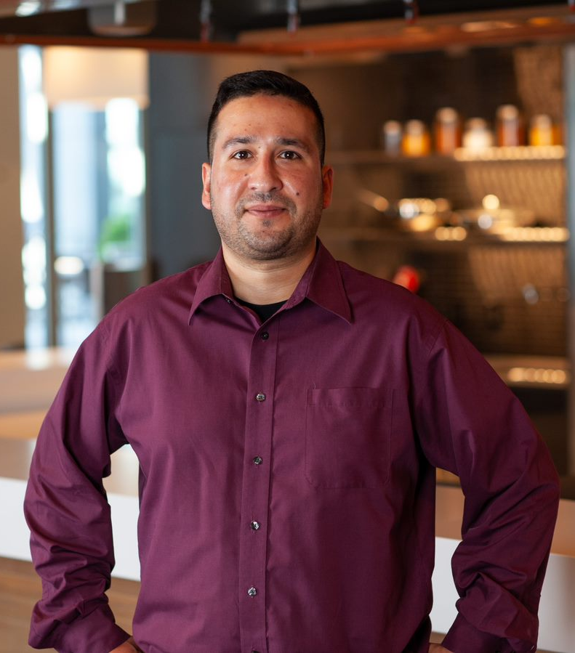
NRAEF ProStart Team
Amy Saltzman
Senior Director, National ProStart Program
Erica Garner
Senior Manager, National ProStart Program
Alex Diachok
Coordinator, National ProStart Program

Slide 4

State of the Program

Slide 5

Program Partners
National Restaurant Association Educational Foundation/National Restaurant Association
State Restaurant Associations
Industry
Notes:
National - Provides programmatic framework
National programming
Pursues funding opportunities to strengthen and expand program
State - Implement at the state level, including recruitment and retention
Provides a bridge between school and industry
Offers annual professional development for educators
Builds relationships with state Departments of Education
Organizes state ProStart Invitationals
Industry - Mentor educators and/or students
Provide employment opportunities for students
Visit classrooms for career pathway discussions
Offer field trips and job shadowing/stages/internships
Join state or local advisory boards to assist with connections

Slide 6
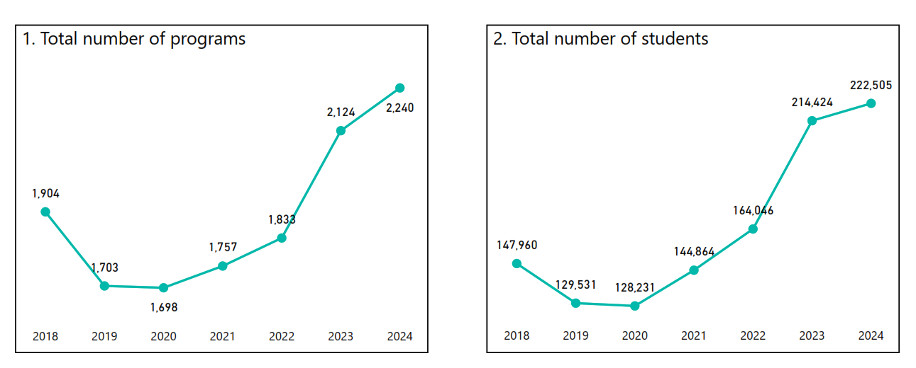
State of the Program
220,000 students in over 2,200 programs nationwide, with 2,500 educators nationwide, DC, Puerto Rico and the territory of Guam*
* Data from December 2024
Notes:
I want to start off with a snapshot of what ProStart looks like today vs the past few years.

Slide 7
State of the Program
37% of all ProStart schools receive Title 1 funding
School breakdown
  70% traditional high schools
  23.6% career and technical education centers, where students travel to take their ProStart courses
  4.2% are non-traditional settings, including Departments of Corrections
* Data from December 2024
Notes:
Here is some of the school breakdown information. I won’t read through all of this, but this gives you an idea where are programs are.

Slide 8
State of the Program
The majority of students earn a ServSafe Food Handler certification, an industry recognized credential
Students entering post-secondary can earn their Certificate of Achievement for up to 18 college credits at various institutions around the country; this entails:
  Passing two exams
  Earning 400 hours industry work experience
  Mastering 52 of 75 core competencies comprised of hard and soft skills
Notes:
Again, some student benefits of the program included their industry recognized credential as most complete the ServSafe food handler certification
And the COA, which allows students to receive up to 18 college credits. We will go into more specifics about the COA a little later.

Slide 9
Program Specifics

Slide 10
ProStart Annual Program Timeline
Notes:
Here is an outline of key programs and dates throughout the year. The timelines year to year may adjust slightly, but overall you can look out for information about all of these around these times each year.
So to highlight:
We just launched annual data collection in August
Grant applications usually go live in January
NPSI happens in May but competition season at the state level usually jumps off in January, so…rules just went out in September to allow plenty of time for everyone to prepare. And I know there’s a session to review those later today.
Exam season, we know can begin as early as February but we generally see the most engagement between March and May, and even into June. One thing we have found helpful, is to plan for exam season early, particularly with regard to account access. (we’ll talk a bit about that more later)
Any national professional development usually takes place over the summer months between June and July
And year-round we are working on ways to increase engagement including our new online community and the return on monthly webinars.
And of course you have your state sponsored activities and events, so there is a lot going on over the course of the year.

Slide 11
Annual Data Collection (Purpose & Flow)
Confirm official ProStart schools for 2025 – 2026 school year
Gather data about ProStart programs nationwide
Inform funding for the 2026 – 2027 school year via ProStart Program Support Grant Funds
Notes:
This is a very important first step each school year to make sure you are confirmed as a ProStart program.
Its also our opportunity to learn more about your programs and schools. So in addition to gathering the numbers, for communications when you hear we have 2,200 schools, serving 222,000 students with roughly 2,500 educators, this is where this information comes from.
But we also get to learn about the types of programs (CTE vs, traditional programs, is your program rolled out over 2 years or 4 years, are you a Title 1 school, etc.).
And most important, this is how we determine the funding that will go to each state for their programs. NRAEF provided overall funding and per school funding for each state so its important to be confirmed so you get that per school money.

Slide 12
Annual Data Collection (Purpose & Flow)
Coordinators confirm all the schools in their state
Coordinators will open the survey for their Educator Points of Contact (POCs) via email
  Email includes a link to data site and the username a POC should use to access it
Educators complete their school surveys

Slide 13
Implications for Failure to Complete
Less funding for SRA from ProStart Program Support Grant funds next year
Lack of access to Certificate of Achievement for students
Schools cannot compete at the National ProStart Invitational
Lack of access to NRAEF resources for teaching ProStart

Slide 14
ProStart Exams
Editions & Levels
  Foundations of Restaurant Management & Culinary Arts (FRMCA) Exams
    Edition 1, 2 & 3; Levels 1 & 2
  Offered in print and online
Exam Ordering/Scheduling
  All exam scheduling takes place on ChooseRestaurants.org regardless of Edition, Level, or exam format
  Print exam answer keys and online exam vouchers can be ordered here for $19 each
    Cost covers administration, grading, record maintenance
  NOTE: It is crucial that Educators schedule their exams at the correct school. If an educator does not see their school listed in the dropdown menu, please reach out to ProStart@nraef.org immediately.
Notes:
Now, I’d like to go over some key areas where we get the most questions. ProStart exams are up first.
Some things to note here:
The third edition of the textbooks launched spring 2025. Questions? Contact textbooks@restaurant.org
Biggest issue we see with exams is schools schedule the wrong edition exam OR students don’t know how to log in and the exam is slated to start in about five minutes; we urge students to get online well in advance throughout the year and for teachers to write down their students’ user names and passwords. This will be a bit easier now that the enterprise has a new account access system, but the sooner the account information is verified the better.
Educators cannot proctor their own class, but another ProStart educator in the school can. If there isn’t another, anyone can apply to proctor.
Online exams close 24 hours after they begin.

Slide 15
ProStart Exams
Exam Scoring
  If using paper exams, be sure you send back the completed Exam Information Form. Without this, exams cannot be graded.
  Exam scoring timelines will vary. Please allow 2-4 weeks for scores to be returned.
  Educators receive notification when the scores for their exams are available, so not receiving notice within a reasonable amount of time (2 - 3 weeks during testing season) should tip off an educator that there may be a snag in the system.
Accessing Scores
  Scores can be accessed on ChooseRestaurants.org either by the Exam Session Number, Date Range, or specific Examinee Name
  Issues accessing scores should be sent to ProStart@nraef.org
Exam Forms & Help Documents
  Found here on ChooseRestaurants.org; Educator-only access
  Resources like: Scheduling exams, administering print/online exams, ordering & returning answer sheets & materials, viewing exam scores
Notes:
Things to note with regard to scores:
If you are using paper, it is imperative that you complete and send the Exam Information Form with your exams. We also recommend making a copy of everything including all shipping information just in case. You never how/when things can get lost so its always best to have back up.
Account for time to receive your scores. It can take anywhere from 2-4 weeks for paper exams and online scores are available once the exam is closed
Of course all of this is housed on the chooserestaurants.org site

Slide 16
Certificate of Achievement (COA)
Exams
  Students must pass FRMCA exams for Levels 1 and 2
Competencies
  Students must verify they have mastery of 52 of the 75 competencies (70%)
Work Hours
  To attain a COA, students must show proof of work or involvement in the restaurant, foodservice, and/or hospitality industries totaling 400 hours
  Students may meet the requirement by participating in either paid foodservice jobs or “alternative” hospitality-related jobs or activities. Jobs may be paid or unpaid (due to the nature of the task)
Expiration
  Students are able to enter valid work hours from up to one year prior to and three years following the date of the Level 1 exam. For example:
    John Doe passes his Level 1 exam on 5/5/2022.
    John Doe can go back in his records and enter work hours he did from 5/5/2021 and forward.
    His COA application will expire on 5/5/2025.
Notes:
The online COA application streamlines the COA process, increases NRAEF’s capacity to award COAs and allows students to take responsibility for earning their COA.
As an FYI, the purpose of the COA is for post-secondary articulation credit – it is not an industry recognized credential.
Expiration
A passing score on a student’s first exam triggers the COA application, and then they may start to add hours at this point. These hours must be completed within a 3 year window from the first exam, but can be back-dated up to a year prior to the exam for 4 years total. The window of time to claim the hours will be unique to when a student passes the first FRMCA exam.
Competency checklist must be completed by a supervisor, not the student!

Slide 17
Certificate of Achievement (COA)
Notes:
This chart is just a reminder of who does what in this process. Each stakeholder’s input is required to move on to the next. So students must submit for educator approval and educators must submit for coordinator approval.

Slide 18
Competition
Showcase of ProStart student talent, innovation, and entrepreneurship
Culinary teams prepare a 3 course menu - appetizer, entrée, and dessert - in 60 minutes without running water or electricity
Management teams create and present an original restaurant concept that integrates operations, marketing, look and feel, and menu recipes and costing
State PSIs
  Team numbers vary by number of ProStart program schools in the State
  Many states utilize exact or slightly modified NPSI rules (e.g. no alcohol, logistics, etc.)
  State Coordinators can download NRAEF’s national scoring rubrics from the Hub
NPSI
  States send winning teams from management and culinary
  Approximately 400 students compete annually
  Winning teams have access to $200,000 in post-secondary scholarships from the NRAEF and other industry organizations

Slide 19
Additional Programs
Educator Grants for Professional Development
Rachael Ray ProStart Grow Grants
Educator Professional Development
ProStart Educator Fellows
CTE (ProStart) Community for Educators in Mobilize

Slide 20
CTE (ProStart) Community in Mobilize

Slide 21
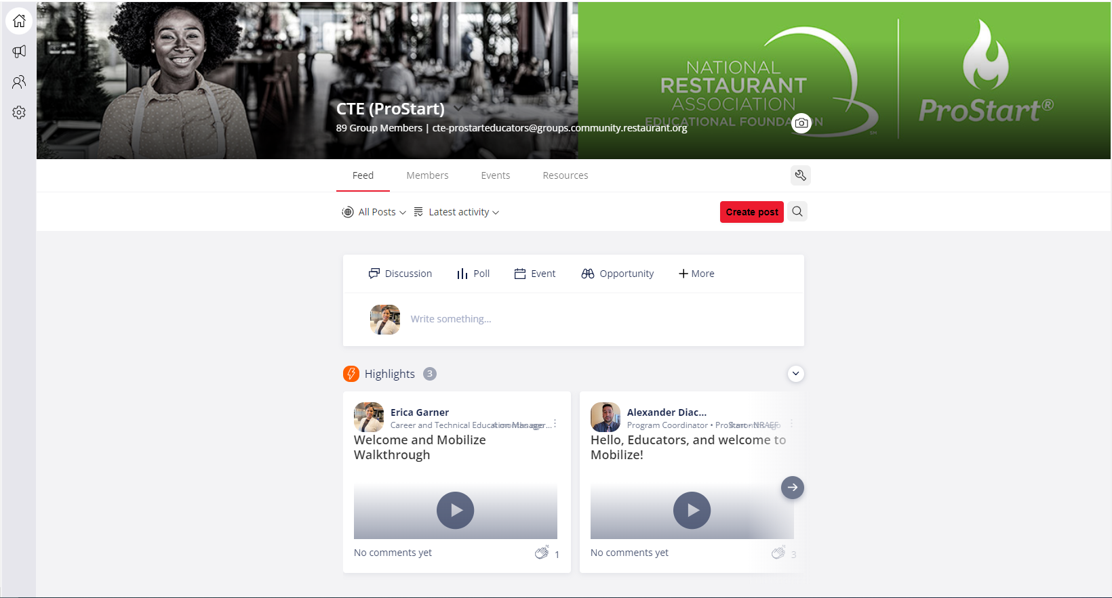
Welcome to Mobilize
What is Mobilize?
Mobilize is an online community platform. The CTE/ProStart Community brings together educators and state coordinators across the country and the national CTE/ProStart team together in one place. We created this group so all stakeholders may network, ask questions, share best practices, host events, and create a catalog of resources for current and new ProStart Educators.
CTE/ProStart Community Goals
Support, Encourage, Uplift – maximize ProStart program performance, teacher engagement, and student support with positive engagement in the community.
Guided Community Member Engagement – use educator feedback and platform analytics to guide themes and overall support for community growth.
Come for the network and resources,
Stay to enjoy all

Slide 22



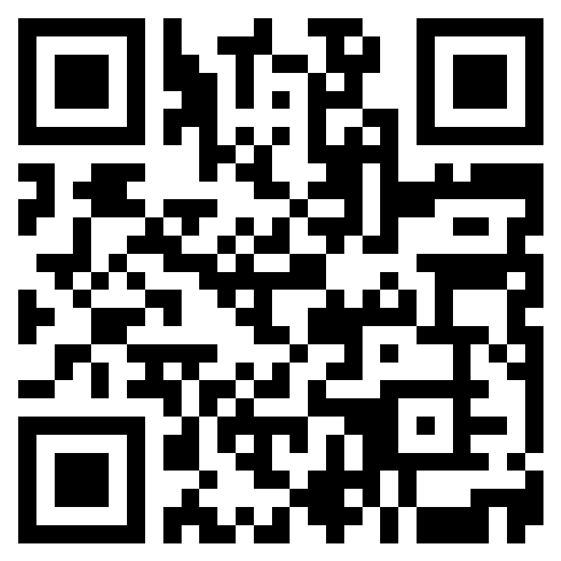
Have you heard the news?
The CTE Online Community in Mobilize provides a one stop shop for ProStart educators, coordinators, and the national ProStart team. The goal of this community is for all stakeholders to network, share best practices, discuss trending topics, and access a library of resources in a positive, supportive online environment.
All ProStart educators are encouraged to join!
Didn’t receive an invitation?
Access the invitation request form here:
CTE (ProStart) Community Invitation Request
or via the QR Code
We can’t wait to see you in the community!

Slide 23
Questions???

Slide 24

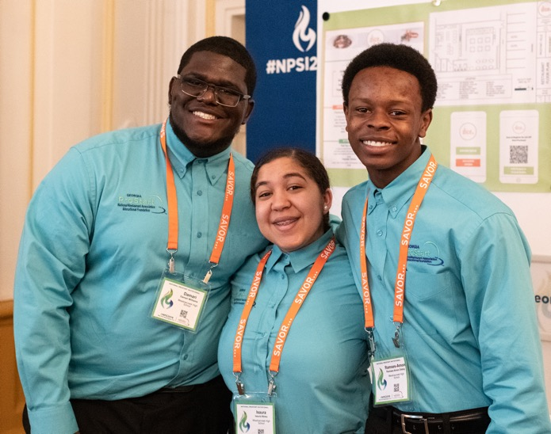
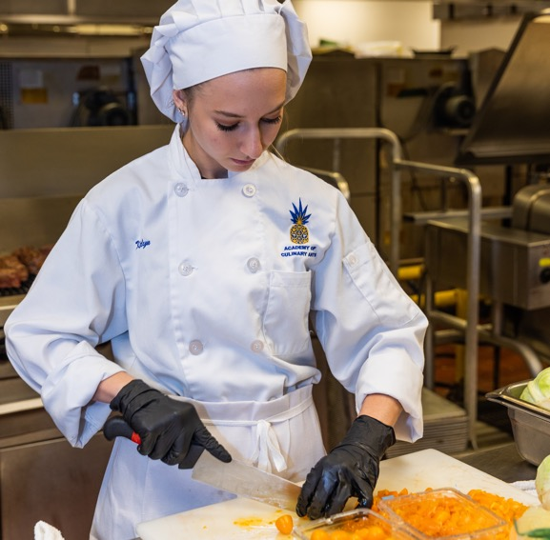
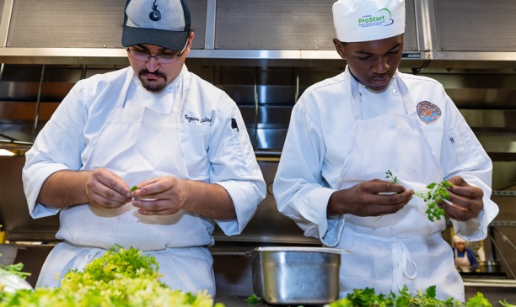
THANK
YOU!
ChooseRestaurants.org

