Slide 1
TRADE SHOW 101
How to succeed at the Greater Charlotte Apartment Association’s Annual Trade Show
Presented by Leah Vinansky & Dana Montgomery
June 3, 2021

Slide 2
Agenda
Visual Marketing & Budgeting
Booth Theme & Décor
Costumes
Giveaways & Swag
Create the Buzz
Set Up & Logistics
Important Regulations & Reminders
What to Expect During the Show
Get out of your Bubble
Follow Up & Lead Retrieval
Best Return on Investment
Call, Email, Rinse & Repeat!!!
New Lead Retrieval
Questions

Slide 3
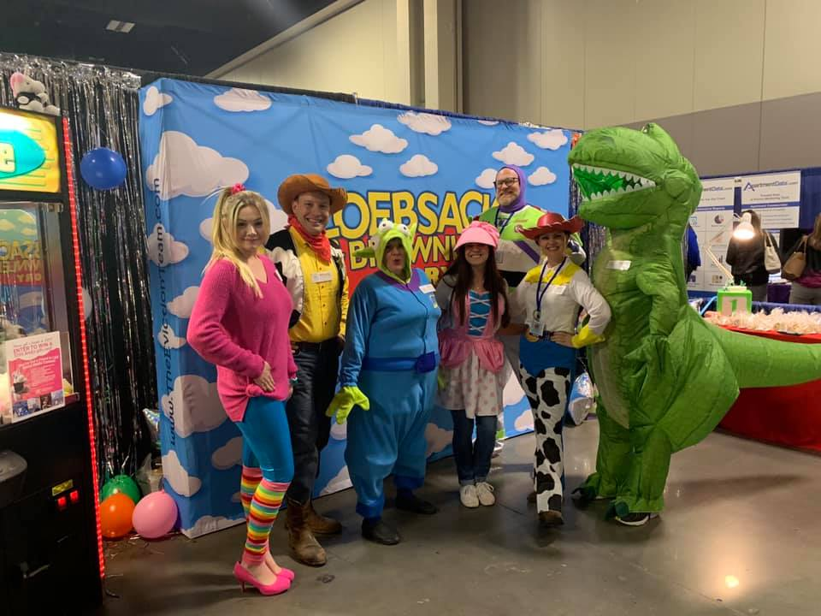
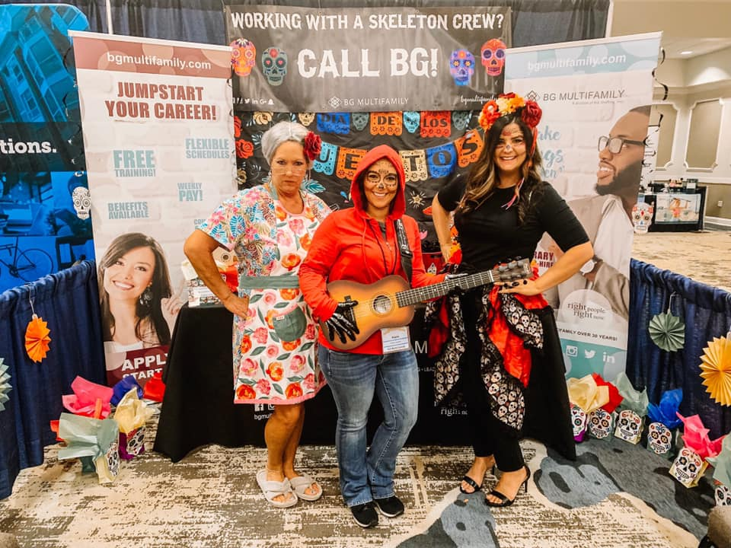
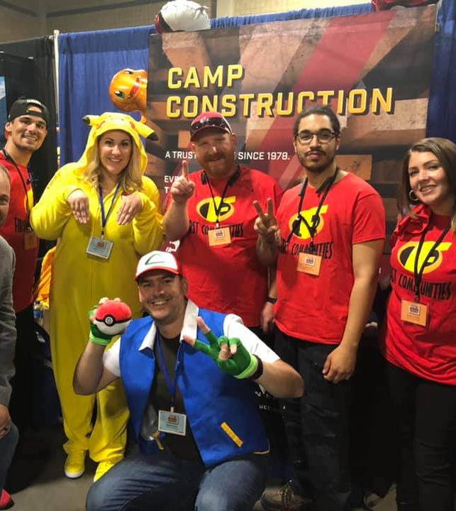
Visual Marketing & Budgeting
Booth Theme & Décor
Costumes
Giveaways & Swag
Creating the BUZZ
Pre-Event Marketing

Slide 4
Setup & Logistics
Logistics
2/25 – Advance Order Discount Deadline
3/10 – Freight to be Delivered by EOD to Avoid Late Charges
3/16 – Last Day of Advance warehouse Receiving
3/18 – Show Site Deliveries
Setup on March 18th
Move-in time: 8am-3pm:
Exhibit: 3:30pm-8pm
Move-out/Teardown: 8pm-10pm

Slide 5
Important regulations/reminders
2 Free Exhibitor Admissions
$49 per additional
Booth Worker Form Online
Standard Booth
10’x10’ Exhibit Space
8’ Red, White, & Blue back drape, 3’ Red side drape, (1) 6’ White Skirted Table, (2) Folding Chairs, (1) Wastebasket, and one (1) black and white 6” x 24” ID sign
Additional Booth Service Options
Food & Beverage (No outside food or beverage allowed)
Booth Service Order Form Online
Internet, Electrical, Plumbing, Telephone

Slide 6
What to Expect During the Show
Get out of your Bubble & Interact
Avoid a hard sell pitch
Get creative with your approach
Be Involved beyond the show
Build contacts & get information
Continue to build relationships

Slide 7
Follow Up & lead retrieval
How to get the Best Return on Investment
Use the Information Provided to You!
Organize contacts & Follow up
Call, Email, Rinse & Repeat!!!
It takes 8 cold calls to reach a prospect
92% of sales pros give up after the 4th call, but 80% of prospects say no four times before they say yes
80% of sales are made by 20% of salespeople
New Lead Retrieval

Slide 8
QUESTIONS

